Slide 1
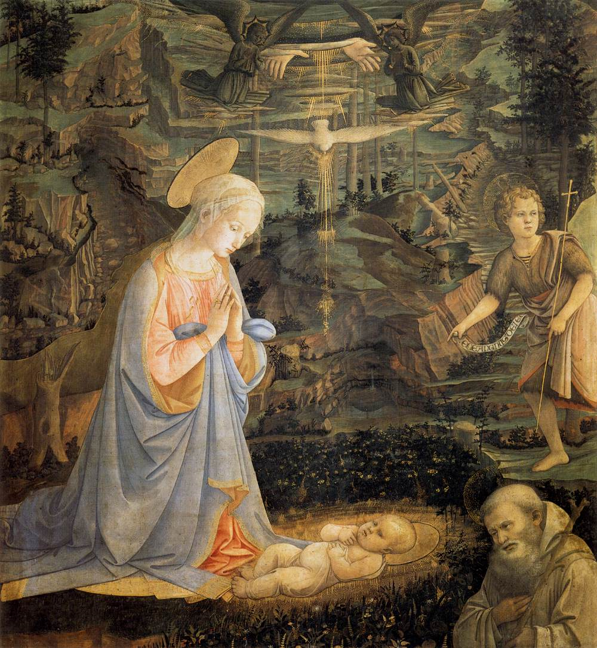
Mary, Mother of Mercy – her Cooperation with her Son’s Work of our Salvation
Fra Filippo Lippi Adoration of the Child with Saints (c. 1463)
Notes:
St John the Baptist and St Romuald are the saints present

Slide 2
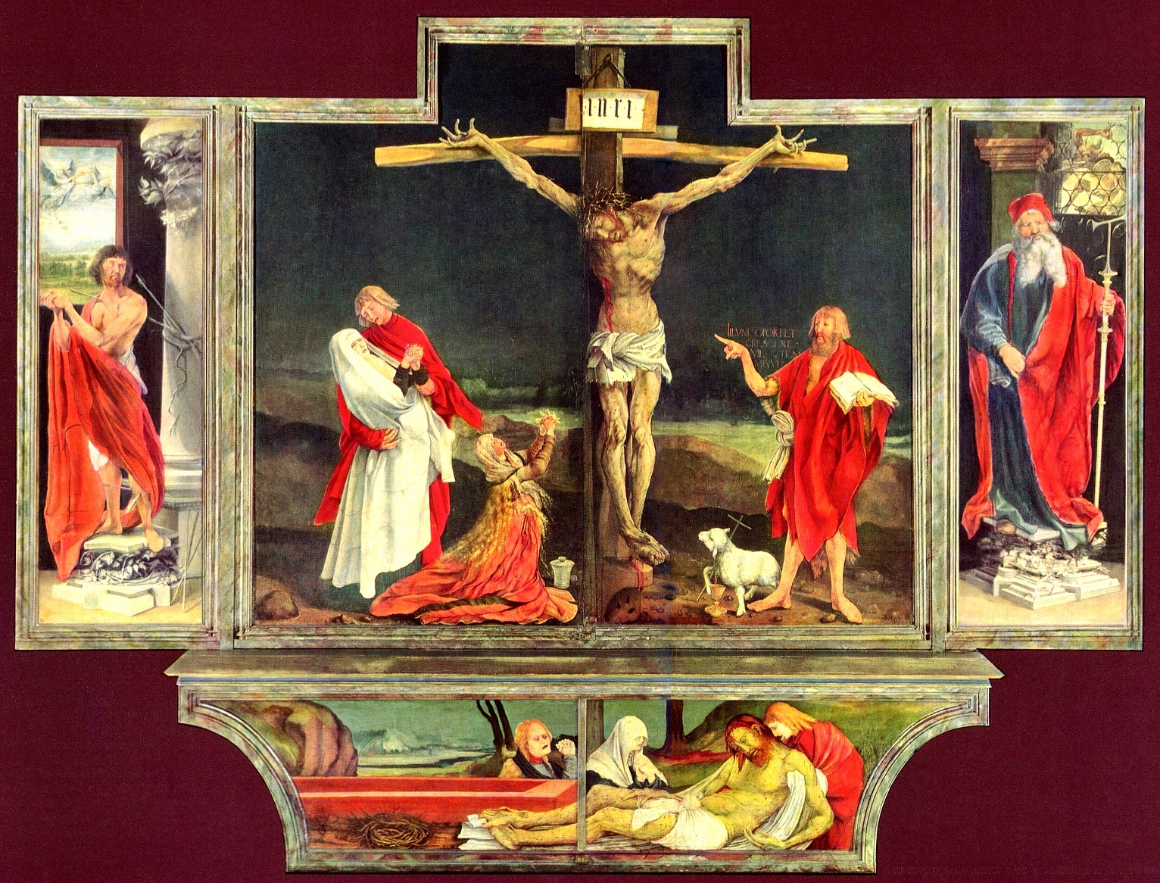
Why do we call Mary, the Mother of Mercy?
Mary is the Mother of God
God is mercy
Mercy = love and God is love (I Jn. 4:8)
Mary is also merciful as her Son is
And invites us to share in that mercy
Notes:
Mother of God – Council of Chalcedon 451
“Let us then with confidence draw near to the throne of grace, that we may receive mercy and find grace to help in our time of need” (Hebrews 4:16)

Slide 4
Why is God so merciful?
Gen. 1:26-28 “Let us make man in our own image, after our own likeness… So God created man in His own image, in the image of God He created him; male and female he created them. And God blessed them.”
CCC 27: The desire for God is written in the human heart, because man is created by God and for God; and God never ceases to draw man to himself. Only in God will he find the truth and happiness he never stops searching for:
GS 19:The dignity of man rests above all on the fact that he is called to communion with God. This invitation to converse with God is addressed to man as soon as he comes into being. For if man exists it is because God has created him through love, and through love continues to hold him in existence. He cannot live fully according to truth unless he freely acknowledges that love and entrusts himself to his creator.

Slide 5
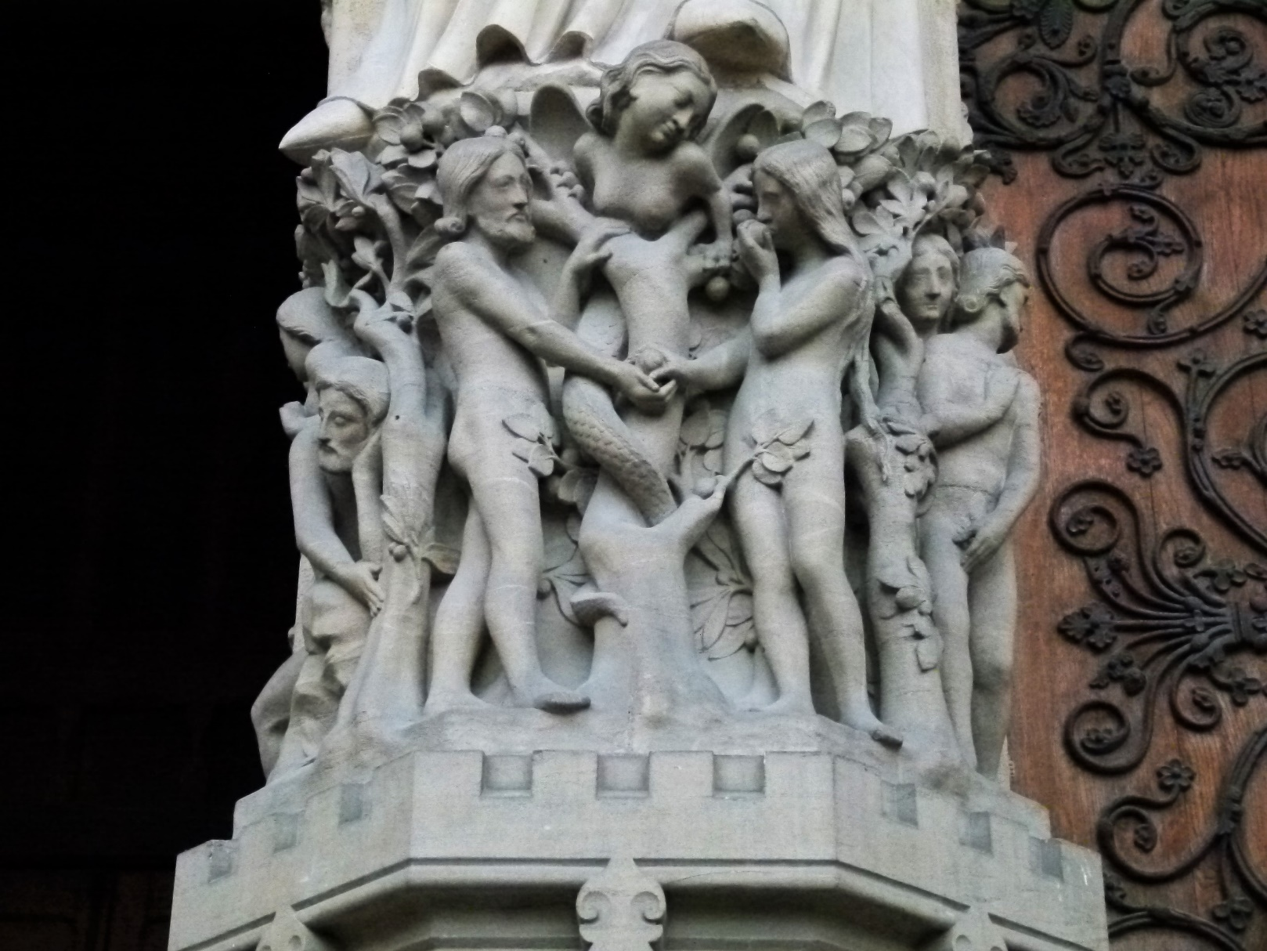
Creation and Original sin
“Sin came into the world by one man and death through sin, and so death spread to all men because all men sinned” (Rom. 5:12).
Adam and Eve, Notre Dame Paris, left portal entrance

Slide 6
The consequence of original sin
From Adam and Eve, man’s original holiness was lost and human nature thus deprived of these gifts of supernatural grace was passed on by propagation. The consequences of this deprivation meant that henceforth for all men, communion with God was seriously damaged and man would not be able to enjoy eternal life with Him (cf. Council of Trent 1546).

Slide 7
God’s plan for our salvation in His Son Jesus Christ began when He sent Adam and Eve from the garden.
Gen. 3:15: (to the serpent) “I will put enmity between you and the woman, between your seed and her seed; he shall bruise your head and you shall bruise his heel.”
Protoevangelium

Slide 8
The Immaculate Conception
Mary’s conception in the womb of her mother
“We declare, pronounce, and define that the doctrine which holds that the most Blessed Virgin Mary, in the first instance of her conception, by a singular grace and privilege granted by Almighty God, in view of the merits of Jesus Christ, the Saviour of the human race, was preserved free from all stain of original sin, is a doctrine revealed by God and therefore to be believed firmly and constantly by all the faithful” (Pius IX Ineffabilis Deus [1854]).
Mary still needed redemption, but by the foreseen merits of her Son, she was redeemed in a “more exalted fashion” (LG 53).

Slide 9
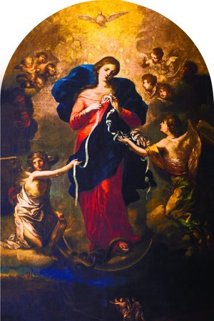
St. Irenaeus said of Mary:
It was fitting that as the Virgin Eve became the cause of death for herself and the whole human race, the obedience of Mary, the new Eve, would lead to salvation for the whole human race, including herself.
“The knot of disobedience was untied through the obedience of Mary” (Against the Heresies).

Slide 10
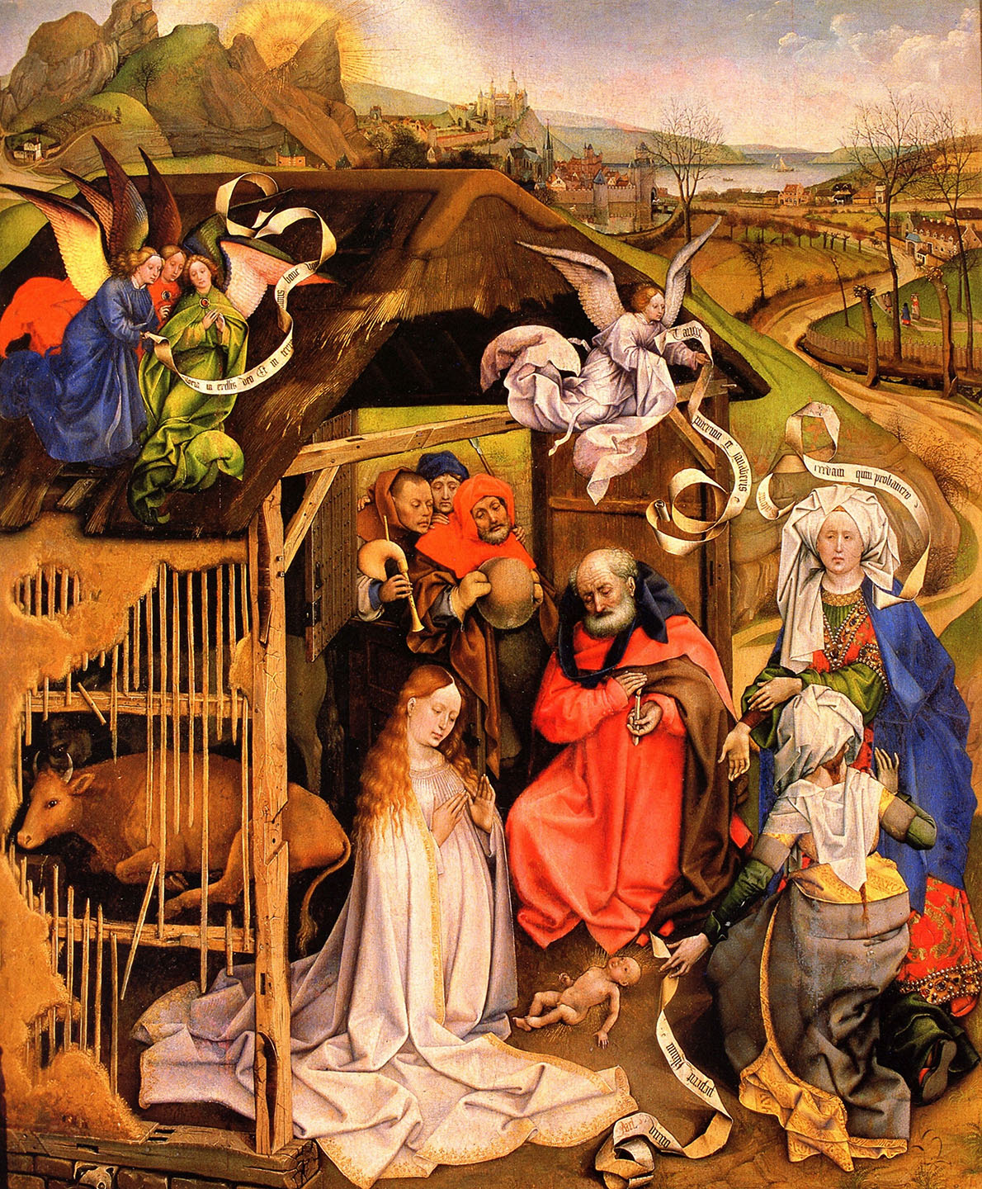
When The Time Was Right
“When the time had fully come, God sent forth His Son, born of a woman, born under the Law, to redeem those who were under the Law, so that we might receive adoption as sons. And because you are sons, God has sent the Spirit of His Son into our hearts, crying “Abba, Father!” (Gal. 4:4-6).
Robert Campin, Birth of Christ, 1425-30

Slide 11
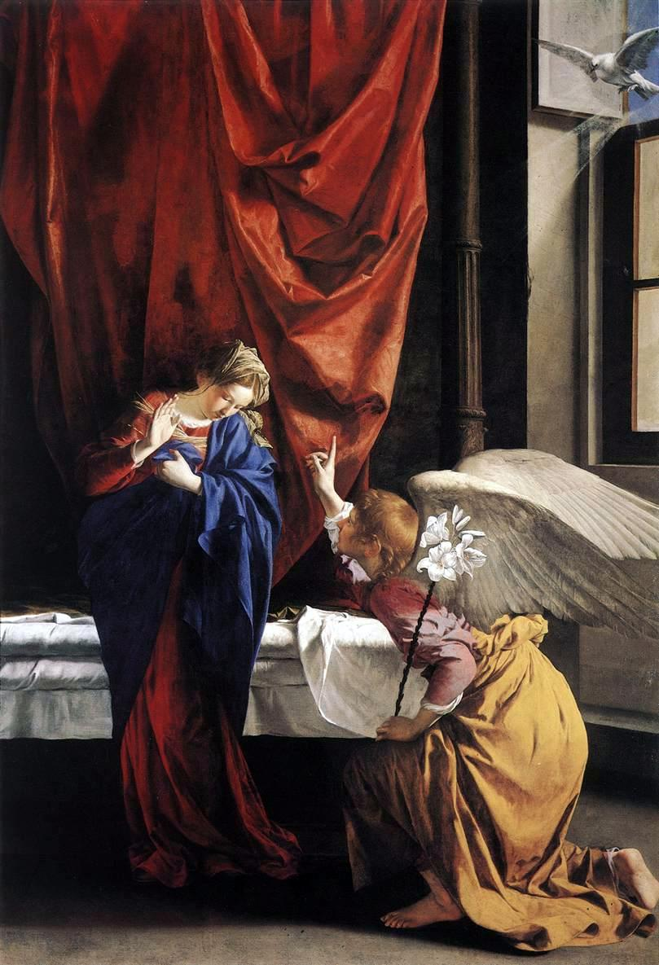
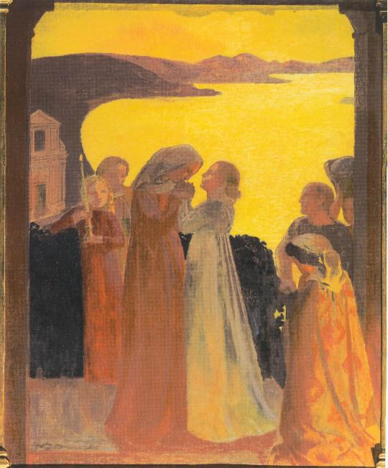
Mary’s cooperation in her Son’s work
The Annunciation – her fiat
The Visitation – Magnificat
Maurice Denis (1909)
Orazio Gentileschi, (1623)

Slide 12
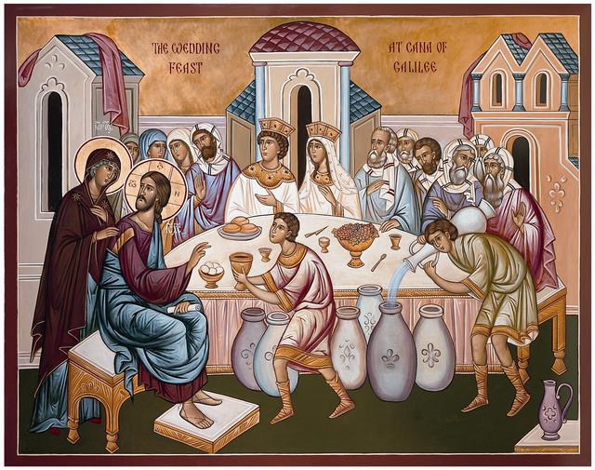
Wedding at Cana: Jn. 2:1-11
“When the wine failed, the mother of Jesus said to Him, ‘They have no wine’”
“Do whatever He tells you”.
And his glory was seen, and His disciples believed in Him

Slide 13
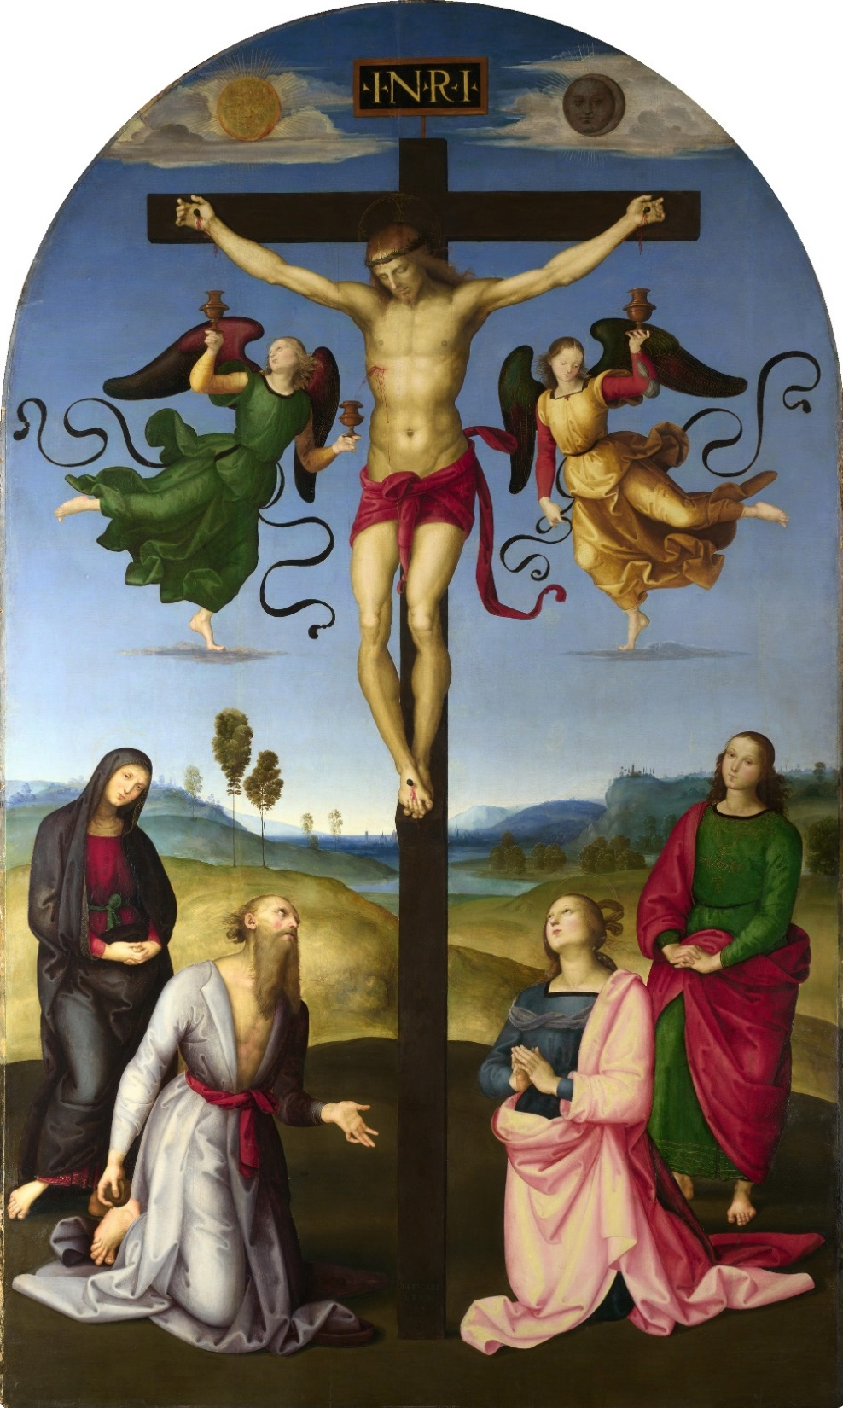
At the Foot of the Cross
“Woman, behold your son”
“Son behold your mother” (Jn. 19:26-27)
Raphael, the “Mond” Crucifixion

Slide 14
Pentecost – the Birth of the Church
“All these (the 11 Apostles) with one accord devoted themselves to prayer, together with Mary, the mother of Jesus and with His brethren” (Acts 2:14)
“When the day of Pentecost had come, they were all together in one place” (Acts 2:1)

Slide 15
Queen of Heaven
“In giving birth you kept your virginity; in your Dormition you did not leave the world, O Mother of God, but were joined to the source of Life. You conceived the living God and, by your prayers, will deliver our souls from death.” (Byzantine liturgy; Feast of the Dormition (15th August).

Slide 16
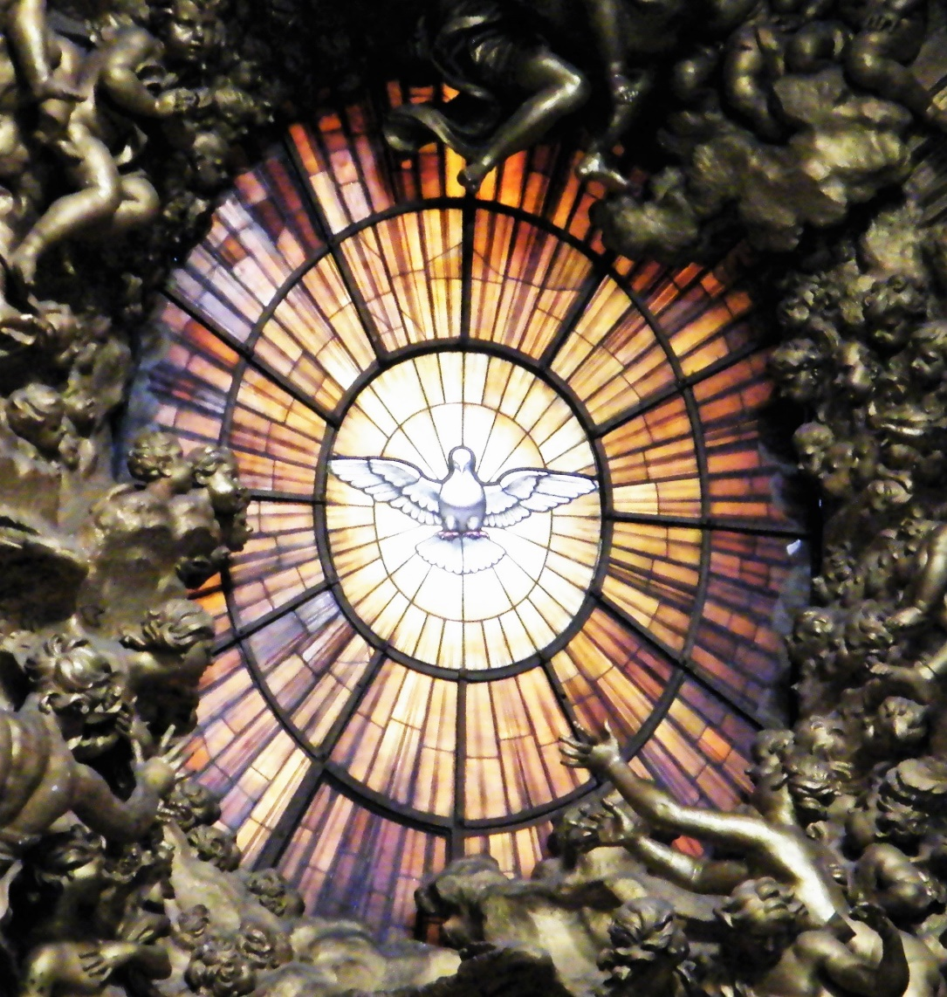
What does this mean for us?
“Whoever does the will of God is my brother and sister and mother” (Mk. 3:35).
Mary is “full of grace” and so she is the closest to her Son’s heart.
We can turn to Mary as she intercedes for us
She will help us to be merciful like the Father
As Mary is her Son’s first disciple, we can model ourselves on her
Her faith is an example to us
Filled with the Holy Spirit at the Annunciation, what Mary does, she does in Christ - so do we

