Slide 1
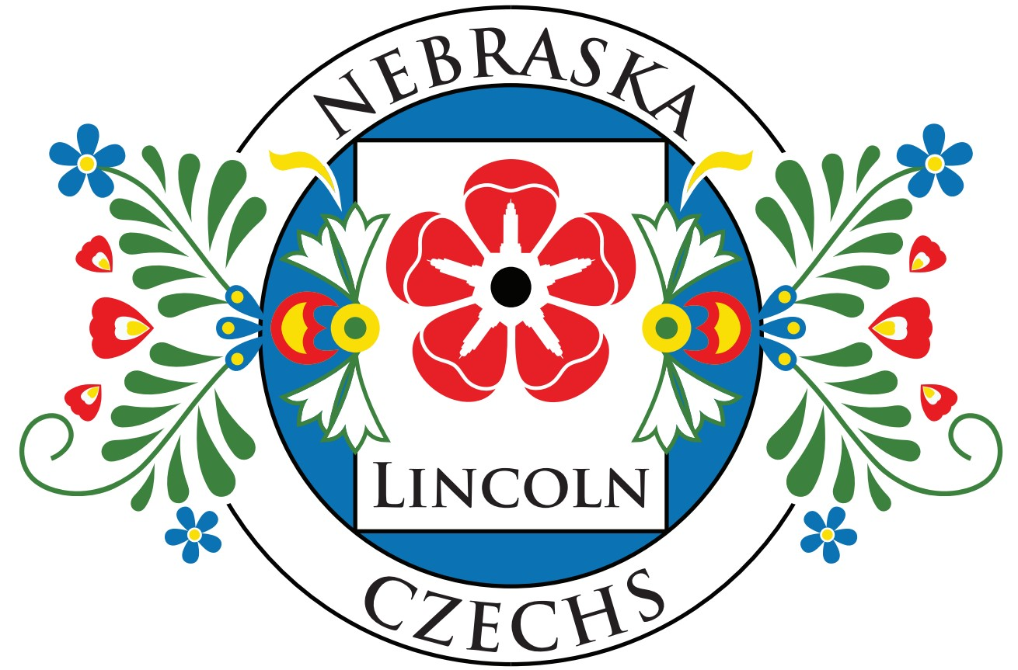
Genealogy – For Beginners & Experts Alike
Maurice & Beverly Vonásek
Notes:
Welcome to tonight’s presentation…we hope you will enjoy and possibly pick up on a few things that will help you in your ancestral research.
Note, sources used in this presentation may be found on our Nebraska Czechs of Lincoln website: https://www.lincolnczechs.org ‘LINKS’ page

Slide 2
Notes:
Just ponder on this for a bit…the numbers are incredible. Every time I see this, I continue to be amazed.
How am I going to be able to find information for some of these relatives even at a lower generational level? Ugh!!!

Slide 3
Is there a difference between Ancestry research and Genealogy research?
Ancestry research is the developing of the family tree with an emphasis on dates. This involves direct and indirect lineages while identifying individuals.
Genealogy research involves collecting historical records and documentation that delves into knowing who the people were and the lives they lived.
It really makes no difference to most people when researching their family tree as they are trying to trace their relatives dating as far back as they possibly can and know what they can about them. In the end, and as far as most people are concerned, both terms are synonymous…only the hard-core researchers will differ.
For our purposes, we are combining the two and will use the blanket term: Genealogy research
Notes:
This is important to know should you decide to seek professional research services….these services can be expensive depending upon the research.

Slide 4
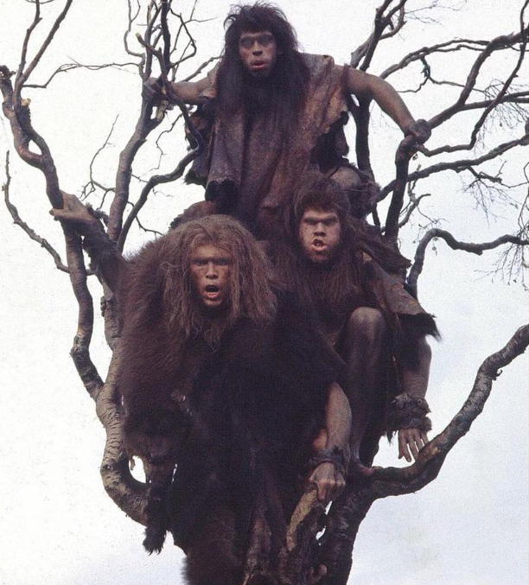
Family
trees
before
the
internet
Notes:
This is probably a bad example….nobody’s family tree should look like this.

Slide 5
‘Genealogy = Confusing the dead and annoying the living’ - by Unknown Author
Why are people so fascinated with genealogy?
Genealogy is an appealing interest because almost all of us have ancestors that immigrated to America from another country. We have a natural curiosity about our ancestral home countries, the relatives our ancestors left behind, and what motivated these folks to leave their home country. We try to imagine the struggles and hardship they faced upon arriving in the new land. We have much curiosity about how and why our ancestors came to make this particular area of the country their new home and question why so many stayed or later moved on.
Today, many Americans do genealogical research as a hobby not only for their own families but also with intrigue of other’s families. Some folks take a serious and methodical approach in their research and validate everything they find. Some may take an opposite approach and rely on assumptions and non-validated research as reported by other researchers. Finally, some may even hire professional genealogy researchers to produce desired results.
Notes:
‘Genealogy = Confusing the dead and annoying the living’ ….. Truer words have not been spoken – with each generation’s departure, it gets harder & harder to recover information.
The first paragraph says much about the passion so many have for learning about their ancestors.

Slide 6
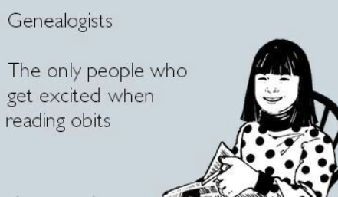
Notes:
As morbid as it may first seem…..Obituaries & Funeral handouts are wonderful sources to read & gain valuable information!
You may find newspaper obituaries from the “olden days” to be eloquently written with great dignity and honor given to the deceased and surviving family members. Today, the cost of posting an obituary are ridiculously high…which doesn’t make sense as most papers are on-line. It used to be that death/funeral notices were published free-gratis as a public service to the community.
Some family members kept these items forever as remembrances that they seldom looked at except for when adding to “the stack”….check with your elder family members to see if they exist or dive into their estate belongings before another family member throws them into the trash.

Slide 7
So how/where do I start?
Start with yourself
You may want to jump right in with your grandparents’ generation, but take the time to document your own life’s milestones. By writing down dates and gathering records for yourself, then your siblings and parents, you’re anchoring your research, connecting each generation to the previous, and creating a strong chain of relationships.
Fill in forms/charts/trees
There are many different forms that can help you document and keep track of your research, but the most basic and well-known is the pedigree chart (aka, the family tree). You can use paper forms or computer software, but the most common is the online tree. (paper is tedious and time consuming) However, use whatever works for you.
Start with the resources you have available
If you have old photos, letters, documents, newspaper clippings, family bibles and even heirlooms, you’re sitting on a treasure trove of family history. Go through those first to see what you can learn. Then set up a time to interview your relatives while you can…especially with your elderly relatives. Take some of those old photos with you to get them talking. Also, take good notes and maybe even use video or voice recordings for posterity and to enhance your note keeping. Visit the family cemeteries and check those names & dates and crosscheck what you find.
Search online
There are a plethora of websites that contain information pertinent to your research. You may have seen the commercials for Ancestry.com and advertisements for DNA testing. All kinds of records may be found on other websites & repositories. Newspapers.com is great! Local libraries/museums are also a great resource. Many Czech-Slovak online resources are available! Church Parish records are the #1 source of ancestral family information…but, be aware of the information recorded….spelling differences, language written, scribe interpretations/assumptions.
Notes:
***Start with the obvious and work backwards.
***When researching it is easy to get distracted and take a wrong turn…so, take notes of where you stopped if you decide to go down another path so you will know where you stopped & return…it’s true, you will get distracted.
***Use of a well-known online service like Ancestry or Myheritage will automatically back up your data…reminder that paper can be torn, burned or water damaged….digital data in the cloud is multi-backed-up.
***Many Czech resources are out there…you just need to know where they are & how to use them.
Most all villages/towns will have a website for municipal/informational purposes…each will have a coat of arms & history of the surrounding area.
Most modern browsers will interpret/translate pages for you…we will get to this later in the presentation. (refer to our website)

Slide 8
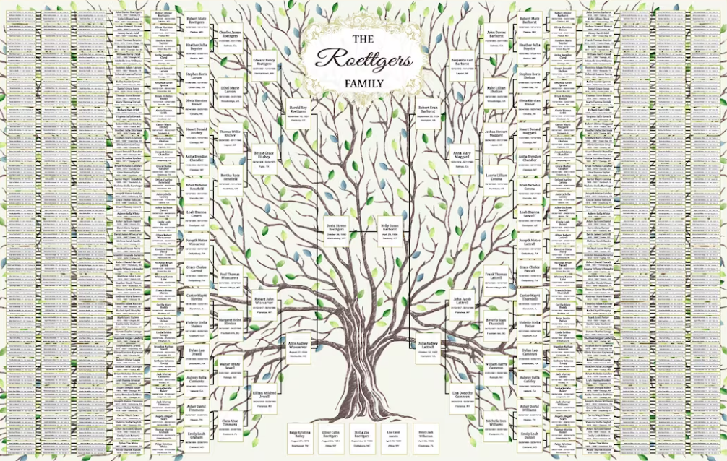
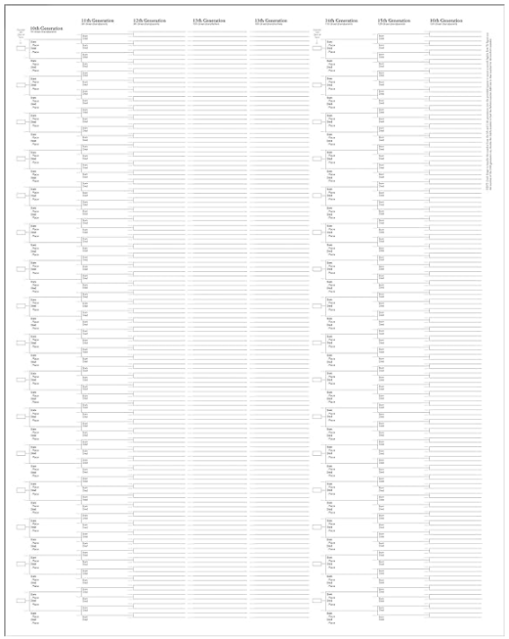
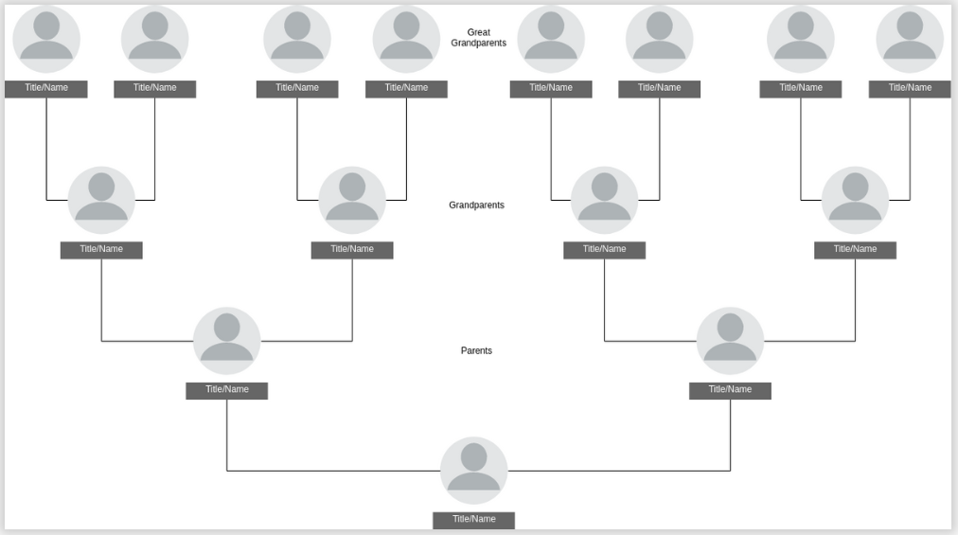
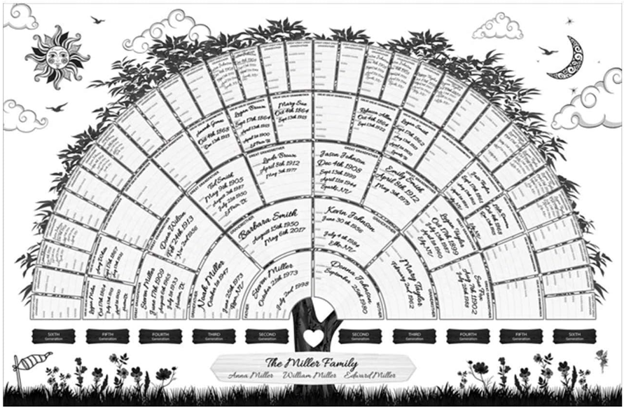
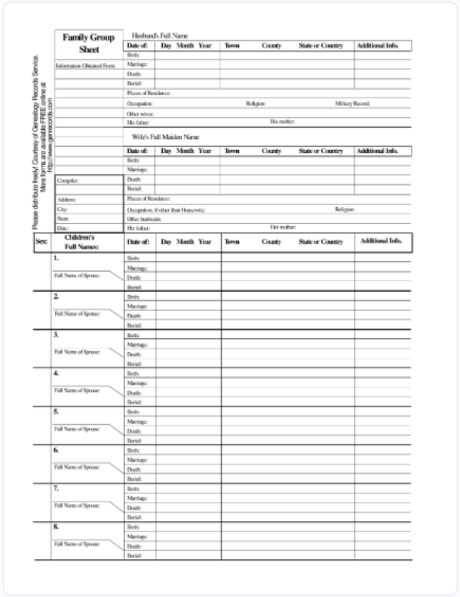
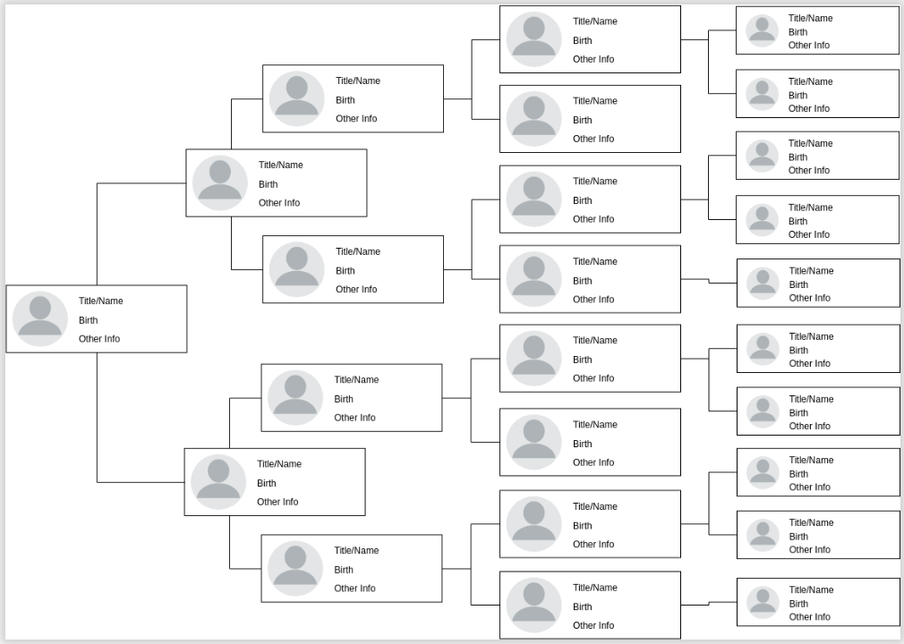
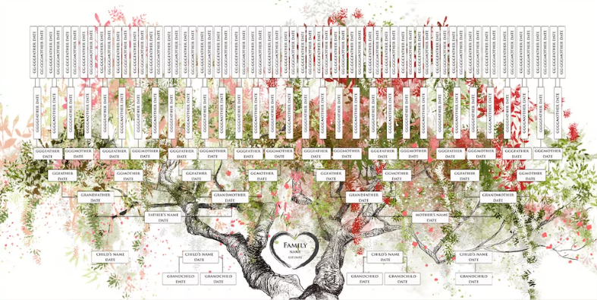
Trees are everywhere
All sizes & shapes
Notes:
So many ancestral tree formats to choose from – simple horizontal/simple vertical/Fan/ornate…etc. OR the plain old straight paper/box format
To store supporting ancestral genealogy data about each of these boxes/entries (people) is where the online services really shine.
Do scan-in/digitize those old paper copies & photos from Aunt Mable for safe keeping! You remember Aunt Mable…she’s the one everyone so many years ago thought it was strange for her to be writing everything down about the family and keeping logs/diaries of every family member/event……those “things” are priceless to have now.

Slide 9
What to watch out for
Ages that Don’t Add Up
Incorrect dates can upset your hard-earned research and raise a lot of questions. Watch out for the oddities. Maintaining a timeline of your ancestor from birth to death will help keep your dates straight and avoid common-sense errors from occurring. Make sure your timeline includes birth year, and note what age your ancestor would have been during life events that you uncover in research.
Data Copied from other Family Trees
Copying information from another person’s family tree without verifying it first is a recipe for genealogical disaster! The information that another tree owner found may apply to another person with a similar name or the data may be incorrect altogether.
Incorrect Records & Indexes
Not all transcriptions or indexes are perfect. You may find records containing the results of a bad record transcription or poorly indexed/scanned documents. Machine scanning with AI may help improve these processes/results. Church Parish records may contain spelling/language interpretation differences and the scribes also may have taken liberty with assumptions on their part.
Typos in Names or Dates
Review your names and dates. Do take a step back and look for typos. Look for nicknames and those name changes! Watch for the “-ova” in female/maiden names. Don’t forget the diacritics! Also, make sure your dates are correct and consistently formatted. Validate using multiple sources when you can.
The Wrong Ancestor(s)
Do use multiple criteria when searching for ancestors, especially those who had common or like names. When evaluating records, consider your ancestor’s birth year, occupation, family members and location within a community to make sure you’re following the correct person back in time (in the correct timeframe).
Notes:
Ages that don’t add up: *Children born at suspect times? *Do the parent’s ages reflect that of the child-bearing age? *Women giving birth before the age of 14 or after 50. *Women married before the age 13 *Individuals who married, bought property, appeared in census records, etc. AFTER their death *Re-marriages & marriages within same families can be another issue….brothers of one family married sisters of another & vice-versa
Data Copied from other Family Trees
Watch out! Data copied may contain mis-information from another tree that was incorrect and that tree was first copied from another and so on. Verify the people: name, age, location, etc.
Incorrect Records & Indexes
Transcribers make mistakes….some make assumptions, even though they do so with good intentions. Immigration/Parish records/School records/Census/etc.
Typos in Names or Dates
It happens a lot! Ship manifests/immigrations/NEWSPAPERS & CENSUS!!! <-especially Census!!!…look out for nicknames & spelling assumptions!
Ethnicity of the Scribe can show up when they recorded names of others (census/legal documents)…after a while some immigrants “took” to using those mis-spellings & nicknames for all their needs. ***Watch for the ‘ova’ after female/maiden names
The Wrong Ancestor(s)
It can happen…how many Waclavs, Mary/Maries, Josef/Josephs, Franz/Franks, Antons/Tonys, Christinas, Ludmillas, Rosalies are there with same surnames?
Parents/Aunts/Uncles/Nieces/Nephews received the same name in their honor – ALSO there is the re-use of naming a child after the death of another (sometimes multiple times).
Old Country Names versus “Americanized” names! <SEE NEXT SLIDE>
Lots of name changes happened over time because some names were intentionally mis-spelled for ease of use/pronunciation.

Slide 10
Austria/Bohemia/Czech/Slovak - First Names & sometimes Last Names
While some families attempted to translate “old country” names when they immigrated to America, often this was found to be difficult. A tradition developed among Austria/Bohemia/Czech/Slovak immigrants to replace given names with that of more “Americanized” names. Many old country names were perceived as unusual in America and had no translation used as a first name by the current Americans. This caused communication difficulties & sometimes persecution.
For example, “James” was a unique English sounding name very acceptable in America even though it did not correspond to any Austrian/Bohemia/Czech first name, however it was a convenient substitution. At the time, the name “James” was often associated with that of the King James Bible. Thus, Waclav (Václav), Wenceslaus, Wenzel were replaced with “James” despite there being no historical or linguistic connection among the names. Many other names (both male & female) have also been changed with these “Americanized” substitutions.
Ancestral and immigration documents often list original European names only to be followed up by these name changes in subsequent historical documents in the following years. Census takers, Assayers, Registers and the like sometimes wrote their own interpretation of spelling of names as many immigrant’s written and/or verbal language skills were not fluent in English. As an example, “W” name spellings were pronounced with that of “V”. Gravestone markers found in the U.S. may be engraved with a mixture of old and new country language spellings.
Note too, the recording of important Dates could also have been mis-interpreted or simply “estimated” as many immigrants had no real supporting documentation to validate their birth or wedding records.
Notes:
For years, I was confused with some ancestral names….until I finally figured it out. My 2nd great-grandfather Waclav "James" Vonásek has on his emigration papers, his first name is recorded with the German spelling of ‘Wenzel’. In America, he went by “James”. His headstone is Waclav. What is the difference between Waclaw and Václav? Be aware of these possible name glitches.
***The television show of 1883 (prelude for Yellowstone) accurately depicts what it was like for those immigrants coming to/crossing America with language & culture barriers.

Slide 11
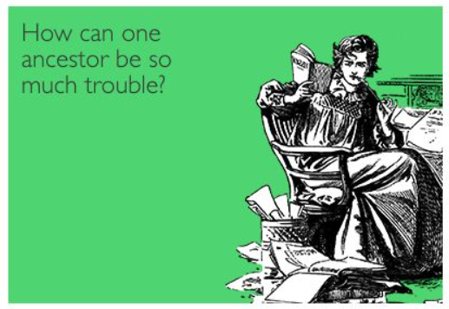
Notes:
One ancestor can really upset your thought processes & cause you to question your sanity….better keep some Pivo close by!
You may run into that proverbial brick wall/dead end with seemingly no hope to go further….take good notes & simply revisit occasionally as more information becomes available with time. (new/old records are found & made public and more shared research from other genealogists comes to light…..database updates via Ancestry.com & MyHeritage & others)

Slide 12
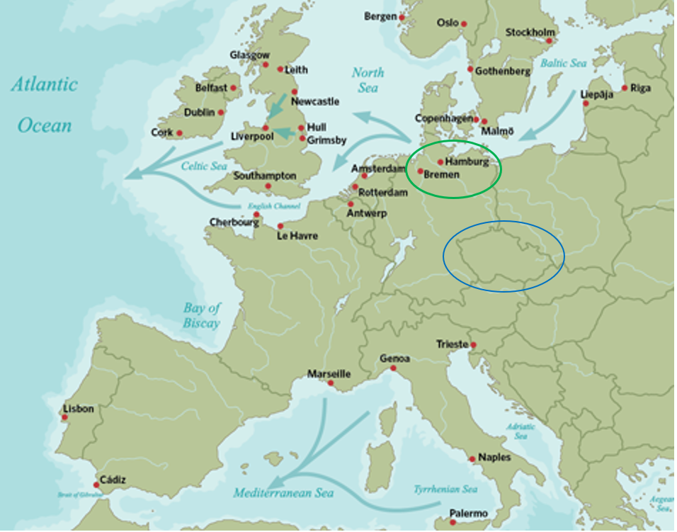
Leaving Europe – Ports of Call
Once emigrants bid friends and family farewell, they headed overland by coach, cart or on foot toward the nearest seaport on the Atlantic Ocean (major ones are shown here). Depending upon the starting point, this might take weeks. Most, having worked for years to finance the voyage, left with little more than what they were wearing. The more fortunate often drug heavy “steamer trunks” with them containing their most precious family possessions.
Many emigrants from the Czechlands traveled to Bremen or Hamburg, Germany as the most feasible points of departure. One has to remember during the mid to late 1800’s the Czechlands were under Austria/Austro-Hungarian Empire rule.
Migrants might have sailed directly to America or made several stops and transfers on a multi-leg trip depending upon available funds and their final destination. Many weeks of riding the waves in a “steamer” was not very comfortable…especially for those with families.
Ship manifests/records are a great place to find where your ancestors arrived in America. Besides Ellis Island, Baltimore, Boston and Galveston were major ports of arrival for most new arrivals from the Czechlands.
Notes:
Bremen and Hamburg were the most common ports of departure for Czechs…there were others such as Amsterdam, Rotterdam, Antwerp and Trieste…though not as frequent.
Riding in a “steamer” was not only uncomfortable but sanitation was often not good as most low-cost merchant ships were built for transport of merchandise & not passengers.
Passengers spent most of their time below deck. Cooking & caring for small children was challenging. I’m sure sea-sickness and other communicable ailments came into play.
It took weeks/months for these travelers to get to their final port destination….try to imagine that.
The ship manifests & port records may reveal a lot to you as to which family members actually came across on the boat vs being born in US…helps validate those immigrated & their ages. Note, some children were born on-board ship. Also, helpers/hired-hands/family friends came over with some families as this was their best & only career option. Most were extremely poor but loyal to the family & some may have even assumed the family name.

Slide 13
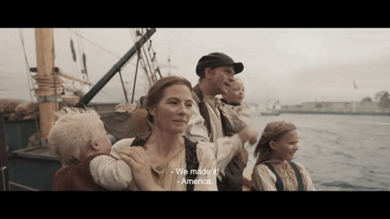
Notes:
Once on American soil….think about trekking across a new & unfamiliar land with family & surrounded by unfamiliar languages that you don’t understand.
Thank goodness for the creation of fraternities…. IOOF ….is it still possible to find those records of fraternities? Where are they kept? That is not a path I have gone down…yet.
***The earliest of Czech settlers had to deal with a lot…unfriendly natives/open-unturned prairie/lack of resources/etc. Not much documentation exists for their trek exploits other than some family stories.

Slide 14
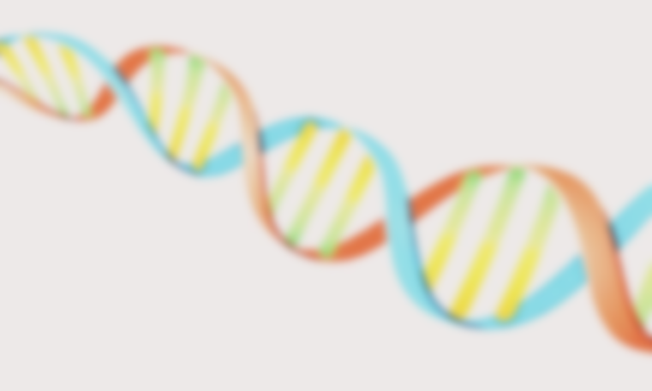
DNA
Regardless of which DNA testing service you use, DNA can provide for ethnicity estimates, ancestor migrations, DNA matches with relatives and your health. Genetic health testing can help provide diagnosis for various genetic conditions and possible risk of cancer development.
Each of your parents passed down half of their DNA to you. This means there is one half of their DNA that you didn't inherit. Inheriting half of a parent's DNA doesn't mean inheriting half of each ethnicity. The DNA, in this sense, you inherit is random. This is why siblings may each inherit a different amount of DNA favoring one parent over the other…..this includes twins.
DNA variations can provide certain clues about where a person's ancestors might have come from and help validate relationships between families. Certain patterns of genetic variation are often shared among people of particular backgrounds. The more closely related two individuals, families, or populations are, the more patterns of variation they typically share. Density of these shared variations help lead to establishing ancient genealogy regions such as, not surprising to us, Bohemia (Eastern Europe & Russia/Germanic Europe).
It is possible that a person you thought was a close relative isn't biologically related to you. Though it is possible that it's a mistake, it's extremely unlikely. DNA relationship predictions are most always accurate for people who are second cousins or closer. It’s when you get to the fifth cousin range (and beyond) is when DNA is thinned to a point that genetic matching results become less conclusive.
When using an autosomal test such as AncestryDNA, 23andMe, or MyHeritage, you'll generally be able to go back 6 to 8 generations. Assuming 25 years per generation, thus you can expect 150-200 years of possible DNA information by taking an autosomal DNA test.
AncestryDNA, MyHeritage DNA, 23andMe and Family Tree DNA are the major DNA testing companies in America.
Notes:
Not going to go into this much as there is a lot to know about the benefits & accuracy of DNA testing…..will pause for a few seconds to let you read.
I will post this power point out on the website so you can read/refer to later.
***You can find a lot of cousins thru DNA testing…have met/talked with several that I would not have otherwise even known about. In doing so, have been able to receive and share ancestral photos & documents & tree information AND THE FAMILY STORIES! These have been fun encounters.

Slide 15
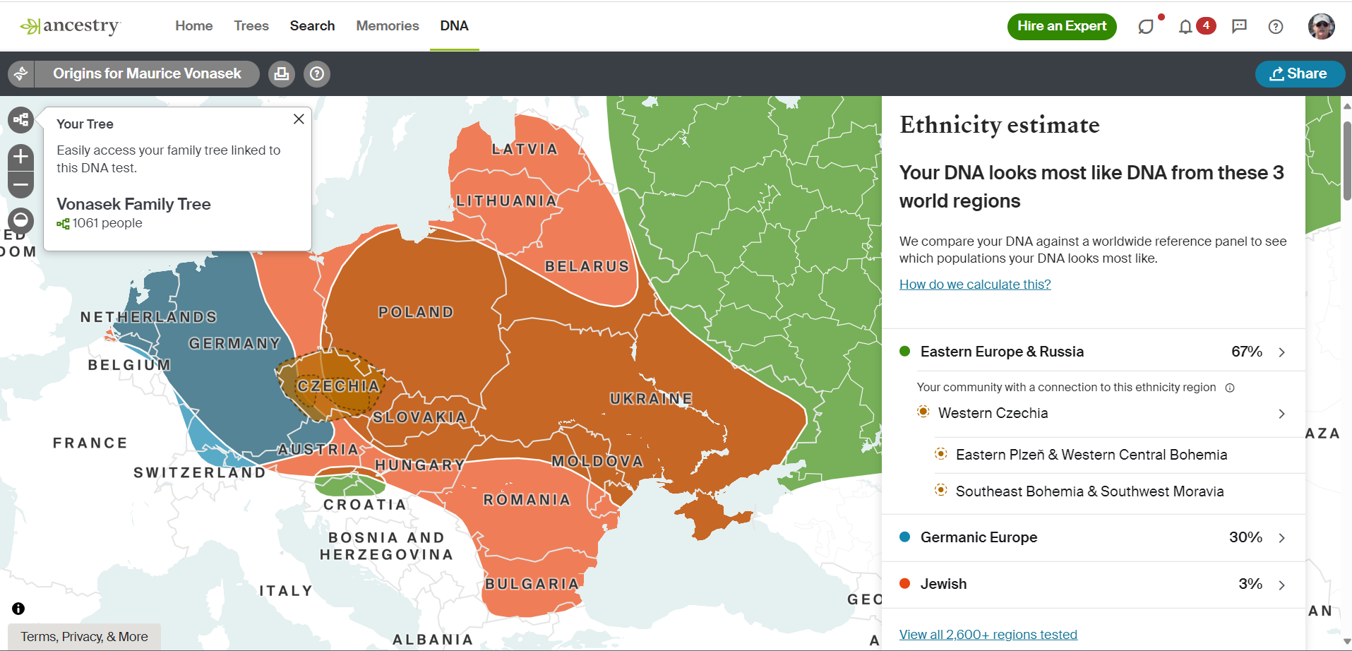
Notes:
This is a quick example of Ethnicity estimates showing where the highest concentrations of (my) matching DNA are located.
These boundaries and estimates change every so often as more and more people participate and more is known about genome representation.
But, this is proof positive that the DNA testing process works, as my ancestors that I have found in my genealogy research are indeed from these concentrated areas shown.
You can examine each of these areas for greater detail & get some great information about each….will not do that now because of time constraints.
Also available are DNA matching relatives…listing both close & distant individuals in US & Europe.
Can reach out & contact these folks just as I have done….I have had phone calls & met with distant cousins & its been amazing!.

Slide 16
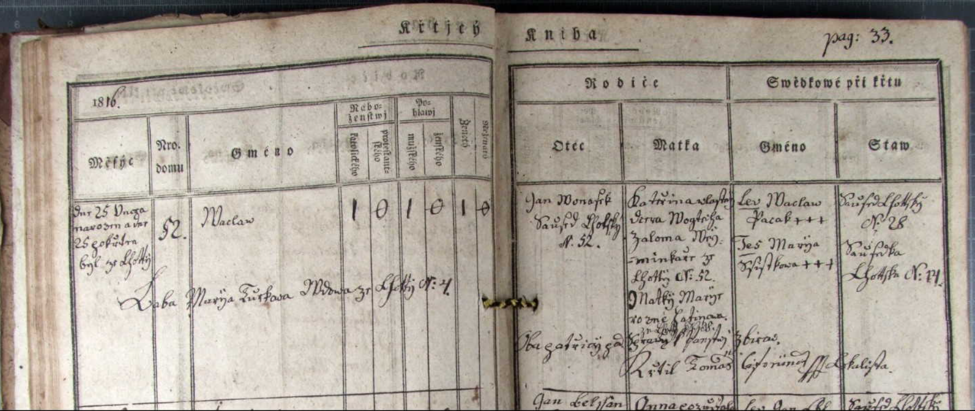
Church Parish Records
https://www.portafontium.eu
This is your best source for obtaining information about your old world ancestors. No official governmental records exist for the populace…in fact, government(s) relied on Parish Records for their information base.
When researching Austria/Bohemia/Czech/Slovak Parish Registries, it must be taken into account that different forms of old country names used may have been written in three different languages; Czech, Latin and German. Keeping in mind that changes in religious beliefs of Roman Catholic, Catholic and Protestant are key to the written language that was used at the time.
Be aware that Priests/Scribes sometimes took liberty in recording their personal “opinion” or intentional & unintentional interpretation and spelling of names.
Waclav Vonásek - Baptism - 1816, Lhota Pod Radčem V05, p.33
Waclav Vonásek & Marjie Pacovský Marriage - 1838 - Lhota Pod Radčem V06, p.49
Notes:
Not all Parish Records are digitized and may be physically housed in Regional/District locations. Can hire folks over there to go find & copy that information.
Be aware of the different written languages and differences in how the Scribe actually wrote…some were very eloquent while others scribbled or were in a hurry.
When recording illegitimate births, sometimes Priests actually knew or sometimes guessed as to who the actual father was and wrote those name in the register.
Information may include parents names (including maiden), grandparents, village/town, house #’s (how I found houses and land), occupation, etc.
Watch for the ‘ova’ after female/maiden names
+/+++ and other symbols used – see the guide on how to for parish records
The photos in this slide are for my 2nd great-grandfather & 2nd great-grandmother

Slide 17
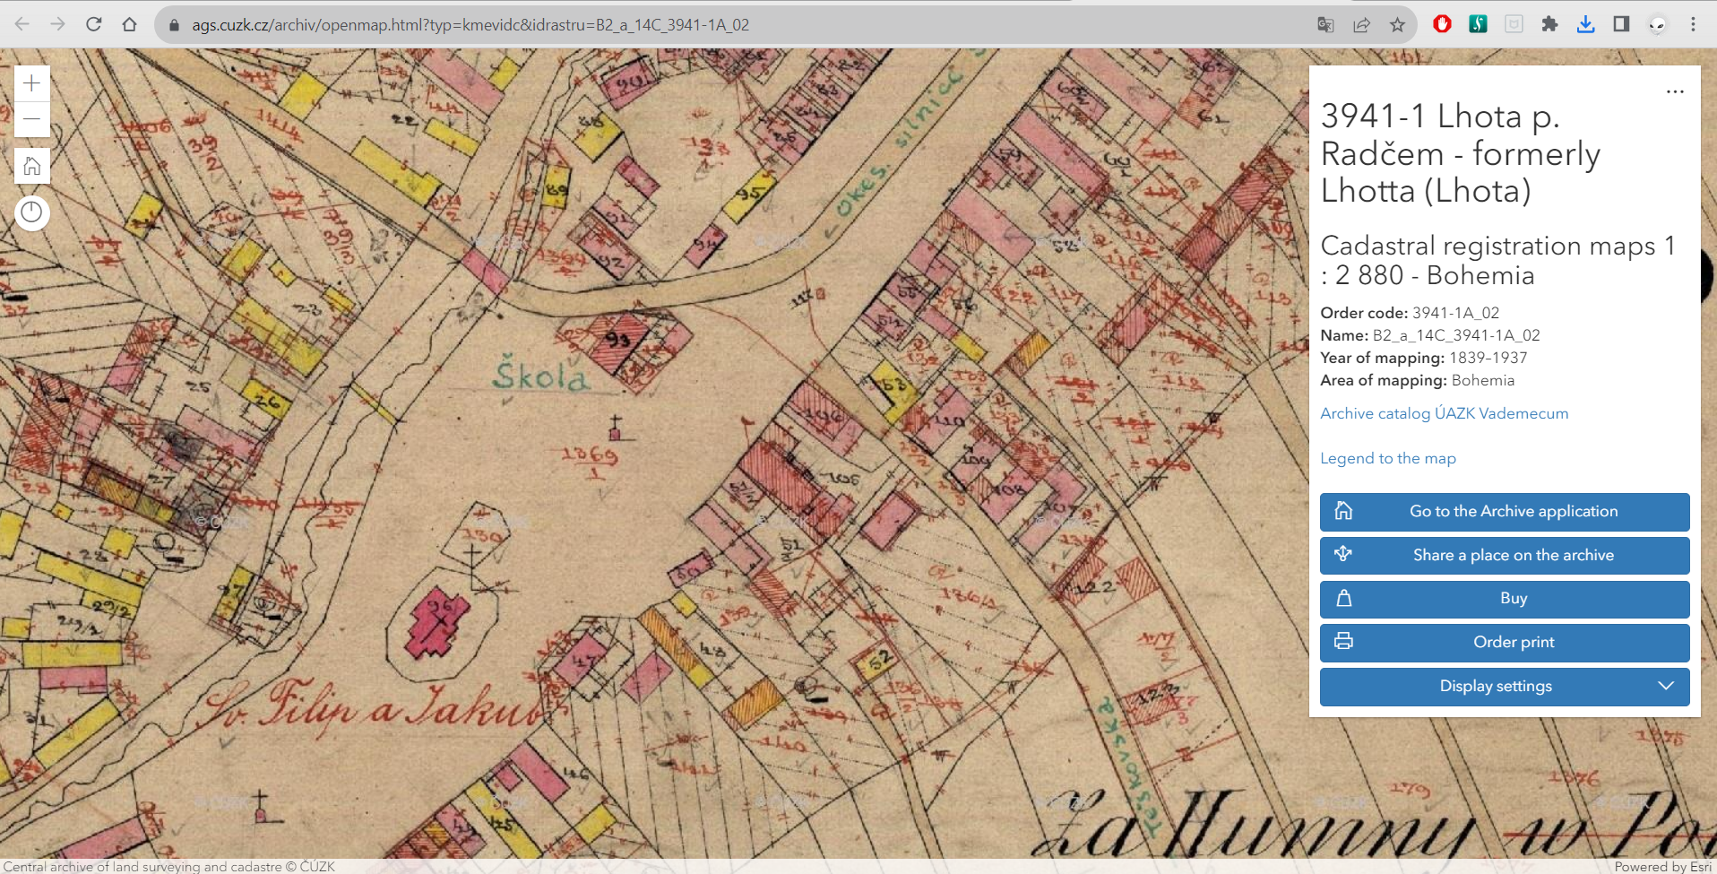
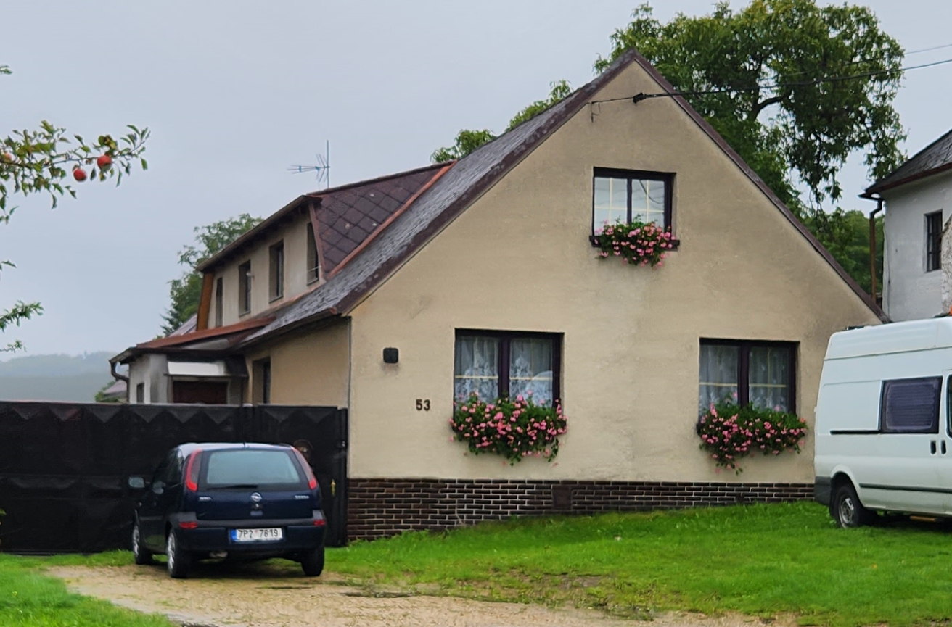
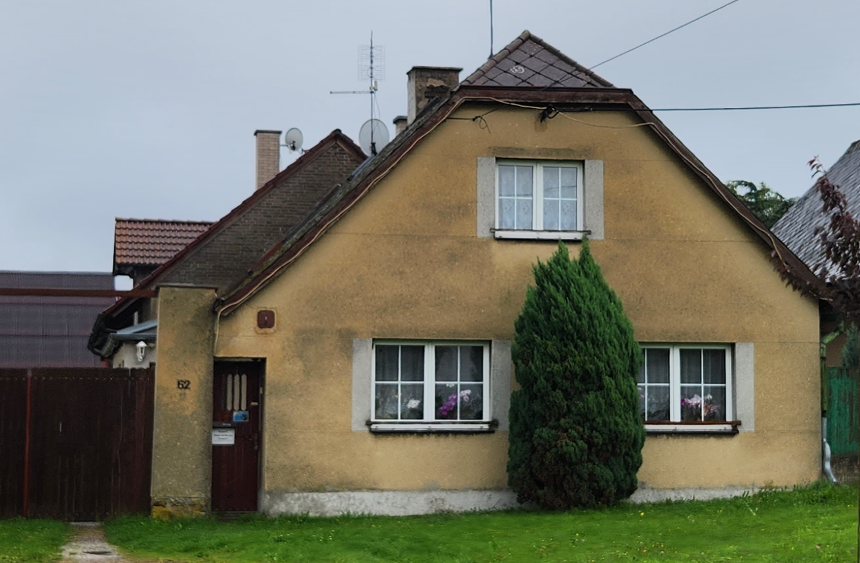
Stabile Cadaster Maps
Who owned the land?
Where was the land?
Notes:
Stabile Cadaster Maps were created for the purpose to assess real estate duties. ..ie; taxes.
Available maps: Bohemia was mapped during years 1826-1843, Moravia during years 1824-1836. Not sure about Slovakia/haven’t got that deep into that area.
Example shown here is for Lhota Pod Radcem….drilling down you can see & tie the house/land owner numbers.
These are my Vonásek ancestor’s homes that are still standing today (pictures taken on our trip September 17, 2022) House #52 & #53 equate to land ownership by the same numbers.
Understand that the land parcels are not laid out the same today…so, when you visit, it may (or may not) be difficult to orient yourself accordingly.

Slide 18
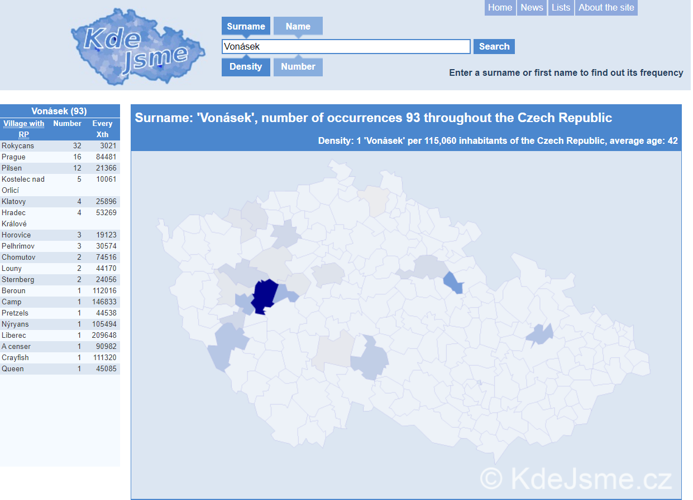
Here is where you may find people having the same last name as yours. Use diacritics for best results!
Notes:
Where in the Czech Republic are our ancestor’s remaining living relatives today? ***Do these areas match my ancestral research & my DNA results? You bet it does!
From here, you can go to the town/district website and potentially inquire about people with that name living there & possibly reach out to them or make contact with town officials for info.

Slide 19
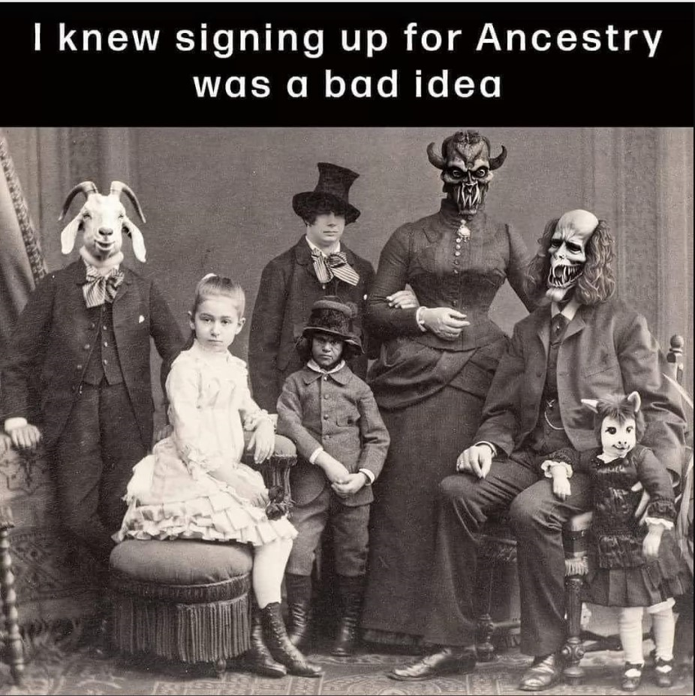
Notes:
Be prepared for what you find out about any given ancestor! (***every family has a crazy aunt Martha or drunk uncle Joe or lunatic cousin Eddie in their tree)
Be accepting of the fact that you are not responsible for anything your family members may have done/had happen to them…today’s standards are different than yesterday’s.
Family history cannot be changed…..it can go unreported if one chooses to do so….but, why hide the truth?
You are the Family Historian reporting the facts that other generations will appreciate knowing.
(I believe that I have a moral responsibility for reporting my true family history no matter how crazy some things may have happened)

Slide 20
Ok, let’s move on and take a look at some available resources… We’ll talk about these & possibly pull up some examples as time allows.
lincolnczechs.org
Links
Genealogy
Notes:
This is our club’s website address and the link path to get to “the good stuff”.

Slide 21
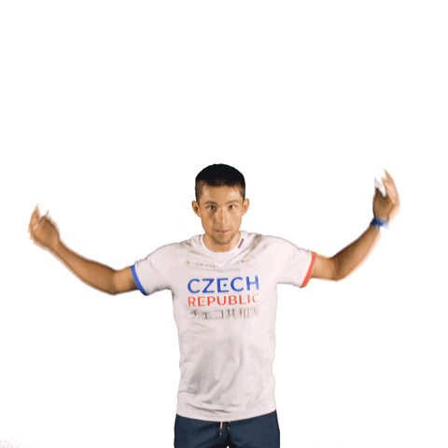
Any
comments
or
questions?
Notes:
This guy is a Czech Republic Olympic Athlete attempting to see if anyone has any questions or comments?
***We will now jump over to the Links / Genealogy page and go over available resources…..then we will come back to here for follow-up comments/questions.

Slide 22
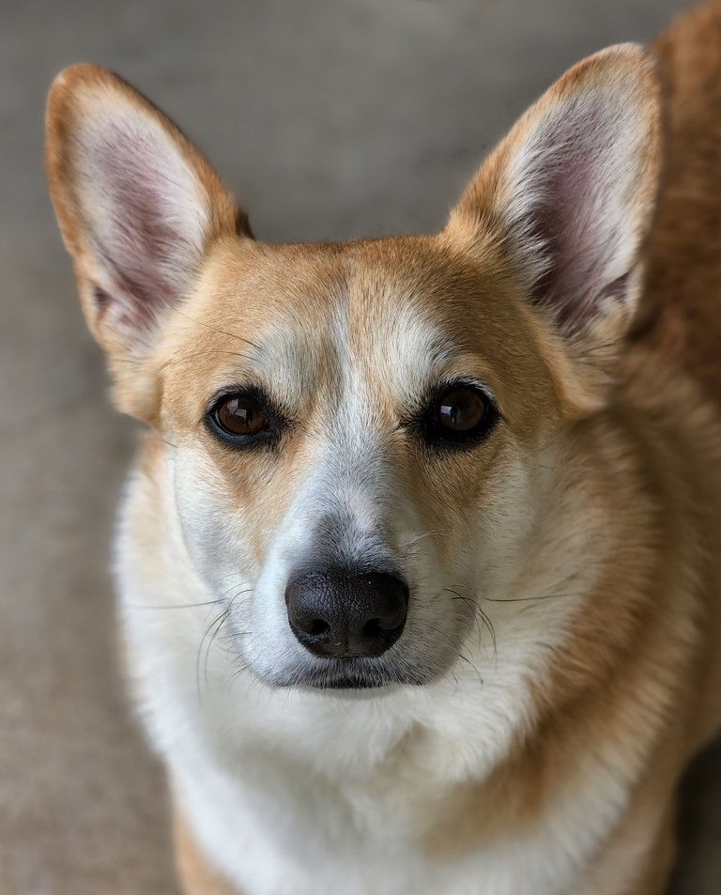
Thank you!
Notes:
This is our Bella….she is a 5-year old Welsh Pembroke Corgi.
She likes to “help” her people with whatever they are doing.
She did “help” in the making of this slide show by barking her approval of the slides as we tested displaying them on our living room wall.

