Slide 1
‘Ancestral Mapping of the Czech Lands’
‘Ancestral Mapping of Czechia’

Slide 2
Notes:
Central Europe - Duchy’s & Kingdoms - From 919 to 1125

Slide 3
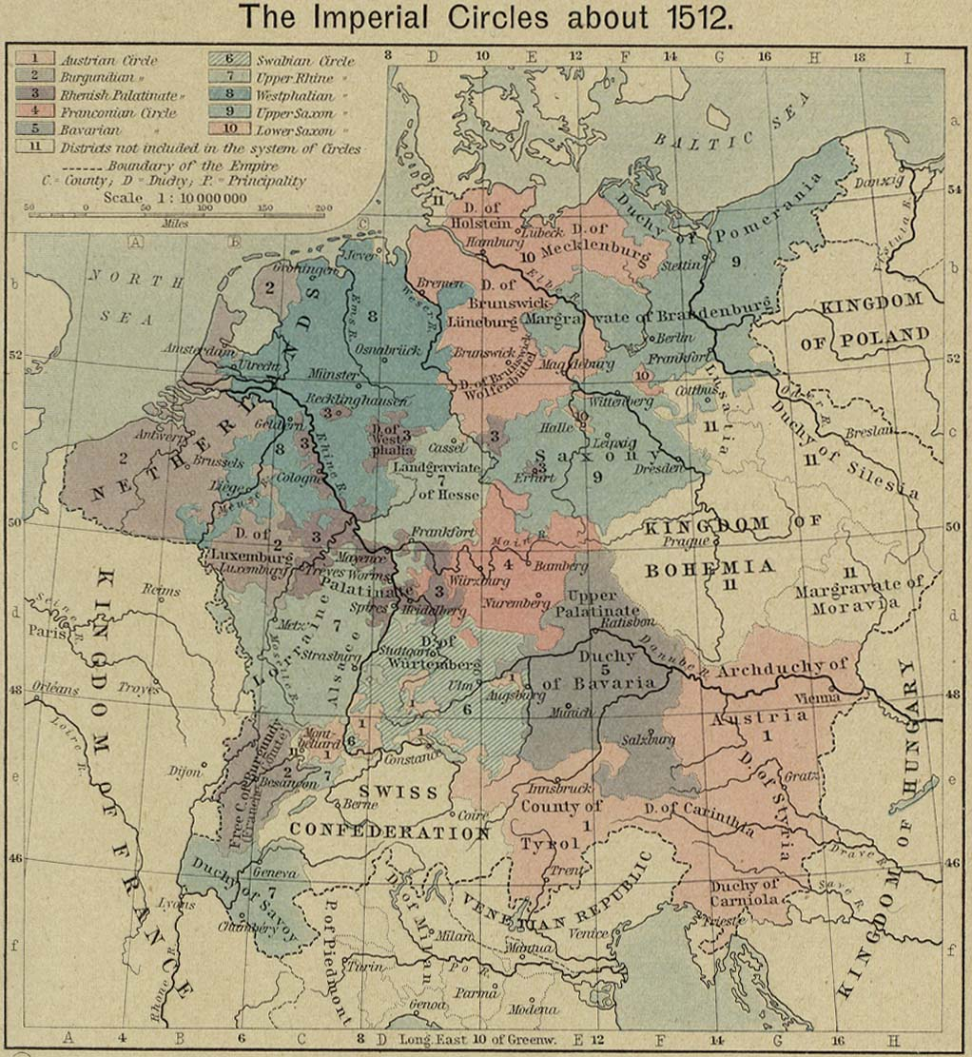
Notes:
The Imperial Circles about 1512 – Kingdom of Bohemia

Slide 4
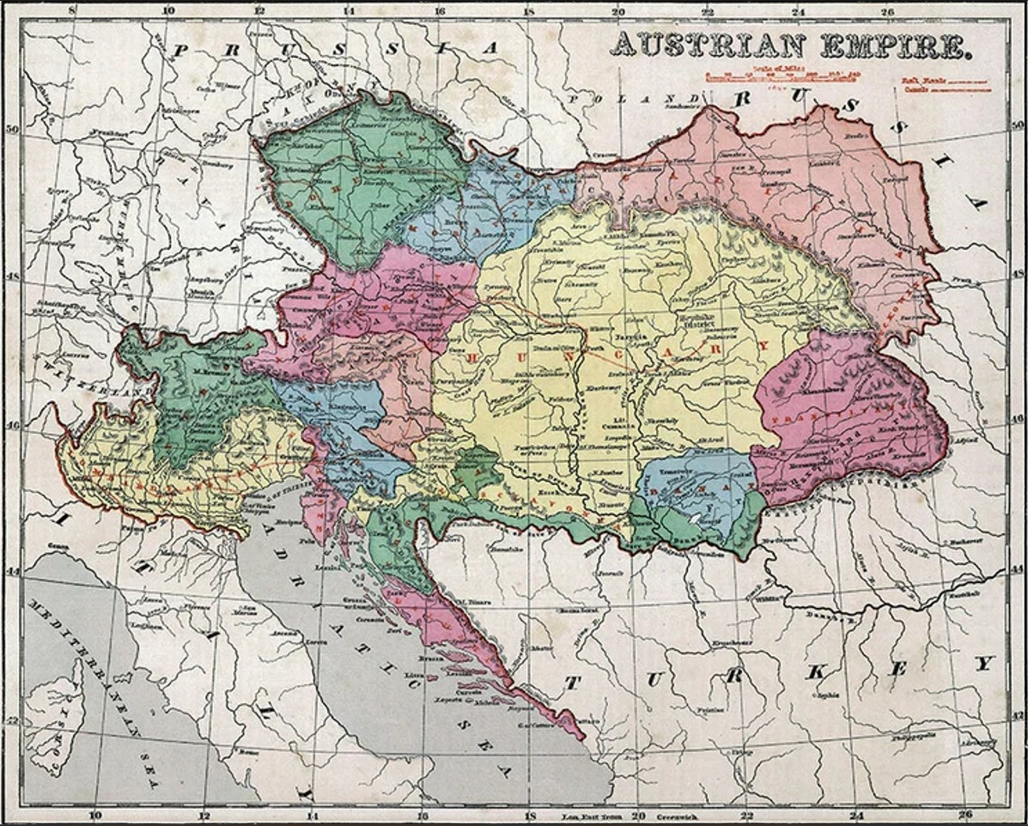
Notes:
1856 Map of the Austrian Empire

Slide 5
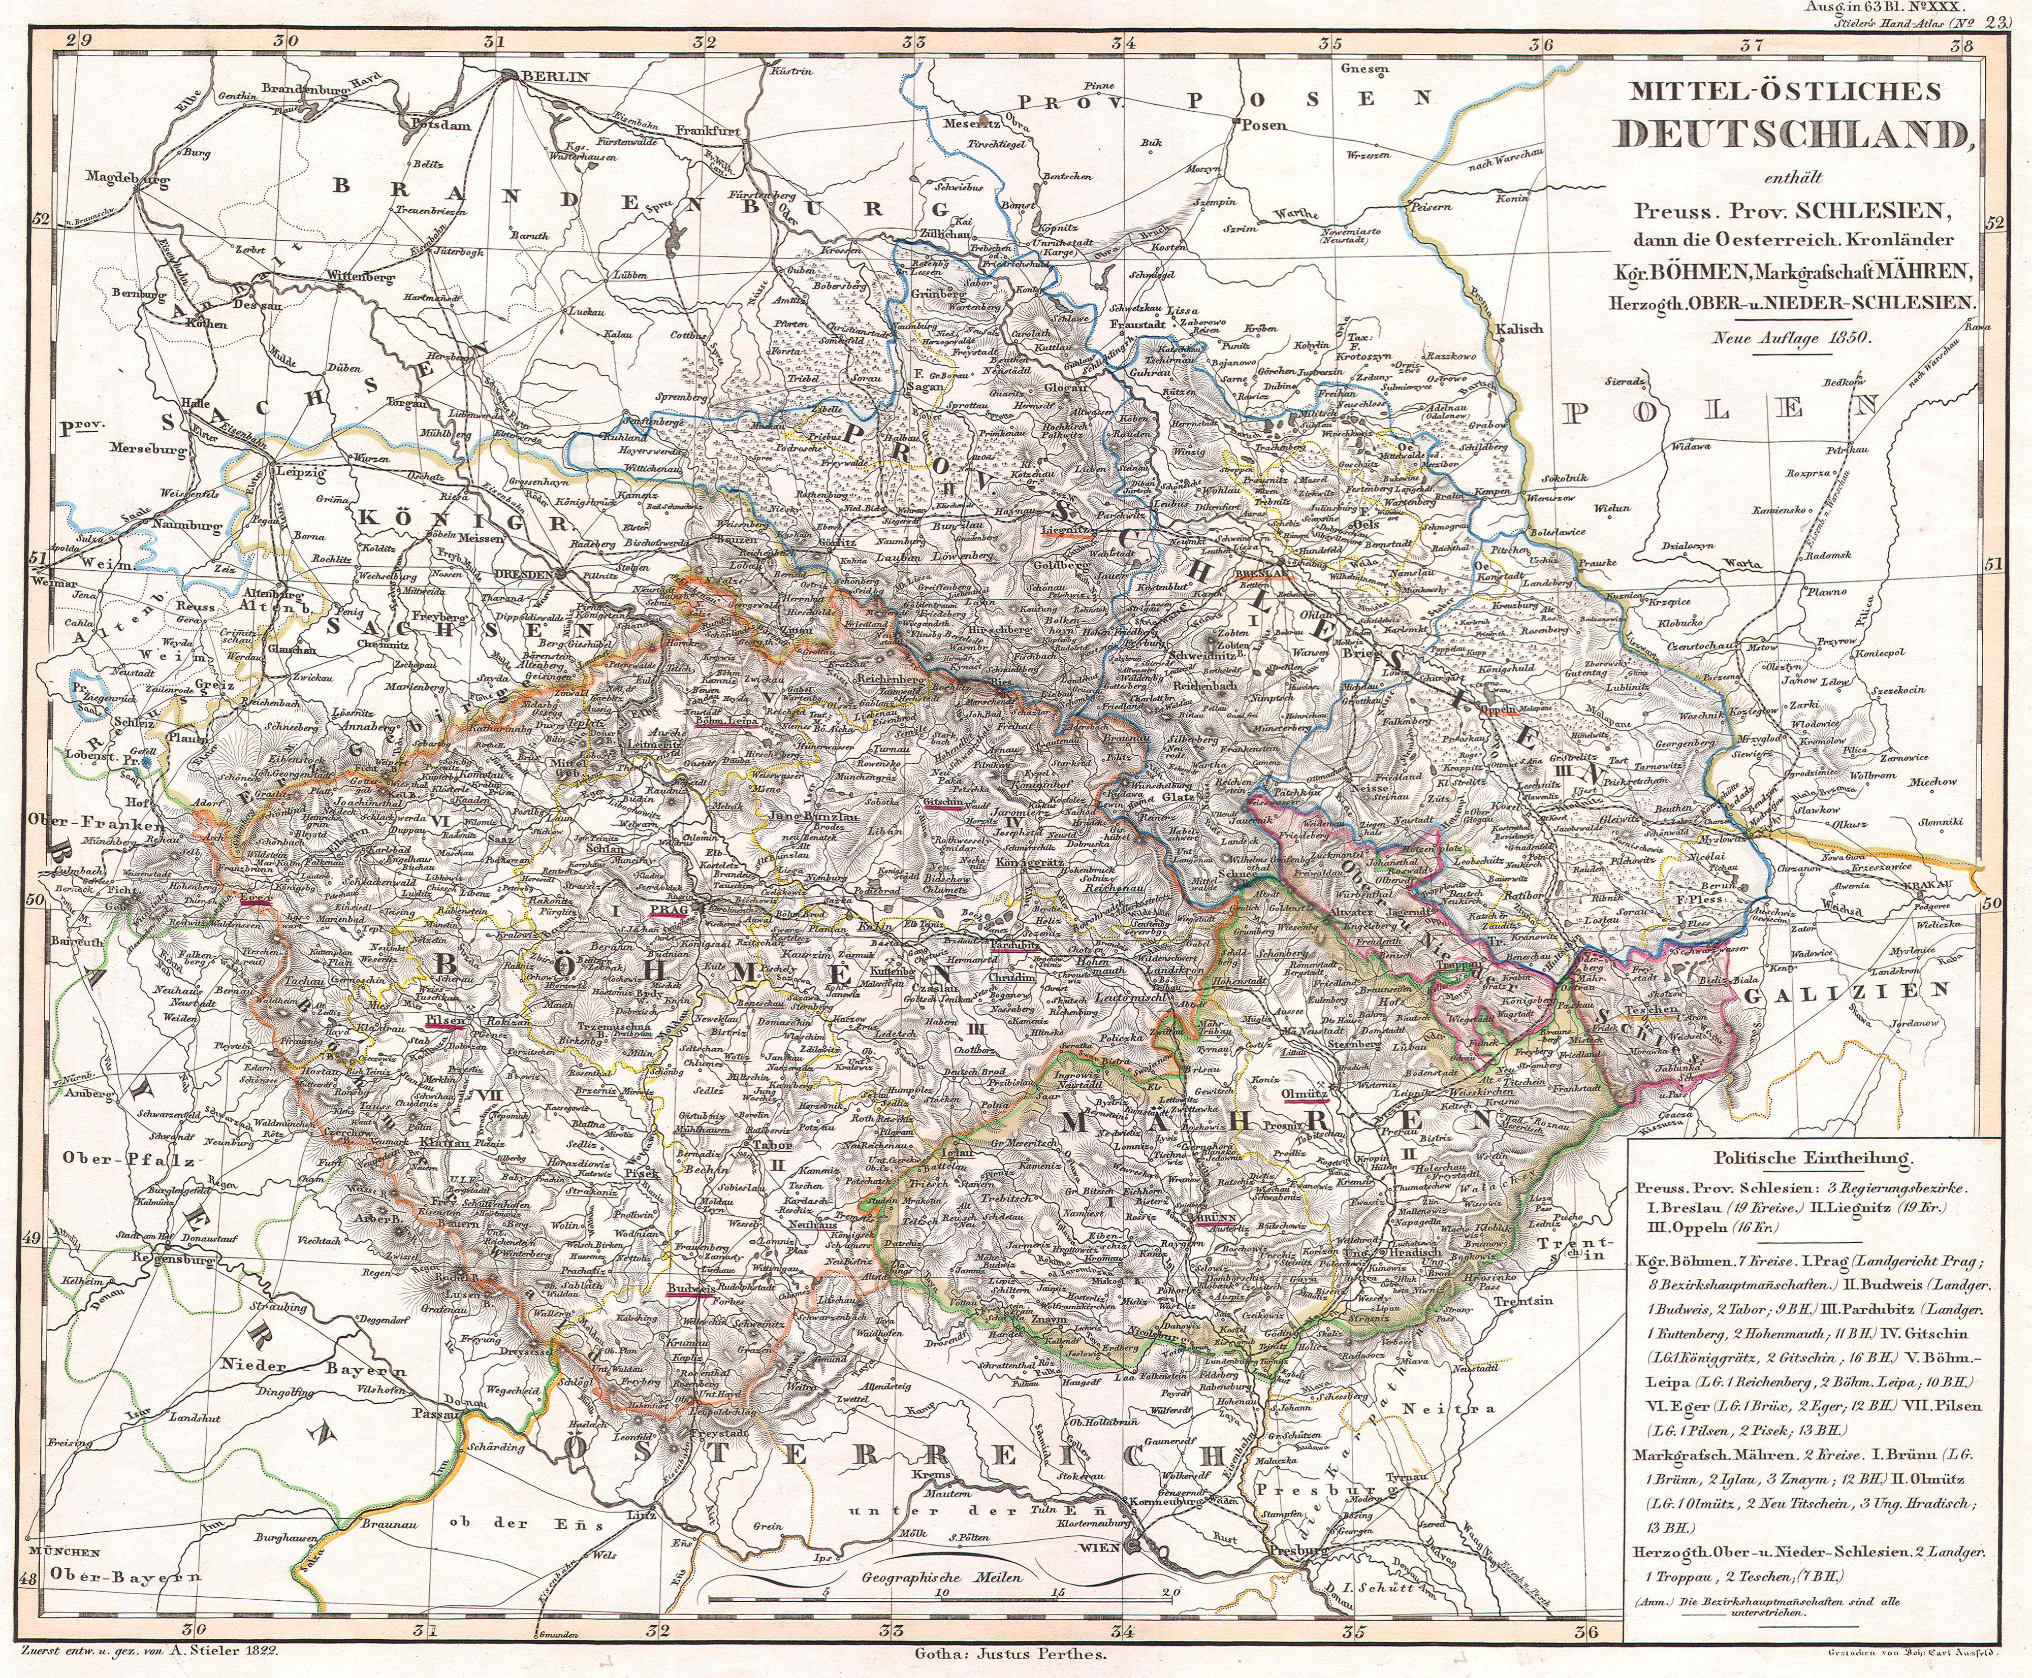
Notes:
1850 Perthes Map – Bohemia, Moravia, Silesia – (note spellings)

Slide 6
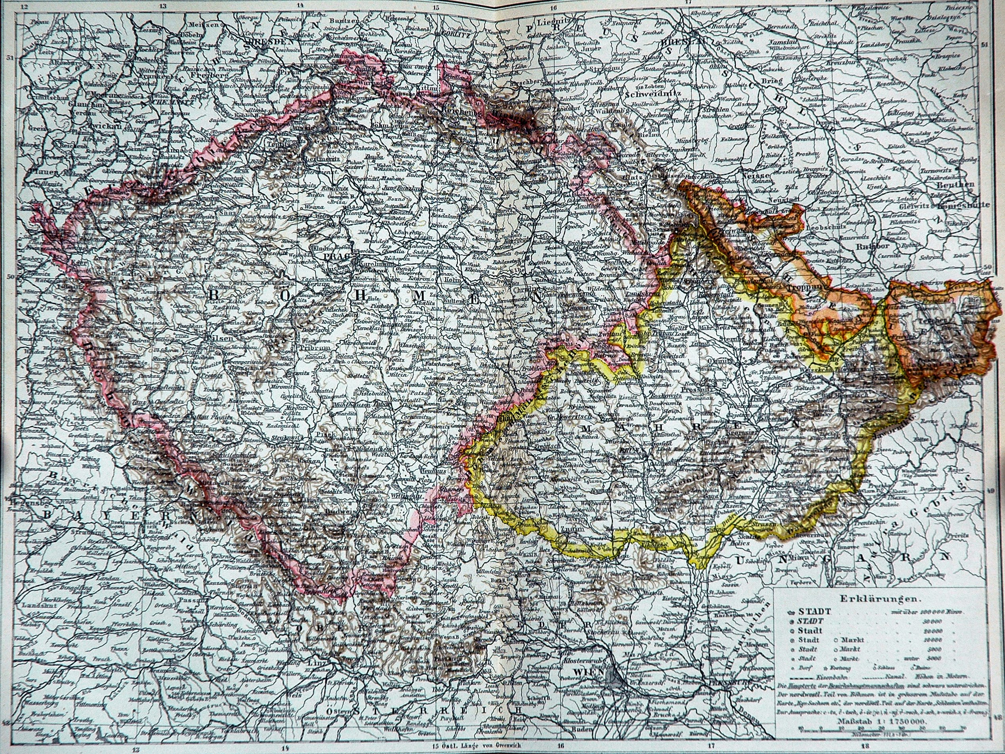
Notes:
Böhmen_Mähren_Österreich_Schlesien – 1892 - Austro-Hungarian Empire - Bohemia - pink, Moravia - yellow, Silesia - orange

Slide 7
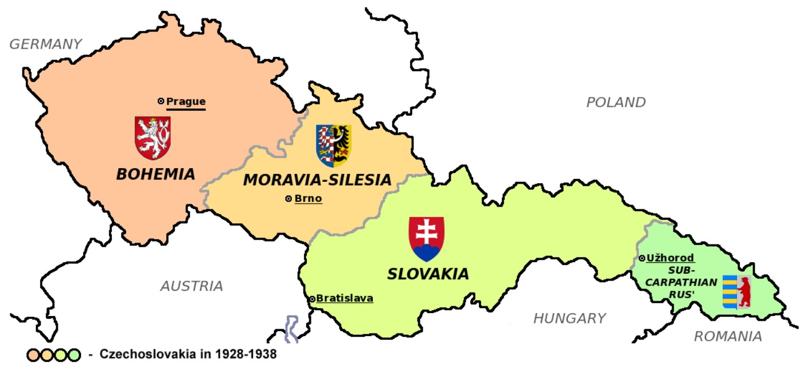
Notes:
Czechoslovakia 1928-1938 – Following WWI…..The annexation of the Sudetenland prior to WWII had begun.
Shortly after the Munich verdict, Poland sent troops to annex the Teschen region. By the Vienna Award (Nov. 2, 1938), Hungary was granted one-quarter of Slovak and Ruthenian territories. With these amputations by 1938, Czechoslovakia lost about one-third of its population

Slide 8
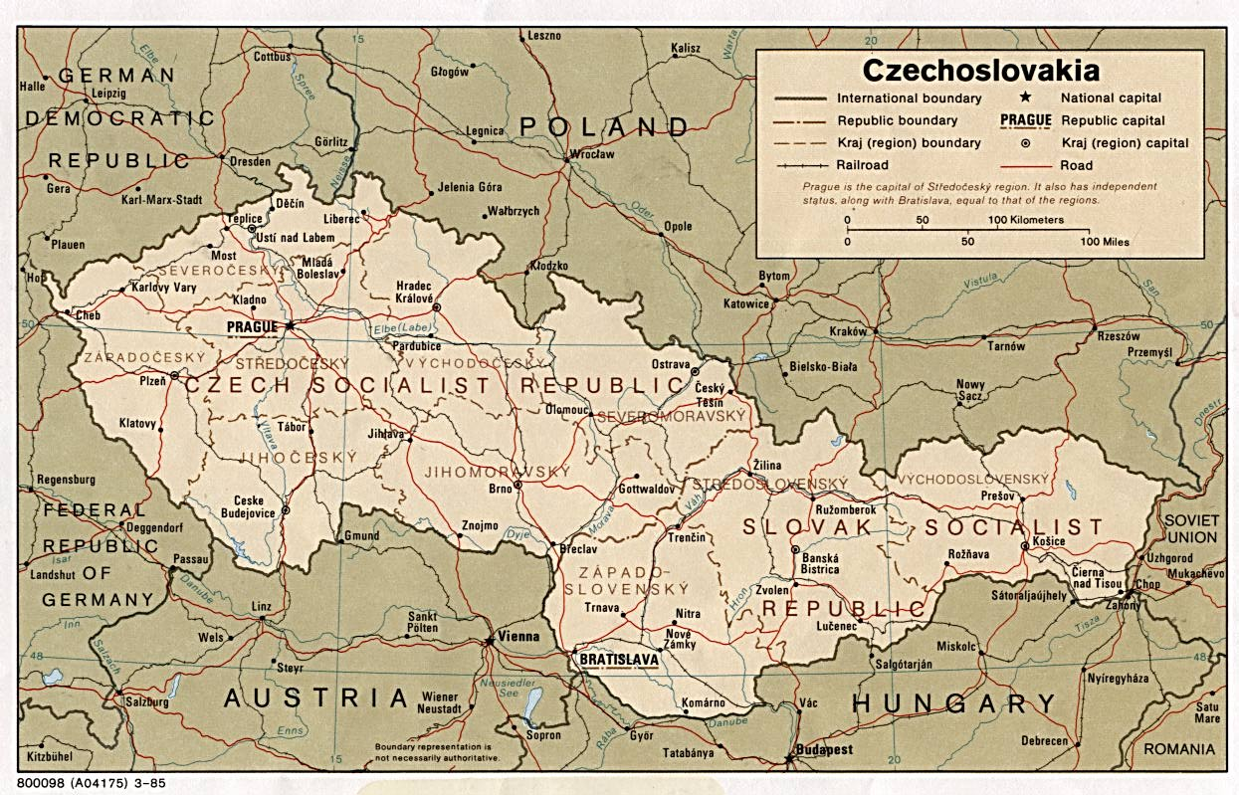
Notes:
Czechoslovakia – 1985 – Following WWII under Communism….this map depicts the Soviet bloc countries before separation.
***Note the Kraj (region) boundary line at the time
In 1989 the Velvet Revolution took place. The last Soviet troops were withdrawn from Czechoslovakia in June 1991, and the Warsaw Pact was disbanded, completing Czechoslovakia’s separation from the Soviet bloc. Soon after, the drafting of a new constitution was hindered by differences between political parties, Czech-Slovak tensions on government rule and power struggles. With the completion of the Velvet Divorce, the independent countries of Slovakia and the Czech Republic were created on Jan. 1, 1993.

Slide 9
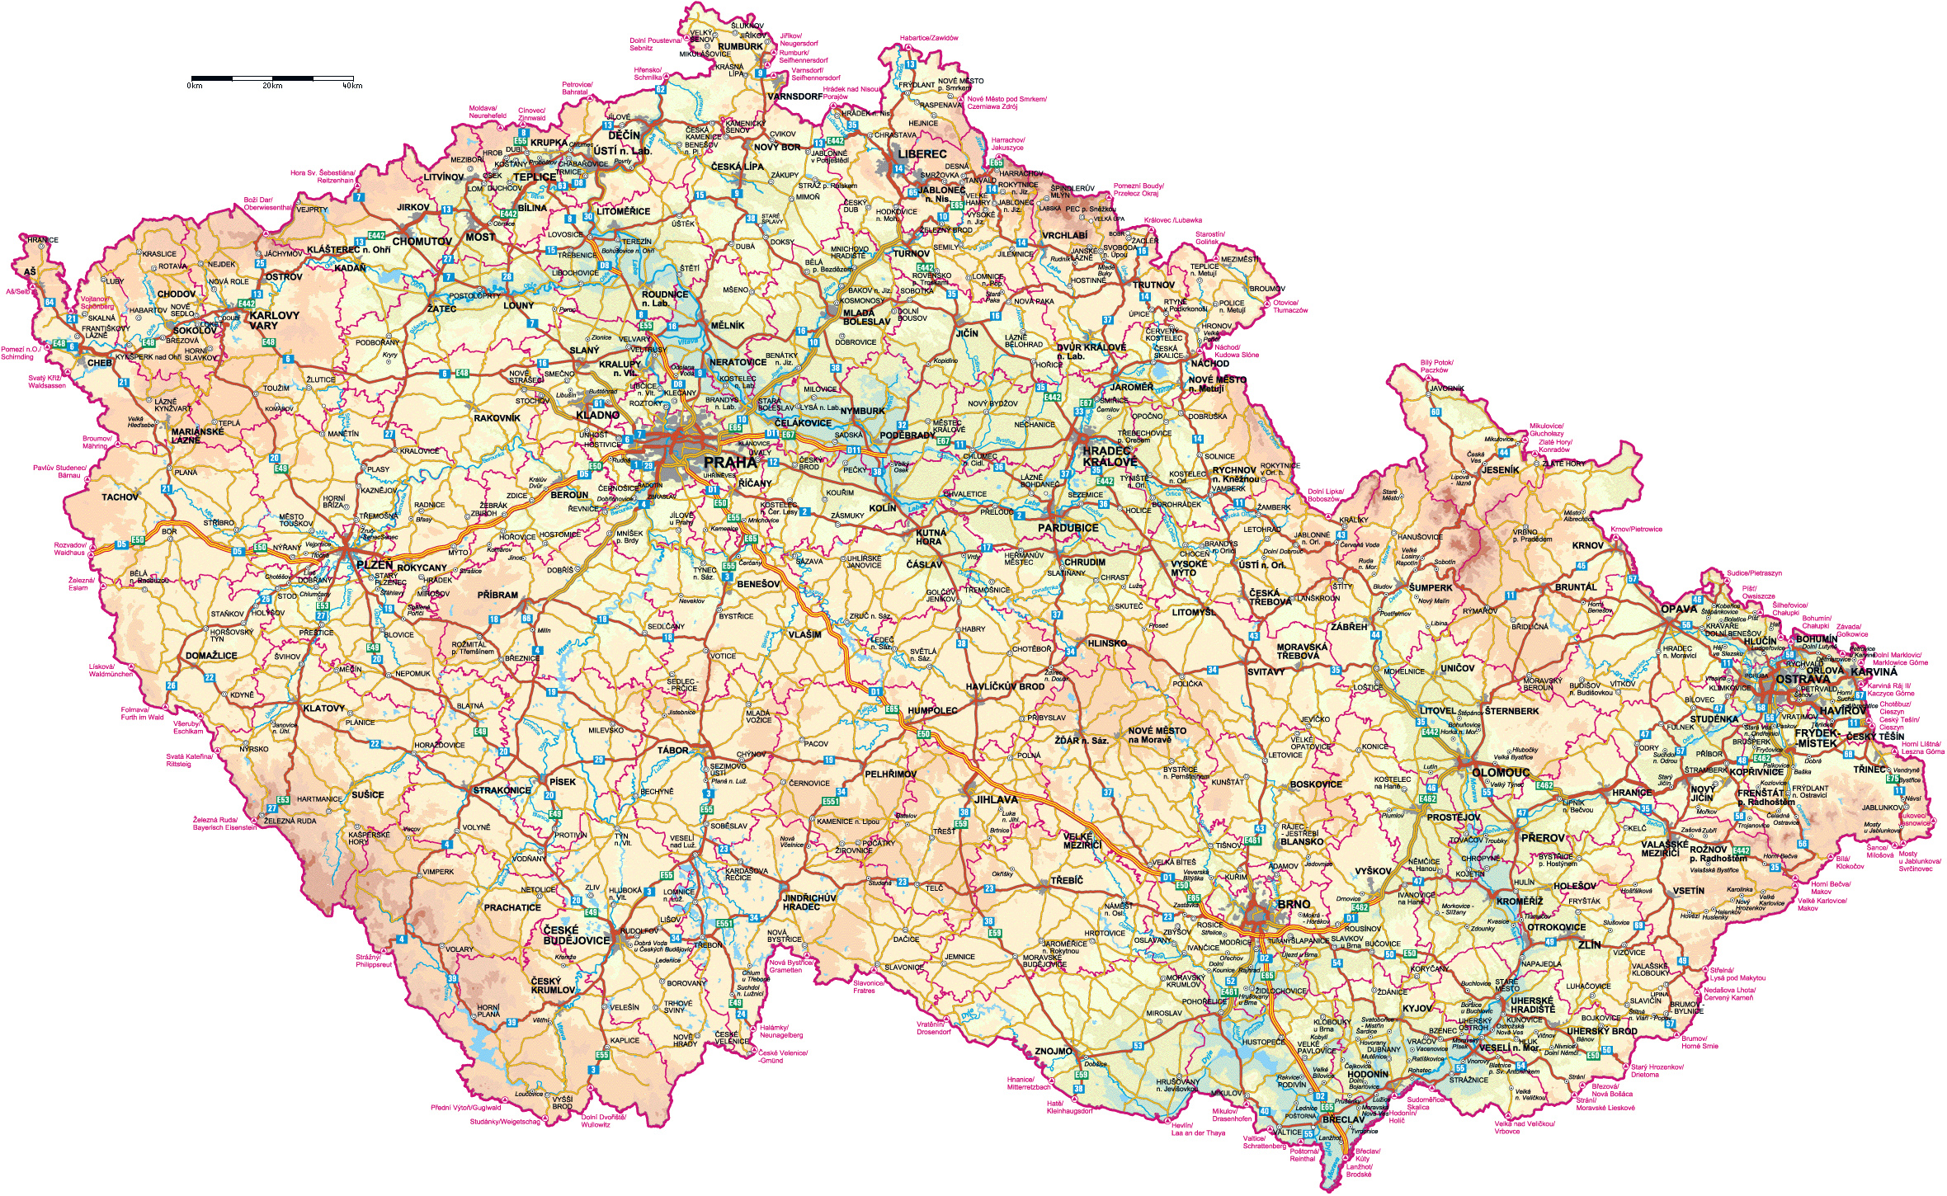
Czechia / Czech Republic today…
Notes:
Czechia - Czech Republic – Current with major cities/towns & roads – Map we will use to locate emigrating ancestors

Slide 10
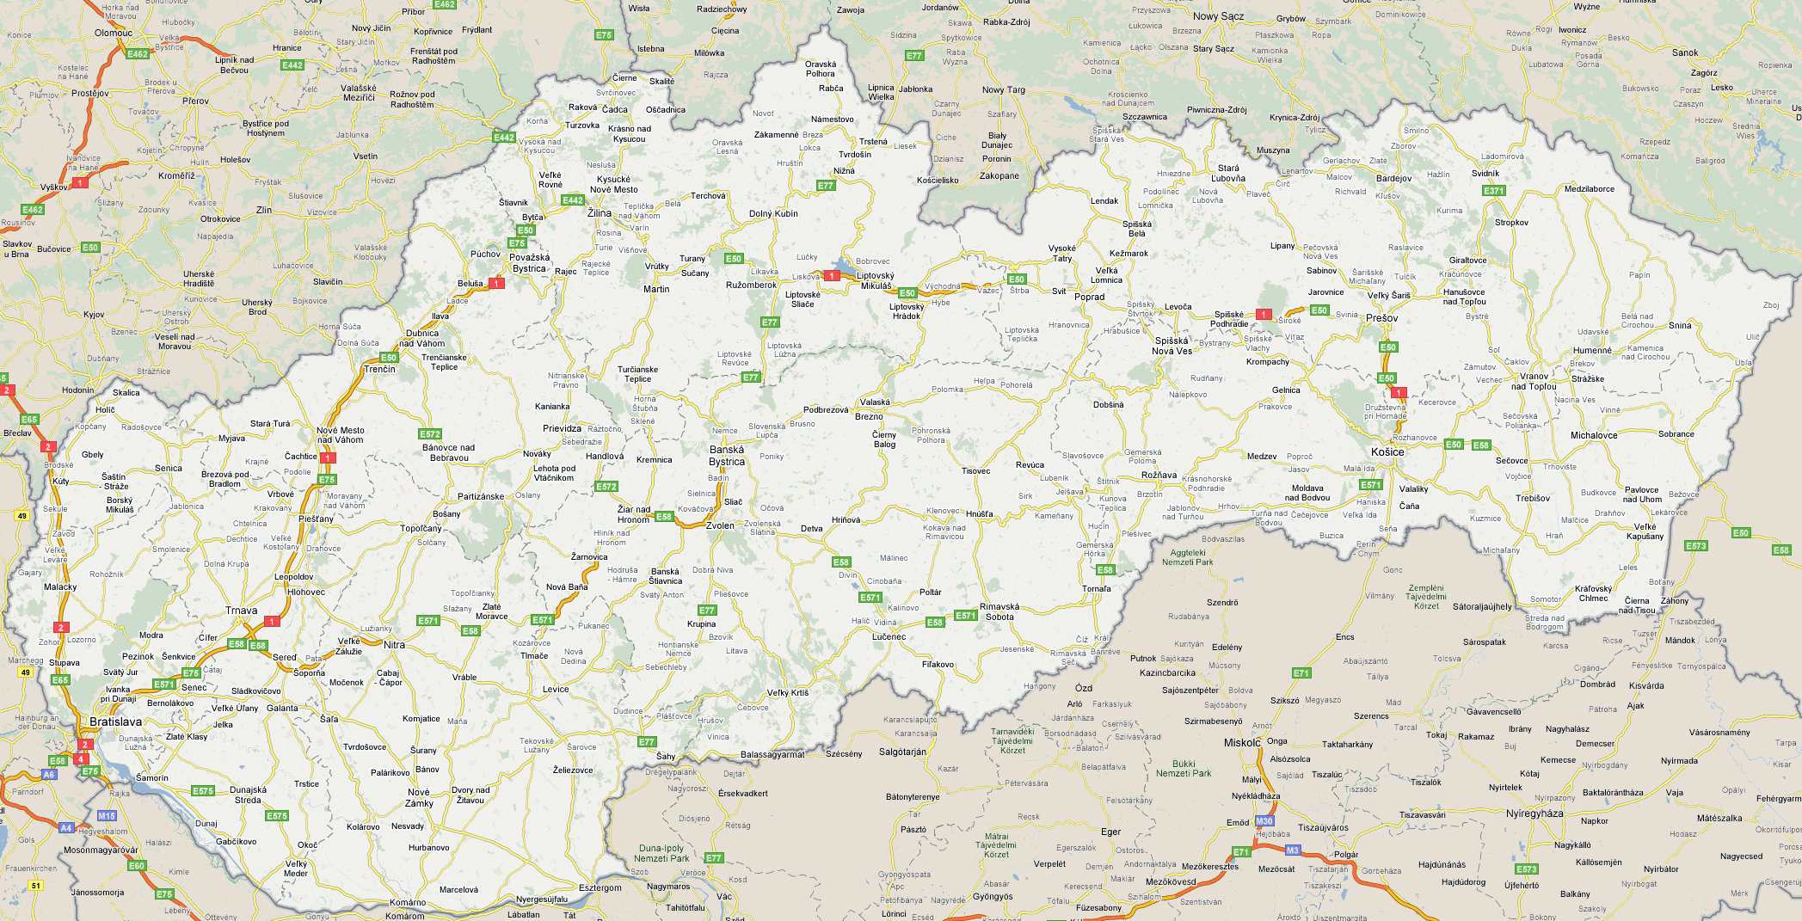
Slovakia / Slovak Republic today…
Notes:
Slovakia – Slovak Republic – Current with major cities/towns & roads – Map we will use to locate emigrating ancestors

Slide 11
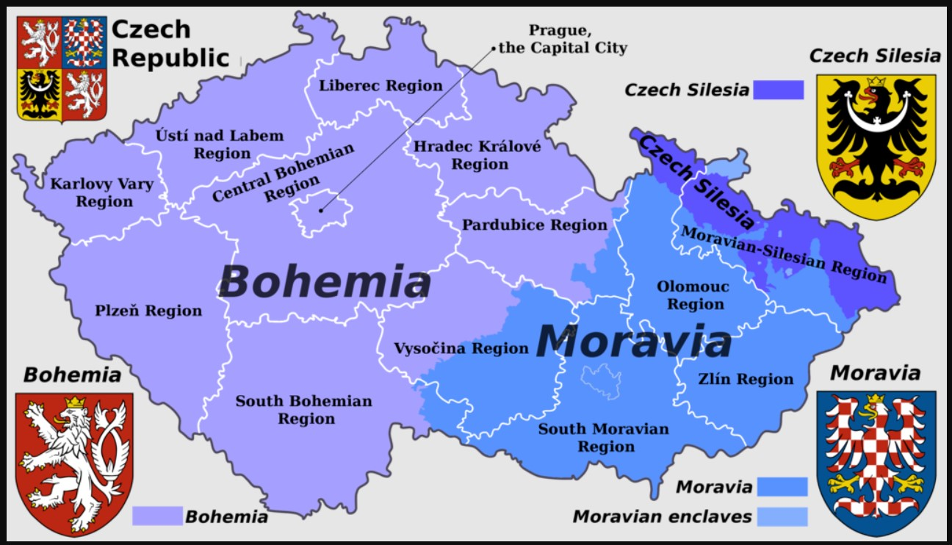
Notes:
Czech Regions with Bohemia, Moravia and Silesia overlays

