Slide 1
Buoyant Force and
Archimedes Principle

Slide 2
The Kinetic Molecular Theory of Liquids & Solids
Distance between gas molecules are so great at ordinary temperatures and pressures (25 *C and 1atm) that there is no real interaction between gas molecules.
Liquids – the molecules are so close together that there is little empty space. Allowing for a definite volume but taking the shape of it’s container.
Solids – molecules are held rigidly in a position with virtually no freedom of motion. So that they have a definite volume and shape.

Slide 3
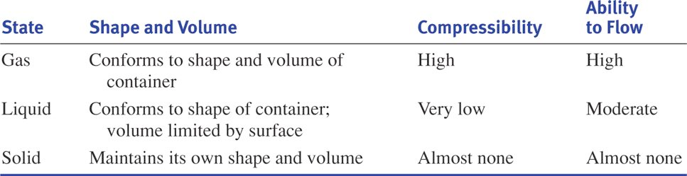

Slide 4
Intermolecular Forces
These are attractive forces between molecules:
  Dispersion (London) Forces
  Dipole-Dipole Forces
  Hydrogen Bonding
These forces are partly responsible for the non-ideal gas law behavior discussed earlier. And these forces are why liquids and solids do not present “ideal behavior”.
Keep in mind that intramolecular forces are forces within a molecule, and intermolecular forces are between molecules.

Slide 5
Intermolecular Forces…………(cont.)
Boiling points and melting points often reflect the strength of these intermolecular forces.
Molecular substances tend to have the following characteristics:
    Non-conductors of electricity when pure, for example pure water and ethyl alcohol are 2 examples of molecular substances that, when pure, will not conduct electricity.
    Generally, are insoluble in water but soluble in non-polar solvents.
    They tend to have low melting and boiling points. The stronger the intermolecular force the higher the boiling or melting point.

Slide 6
A Vapor
A gas is a substance that is normally in the gaseous state at ordinary temperatures and pressures.
A vapor is the gaseous form of a substance that is a liquid or a solid at normal temperature and pressure – generally 25*C and 1 atm.

Slide 7
Vapor Pressure
The pressure exerted by the vapor over the liquid remains constant (in a sealed container the rate of condensation becomes equal to the rate of evaporation).
  Diagram:
Thus there is a state of dynamic equilibrium between the liquid and the vapor.
So as long as the pressure exerted by the liquid is less than that of the atmosphere than the liquid will not boil.
  Diagram:
Once the vapor pressure exerted by the liquid is equal to that of the atmosphere the liquid boils (this is considered the normal boiling point)
  Diagram:

Slide 8
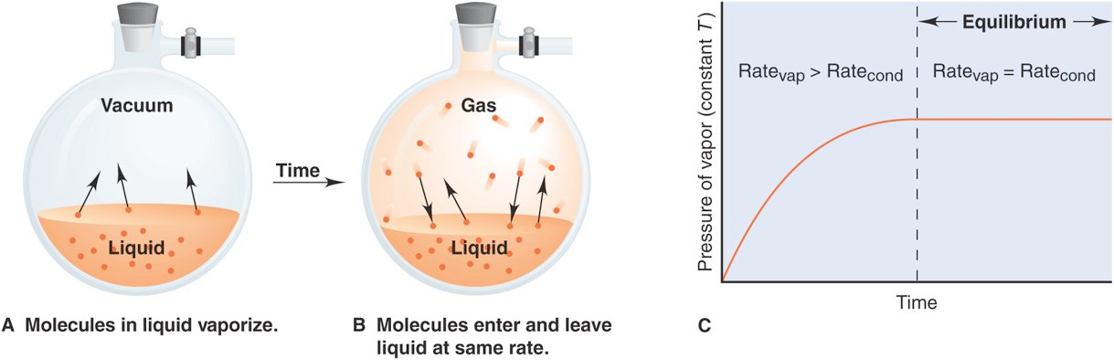

Slide 9
Vapor Pressure………………..(cont.)
Vapor pressure always increases with temperature. The higher the average kinetic energy then the more collisions and the stronger the force exerted by the liquid (the vapor pressure).
  What pressure would be required to boil water at a temperature of 70*C if water exerts a pressure of 24mmHg?
The stronger the intermolecular forces in the liquid the lower the vapor pressure of that liquid. Examples: Water – 24 mmHg Ether – 537 mmHg
  Why?

Slide 10
Important Terms
Critical temperature – the temperature above which the liquid phase of a pure substance cannot exist. Basically, above this temperature the substance is a gas and below it the substance is a liquid.
  Reference: Table 9.1 – page 230
Critical pressure – conversely, this is the pressure that must be applied at the critical temperature to cause condensation.
Supercritical Fluid – just means that the substance is above the critical temperature (refers to a gas).
Melting point – pressure has little effect on melting point. Most solids are denser than their liquid form. There is a very important exception to the aforementioned, guess what it is?

Slide 11
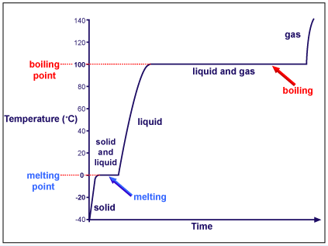
Heating Curve

Slide 12
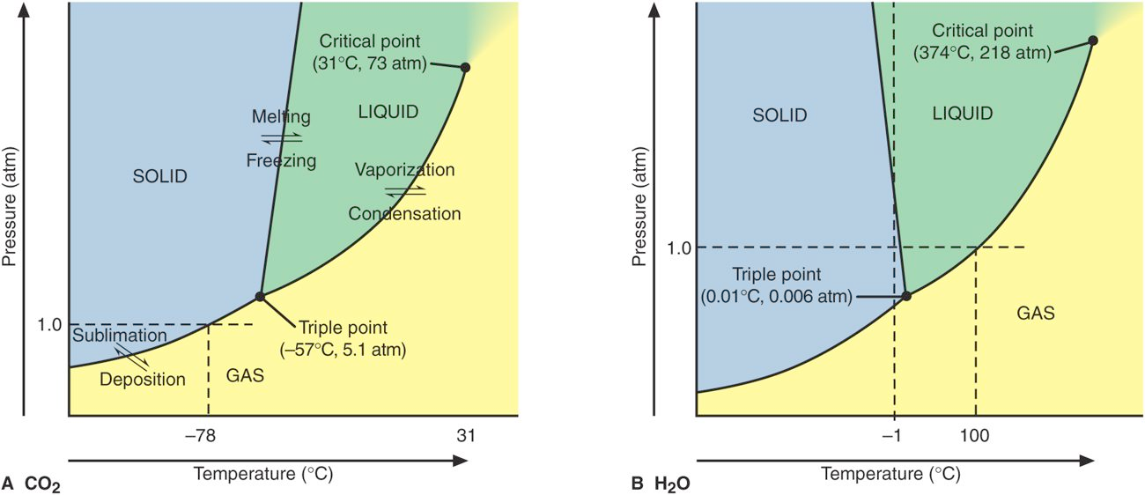
Triple Point Diagrams

Slide 13
Pressure Review
What affects the pressure of a liquid?
  The Density of the liquid
  The depth of the liquid
  The speed the liquid molecules
What affect the pressure of the air (atmospheric pressure)?
  The Density of the liquid
  The depth of the liquid
  The speed the liquid molecules

Slide 14
Pressure Review
Where will you experience more pressure: at the top of a mountain or the bottom of the sea? Why?
  More pressure at the bottom of the sea because of the greater depth?
What happens to pressure when molecules increase speed? Defend with a law/theory!
  when molecules increase speed pressure decreases according to Bernoulli’s principle

Slide 15
New Type of Learning
Let’s imagine you are taking a class where the professor gives you the notes in a PowerPoint.

Slide 16
What are you doing?
Today, your job is to
  Read section 19.2 and 19.3
  Review the notes from the teacher
  Go to the lab stations to get a hands-on experience
  Generate questions for the teacher
  Reflect on this experience

Slide 17
Buoyant Force
Upward force that the liquid (water) exerts, opposite to gravity
Recall that forces are greater at greater depth
  Thus, results from the difference of the upward and downward forces applied to a submerged object (objective #3)
Since the upward forces come from deeper in the liquid, the object is pushed up making is lighter (we will draw in forces of a rock submerged in water)

Slide 18
Buoyant Force
Bigger Buoyant force in deeper liquids

Slide 19
Why do I feel lighter in water?
Because the buoyant force pushes up against gravity, making you seem lighter in water

Slide 20
Recall Displaced Water
the amount of liquid pushed aside by a submerged object
volume of liquid displaced equals the volume of the submerged object
the depth of the liquid is increased by the submerged object because the liquid rises.

Slide 21
Archimedes’ Principle
An immersed object is buoyed up by force equal to the weight of the fluid it displaced (Hewitt 278)
WHAT?!!

Slide 22
Archimedes Principle
Common language:
The buoyant force of an object is equal to the weight of the displaced
The weight of this volume is equal to the buoyant force.

Slide 23
Think About It
Let’s say the volume is 2 ml of water
2 ml = 2 g = 0.002 kg = 0.02 N
(w = mg)
5N
The weight of this volume is equal to the buoyant force so the buoyant force = 0.02 N

Slide 24
Go the lab and try to find the buoyant force of an object
Write the steps you took to find the buoyant force.

Slide 25
See how the buoyant force works
Object floats because the buoyant force is bigger than weight
Sinks. Why?

Slide 26
Think About It
Let’s say the volume is 2 ml of water
20 ml = 20 g = 0.02 kg = 0.2 N
(w = mg)
5N
The weight of this volume is equal to the buoyant force (Archimedes Principle)
so the buoyant force = 0.2 N
The actual weight of the object in water is 4.8 N because:
weight of object – buoyant force = weight of object in water
5 N – 0.2 N = 4.8

Slide 27
Think About It Some More
Let’s say the volume is 2 ml of water
20 ml = 20 g = 0.02 kg = 0.2 N
(w = mg)
5N
The weight of this volume is equal to the buoyant force (Archimedes Principle)
so the buoyant force = 0.2 N
Will the object sink or float?
Sink, because the buoyant force is less than the weight of the object. There is not enough upward force for the object to float!

Slide 28
Closing
Why does the buoyant force act upward for an object submerged in water?
How does an object submerged in water change the depth and pressure of the liquid?
How does Archimedes principle relate to buoyant force and whether an object floats

Slide 29
Reflection
How was this experience?
What do you need the teacher to review? (save for next class so you can share and ask these questions!)

Slide 30
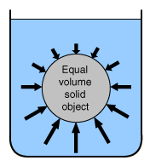
Buoyancy
The buoyant force is the
upward force caused by
the difference in pressure
on submerged objects.
Because pressure increases as a fluid gets deeper, there is more pressure on the bottom of the object in a fluid.

Slide 31
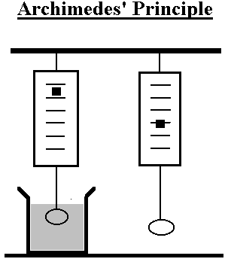
The buoyant force pushes up on all objects in a fluid.
2N
4N
2N

Slide 32
Archimedes Principle
The magnitude (size) of the buoyant force is equal to the weight of the fluid that is displaced by the object.
Remember that weight is a force!

Slide 33
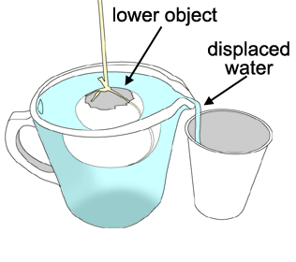
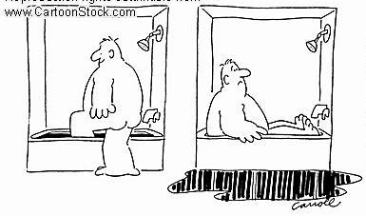
What does displaced fluid mean?
displaced fluid

Slide 34
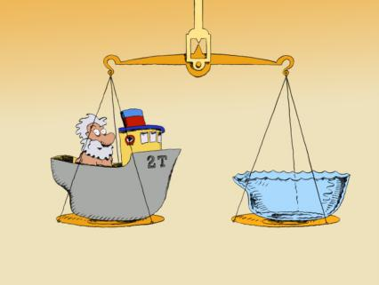
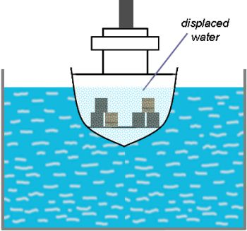
Archimedes Principle
The magnitude (size) of the buoyant force is equal to the weight of the fluid that is displaced by the object.

Slide 35
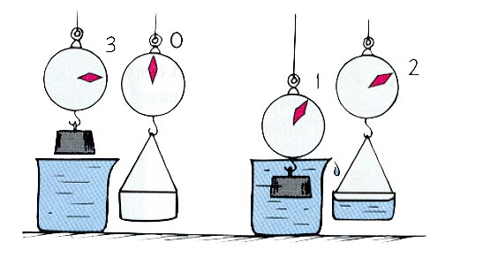
3N
0N
2N
1N
2N
Buoyant Force!
The weight of the displaced water is equal to the strength of the buoyant force!
Why does the metal piece only weigh 1 Newton now?

Slide 36
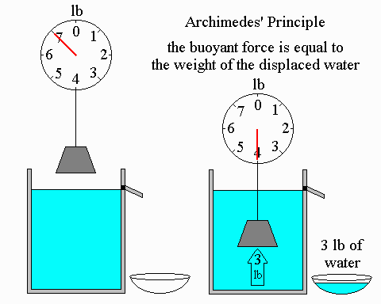
Equal!

Slide 37

Imagine the volume of water that is pushed aside (displaced) by the red area of the boat… That volume of water has some weight. The weight of that amount of water is equal to the buoyant force.

Slide 38
=
Weight of this water
This force
If a boat displaces more water, then it has a stronger buoyant force!

Slide 39
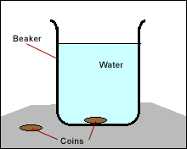
Objects float when the forces are balanced!
Objects sink when the forces are unbalanced!
Weight
of the
boat
Weight
of the
coin
Buoyant
Force
Buoyant
Force

Slide 40
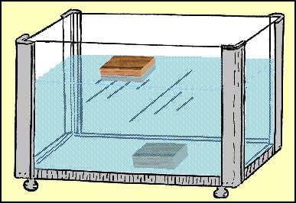
When weight is equal to buoyant force, things float.
When weight is more than buoyant force, things sink.
Weight
Buoyant
Force
Weight
Buoyant
Force

Slide 41
How do you know if an object will float or sink?
weight
weight
buoyant
force
buoyant
force
Objects float when the forces are balanced!
Weight = Buoyant force
Objects sink when the forces are unbalanced!
Weight > Buoyant force

