Slide 1



Slide 2
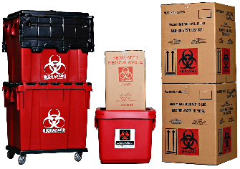
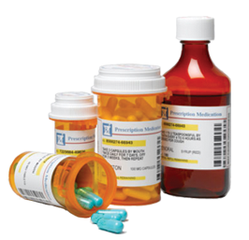
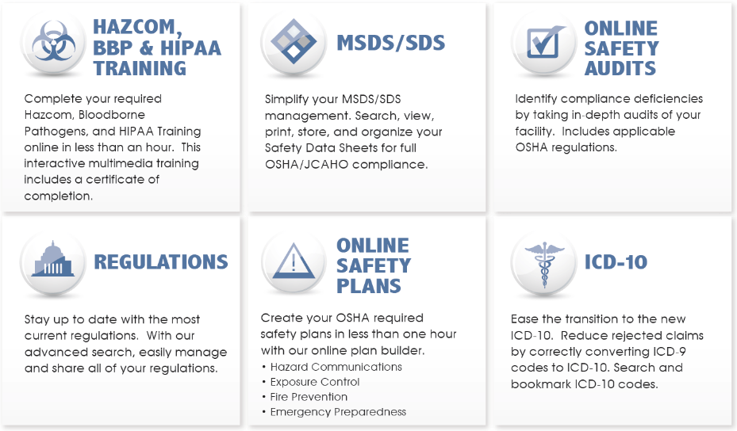
Standard Services
Regulated Medical Waste Disposal
Pharmaceutical Disposal
OSHA Compliance Training
Coming Soon…
Hazardous Waste

Slide 3
Save your customers from fees and price increases!
They’re already paying for medical waste disposal.
(They have to)
They trust you to provide value to their business.
Often, customers have no idea there’s an alternative to their current vendor. It’s assumed they’re a utility.
Their bills go up and up, and they don’t even notice!!!

Slide 4
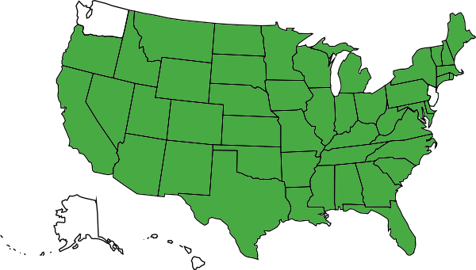
Who is MedPro Disposal?
Formed in 2009, local to Chicago.
Expanded to cover:
46 of 50 states
The reason we expanded nationally:
We heard the same complaints over and over, like a broken record.

Slide 5
What most customers experience
“I got my bill and it’s 20% higher than last month.”
“Why do I have to pay a $150 environmental fee?”
83% of your customers are likely overpaying for their medical waste disposal.
Many are completely unaware of an alternative solution.

Slide 6
Savings
The average physician’s office that switches to MedPro saves:
$2,850 per year
The most we’ve saved a facility (so far):
$99,432 per year!

Slide 7

Outliers
What MedPro is doing for customers in Illinois:
Surgery Center: $54,601 saved per year
$163,803 over course of the contract
Healthcare Clinic: $39,072 saved per year
$117,216 over the course of the contract
Funeral Home: $34,200 saved per year
$102,600 over the course of the contract

Slide 8
WIIFM – What’s In It For Me?
Possible entrée into new markets - MedPro users include physician, dental and veterinary offices as well as funeral homes. Representing MedPro can help you expand your client base.
Relationship builder – By representing MedPro, you are offering your clients a solution, which will enhance their bottom line.
Commissions – MedPro representatives receive commission for the entire duration of the waste contract
Awesome Support Team – We understand that your time is valuable. Our team does all follow up and customer service for the leads you submit!

