Slide 1
UNION POWER COOPERATIVE Outdoor Lighting
04/24/24
Notes:
2018 Commitment to implement an outdoor lighting program
Coming up on a year and a half now, so we wanted to provide an update
Here’s how it started for me

Slide 2
2017 Yard Light System conversion to Outdoor Light System
2018 Created an Outdoor Light Coordinator position
Company-wide buy-in
Recognized an initial 3-5 year project to identify/align
Currently 27,000+ active lights, 7,000+ inactive lights
2024 COSS study and complete overhaul of I.D.’s, Rates and Types

Slide 3
Initial Quotes:
“Congratulations, you’re now responsible for our Outdoor Lighting Program”
“It’s better you than me”
“It’s going to open Pandora’s Box”
“If you’re off one or two lights here or there it’s no big deal”
“What’s the big deal, it’s just pennies on the dollar”
“All of our lights are out during the daytime when we are working”
“We need to get out of the light business”
Notes:
#1 How I first learned about the OL Program
#2 Getting started, a couple people came up to me and said “ “
#3 When discussing the best way to get started
#4 Not shown:
We have all heard the saying “stuff flows down hill”……Well my favorite quote was, congratulations Brad, you are the new OL Coordinator!
2017
YL to OL Conversion
Consolidation of Light I.D.’s
2018
Commitment to the OL Program
Creating OL Coordinator position
2019
Brad will give us an overall update
Without any doubt, one thing’s for certain……we have the right individual in the position of OL Cordinator

Slide 4
Initial Findings/Challenges:
Field Audits:
Approximately 70% of audits have shown a discrepancy:
Incorrect Light I.D. (Rate/Type) entered:
Three security lights, same monthly charge
2024 Cost of Service Study reactions
Lights previously installed in the field but never billed:
Temp to Perm
Lights installed, application for service not completed
Quantity of lights staked vs lights installed vs lights billed
OL Repair Orders marked as “Done” or “Repaired” vs “Replaced“

Slide 5
Initial Findings/Challenges: (continued):
Field Audits:
OL Repair Order entered on incorrect account:
Member’s account vs HOA, City, Town, Village, etc.
City of Monroe: 23 accounts, 11 with OL’s, 488 active lights
Town of Indian Trail: 18 accounts, 12 with OL’s, 1,471 active lights
Work Order for installation of 18 lights-entered on three different accounts
OL Repair Order completed at incorrect location (neighbor’s house)

Slide 6
Initial Findings/Challenges: (continued):
Field Audits:
Service rolled-up, pole/light removed from field-member continues to be billed for light (storm related, structure fire, house demo, etc.)
Contractor crews replacing inactive/broke lights with new lights and made active
Town requested that they take over billing for an HOA:
Account had 100+ active lights
When questioned, member only intended to assume 18 lights
OL Repair Order completed on an inactive account (missing bulb)
“Special Pricing”
Contracts, Buy-downs, Catalog to pick from

Slide 7
Tampering: (continued):
UPC owned 400w Flood replaced with member owned 1,000w Flood
BBQ pit wired after the light wire coming down a pole
Safety concerns, MAD Zone of Primary
Additional member-owned lights added
Existing UPC lights manipulated:
Member replaced existing lights from 400w MH to LED (17 lights)
Homeowners replaced HID bulbs with LED bulbs in neighborhood
Member connected to UPC secondary wire and fed member installed/owned lighting

Slide 8
Results:
Recovered $11,000.00 in loss revenue, $500/month re-payment plan
Recovered $1,103.00 in line tampering and foreign lights
$166,125.00+ in credit adjustments:
Initially, 30+ accounts, $67,000 per year to 2023; 2 accounts, $79
Two member’s paying for a single light
Incorrect number of lights (Actual vs Billed)
Incorrect billing related to Light I.D. (Rate/Type of light)
Member notifies UPC:
No light at property
Light doesn’t work
Never requested light

Slide 9
Results: (continued)
Through 2023:
Estimated Loss Revenue: $361,852.00
Estimated New Revenue: $95,586.00
Both derived from 200 accounts

Slide 10
Improvements Made:
OL Repair Orders now include:
Confirmation of the Union Power Pole Number OL is on
What was found
Existing wattage/type/any damage/tampering
What work was completed
Summarize work completed/additional information necessary
Employee Number
Operations enters employee ID #

Slide 11
Improvements Made (continued):
Warranties:
250 Long Life LED photocells. Manufacturer defect $6,500.00
2023 LED Replacement fixtures due to warranty $7,593.00 (18 fixtures)
2024 LED Replacement fixtures to date $6,550.00 (17 fixtures)
2022, 2023, 2024 (purple lights) 210 fixtures (2 for 1)

Slide 12
Improvements Made (continued):
Improved reporting:
Approximately 500+ Outdoor Lighting services orders produced monthly
Survey 123
Implemented contractors to report light fixture status
Day burner/no bulb/fixture broke
GIS Light Job emails
System Ops storm related or public related emails
Report IQ

Slide 13
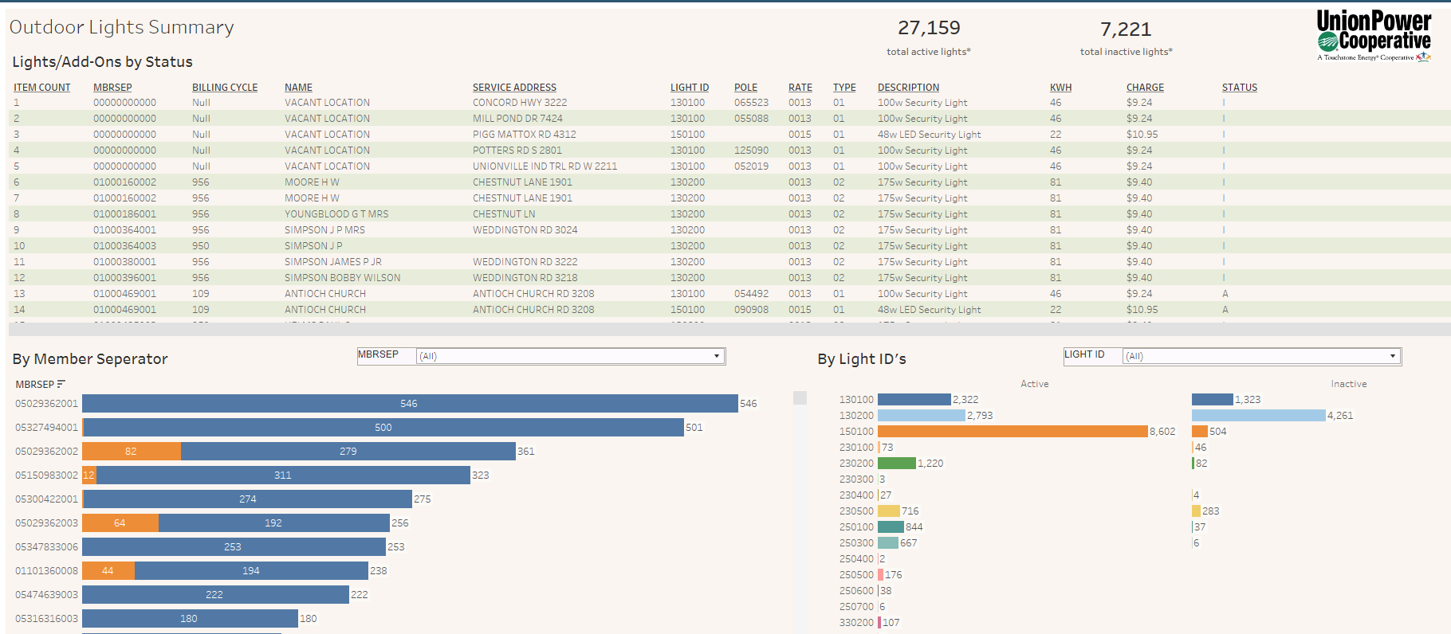

Slide 14
What’s Next?
Field/Paperwork Audits
Take advantage of conferences, plant tours, manufacturing tours
Training; Field and Office personnel
Internal collaboration, training, awareness of practices and policies
IT TAKES A VILLAGE!

Slide 15
Questions?

