Slide 1

Santa Fe BioLabs LLC
3600 W Pioneer Parkway, Suite 18
Pantego, Texas 76013
+1 817 808 7747
www.santafebiolabs.com
Wolfram Siede, CEO/Principal Scientist
wolfram@santafebiolabs.com

Slide 2
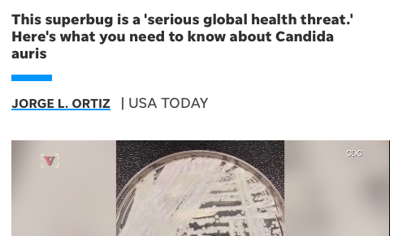
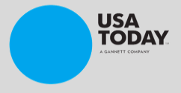
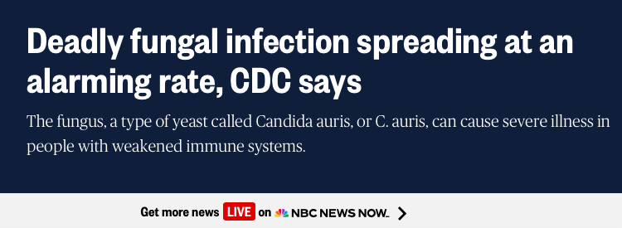
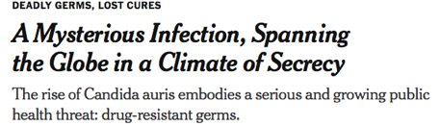
Candida auris

Slide 3
The Yeast Candida auris
A global health threat
Present in hospitals leading to systemic infections in susceptible patients
COVID made things worse
High lethality due to antifungal-resistant strains
Can easily colonize skin
Excellent survival on dry surfaces

Slide 4
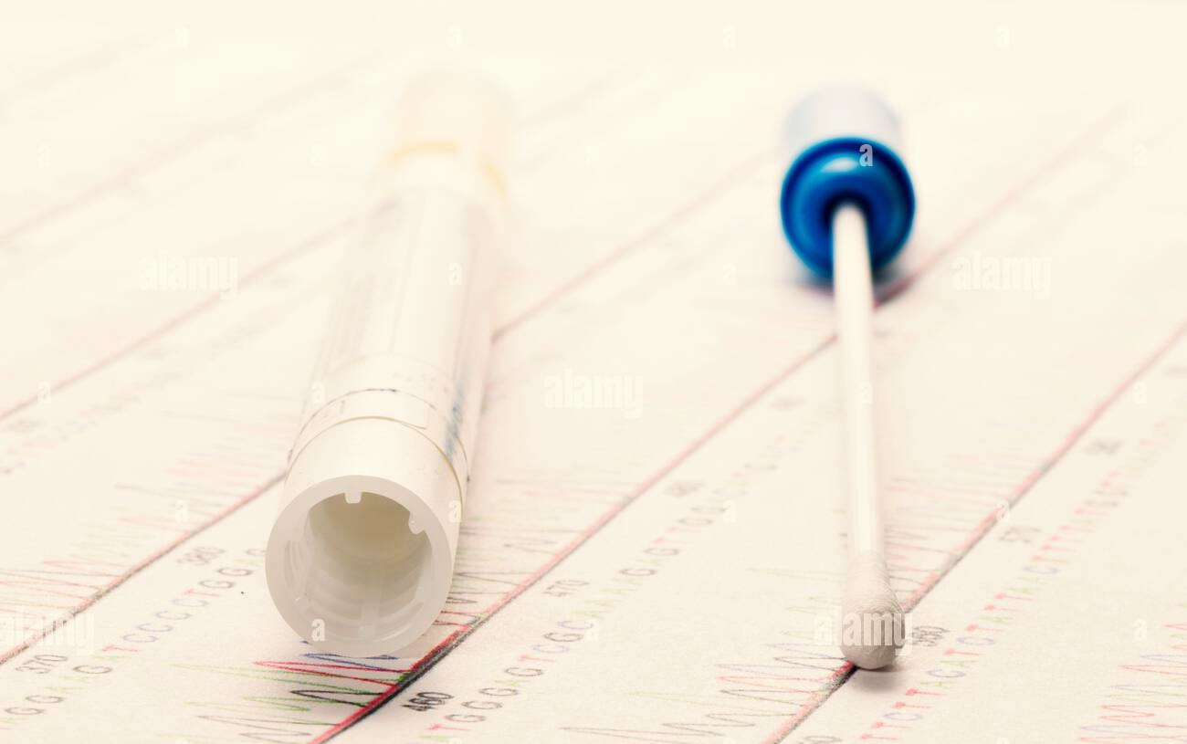
Monitoring Candida auris
Living cells may need to be detected and isolated as macrocolonies, e.g. to
  Evaluate sensitivity to antifungals
  Validate disinfection protocols
PCR is faster but doesn’t provide the cells

Slide 5
Monitoring for Viable Candida auris: A Two-Step Process
ReCandTM plate medium is designed to optimize colony yield from dry surfaces or human skin
AuriFindTM plate medium is used to classify colonies as Candida auris or not
= “Classic” approach: slow but cheap, not requiring special equipment

Slide 6
Problems with Candida auris from Dry Environments
Colony yield on conventional media severely underestimates the number of viable cells
May also complicate recovery from patient skin
ReCand plate medium is designed to optimize colony yield

Slide 7
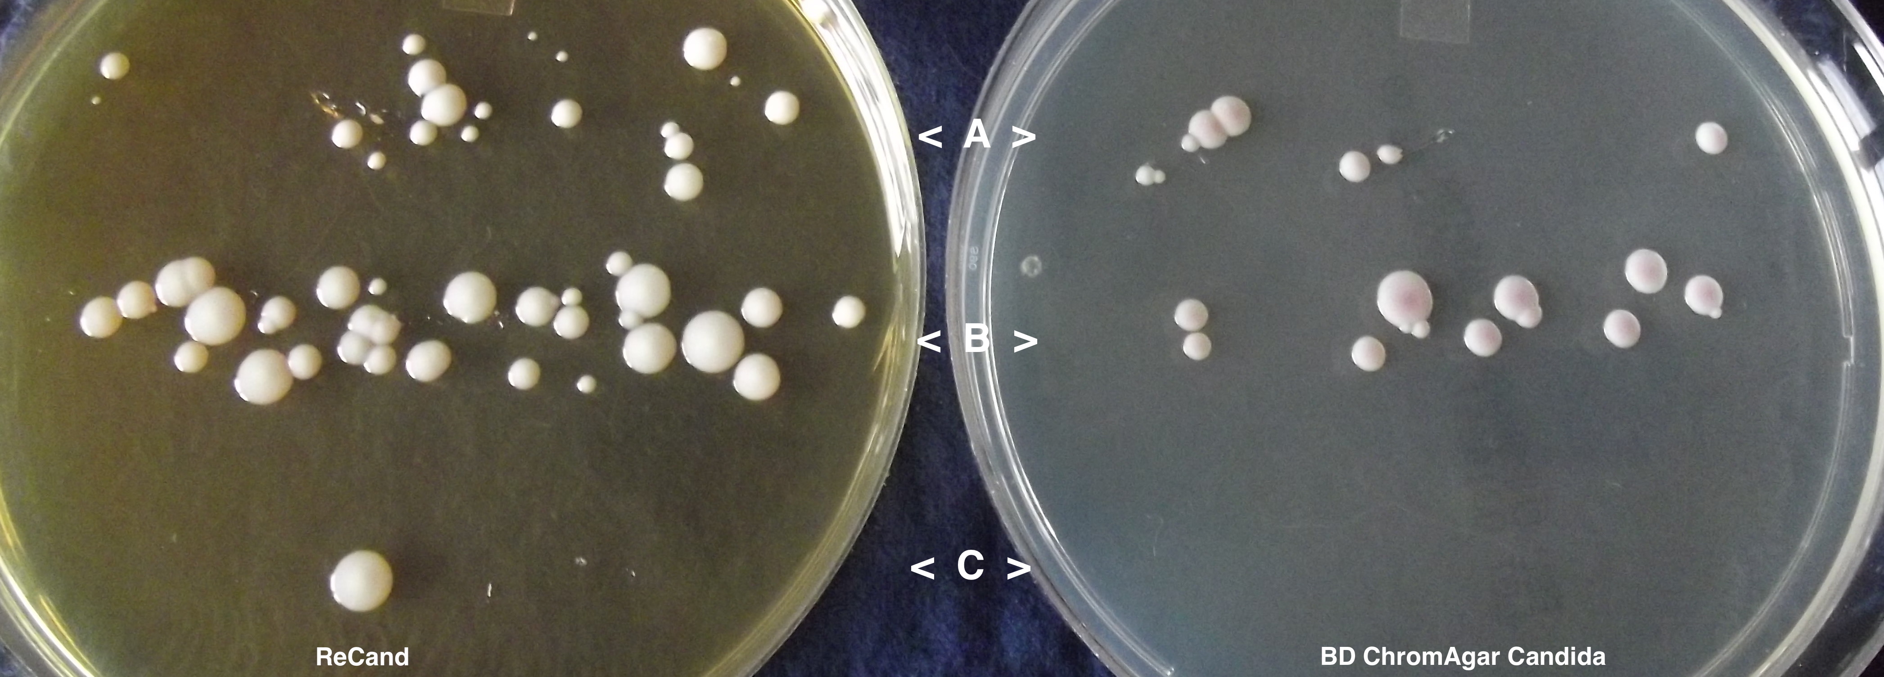
ReCand Improves Colony Yield of Dry Candida auris
ReCand
compared to
BD ChromAgar CandidaTM
These media are not selective!

Slide 8
Why Two Transfer Solutions?
ReCand Transfer solution and conventional AMIES (sample) provided
Start with ReCand Transfer solution!
  In most cases, this is a significant improvement over AMIES. Or there is no difference.
  In rare cases, AMIES works better – dependent on strain and degree of dry-stress → impossible to predict.
Observe recommended timing if ReCand Transfer is used
  Less critical with AMIES

Slide 9
Why Two Transfer Solutions?
ReCand Transfer solution should be frozen upon arrival
Do not waste ReCand Transfer solution, no excess provided
Contact us to reorder ReCand Transfer
Order AMIES (without charcoal) from e.g. HiMedia Labs (hard to find without swabs)

Slide 10
How to Run ReCand
Semi-Selectively – Strategy 1
Plate and incubate at 30-33°C as usual
Shift temperature to 41°C at 28-32 hrs.
This stops many molds from growing
This stops 20-30% of non-C. auris yeast from growing
  Optional: If colonies already become visible at 30-33°C, mark their size before temperature shift. Or spread them in place.

Slide 11
How to Run ReCand
Semi-Selectively – Strategy 2
Plate, incubate at 30-33°C and shift to 37°C as usual
Check plates periodically: Too many (mini)colonies? Are molds taking over?
Shift temperature to 41°C, only if needed

Slide 12
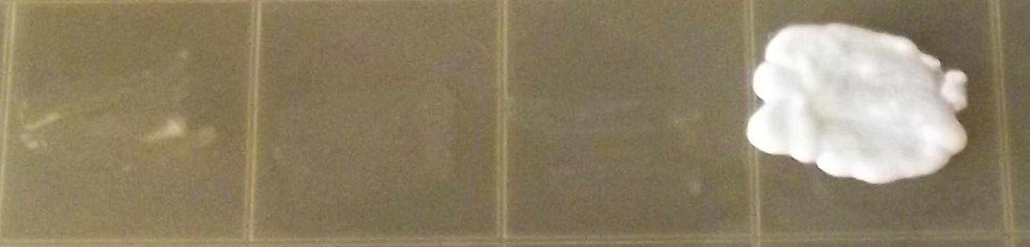
AuriFind
Differential plate medium to identify Candida auris among existing isolates
  Test for growth vs non-growth
Initial results possible within < 20 hrs

Slide 13
AuriFind
Assay A: streak out patches
OR
Assay B: make dense suspension and place drops (dilutions optional)
Confirmatory Assay (the “gold standard”): Assay B + dilutions, after preferred preculture conditions

Slide 14
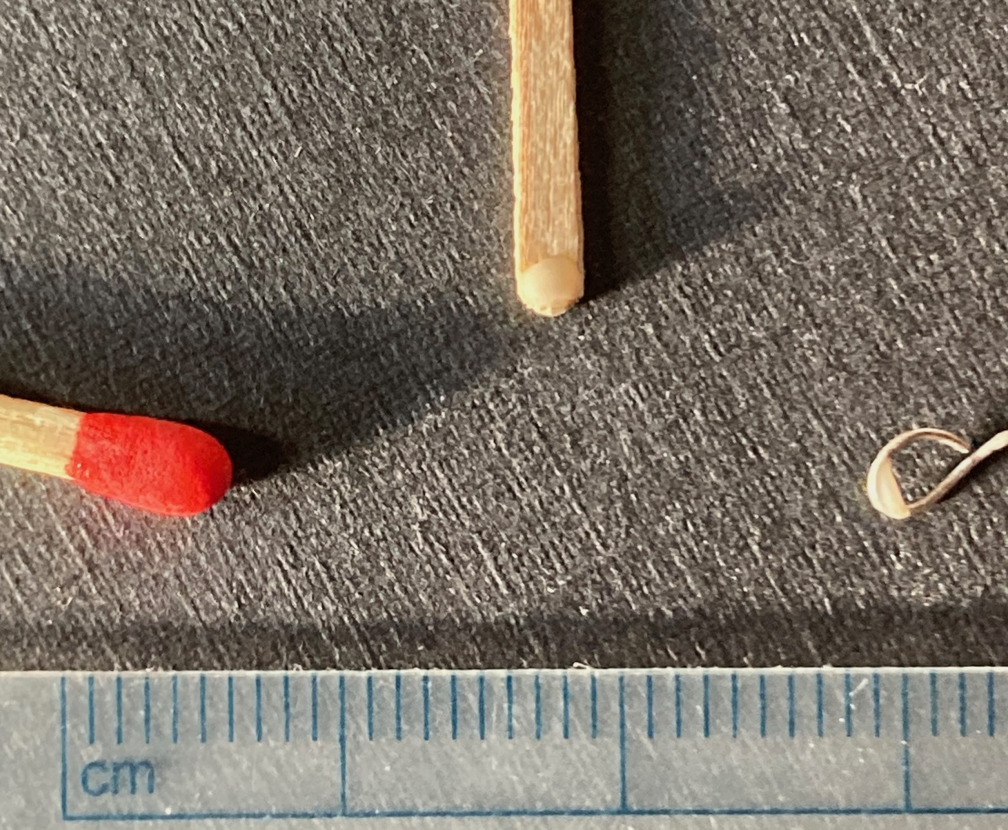
How Much Cell Material is Needed?
That’s a flat toothpick with the required amount of cells = size of a fairly big colony
That’s a match
That’s a loop with the required amount of cells
For Assay A, streak on plate. For Assay B, suspend in 50 µl water.

Slide 15
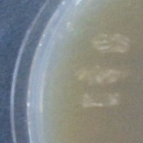
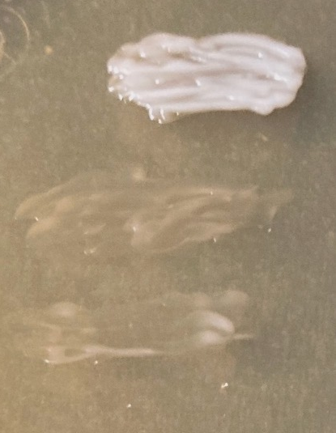
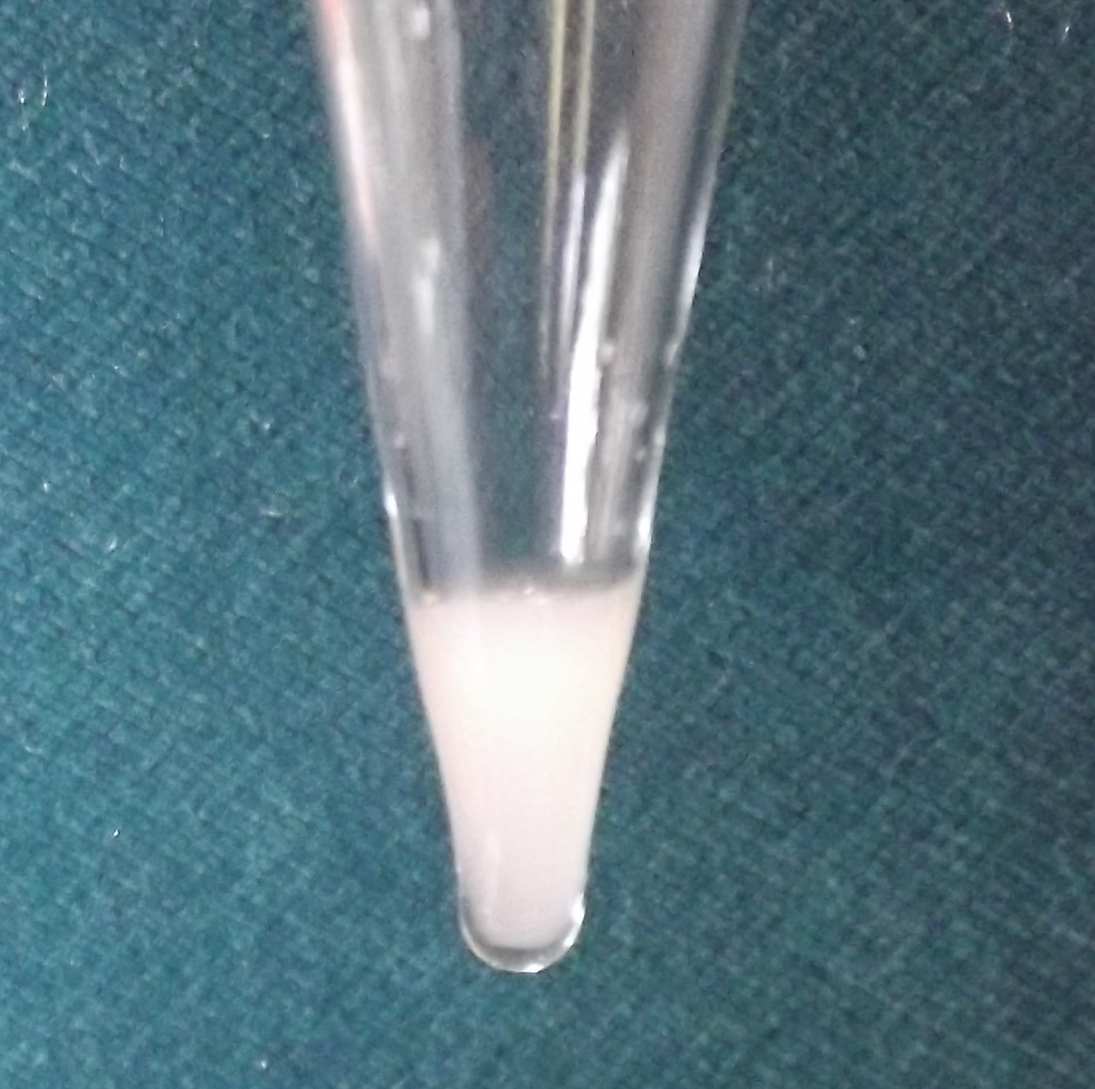
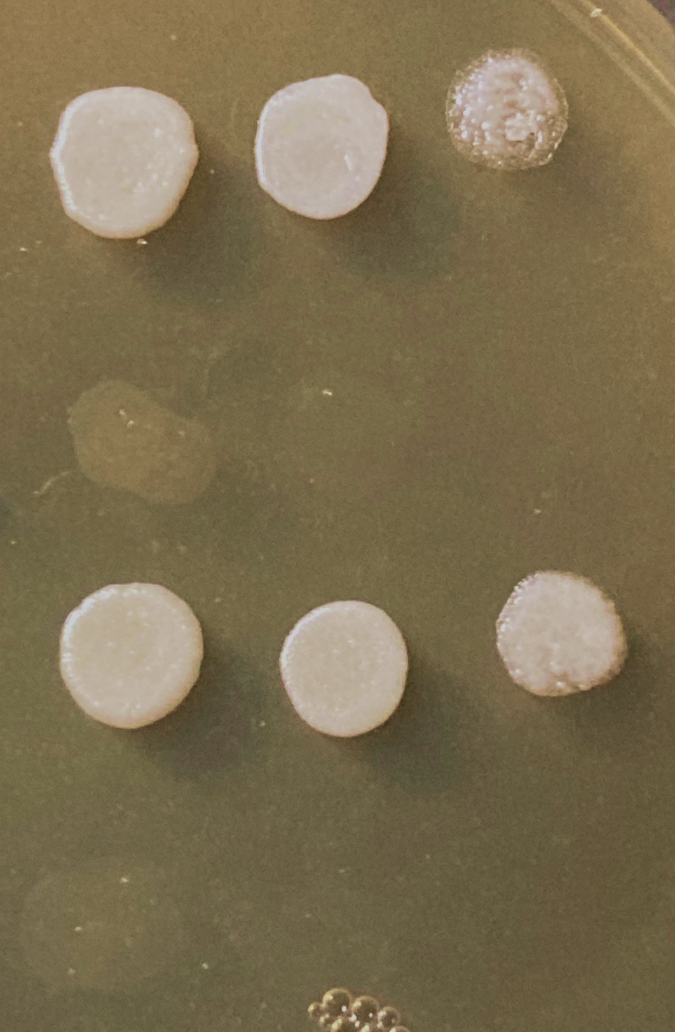
~ 12 mm
~ 5 mm
+
Assay A
–
–
Incubation at 37°C
+
Assay B
Drops of 12 µl
Optional:
from 1:4, 1:8 dilutions
–
OD 600 ~ 8-10

Slide 16
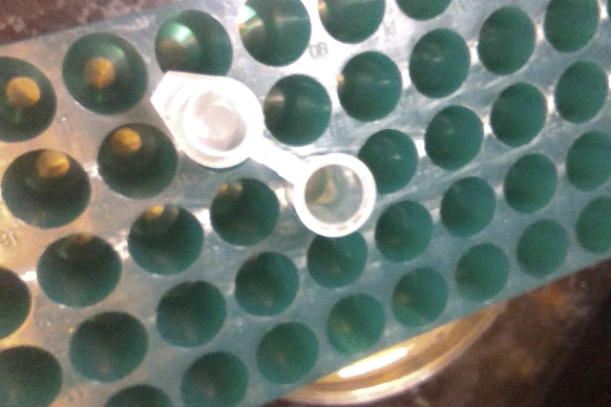
Assay B, Part 1: Procedure (click on movie)

Slide 17
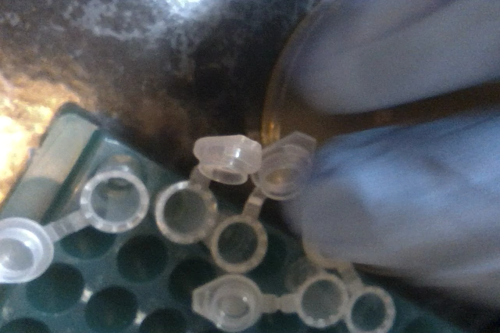
Assay B, Part 2: Procedure (click on movie)

Slide 18
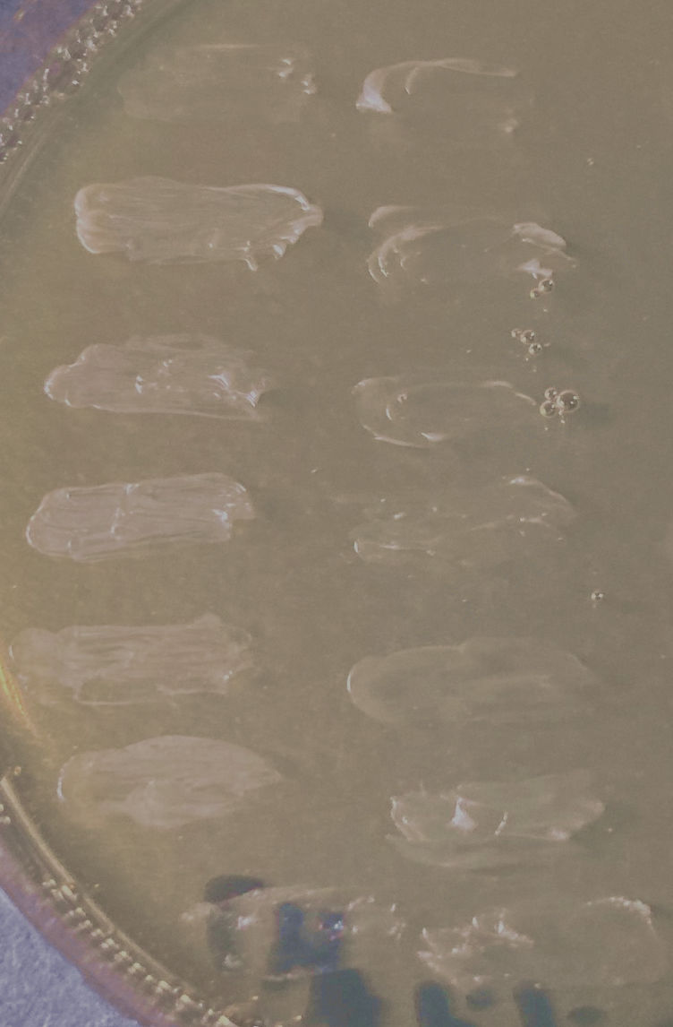
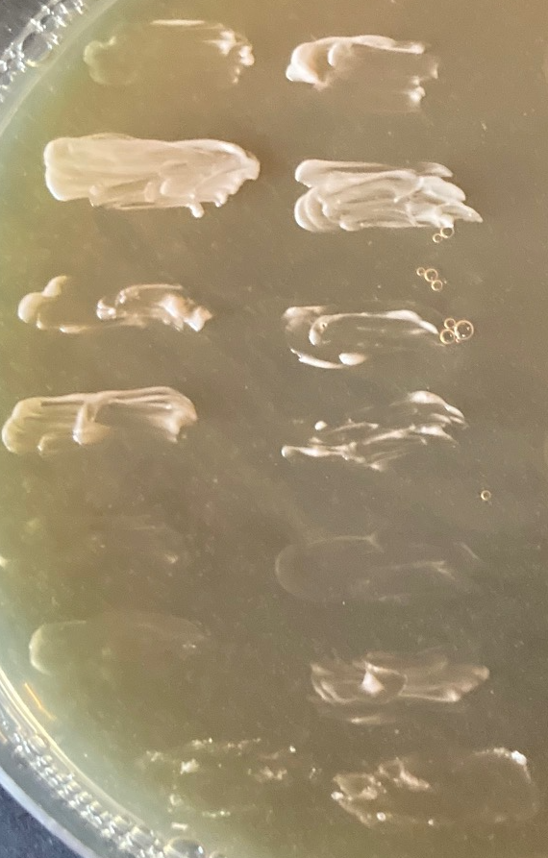
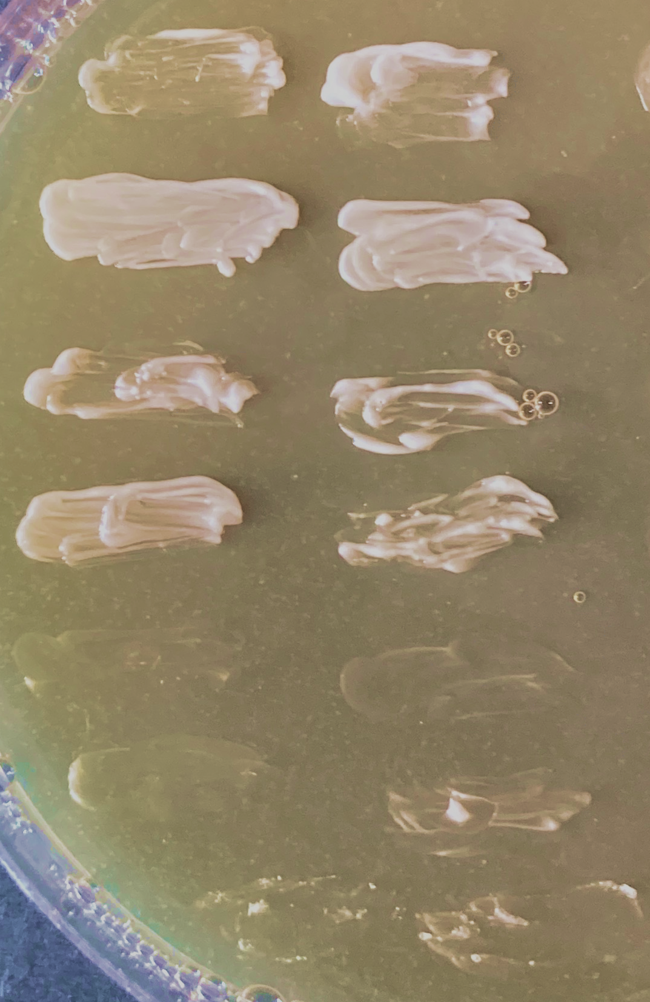
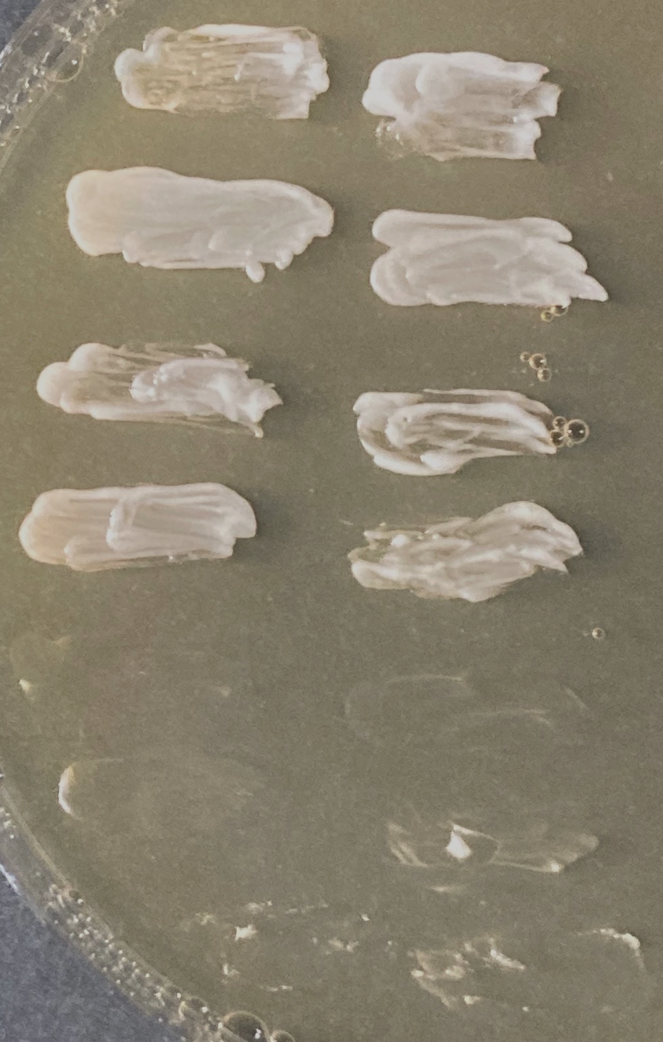
Assay A: Representative Results
1
2
3
4
5
6
7
6 hrs
16 hrs
24 hrs
30 hrs
1-4 = Candida auris (different strains)
5-6 = Candida duobushaemulonii (different strains)
7 = Candida parapsilosis
Note:
Thick areas of patch grow first. Thinner areas fill in later.
Left/right column = different preculture conditions

Slide 19
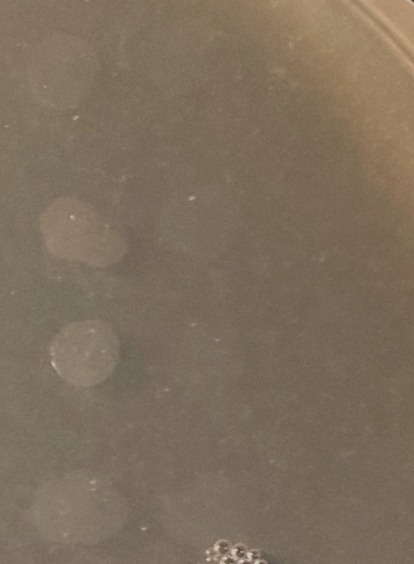
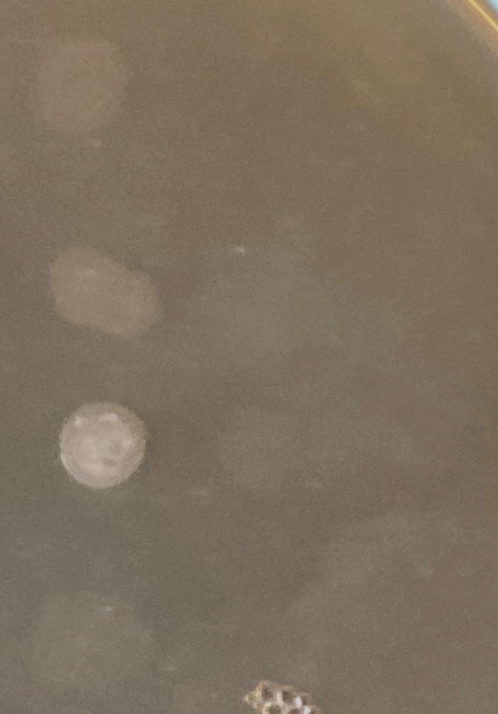
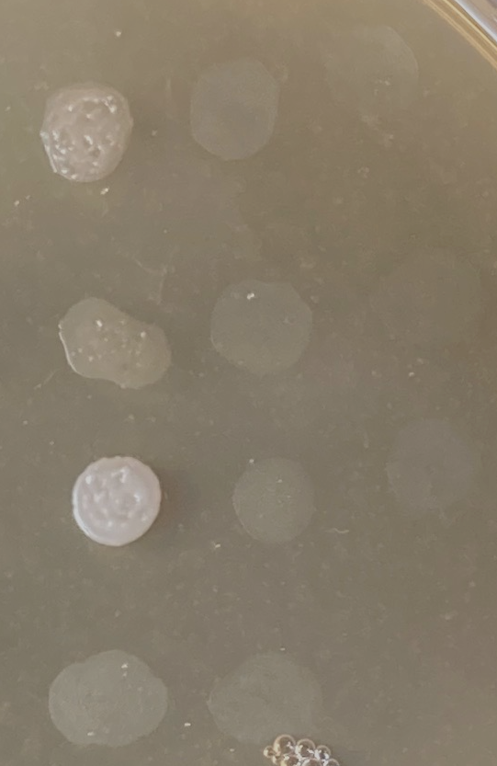
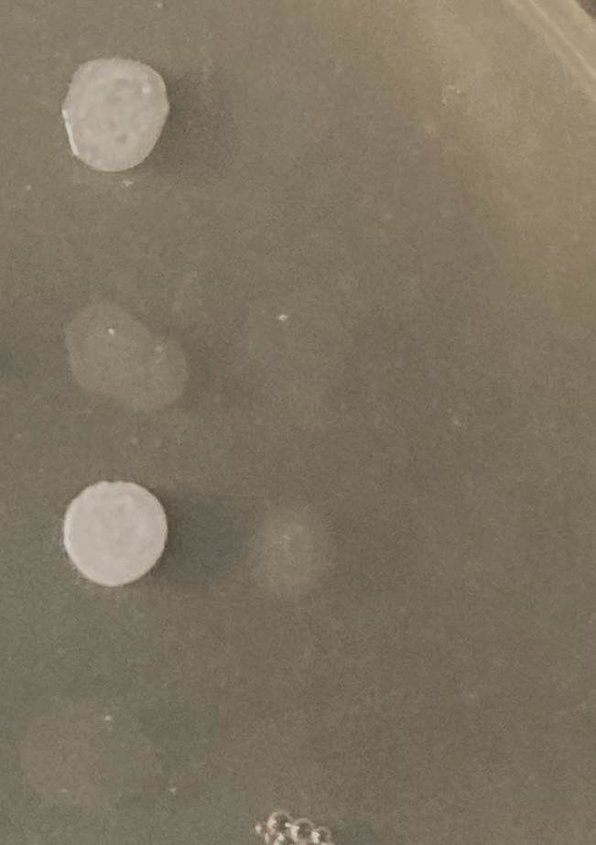
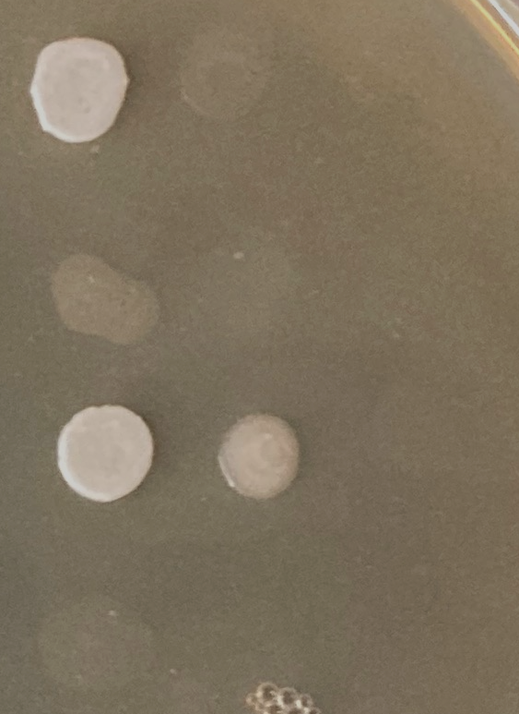
Assay B: Representative Results
(continued on next slide)
Drop dilution
1:8
1
1:4
1:8
1
1:4
1:8
1
1:4
1:8
1
1:4
1:8
1
1:4
1
2
3
4
6 hrs
16 hrs
24 hrs
30 hrs
40 hrs
Note:
Comparing a sensitive C. auris strain and a resistant C. duob. strain = worst-case scenario!
“Real” and background growth are difficult to distinguish at early timepoints with undiluted drops.
1, 3 = Candida auris
(different preculture conditions)
2, 4 = Candida duobushaemulonii
(different preculture conditions)

Slide 20
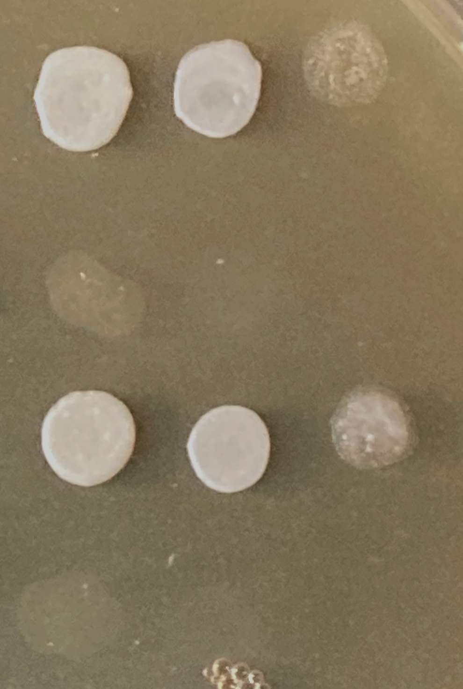
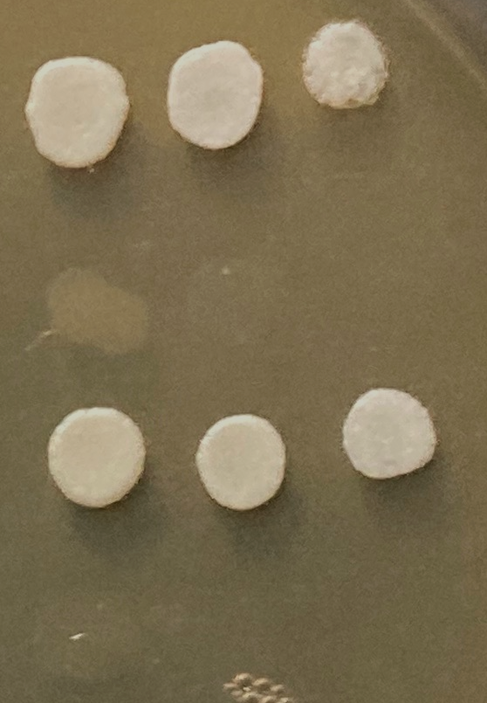
Assay B: Representative Results
(continued from previous slide)
Drop dilution
1
1:4
1:8
1
1:4
1:8
1
1:4
1:8
1
1:4
1:8
1
2
3
4
48 hrs
64 hrs
78 hrs
88 hrs
1, 3 = Candida auris
(different preculture)
2, 4 = Candida duobushaemulonii
(different preculture)
Note:
Drops made from diluted suspensions grow with
~1 and 2 day delay

Slide 21
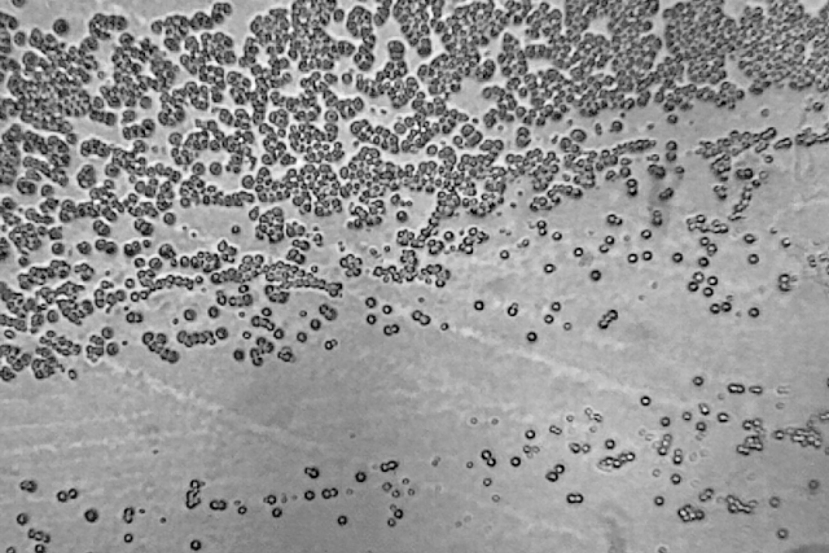
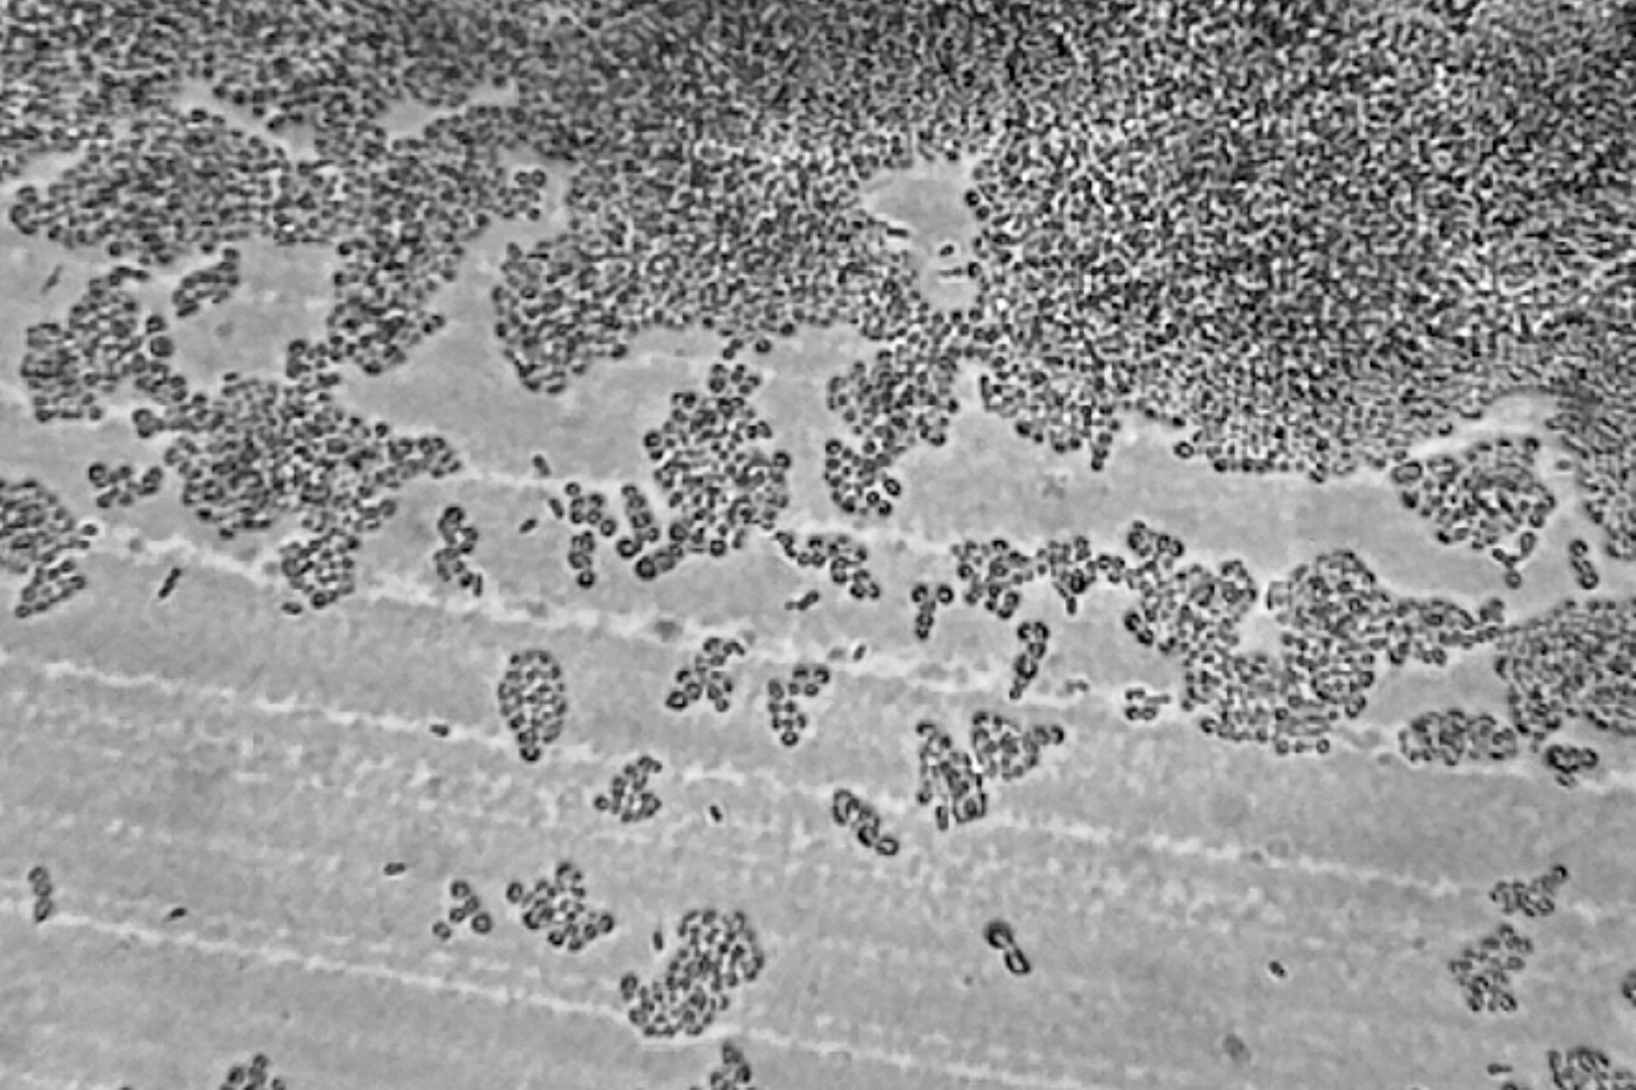
Early Result Detection
Open plate and observe under microscope
160x
A negative result
(C. duobushaemulonii):
Cell aggregates in dense areas
In areas of low density: mostly single cells or not more than one division (or cells that were never segregated)
A positive result (C. auris):
Microcolonies forming lawn in dense areas
In areas of low density: for most cells evidence of multiple divisions, formation of microcolonies

Slide 22
Comparing C. auris Isolates with AuriFind
Hospital may ask: Are two isolates representing the identical strain?
  Preliminary answer without sequencing
Any hint at the clade and geographical origin?
Suggested technique: Identical preculture, e.g. patches for 48 hrs on YPD at 37°C.
Compare in Assay B, with dilutions of 1:4, 1:8, 1:16, at initially more stringent conditions (24 hrs at 42°C).

Slide 23
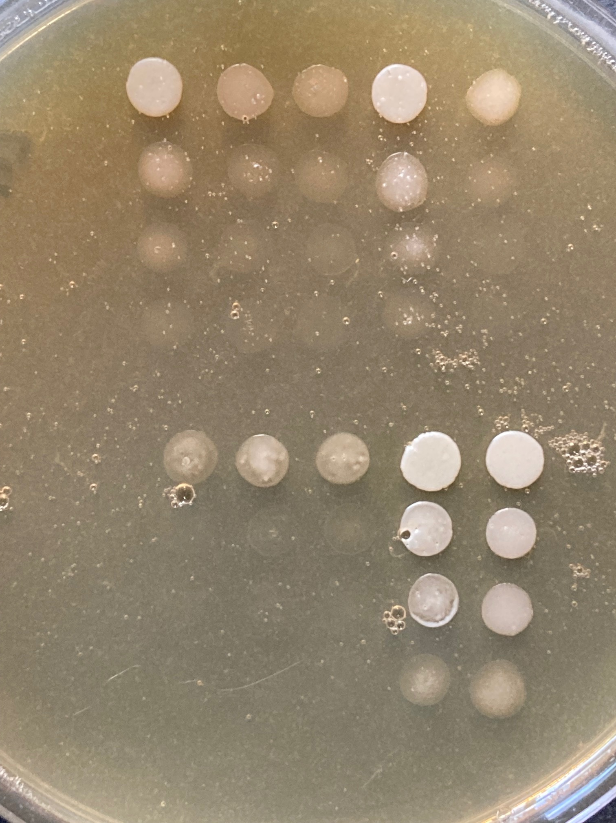
Comparing C. auris Isolates with AuriFind
CAU6
CAU1
CAU7
CAU2
24 hrs
CAU3
CAU8
CAU4
CAU9
CAU10
CAU5
1
1:4
1:8
1:16
1
1:4
1:8
1:16
This is Assay B with dilutions of 1, 1:4, 1:8, 1:16;
incubated for 24 hrs at 42°C. Continued on next slide.

Slide 24
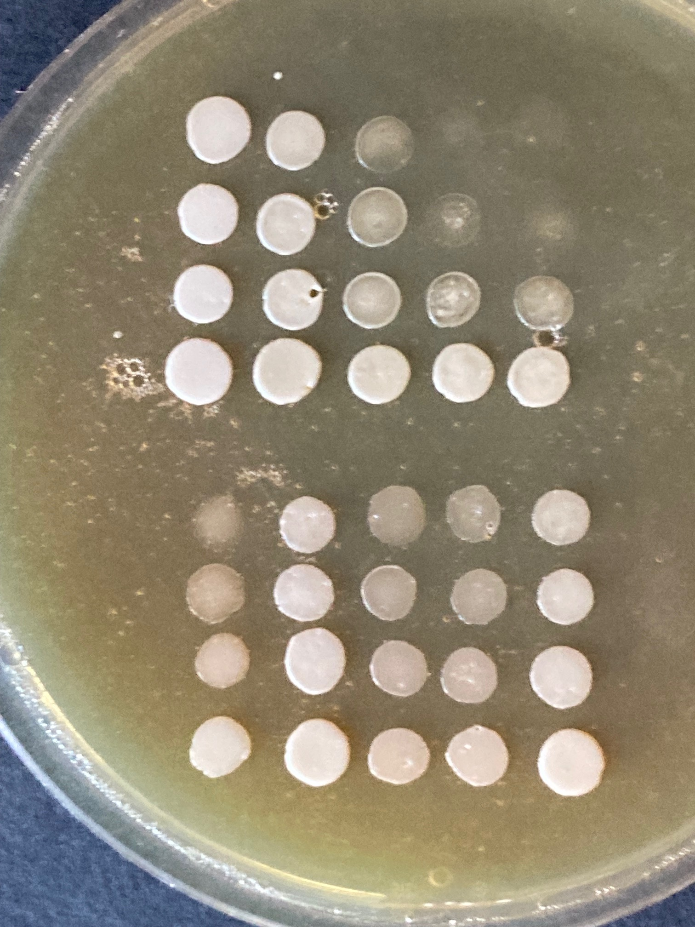
Comparing C. auris Isolates with AuriFind
CAU1
CAU6
CAU7
45 hrs
CAU2
CAU3
CAU8
CAU4
CAU9
CAU5
CAU10
1
1:4
1:8
1:16
1
1:4
1:8
1:16
This is Assay B with dilutions of 1, 1:4, 1:8, 1:16;
incubated for 24 hrs at 42°C, then 21 hrs at 30°C.

Slide 25
Comparing C. auris Isolates with AuriFind
Clade assignment is not straightforward and so far based only on very limited numbers (CDC strains):
African strains (CAU 3, 4) appear sensitive and give a very uniform response
South American strains (CAU 5, 6) are overall moderately sensitive but differ in their response
South Asian strains seem to fall roughly into two distinct groups – very sensitive (CAU 8, 9, 10) or very resistant (CAU 2, 7)
East Asian strain (the original reference strain, CAU 1) is quite sensitive.

Slide 26
Assay Variations
Stringency of the assay is determined by temperature, cell density, plate volume and (less) by conditions of preculture.
The provided protocols have been tested as reliable and not prone to artifacts. User-defined assay variations are possible.
If a new variation is tested, positive and negative controls need to be included.

Slide 27
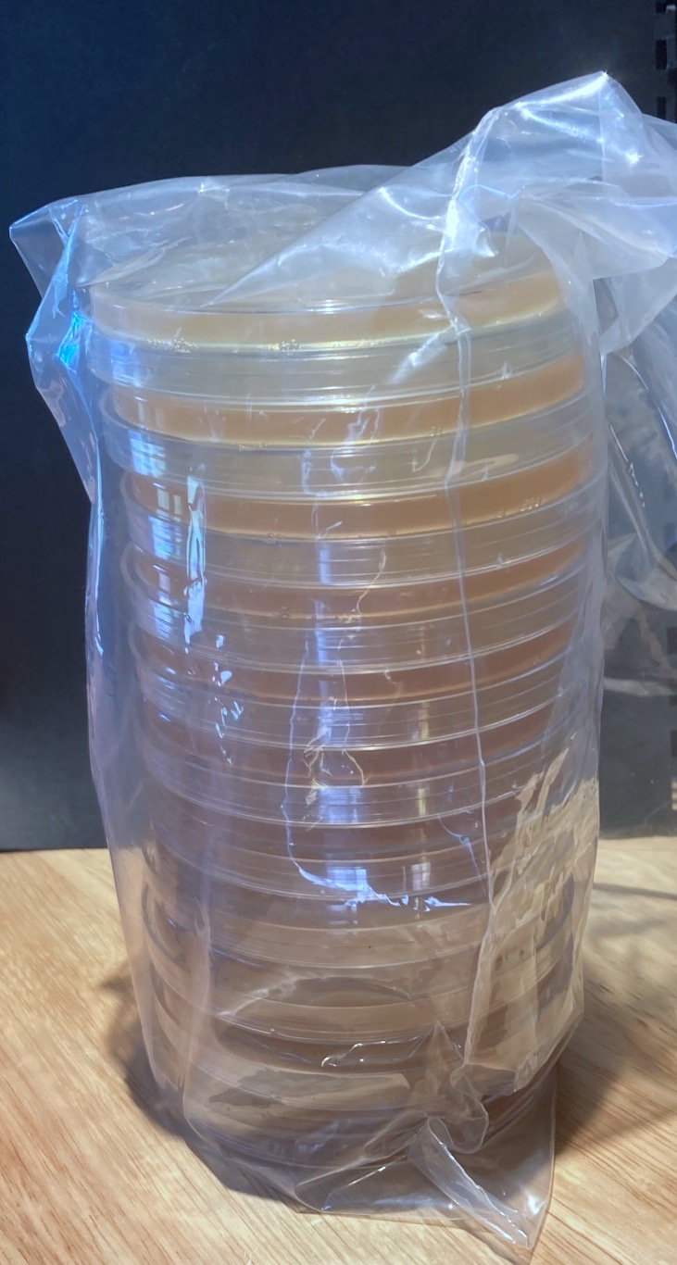
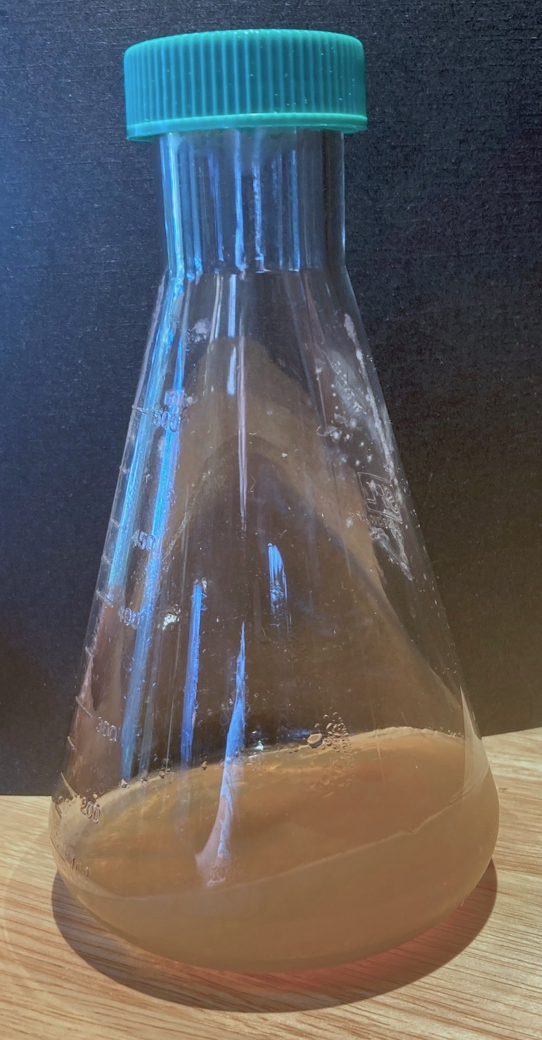
Two Versions of
ReCand or AuriFind
Choose ready-to-use plates
OR
Pour your own plates when needed after microwaving solidified medium → “rugged”, ideal for shipping overseas

Slide 28
Visit Our Ebay Store
https://www.ebay.com/str/santafebiolabs
Visit Fort Worth Diagnostics for molecular detection products!

