Slide 1
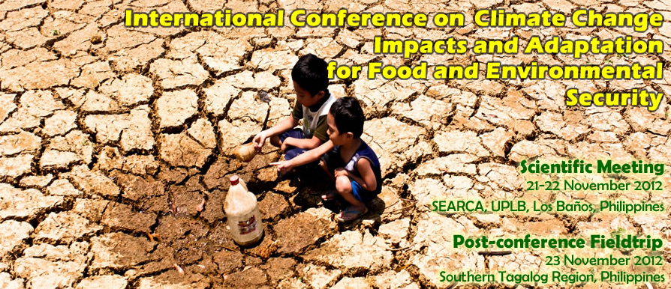
www.climatechange-foodsecurity.org
Unavoidable Global Warming Commitment
Its Food Security Impacts and Risks: Implications for Southeast Asia
Peter Carter, MD
International Conference on Climate Change Impacts
and Adaptation for Food and Environmental Security

Slide 2
Global climate change
and food security
is the most important issue for the entire world today
International Conference on Climate Change Impacts
and Adaptation for Food and Environmental Security

Slide 3
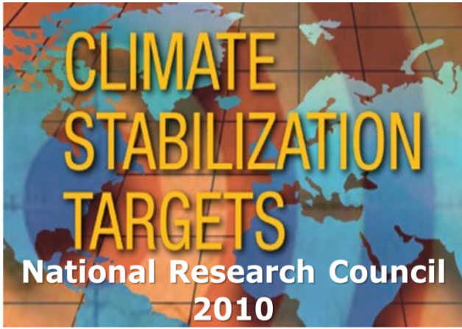
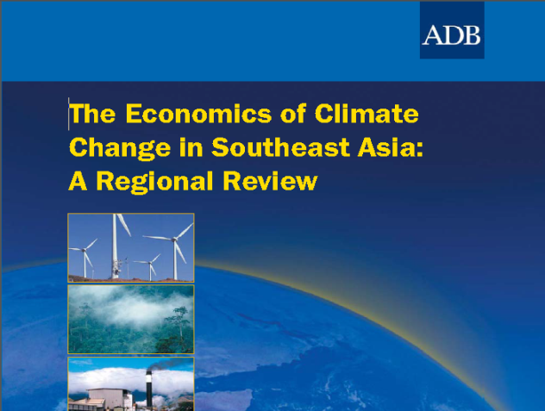
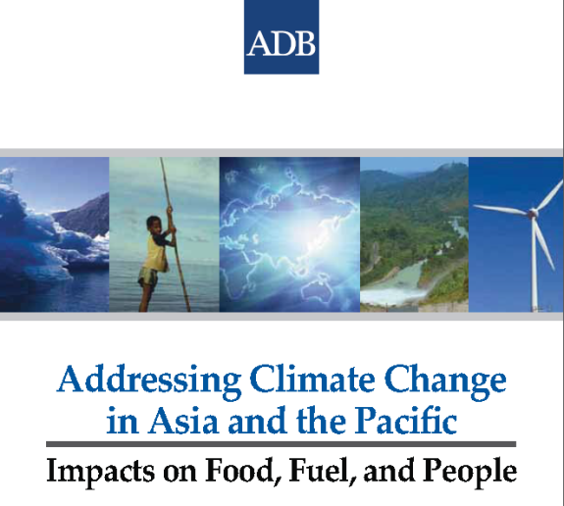
Presentation
Committed global warming
Climate-crop models
Extreme weather events
Drought
World food prices
Climate-crop model results
2009
Climate Change Facts & Figures
ADB 2010

Slide 4
Today is a committed
global climate change
food security emergency

Slide 5
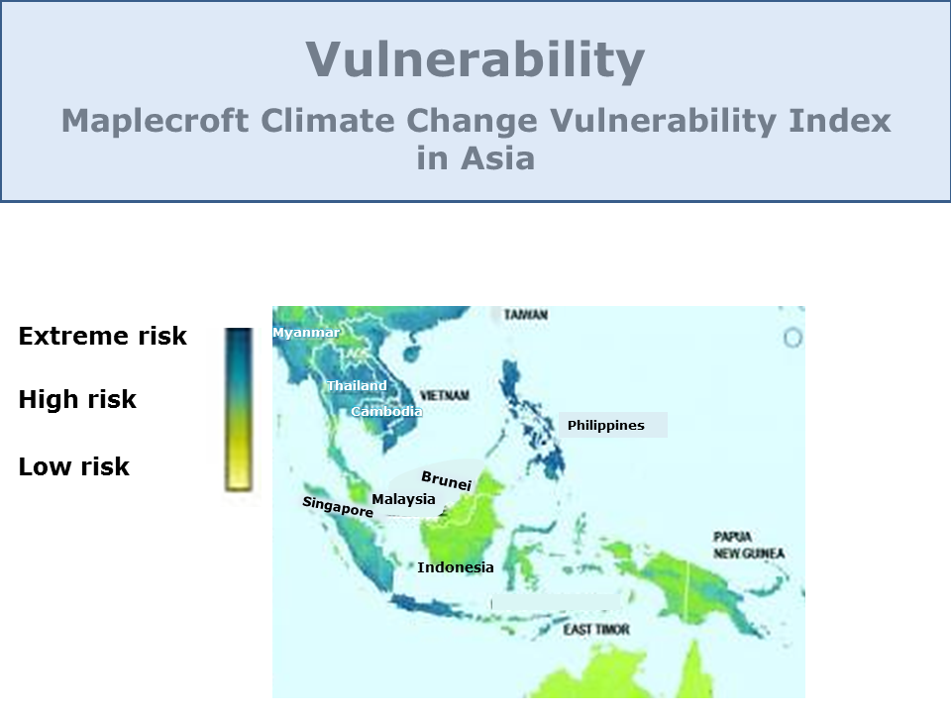
Vulnerability
Maplecroft Climate Change Vulnerability Index
in Asia
Extreme risk
High risk
Low risk
Myanmar
Thailand
Vietnam
Cambodia
Philippines
Brunei
Singapore
Malaysia
Indonesia

Slide 6
Vulnerability
Maplecroft Climate Change Vulnerability Index
in Asia
Vulnerable to world food prices
Extreme risk
High risk
Low risk
Myanmar
Thailand
Vietnam
Cambodia
Philippines
Brunei
Singapore
Malaysia
Indonesia

Slide 7
We are committed to a very much
greater global warming
than today’s 0.8°C
(only to 2100).
Notes:
What do we have to plan to adapt to?

Slide 8
We are committed to much
greater global warming
than today’s 0.8°C
(only to 2100).
1. Climate system science 3.0°C - 4.0°C
(IPCC, NRC,)
2. Policy 4.4°C - >7.0°C
(Climate Interactive, 2012)
3. Global emissions 6.0°C - >7.0°C
(International Energy Agency, World Energy Outlook, 2011)
4. To limit warming takes zero industrial carbon emissions
(www.onlyzerocarbon.org)
Warming lasts >1000 years
(S. Solomon, 2009)
Notes:
What do we have to plan to adapt to?

Slide 9
We are committed to much
greater global warming
than today’s 0.8°C
(only to 2100).
1. Climate system science 3.0°C - 4.0°C
(IPCC, NRC,)
2. Policy 4.4°C - >7.0°C
(Climate Interactive, 2012)
3. Global emissions 6.0°C - >7.0°C
(International Energy Agency, World Energy Outlook, 2011)
4. To limit warming takes zero industrial carbon emissions
(www.onlyzerocarbon.org)
Warming lasts >1000 years
(S. Solomon, 2009)
Notes:
What do we have to plan to adapt to?

Slide 10
We are committed to much
greater global warming
than today’s 0.8°C
(only to 2100).
1. Climate system science 3.0°C - 4.0°C
(IPCC, NRC,)
2. Policy 4.4°C - >7.0°C
(Climate Interactive, 2012)
3. Global emissions 6.0°C - >7.0°C
(International Energy Agency, World Energy Outlook, 2011)
4. To limit warming takes zero industrial carbon emissions
(www.onlyzerocarbon.org)
Warming lasts >1000 years
(S. Solomon, 2009)
Notes:
What do we have to plan to adapt to?

Slide 11
We are committed to much
greater global warming
than today’s 0.8°C
(only to 2100).
1. Climate system science 3.0°C - 4.0°C
(IPCC, NRC,)
2. Policy 4.4°C - >7.0°C
(Climate Interactive, 2012)
3. Global emissions 6.0°C - >7.0°C
(International Energy Agency, World Energy Outlook, 2011)
4. To limit warming takes zero industrial carbon emissions
(www.onlyzerocarbon.org)
Warming lasts >1000 years
(S. Solomon, 2009)
Notes:
What do we have to plan to adapt to?

Slide 12
We are committed to much
greater global warming
than today’s 0.8°C
(only to 2100).
1. Climate system science 3.0°C - 4.0°C
(IPCC, NRC,)
2. Policy 4.4°C - >7.0°C
(Climate Interactive, 2012)
3. Global emissions 6.0°C - >7.0°C
(International Energy Agency, World Energy Outlook, 2011)
4. To limit warming takes zero industrial carbon emissions
(www.onlyzerocarbon.org)
Warming lasts >1000 years
(S. Solomon, 2009)
Notes:
What do we have to plan to adapt to?

Slide 13
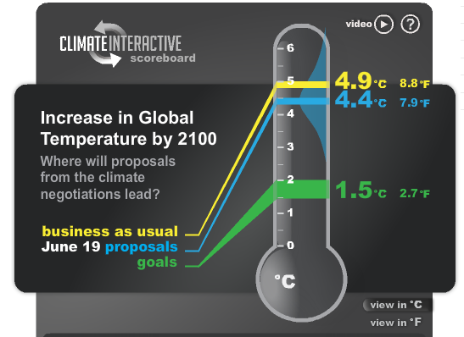
2.
4.4°C by 2100

Slide 14
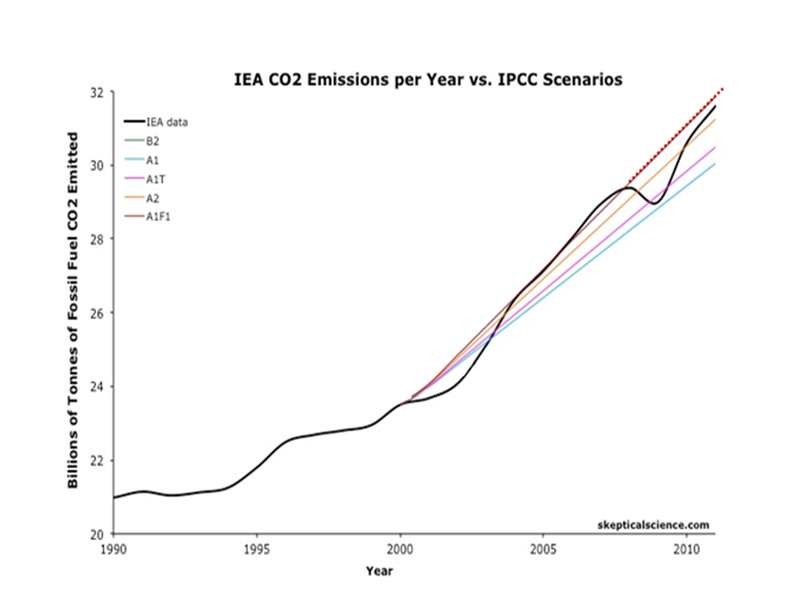
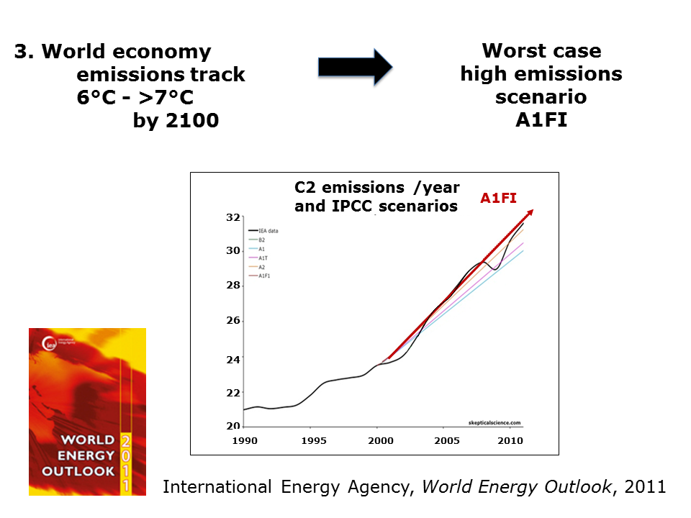
3. World economy
emissions track
6°C - >7°C
by 2100
Worst case
high emissions scenario
A1FI
C2 emissions /year and IPCC scenarios
A1FI
32
30
28
26
24
22
20
1990 1995 2000 2005 2010
International Energy Agency, World Energy Outlook, 2011

Slide 15
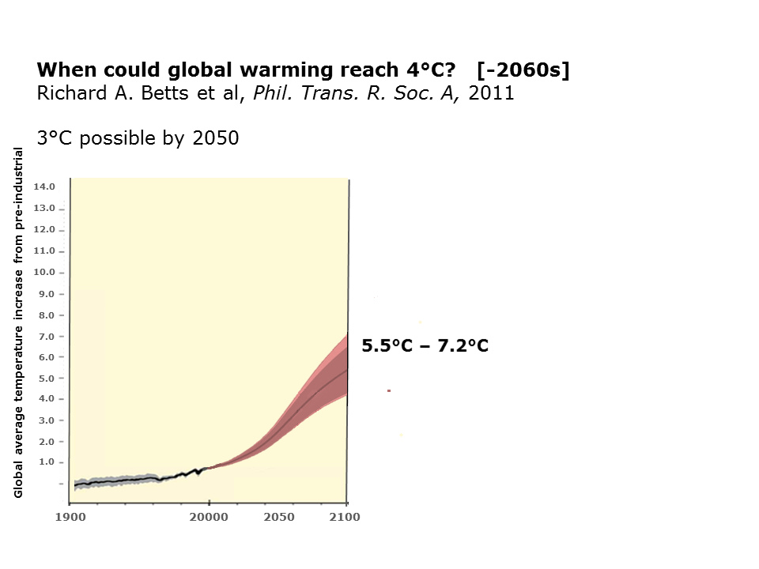
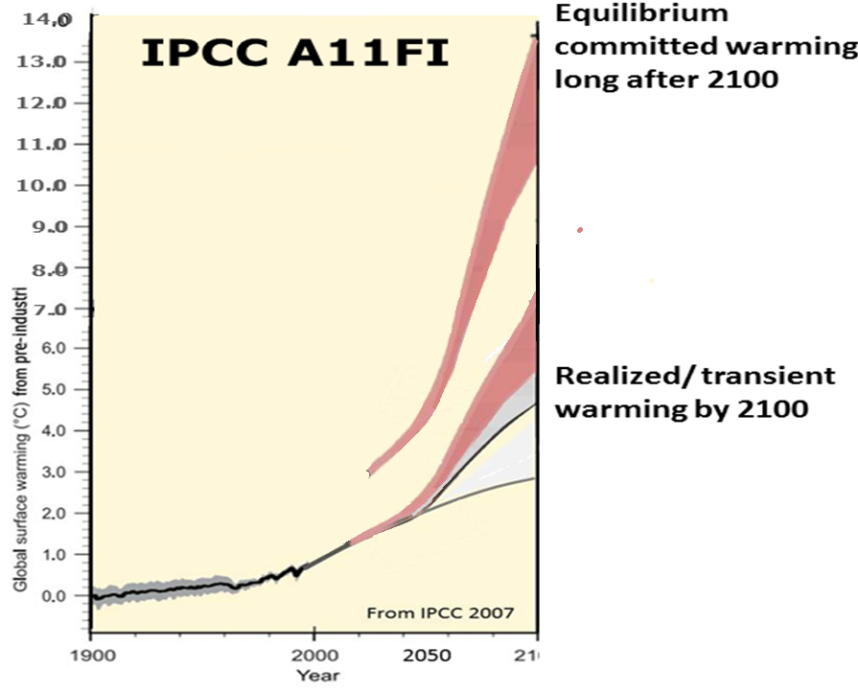
When could global warming reach 4°C? [-2060s]
Richard A. Betts et al, Phil. Trans. R. Soc. A, 2011
3°C possible by 2050
World economy is fixed on worst case high emissions scenario
A1FI
14.0
Realized/transient warming
14.0
13.0
12.0
11.0
10.0
9.0
8.0
7.0
6.0
5.0
4.0
3.0
2.0
1.0
3.0
8.0
5.5°C – 7.2°C
Global average temperature increase from pre-industrial
Realized/ transient warming by 2100
1900 20000 2050 2100
2100
When could global warming reach 4°C?
(Betts et al, Phil. Trans. R. Soc. A, 2011)

Slide 16
The co
The committed warming (from the ocean heat lag alone) is about double the transient warming
Eventual equilibrium
warming

Slide 17
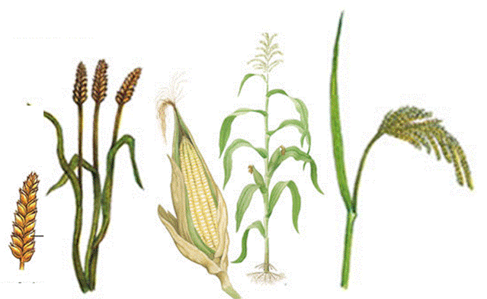
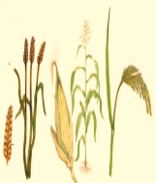
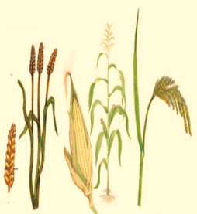
Committed crop yield loss
at 2080
Must plan for food according to committed unavoidable warming –
not model-projected realized/transient warming
Realized/transient warming
Transient
crop loss
at 2050
Crop yield today

Slide 18
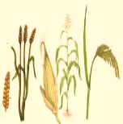
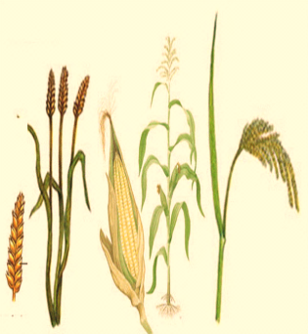
Must plan for food according to committed unavoidable warming –
not model-projected realized/transient warming
Ocean heat lag alone
Committed crop
loss at 2050

Slide 19
Committed unavoidable
global warming
1. Climate system science 3-4°C
(inertias)
This approach works for anticipating crop losses

Slide 20
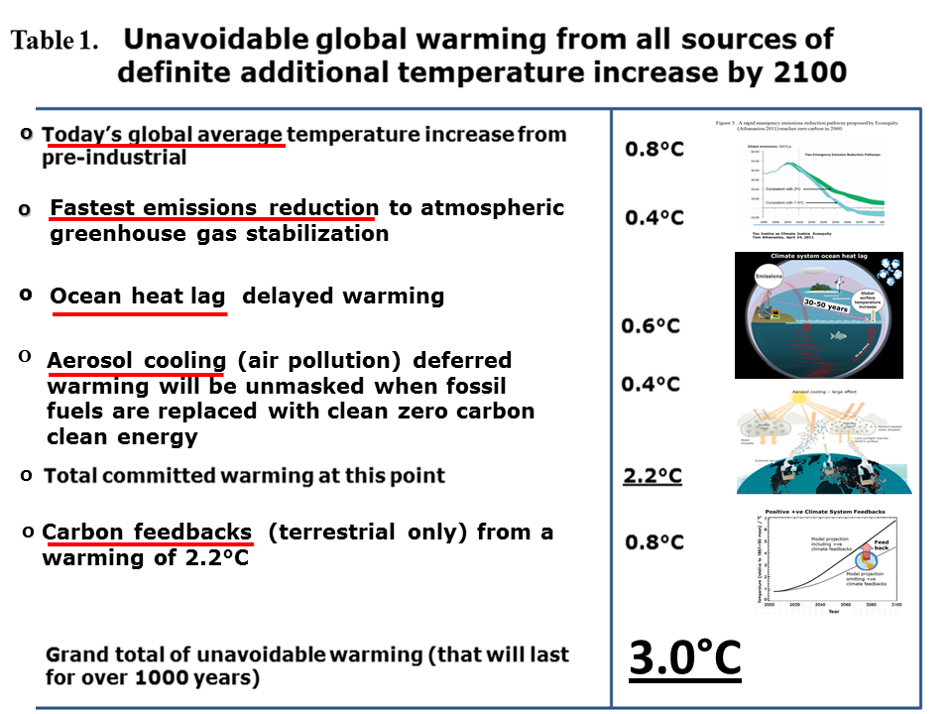
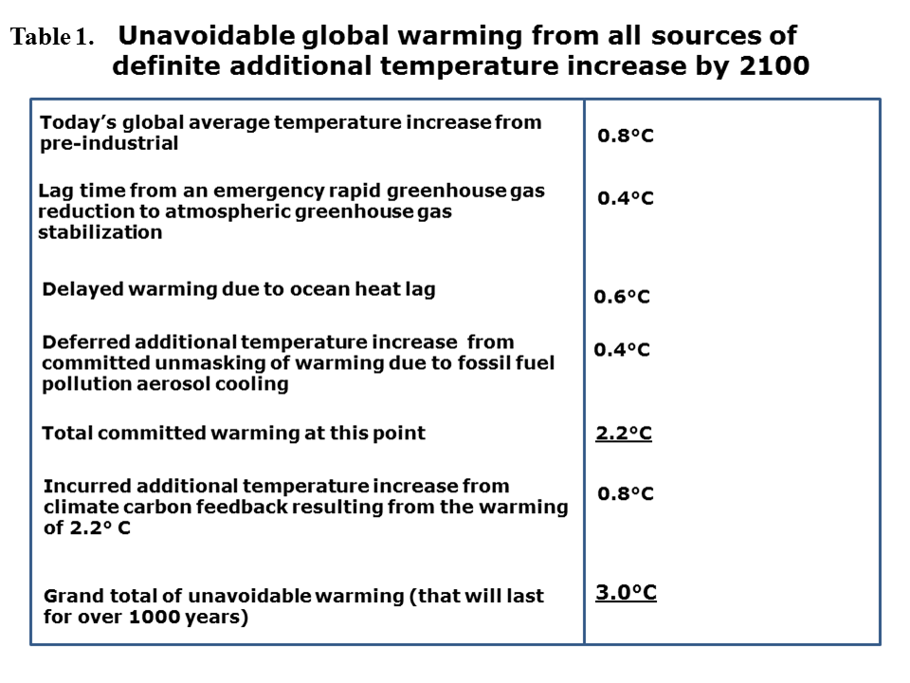
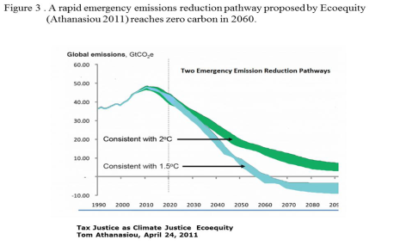
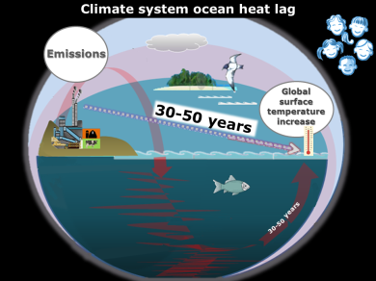
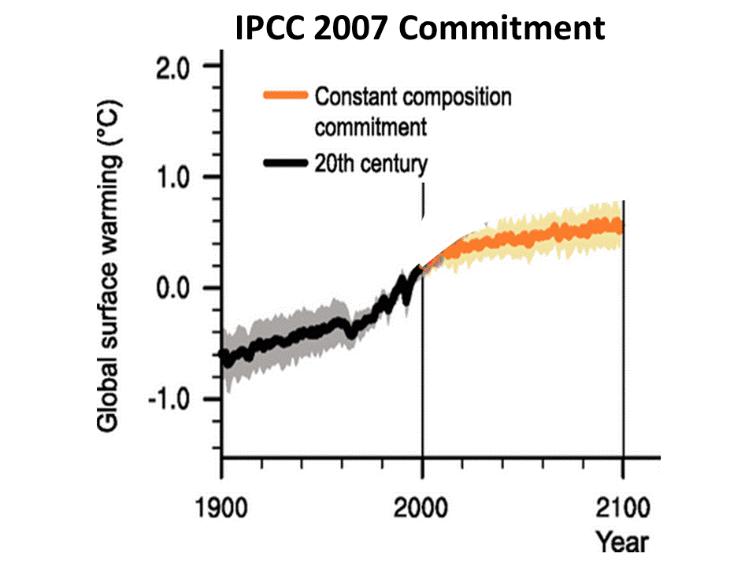
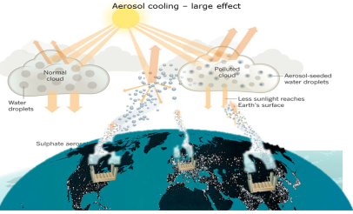
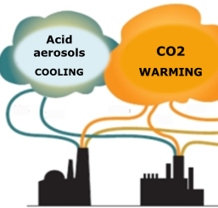
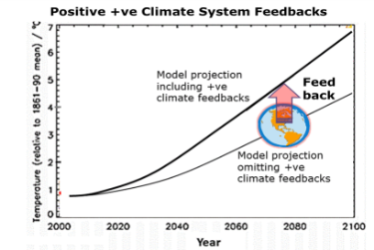
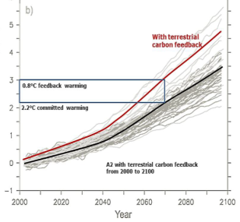
o
0.8°C
0.4°C
0.6°C
0.4°C
2.2°C
0.8°C
o
emissions
Fastest emissions reduction to atmospheric greenhouse gas stabilization
o
Ocean heat lag delayed warming
0.6°C
o
O
Aerosol cooling (air pollution) deferred warming will be unmasked when fossil fuels are replaced with clean zero carbon clean energy
o
o
o
Carbon feedbacks (terrestrial only) from a warming of 2.2°C
IPCC
3.0°C

Slide 21
The 2°C limit is impossible
and we could be committed to 4°C
When could global warming reach 4°C? [-2060s]
Richard A. Betts et al, Phil. Trans. R. Soc. A, 2011
Reframing the climate change challenge in light of post-2000 emission trends
Kevin Anderson and Alice Bows, Phil. Trans. R. Soc. A, 2008
On avoiding dangerous anthropogenic interference with the climate system
V. Ramanathan and Y. Feng, PNAS, 2008

Slide 22
uuu
How do we plan now
for future food?

Slide 23
uuu
What’s the situation today?

Slide 24
The Economics of Climate Change in Southeast Asia: A Regional Review
(Asia Development Bank, 2009)
At 0.8°C: there is already a "decline in agricultural production potential in many parts of the region" due to
INCREASING
heat stress
water stress
extreme weather events
floods
climate-associated pests
climate-associated diseases

Slide 25
Global climate change is irreversible
Irreversible climate change due to carbon dioxide emissions
Susan Solomon et al, PNAS, 2009
We must plan according to
committed unavoidable warming

Slide 26
We must assume that climate-crop models underestimate

Slide 27
Processes not considered or adequately quantified
in climate-crop models
critical thresholds
responses of weeds
responses of insects
responses of pathogens
changes in water resources available for irrigation
increased surface ozone levels
increased flood frequencies
extremely high temperatures
sustained droughts
year-to-year variability
soil salinization - sea level
floods
land degradation - soil erosion
COMBINED IMPACTS
10

Slide 28
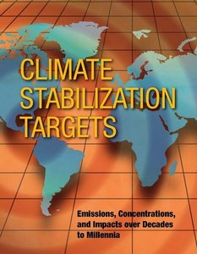
We must plan adaptation, but there’s no evidence it will help above 2°C
Only response is an emergency response
"Adaptation responses by growers are also poorly understood and could, in contrast, reduce yield losses."
"More commonly, adaptations will at best be able to offset 2°C of local warming (Easterling et al., 2007), and they will be less effective in tropical regions where soil moisture, rather than cold temperatures, limits the length of the growing season."
"Very few studies have considered the evidence for ongoing adaptations to existing climate trends and quantified the benefits of these adaptations."
(Chapter 5, p. 162)

Slide 29
We can assume that
world food prices
are committed
to keep increasing
due to an increasing trend of
Northern Hemisphere drought
— severe NH drought at
today’s 0.8°C

Slide 30
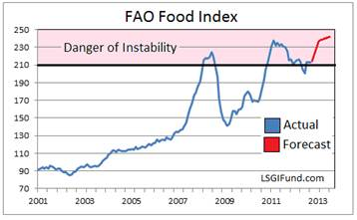

Slide 31
N.H. drought = world food $s
UCL Global Drought Monitor
July 2012
Palmer Drought Severity Index PDSI
University College London Hazard Research Centre

Slide 32
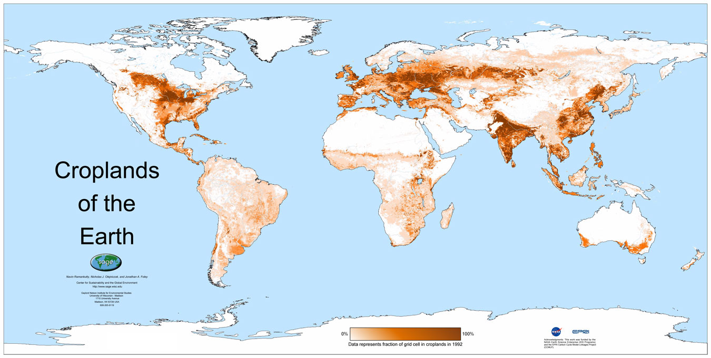
N.H. drought = world food $s
UCL Global Drought Monitor
July 2012
Palmer Drought Severity Index PDSI
University College London Hazard Research Centre

Slide 33
Global Drought Monitor November 2012
Palmer Drought Severity Index PDSI

Slide 34
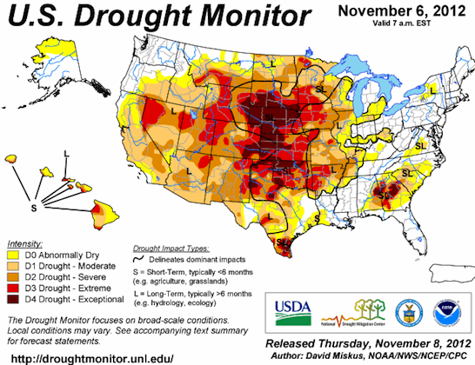
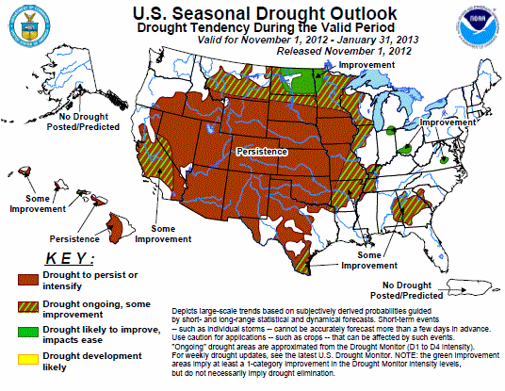
U.S. Drought Monitor November 6, 2012

Slide 35
Assess first by
extreme weather events
A top determinant
of
food production
not accounted for in assessment models

Slide 36
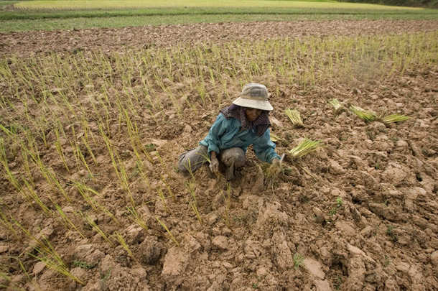
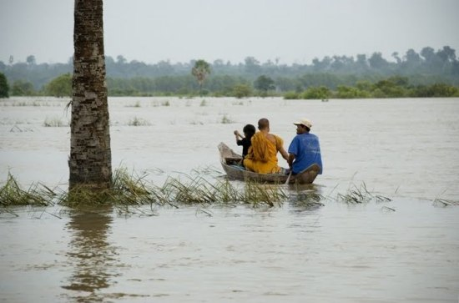
Extreme Weather Events
the most damaging category of climate change effects on both crop yields and human health
these impacts compound each other
they are not modeled in assessments

Slide 37
Future extreme events and disasters
will increase much more
The frequency and intensity of extreme weather events in Southeast Asia are likely to increase further, including more
drought
heat waves
flooding
intense precipitation events
tropical cyclones (more and more intense)
inter-annual variability of daily precipitation in the Asian summer monsoon
amplification in storm-surge heights
increased frequency and intensity of La Niña events
Combined?

Slide 38
Drought
Not accounted for in assessment models

Slide 39
Southeast Asia
Increasing drought
followed by
increasing precipitation
(Not modeled in assessments)

Slide 40
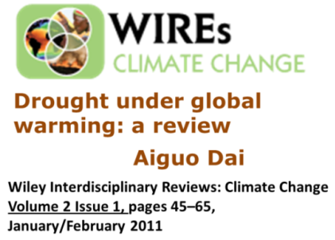
2.8°C
2.8°C

Slide 41
2.8°C
2.8°C

Slide 42
2.8°C
drought, floods
Vietnam
Philippines
Thailand
Cambodia
Malaysia
Brunei
Indonesia

Slide 43
Climate-Crop
Computer Model
Projection Results
(Assume underestimates)

Slide 44
According to models,
all crops in all regions will be in declining yields from 2.0°C global increase
World food output is at risk from 1.5ºC
C3 crops (rice, wheat, soybeans, fine grains, legumes) decline at roughly 1.25-2°C in global average temperature increase.
For C4 crops (maize, millet, sorghum), even modest
amounts of warming are detrimental in major growing
regions given the small response to CO2.
(NRC, Climate Stabilization Targets, Ch. 5, p. 160)
At lower latitudes, especially seasonally dry and tropical regions, crop productivity is projected to decrease for even small local temperature increases of 1.0-2.0°C [0.8-1.8ºC global from pre-1900].
… global production potential […] is threatened at +1°C
[1ºC global from pre-1900] local temperature change….
(IPCC, 2007, Figure 5.2 http://www.ipcc.ch/publications_and_data/ar4/wg2/en/ch5s5-4-2-2.html)

Slide 45
Climate-Crop Model Results
Southeast Asia
Asia Development Bank
August 2010

Slide 46
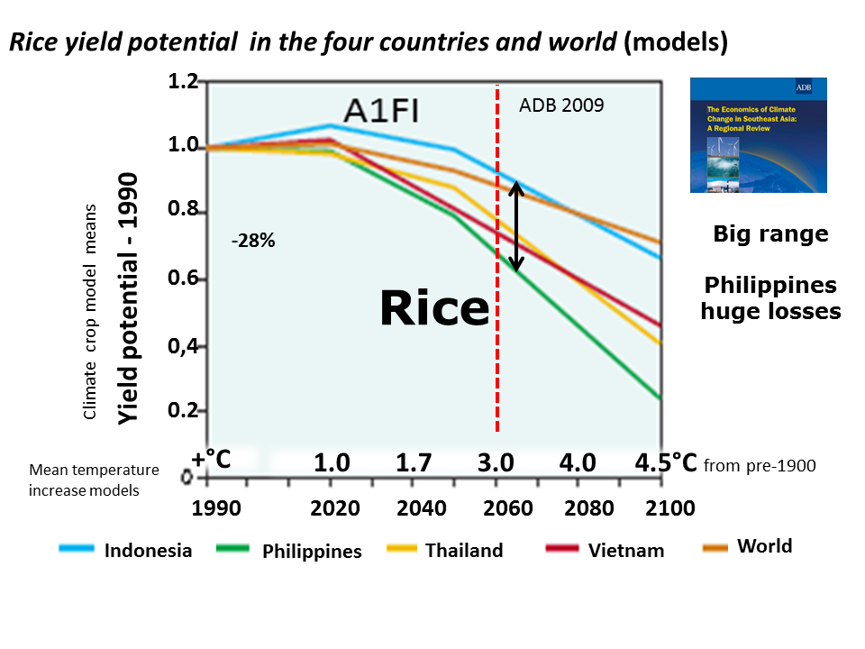
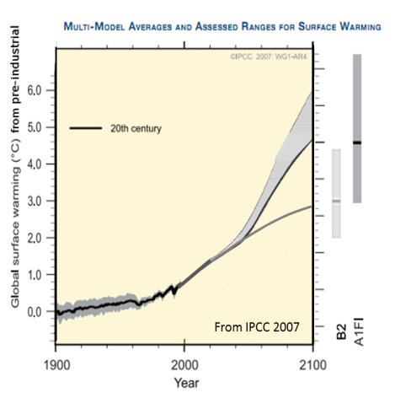
Rice Yield Potential in Four Southeast Asian Countries and the World (from models)
Rice yield potential in the four countries and world (models)
1.2
1.0
0.8
0.6
0,4
0.2
ADB 2009
-28%
Yield potential - 1990
Climate crop model means
Rice
Big range
Philippines huge losses
+°C
1.0 2.0 3.0 4.5 5.5 from pre-1900
Mean temperature increase models
1990 2020 2040 2060 2080 2100
Indonesia
Philippines
Thailand
Vietnam
World

Slide 47
Crop yield reductions and price rises over the next 40 years
(according to models)
Irrigated agriculture in the region is
expected to decline in the range of:
Rice 14-20%
Wheat 32-44%
Maize 2-5%
Soybean 9-18%
over the next 40 years
Food prices are expected to increase sharply by 2050 compared to those predicted in the absence of climate change, with
Rice prices up 29-37%
Wheat prices up 81-102%
Maize prices up 58-97%
Soybean prices up 14-49%
Asia Development Bank 2010

Slide 48
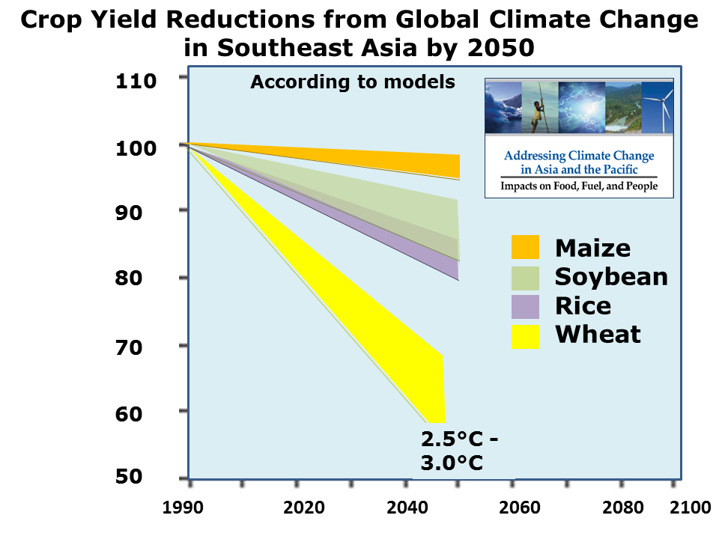
Crop Yield Reductions from Global Climate Change in Southeast Asia by 2050
Crop yield reductions from global climate change in S. E Asia by 2050
Asia Development Bank 2010
110
100
90
80
70
60
50
According to models
Maize
Soybean
Rice
Wheat
2.5°C - 3.0°C
1990 2020 2040 2060 2080 2100

Slide 49
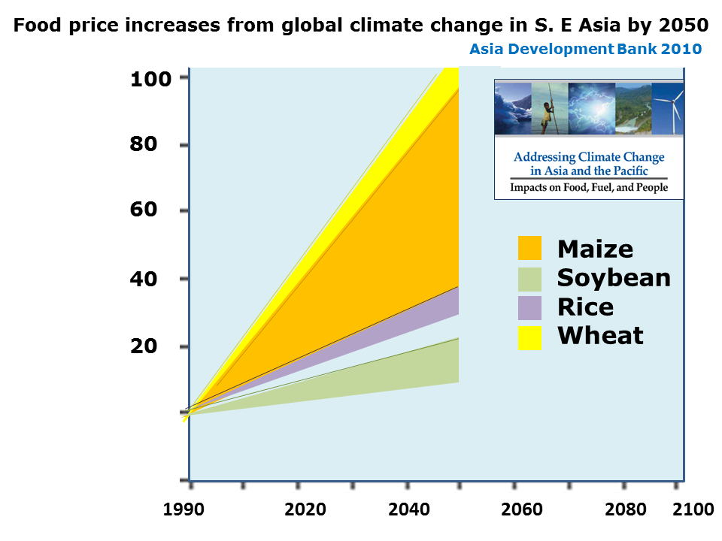
Food Price Increases from Global Climate Change
in Southeast Asia by 2050
100
80
60
40
20
Food price increases from global climate change in S. E Asia by 2050
Asia Development Bank 2010
According to models
% increase
Maize
Soybean
Rice
Wheat
1990 2020 2040 2060 2080 2100

Slide 50
Committed unavoidable global warming is several times
today’s warming.
It is a food emergency, affecting the world and all major food-producing regions.
This can only be mitigated or adapted to by a united global emergency response.
We are all in this emergency
together.

Slide 51
Today is a committed
global climate change
food security emergency

Slide 53
More supporting material

Slide 54
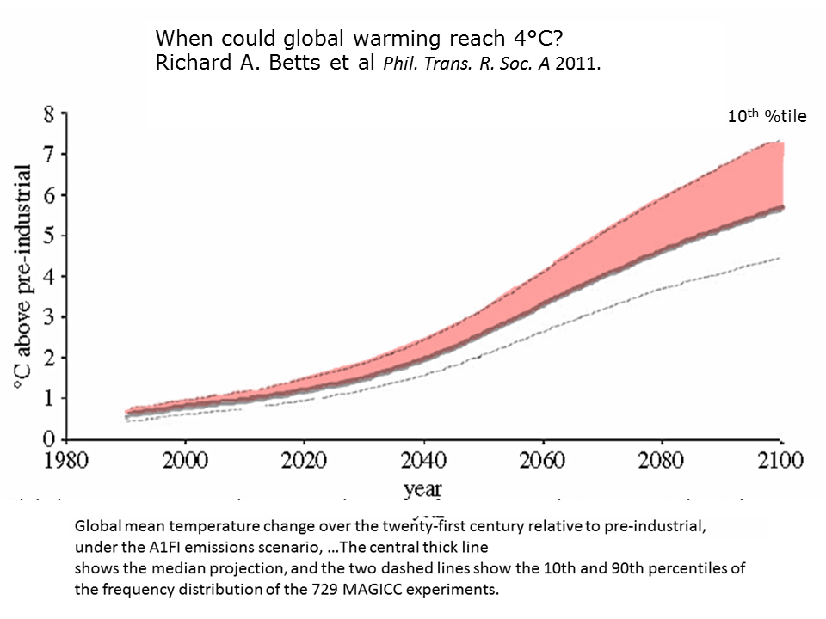
A1FI with terrestrial (only) carbon feedback

Slide 55
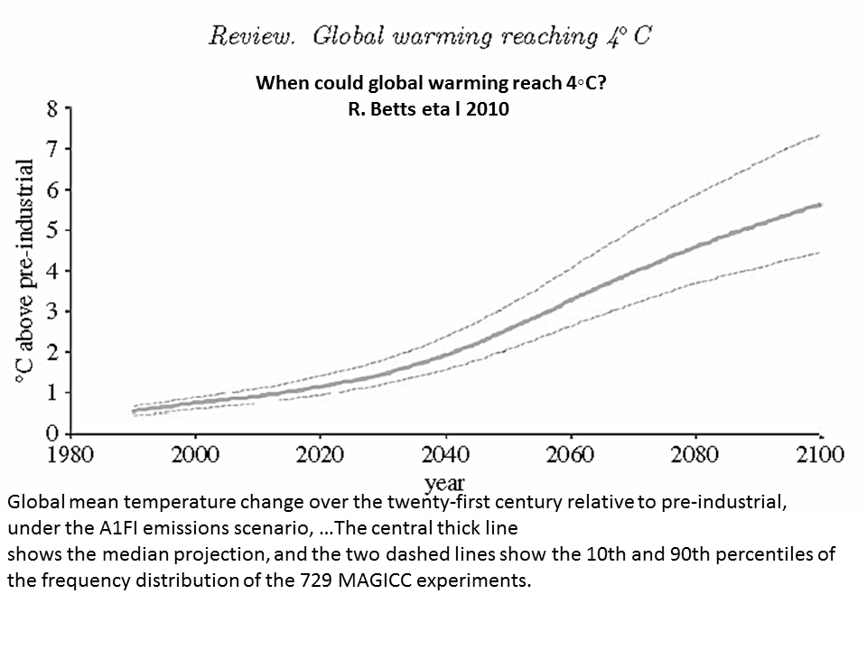
When could global warming reach 4°C? Richard A. Betts et al Phil. Trans. R. Soc. A 2011.
Recent research indicates climate sensitivity at or above top IPCC range
A Less Cloudy Future: The Role of Subtropical Subsidence in Climate Sensitivity . Fasullo K. Trenberth Science 2012
The Impact of Global Warming on Marine Boundary Layer Clouds
over the Eastern Pacific—A Regional Model Study A. LAUER Climate 2010
10th
%tile
2045

Slide 56
Multiple adverse impacts of global climate change on crops
+ ve
- ve
X
?

Slide 57
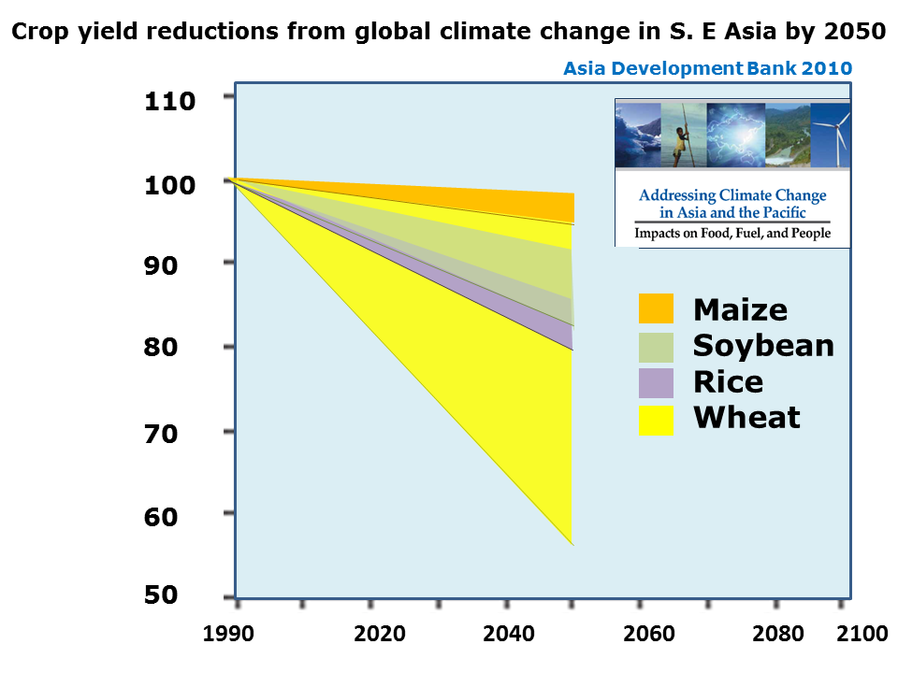
Must assume high end of crop
yield losses ranges

Slide 58
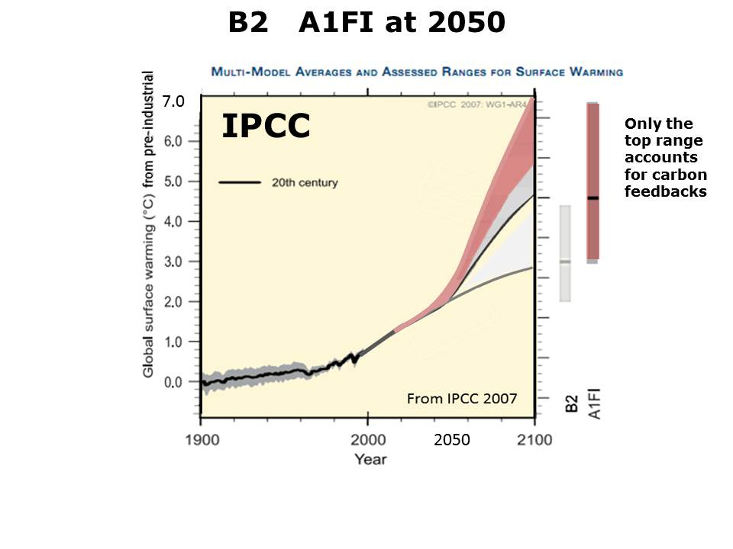
At 2050 there difference between A1FI and B2
is not great

Slide 59
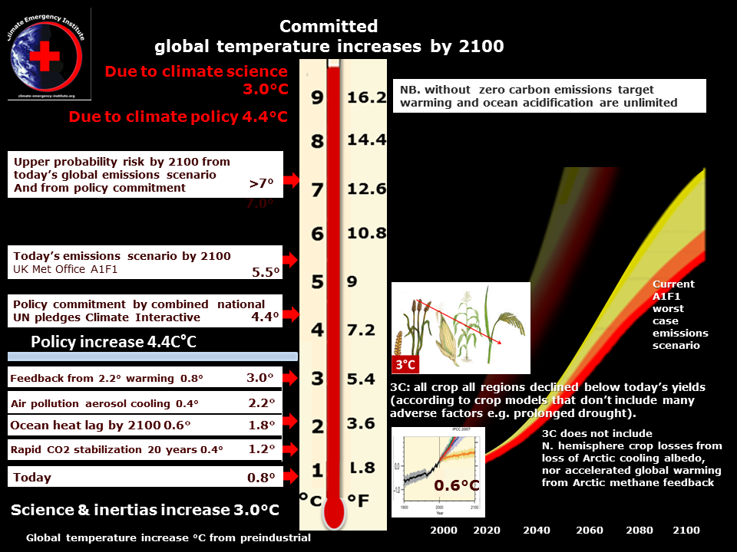
3.0°C
0.8 3.0°
0.4 2.2°
0.6 1.8°
0
0.4 1.2°

Slide 60
50 years from 2012

Slide 61
0.6°C by 2100

Slide 62
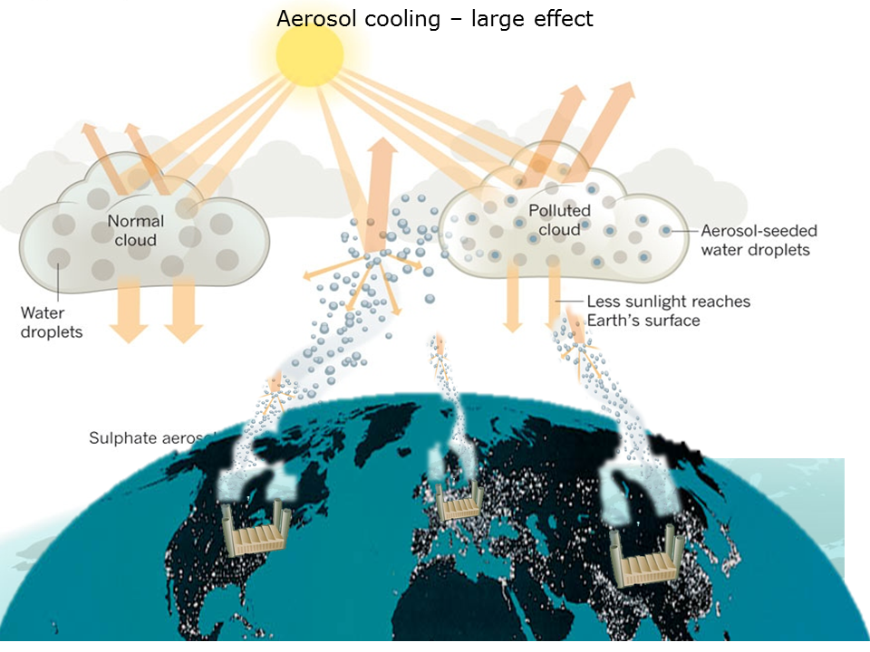
Burning fossil fuels emits cooling air pollution acid aerosols
as well as warming CO2 and black carbon soot

Slide 63
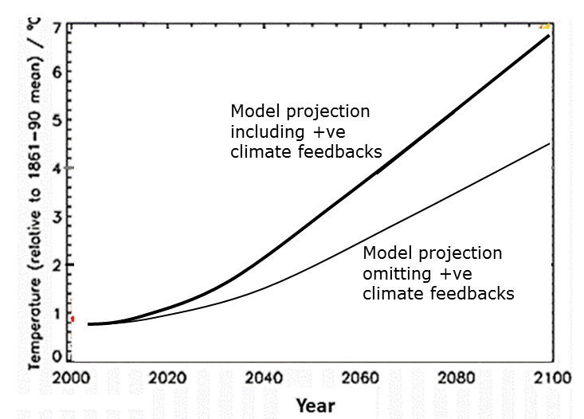
Positive +ve Climate System Feedbacks
Feed
back
- for assessment of most likely warming

Slide 64
Terrestrial carbon feedbacks (only) from a committed 2.2°C warming
= 0.8°C
Total 3.0°C

Slide 65
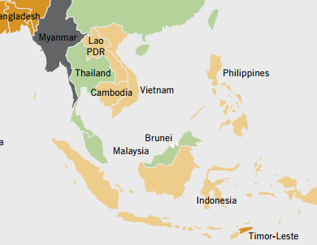
Vulnerability
2012 Global Hunger Index by Severity

Slide 66
Vulnerability
Child Malnutrition in S. E Asia 2005-2011 (WHO 2012)
Sources: WHO, World Health Statistics 2012, available at:http://www.who.int/gho/publications/world_health_statistics/2012/en/index.html.

Slide 67
B2 & A1FI at 2050
IPCC
Only the top range accounts for carbon feedbacks
7.0
2050

Slide 68
The Economics of Climate Change in Southeast Asia: A Regional Review 2009
Asia Development Bank

Slide 69
Projected warming
(A1FI and B2 are the two scenarios in this report)
(NB. The world economy
is fixed on IPCC worst case scenario A1FI)
The Economics of Climate Change in Southeast Asia: A Regional Review 2009
Asia Development Bank

Slide 70
In the Philippines, the frequency of typhoons increased more than four-fold during 1990–2003.
On average, 20 tropical cyclones, frequented the area each year,
Observations have increasingly supported the
scientific claim that rising sea surface temperatures are already enhancing the destructiveness of tropical cyclones worldwide
(Emanuel 2005).
During the past 15 years, the country was hit by the
strongest typhoon ever recorded,
most destructive typhoon,
deadliest storm, and t
typhoon that registered the highest
recorded 24-hour rainfall.
The Economics of Climate Change in Southeast Asia: A Regional Review 2009
Asia Development Bank

Slide 71
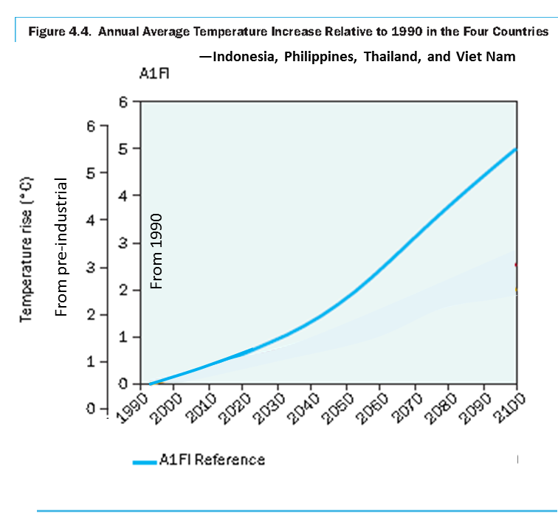
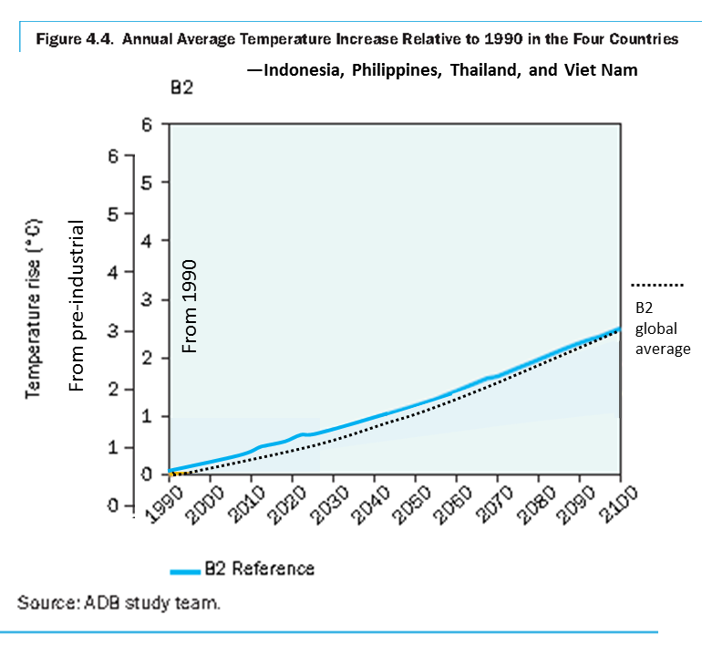

Slide 72
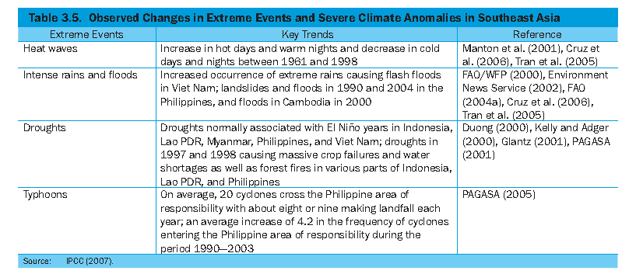
The Economics of Climate Change in Southeast Asia: A Regional Review 2009
Asia Development Bank

Slide 73
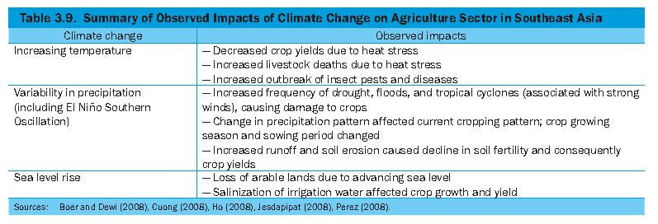
The Economics of Climate Change in Southeast Asia: A Regional Review 2009
Asia Development Bank

Slide 74
Crop yield reductions and price rises
over the next 40 years
(according to models_)
Irrigated agriculture in the region is expected to decline over the next 40 year in the range of:
Rice 14%–20%
Wheat 2%–44%
Maize 2%–5%;
Soybean 9%–18%
over the next 40 year
Food prices are expected to increase sharply
29%–37% higher in 2050
compared to those predicted in the absence of climate change, with
wheat prices 81%–102% higher,
maize prices 58%–97%, and
soy bean 14- 49%
Asia Development Bank 2010

Slide 75
The Economics of Climate Change in Southeast Asia: A Regional Review 2009
Asia Development Bank

Slide 76
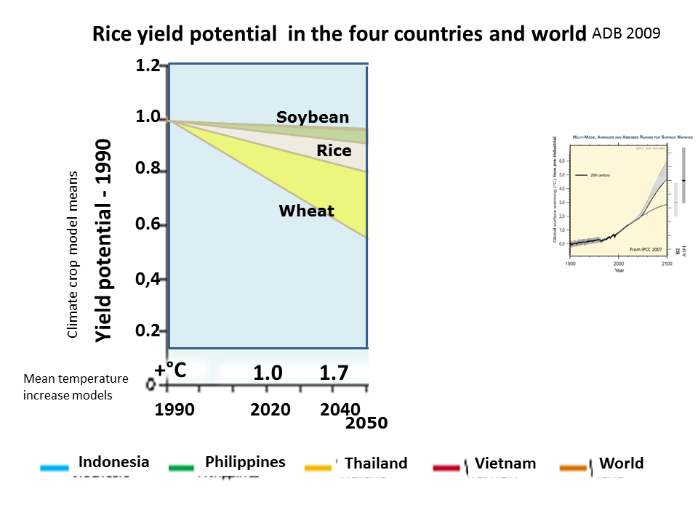
Rice yield potential in the four countries and world
ADB 2009
1.2
1.0
0.8
0.6
0,4
0.2
w
Current A1FI IPCC high emissions scenario
Soybean
Rice
Rice
Yield potential - 1990
Wheat
Climate crop model means
+°C
1.0 1.7 3.0 4.0 4.5°C from pre-1900
Mean temperature increase models
1990 2020 2040 2060 2080 2100
2050
Indonesia
Philippines
Thailand
Vietnam
World
The Economics of Climate Change in Southeast Asia: A Regional Review 2009
Asia Development Bank

Slide 77
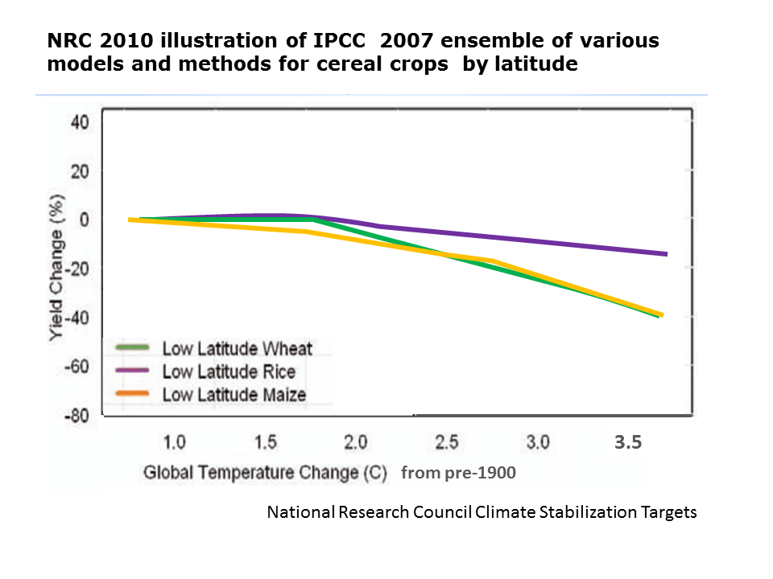
NRC 2010 illustration of IPCC 2007 ensemble of various models and methods for cereal crops by latitude
IPCC
by latitude
3.5
from pre-1900
National Research Council Climate Stabilization Targets

Slide 78
Drought under global warming: a review Aiguo Dai Wiley 2011
Drying trend
1950-2008
Precipitation
1950-2008
Drought
Drought under global warming: a review Aiguo Dai Wiley 2011

Slide 79
Drought under global warming: the great equalizer
Northern hemisphere drought increase will reduce NH yields greatly escalating world food prices

Slide 80
Rice yield potential in the four countries and world
‘B2’ 450 ppm CO2 Current CO2 390 ppm
No increase
Some decrease
Climate crop model means
B2 450 ppm CO2
The Economics of Climate Change in Southeast Asia: A Regional Review 2009
Asia Development Bank

Slide 81
The Economics of Climate Change in Southeast Asia: A Regional Review 2009
Asia Development Bank

Slide 82
Wheat 2050
Crop model validation studies.
Many of the papers found in the systematic review were actually
studies to assess the suitability of specific crop growth models to predict yield response under future conditions, rather than climate change impact studies per se

Slide 83
The Economics of Climate Change in Southeast Asia: A Regional Review 2009
Asia Development Bank

Slide 84
Southeast Asia in recent years has been frequented by many strong tropical cyclones and intensified ENSO events, with significant effects on agricultural production.
Planting time and growing season have been changing due to erratic patterns of precipitation. Farmers, particularly those who depend on rainfall for water supply, have to take more risks in growing crops.
When hit by El Nino in the middle of the growing season, the shortage
of water will impair crop growth and consequently reduce its potential yield.
During the El Nino period, agricultural crops become vulnerable to pest attacks
and diseases. La Nina years bring heavy rain, causing massive runoff, severe
erosion of fertile soils, and inundation of agricultural areas and aquaculture
farms.
The Economics of Climate Change in Southeast Asia: A Regional Review 2009
Asia Development Bank

Slide 85
Food
Heat stress, water stress (drought), climate-associated pests and diseases, flooding, and typhoons will all contribute to the decline in the production of rice, maize, soybean and other crops in Southeast Asia.
Industrial crops such as rubber trees, oil palms, coconut, and fruit trees will not be spared the threat of heat and water stresses as well as wildfires.
The decline in grain production and industrial crops will impact the livestock industry
A rise in sea levels also adds to the burden, claiming fertile agricultural areas near the coast (coastal erosion) and reducing arable lands by soil salinization.
Food insecurity and loss of livelihood are likely to be exacerbated further by the loss of arable land and fisheries to inundation and coastal erosion in low-lying areas.
Rising temperatures will lead to a reduction in fish production, threatening the entire region’s potential as the world’s largest producer of fish and marine products.
More people will be at risk of hunger and malnutrition, which will cause more deaths.
The possibility of local conflicts may increase.
The Economics of Climate Change in Southeast Asia: A Regional Review 2009
Asia Development Bank

Slide 86
The Economics of Climate Change in Southeast Asia: A Regional Review 2009
Asia Development Bank
Key Messages
Southeast Asia is one of the world’s most vulnerable regions to the impact of climate change because of its unique economic and social characteristics, long coast lines, and mostly tropical climate.
The poor are the most vulnerable to climate change impact.
Agriculture remains an important sector—despite rapid economic growth and structural transformation—accounting for 11% of gross domestic product (GDP) in 2006 and providing 43.3% of employment in 2004. And increasing demand for food and industrial crops has intensified agricultural production and competition for land and water resources.
Southeast Asia’s average temperature has increased at a rate of 0.1–0.3°C per decade and sea level has risen at 1–3 millimeter (mm) each year over the last 50 years or so.
The region also experienced a downward trend in precipitation during 1960–2000.
The increasing frequency and intensity of extreme weather events such as heat waves, droughts, floods, and tropical cyclones in recent decades are also evidence that climate change is already affecting the region.
Climate change is worsening water shortages; constraining agricultural production and threatening food security; and causing forest fires, coastal degradation, and greater health risks.
The region is projected to warm further, following the global trend; become drier still in the coming decades in many parts, particularly in Indonesia, Thailand, and Viet Nam; and experience further rises in sea level.
Southeast Asia is likely to suffer more from climate change than the global average, in terms of increased frequency and intensity of extreme weather events; declining crop yields; loss of rich forests; damage to coastal resources; increased outbreaks of diseases; and associated economic losses and human suffering.
The Economics of Climate Change in Southeast Asia: A Regional Review 2009
Asia Development Bank

Slide 87
E. Conclusion
In the coming decades, Southeast Asia’s climate patterns are likely to change significantly, with impact on the environment, economies, and other human activities more severe than the world average.
The agriculture sector would suffer severely under climate change.
In the four countries, the yield potential for rice will decline by about 50% on average, relative to 1990, toward the end of this century.
Corn and soybean production would also decline.
Water stress or shortage and the decline in agricultural production would pose a serious threat to the region’s long-term food security and to lives and livelihoods, especially of the poor.
Climate change would have significant impact on human health.
Modeling results show that the number of deaths from thermal stress causing cardiovascular and respiratory diseases would increase in the region.
Modeling results also show that the number of deaths due to vector-borne infectious diseases (malaria and dengue) in Southeast Asia is likely to increase.
The Economics of Climate Change in Southeast Asia: A Regional Review 2009
Asia Development Bank

Slide 88
Climate crop models do not account for a very large degree
of crop yield damage
that will increase with the temperature
Crop model validation studies.
Many of the papers found in the systematic review were actually studies to assess the suitability of specific crop growth models to predict yield response under future conditions, rather than climate change impact studies per se.
Climate change impacts on crop productivity in Africa and South Asia
2012 Environ. Res. Lett. 7 034032 J. Knox. T. Hess, A. Daccache, T. Wheeler Sept. 2012

Slide 89
S.E. Asia Significant changes in precipitation and temperature may induce higher agricultural yields. (To 2050 )
International Water Institute
Multi year variability or unidirectional Trends.
Mapping long-term precipitation and temperature changes in continental South East Asia, G Lacombe et al. CLIMATIC CHANGE Volume 113, Number 2 (2012)

Slide 90
Must assume climate sensitivity is at the high end of the IPCC truncated upper range 4.5°C.
A Less Cloudy Future: The Role of Subtropical Subsidence in Climate Sensitivity . Fasullo K. Trenberth Science 2012
The Impact of Global Warming on Marine Boundary Layer Clouds
over the Eastern Pacific—A Regional Model Study A. LAUER Climate 2010

Slide 91
Unavoidable Global Warming
from All Sources of Definite Additional Temperature Increase by 2100

