Slide 1
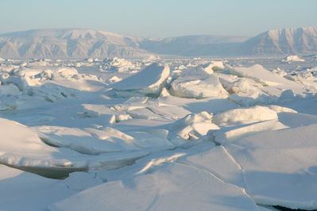
Mathematics Meets the Cryosphere!
Presented by:
Ellen Falk
North Salem Middle High School
www.mathizaverb.com
A jumble of ice was caused by large rocks and the tide in shallow water below. Image courtesy Andy Mahoney

Slide 2
MOTIVATION
What was my catalyst?
Bring it!
STEM-PBL

Slide 3
Modeling Arctic Sea Ice –open questions
When do you think sea ice will be gone?
At what rate is it decreasing? How fast?
What month is most important to study and why?
Is Climate change real? Causes?
Why is it important?
How was it caused?
Weather verses climate?
Cryosphere- where is it ? Why is it important?
World Politics?

Slide 4
The Problem- Need To Know-entry event
We all understand that arctic sea ice is melting.
We hear about it on the news.
Can we determine when sea ice will be completely gone?

Slide 5
Build Content & Skill Understandable and Engaging
Build content knowledge through research
Internet research at several reputable websites
NSIDC, NASA, NOAA
Film : “NOVA: What’s Up with the Weather”
Build mathematical skills through activities and other related data sets
Graphing calculator for small set, Excel for larger
Interpolation, extrapolation, meaning of slope as an average rate of change.

Slide 6
The Problem…Refined
Determine through mathematical models how fast sea ice is decreasing.
When will sea ice be depleted?
What effect it will have on the climate and the Arctic region?

Slide 7
The Purpose
You are a Climate Change Advisor for the UN and have been asked by your committee to make a presentation of the Sea Ice situation in the Arctic for a particular month of study. You must determine when ( in what year for your month ) will sea ice be completely gone.
Voice and Choice

Slide 8
www.mathizaverb.com

Slide 9
Background Knowledge
NASA for Educators-Space Math
NASA Cryosphere Program Manager Tom Wagner shares his insights on the 2011 minimum. (Credit: NASA's Goddard Space Flight Center) video
CCLS-

Slide 10
5 E Model
Engage
Explore
Explain
Elaborate / Extend
Evaluate

Slide 11
Explore and Connect NASA Vital Signs
Excellent resources and data!

Slide 12
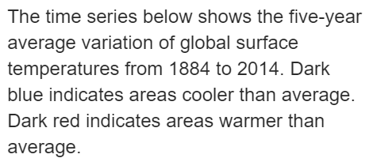
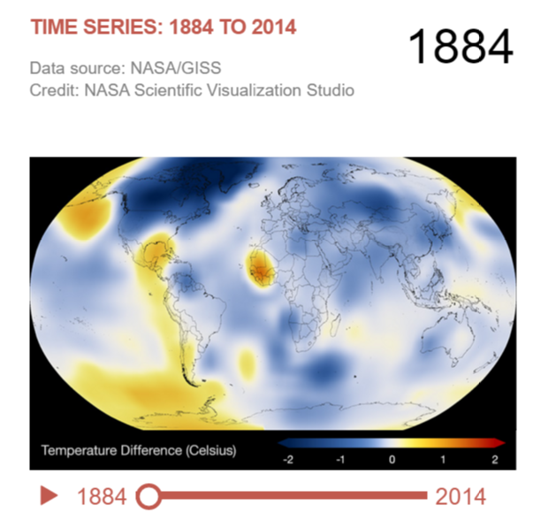
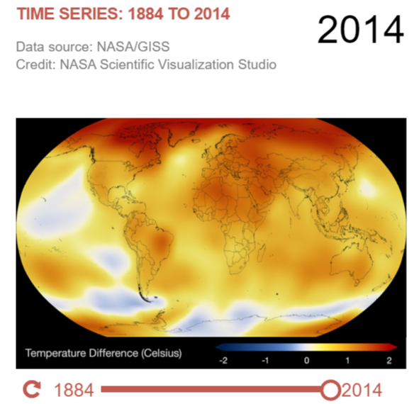
Engage/Explore/Explain
Global Temperature Changes
Visual Engagement- What do the graphs show?
What could we ask?
Notes:
Warming is NOT uniform across the planet

Slide 13
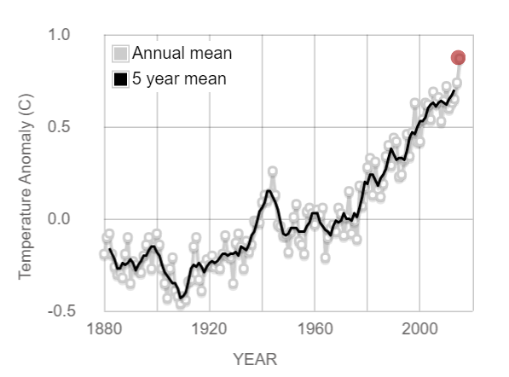
Explore/Explain
This graph illustrates the change in global surface temperature relative to 1951-1980 average temperatures. The 10 warmest years in the 134-year record all have occurred since 2000, with the exception of 1998. The year 2015 ranks as the warmest on record. (Source: NASA/GISS).
Observations?
What about local anomalies?
Averaging?
How is the data
collected?
Relative Extrema

Slide 14
Thinking!
Now compare our location to that of the world by clicking on or going to the following link http://paldhous.github.io/climate-change/
Explore the Cryosphere!
What do we notice?

Slide 15
POLL Question…..
What does the comparison show?
Can you determine which graph is closest to the Arctic? Why?
Not the same everywhere! Connect to previous images.
Notes:
Changes are not the same. Left – north salem ny right – Barrow Alaska

Slide 16
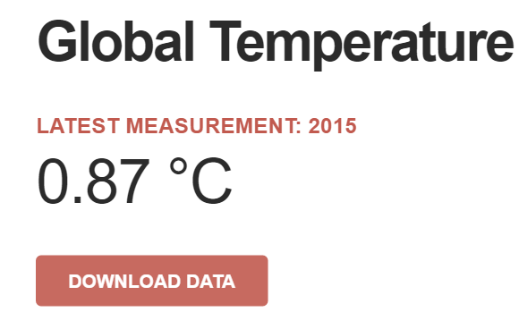
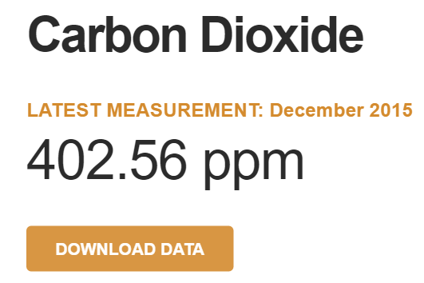
Data- Extend to sea ice question
Access the data and apply linear regression
NASA Vital Signs makes it easy to download data for analysis
Supports practice for working with large TXT files. Need for Excel.
NSIDC data

Slide 17
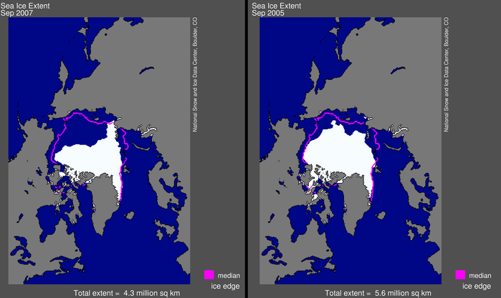
National Snow and Ice Data Center
The National Snow and Ice Data Center (NSIDC) supports research into our world's frozen realms: the snow, ice, glaciers, frozen ground, and climate interactions that make up Earth's cryosphere.

Slide 18
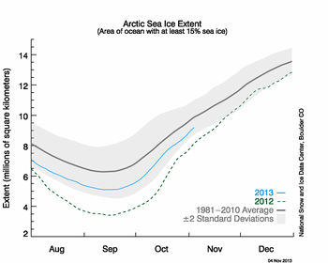
Observations?

Slide 19
Interactive Graph

Slide 20
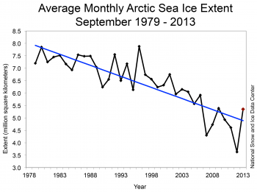
Data in Context
September average sea ice extent for 2013 was the sixth lowest in the satellite record.
The 2012 September extent was 32% lower than this year’s extent, while the 1981 to 2010 average was 22% higher than this year’s extent. Through 2013,
the September linear rate of decline is 13.7% per decade relative to the 1981 to 2010 average.
Figure 3. Monthly September ice extent for 1979 to 2013
shows a decline of 13.7% per decade. Credit: National Snow and Ice Data Center High-resolution image

Slide 21
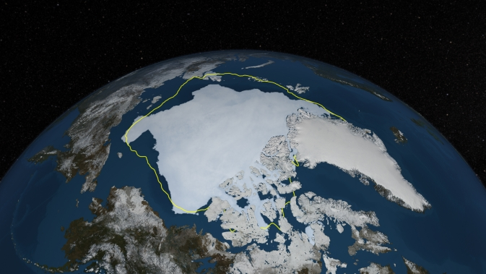
Depiction of Arctic sea ice on Sept. 12, 2013, the day before NSIDC estimated sea ice extent hit its annual minimum, with a line showing the 30-year average minimum extent in yellow. The data was provided by the Japan Aerospace Exploration Agency from their GCOM-W1 satellite's AMSR2 instrument.

Slide 22
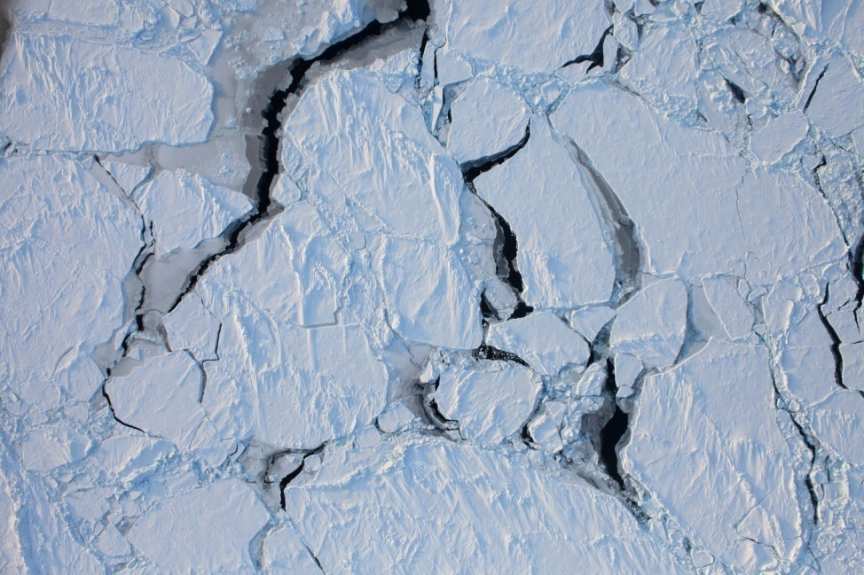
SHOW ME THE NUMBERS!
Start at NSIDC
Go to Data
Access can change
Sea Ice Index
Select FTP
Save data as a TEXT file.
Use MS Excel to open

Slide 23
Sample Data- September Sea Ice Extent
year | mo | data_type | region | extent | area
1979 | 9 | Goddard | N | 7.2 | 4.53
1980 | 9 | Goddard | N | 7.85 | 4.83
1981 | 9 | Goddard | N | 7.25 | 4.38
1982 | 9 | Goddard | N | 7.45 | 4.38
1983 | 9 | Goddard | N | 7.52 | 4.63
1984 | 9 | Goddard | N | 7.17 | 4.05
1985 | 9 | Goddard | N | 6.93 | 4.17
1986 | 9 | Goddard | N | 7.54 | 4.66
1987 | 9 | Goddard | N | 7.48 | 5.6
1988 | 9 | Goddard | N | 7.49 | 5.31
1989 | 9 | Goddard | N | 7.04 | 4.81
1990 | 9 | Goddard | N | 6.24 | 4.5
1991 | 9 | Goddard | N | 6.55 | 4.46
1992 | 9 | Goddard | N | 7.55 | 5.37
1993 | 9 | Goddard | N | 6.5 | 4.52
1994 | 9 | Goddard | N | 7.18 | 5.08
1995 | 9 | Goddard | N | 6.13 | 4.38
1996 | 9 | Goddard | N | 7.88 | 5.58
1997 | 9 | Goddard | N | 6.74 | 4.84
1998 | 9 | Goddard | N | 6.56 | 4.24
1999 | 9 | Goddard | N | 6.24 | 4.22
2000 | 9 | Goddard | N | 6.32 | 4.31

Slide 24
Linear Regression Model Sept. 2012

Slide 25
Algebraic Solution
y = -0.091x + 8.037
0= -0.091x+8.037
X=88.31 years from 1978
1978 + 88.31 = 2066
In 2066 sea ice extent will be gone for Sept

Slide 26
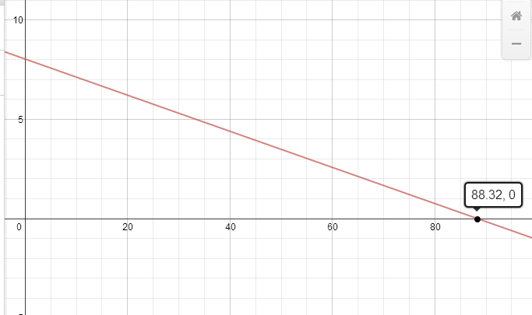
Graphical Solution 1 Desmos.com

Slide 27
Linear Regression Model Sept. 2013

Slide 28
Algebraic Solution
y = -0.089x + 183.9
0 = -0.089x + 183.9
X= 2066.291
Wow ! Compare to the previous model.

Slide 29
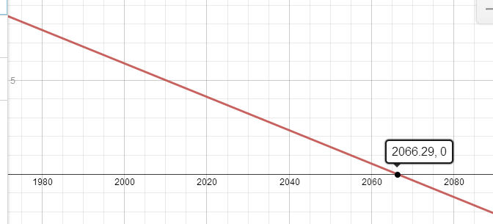
Graphical solution 2

Slide 30
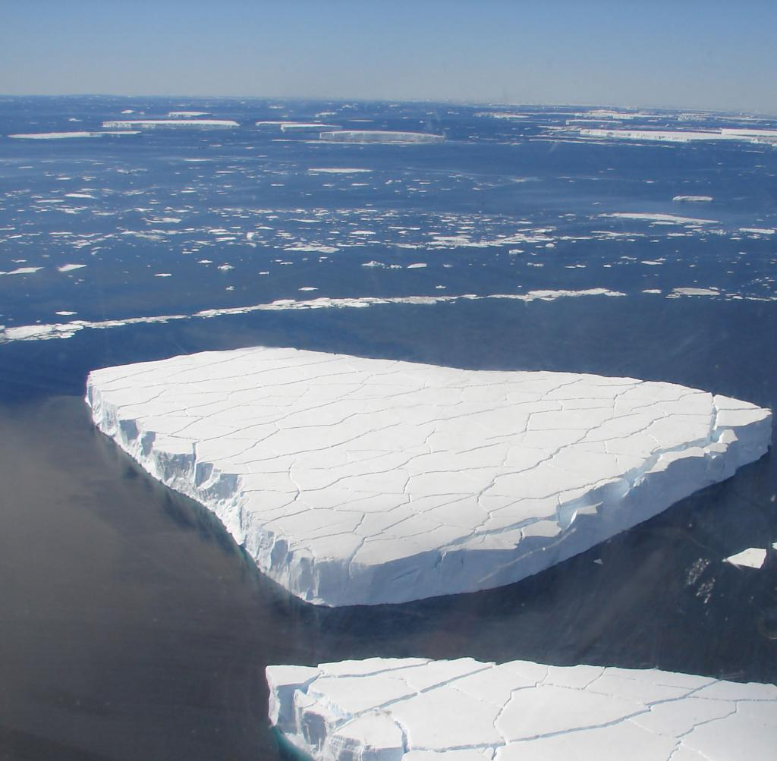
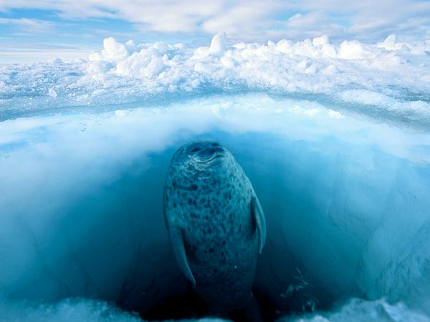
In December 2012, the National Oceanic and Atmospheric Administration announced that the ringed seal, as well as the bearded seal, would be listed as a threatened species under the Endangered Species Act because of the risks posed by melting sea ice and reduced snowfall.
In 2008, the polar bear was listed as a threatened species under the Endangered Species Act

Slide 31
Evaluate- When will sea ice be gone?
Apply knowledge to Arctic sea ice open ended question.
What month of data is best to examine and why? How does sea ice change over time? What are the impacts of this change?
Prepare your findings in present to the UN Committee on Climate Change

Slide 32
Student Exemplars
Actual projects from students are available at
www.mathizaverb.com
Revision
Reflection
Public Audience

Slide 33
Open Ended Questions-How do they facilitate mathematical thinking?
Real and Relevant-How can you connect it to CCLS?
Math has meaning-Why am I learning this?
Curiosity and Motivation

Slide 34
NASA FOR EDUCATORS
It all starts here:
http://www.nasa.gov/audience/foreducators/index.html
Sample- math and science-vomit comet
http://www.nasa.gov/audience/foreducators/mathandscience/exploration/index.html
EXPLORING SPACE THROUGH MATH SERIES
http://www.nasa.gov/audience/foreducators/exploringmath/home/index.html

Slide 35
Other NASA SOURCES
Space Math – Dr. Sten Odenwald
Launching point to the home site
http://spacemath.gsfc.nasa.gov/SpaceMath.html
Direct to modules
http://spacemath.gsfc.nasa.gov/media.html
NASA Video and real science applications
http://www.nasa.gov/topics/earth/features/2011-ice-min.html#backtoTop

Slide 36
Supporting Sources
Free Resource for teachers
http://www.pbslearningmedia.org/shared/ellenfalk/math-modeling/
https://www.nwf.org/Wildlife/Threats-to-Wildlife/Global-Warming/Effects-on-Wildlife-and-Habitat/Ringed-Seals.aspx
https://www.climate.gov/news-features/understanding-climate/climate-change-minimum-arctic-sea-ice-extent

