Slide 1
Product Testing the Nerf FireStrike
By: Georges Fox-Mills

Slide 2
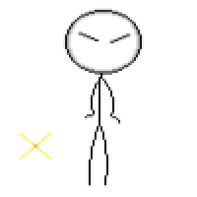
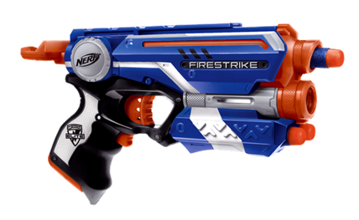
Finally, it's Christmas morning, and you’re breaking out your happy dance because the Nerf gun that you were hoping for is under the tree, the box even says this one will go 75 feet! Your boy Santa came through.

Slide 3
Ecstatic you bolt outside and set up a firing range, extremely excited to see your new gun in action, but when you fire it you become extremely disappointed. It doesn’t seem like this gun can fire nearly up to 75 feet. But it says so on the box! How could they lie to you like that? You’re heartbroken.

Slide 4
What is the problem?
Here in Math Modeling, we decided once and for all to put Nerf Guns to the test. Do they really fire as far as they are advertized? We fired and collected data of the Nerf Gun, and using what we have learned in class we found the firing velocity and the max distance that the bullet of the Nerf Gun could travel.

Slide 5
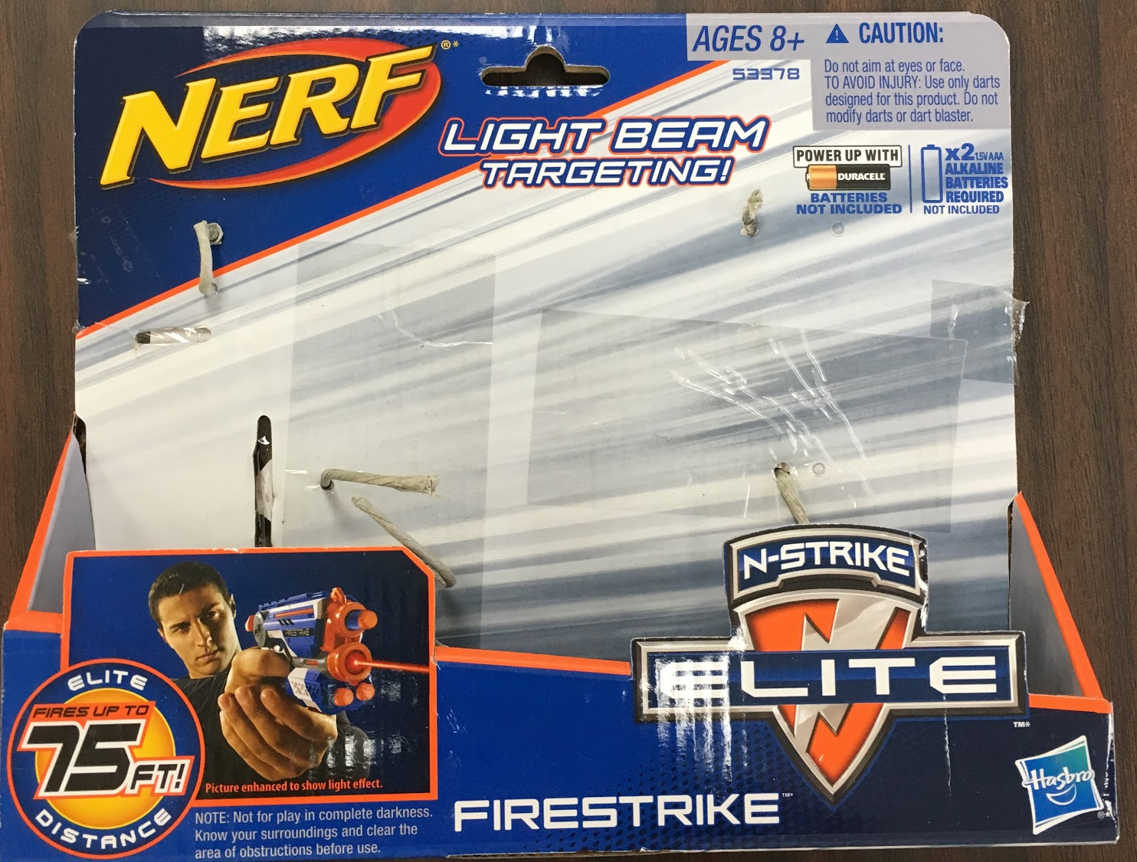
Nerf FireStrike Specs:
~Advertised to shoot 75 Feet
~23.114 x 19.304 x 4.826 Cm
~280.66 Grams
~Shoots one bullet at a time
~Spring Loading Firing System

Slide 6
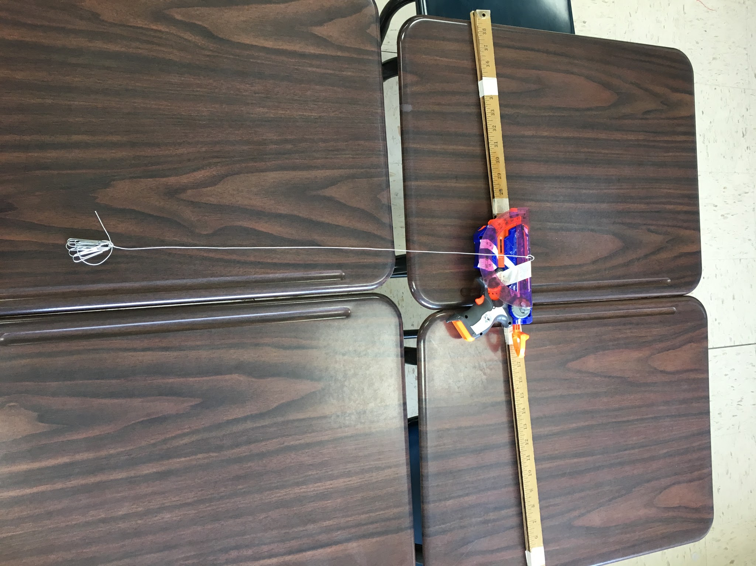
Gun Modifications:
To ensure that the gun would consistently be fired at 0⁰, we glued a protractor level to the muzzle of the gun. The meter stick was attached to create an easier way to prop the gun onto the desk that we were firing it from. Both of these things were done to create consistent and reliable data.

Slide 7
Why Fire at 0^{O}?
We are firing at a degree of 0 to find the firing velocity. Since the force of gravity on the bullet is a constant of 9.8 m/s² downwards, or in the Y-direction, when firing at 0 degrees we are able to calculate the velocity in the X-direction. Gravity only acts on the particle in the Y-component which is why the X-component is constant. https://www.youtube.com/watch?v=D9wQVIEdKh8

Slide 8
Variables:
~The force of gravity is “g”, which is 9.8 m/s²
~“T” is the variable for time
~The variable “H” represents the height of the bullet ~“V_{O}” or “V_{X}” is the firing velocity, which is also the velocity in the X-direction.
~“V_{Y}” represents the velocity of the bullet in the Y-direction
The independent variable for this experiment was time, and the dependent variable was everything else that dependent on time.

Slide 9
Equations:
~The equation H(t) = ½(9.8)t² will be used to find the time taken for the bullet to reach the ground after it is fired
~x(t)=V_{o}t will be used to find the velocity of the bullet in the X-direction
~The equation H(t)=½(-9.8)t²+(V_{Y})t+H_{o} will be used to find the motion of the projectile on our calculators and will give us the hang time and the maximum height of the projectile.
~V_{Y}=V_{O}sin(⊖) will be used to find the velocity in the Y-direction.
~Finally, V_{x}=V_{O}cos(⊖) will give us the max distance of the projectile

Slide 10
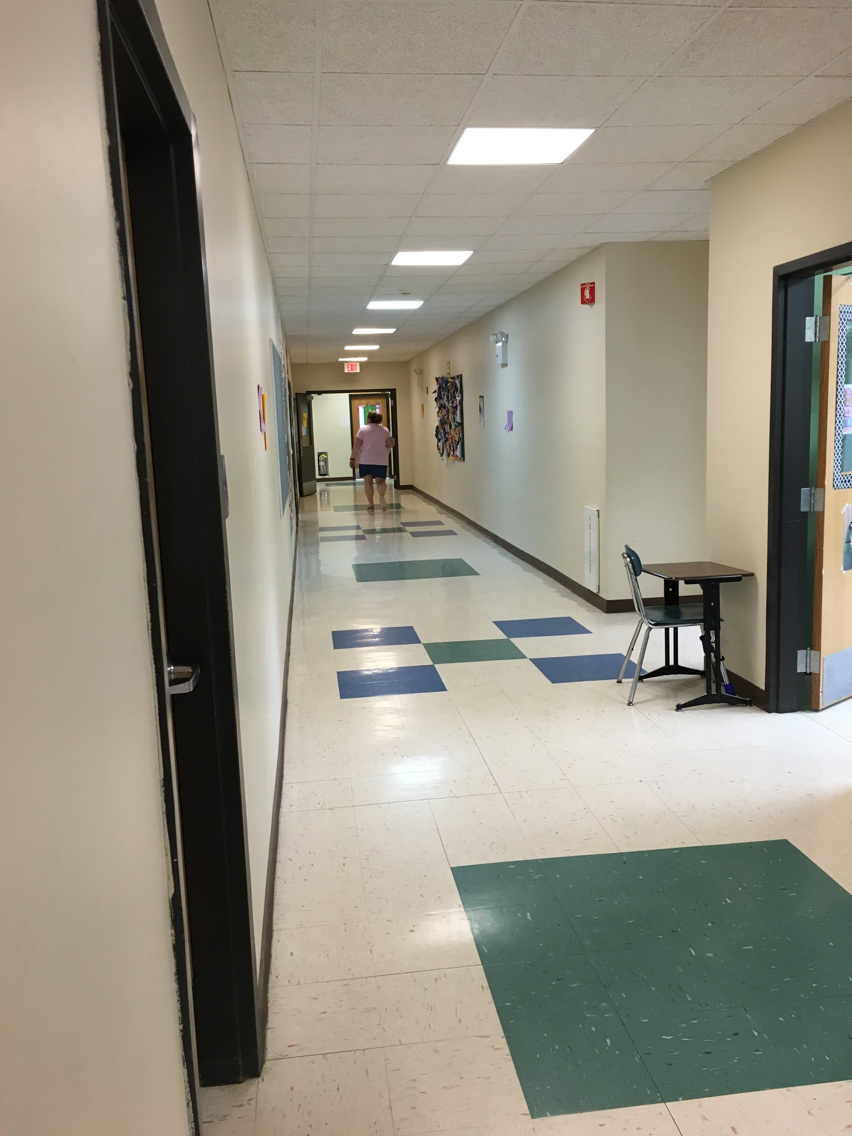
Procedure:
Find a long empty corridor to fire your gun
Measure height from gun to floor ~We fixed the gun to a desk measuring 0.7366m high
Make sure that surface of desk is level and that the gun is firing level as well.
Fire gun
Measure distance from gun muzzle to where the bullet landed
Collect 5 or more data points.

Slide 11
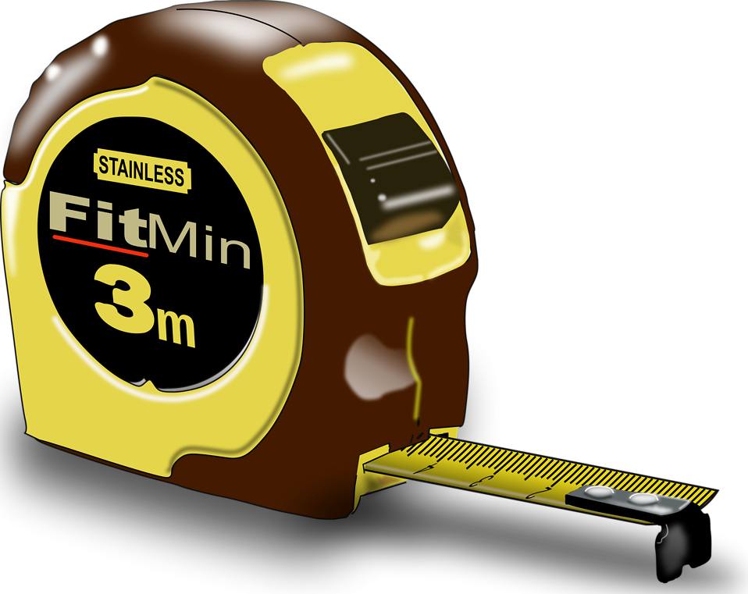
Data: After firing the gun 5 times we collected consistent data on how far the gun would travel. Collecting this data was important because with this we can discover the firing velocity as well as hang time.
Trial Number | X(t)
1 | 12.611m
2 | 12.6873m
3 | 11.43m
4 | 13.31m
5 | 13.055m
Average Distance:
12.62m

Slide 12
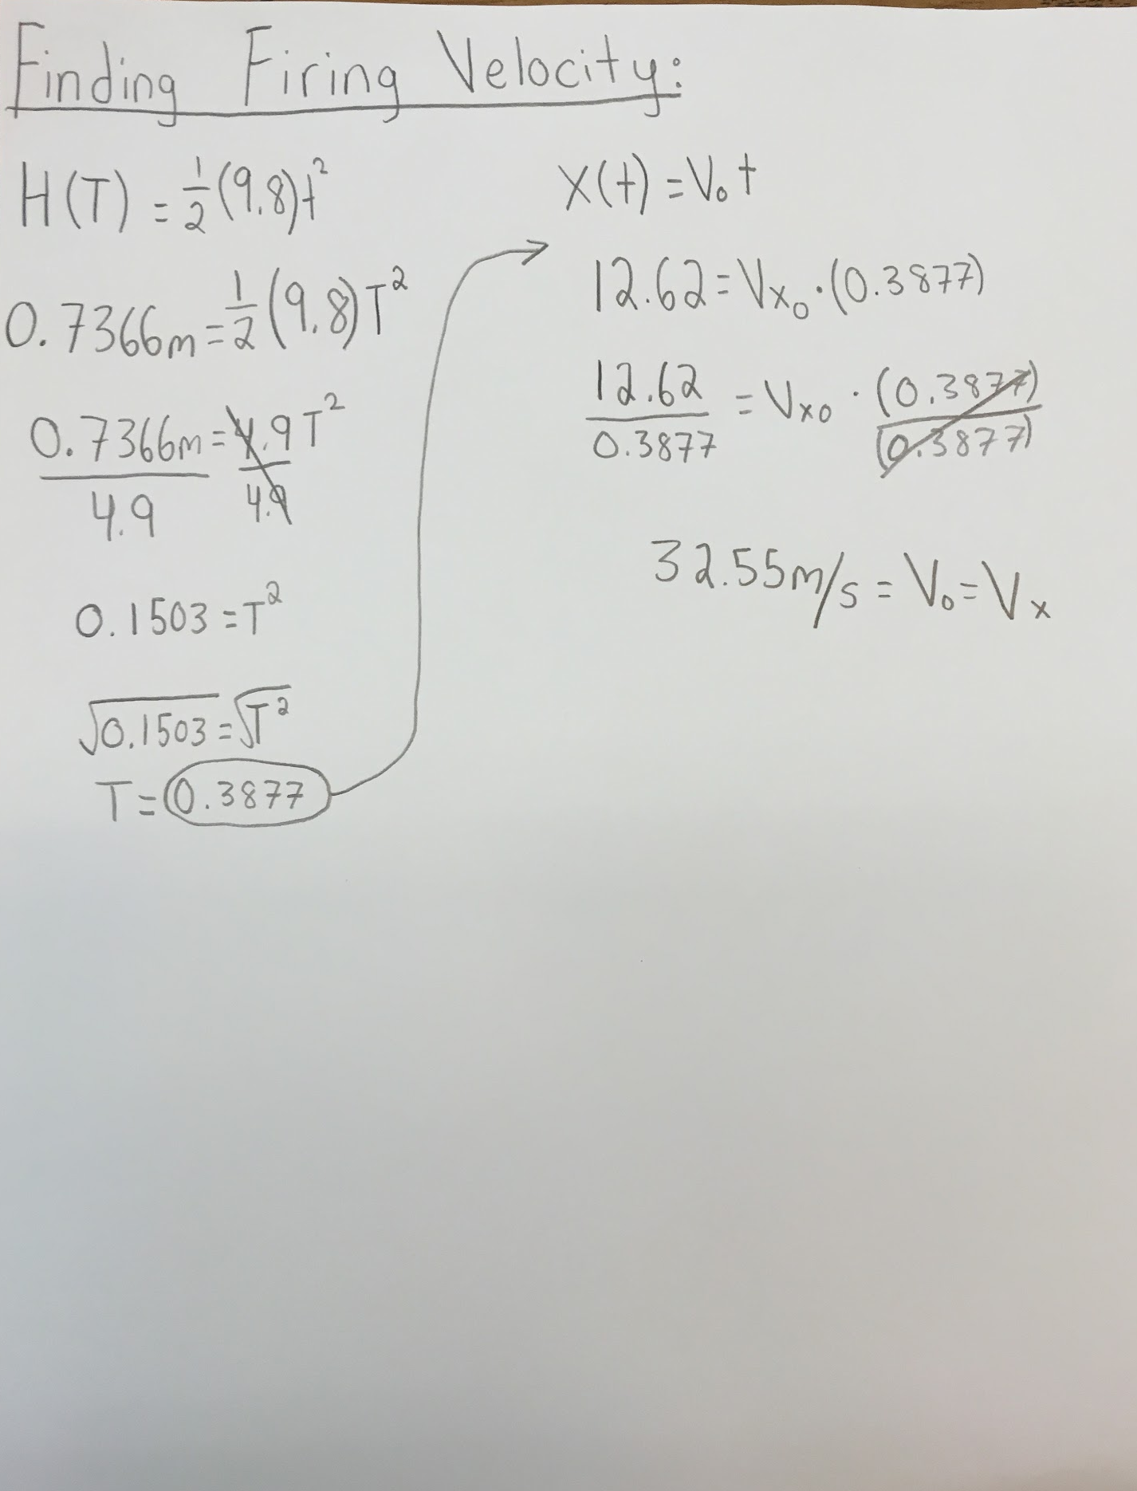

Slide 13
Now that we have discovered the firing velocity, we are able to use that velocity of 32.55m/s to predict other things, like max possible height of the Nerf Bullet as well as max distance the bullet can travel, and hang time. We are able to use formulas and the velocity we found to predict these things, but we also did real life experiments of firing the gun at 45⁰.

Slide 14
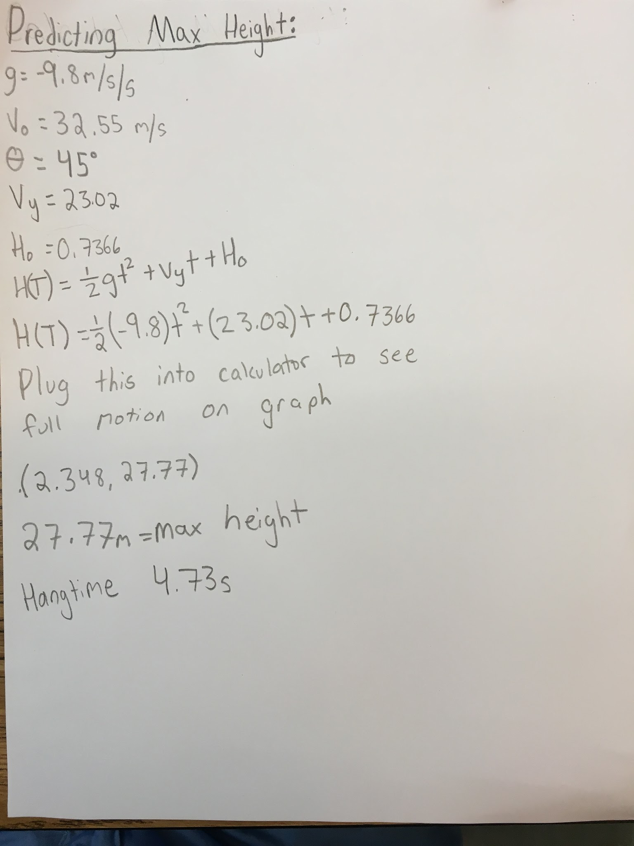

Slide 16
The only problem that our experiment has not addressed is air resistance. The number that we got from our experiment are just extrapolated and a prediction. When actually performing the experiment the results will not be nearly that far as our math never accounted for drag. We performed the experiment and got closer data to the claim made by Nerf.

Slide 17
Firing at 45º
After using the firing velocity to predict the farthest distance it could travel, however that did not account for wind or air resistance, so some real test shots were necessary. After taking a
good amount of test shots
We got an average distance
of 18.33m which is 60.14 feet.
Not quite 75 but a closer
number than I was originally
expecting. Seems like Nerf’s
claims are close to the truth.
Trial Number | Distance
Bullet 1 | 20.15m
Bullet 2 | 16.9m
Bullet 3 | 18.2m
Bullet 4 | 18.2m
Bullet 5 | 18.2m
Avg Distance: 18.33m

Slide 19
After experimentation and “product testing” we have come to the conclusion that while the Nerf gun doesn’t shoot quite 75 feet, sixty feet is still a close number. Using physics and mathematics we were able to find the firing velocity and make our own predictions to what would happen is this experiment were to happen inside a vacuum. We were able to successfully complete this experiment and ended with a final number of a average max distance that the bullet can travel of 60 feet.

Slide 20
If I were to do this experiment again I wish there was a way to fire this gun in a vacuum to see if our predictions using the various equations would be correct. From this experience we were able to gain knowledge into how product testing occurs and also clarity to see how valid company's claims really are. Setting out to do our best work, our group worked diligently towards the goal of finding the max distance this gun could fire. Working with people that we hadn’t worked with all year was also a valuable experience. The project is intuitive and interesting and I believe that other kids in the future will enjoy doing it as well.

Slide 21
Thanks for a wonderful year of Math Modeling! We were able to undertake a lot of projects and using the STEM method learned about many different topics of math in ways that we haven’t before. Each project had its own draws and completing everyone was no problem! A class I would definitely recommend. HAve a great summer Mrs. Falk :D

