Slide 1
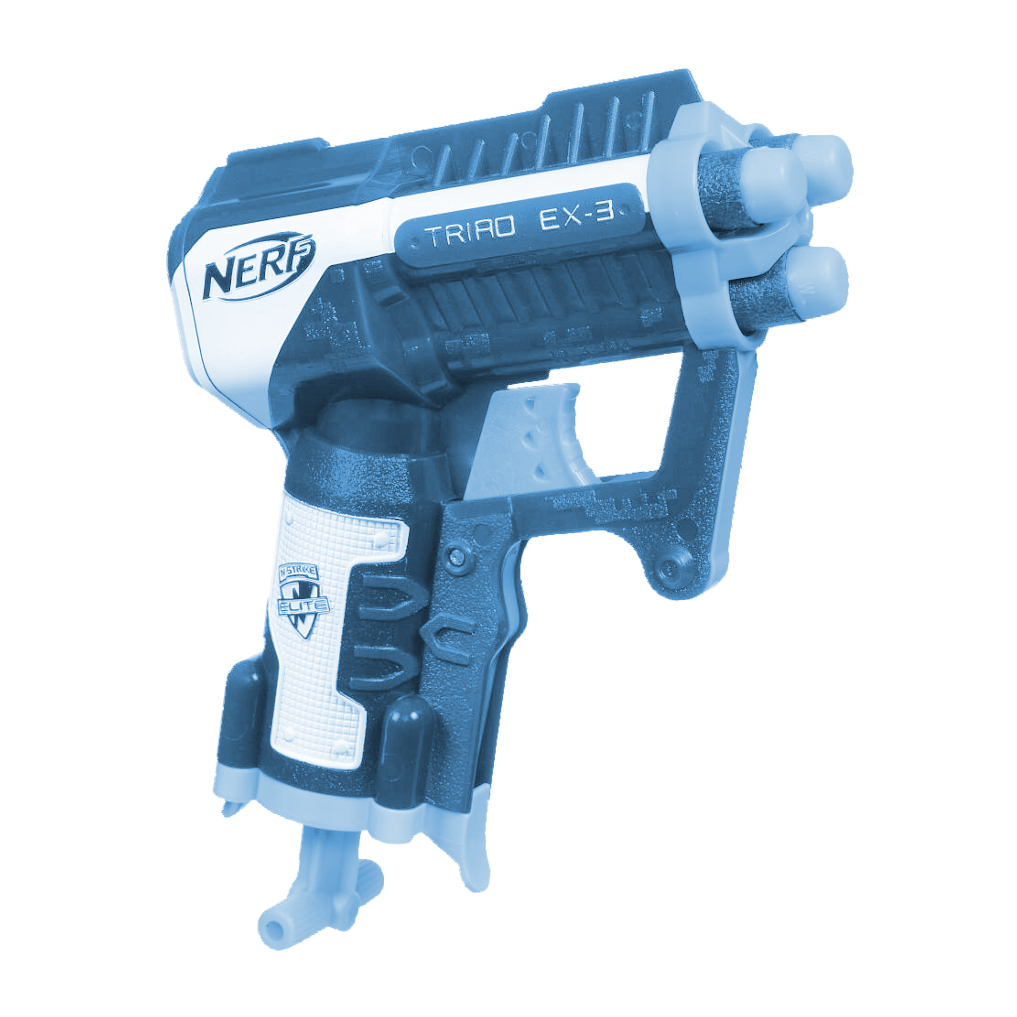
Nerf “Triad X3” Product Test
Jack Zimmer

Slide 2
Our Goal
The goal of our group was to calculate the maximum distance that we can shoot the Nerf Fun. We were taught the formulas needed to calculate the distance the dart can go. Then we compared our collected data to the claim that was made on the box.
X

Slide 3
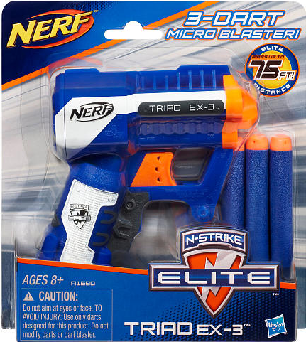
The Gun We Used: Traid X3
Claim:
Fired Up To 75
Bullet Used:
N Strike Elite
Firing Location:
Outside In between buildings with slow moving winds
Type of weapon:

Slide 4
Nerf’s Claim
They made a claim that the gun we were shooting shot up to 75 feet, but they did not include how they test the guns. If they shot the gun in a vacuum it would go alot further because there would be no wind resistance to slow down the bullet while it's in the air. I contacted Hasbro but they did not give me the number because Nerf didn't have a customer support number.

Slide 5
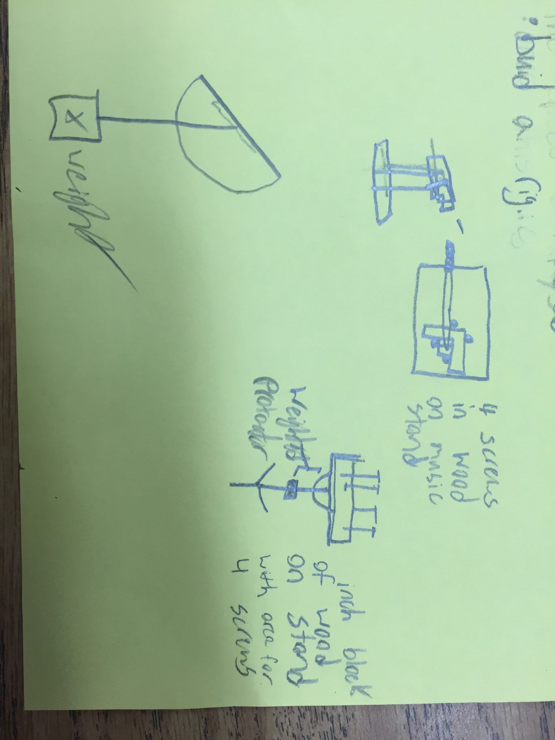
Original Plan
When we wanted to test the nerf gun we came up with many different designs. Our first planned design was to attach a nerf gun to a music stand. We wanted to use this because we could easily adjust the angle of the nerf gun, there would be a set height, we could easily add a gravity protractor to find the angle, and it was sturdy so it couldn't be bumped into or accidently adjusted.

Slide 6
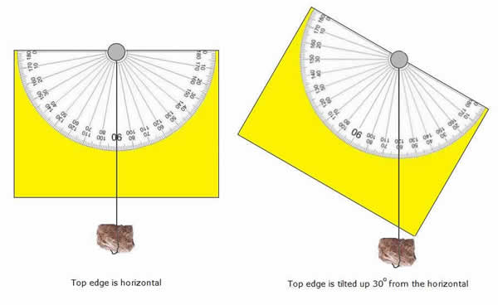
Final Plan
Our Final plan was to attach the weighted protractor to gun itself, then shoot it at the height of a desk. This made it easier because it was difficult to find time to create a rig for the nerf gun and, with a more simplistic design we were able to test more often in more locations.

Slide 7
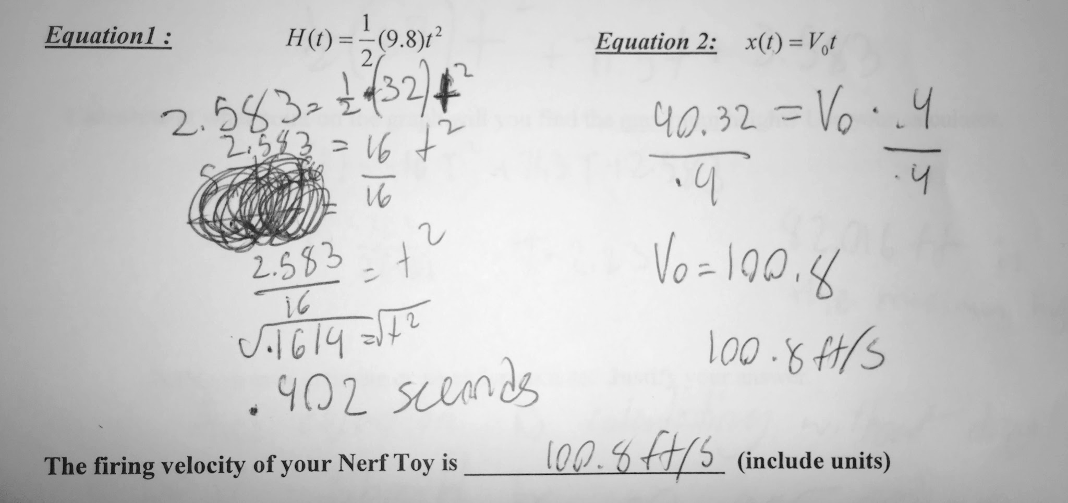
How We Calculated Firing Velocity
We first needed to calculate the speed our projectile moved in the air. We did this by using the formula h(t)=(1/2)(9.8)t^2. We then had to convert the 9.8 or the “G” to 32 because we wanted to use feet instead of meters. Once we found out the amount of time the projectile stays in the air at our firing height We needed to use the equation x(t)=v_{O}t. We then plugged in our previous data to find out that our V_{O} (or Initial Velocity) = 100.8 ft/s. Then we could convert this into miles per hour to interpret how fast it's going. We then used a conversion app to convert our feet per second into miles per hour and calculated that our dart moves 68.72 mph

Slide 8
Calculating the Height Of The Projectile
In order to calculate the height of the projectile we needed to use these formulas and .
Then we had to take our data and input it into the formulas.
First we found V_{y} by multiplying our velocity by Sin(45º)
Then we input the rest of the data into the formula to have the final equation for max height to be: H(t)=-16T²+71.3T+2.583
By using Desmos we calculated that the maximum height of our projectile is 82.016

Slide 9
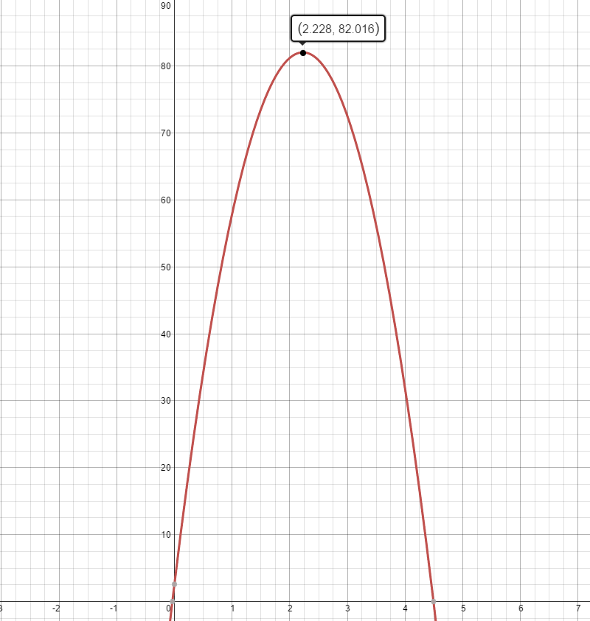
Desmos
After all of our data was entered into the formula H(t)=-16T²+71.3T+2.583, we then inserted it into desmos to find the maximum height.

Slide 10
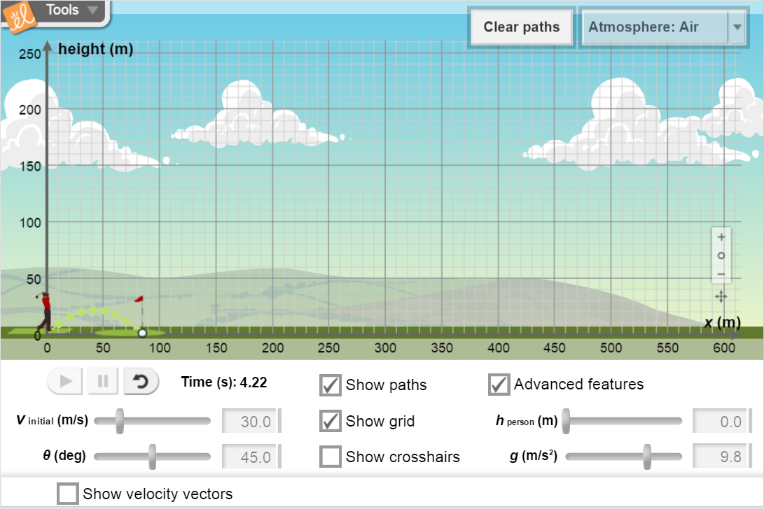
Explore Learning
After I converted the feet/second into meters per second I was able to go back to the work our class did in explore learning to simulate the nerf gun inside the golf simulation.

Slide 11
Calculating Horizontal Position of The Projectile
In order to find the maximum height it took for the projectile to hit the ground from the 45º angle we had to collect the data from the x intercept. Where the function intersected with the x axis was the amount of time in seconds for the bullet to hit the ground.
Then we had to find V_{X} by setting it equal to our velocity times cos(45). Once we did this we calculated that V_{X}=71.2764
Once we found V_{X} we had to input the solution into the formula x(t)=V_{X} * t . T stood for the time the bullet was in the air at the 45^{O} angle. Then all we had to do to find the horizontal position of the projectile was to multiply the time the bullet took to hit the ground by V_{X}. After Doing this I calculated that the maximum distance, or X(T) was equal to 320.174 feet.

Slide 12
Different Variables
Independant
Height of the muzzle to the ground
Type of gun used
The angle the weapon is fired
Wind
Whether or not we tested the gun in a vacuum
Dependant
Distance the dart fires
Maximum Height
Time the dart is in the air

Slide 13
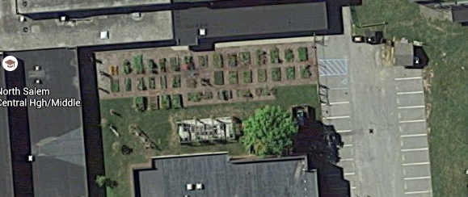
Testing Location
We needed to find a testing location that was just above the maximum height that the gun could shoot. We had originally planned to test fire in the gym because there would be no wind indoors and would have enough distance for our guns to shoot. Although, we did not expect that the bullet could exced the height of the ceiling so in order to compromise on a location, we went outside in a strip of land between the buildings. This allowed us to have less variables acting on the bullet, like wind and the confines of a building.

Slide 14
Wind And Its Effects On Projectiles
Wind can affect a mid air projectile many ways. It can be pushed and pulled which would case the bullet to deviate from its projected distance. This can be shown in the video below when we fired our Nerf Gun at an angle of 45^{O} and recorded the bullet in slow motion. It shows that after it's fired, the bullet veirs to the left and gets moved while it's in the air.

Slide 15
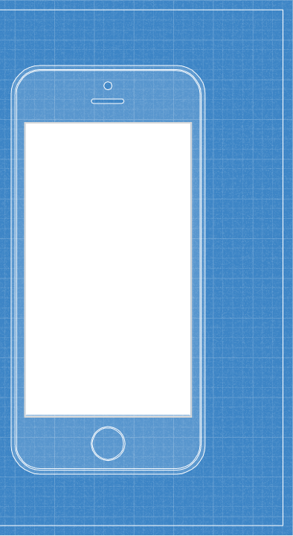
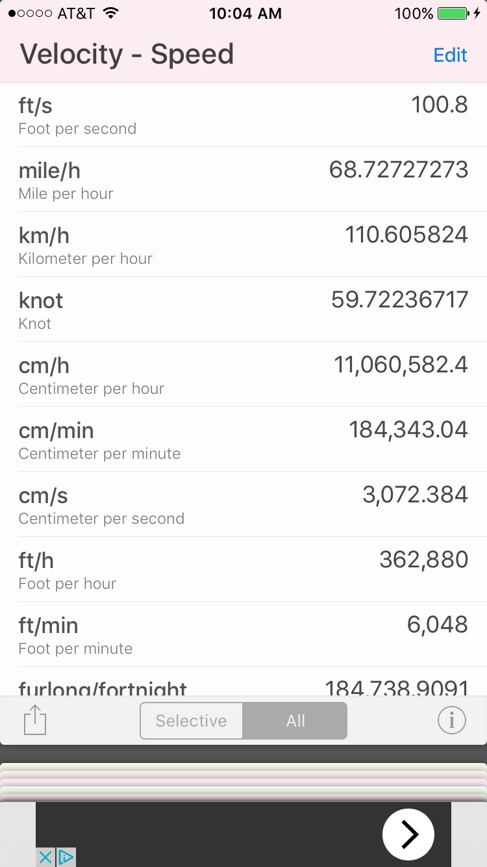
Tools That Were Used
Converter+
Conversions
Calculations
GraphNCalc63
Calculations
Graphing
Desmos
Graphing
Pixlr
Image Editing
Explore Learning
Simulation

Slide 16
iPHONE Recordings
We were able to use our iPhones to record footage of in air bullet movement.
This allowed us to see, in
real time, the effects air
has on the nerf dart bullets

Slide 17
Weapon Testing Process
First Test:
For our original test we shot our gun at exactly 0º; this allowed us to to calculate the time it takes for the bullet to hit the ground. Since the dart’s height was not increasing we did not have to test it outside; we were able to test in a long corridor. Also because we shot the gun on a tile floor and each tile is exactly 1 foot we were able to easily calculate the distance the nerf dart went.
First second:
For our second test we had to test outside. This meant because of extra variables, such as wind and drag, we had to test the gun an increased number of times.
Since we were shooting the gun a long distance we had to use paces to calculate the maximum distance our Nerf Dart could go.

Slide 18
Paces
Since our second testing process was over a long distance and on difficult terrain to measure we had to use paces. In order to count paces we counted every other step from the gun to the dart. After we did this we had to calculate how much 1 pace was. Since each pace is individual to the person walking them we had to measure the distance a pace took for the same person that walked the distance. We calculated that one pace was 4.5 feet and, since we walked an average of 17.5 we calculated the nerf dart went a distance of 78.75 feet.

Slide 19
Conclusion
In conclusion, our calculated maximum distance of 320.174 feet, was a lot farther than the our actual distance of 78.75 feet. This meant that our data could have been affected by two factors; drag and human error. In the calculations we never calculated for the drag the bullet would have while it is in the air. Also we could have made a mistake when setting the angle or counting the paces. This could have had an effect on the final solution which would make it seem longer than it actually would be.

Slide 20
Final Reflection
Overall I enjoyed this project allot. It has taught me how to collect data to predict locations of a projectile without testing it. If I were to do this project again, I would have liked to create a rig to more accurately shoot the nerf gun. This would have allowed us to have the correct angle every time at the exact height we would have wanted. Also, I would have liked to be able to test multiple guns. This would have allowed a diversity in the types of weapons that were used by our classmates. Furthermore I would have wanted to put more focus on calculating the drag and wind resistance on the bullet to find out more accurately how far the bullet could go.

