Slide 1
Investigation and Troubleshooting of EQA
This project has been funded in whole or in part with Federal funds from the Division of AIDS (DAIDS), National Institute of Allergy and Infectious Diseases, National Institutes of Health, Department of Health and Human Services, under contract No. HHSN266200500001C, titled Patient Safety Monitoring in International Laboratories.
Notes:
Due to time restrictions for our afternoon presentations we need to begin on time. We have allowed time at the end for questions and tomorrow morning we will be available for individual questions and assistance from 9 – 12 in the SMILE drop-in room located in _______.
We have two handouts available for you at the door that look similar. One is the General SMILE Investigation form and one is the Microbiology Testing Investigation form. These forms, guidelines on their use and our presentation slides will be available on www.pSMILE.org, our website after the summer meetings.
Please be sure to sign in with your e-mail address so that you can receive a certificate of attendance. Due to the short time frame we have had to revise our topic as both investigation and troubleshooting are full topics for presentations.

Slide 2
Taking the Pain Out of the Investigative Process www.pSMILE.org
SMILE Presentation
IMPAACT Annual Meeting
June 2012
Notes:
This is the training session titled Investigation and Troubleshooting of EQA which we have retitled as “Taking the Pain out of the Investigative Process”. Good afternoon, my name is Peggy Coulter and I am one of the QA/QC Coordinators with the SMILE contract at Johns Hopkins University.

Slide 3




Acknowledgements
The presenters would like to thank:
  NIH/DAIDS -Daniella Livnat and Mike Ussery
  IMPAACT Network
  Johns Hopkins University
    Dr. Robert Miller - Principal Investigator
    Barbara Parsons - Operations Manager
    Kurt Michael - Project Manager
    SMILE Staff
Notes:
Before we begin our presentation topic …. we would like to acknowledge the following –
NIH/DAIDS -Daniella Livnat and Mike Ussery
Contract No. HHSN266200500001C
IMPAACT Network
Johns Hopkins University
Dr. Robert Miller - Principal Investigator
Barbara Parsons - Operations Manager
Kurt Michael - Project Manager
SMILE Staff

Slide 4
Presentation Outline
Introduction – Peggy Coulter
Pre-Analytic processes – Omar Dualeh
Analytic processes – Heidi Hanes
Post- analytic processes – Arden Bongco
Closing out the investigation and presentation summary – Orlinda Maforo
Notes:
The SMILE investigation form has been revised to follow the typical laboratory workflow. This new format will add structure to the investigative process. In this presentation we will walk you through the investigative process using the form and examples of lab errors found during the process.
At this time I would like to introduce our presenters and our presentation outline:
I will start off with the Introduction followed by
Omar Dualeh who will discuss the Pre-analytic processes.
Heidi Hanes will discuss the Analytic processes section
Arden Bongco the Post-analytic processes
And Orlinda Maforo will close out the investigation and the presentation summary.

Slide 5
Goal of Presentation
Provide tools to assist in the development of an investigative process for External Quality Assurance (EQA) failures
Notes:
The Goal of our Presentation is to provide the QA Manager/Supervisor with the tools to assist in the development of an investigative process for External Quality Assurance failures.

Slide 6
Objectives:
Use new SMILE EQA investigation forms
Effectively detect clinical laboratory associated errors through root cause analysis
Develop appropriate corrective action
Review and revise processes for prevention of future errors
Determine the impact of errors to study data (patient safety)
Notes:
After this presentation a QA manager/Supervisor should be able to:
Use the SMILE EQA investigation forms and in this process,
Effectively detect clinical laboratory associated errors through root cause analysis
Develop appropriate corrective action
Review and revise processes for prevention of future errors
Determine the impact of errors to study data (patient safety)

Slide 7
Why is an EQA investigation critical?
Failures = problems
Root cause
Impacts:
study data
patient safety
Result = Correction and Prevention
Notes:
To begin we need to understand why an EQA investigation is important.
EQA failures indicate problems in the process. These problems may or may not be solely associated with the EQA process but this can not be determined until a complete investigation is performed. The investigative process will determine the root cause of the EQA problems and if/ how patient specimens were affected. Once the cause is identified, corrections can be made and with measures developed and implemented to prevent future errors.

Slide 8

The investigative process should
Have a more user friendly approach
Provide Quality Management and process improvement
Be positive, not negative process
More educational, not punitive
Provide a forum for “Continuing Education”
Notes:
The QA/QC Coordinators with SMILE believe that the investigative process should:
Have a more user friendly approach
Provide Quality management and process improvement
Be a positive, not negative process
More educational, not punitive
And it should provide a forum for “Continuing education”

Slide 9
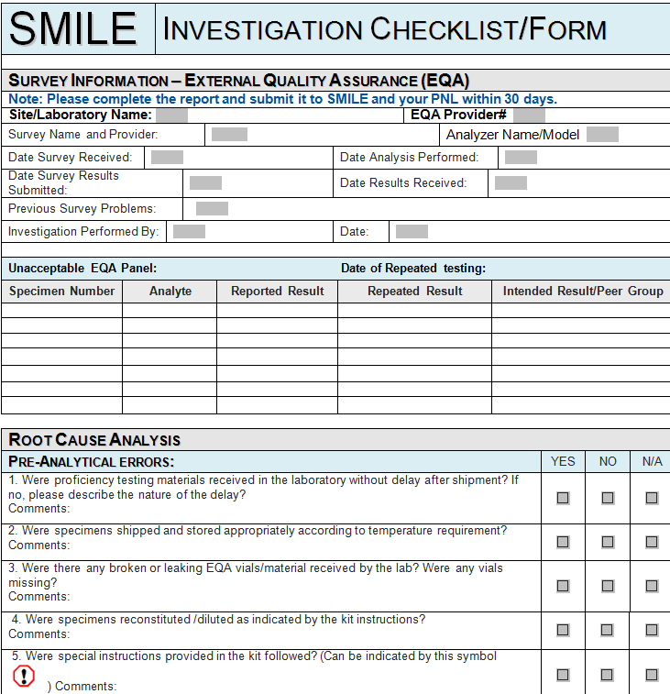
SMILE EQA Investigation Form
Develop a systematic approach to an investigation
More efficient, thorough, streamlined process
Opportunity for improvement
Notes:
So with our newly revised SMILE EQA Investigation form we aim to assist the laboratory to:
Develop a systematic approach to the investigative process
Process will be more efficient, thorough, streamlined process- resulting in better turn around times for the IR
Used as an opportunity for improvement- improvement not only in reports but in overall quality

Slide 10
Laboratory Path of Workflow
Pre-Analytic
Analytic
Post-Analytic
Notes:
The form has been revised to address the 3 phases of clinical lab testing; pre-analytical/analytical/post-analytical.
We will lead you through these phases using the new, improved SMILE investigation forms with examples of good responses from the labs we monitor.

Slide 11
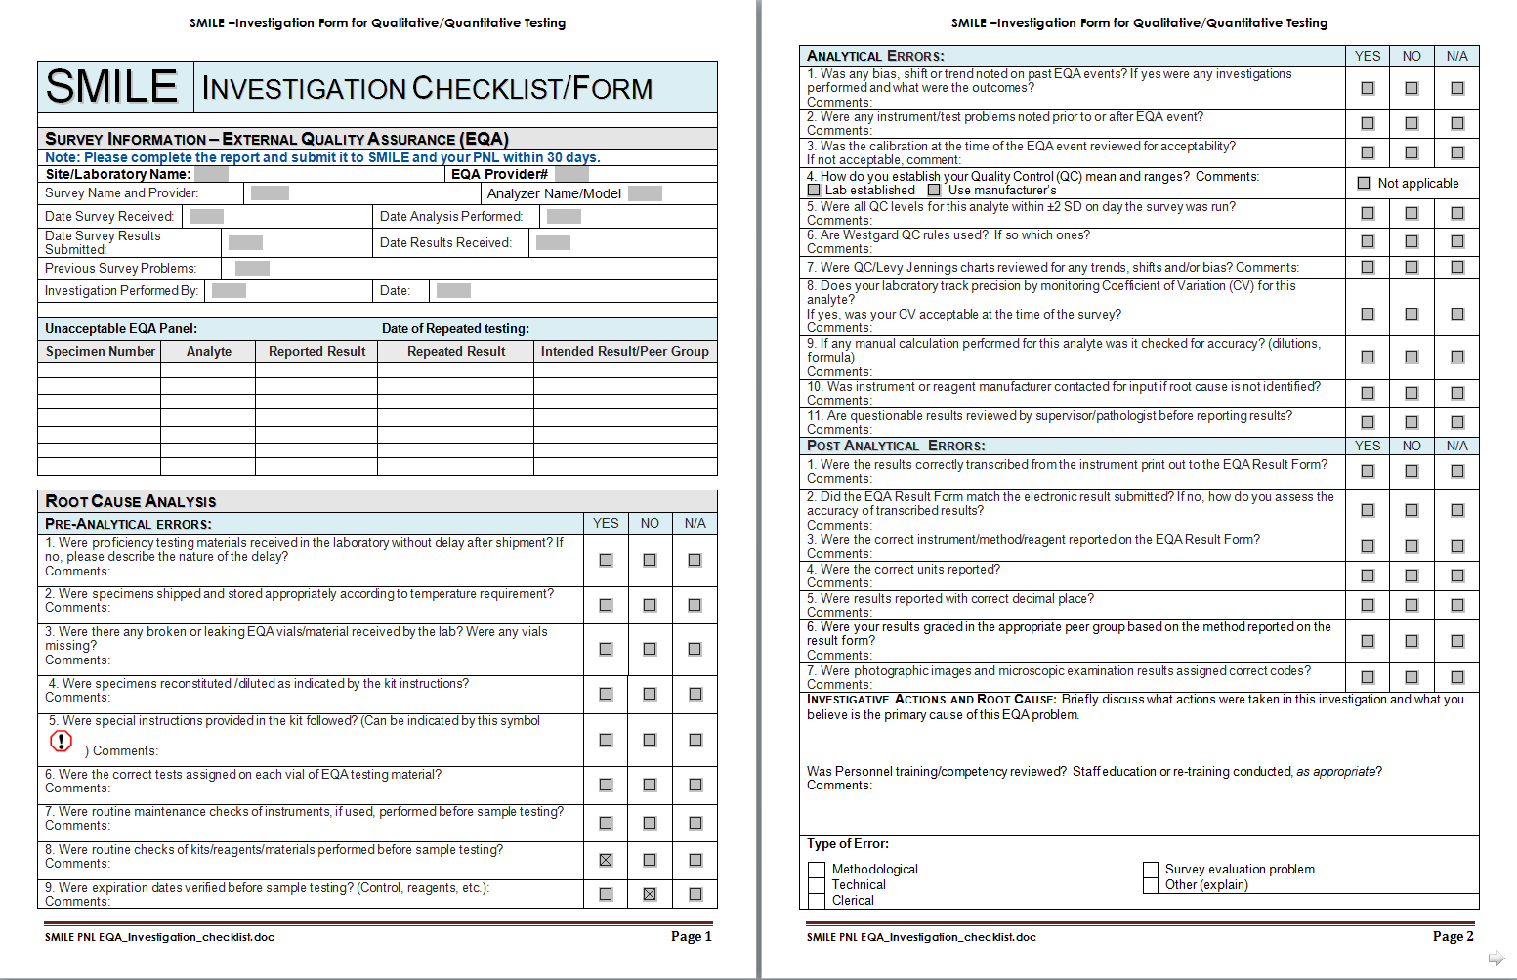
Notes:
In overview, the new form is three pages which expands as it is completed.

Slide 12
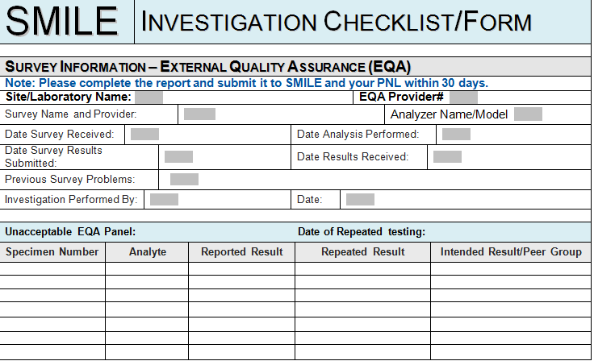
Notes:
The top of the form collects information from the survey. Lab name, EQA provider and account number. Specific survey, if an analyzer is applicable. Dates pertaining to receipt, performance, submission, evaluation. There is an area to capture previous problems and the investigator or person completing the form.
There is plenty of room to document results from the unacceptable event with repeat results and peer group responses.

Slide 13
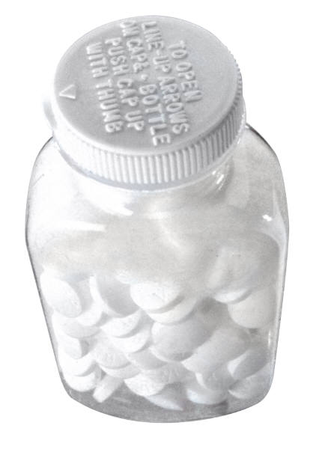
Taking the Pain Out of the Investigative Process
Notes:
So now I am ready to hand off to the presenters we have lined up to help
“take the pain out of the investigative process”.
Omar will start us off by reviewing the Pre-analytic processes within the laboratory for possible problem areas.

Slide 14
Pre-Analytical
Before the actual analysis of Sample
This stage of processing can account for 30-75% error
Pre-analytical errors are largely attributable to human errors
Majority of these errors are Preventable
Pre-analytical phase involves much more human handling
Notes:
What is pre-analytical: Click
Just as it sounds it involves the processes before the actual analysis of the sample. Click
This stage of processing can account for 30-75% error of testing. Click
Preanalytical errors are largely attributable to human mistakes and
the majority of these errors are preventable. Click
The Preanalytical phase involves much more human handling, compared to the analytical and post analytical phases. Click

Slide 15

Where Do I Start?
Notes:
Click

Slide 16
What areas to investigate for pre-analytical errors?
Instrument/
Equipment
Samples
Reagent/Material
Notes:
What area to investigate for pre-analytical errors? Click
The Pre-analytical investigation process involves three areas the: Click
Samples Click
Instrument/Reagent: Click
Reagent/Material: Click
These questions are applicable to both forms
So let’s look at areas you need to check in an investigation using the form: Click

Slide 17
Sample Shipping
Sample Receiving
Samples
Sample Handling
Notes:
(15) Lets look at Sample errors at this point they include: Click
Sample shipping/transportation: Click
Receiving: Click
Handling: Click

Slide 18
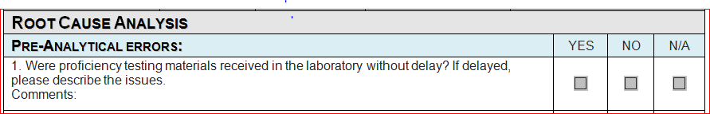
Sample Shipping
Samples
Notes:
Start with ------- Shipping is single most important step in distributing EQA panels; we must ensure transport requirements and regulations
are followed at all time . Remember that this is the time where the samples are most vulnerable.
Click
First we will look at the question dealing with the sample shipping
Specifically the transportation of the samples
Read question ----- check to see how long it took to get the sample to the laboratory
Click

Slide 19
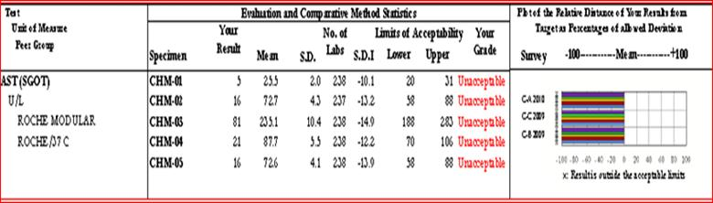
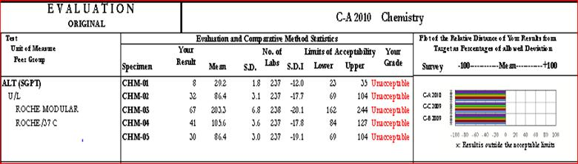
Sample Integrity
19
Notes:
This example ----here is what you can see----- on your chemistry survey results---- if there was a delay….. note the enzymes results.
***More explanation – temperature sensitive
As you all know enzymes are sensitive to temperature and thus first to deteriorate if proper temp is not ensured.
Click…here is a response from one of our laboratories.

Slide 20
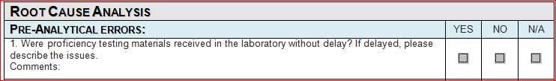
Sample Integrity
Survey was delayed three weeks in customs under unknown temperature storage
Notes:
Same question ----------------Sample Integrity
Click

Slide 21
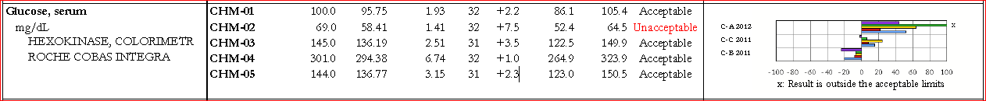
Sample Integrity?
Notes:
Here is an example where the lab noted on their IR the root cause was specimen integrity….. Clearly that is not the case as only one sample is unacceptable. Click

Slide 22
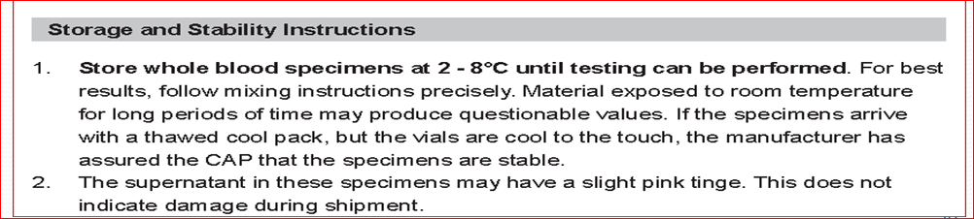

Survey arrived with all the dry ice melted and 30 ºC
    Was the temperature before and after sample received documented?
Notes:
Question 2 : Read
Here is an example of a survey storage requirements.
Check your documentation to see what Was the temperature before and after sample received --------- and note if not required. …… delay in sample analysis may not indicate or nullify the integrity of the survey.
Here is a response by one of our labs: Survey arrived with all the dry ice melted and 30 ºC

Slide 23
Sample Receiving
Three vials were leaking when survey received, Provider and SMILE not Notified.
    If the kit contents were correct and in acceptable condition
Notes:
(19) Read question - Check to see if the “Kit contents are correct and; in acceptable condition”.
This is a comment we saw

Slide 24
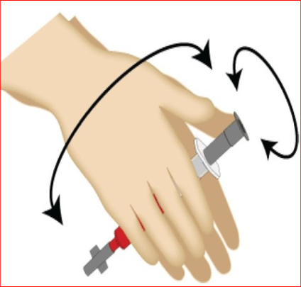
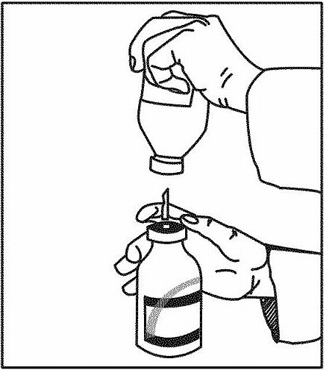
Sample Handling
Were samples mixed properly before testing?
Was reconstitution performed correctly before testing?
Notes:
Next is the handling of the sample
Read question ---- check back on all instructions to make sure that the specimens were reconstituted properly.
You can go back and talk to the technologist who conducted the testing and ask if………. Click

Slide 25

Note: For the Sysmex XE-2100, XE-5000 and XT series instruments, specimens must be analyzed in the QC program to obtain WBC differential data. Read and follow the sample handling instructions before analyzing the samples..
Notes:
Read Question --- Check to see if there were any special instructions on handling the specimens --- Click
------- Here is an example of a special instruction for running the specimens
------ Check if the Technologist follow these instruction.

Slide 26
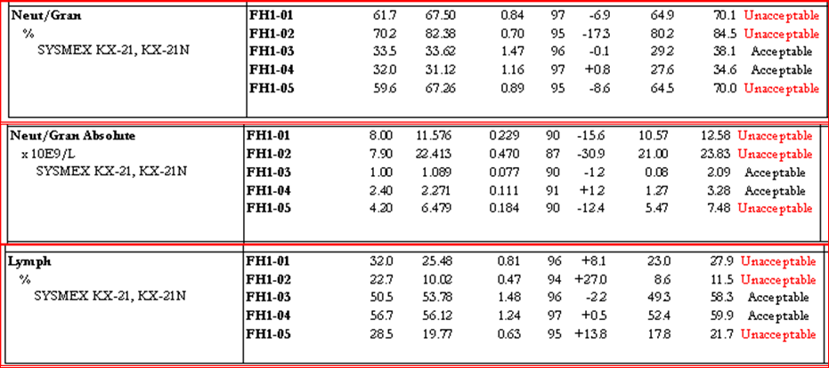
Wrong mode
Notes:
Here is an example ------- you may see if the survey was not run as indicated by the special instruction…….. in this case the QC mode. Most of the analytes would be unacceptable especially in the differential section.

Slide 27
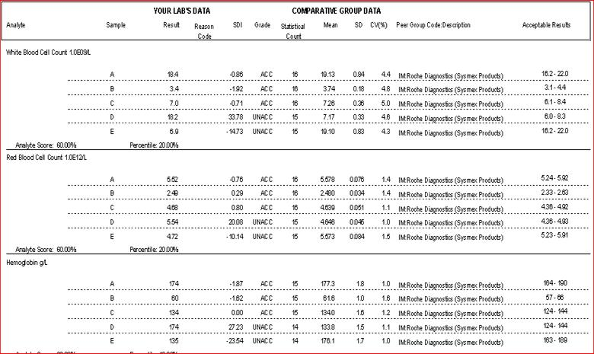
Notes:
Next question – Read
Go back to check ----- if the survey tubes had been labeled correctly. ------ Ask the tech that performed if correct samples were run.
Click: Here is an example where sample D and E were switch during the analysis

Slide 28

Instrument/Equipment
Instrument/Equipment:
  Daily and weekly maintenance
  Monthly and as needed maintenance
Notes:
The next area to check is if equipment were used for testing
Proper maintenance of medical equipment is essential;----- Click
Read question -- Check the maintenance logs to make sure all maintenance had been performed before testing

Slide 29
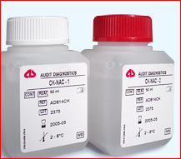
Reagent/Material
Reagents/Materials
  Lot Numbers
  Storage – Temperature
  Expiration Dates
Notes:
The last two questions deal with reagent/material: Click
Read Question --- check if the technologist used the correct and current lot #; check reagent logs to make sure all were within expiration dates. Click
Read question -- Check with testing staff to make sure that all materials are maintained and stored at proper temperature.
So this brings me to the end of my section And know I will turn it over to Heidi who will be presenting the analytical Section

Slide 30
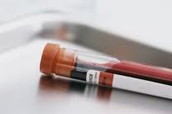
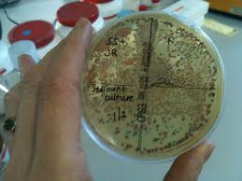
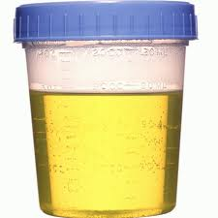

Slide 31
Analytical
Quantitative
Qualitative
Microbiology
  Bacteriology
  Mycology
  Mycobacteriology
  Parasitology
Notes:
Thank you Omar.
As Omar said I will be going over the analytical process. Whether you are doing an investigation for EQA or patients the areas you should investigate are basically the same. It is the actual testing of the sample.
Testing usually fall into three categories and they can be -
Quantitative – numerical results
Qualitative – Pos/neg results
Microbiology which includes bacteriology, mycology, Mycobacteriology and parasitology – identification of organism, susceptibility testing
So starting with the General investigation form we will go through questions you should be asking when you have unacceptable results.

Slide 32

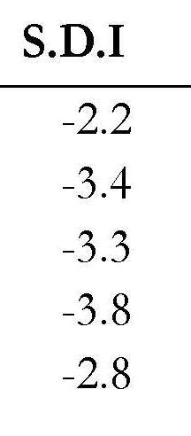
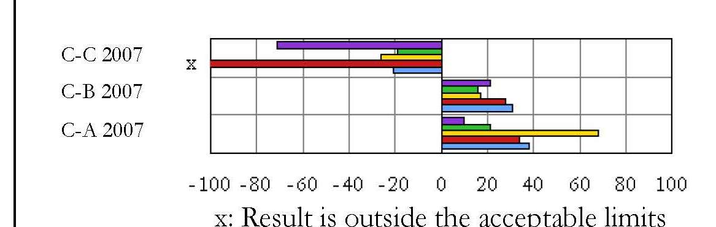
Quantitative
EQA History
  SDI - Result – Mean/SD
  Bias –two or more specimen’s SDI are > 2.0
  Shifts –All specimen’s SDI in single event > 1.0 on opposite side of previous event
  Trends – SDIs increase progressively in one direction for three EQA events away from mean
Notes:
We start with Quantitative testing question first
EQA History-
Read question
When we look at EQA results the terms bias, shifts or trends have slightly different mean than when looking at QC charts
SDI values are used which are calculated by taking the result minus the mean and dividing it by the SD for that answer. So for
a bias is indicated when two or more specimen’s SDI in a single EQA event are > ± 2.0 as seen with this ex.
This could indicate that your instrument may need adjustment of the calibration or laser.
A shift is indicated when all the specimens in a EQA event are at least 1 SDI on the opposite side of the mean from the previous event as seen here with this ex
May be seen if you had service – parts changed or adjustments made.
trend is indicated when the SDIs increase progressively in one direction for three consecutive EQA events away from the mean. If the decrease toward the mean this is a good thing
Could indicate a part such as a lamp wearing out, may need replaced.

Slide 33
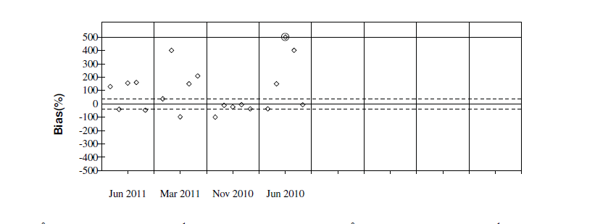
Different Providers
Notes:
Accutest charts look different from the CAP charts. The are turned onto their side and the points are either above or below the mean.
Any of these should be noted and investigated into the cause

Slide 34
Instrument Problems
  Check Instrument logs – changed parts, adjustments
x
Notes:
Which leads to our next Question which ask read
check the instrument log for any Instrument problems such as changed parts, adjustments
Here is an example from an investigation that had instrument problems
About a month after the EQA event the site noticed some trends and bias on the QC and high differential results. Service was halted and service called. A new laser was installed. When they got their EQA results they had 40% on their monocytes %. They retested the samples and all results were in the acceptable range. Most like cause of the unacceptable results was the bad laser at the time of the eqa event.

Slide 35
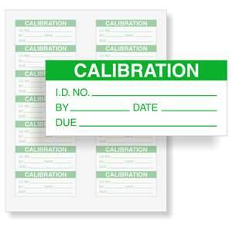
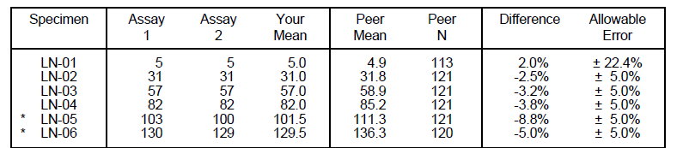
Calibration History
  Check expiration dates on calibrators
  Check Calibration factors
  Calibrator OD/values
x
Notes:
Next check the Calibration History
Read question
Check expiration dates – used within expiration dates
Check calibration factors make sure entered correctly
Check the calibrator OD/values- compare to previous calibrations should be similar. If you have acceptability criteria for data points make sure they were in
All of these could influence your results
Here is an example from an investigation on a chemistry linearity.
One of the upper points was outside the allowable limit. When they checked ther calibration documentation they say that one of the upper factors point was incorrectly entered. Since the first linearity a new calibration had been performed and an new linearity was evaluated. This analyte was linear in the full range now so most likely cause was the incorrect factor point.

Slide 36
QC History
Notes:
The next questions pertain to the QC and what it was doing around the time of the unacceptable result which may help point out a problem.
First question ask how you have established your QC mean and ranges - either lab established or manufacturer’s.
This could indicate whether your mean and range are appropriate for your instrument.
Next question ask if you all levels of your QC are within acceptable range. Check your QC charts at the time of the testing to make sure all were within acceptable criteria.
For Qualitative testing you want to make sure that QC was run and that the appropriate results were recorded.
Next question ask if you use Westgard QC rules and which ones you use. Does everyone know what I mean by Westgard rules? It is a multi-rule QC system that use combination of decision criteria or control rules to decide whether an analytical run is in-control or out-of-control. If you want to learn more about these rules check out our Resource section of our website.
Note any out of control rules during the time the unacceptable results was run

Slide 37
QC History
Notes:
question 7 ask about your QC charts
Ideally you should have points on either side of your mean but sometimes you may have bias, trends or shifts Here is an example of a QC chart that show all three possibilities
First - Bias where QC points run on one side of the mean this could indicate you need to adjust your mean especially if you are using manufacturer’s mean and ranges.
Shifts – where QC points moves abruptly to the opposite side of the mean and stays there. This could happen where you have opened up a new vial and it differs significantly from the last vial, or may be a problem with your instrument
trend – where the QC moves either in a upward or downward steady direction could occur with a lamp wearing out.
All should be noted and investigated for the cause.
The last question for your QC ask if you monitor your instrument precision by monitoring CV – Coefficient of Variation
If it was out of acceptable criteria it could indicate a precision problem with your instrument.

Slide 38
Calculations
  Dilution
    Check dilution factor
  Calculated Analyte
    Check to see if calculation performed correctly
    Check analytes used for calculation for unacceptable results
Notes:
The last area to check for Quantitate testing is Calculations – read question
A calculation may have been needed for a dilution if the result was outside your analytical measurement range (AMR) – check to make sure correct factor was used
Or is may be an analyte that needs a calculation for the result such as LDL Cholesterol, Micro Albumin/Creatinine Ratio check to make sure calculation performed correctly or
Check analytes used for calculation for unacceptable results which could also caused the calculated result to be unacceptable.
Now we will switch to the microbiology form and look at the questions under analytical section

Slide 39

Microbiology
x
Notes:
Question 1 – were they analyzed the same as any routine patient testing?
Check to make sure you handled the testing the same way as your patient
Here is a parasitology survey result from one of our sites. These two specimens were photographs. The site did not realize they were of permanent stain – testing not performed at their site. They tried to result them getting unacceptable results. This was their response on the investigation. So it is important that you analyze samples as you would your patients.
Question 2 ask if the Correct Algorithm – Check to make sure all testing was performed for the organism Did it nee supplemental confirmatory testing, again was same way as a patient sample.

Slide 40

Notes:
Question 3 were Recommended Practice performed on the testing– These could come from CLSI or ASM guidelines such as appropriate drugs for susceptibility testing. This is an example from one of our sites for a bacterial susceptibility testing. The sample was graded as unacceptable. It was unacceptable because according to CLSI Guideline 100M this antibiotic fall into the Other category. It falls into the inappropriate reporting category for this type of organism and specimen because there are more appropriate drugs in the other categories.

Slide 41

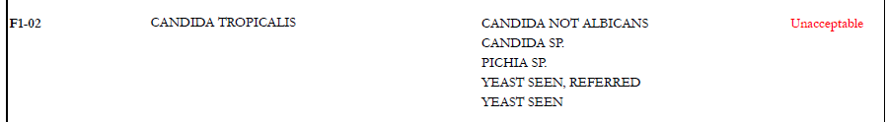
Notes:
Question 4 were the organisms identified to the same Level as routine patient testing. This is an example of a mycology survey. The site usually reports Candid albicnas or Candid, not albicans. They tried to report to a specie level they usually don’t perform and got an unacceptable results. So report only to the level you do normally for patient testing.
Question 5 looks at previous EQA History – Whether you may had similar unacceptable values in previous events this could indicate a problem in your testing/interpretations procedure.
Now we will look at the last two questions that are common to all three types of testing

Slide 42
Analytical
Product Alerts
Problem Lot numbers
Service request
Notes:
Did you contact either the instrument or reagent manufacturer to see if there had been any problems
Product Alerts such as incorrect calibration factor
Questionable lot number problems
Request service
And final question ask if questionable results are reviewed before reporting by either a supervisor/Pathologist.

Slide 43

Notes:
So as I ride off into the sunset hopefully I have given you something to think about.
I will now turn it over to Arden that will talk about the Post Analytical process sections
Thanks you

Slide 44
Post Analytical
What areas to investigate for Post Analytical errors?
Result transcription
Instrument/ Reagent/ Method
Units/Decimal Places /Peer group
= Careful attention to
d e t a I l s
Notes:
#1 Thank you, Heidi. (CLICK) We will now move to the ► POST-ANALYTICAL phase as this concludes and summarizes all previous observations. Based on SMILE’s experience with various sites’ failed EQA
challenge involving POST-ANALYTICAL errors, failures may be grouped into (3) primary identified areas such as:(CLICK)
a.) Result Transcription ( automated, manual, & faxed ) :(CLICK)
b.) Instrument/ reagent/ or method reported or selected on the result form:(CLICK)
c.) Incorrect units / decimal places/ or peer group used:(CLICK)
Elements that are ALL prone to common pitfalls but are easily avoided through (CLICK) careful attention to (CLICK) D E T A I L S
We will now embark on these mentioned areas as we go through each of the questions presented in the post-analytical section
#44 Thank you, Heidi. We will now move to the POST-ANALYTICAL phase as this concludes and summarizes all previous observations. Based on SMILE’s experience with various sites’ failed EQA challenge involving post-analytical errors, FAILURES may be grouped into (3) primary identified areas such as:
a.) Result Transcription
b.) Instrument/ reagent/ or method reported or selected on the result form
c.) Incorrect units / decimal places/ or peer group used
Elements that are ALL prone to common pitfalls but are easily avoided through careful attention to D E T A I L S. We will now embark on these mentioned areas as we go through each of the questions presented in the post-analytical section using our new general investigation report form. Along with each item are actual examples of “failed” EQA’s.
using our new general IR form. Along with each item are actual examples of “failed” EQA’s.

Slide 45
Factors to consider:
Result of BP-12 & BP-13 were inadvertently switched and was confirmed by repeat testing
Specimen Number | Analyte | Reported Result | Repeated Result | Intended Result/Peer Group
BP-12 | Blood Parasite | Plasmod/Babesia spp | Bld Parasite, not Plas/Bab | Bld Flag, NOS Bld Parasite, not Plas/Bab
BP-13 | Blood Parasite | Bld Parasite, not Plas/Bab | Plasmod/Babesia spp | Plasmod/Babesia spp
Transcription error
- Due to result mismatch or result switching
Result A Result B
Notes:
#45 Let us start with question #1 “Were the results correctly transcribed from the instrument print-out / worksheets to the EQA result form?
Based on the submitted IR, the table provided shows that the two results for BLOOD PARASITE, BP 12&13 were “accidentally” switched upon recording. The error was confirmed to be a TRANSCRIPTION error upon comparison of repeated result to the intended result . Plasmodium/ Babesia spp. was reported as BP not Plasmodium/ Babesia spp. INSTEAD and vice versa.
A transcription error mainly due to result switching.

Slide 46

- Primarily attributed due to “clerical error”
Comparing raw data to EQA form, a clerical error was detected. The result on the raw data form was 9.17 but transcribed as 8.17
Notes:
#46
Still on question #1 but a different scenario. Looking at the submitted IR, a clear evidence of transcription error is shown here wherein a CALCIUM value of 9.17 was erroneously reported as 8.17 upon comparison and verification against the instrument printout. Anotherexample of transcription error primarily due to CLERICAL mistake.

Slide 47

Result Entry
Results were originally faxed but submitted results did not reflect what
was on the final result form as entered by the provider.
- via electronic or on-line entry
- faxed method
Notes:
#4 (CLICK #1) Let us now move on to question #2 “Did the EQA result form match the electronic result submitted? If no, how do you assess the accuracy of transcribed results?” (CLICK #1). In this instance, the
laboratory had originally faxed their results which were found to be discrepant caused by the PROVIDER upon result recording. As each laboratory ‘s available resources and technology varies (CLICK #1), submission of results are
handled in various ways or modes such as the fig:(CLICK #1)
a.) electronic or on-line entry (CLICK #1).
b.) faxed method #47 Let us now move to question #2 “Did the completed EQA result form match the electronic results submitted? If no, how do you assure the accuracy of transcribed results?”
In this instance, the laboratory had originally faxed their results which were found to be discrepant caused by the PROVIDER upon result recording. As each laboratory ‘s available resources and technology varies, submission of results are handled in various ways or modes such as the ffg:
via electronic or on-line entry
b.) faxed method

Slide 48
We had changed reagent at the time of the survey.
The old reagent was entered into the survey instead of the new one. The new one is Vanadate Oxidation by Bayer. Result evaluated against the proper peer group. All results acceptable, see table below.
Specimen Number | Analyte | Reported Result | Repeated Result | Intended Result/Peer Group
CHM-11 | Total Bilirubin | 0.3 | Did not need to repeat | 0.1-0.8
CHM-12 |  | 3.2 |  | 3.0-5.2
CHM-13 |  | 4.5 |  | 4.0-8.0
CHM-14 |  | 2.4 |  | 2.0-3.6
CHM-15 |  | 0.8 |  | 0.5-1.5
Notes:
#48 Next is “Were the correct instrument/ method/ reagent reported on the EQA result form?”
Our table here shows 3 out of 5 challenges for TBIL was unsuccessful, NOT really an evaluation to be excited about, huh!!! Per site response to this IR, the lab started using VANADATE OXIDATION, a new REAGENT based on a completely different principle and methodology from the original. The tech neglected to capture the changes when the EQA result form was filled out for correct method and instrument code. As such, evaluation was continued to be carried out based on the”old” method as recorded and reflected on the original subscription submitted to the provider. Incorrect peer group was used for comparison and grading which led to a consequence of failed EQA as shown by this survey result. Upon investigation and discovery of the discrepancy, re-evaluation was performed with the appropriate method selected and survey was found to be successful for all (5) challenges eliminating the need for repeat testing.

Slide 49
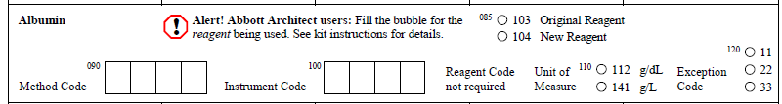
Correct Instrument / Method / Reagent
Notes:
#49 As an investigative tool, the accuracy of information supplied i.e. METHOD, INSTRUMENT &/or REAGENT (original and new) CODE as needed on the result form must be verified.

Slide 50



Communication
- Contact manufacturer or SMILE rep.
- Right “peer group” for grading purposes
Notes:
#50 COMMUNICATION is an important aspect for a successful EQA and is a vital component of an investigation process. Recognition of a need to check or consult with manufacturer or SMILE coordinator for any questions without relying on “assumption” plays an important key in obtaining a satisfactory performance. This needs to include “correct peer group” selection for accurate grading.

Slide 51

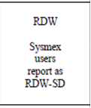
- Percent vs. Fraction ( Hct, Diff. )
Results were in percentage and result form in fractions
Unit/s of Reporting
-Survey specified
Notes:
#8(CLICK#1) Moving now to question #4, “Were the correct units reported?” (CLICK) Based on IR submission, the lab reported the results in percent(CLICK #2) instead of reporting it in fraction commonly seen with Hematology surveys. (CLICK) We also need to be aware in certain instances where the “reporting unit” is particularly specified(CLICK#1) by the provider per kit instruction as shown on this example (CLICK#1) where Sysmex users were instructed to report RDW as RDW-SD.

Slide 52
Decimal Point Placement
Result reported incorrectly due to misplaced decimal point
Notes:
#52 Question # 5, “Were results reported with correct decimal place?”
This table exemplifies a common example of a misplaced decimal point where a platelet result of 150 x109/L was incorrectly captured and reported by the site as 15 x10 9/L instead, a significant difference between the actual versus the reported value obtained due to decimal point transposition … an error that perhaps carries serious potential or impact with study participants.

Slide 53
      Peer Group Comparison
- Based on method/instrument/reagent
selected
Notes:
#53 Next question is, “Were your results graded in the appropriate peer group?”.
As part of the investigation process, review of submitted information must be thoroughly checked and verified to ensure that method reported matches actual testing for accurate evaluation against the correct peer group and graded appropriately, as shown on the next slide…

Slide 54
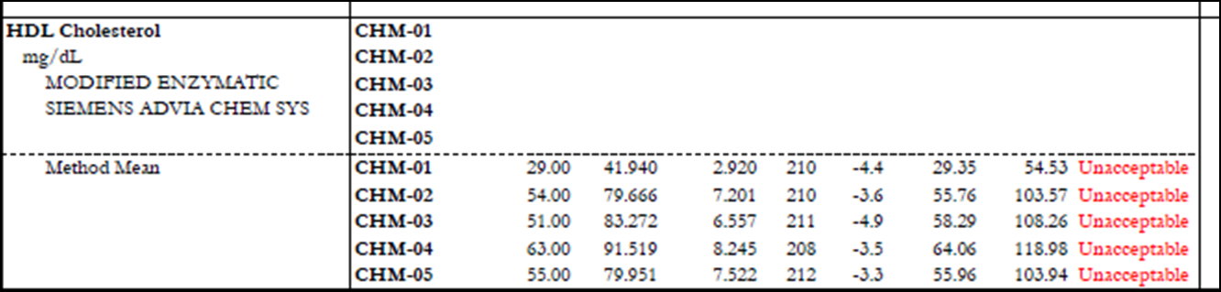
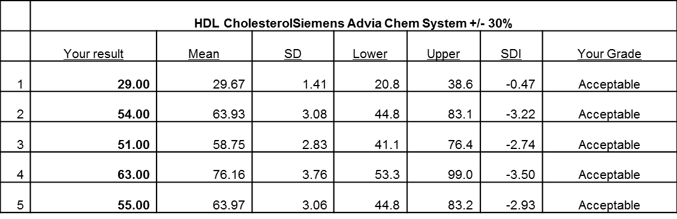
Incorrect method reported, re-evaluated based on instrument method
Notes:
#54 This IR shows that HDL Cholesterol was evaluated and graded based on “Method Mean” leading to unfavorable outcome.
But, upon resolution of the discrepancy with the analyte
re-evaluated appropriately against the correct peer group (based on “instrument” peer group ) seen on the ffg. table, an excellent performance is immediately noted. This scenario may be seen in instances where instrument and reagents are from different manufacturers.

Slide 55
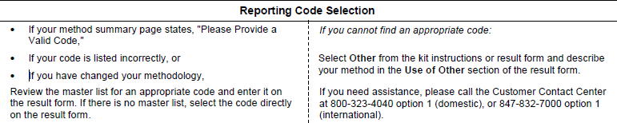
Notes:
#55 A “Reporting Code Selection” section is available for reference which is specifically intended to guide and instruct users on how to accurately fill out the form and pick the correct responses such as method code, instrument code, exception code, etc. This ensures proper evaluation with the appropriate peer group and merits grading from the provider. For DPT/Accutest, all these information are supplied by the sites during pre-registration.

Slide 56
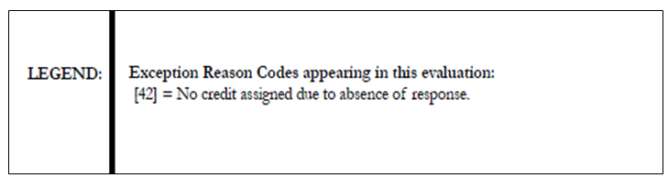
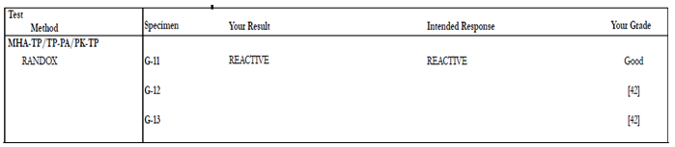
No Response
Notes:
#56 If the site fails to provide a valid response code, an exception reason code is issued by the provider, …in this case, CODE #42 was issued by CAP as no credit assigned due to absence of response leaving the PT ungraded for laboratory’s self-evaluation against the proper statistics supplied in the participant summary such as with this MHA-TP test found with syphilis survey.

Slide 57
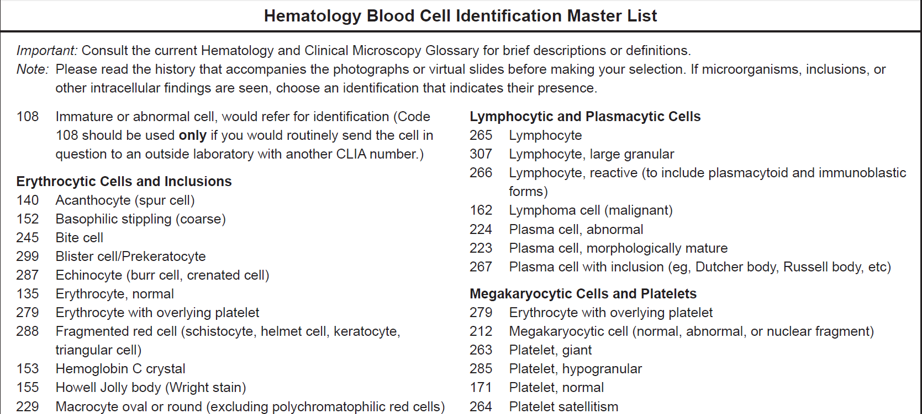
Photomicrograph / Microscopic Results
- “Master List”
Notes:
#57 And finally question #7, "Were your intended result code(s) selected for photographic images and microscopic examination?” Included in the kit is an instruction and response code page called “MASTER LIST” with choices for selection that correctly matches and identifies the photomicrograph and/or microscopic challenge. The accompanying history should be reviewed by the site as this is intended to clue in and help in the right identification of the “image”. As you will see on the next IR

Slide 58
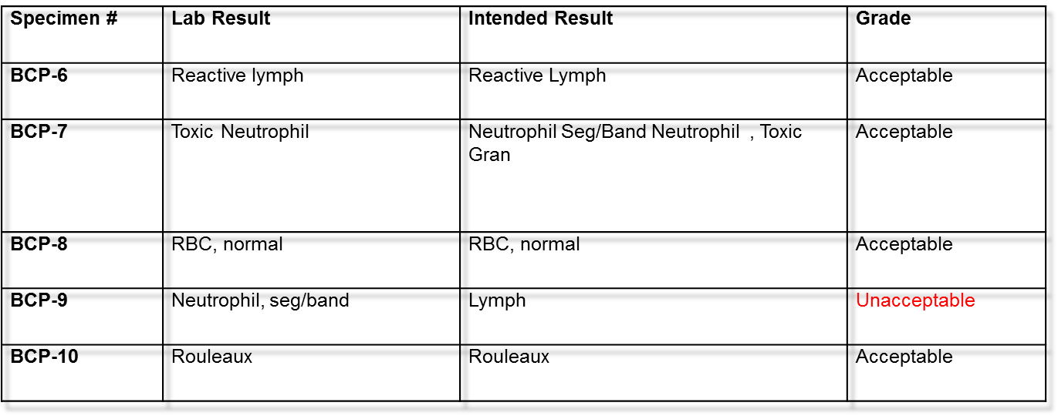
Incorrect code entered
Notes:
#58 In this scenario, the site correctly identified the image as LYMPHOCYTE but carelessly recorded the incorrect code instead which is for “neutrophil, segmenter/band.
(Now we will look at a post-analytical question that appears on the Micro IR form)

Slide 59

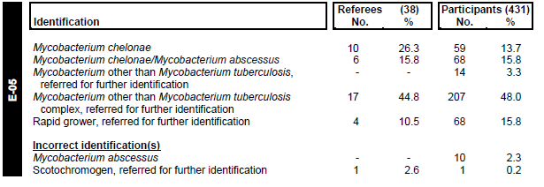

Microbiology
Notes:
#59 For post-analytical MICROBIOLOGY(CLICK) investigation report question #1 “Was the PSR reviewed for other participant failures and related comments?”
A review of the Participant Summary Report is available on line through the provider website is a good way to start your investigation. This will show you how you compare with other participants’ failures among your peer group to include successful organism identification. On this example here, the correct response is M. chelonae but a few went overboard by including M. abscessus which in this case was an unlikely choice for a correct answer. By conducting a comparative study with other participants , we are able to better understand on how to accurately determine and select the best response in consensus with the majority. I now turn you over to Orlinda to discuss the remaining part of our investigation form about root cause & an overall summary of today’s presentation. Thank you.

Slide 60

Victoria Falls-The Smoke That Thunders!
Notes:
Thank you Arden
This is a picture of one my favorite places The mighty Victoria Falls, colloquially known as Mosi oa Tunya which means the smoke that thunders!!!

Slide 61
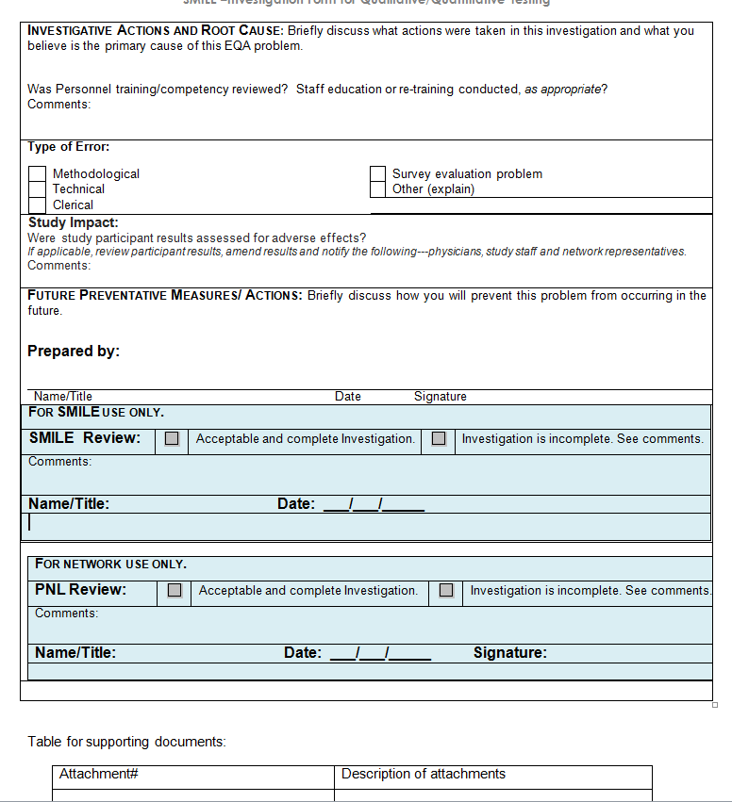
Closing Out the Investigation
Last 5 sections of IR Form:
    Investigative actions & root cause
    Impact on study participants
    Future preventive measures/ actions
    Investigation review & approval
    Table-supporting documents
Summary
Notes:
1. Intro- Read title then Click
Now we have arrived at the place where you would be ready to close out the investigation. There are 5 important areas that are captured/ documented at the bottom of the investigation form: both the general and the microbiology form. Click List 1 to 5 Click.
Lastly I shall wrap-up our presentation by summarizing the important areas we discussed today.

Slide 62
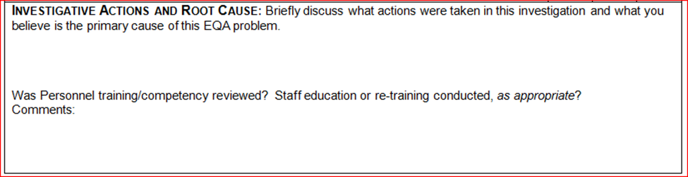



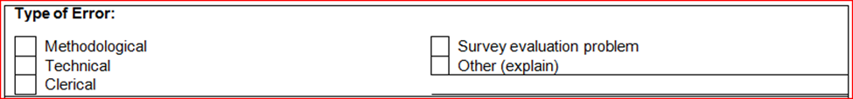
Investigative Actions & Root Cause
Notes:
2. Root Cause-We will start with “Title”. A root cause analysis and any subsequent corrections are important in order to prevent the same problems from happening again. Click
a. This box provides an opportunity to capture succinctly the troubleshooting process or in other words the results/ conclusion of the root cause analysis conducted. Click Emphasis is on the words “root cause”.
The conclusion documented here should answer the question: What was the root cause of the EQA failure in question? b. Just below this summary is a place to document a review of any training and competency records. We will discuss this further on the next slide.
c. The last box in this sub-section helps you to classify the type of error being reported. Click Too often we at SMILE will receive an IR stating that the type or root cause of the error is either “random error” or “sample integrity”. While both deductions are not without some merit, we have seen that more often than not, when we have encouraged further investigations, deeper underlying problems within the testing system have been revealed. Click

Slide 63
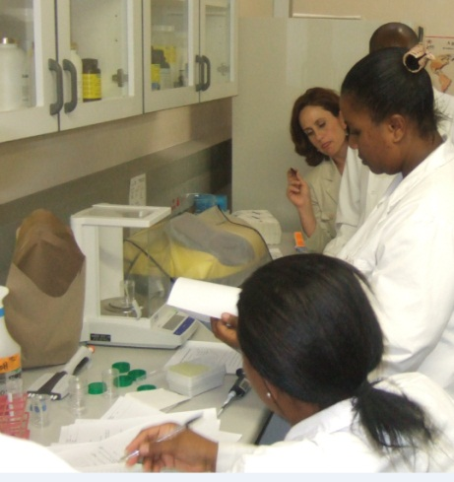
Training & Competency
Assay specific training
SOP’s
Competency Assessment
Re-training
Example of re-training:
“The testing staff did not recognize trending of QC. We have implemented Levy-Jennings QC charts. We have performed training on all personnel in the department. Training included the correct response to any trends, bias or shifts seen in the QC and to do corrective action as needed.”
Notes:
As part of the investigative process, it is good practice to review assay-specific training records and SOP acknowledgements for everyone who handled the EQA that failed. Click
Also check to make sure that all relevant competency assessments are current. Click
Furthermore, if the EQA failure warranted the need for retraining and was this done? Some EQA failures like cell Identifications, mycobacteriology identification, unusual calculations typically require some level of re-training.

Slide 64


Impact on Study Participants
Notes:
This is a critical section in the investigative process. The most important aspect of our work is patient safety. Therefore it behooves the laboratory team to closely examine the study participant results that were reported on the same day that the failed EQA was performed and surrounding days or even shifts if need be.

Slide 65
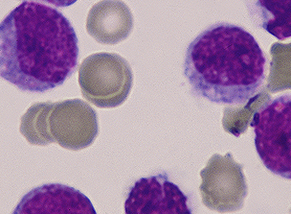
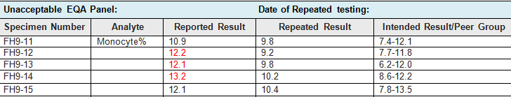
Example: Impact on Study Participants
“We use XE2100 and XT2000i to perform CBC testing for the patients and research cases. During the time that XE2100 was ordered to stop operating (17 Oct 2007 to 29 October 2007) we used only the XT200oi for testing. We checked patient records of patients tested from 17 September until 17 October for any adverse effect. Only 10 samples were resulted on XE2100 during that time period. Only two participants during that time period had monocyte% above the 10% upper reference range. Retesting of patient on other instrument showed similar high results concluding that they were true positive monocytosis.
No patient impacted on error.”
Notes:
5. Example-Study Impact We will now look at an example where there was a good possibility that the EQA failure was highlighting an adverse effect on study participant results. In this example, 3 Hematology EQA samples yielded results that were higher than the upper limit of the acceptable range. The probable danger highlighted by this EQA failure was that of having reported some study participants with falsely elevated monocyte results. Click for Part 2
The lab conducted a thorough investigation. Firstly the lab team identified the instrument used and were able to narrow down the dates to the period between September 17 and October 17^{th.} .Thereafter they counted the study participants reported in this time-frame and discovered that potentially 10 were affected. Of these 10 only 2 had elevated monocytes. They then re-tested the study participants on the 2nd instrument and after consulting with the clinical team concluded that these study participants were true cases of monocytosis. Click Thus study participants were not affected.

Slide 66
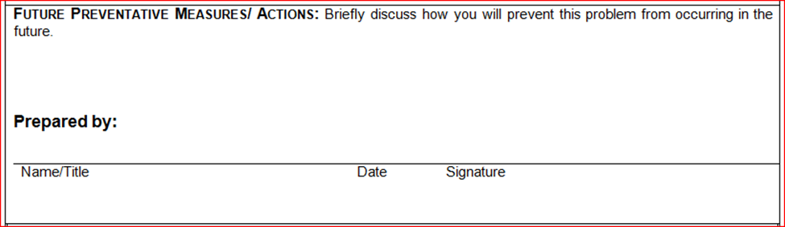
Future Preventative Measures/ Actions
Develop & implement measures to prevent re-occurrence:
Pre-analytical, Analytical & Post Analytical
Notes:
This is the place where the lab documents their best efforts to eliminate recurrence. Therefore, in this part of our presentation I will be making reference to the examples & pointers given by Omar, Heidi and Arden In. Click It is important to plan, develop and implement preventative measures to minimize and/ or eliminate the chances of this same EQA failure in future. These measures are typically outlined in EQA-related SOPs and become part of the overall management system. For the purposes of this presentation these preventative measures have also been classified under the 3 main categories of: pre-analytical, analytical and post analytical. We will now discuss the most common and useful measures that can be implemented by a lab.

Slide 67
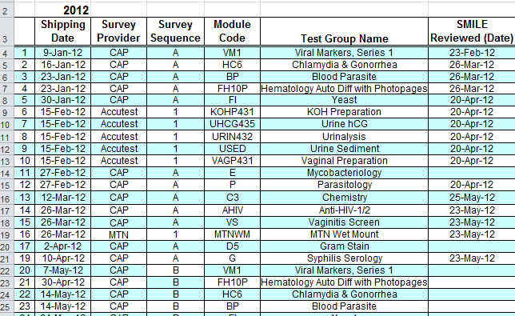
Preventative Measures : Pre-analytical
Shipping
  Track shipments
  Import permits
Notes:
Pre-analytical measures
We will start with the preventive measures that can be implemented for EQA failures occurring in the pre-analytical stages. a. Shipping-to prevent errors stemming from problematic shipments develop & implement ways to proactively anticipate each survey event. This can be done by using the tools provided by SMILE and the EQA provider. We have made it easy for you! Every month SMILE sends out an EQA report which includes an excel-based Summary document. The first page of this EQA Summary spells out your entire EQA order including shipping dates, EQA providers & survey events all chronologically arranged. Thus your EQA SOP should include ways to track shipments, prepare for custom clearance and any import paperwork as needed. So let’s break down this process: 1. The EQA Summary tells you when the provider will ship. 2. Each survey shipment is preceded by a commercial invoice, within the invoice is a tracking number to show you the whereabouts of the package until delivery. 3. Some countries require an import permit for all surveys, others require an import permit for select surveys. In fact both CAP and Accutest have specific documents describing needs for import permits: CAP has a hazardous shipment list and Accutest has the Shipping document requirements for International Customer”. To further assist with this process SMILE issues a reminder in the last quarter of each year to alert each site that it is time to renew import permits.

Slide 68
Preventative Measures : Pre-analytical
Shipping
Receipt & Storage
Instrument/ Material
  Track shipments
  Import permits
  Designated team/person & location
  PM up-to-date
  Inventory
  Prompt communication-EQA Provider with SMILE & PNL
Notes:
Pre-analytical measures
In addition to shipping there are 2 other main areas in the pre-analytical phase starting with Receipt & Storage-It is very useful to have a designated person/ team that receives EQA material, paying attention to storage instructions.
Instrument/ Material- the lab QMP should ensure that all PM activities are current and that all inventory levels are sufficient.
Lastly, timeous communication is invaluable when problems are encountered.

Slide 69
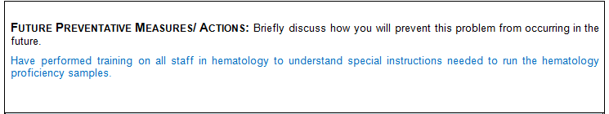
Example - Preventative Measures for
Pre-analytical Error
Example-Missed special instructions for CAP 2008 FH9-B Survey
Note: For the Sysmex XE-2100, XE-5000 and XT series instruments, specimens must be analyzed in the QC program to obtain WBC differential data. Read and follow the sample handling instructions before analyzing the samples. Perform analysis of all samples using the aspiration mode that the majority of your patient samples are processed in: either closed vial (primary) or open vial (secondary) mode.
Notes:
Here is an example of the steps taken by a lab to prevent a pre-analytical type of error from recurring.
It was a CAP 2008 FH9-B survey and an unusually high number of WBC differential results were unacceptable. The investigative process revealed that the EQA samples were not run in the QC mode as specified in the Kit instructions. Please pay careful attention to kit instructions.
To prevent this, the lab (read writing on slide)

Slide 70

Preventative Measures: Analytical
Develop a robust QC policy
  Implement and monitor QC
  Track calibration data
Example- Positive Bias
“Staff was re-trained on proper monitoring of QC charts. SOP modified to explain corrective action required for trends, bias and shifts problems. Instrument had not been calibrated for almost a year. Change calibration schedule to every 6 months per manufacturer’s suggestion.”
Notes:
Analytical
We will now look at preventive measures targeting errors that occur in the analytical phase Click
It is not enough to implement good QC, it is equally important to record & monitor QC. Therefore develop a robust QC policy. Institute diligent tracking & monitoring of calibration set-points and Quality Control data including Levy Jennings which will alert the user to any testing system changes.
In our example a positive bias on QC had been discovered on the day of the EQA failure. The preventive measures documented said (read the writing on slide)

Slide 71

Preventative Measures: Post Analytical
EQA SOP should include procedures to check for any result errors BEFORE submission
Example-Transcription Error
“We have added a new step in our EQA SOP. We will have a second person comparing all results. This will include transcription from the raw data to the Result Form and the Electronic Saved Entry.”
Notes:
Transcription/ typographical errors are very common. Develop a method for transcription and calculation verification. Click (Read the slide)
These verification procedures may also be applied, where applicable to the review process of patient/ study participant results especially in the absence of an LIS. In the selected example, a transcription error was the cause of the EQA failure. To prevent this from happening again, the lab said they (read the slide)

Slide 72
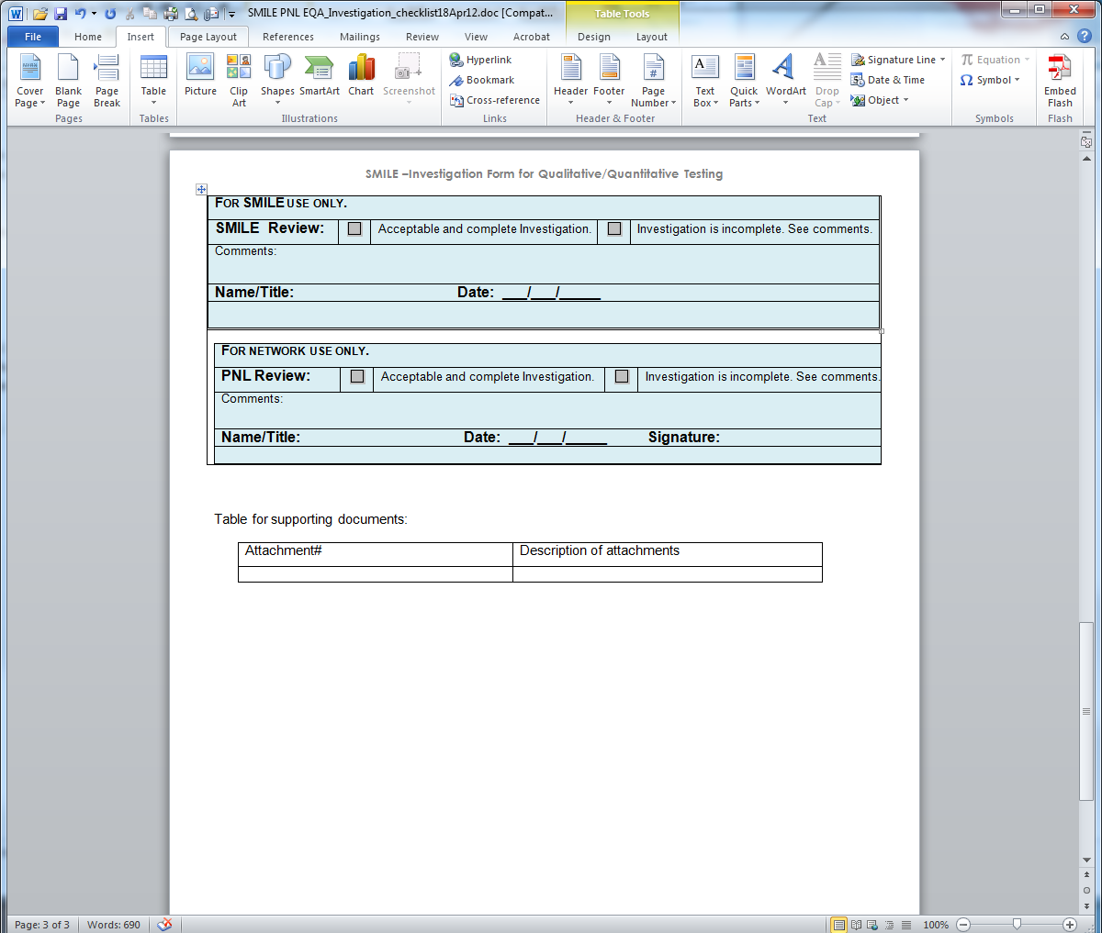
Review and Approval
SMILE and PNL
Notes:
Finally the troubleshooting process has been completed and the investigation is submitted to SMILE and or the PNL. The IR is reviewed for completeness. In some cases an IR will not be accepted and will be returned to the lab for further investigation, good examples of this are when we receive IR’s whose root cause is random error or sample integrity.
When the IR is complete and both SMILE and PNL are satisfied that
Root cause of the error was identified
Impact on study participants was investigated and any necessary corrective action implemented
Preventative measures have been developed and adopted
The IR will be approved and signed off by both SMILE and PNL. An official copy is posted on www.psmile.org

Slide 73
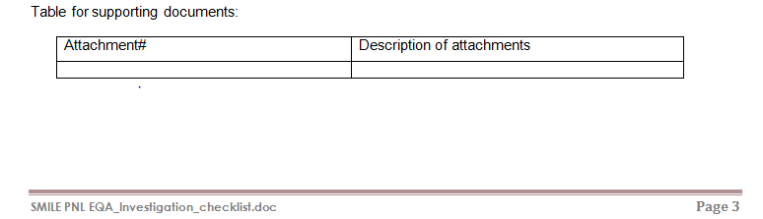

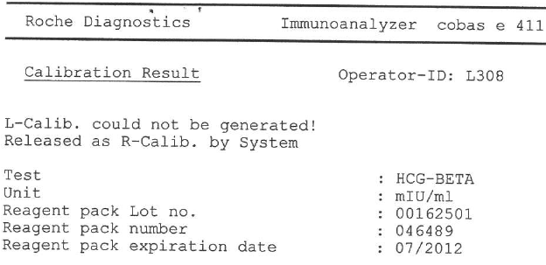
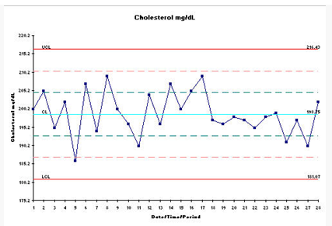
Supporting Documentation
Notes:
A space is provided to list any appendices like QC charts, calibration data or even pictures of results.

Slide 74
Summary and Conclusion
Pre-Analytic
Specimen
Analytic
Test
Post-Analytic
Results
Notes:
Summary & Conclusion
To wrap up our presentation we will now re-cap the main points presented today:
Hopefully at this stage undertaking an investigation and completing the new SMILE forms is now clearer and less daunting. We took time to include real-life examples and to review the different sections of the investigation forms as we believe that as the lab team does this a thorough troubleshooting, they will actually be conducting a thorough investigation. In addition, it is our hope that the tools we discussed today will not be restricted to EQA material but will also be applied to study participant samples where applicable.
In the pre-analytic section we focused on the specimen & instrument: “Did anything go wrong with the EQA material?” and “was anything missed in the PM of instrument?”
In the Analytic section we honed in on the actual test: “was the QC for that day valid?”
Under Post Analytic we looked at the results “did anything go wrong when generating, calculating or transcribing the result?”
We discussed documenting the conclusions drawn from the root cause analysis.
The importance of assessing any adverse effect on study participant results was highlighted.
And lastly, we went over measures that can be implemented to prevent EQA failures.

Slide 75
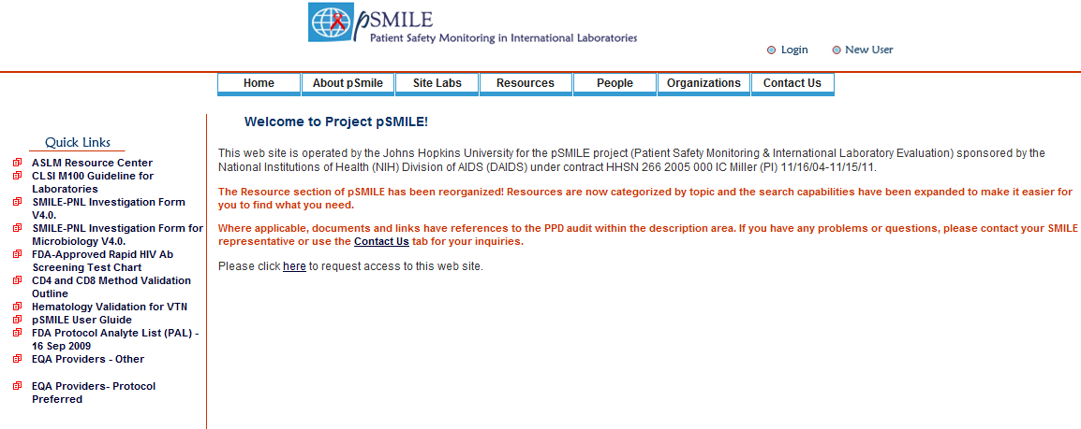
www.psmile.org
Notes:
15. www.psmile.org
This presentation, the investigation forms and the guidelines which are detailed instructions for completing the forms, are all currently available on www.psmile.org as quick links. Later on these will be moved to the Resources section of the psmile website. The resources section is freely accessible to all- log in privileges are not required.
The presenters will be available in the drop in room to answer any questions not addressed today.

Slide 76

Notes:
Thank you for your attention.

Slide 77

Questions and Answers
Notes:
We will now open up the floor for questions. for your attention.

