Slide 1
Presented by Ernesto Tejada & Peter Carter
https://proton.me/pass
Notes:
Proton Pass is a secure multifunction Password Keeper that make securing your important information easy

Slide 2
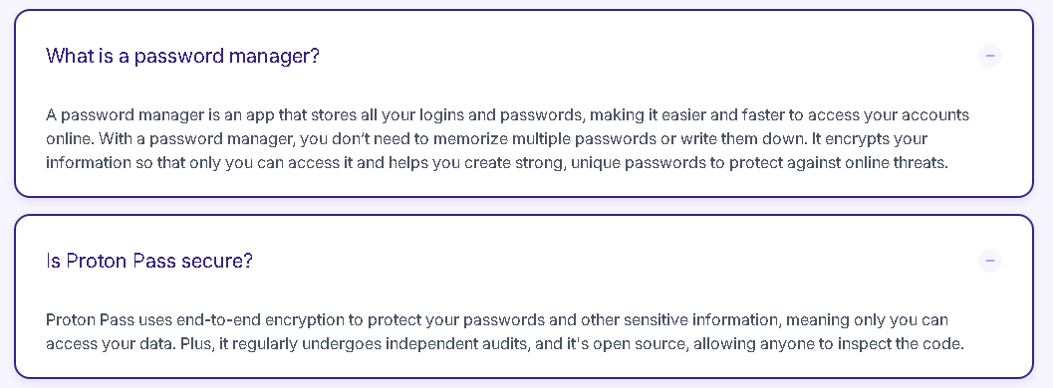

Slide 3
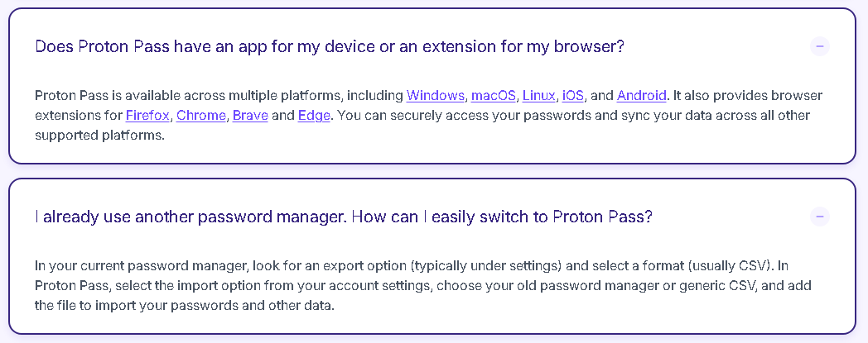

Slide 4
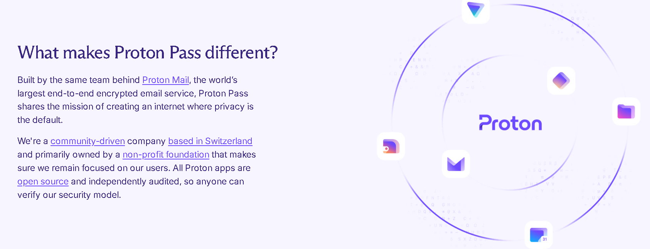

Slide 5


Slide 6

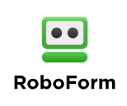

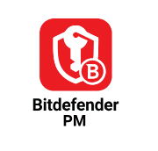


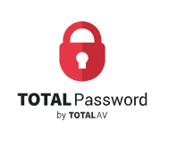
Other Password Keepers
Notes:
Other password keepers that usually have a limited free version available, We are showing Proton Pass because this is the one we use and know the best. This doesn’t mean the ones listed above are not good.

Slide 7
How to get Proton Pass

Slide 8
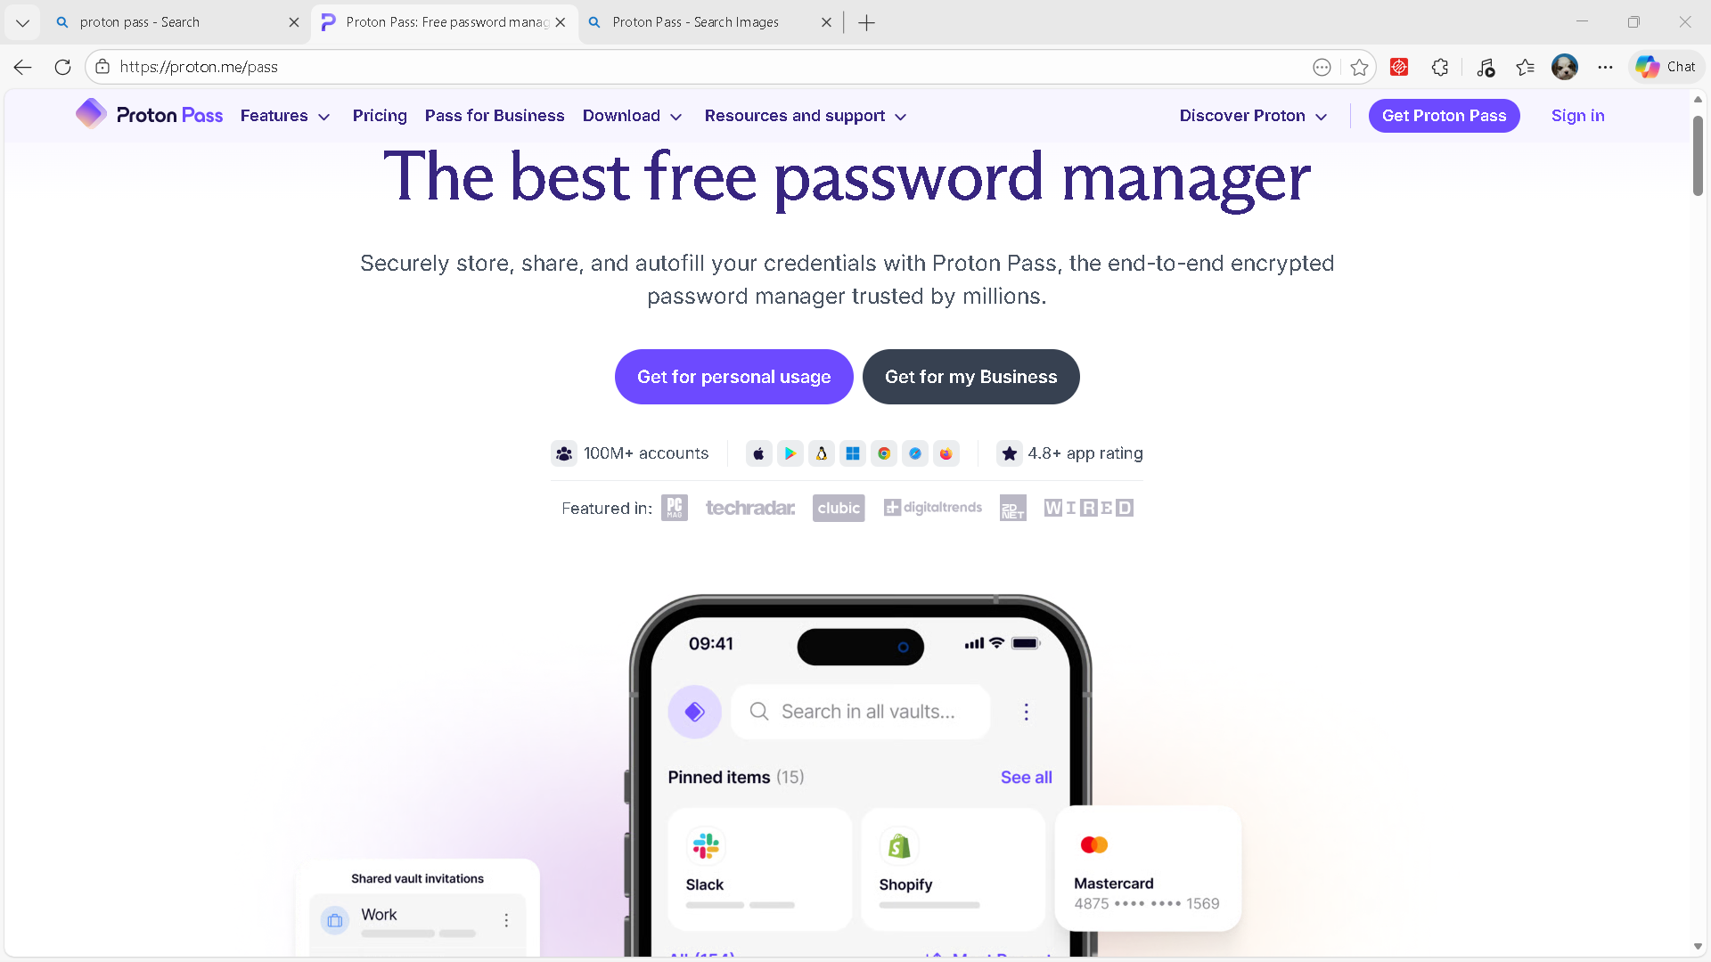


Notes:
To get started with proton pass type the link in your browser (yellow arrow). Then click on the “Get for Personal Use button (red X)

Slide 9
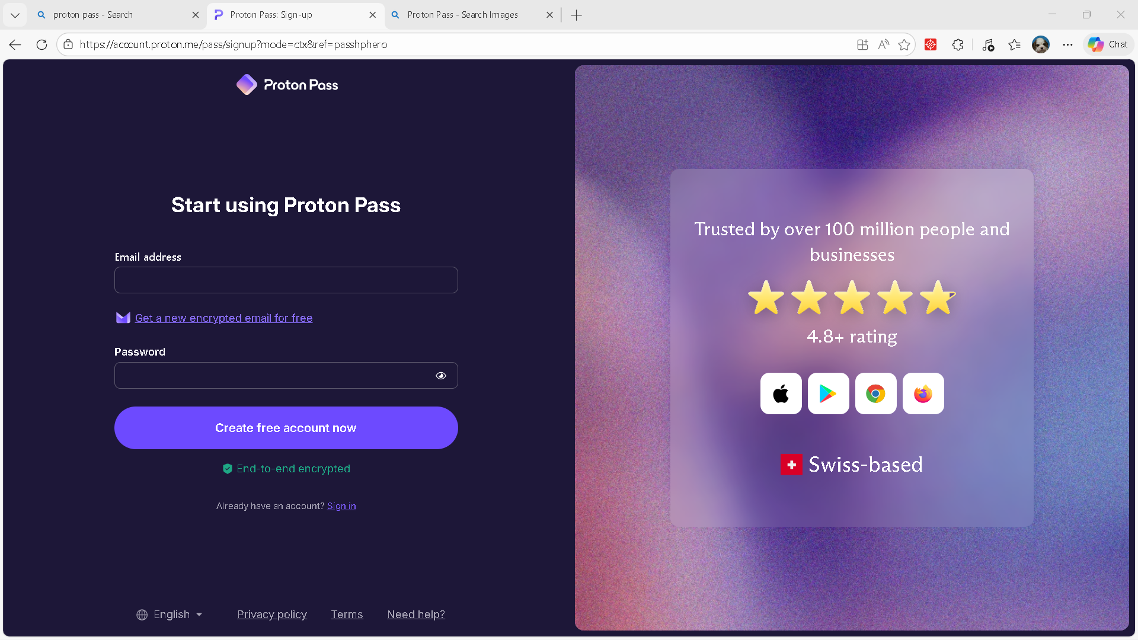






Anyname@proton.me
****************

Slide 10
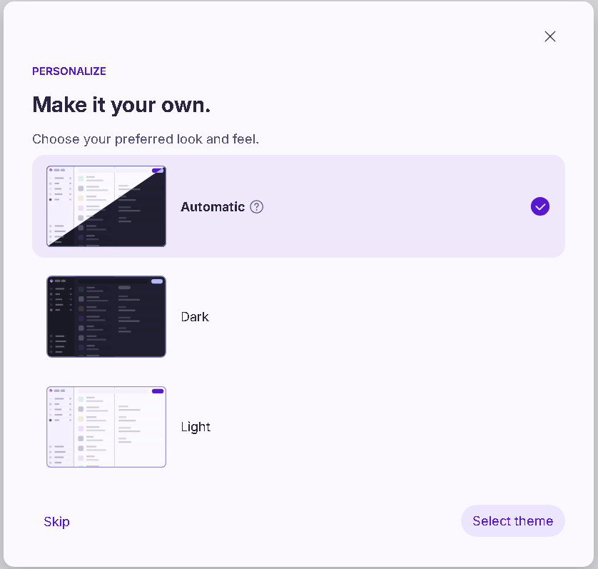

Slide 11
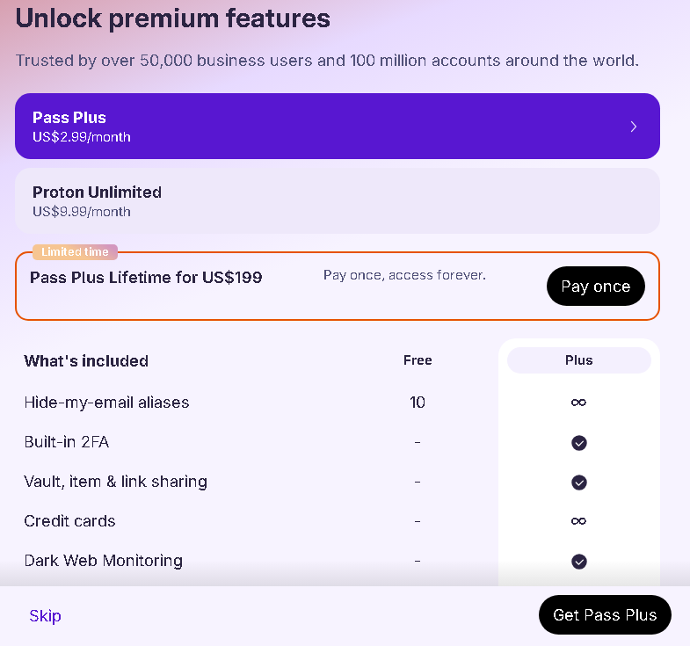

Slide 12
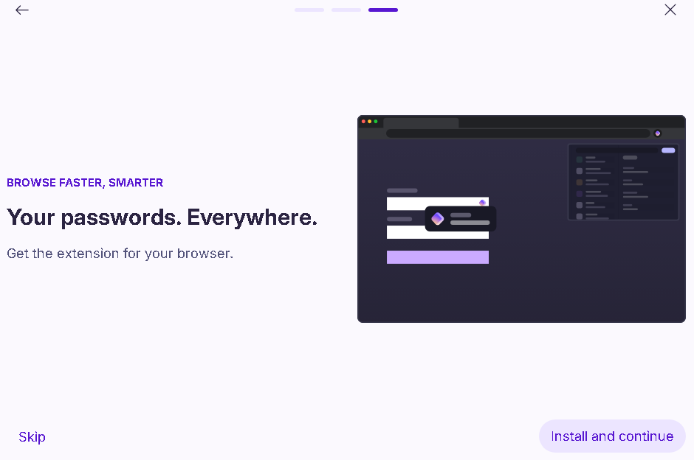
Notes:
Depending on which browser you use, you should see information at the to of the screen to install the Proton Pass browser extension

Slide 13


Slide 14


Slide 15
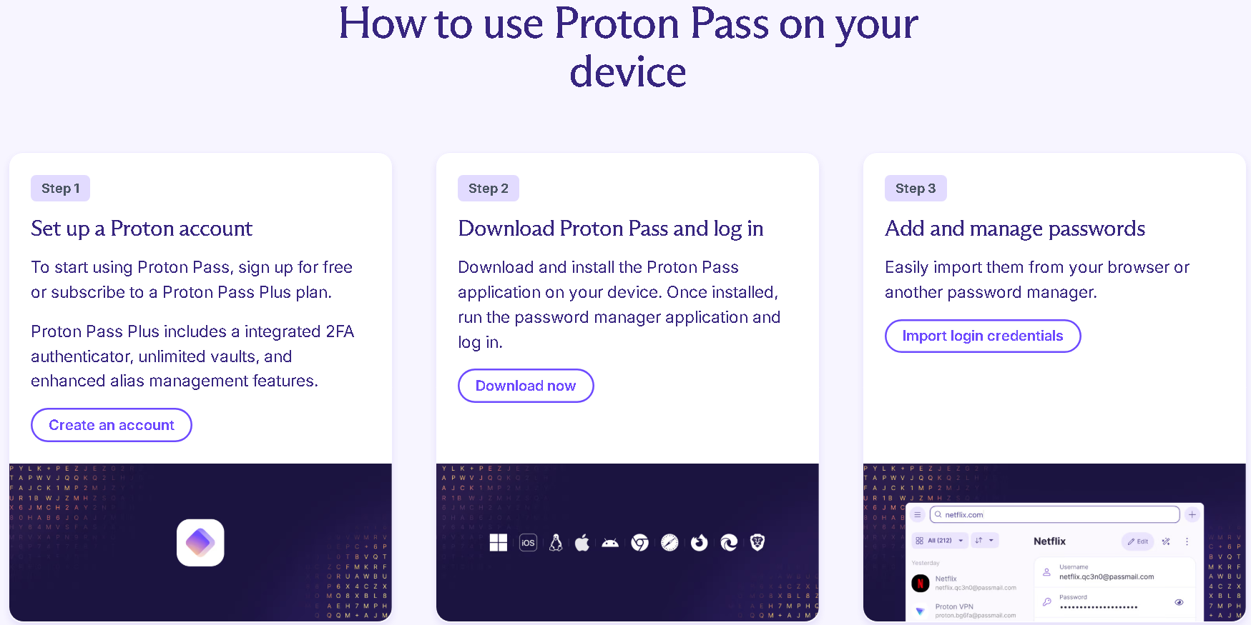

Slide 16


Slide 17
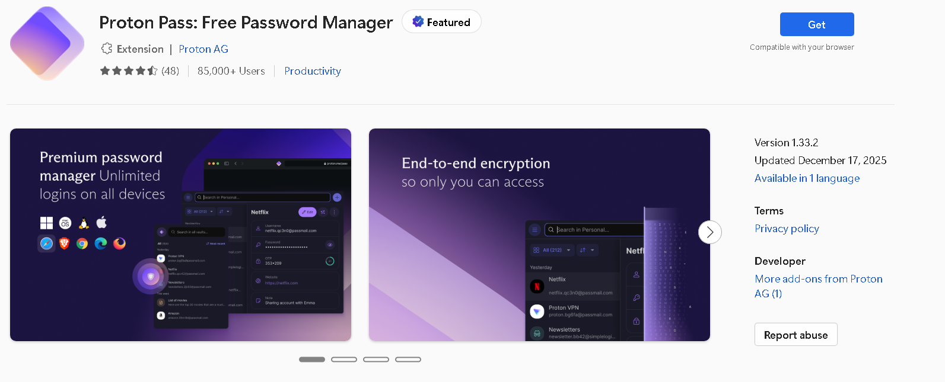

Slide 18
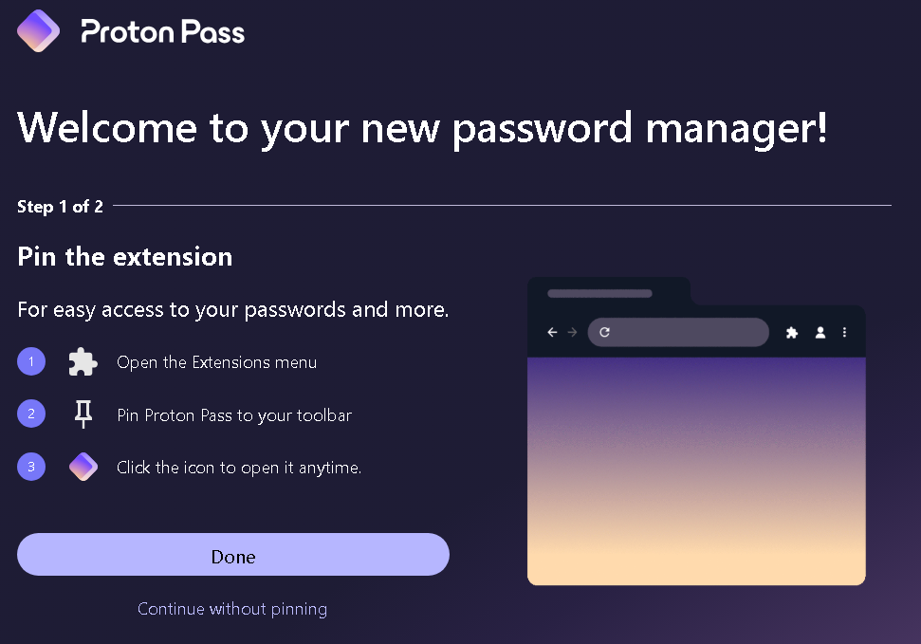

Slide 19
Using Proton Pass

Slide 20
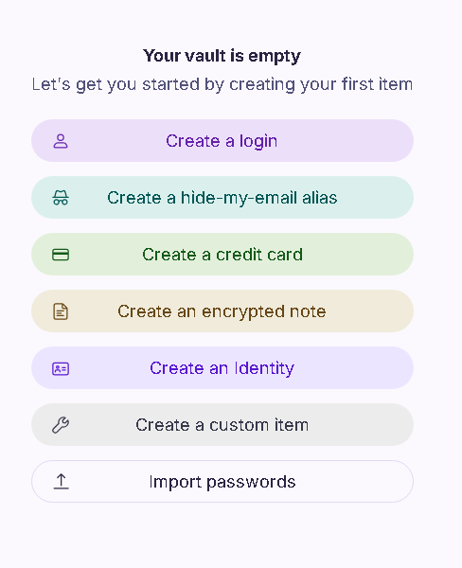

Slide 21
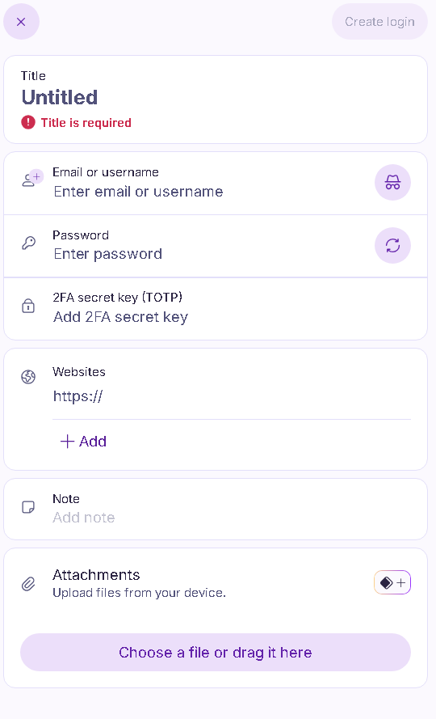


Slide 22


Slide 23

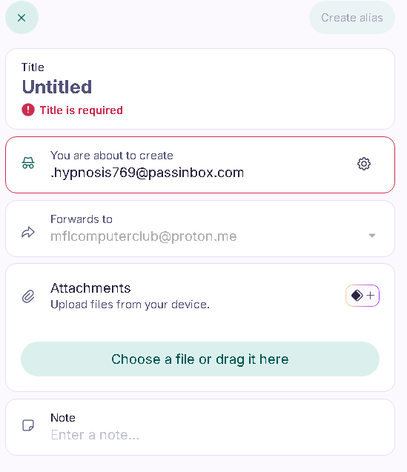

Slide 25
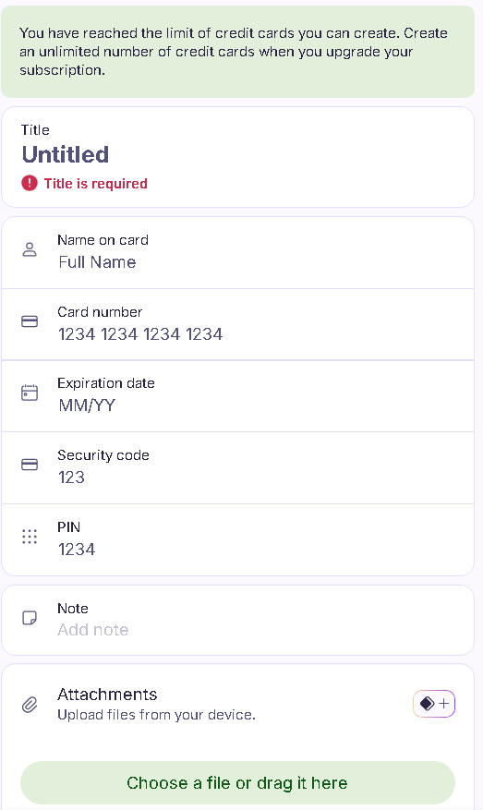

Slide 27
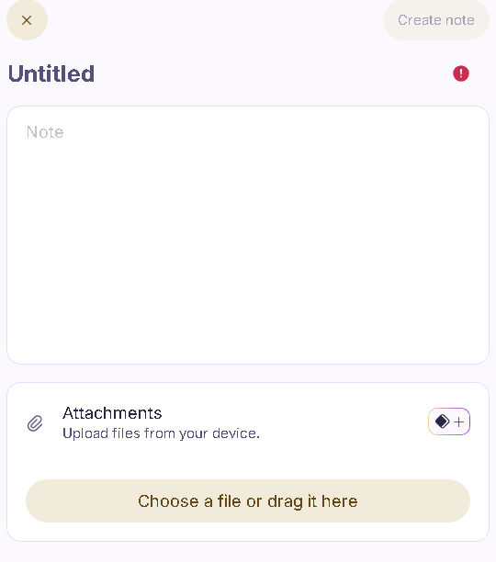


Slide 29

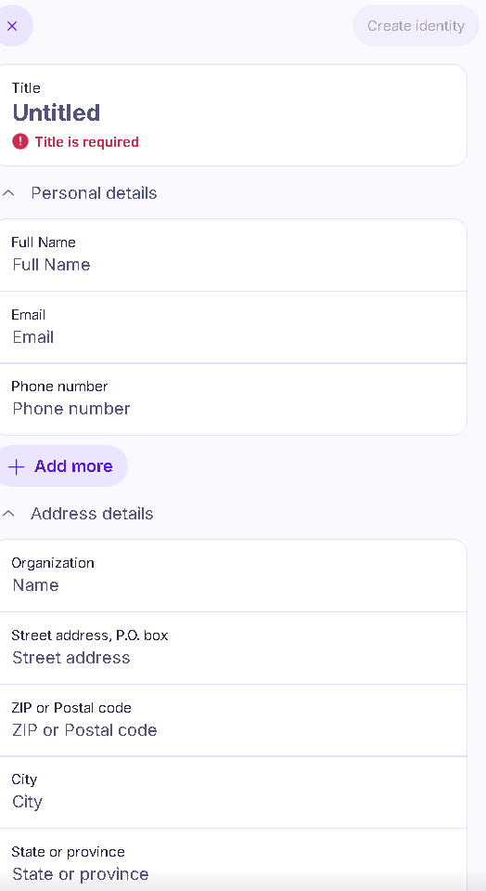

Slide 31
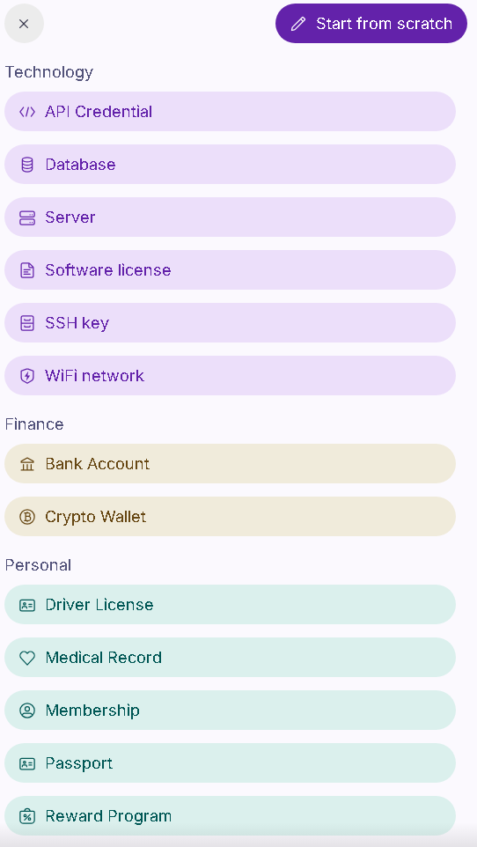

Slide 33
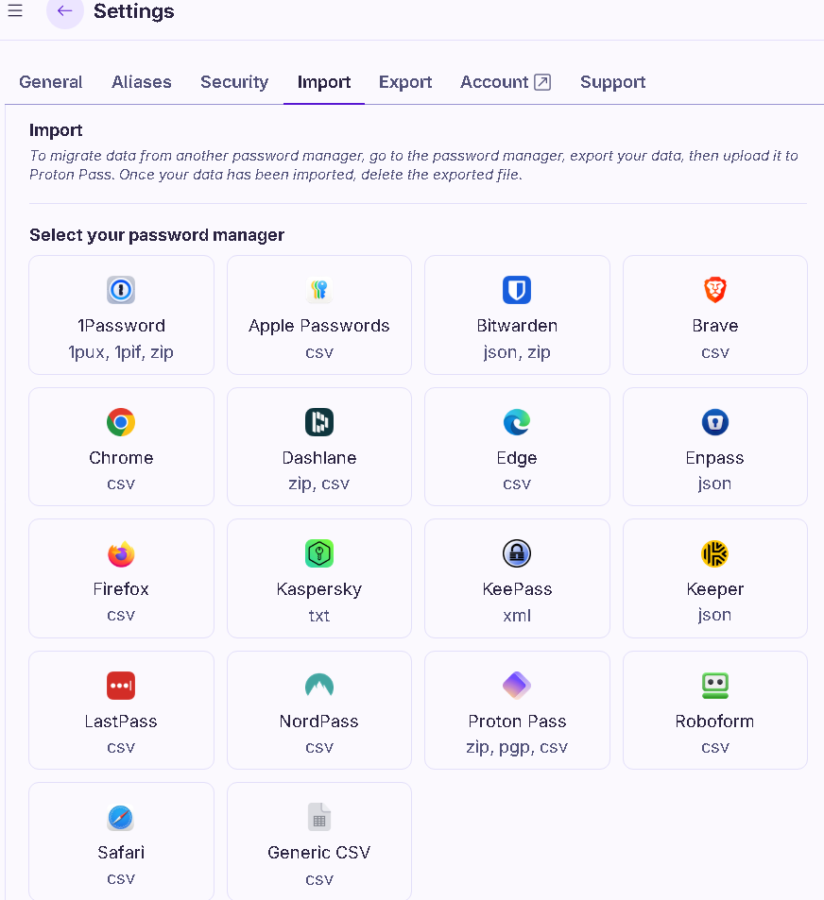

Slide 34
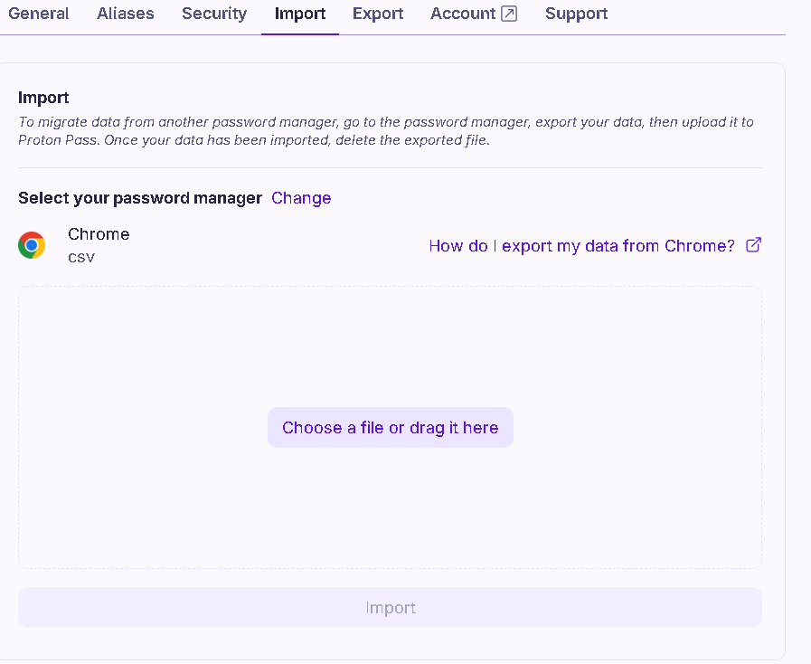

Slide 35
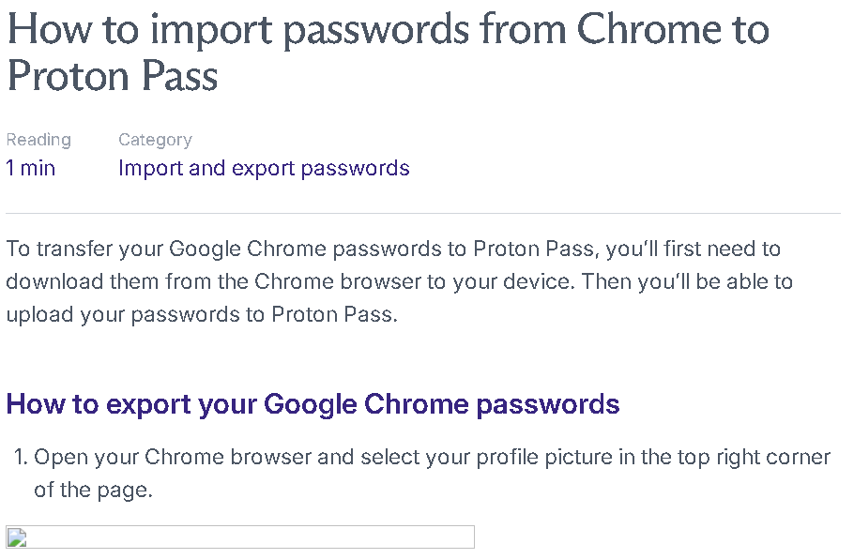

Slide 36




Slide 37
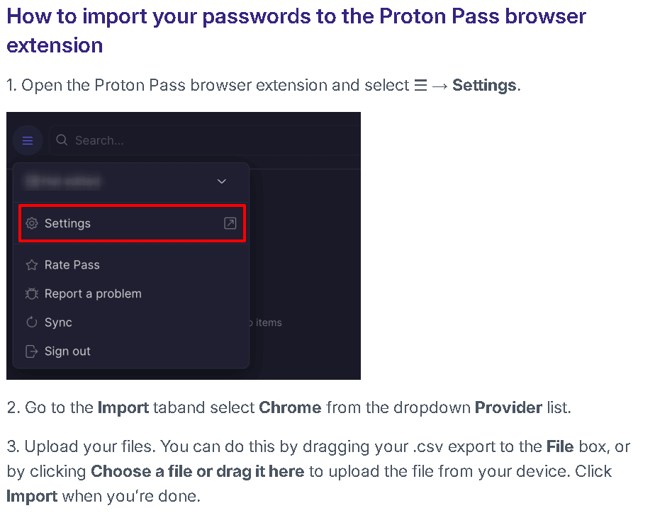

Slide 38
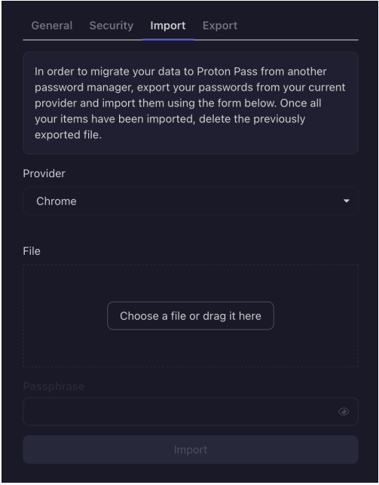

Slide 40
