Slide 1
The Search Committee Word Clouds:
One of the first steps in our search process was to ask the members of the parish to help us understand their thoughts about our faith community and its path forward. In small group discussions we asked for one word answers to the following questions:
Who are we?
What do we do well?
What would be our most important accomplishment in next 3-5 years?
What’s holding us back from achieving that?
What Skills & Talents should our new priest have?
The Word Clouds were discussed with the membership at the annual meeting and made into posters that are in the Fellowship Hall.
St. Stephen’s Episcopal Church

Slide 2
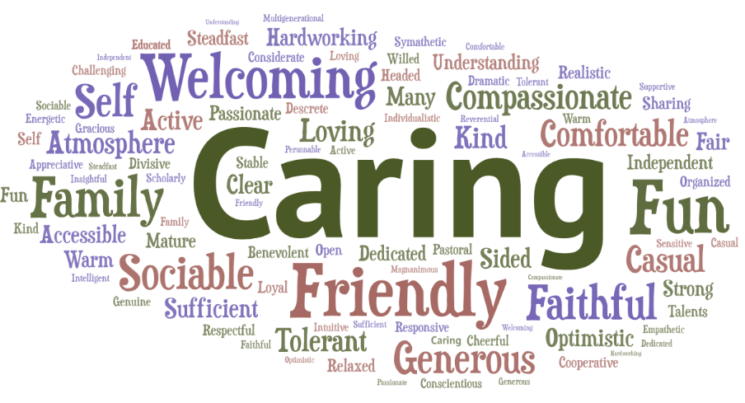
Information gathered in the Small Group Discussions
Who we are:
St. Stephen’s Episcopal Church

Slide 3
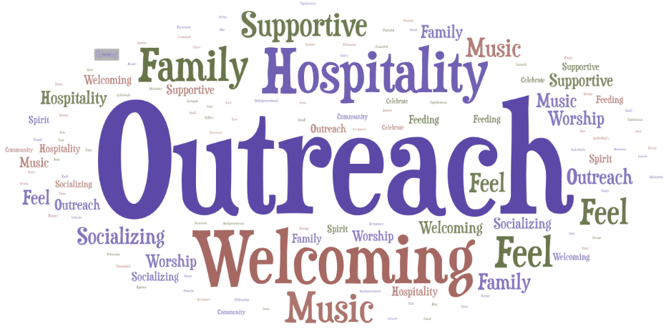
Information gathered in the Small Group Discussions
What we do well:
St. Stephen’s Episcopal Church

Slide 4
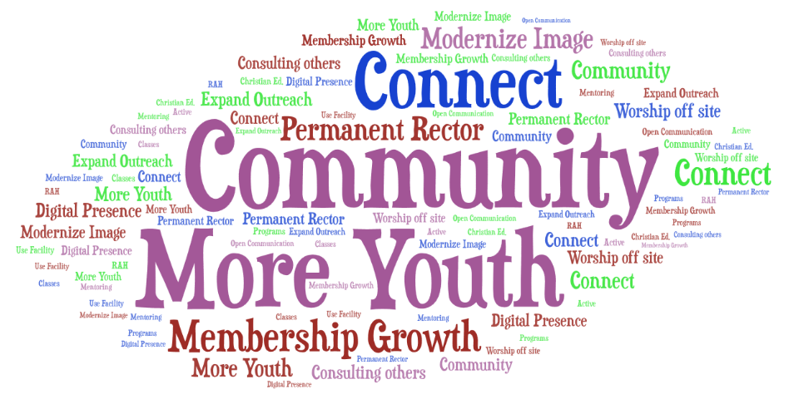
Information gathered in the Small Group Discussions
Most important accomplishment next 3-5 years:
St. Stephen’s Episcopal Church

Slide 5
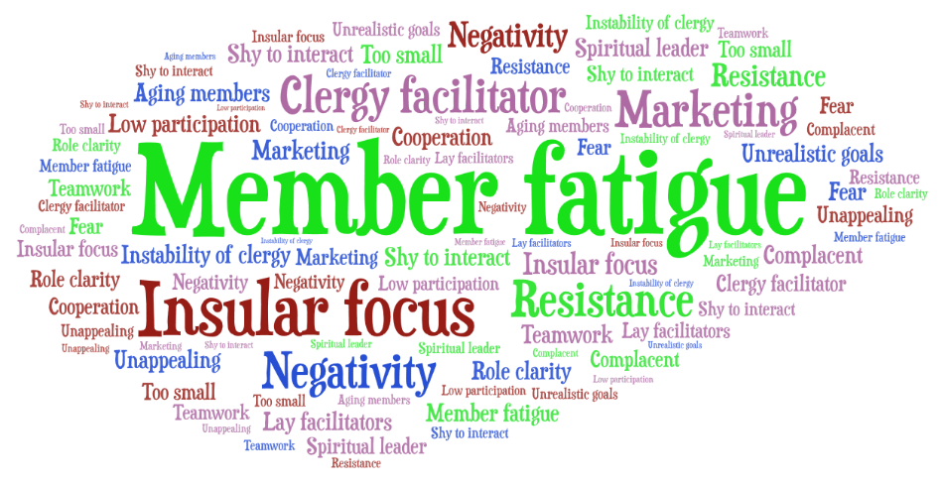
Information gathered in the Small Group Discussions
What’s holding us back:
St. Stephen’s Episcopal Church

Slide 6
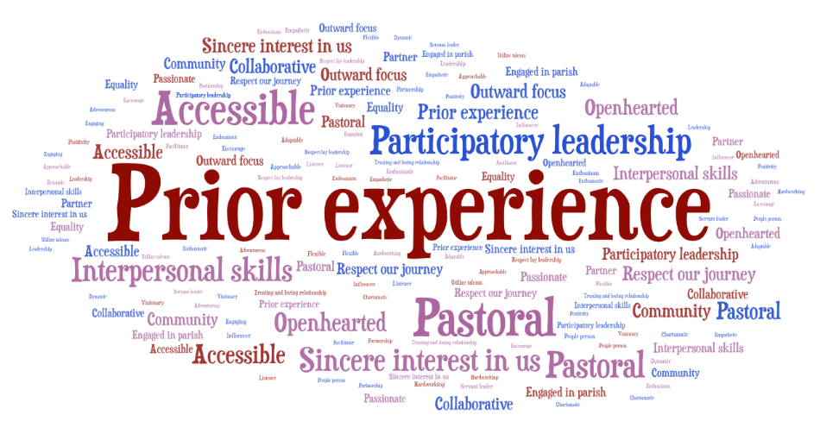
Information gathered in the Small Group Discussions
Skills and Talents of new Priest:
St. Stephen’s Episcopal Church

