Slide 1
Getting Started
Episcopal Diocese of Michigan – Transition Process

Slide 2
Opening Prayer
For the Parish Almighty and everliving God, ruler of all things in heaven and earth, hear our prayers for this parish family. Strengthen the faithful, arouse the careless, and restore the penitent.
Grant us all things necessary for our common life, and bring us all to be of one heart and mind within your holy Church; through Jesus Christ our Lord. Amen.

Slide 3
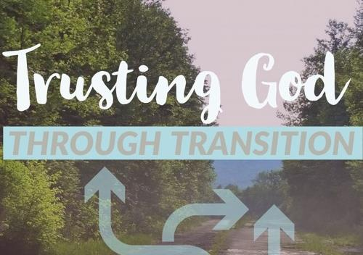
Notes:
Setting Intention – Chronos and Cairos

Slide 4
The Nature of Transitions A Guide for Vestries taken from William Bridges “Managing Transitions”
Change is situational i.e. the leaving or retiring of a priest
Transition is the psychological process or accepting and working with change.
Vestry leadership during this time is about helping people and preparing people to move through the transition.

Slide 5
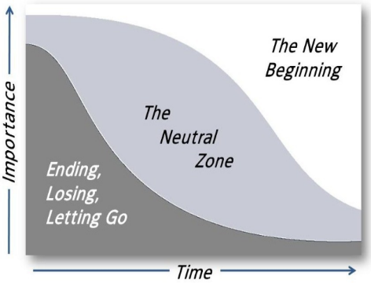
The Nature of Transitions
People are at different phases at different times and so transitions happen:
Unevenly
Concurrently
At each person’s own pace

Slide 6
Ending, Losing, Letting Go
As a Faith Community,
we need to:
Accept people’s resistance to acknowledge losses openly
Understand each others emotions and work through signs of grieving
Listen empathetically and treat the past with respect
Communicate openly throughout the process

Slide 7
The Neutral Zone
As a Faith Community,
we need to:
Be willing to live with ambiguity and be open to trying new things
Let the creativity flow
Set concise short-term goals and celebrate when they are accomplished to keep spirits up
Be Consistent, Truthful, Communicate with Clarity

Slide 8
The New Beginning
Our new priest’s arrival is a time of:
Acceptance and energy
Change being embraced
Building of new skills
Renewed commitment to our community of faith and its mission.
Opportunity to burst out into the larger community
The New Beginning
When a new priest arrives is a time of acceptance and energy, change being embraced, and building of new skills. It’s also a time when you may see a renewed commitment to your community of faith and its mission.
The vestry’s leadership is key to the ability for your new priest to be successful. We invite vestries to continue to develop their leadership skills as they advise the new priest and lead their community of faith.

Slide 9
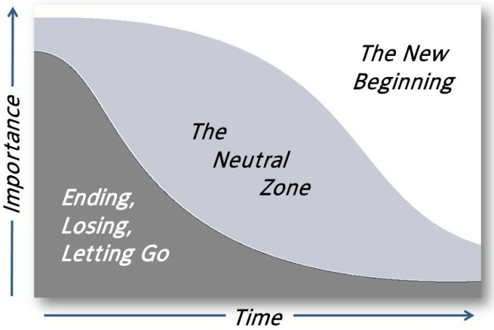
Where are you in this transition model?

Slide 10
The Big Picture
Transition and Search Process

Slide 11
Getting Started (Vestry or Bishop’s Committee/Wardens) | Self-Assessment and Written Materials (Search Committee) | Search & Discernment (Search Committee) | Issuing a Call & Welcoming a New Priest (Vestry/Wardens)
Timeline for PIC Last Sunday and Planing a Good Goodbye with outgoing priest Appoint a Search Committee which is a sub committee of the vestry. Between 5-7 people Pray for Search Committee Website Update End Goals: A good farewell Empower Search Committee to do its work Vestry work with interim/priest-in-charge or supply priests and lead the church | Look at previous materials with Transition Ministers and identify gaps and changes. Complete small group self-study. Complete Written materials (Profile, OTM form): Documents must be approved by vestry and bishop’s staff, before posting the position. *The Vestry works to complete the financial piece of the OTM Update Website Post Position (bishop’s staff does this, minimum 8 weeks) End Goals: Clarity about congregation’s history, mission, vision, future goals Written materials that clearly express who you are as a congregation and what you seek in your next rector/vicar | Interview Candidates Review written materials Zoom interviews In-Person Interviews (including meeting with Bishop and Transition Officer) Vestry meets candidates but does not interview Discern Finalist Recommend ONE name to the vestry End Goals: Discernment of Finalist to present to vestry (Do not notify other finalists until call is issued and LOA is signed by candidate and wardens) | Vestry accepts recommendation from Search Committee Notify the Bishop’s Office request her final approval to issue the call (wardens) Negotiate Letter of Agreement (Wardens) Celebrate the work of the Search Committee vestry, and parish!! Welcome new Priest Mutual Ministry Review at 1 year mark. End Goals: Successful, life-giving partnership between a new priest and the congregation

Slide 12
Vestry’s Tasks
Appoint Search Committee
Approve Profile and OTM
Provide Financial Information
Approve final package
Socially Meet finalists

Slide 13
Search Committee Tasks
Self Assessment - Small Group Meetings
Written Material: OTM* and Profile
Interview Candidates (Written, Zoom, Finalist visit)
Discern and Recommend ONE Name to the Vestry
COMMUNICATE, COMMUNICATE, COMMUNICATE!
*OTM = Office for Transition Ministry

Slide 14
Our Search Committee
Dave Stein – Chairperson
Ken Fuhr
Don Ingersoll
Mary Rini
Miranda Spates
Ann Williams
Rev. Ellen Ekevag – Transition Minister
Notes:
Once search committee gets to interviewing that is where confidentiality expectations are set in.
We will tell you where we are in the interview process but not who.
This is about mutual discernment, and sometimes priests discern they want to stay where they are at. If that confidentiality is breached it causes immense harm not just to that clergy person, but to their congregation.
This is where I say, we are not trying to be obtuse or nontransparent, this is an expectation of clergy who apply.

Slide 15
Congregation’s “Tasks”
Participate in the Small Group Meetings
Review and give feedback to written materials
Ask questions!
Financial awareness- not the time to hold back
Pray for our search process
Understand the search committee and vestry must keep confidentiality during the interview process.

Slide 16
Transition Minister’s Tasks
Coach/advise/meet with Search Committee
Approve (with bishop) written materials (OTM and Profile)
Recruit and Vet Applicants
Other tasks as requested or needed

Slide 17
Our Next Steps
December 2024
Select Search Committee – DONE
Review Small Group Meeting Facilitator Guide – DONE
Develop The Plan and present to Vestry – DONE
Parish Meeting to explain next steps – TODAY!
Communicate – Begin dialog with parish members
Mailing to all parish members
Sign up sheets for small groups

Slide 18
Our Next Steps
January & February 2025
Search Committee hosts Small Group discussions to help in developing Priest’s profile information
Search Committee gives feedback to parish members about findings
Search Committee finalizes written materials with vestry, bishop etc. approval
March 2025
Post written material.
Late Spring/Early Summer 2025
Interview and Discernment

Slide 19
A Word about Confidentiality
From the moment the Search Committee receives an application, it assumes the duty of safeguarding the applicant’s confidentiality.
Committee members may not share any details at all about applicants: obviously not names, but also not details about age, gender, geographic location, make of car, whether they are a dog or a cat person, or anything else no matter how inconsequential.
Notes:
Once search committee gets to interviewing that is where confidentiality expectations are set in.
We will tell you where we are in the interview process but not who.
This is about mutual discernment, and sometimes priests discern they want to stay where they are at. If that confidentiality is breached it causes immense harm not just to that clergy person, but to their congregation.
This is where I say, we are not trying to be obtuse or nontransparent, this is an expectation of clergy who apply.

Slide 20
A Word about Confidentiality
WHY?
The goal is to create a safe space for mutual discernment.
The reason for all this seriousness is the profound harm that can come even from innocent mistakes. Breaches of confidentiality, even unintentional ones, have derailed search processes, divided congregations, and betrayed candidates.
Notes:
Once search committee gets to interviewing that is where confidentiality expectations are set in.
We will tell you where we are in the interview process but not who.
This is about mutual discernment, and sometimes priests discern they want to stay where they are at. If that confidentiality is breached it causes immense harm not just to that clergy person, but to their congregation.
This is where I say, we are not trying to be obtuse or nontransparent, this is an expectation of clergy who apply.

Slide 21
Guiding Principles
Covenant: TRUST THE SEARCH
COMMITTEE TO DO ITS WORK.
The vestry and search committee are entrusted with the holy work of finding our next pastor, priest, and teacher. By appointing a Search Committee the Vestry is freed to focus on leading the church through the transition.
It is the responsibility of both the Vestry and the Search Committee to steep this process in prayer from beginning to end.

Slide 22
Guiding Principles
Communication
Anxiety on the part of the congregation can be reduced if the vestry and search committee communicate the search timeline and process in a transparent and dependable way.
Additionally, it is crucial for the warden and search committee chair to maintain frequent and clear communications with one another and with the Transition Minister throughout the search.

Slide 23
Guiding Principles
Confidentiality
PEOPLE’S LIVES AND LIVELIHOODS
ARE AT STAKE
The search committee must maintain strict confidence about the names of candidates being considered in the search, even with spouses and partners. To do otherwise is to risk great hurt to the candidate, your church, and other churches.

Slide 24
QUESTIONS, COMMENTS, THOUGHTS?

Slide 25
Closing Prayer
“Now to him who by the power at work within us is able to accomplish abundantly far more than all we can ask or imagine, to him be glory in the church and in Christ Jesus to all generations, for ever and ever. Amen.”
Ephesians 3:21-21

