Slide 1
My Dream Vacation
By Haylie Hawxhurst

Slide 2
WHERE I WISH TO TRAVEL
I would love to travel to the United Kingdom
Scotland
England
This Photo by Unknown Author is licensed under CC BY-SA

Slide 3
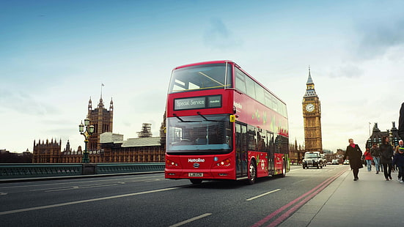
Methods of Travel
To get there
Airplane
While There
Train
Bus

Slide 4
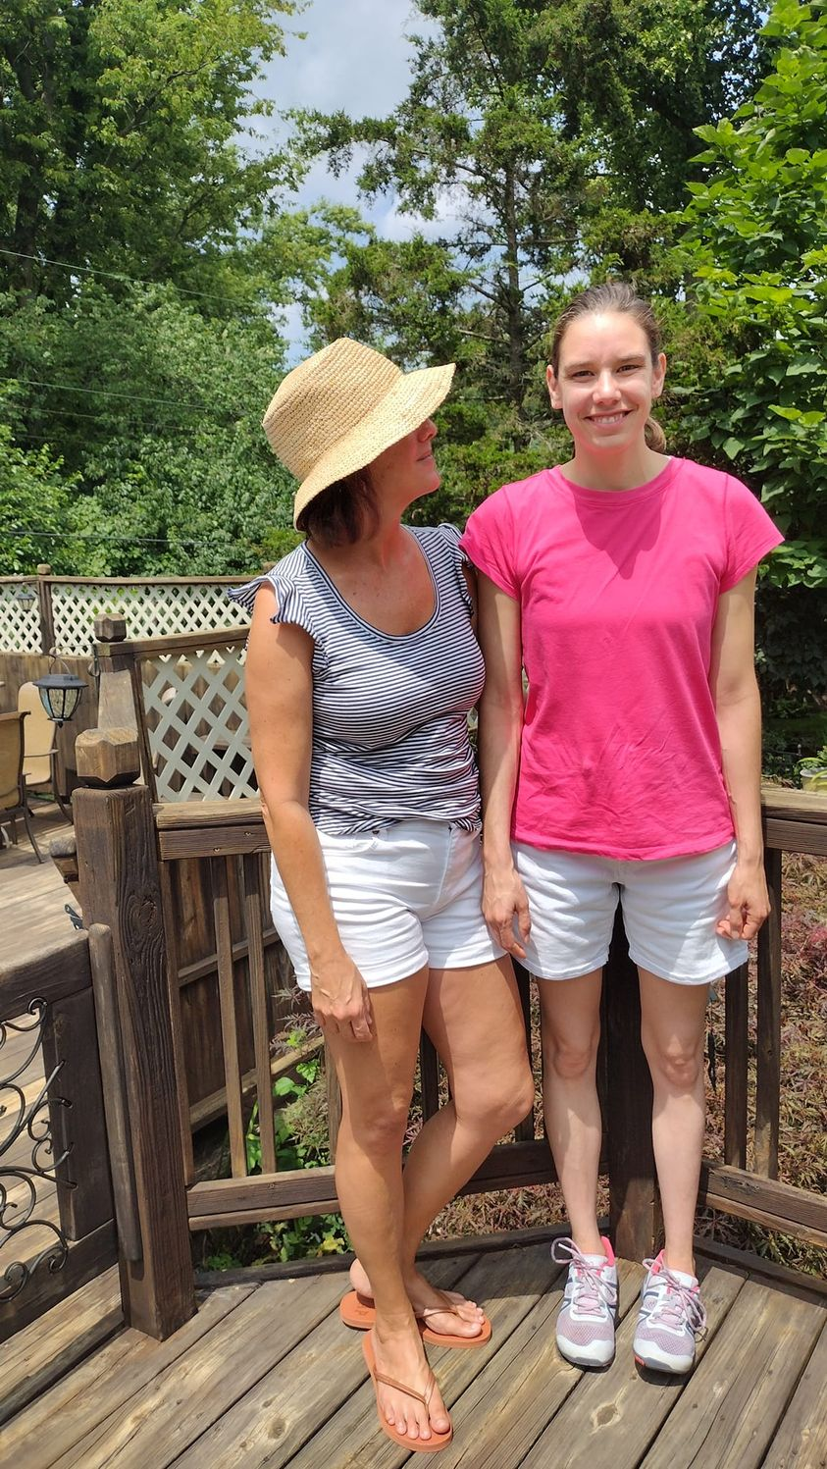
Who I Would Like To Go With Me
I would take my mom as my travel companion
We both love to travel and explore new places
Both are excited about traveling to England

Slide 5
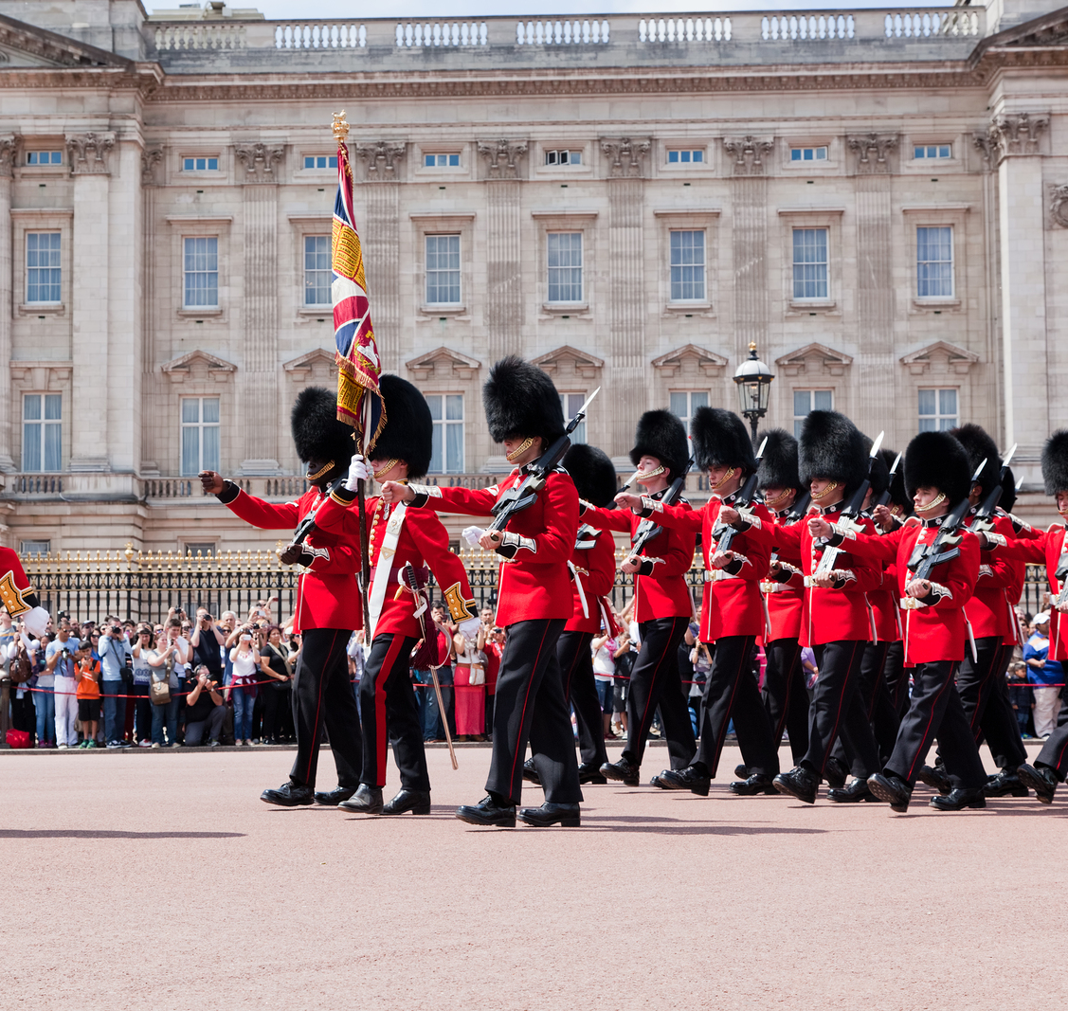
Why I Want to Go There
I’m fascinated with the history & culture
My family generations back is originally from England & I want to explore the country

Slide 6
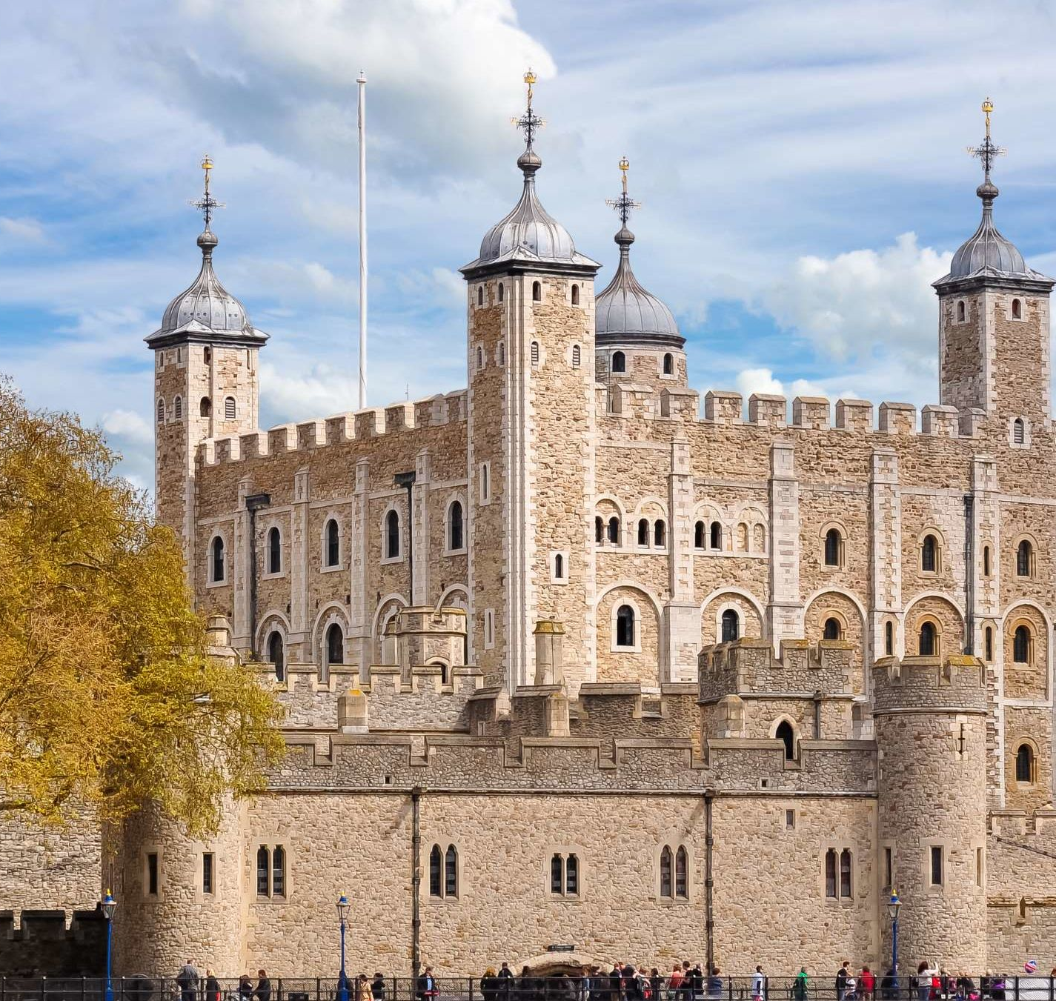
Places I Can Visit
City of Edinburgh Scotland
Edinburgh Castle
Tower of London
Greenwich in London

Slide 7
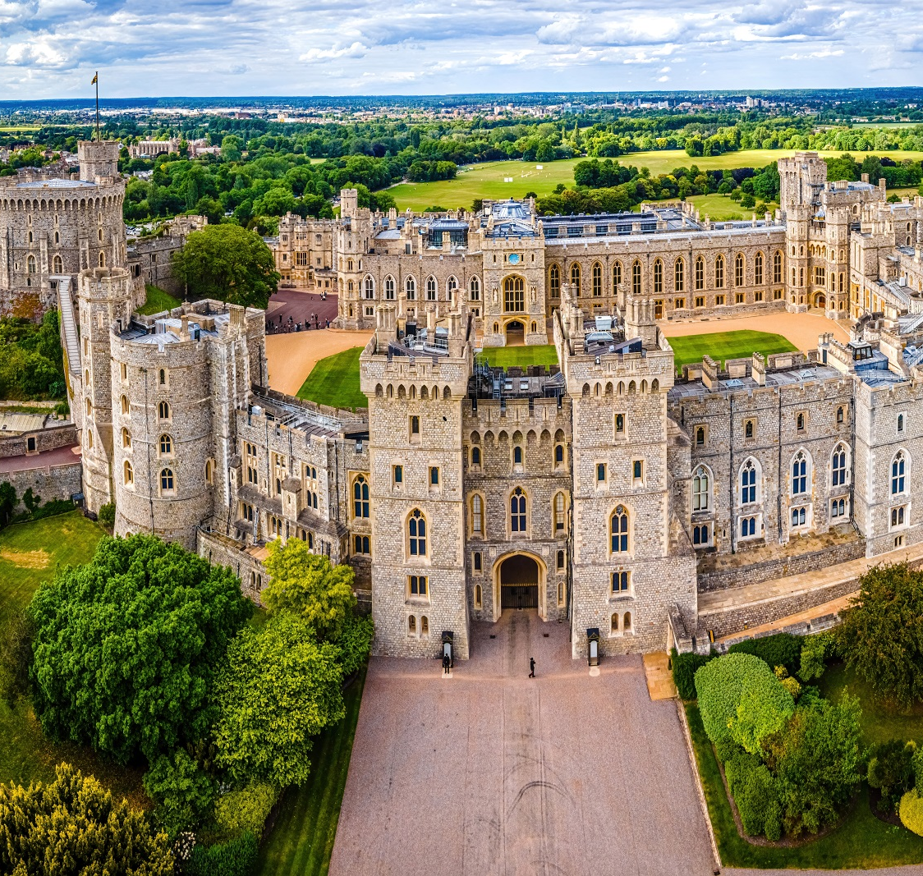
Cultural Activities to Participate in
Tour Windsor Castle
Oldest inhabited castle
Rich in British culture & tradition
Longest occupied castle & home of Queen

Slide 8
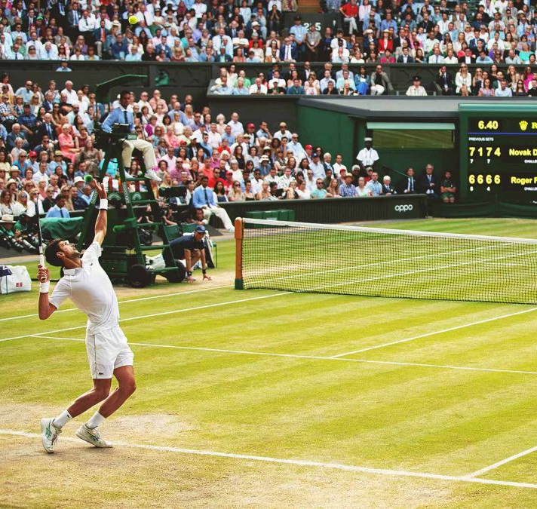
Sport Activities to Participate In
Would love to go to a live Wimbledon event
Really like tennis & have heard lots about this event
Fun to see it in person
Huge sports event in England

