Slide 1
The 2021 Climate Change Science
Earth Catastrophe
Warning to the World
Peter Carter
petercarter46@shaw.ca
23 January 2021
Today’s most up-to-date comprehensive state of the climate in 90 referenced data-set images
DRAFT for response

Slide 2
World-wide 64% of people think climate change
is a global emergency
Sixty-four percent of people believe climate change is a global emergency, despite the ongoing COVID-19 pandemic
UNDP's (UN Development Program) "Peoples' Climate Vote" reflects over half the world's population after results processed by the University of Oxford. Sixty-four percent of people believe climate change is a global emergency, despite the ongoing COVID-19 pandemic

Slide 3
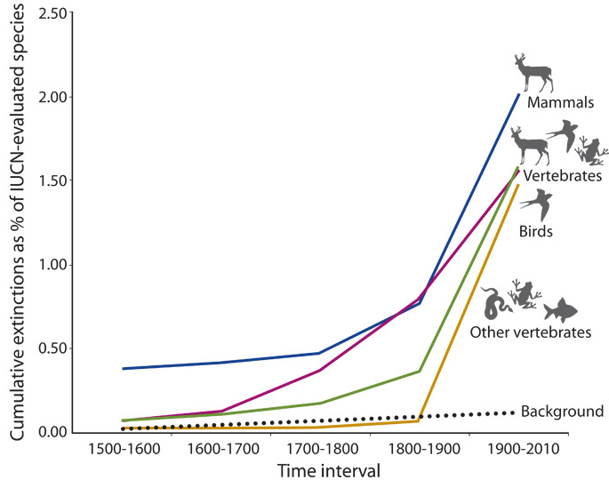
2 June 2020,
Earth's Sixth Mass Extinction Isn't Just Happening,
It's Accelerating
Extinction rate
(in general)

Slide 4
RACING EXTERMINATION
Vertebrates on the brink as indicators
of biological annihilation
and the sixth mass extinction
Gerardo Ceballos et al, 16 June 2020, Proceedings of the National Academy of Science

Slide 5
Rapidly accelerating extinction of species
Climate change increases the extinction rate
Extinction risk is increased under all RCP scenarios, with risk increasing with both magnitude and rate of climate change.
(IPCC 2014 5th assessment WG2 SPM)
(in general)

Slide 6
If global heating greenhouse gas emissions are not stopped, including stopping deforestation (CO2 emissions)
Life on Earth will be driven to extinction
We need no more reasons than this one reason
to stop burning fossil fuels

Slide 7
The world economy and governments have
global climate change on
an accelerating worst-case
global suicide scenario heading
Peter Carter
23 January 2021
DRAFT

Slide 8
BEYOND GLOBAL CLIMATE EMERGENCY
Global climate change indicators are at record highs (adverse),
on a worst-case scenario heading,
and accelerating

Slide 9
Declared climate emergency nations, January 2021
18 countries + EU
Source: The Climate Mobilization

Slide 10
Introduction

Slide 11
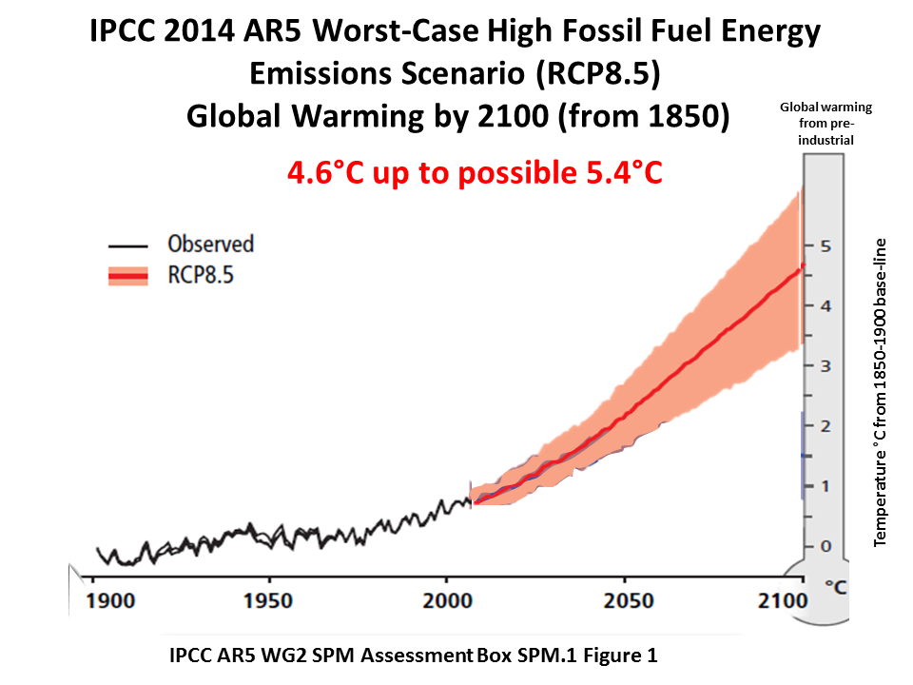
The worst-case scenario RCP 8.5
by 2081-2100 4.3°C up to 5.4°C
This IPCC AR5 image puts a temperature for RCP 8.5 at 2100 of 4.6°C
Pre-ind
5.4

Slide 12
High risk of worst-case scenario heating up to 7.8°C by 2100
Without additional efforts to reduce GHG emissions beyond those in place today… baseline scenarios, those
without additional mitigation, result in global mean surface temperature increases in 2100 …
to 7.8°C when including climate uncertainty .
(IPCC 2014 5th assessment , WG3, SPM p.8)
Climate “uncertainty” here means including amplifying feedback emissions (not accounted for in the projections') and a higher climate sensitivity by 2100, which are to be expected by 2100
+7.8°C
adapted
IPCC 2014 5th assessment, WG2 , Assessment Box SPM.1 Figure 1
RCP8.5 at 2100 is +4.6°C mean (slightly higher than the 4.3°C given
by IPCC for 2081-2100 average

Slide 13
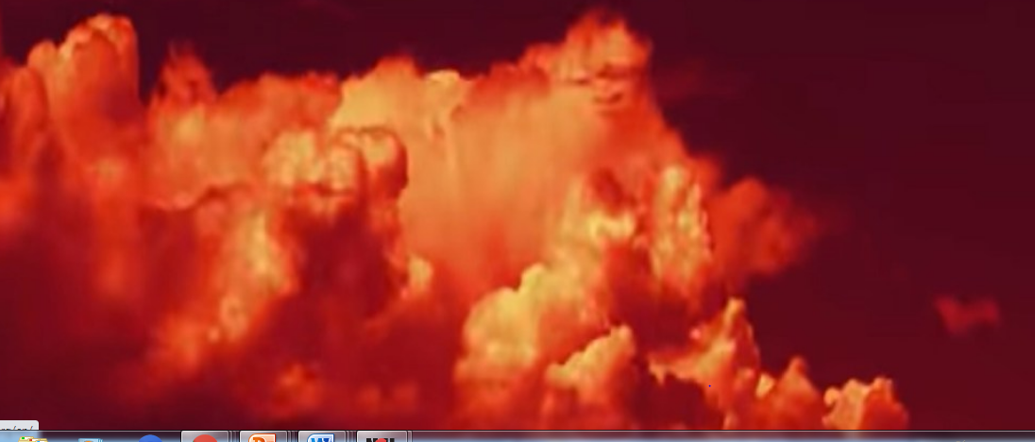
10 March 2020,
Flagship UN study (WMO) shows accelerating climate change
on land, sea and in the atmosphere
The report, The WMO Statement on the State of the Global Climate in 2019, which is led by the UN weather agency (World Meteorological Organization), contains data from an extensive network of partners.
It documents physical signs of climate change – such as increasing land and ocean heat, accelerating sea level rise and melting ice – and the knock-on effects on socio-economic development, human health, migration and displacement, food security, and land and marine ecosystems.

Slide 14
THE CONTEXT
The Global Survival Scenario
Climate change is an existential threat to most life on the planet,
including particularly humankind
UN Secretary General May 2015, Austria World Summit

Slide 15
Caution
This document is on data set trends.
It uses IPCC projections to compare current data trends with the worst case IPCC projection (RCP8.5)
The projections are under estimates
All projections here are calculated from a single climate sensitivity metric of 3°C, while there are now many research papers finding a much higher sensitivity
The projections are only to 2100, while effects are committed continue many centuries to millennia after 2100
The projections do not include global warming amplifying feed backs, nor reduced efficiency of carbon sinks.

Slide 16
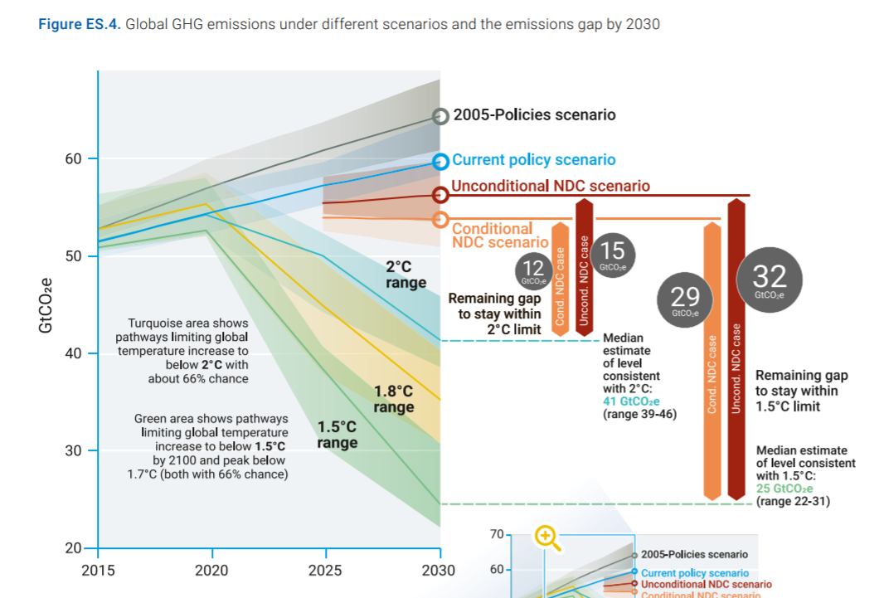
For a chance at 1.5°C or 2°C (by 2100) global emissions have to go into rapid decline in and from 2020
but current policies are for increase
Original
Adapted for clarity and focus
2020
66% chance
NDC: Nationally determined contributions. Non-binding national emissions targets reported to the UN Climate Secretariat
66% chance
66% chance
UNEP 2020 Emissions Gap Report

Slide 17
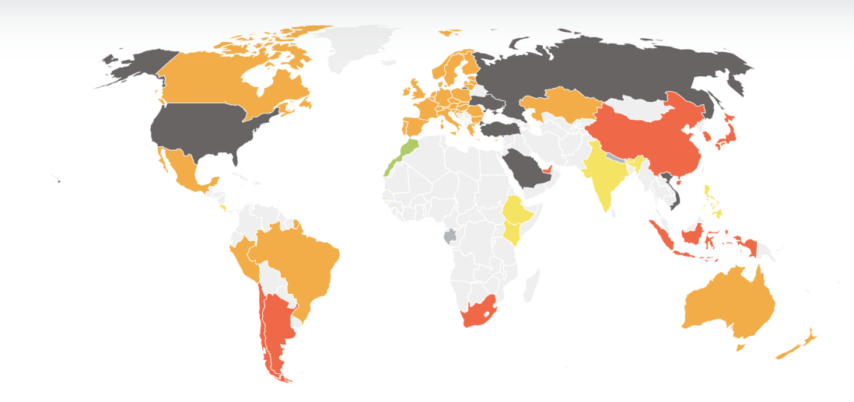
CLIMATE PLANET CATASTROPHE CURRENT NATIONAL
EMISSIONS POLICIES
Climate Action Tracker global emissions projections from current policies
are a global suicide scenario
These temperature increases (3°C up to 4.1°C) are not true increases for policy making because they are only to 2100
LAST UPDATE: Dec 2020
https://climateactiontracker.org/
3°C up to 4.1°C
by 2100
Only by 2100
Morocco
Gambia
Planetary catastrophe policies
2°C Only by 2100
The central objective of the Paris Agreement is its long-term temperature goal to hold global average temperature increase to “well below 2°C above preindustrial levels and pursuing efforts to limit the temperature increase to 1.5°C above pre-industrial levels”. This is referred to by the CAT as the 1.5°C Paris Agreement goal ,This goal is linked to a requirement in the Paris Agreement1 that all countries work together to bring greenhouse gas emissions to zero within the second half of the 21st century,

Slide 18
Recent published science on the worst-case scenario

Slide 19
Recent published research (2020) shows climate change is tracking
on or closest to the worst-case scenario
Global Temperature in 2020 , 14 January 2021, NASA GISS climate expert group
J. Hansen, M. Satoa,, R. Ruedy , G. Schmidtc , K. Lob, M. Hendrickson
Abstract. Global surface temperature in 2020 was in a virtual dead-heat with 2016 for warmest year . The rate of global warming has accelerated in the past several years. The 2020 global temperature was +1.3°C (~2.3°F) warmer than in the 1880-1920 base period. The six warmest years in the GISS record all occur in the past six years, and the 10 warmest years are all in the 21st century.
Growth rates of the greenhouse gases driving global warming are increasing, not declining.
NOAA 2020 In 2020 the Northern hemisphere had its hottest summer on record
Cumulative CO2 emissions track worst-case scenario
August 2020, PNAS, C. R. Schwalm, RCP8.5 tracks cumulative CO2 emissions
Jan 2021 Greater committed warming after accounting for the pattern effect (Chen Zhou et al, Jan 2020
Arctic heating worst-case scenario 29 July 2020, Nature, Past perspectives on the present era of abrupt Arctic climate change, Eystein Jansen et al
The Arctic is currently experiencing an abrupt climate change event, and that climate models underestimate this ongoing warming.
Arctic heating is happening far faster than anybody had anticipated.
And the ice record suggests this has happened before.
Ice sheet melting for sea level rise tracks worst-case scenario
August 2020 , Nature, T. Slater, Ice-sheet losses track high-end sea-level rise projections.
The Greenland and Antarctic ice sheets, which hold enough frozen water to lift oceans 65 metres, are tracking the UN's worst-case scenarios for sea level rise, researchers said Monday, highlighting flaws in current climate change models.
In episodes of Greenland warming, temperatures rose by 10°C or even 12°C, over a time frame of between 40 years and a century, occurring from ice core records between 120,000 years and 11,000 years ago - more than 20 abrupt periods of warming, known as Dansgaard–Oeschger (D–O) events.

Slide 20
Cumulative CO2 tracking the very worst-case scenario
published paper, 2020

Slide 21
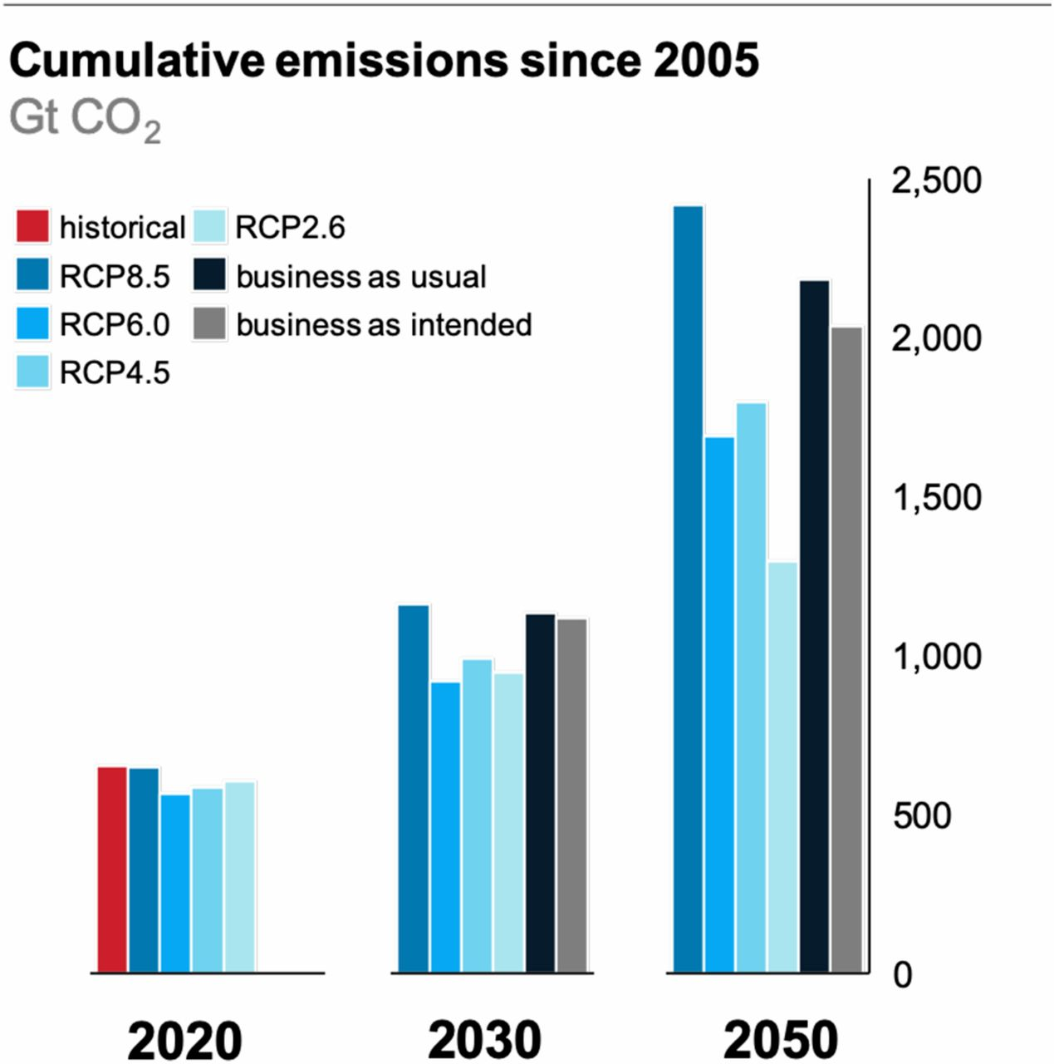
August 2020: Cumulative CO2 emissions are tracking
the worst-case scenario
adapted
“Not only are the emissions consistent with RCP8.5 in close agreement with historical total cumulative CO2 emissions (within 1%), but RCP8.5 is also the best match out to mid-century under current and stated policies with still highly plausible levels of CO2 emissions in 2100”.
Worst-case
RCP8.5
Worst-case
RCP8.5
3 August 2020, PNAS, C. R. Schwalm
RCP8.5 tracks cumulative CO2 emission
Fig. 1.
Total cumulative CO2 emissions since 2005 through 2020, 2030, and 2050.
Peter Carter, Climate Emergency Institute

Slide 22
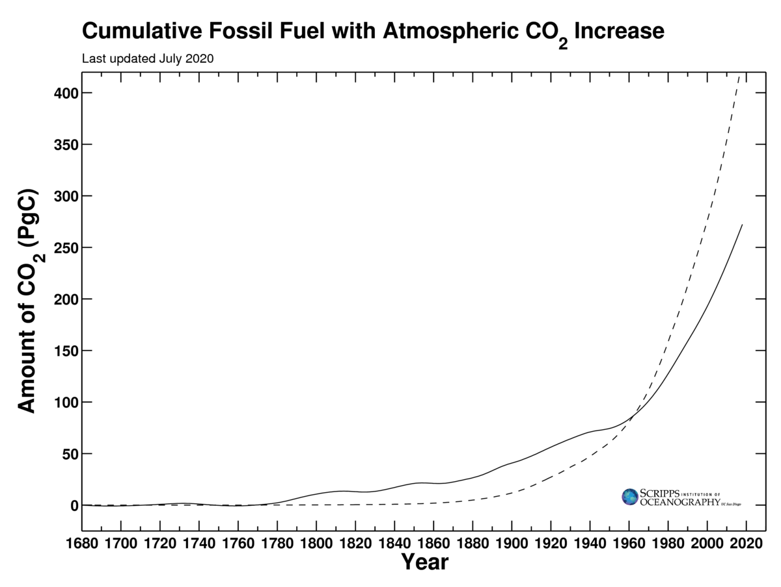
2020: Accelerating atmospheric cumulative CO2 emissions
tracking the very worst-case scenario
Scripps graph
Adapted for clarity
Billion metric tonnes carbon
4 August 2020, PNAS, C.R. Schwalm et al, RCP8.5 tracks cumulative CO2 emissions
Cumulative CO2 in billion tonnes carbon
Scripps July 2020

Slide 23
CO2

Slide 24
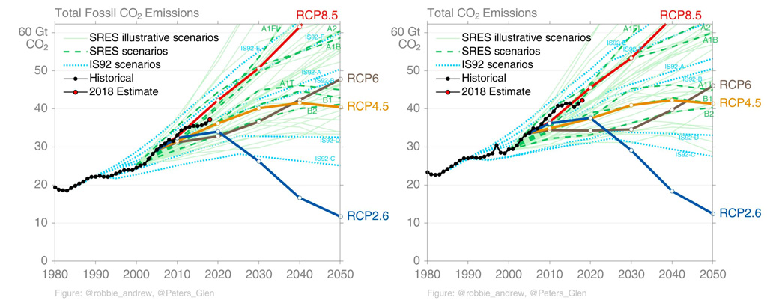
CO2 emissions tracking towards wost-case scenario
Source Carbon Brief, 21 Aug 2019, Explainer: The high emissions scenario RCP 8.5, Credit Glen Peters

Slide 25
CO2 emissions tracking towards worst-case scenario
In 2019, global CO2 emissions increased by an estimated 0.9%
PBL December 2020
Emissions declined in 2020 due the pandemic
2018
Adapted from Carbon Brief, 21 Aug 2019, Explainer: The high emissions scenario RCP 8.5, Credit Glen Peters

Slide 26
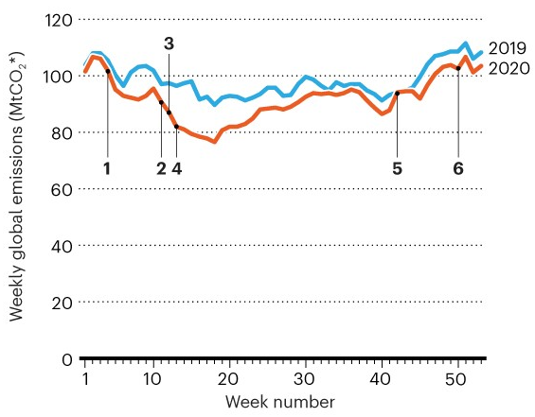
Governments promoted a rapid rebound in CO2 emissions in 2020
Nature, 15 JANUARY 2021
COVID curbed carbon emissions in 2020 — but not by much
Despite sharp drops early in the pandemic, global emissions of carbon dioxide picked up in the second half of the year, new data show.
Week number
Liu, Z. et al. Nature Commun. 11, 5172 (2020).

Slide 27
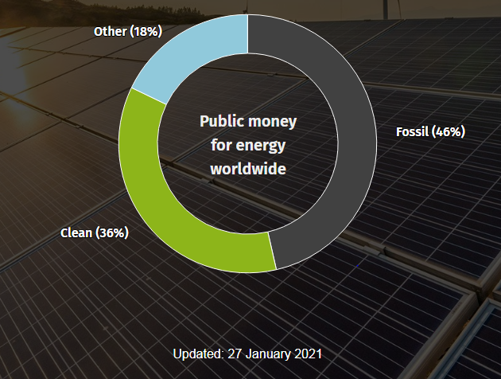
With fossil fuel corporations failing (started pre-Covid), world governments rejected the opportunity the transform the world economy
to a renewable energy driven future
by bailing out the fossil fuel industry
energypolicytracker.org
Track public money for energy in recovery packages
30 major economies pledged $271 billion to fossil fuels, 46% of all public money committed to energy-intensive sectors

Slide 28
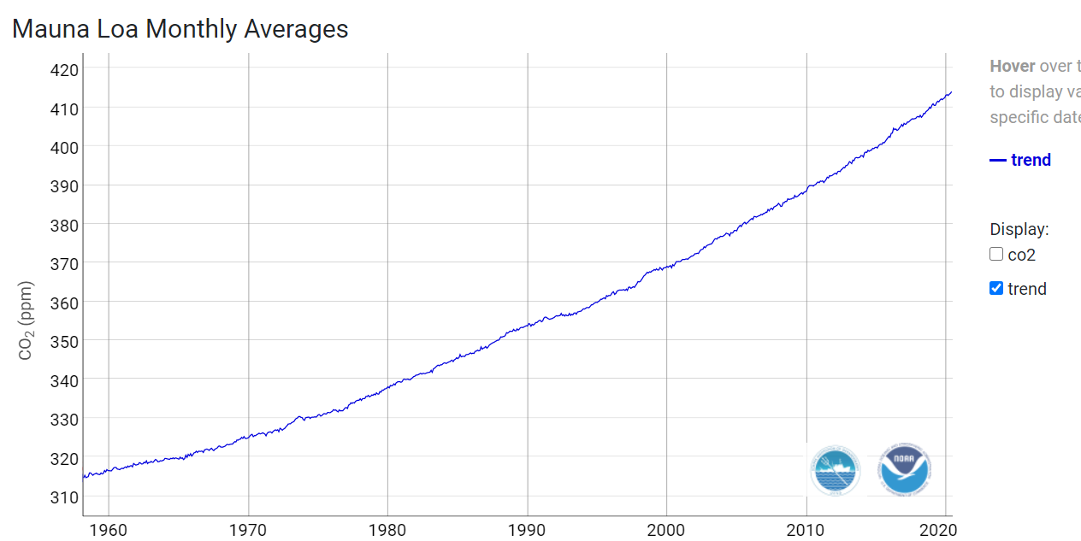
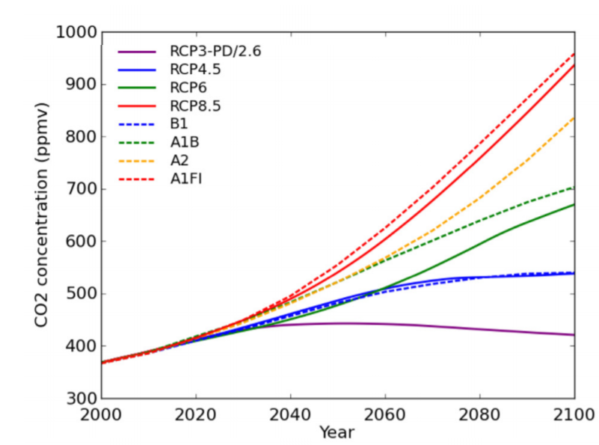
2020: Accelerating ATMOSPHERIC CO2 CONCENTRATION is tracking
the worst-case scenario (RCP 8.5)
Actual present December 2020: 414.75 ppm
600
500
400
300
NOAA Trends in atmospheric CO2,
July update
Focused present day for RCP 8.5
RCP8.5
Seasonally adjusted
mean CO2
2020 RCP8.5: 412 ppm
Original for RCP 8.5
Actual Dec 2020: 414.75
2000 2020 2040
https://www.cawcr.gov.au/projects/Climatechange/wp-content/uploads/2016/11/ACCSP_RCP.pdf
Australian Climate Change Science Program Information Paper
Representative Concentration Pathways (RCPs) Authors: Imogen Jubb, Pep Canadel, and Martin Dix
Climate Emergency institute

Slide 29
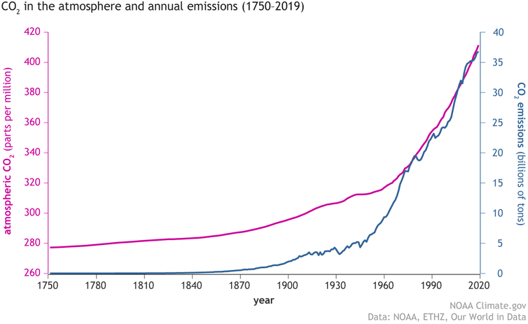
Acceleration of global CO2 emissions and atmospheric CO2
https://www.climate.gov/news-features/understanding-climate/climate-change-atmospheric-carbon-dioxide
Atmospheric CO2
Global CO2
emissions

Slide 30
The other main greenhouse gases
methane and nitrous oxide
accelerating

Slide 31
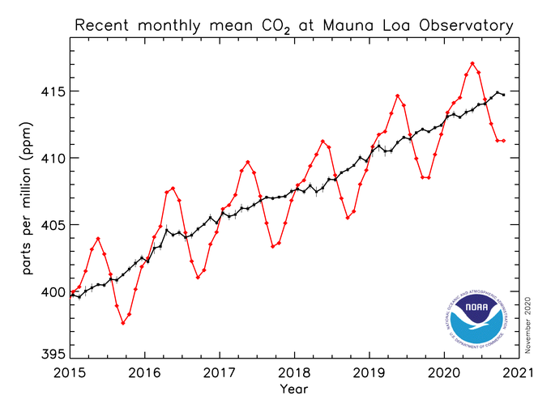
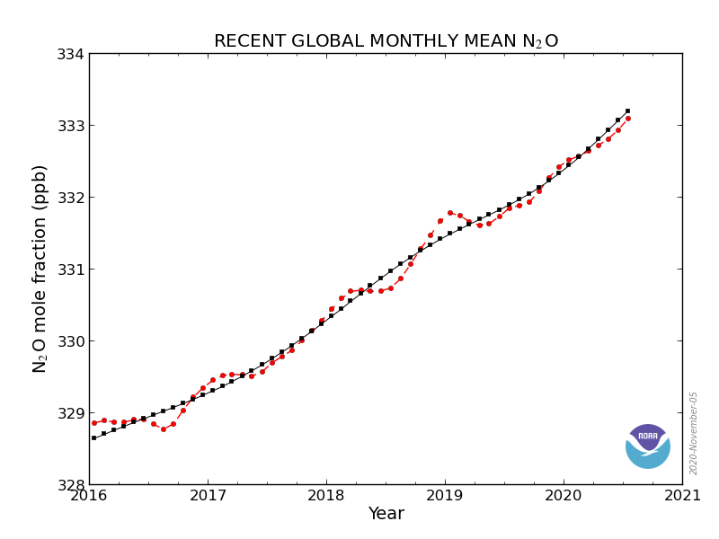
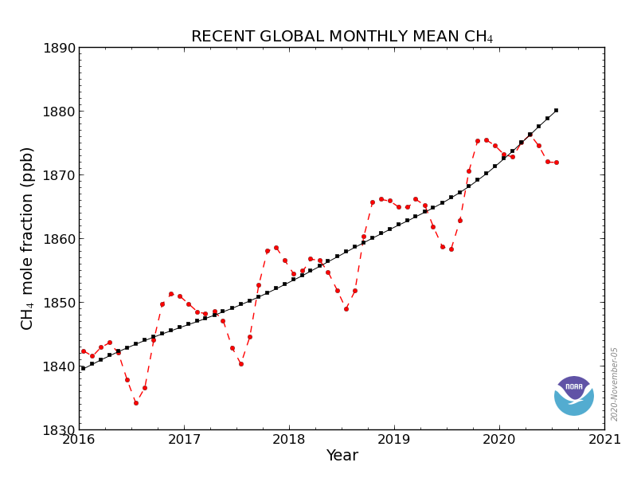
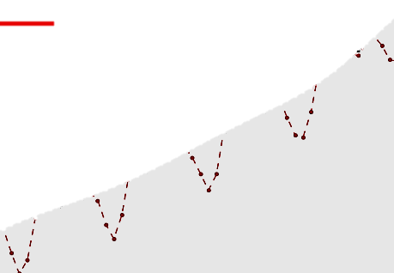
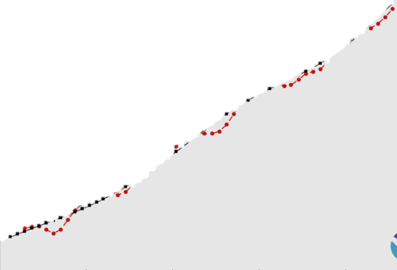
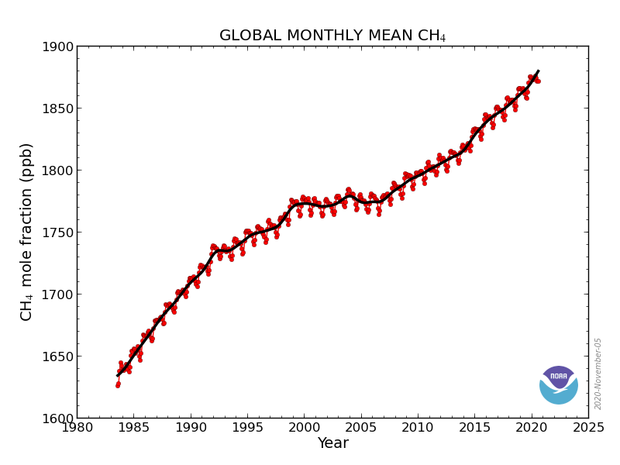
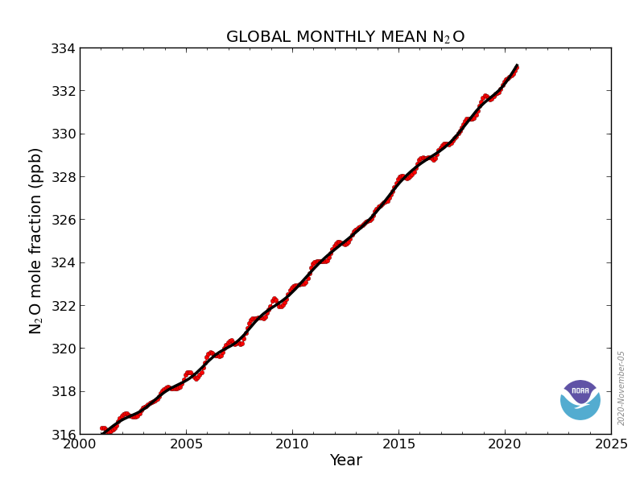
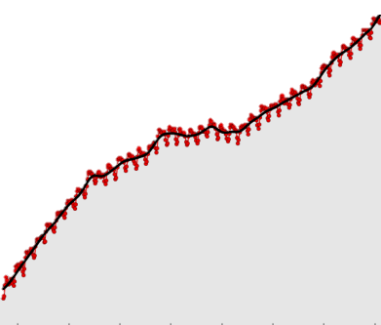
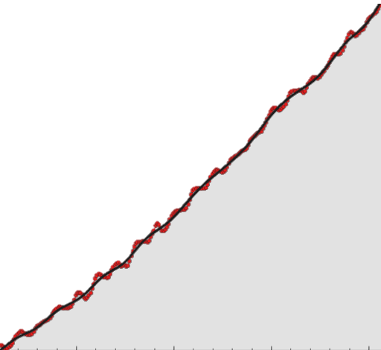
November 2020: Record accelerating atmospheric greenhouse gas concentrations
Methane (CH4) and Nitrous oxide (N2O)
NOAA
Atmospheric methane
Methane (CH4) Nitrous oxide (N2O)
1880 ppb
2016 to 5 Nov 2020
2016 to 5 Nov 2020
Monthly av
Mean methane
Mean nitrous oxide
Mean methane
Monthly methane
N2O
CH4
Atmospheric methane is 235% higher than its 80,000 years ice core limit of 800 ppb
Atmospheric nitrous oxide is higher than its 80,000 years ice core limit of 300 ppb
2016 2020
2016 2020
1985 to 5 Nov 2020
2000 to 5 Nov 2020
1885 to 5 Nov 2020
N2O
CH4
1984 2020
2000 2020

Slide 32
Methane

Slide 33
Anthropogenic Methane Emissions & Socioeconomic Pathways (SSPs)
Global methane emissions tracking the worst-case scenario
Global Carbon Project 2020
The projections represented here correspond to SSPs
defined for IPCC 6th Assessment Report
Anthropogenic emissions:
All inventories, except EPA, infers an increase in emissions as fast as the warmest scenarios between 2005 and 2017.
Adapted
Worst-case scenario
Best-case mitigation scenarios for 1.5°C
and 2°C limit by 2100
Source: Saunois et al. 2020, ESSD (Fig. 2)

Slide 34
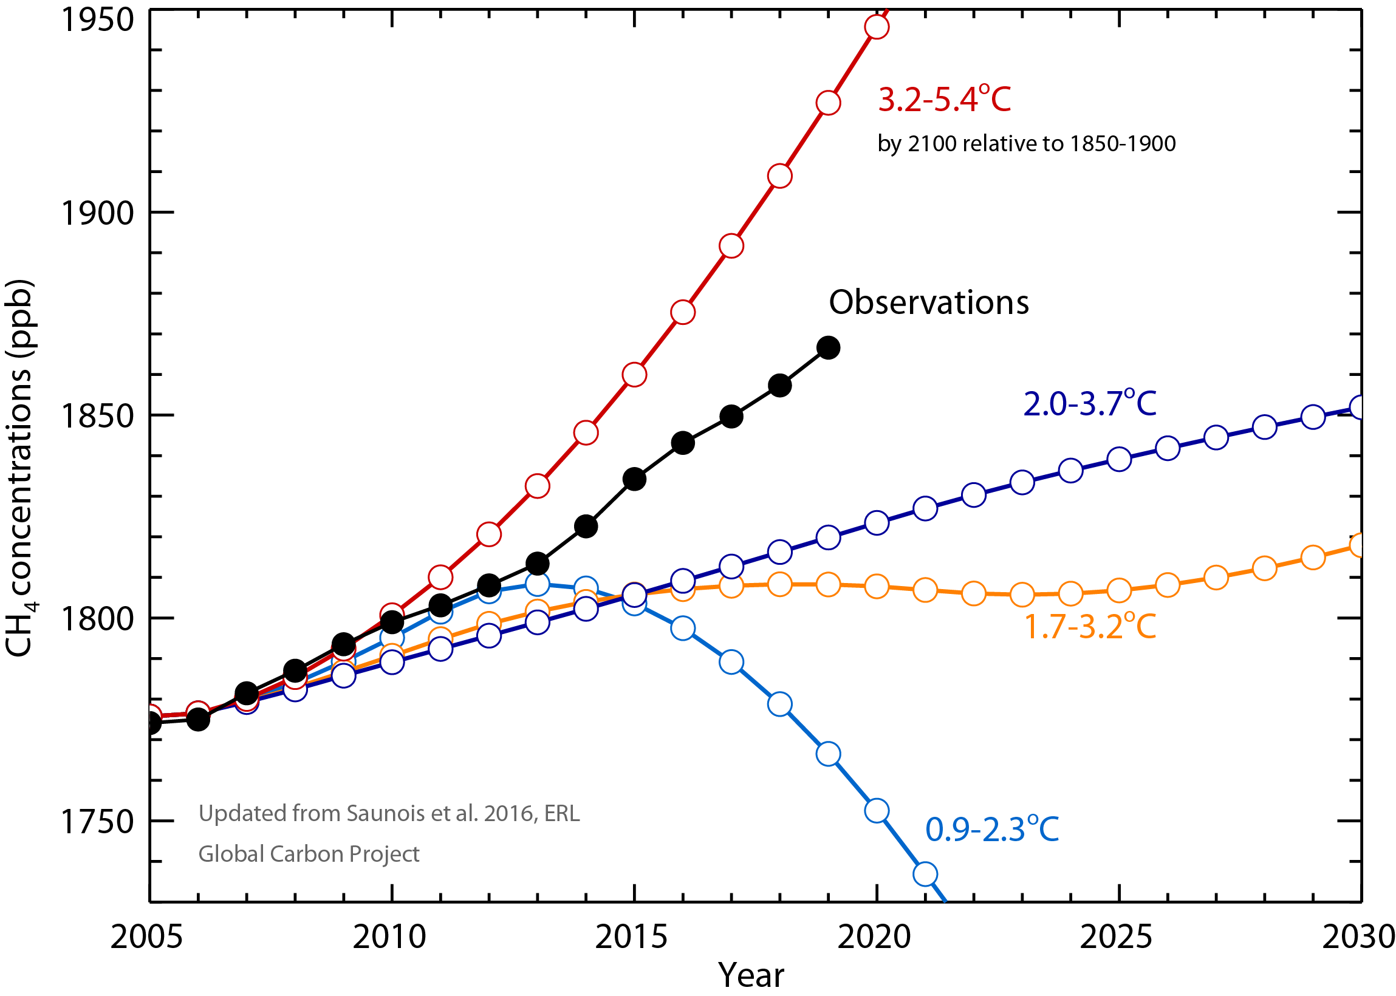
Atmospheric methane closest to worst-case scenario
Since 2013, the atmospheric [methane] increase is approaching
the warmest scenario of IPCC AR5 report
Global Carbon Project Global methane budget, 2020
Note that for best case
2°C mitigation scenario
atmospheric methane
declines by 2015
RCP 8.5
Observations: Globally averaged marine surface annual mean data from NOAA
RCP 2.6 (only scenario not above 2°C by 2100)
Methane concentrations rose faster in 2014, 2015 and 2019 with more than 10 ppb/yr.
Since 2013, the atmospheric increase is approaching the warmest scenario of IPCC AR5 report

Slide 35
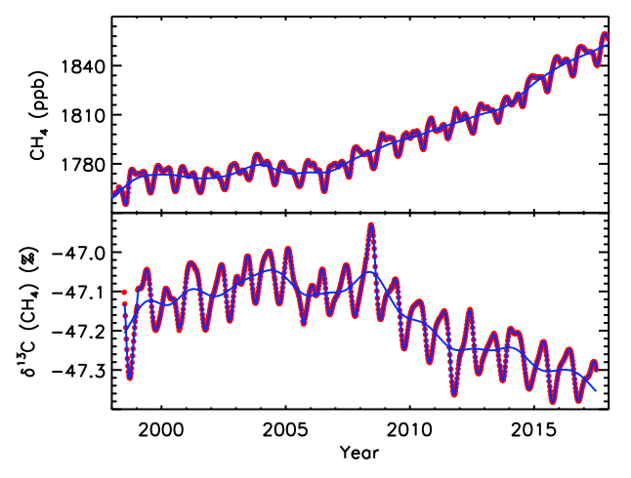
Since 2007: a sustained atmospheric CH₄ growth and δ¹³C-CH₄ decrease
Global Carbon Project Global methane budget, 2020
NOAA Global surface CH₄
Note: 13C carbon decrease indicates
feedback emissions since 2007
Renewed growth
1867 ppb reached in 2019 !
CH₄ Growth rates :
2014 : 12.7±0.5 ppb yr⁻¹
2015 : 10.1±0.7 ppb yr⁻¹
: 7.0±0.6 ppb yr ⁻¹
: 7.0±0.9 ppb yr⁻¹
: 8.5±0.6 ppb yr⁻¹
: 10.7±0.6 ppb yr⁻¹
δ¹³C-CH₄ decreased by -0.2‰ in 10 years
Stabilisation
Decline indicates feedback emissions
Global surface δ¹³C-CH₄
Source : Nisbet et al., 2019
Global Carbon Project, Global methane budget, 2020

Slide 36
Nitrous oxide

Slide 37
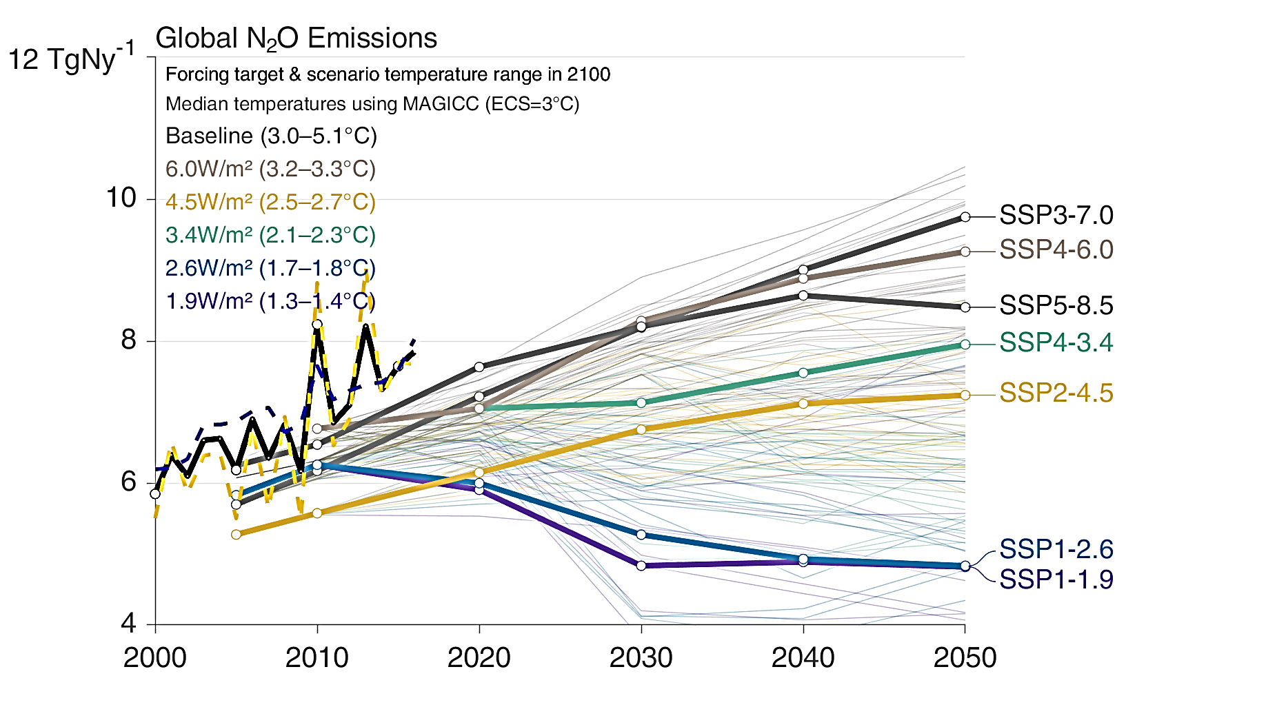
Shared Socioeconomic Pathways (SSPs)
Global nitrous oxide emissions tracking worst-case scenario
Global Carbon Project
The SSPs lead to a broad range in baselines (grey), with more aggressive mitigation leading to lower temperature outcomes. The bold lines are scenarios that will be analysed in CMIP6 and the results assessed in the IPCC AR6 process.
The bold black and dashed blue and yellow lines are the estimated actual emissions
Historical emissions
The recent increase in global N2O emissions exceeds the emission trends of the least optimistic scenarios developed by the Intergovernmental Panel on Climate Change (IPCC), underscoring the urgent need to mitigate N2O emissions.
Worst-case Scenario
Best-case scenario
Only scenarios below 1.5°C-2°C, by 2100
This set of quantified SSPs are based on the output of six Integrated Assessment Models (AIM/CGE, GCAM, IMAGE, MESSAGE, REMIND, WITCH). Model and Data Sources: Riahi et al. 2016; Rogelj et al. 2018; IIASA SSP Database; IAMC; Global Carbon Budget 2019
Global Carbon Project Global nitrous oxide budget 2020

Slide 38
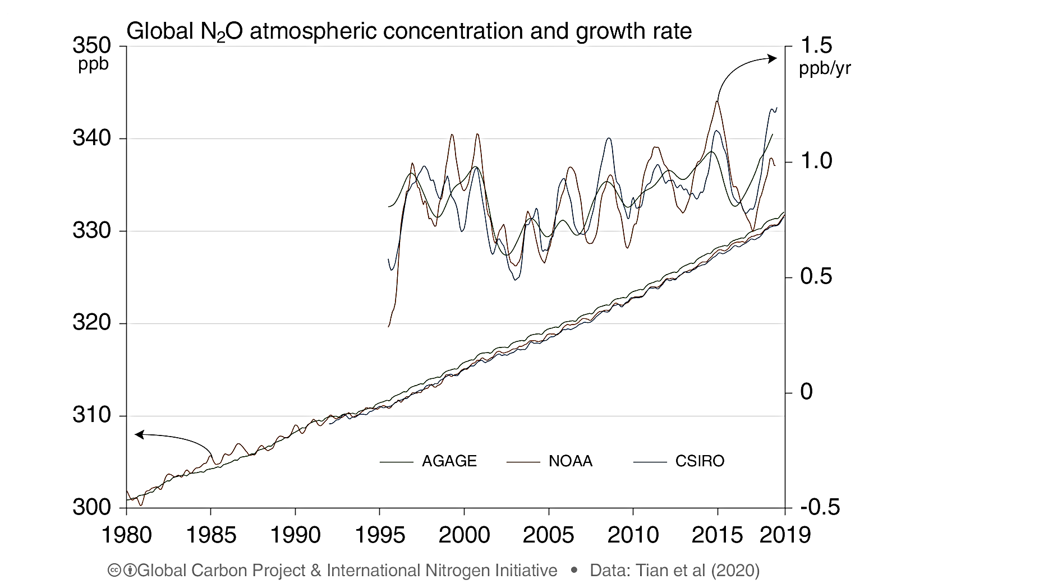
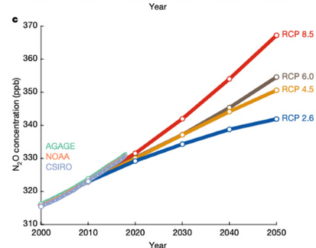
Accelerating atmospheric nitrous oxide concentration
tracking worst-case scenario
The growth in global atmospheric N₂O is accelerating The mean growth rate since 2000 is 0.84 ppb/yr
Data: Global Carbon Project, Global nitrous oxide budget, 2020
Global Carbon Project
Global nitrous oxide
Budget 2020
Current
Source Carbon Brief 7.10.2020

Slide 39
Climate effects based on terrestrial biosphere model simulations
Accelerating soil nitrous oxide emissions
indicates feed-back process
Global Carbon Project
Process-based model estimates show that soil N₂O emissions increased substantially due to climate change since the early 1980s constituting a positive nitrogen-climate feedback.
Data: Global Carbon Project
Climate only
N₂O emission anomaly (Tg N yr⁻¹)
Temperature anomaly (°C)
N₂O (Tg N yr⁻¹)
All factors included
Source: Modified from Tian et al. 2020, Nature

Slide 40
Atmospheric CO2 equivalent (CO2e /CO2 eq.)
Accounts for the other GHGs as well as CO2

Slide 41
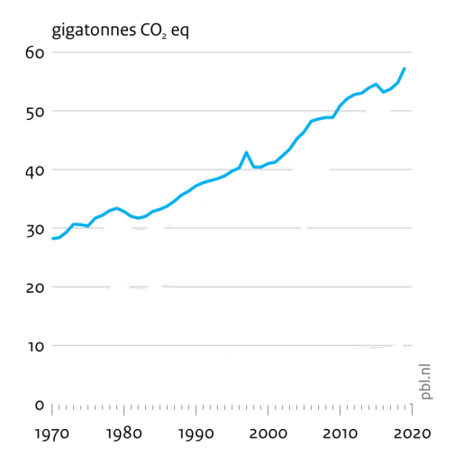
Accelerating atmospheric CO2 equivalent to 2019
Netherlands Environmental Assessment Agency, 2020
Trends in global CO2 and total greenhouse gas emissions: 2020 Report
December 2020, PBL Netherlands Environmental Assessment Agency

Slide 42
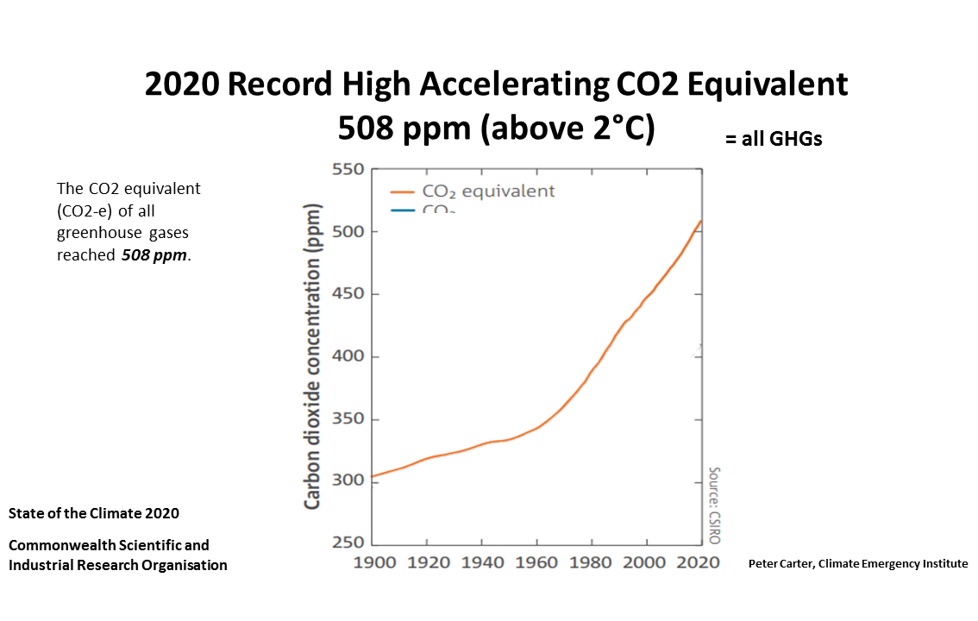

Slide 43
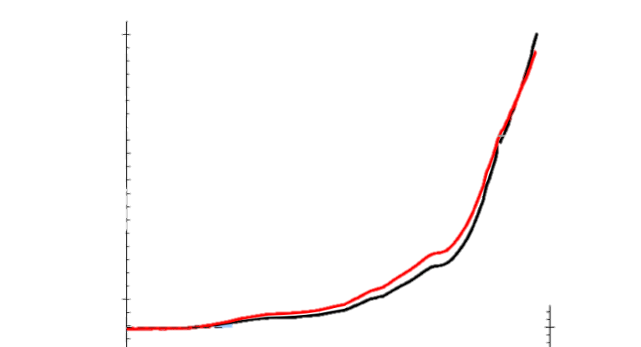
ATMOSPHERIC CO2 EQUIVALENT (2020: 508 ppm)
is tracking the worst-case scenario RCP 8.5
Original for atmospheric CO2 eq.
2020 State of the Climate CSIRO (Australia govt.)
The CO2 equivalent includes the other greenhouse gases, like methane and nitrous oxide
so it is higher than CO2 alone. It is the metric used by the IPCC in mitigation calculations
Worst-case
Highest emissions RCP 8.5
Present day focus
with RCP8.5 and today’s concentration
2020 CO2 equivalent (CO2-e) of all
greenhouse gases 508 ppm
600
400
200
2018 CO2 eq 496 ppm
Actual 2019: 500 ppm
2019 RCP8.5: 448 ppm
Original for RCP8.5
Source: EPA Climate change science
Future of climate change
2017
2000 2020 2040
https://19january2017snapshot.epa.gov/climate-change-science/future-climate-change_.html
Climate Emergency institute

Slide 44
UNEP reveals that atmospheric CO2 equivalent is tracking
the UNEP “no policy” scenario

Slide 45
GLOBAL GREENHOUSE GAS EMISSIONS HAVE TRACKED
UNEP BUINESS-AS-USUAL (no policy) SCENARIO
FOR THE PAST 10 YEARS!
(UNEP 2019)
“The current level of global GHG emissions is by now almost exactly at the level of emissions projected for 2020 under the business-as-usual, or no-policy, scenarios used in the Emissions Gap Reports.
In other words, essentially there has been no real change in the global emissions pathway in the last decade. “
United Nations Environment Program
Lessons from a decade of emissions gap assessments, UNEP, Special Report April 2019

Slide 46
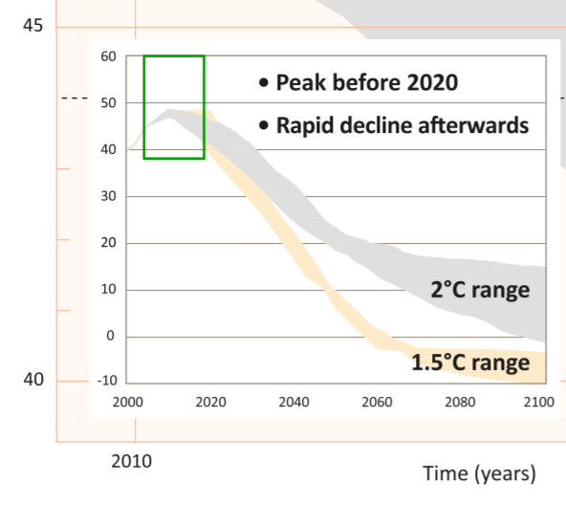
UNEP, 2019: Past 10 years emissions business as usual scenario
26 NOV 2019 STORY CLIMATE CHANGE
10 things to know about the Emissions Gap 2019
https://www.unenvironment.org/news-and-stories/story/10-things-know-about-emissions-gap-2019
In 10 years of producing the emissions gap report, the gap between what we should be doing and what we actually are is as wide as ever.
On the brink of 2020, we now need to reduce emissions by 7.6 per cent every year from 2020 to 2030. If we do not, we will miss a closing moment in history to limit global warming to 1.5°C. If we do nothing beyond our current, inadequate commitments to halt climate change, temperatures can be expected to rise 3.2°C above pre-industrial levels, with devastating effect (there are only 2100 temperature increases) .
And these projections do not include extra feedback emissions caused by global surface heat, for example Amazon fires and droughts.
Lessons from a decade of emissions gap assessments, Special Report 2019
https://wedocs.unep.org/bitstream/handle/20.500.11822/30022/EGR10.pdf?sequence=1&isAllowed=y
The current level of global GHG emissions is by now almost exactly at the level of emissions projected for 2020 under the business-as-usual, or no-policy, scenarios used in the Emissions Gap Reports
In other words, essentially there has been no real change in the global emissions pathway in the last decade.
Source: UNEP (2011)

Slide 47
Accelerating trend, even over the past few years
2020 was a record equal, or marginally higher the 2016 record
2016 was boosted by a strong warming El Nino, while 2020 was under a cooling La Nina
2020 was a new record for a non El Nino year
Note the exact temperature increases given varies amongst the climate science centers.
The NASA GISS tends to be highest, (?most accurate) because it accounts for the Arctic better.

Slide 48
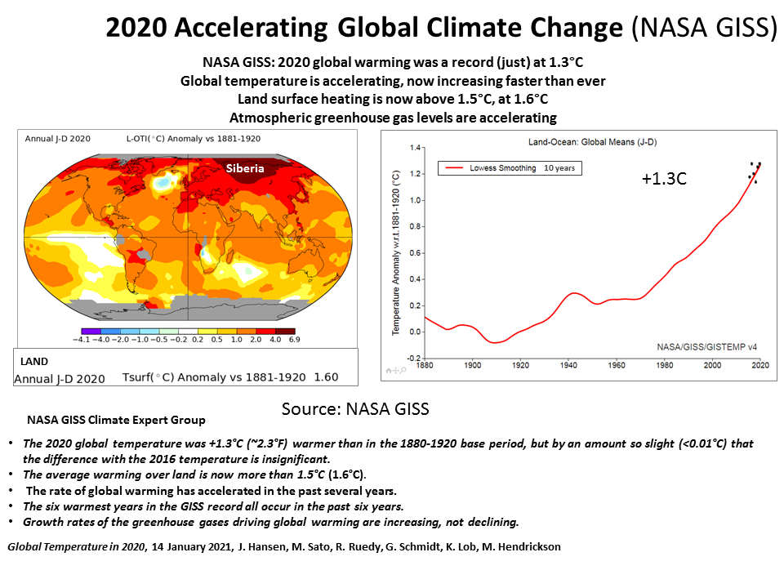

Slide 49
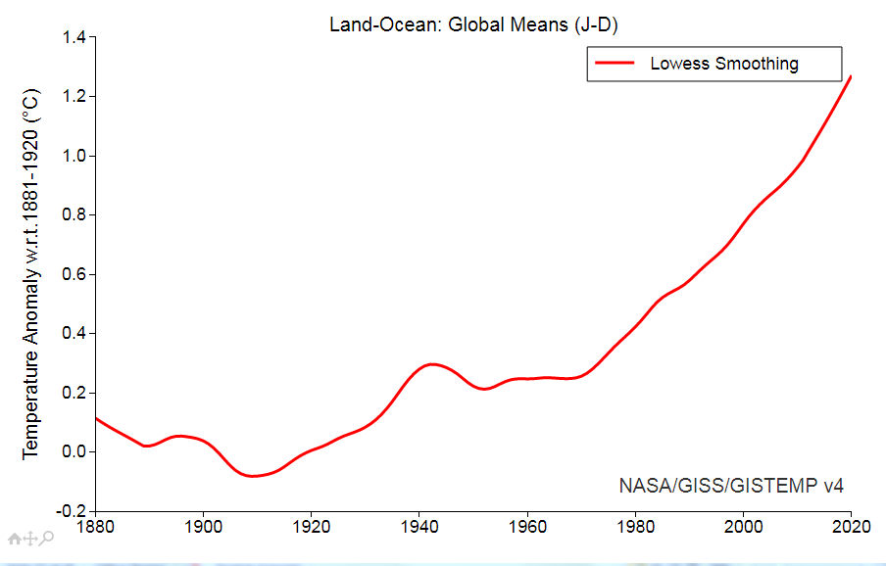
130 Years of accelerating global average surface temperature increase
to 2020
NASA GISS
From 1881-1920 average for pre-industrial
10 years

Slide 50
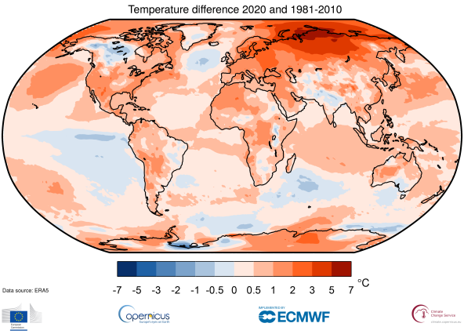
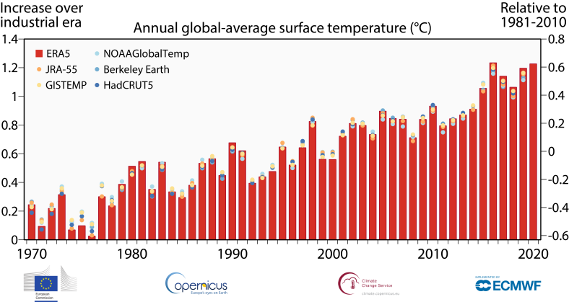
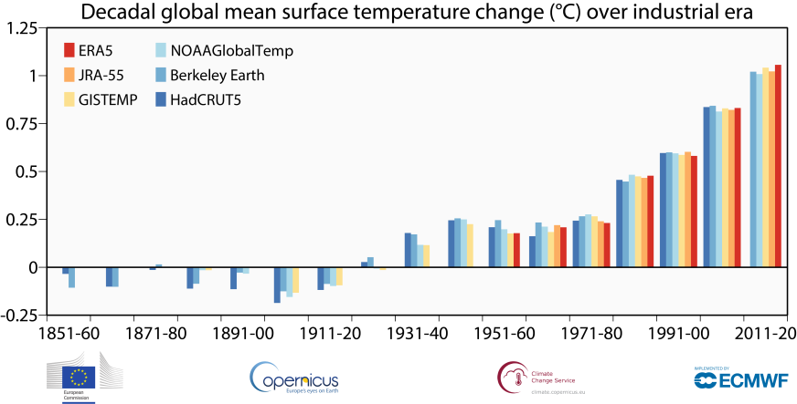
Copernicus (Europe): 2020 is a record high (tied with 2016),
making 2020 a new high for a non-El Nino year
and accelerating global surface heating sustained
Tied Record 2020 (re. 1981-2010)
Globally, 2020 was on a par with the 2016 record at around 1.25°C
above the 1850-1900 pre-industrial period.
This makes the last six years the warmest six on record.
Europe saw its warmest year on record at 1.6°C above the 1981-2010 reference period, and 0.4°C above 2019, the previous warmest year.
The largest annual temperature deviation from the 1981-2010 average was concentrated
over the Arctic and northern Siberia, reaching to over 6°C above average and on a monthly basis, fffthe largest positive temperature anomalies for the region repeatedly reached more than 8°C.
.
Siberia
Note: Siberia holds most permafrost carbon
Accelerating Annual 1970 to 2020
*2020 ties with 2016, but while 2016 was boosted by a warming El Nino, 2020 was under a cooling La Nina.
Accelerating Decadal temperature 1850 to 2020
Peter Carter, Climate Emergency Institute

Slide 51
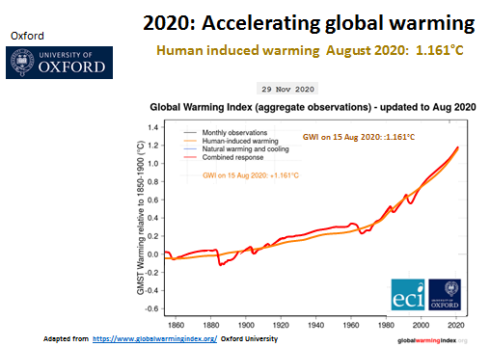
The Global Warming Index
The Global Warming Index uses
attribution science to remove external influences, like ENSO (El Nino) and volcanoes, to isolate the surface temperature increase caused by human emissions alone.
The index shows the global temperature acceleration driven by emissions clearly.
Recorded increase
Calculated emissions increase
Global warming index

Slide 52
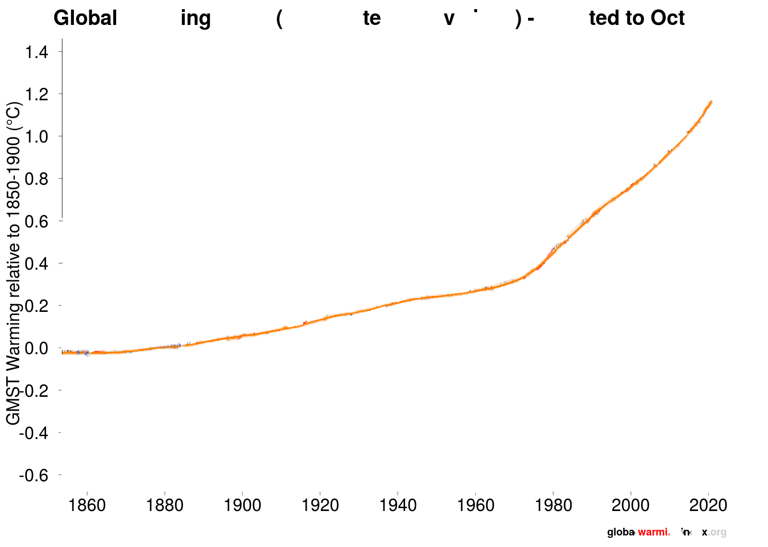
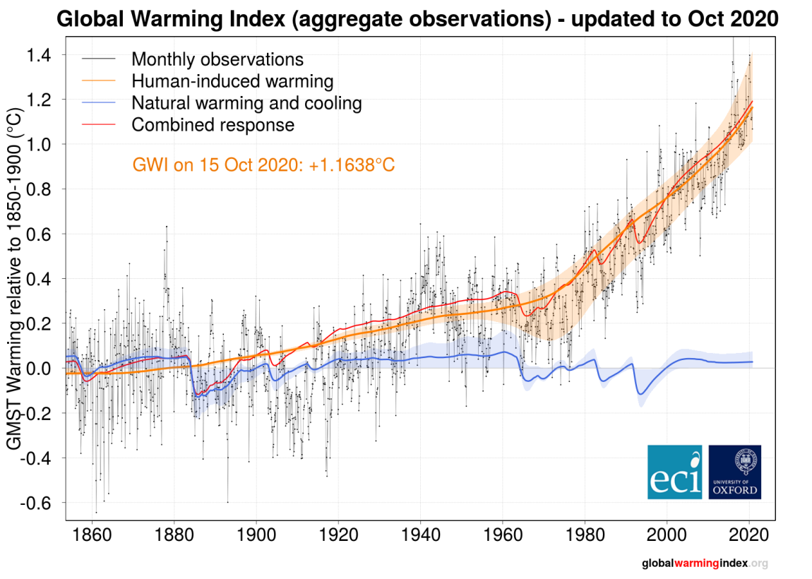
January 2021 Global warming index +1.17°C
(isolated greenhouse gas emissions effect only)

Slide 53
IPCC 2018 1.5C Report model short-term projections
Because the world is tracking the worst case scenario and because of system inertias, with no global emergency emissions response
1.5°C will be at 2035
2°C will be by 2045
As projected for worst case RCP 8.5 by IPCC 2018 1.5°C Report models

Slide 54
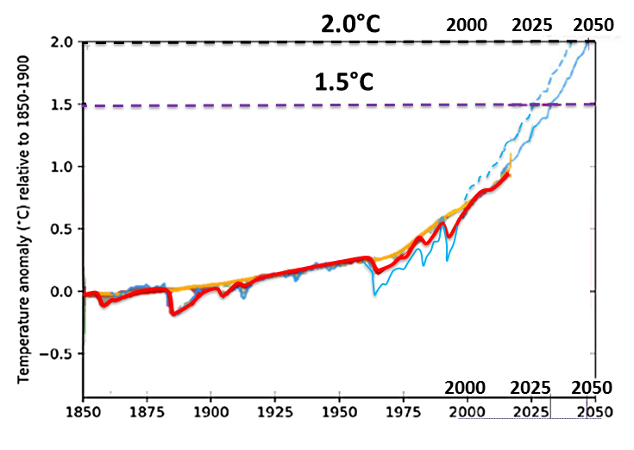
IPCC 2018 1.5°C Report’s
global warming projections to 2050
1.5°C by 2035
2.0°C by 2045
With no immediate rapid global emissions decline 1.5°C and °2C in this time period
is unavoidable
CMIP5 model average Surface Air Temperature
CMIP5 model average blended & masked
Recorded temperature
Calculated warming index
Pink shading indicates the range for temperature fluctuations over the Holocene
Pre-industrial reference
Adapted from IPCC 2018 1.5°C Report, Figure 1.2 Evolution of global mean surface temperature over the period of instrumental observations

Slide 55
Climate change indicators- Impacts

Slide 56
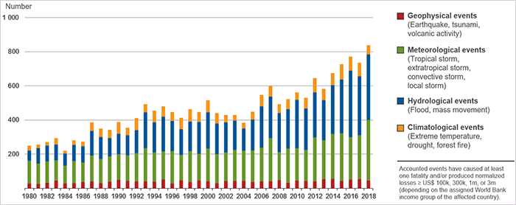
Accelerating extreme events 1980-2019
2019 natural catastrophes
Insurance Information Institute , Facts + Statistics: Global catastrophes

Slide 57
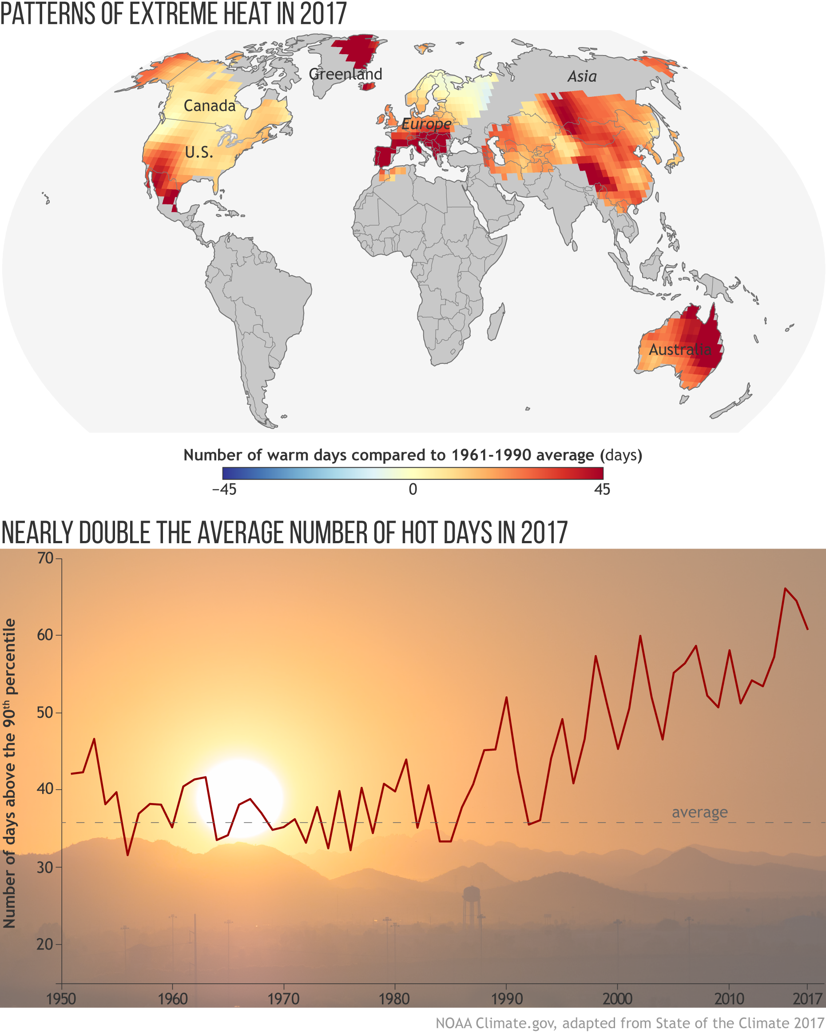
Accelerating global extreme heat
NOAA 2018
2017 NOAA,
State of the
global climate:
Hot days
August 1, 2018
1950 1960 1970 1980 1990 2000 2010 2017

Slide 58
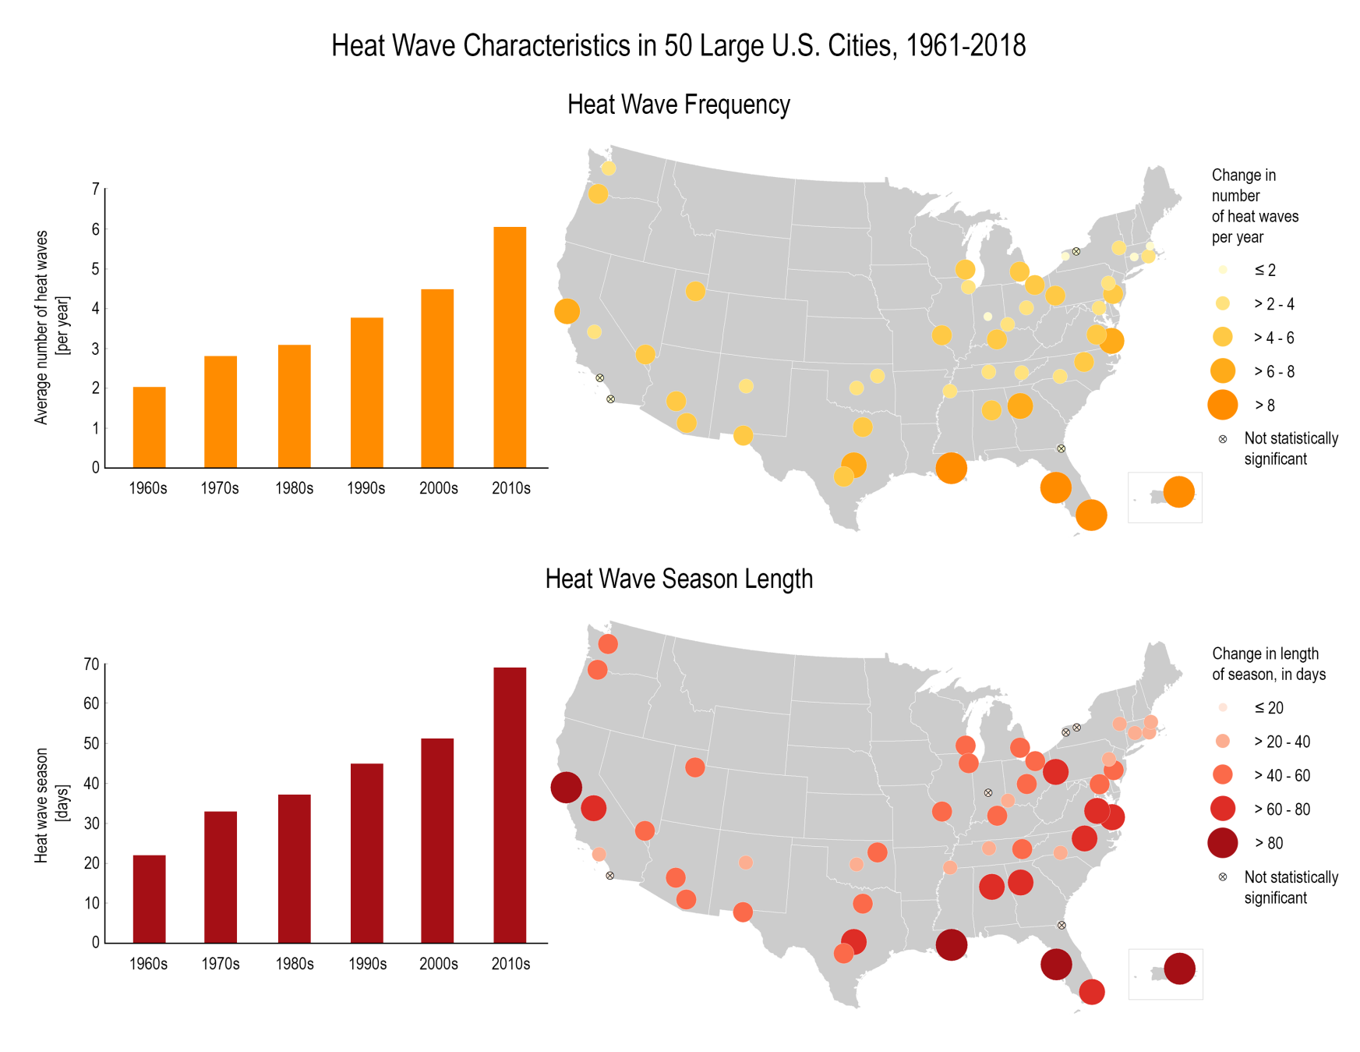
Accelerating heat waves affecting US cities
Fifth National Climate Assessment
(NCA5) , USA, accessed 2020
Heat waves recorded in 50 Large US cities,1961-2018
Frequency
1960s 2010s
Length
1960s 2010s

Slide 59
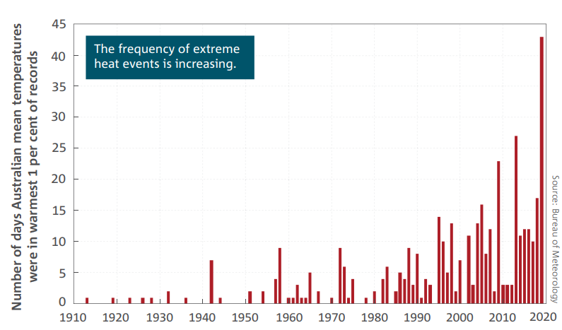
Australia accelerating extreme heat
State of the Climate 2020, Australia Bureau Meteorology

Slide 60
Oceans

Slide 61
Multiple rapidly increasing damaging effects on the ocean
(tropical North Atlantic here)
16 October 2020, Acceleration of ocean warming, salinification, deoxygenation and acidification in the surface subtropical North Atlantic Ocean, N. Roberts, R. Johnson
Surface temperature & anomalies
Surface dissolved oxygen & anomalies
Acidification is the inverse of pH (hydrogen ion potential
Graph below shows relative acidification
Surface pH and anomalies.
Relative ACIDIFICATION

Slide 62
Ocean heat
93% of added atmospheric greenhouse heat has gone to ocean heat
making ocean heat a far better climate change indicator than global average surface warming
Ocean heat is definitely accelerating (multiple sources) and fast

Slide 63
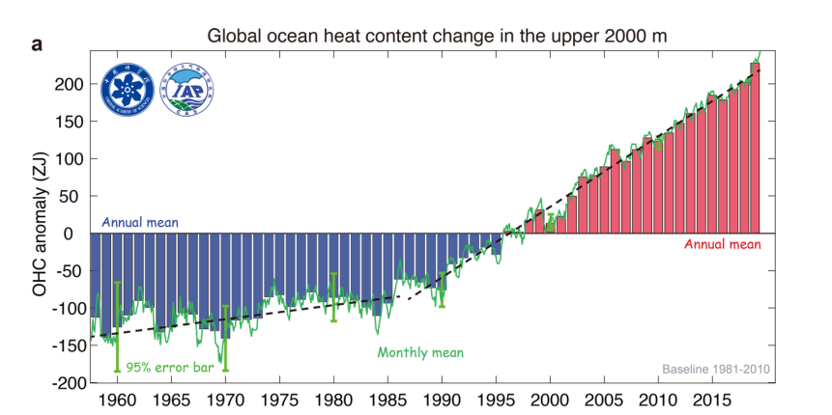
2019:OCEAN HEAT
Accelerating
Ocean heating causes ocean deoxygenation (deep open ocean)
Record-Setting Ocean Warmth Continued in 2019, Lijing Cheng et al, 27 Jan 2020

Slide 64
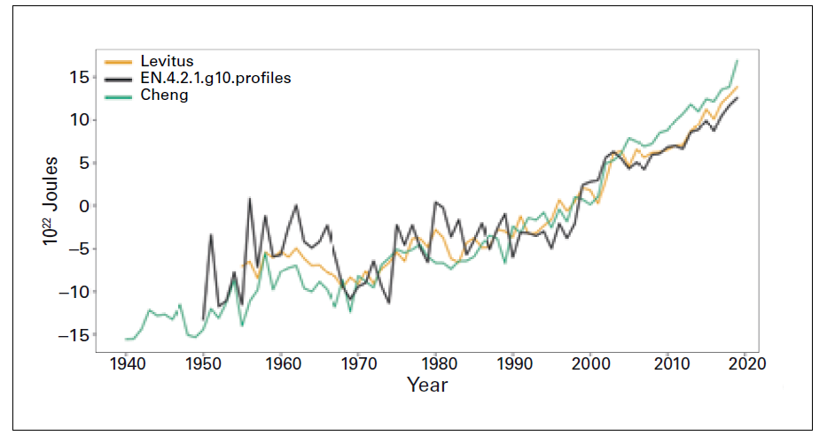
2019 OCEAN HEAT
Accelerating
(2014-2019 average, WMO, 2020)
WMO Climate 2014-2019
Figure 7. Global ocean
heat content change
(x 1022 J) for the 0–700-
meter layer relative to
the 1981–2010 baseline.
The lines show annual
means from the Levitus
analysis produced by
NOAA NCEI, the EN4
analysis produced by the
UK Met Office Hadley
Centre, and the Institute
of Atmospheric Physics
ocean analysis (Cheng
et al., 2019).
2020, The Global Climate in 2015–2019, World Meteorological Organization

Slide 65
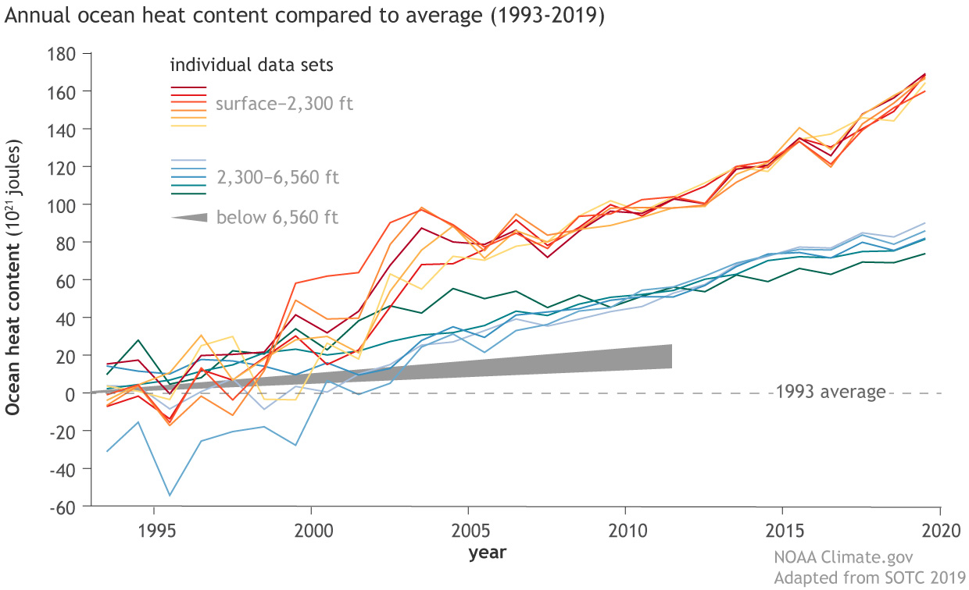
Accelerating ocean heat content to 2019 , NOAA
Climate Change: Ocean Heat Content
August 17, 2020, NOAA article

Slide 66
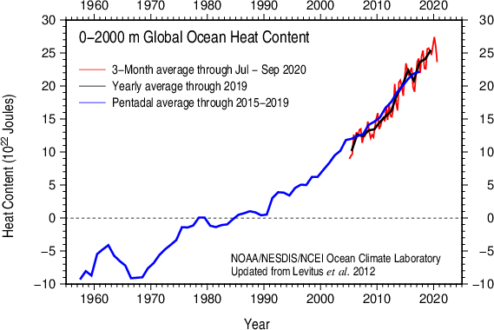
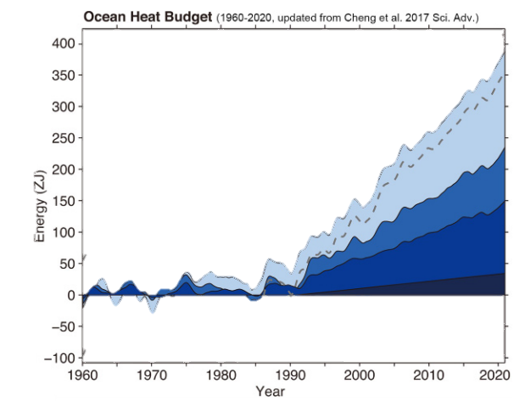
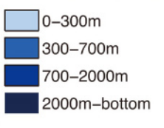
Accelerating ocean heat with incredibly
large increase 2019-2020
1919
Ocean heat 1960-2020
Total heat
93% of greenhouse gas heat added to the lower atmosphere has gone to the oceans, which makes ocean heat a far better climate change indicator than global average warming.
Ocean heat is even penetrating to the bottom of the oceans and increasing there
Ocean Temperatures Hit Record High in 2020 , Lijing Cheng,et al, January 2021
Peter Carter, Climate emergency Institute
Notes:
e

Slide 67
Ocean Heat (IPCC, 2019)
Considering acceleration headed towards worst-case
Though it is not possible to discern a deviation of the scenarios from the latest IPCC report data illustration, ocean heat is accelerating (Figure 5.1, see also next) which would be towards the worst-case.
IPCC 2019 Ocean and Cryosphere Figure SPM.1
A.2 “Since 1993, the rate of ocean warming has more than doubled”
Original
800
0
The rate of heat uptake in the upper ocean (0–700 m) is very likely higher in the 1993–2017 (or 2005–2017) period compared with the 1969–1993 period (see Table 5.1).
The deeper layer (700–2000 m) heat uptake rate is likely to be higher in the 1993–2017 period compared with the 1969–1993 period. (IPCC 2019 Oceans and Cryosphere Report 11.142)
2000 2050
Table 5.1
https://www.ipcc.ch/srocc/download/

Slide 68
Sea level rise
Sea level rise is a specially good climate change indicator because it results from ocean heat and the impact of surface warming (melting land ice)
Sea level is accelerating
TS. A.3 Global mean sea level (GMSL) is rising, with acceleration in recent decades due to increasing rates of ice loss from the Greenland and Antarctic ice sheets (very high confidence), as well as continued glacier mass loss and ocean thermal expansion.
IPCC , 2019, Special Report on the Ocean and Cryosphere in a Changing Climate

Slide 69
Accelerating sea level rise is tracking the worst-case scenario (RCP8.5)
2005 to 2020: 55 mm
IPCC 2014
Change in sea level since 1993 as observed by satellites.
IPCC 2014 5th assessment, WG1, SPM
Original for RCP8.5
2006
NASA, climate change, vital signs
2020
IPCC 2014 5th assessment Figure SPM.6 global mean sea level rise (b) from 2006 to 2100 as determined by multi-model simulations. All changes are relative to 1986–2005.
From https://ar5-syr.ipcc.ch/topic_summary.php
Accelerating sea level rise
December 2019: 95 mm
Present day focus
Supporting data set
Actual rise 95 mm
RCP8.5 at 2020:
80 mm
1880 2020
NOAA, Climate Change: Global Sea Level Article, November 19, 2019

Slide 70
ACCELERATING GLOBAL SEA LEVEL RISE
is tracking the worst-case scenario RCP 8.5
Worst case RCP8.5
Observations,
Church & White
APRIL 9, 2018
Early climate action has big effect on rising sea levels
by Larry O'hanlon, American Geophysical Union
https://phys.org/news/2018-04-early-climate-action-big-effect.html

Slide 71
SEA LEVEL RISE ACCELERATION
IPCC 2019 Special Report
IPCC , 2019, Special Report on the Ocean and Cryosphere in a Changing Climate SPM.1
The IPCC 2019 Report shows historic sea level rise to 2016
A.3.2 “Sea level rise has accelerated due to the combined increased ice loss from
the Greenland and Antarctic ice sheets (very high confidence).
Mass loss from the Antarctic ice sheet over the period 2007–2016 tripled relative to 1997–2006.
For Greenland, mass loss doubled over the same period “
https://www.ipcc.ch/srocc/download/
A.3.3 “Acceleration of ice flow and retreat in Antarctica, which has the potential to lead to sea level rise of several metres within a few centuries, is observed in the Amundsen Sea Embayment of West Antarctica and in Wilkes Land, East Antarctica (very high confidence).
These changes may be the onset of an irreversible ice sheet instability.”

Slide 72
Ocean Acidification
The science metric is ocean pH (hydrogen ion potential) which is the inverse of ocean acidification

Slide 73
Rapidly accelerating ocean acidification
Unprecedented in past 300 million years
“The rate of decrease in pH has accelerated to over 0.02 per decade, more than five times faster than from 1900 to 1960.
This current rate of change is also 10 times faster than at any time in the past 300 million years. “
State of the Climate 2020, Australia Bureau Meteorology
CSIRO (Commonwealth Scientific and Industrial Research Organisation)
The pH of surface waters around Australia.
Inverted pH for relative ocean acidification
Inverted pH

Slide 74
OCEAN ACIDIFICATION
is tracking above the worst-case scenario (RCP8.5)
IPCC 2019 Ocean & Cryosphere Report
The Lower the pH- the Higher the Acidity
The Lower the pH- the Higher the Acidity
IPCC 2019 Ocean & Cryosphere Report Figure SPM.1 | Observed and modelled historical changes in the ocean and cryosphere since 1950, and projected future changes under low (RCP2.6) and high (RCP8.5) greenhouse gas emissions scenarios.
Present day focus
Original for RCP8.5l
8.185
https://www.ipcc.ch/srocc/download/
https://www.ipcc.ch/srocc/chapter/summary-for-policymakers/

Slide 75
Ocean de-oxygenation
Ocean heating leads to ocean de-oxygenation (open deep oceans)

Slide 76
OCEAN DEOXYGENATION
is tracking above the worst-case scenario
IPCC , 2019, Special Report on the Ocean and Cryosphere in a Changing Climate
https://www.ipcc.ch/srocc/download/

Slide 77
Sea surface temperature
Sea surface temperature rise is accelerating
Is the global sea surface temperature rise accelerating?
H.Bâki Iz, .2018
https://doi.org/10.1016/j.geog.2018.04.002

Slide 78
Accelerating sea surface temperature rise is headed
for the worst-case scenario
IPCC 2019 Oceans and Cryosphere report

Slide 79
Great Barrier reef 2020: Record high summer surface temperature increase and mass bleaching event
The 2020 extensive bleaching of the Great Barrier Reef was an unprecedented three mass bleaching events in the past five years, and affected more o0f the reef than ever down to the southern reef.
In the 2016 bleaching, more than half of the severely bleached coral in the reef’s northern (most vulnerable) section died. (Science Journal 8 April 2020 Great Barrier Reef experiences massive coral bleaching)

Slide 80
The Arctic
The frozen Arctic is vital to life on Earth.
Scientists call it the air conditioner of the entire northern hemisphere
The loss of the summer Arctic sea ice and snow will change the temperate climate of the northern hemisphere –for the worse
Arctic summer sea ice and snow reflect in coming solar energy back out to space , instead of converting to heat energy , like the unfrozen land and ocean surface. The melting away of the sea ice and snow is a global warming amplifying feedback.
Other vast enormous sources of Arctic feedback GHG emissions under global warming are the subarctic wetlands, Boreal forest permafrost, and Arctic sub sea floor methane.

Slide 81
NOAA 2020: Accelerating Arctic temperature increase
Arctic amplification (of global warming) is evident from 2020 with rapidly increasing degree of amplification
NOAA Arctic Report Card, Dec 2020

Slide 82
Arctic Amplification (of global warming)
Northern hemisphere warming faster than rest of planet
Source: NASA GISS

Slide 83
Arctic global warming impacts accelerating on worst-case scenario
Arctic heating races ahead of worst case estimates
By Tim Radford, Climate News Network, Sept. 3, 2020
The latest study is a reminder that temperatures in the Arctic are rising far faster than that. And the news is hardly a shock: within the past few weeks, separate teams of researchers, reporting to other journals, have warned that Greenland – the biggest single reservoir of ice in the northern hemisphere – is melting faster than ever; more alarmingly, its icecap is losing mass at a rate that suggests the loss could become irreversible.
Researchers have also confirmed that the average planetary temperature continues to rise inexorably, that the Arctic Ocean could be free of ice in summer as early as 2035, and that the climate scientists’ “worst case” scenarios are no longer to be regarded as a warning of what could happen: the evidence is that what is happening now already matches the climate forecaster’s worst case. The latest finding implicitly and explicitly supports this flurry of ominous observation.
“We have looked at the climate models analysed and assessed by the UN Climate Panel,” said Professor Christensen. “Only those models based on the worst case scenario, with the highest carbon dioxide emissions, come close to what our temperature measurements show over the past 40 years, from 1979 to today.” – Climate News Network
"The abrupt rise in temperature now being experienced in the Arctic has only been observed during the last ice age. During that time, analyses of ice cores revealed that temperatures over the Greenland Ice Sheet increased several times, between 10 to 12 degrees, over a 40 to 100-year period," explains Jens Hesselbjerg Christensen.
Report is on paper Past perspectives on the present era of abrupt Arctic climate change, Eystein Jansen et al, Nature, 29 July 2020

Slide 84
The Arctic has switched from carbon sink to source
Due to increasing feedback emissions of methane and CO2
over most Arctic months
NOAA Arctic Report Cards 2016, and confirmed 2019

Slide 85
Jan 2021 research: Ice loss from Greenland and Antarctic ice sheets accelerating
Ice loss accelerating at record pace globally, shows research
Global warming due to carbon emissions is a key factor, Business Insider 25 Jan 2020
Lead author Dr. Thomas Slater, a Research Fellow at Leeds' Centre for Polar Observation and Modelling said, "Although every region we studied lost ice, losses from the Antarctic and Greenland ice sheets have accelerated the most.
"The ice sheets are now following the worst-case climate warming scenarios set out by the Intergovernmental Panel on Climate Change. Sea-level rise on this scale will have very serious impacts on coastal communities this century," Slater added.
From the research paper The Earth has lost 28 trillion tonnes (Tt) of ice since 1994 from Arctic sea ice (7.6 Tt), ice shelves (6.5 Tt), mountain glaciers (6.1 Tt), the Greenland (3.8 Tt) and Antarctic ice sheets (2.5 Tt), and Antarctic sea ice (0.9 Tt). It has taken just 3.2 % of the excess energy Earth has absorbed due to climate warming to cause this ice los.
The annual melt rate grew from 0.8 trillion tons in the 1990s to 1.3 trillion tons by 2017, and has accelerated most in the places with the most ice—the Greenland and Antarctic ice shelves and sheets.
Review article: Earth's ice imbalance. The Cryosphere, 25 Jan 2021, Thomas Slater et al

Slide 86
IPCC 2019: Accelerating Arctic changes are on a heading for the worst-case scenario
and they include powerful global warming amplifying feedback sources
IPCC , 2019, Special Report on the Ocean and Cryosphere in a Changing Climate
Accelerating decline of Arctic summer sea ice, snow cover, and surface permafrost are on a heading for the worst-case scenario
These are all amplifying feedback sources
Figure SPM.1
https://www.ipcc.ch/srocc/download/

Slide 87
2020, UNEP: Arctic summer sea ice extent loss accelerating
28 SEP 2020 UNEP Another wake-up call: sea ice loss is speeding up

Slide 88
Arctic summer sea ice loss trend is tracking worst-case scenario
IPCC , 2019, Special Report on the Ocean and Cryosphere in a Changing Climate Figure SPM.1

Slide 89
21 May 2020, Juhi Yadav,
Dramatic decline of Arctic sea ice linked to global warming
Global warming and accelerated decline in Arctic sea ice.

Slide 90
Variability of Arctic Sea Ice Thickness Using PIOMAS and the CESM Large Ensemble
ZACHARY LABE AND GUDRUN MAGNUSDOTTIR

Slide 91
Arctic sea ice loss is abrupt and accelerating
24 August 2020 World Economic Forum article Global warming: Scientists 'stunned' by how much ice we've lost
Nature, 29 July 2020, Eystein Jansen , Past perspectives on the present era of abrupt Arctic climate change
Arctic warming and sea ice loss are are abrupt

Slide 92
Planet’s melted ice-accelerated to 1.3 trillion tonnes/year
The frozen world is shrinking at a “staggering” rate. New research takes a measure of the world’s huge ice loss.
LONDON, 27 January, 2021 Climate News Network − Planet Earth is losing its frozen mantle faster than ever as the world’s huge ice loss intensifies. Between 1994 and 2017, the polar regions and the mountain glaciers said farewell to a total of 28 million million tonnes of ice. This is a quantity large enough to conceal the entire United Kingdom under an ice sheet 100 metres thick.
More alarmingly, scientists warn, the rate of loss has been accelerating. Over the course of the 23-year survey of the planet’s ice budget, there has been a 65% increase in the flow of meltwater from the glaciers, ice shelves and ice sheets.
Early in the last decade of the last century, ice loss was counted at 0.8 trillion tonnes a year. By 2017, this had increased to 1.3 trillion tonnes a year, says a new study in the journal The Cryosphere.
The finding should come as no great surprise. Thanks to profligate combustion of fossil fuels and the clearance of forests and grasslands, the planet is warming: 2020 has been awarded the unwelcome title of equal place as warmest year ever recorded, and the last six years have been the six warmest since records began.
Accelerating melt of land ice
Review article: Earth's ice imbalance, Thomas Slater et al, 25 Jan2021

Slide 93
Accelerating loss of Greenland mass, tracking worst-case scenario
IPCC 2019
Figure SPM.1
IPCC , 2019, Special Report on the Ocean and Cryosphere in a Changing Climate

Slide 94
Greenland ice sheet loss accelerating
tracking worst case scenario
Fig. 4: Ice mass change.
Centennial response of Greenland’s three largest outlet glaciers
Shfaqat A. Khan, et al, 17 November 2020
We infer that projections forced by RCP8.5 underestimate glacier mass loss which could exceed this worst-case scenario.
Review article: Earth's ice imbalance. The Cryosphere,
25 Jan 2021, Thomas Slater et al
Time series of accumulated ice mass change from 1880 to 2012 for a Jakobshavn Isbræ. b Kangerlussuaq Glacier. c Helheim Glacier. Negative values denote mass loss. Black dashed curve denotes total observed ice mass loss change and the vertical bars denote uncertainty. The blue curve denotes SMB. Map of Greenland is shown in lower left corner and the red area denotes drainage area of the considered glacier. Right axis shows sea level change in mm and the left axis shows the corresponding ice mass change in gigaton.

Slide 95
Greenland’s melting ice sheet surpassing worst-case-scenario predictions: study
NEW YORK DAILY NEWS |CNN
NOV 17, 2020
Centennial response of Greenland’s three largest outlet glaciers
Shfaqat A. Khan et al , 2020

Slide 96
Abrupt Greenland surface temperature increase
Past perspectives on the present era of abrupt Arctic climate change
July 2020, Nature, Eystein Jansen et al

Slide 97
Accelerating loss of Antarctic ice sheet mass,
tracking the worst-case scenario
approaching irreversibility
IPCC 2019 A.3.3 Acceleration of ice flow and retreat in Antarctica, which has the potential to lead to sea level rise of several metres within a few centuries, is observed in the Amundsen Sea Embayment of West Antarctica and in Wilkes Land, East Antarctica (very high confidence).
These changes may be the onset of an irreversible ice sheet instability.
IPCC , 2019, Special Report on the Ocean and Cryosphere in a Changing Climate

Slide 98
Triggering irreversible loss of the ice sheets risks much more
than sea level rise.
The albedo global cooling effect of the ice sheets is huge, and their loss would greatly increase the global average surface temperature as an amplifying global warming feedback. This would be in addition to the global warming amplifying feedback due to the loss of Arctic sea ice and far north snow cover
Climate change and trace gases, James Hansen, et al, 8 May 2007
Palaeoclimate data show that the Earth's climate is remarkably sensitive to global forcings. Positive feedbacks predominate. This allows the entire planet to be whipsawed between climate states. One feedback, the ‘albedo flip’ property of ice/water, provides a powerful trigger mechanism. A climate forcing that ‘flips’ the albedo of a sufficient portion of an ice sheet can spark a cataclysm. Inertia of ice sheet and ocean provides only moderate delay to ice sheet disintegration and a burst of added global warming. Recent greenhouse gas (GHG) emissions place the Earth perilously close to dramatic climate change that could run out of our control, with great dangers for humans and other creatures
September 2020, Thomas Westerhold et al, High-fidelity record of Earth's climate history puts current changes in context
Image from UNIVERSITY OF CALIFORNIA - SANTA CRUZ
In the hothouse Earth scenario from multiple cascading amplifying feedbacks global temperature increase reaches +15°C

Slide 99
Atlantic Meridional Overturning Circulation (AMOC)
of the Great Ocean Conveyer Belt
Note Northern hemisphere climate disruption
It is being slowed by vast volumes of cold fresh melt-water spilling off Greenland melt
Recent evidence suggests that the AMOC began weakening 150 years ago.
Alaska
Greenland
Scandinavia
Siberia

Slide 100
Atlantic Meridional Overturning Circulation (AMOC
of the Great Ocean Conveyer est6.
It is being slowed by vast volumes of cold fresh melt-water spilling off Greenland melt
Models underestimate risk from Greenland freshwater on the MOC ..
Labrador Sea circulation collapse alone may have detrimental effects
On RCP 8.5 complete MOC collapse by 2100
Abrupt cooling over the North Atlantic in modern climate models
Giovanni Sgubin et al,
15 Feb 2017

Slide 101
Amplifying feedbacks
The worst single effect of global surface temperature increase

Slide 102
Most of the enormous sources of feedback are Arctic

Slide 103
Enormous sources of global surface heating amplifying feedbacks
Including tipping points
Already tipped/
close to tipping
Arctic Summer sea ice- loss of albedo reflective cooling
Far North snow- loss of cooling
Greenland ice sheet- loss of cooling
Subarctic wetlands- methane
Boreal forest: CO2
Permfrost-methane,CO2, nitrous oxide
Subsea floor methane -methane
Tropical wetlands-methane
Antarctic ice sheet-loss of cooling
Snow
Snow
Perma
Snow
Arctic summer sea ice
? Greenland ice sheet
?Amazon
?Antarctic ice sheets
Permafrost has an internal heat generation tipping point.
Model projections of the individual Arctic tipping points doe not account for their inter-reinforcing effect.
It is possible that today’s committed (locked-in) higher global surface temperature increase, would trigger all these tipping points.
>
Snow
frost
Wet
WLands
lands
sub
seafloor
methane
Based on many published tipping point world maps
Peter Carter Climate Emergency Institute

Slide 104
Land biosphere carbon sink to drop 50% as early as 2040
The land biosphere forest carbon sink has started to decline due to increasing maximum temperatures
This will further increase the rate of global surface heating
How close are we to the temperature tipping point of the terrestrial biosphere?
13 Jan 2021, Katharyn A. Duffy et al
Current worst-case scenario
RCP 8.5
Fig. 3 Spatial patterns of temperature tipping points for the biosphere.
(A) Current cumulative monthly dose of temperature above TmaxP by biome based on 1950–2010 (B) Cumulative temperature dose above TmaxP under Representative Concentration Pathway 8.5 (RCP8.5) by 2040–2060 (C) Cumulative fraction of terrestrial biosphere in exceedance of TmaxP by RCP scenario based on multimodel mean monthly data. Vertical bars represent an integration of the uncertainty across CMIP5 ensemble member projections for changes in temperature, translated into a range of exceedance of TmaxP for the vegetated surface. (D) Current mean gridded gross photosynthesis (2003–2013) along with reductions in biosphere productivity due to exceedance of Tmax for 2040–2060 (44% reduction) and 2070–2090 (49% reduction)
Peter Carter, Climate Emergency Institute

