Slide 1
3 Jan 2019, Visualizing the Interconnections Among Climate Risks T. Yokohata , 18 others
Key Points:
• The paper developed a methodology for visualizing how climate change can generate various risks and how they can be interconnected
• We identified 91 climate risks and 253 causal relationships among them based on a literature survey and graphically presented the interconnected risks
• We found that changes in the climate system impact the natural and socioeconomic system, influencing ultimately human security, health, and well‐being. This indicates that climate change can trigger a cascade of impacts across sectors. Our findings point to the need to address the climate risk interconnections in impact and vulnerability studies. We tested our visualization approach with potential users and identified likely benefits and issues. The implications of our study go beyond science. Our study is useful to inform stakeholders of a broad yet fresh perspective of climate risks that have not been presented before.
Abstract It is now widely recognized that climate change affects multiple sectors in virtually every part of the world. Impacts on one sector may influence other sectors, including seemingly remote ones, which we call “interconnections of climate risks.” While a substantial number of climate risks are identified in the Intergovernmental Panel on Climate Change Fifth Assessment Report, there have been few attempts to explore the interconnections between them in a comprehensive way. To fill this gap, we developed a methodology for visualizing climate risks and their interconnections based on a literature survey. Our visualizations highlight the need to address climate risk interconnections in impact and vulnerability studies. Our risk maps and flowcharts show how changes in climate impact natural and socioeconomic systems, ultimately affecting human security, health, and well‐being. We tested our visualization approach with potential users and identified likely benefits and issues. Our methodology can be used as a communication tool to inform decision makers, stakeholders, and the general public of the cascading risks that can be triggered by climate change. Plain Language Summary The paper demonstrates in a most holistic manner how climate change can generate various risks and how they are actually interconnected. Based on a literature survey using the Intergovernmental Panel on Climate Change Fifth Assessment Report, we identified 91 climate risks and 253 causal relationships among them and graphically drew such interconnected risks. We found that changes in the climate system impact the natural and socioeconomic system, influencing ultimately human security, health, and well‐being. This indicates that climate change can trigger a cascade of impacts across sectors. Our findings point to the need to address the climate risk interconnections in impact and vulnerability studies. We tested our visualization approach with potential users and identified likely benefits and issues. The implications of our study go beyond science. Our study is useful to inform stakeholders of a broad yet fresh perspective of climate risks that have not been presented before

Slide 2
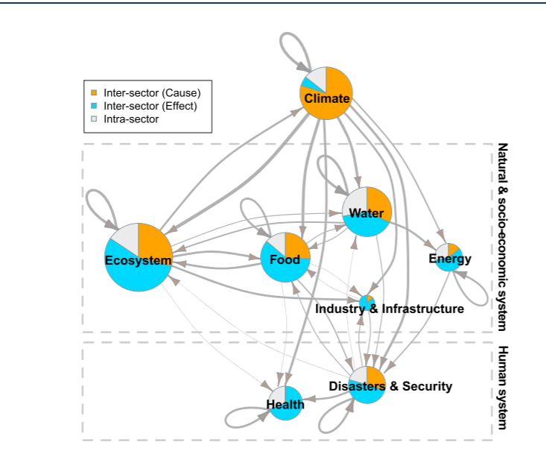
Figure 1. Climate risks and their cause–effect relationships shown at the sectoral level. The arrow thickness indicates the number of risk interconnections represented. Arrows connecting different sectors indicate intersectoral causal relationships, and those looping back to the same sector represent the causal links within the sector.
The node size also reflects the number of risks identified within the sector. The colors of nodes indicate the portion of intersector cause (orange), effect (blue), and intrasector cause and effect (gray). For example, in a linkage between “increase in flooding” (water) causing “increase in damage to agricultural land” (food), as shown in Table S2, the former is an intersector cause, and the latter is an intersector effect. This linkage is represented by an arrow from the water to food sector. In a linkage such as “change in food distribution” (food) leading to “destabilization of food supply” (food), where both are an intrasector cause and effect.
This linkage is represented by an arrow starting and looping back to the food sector. The upper and lower dashed gray
rectangles encompass sectors related to the natural and socioeconomic systems and the human system, respectively.

Slide 3
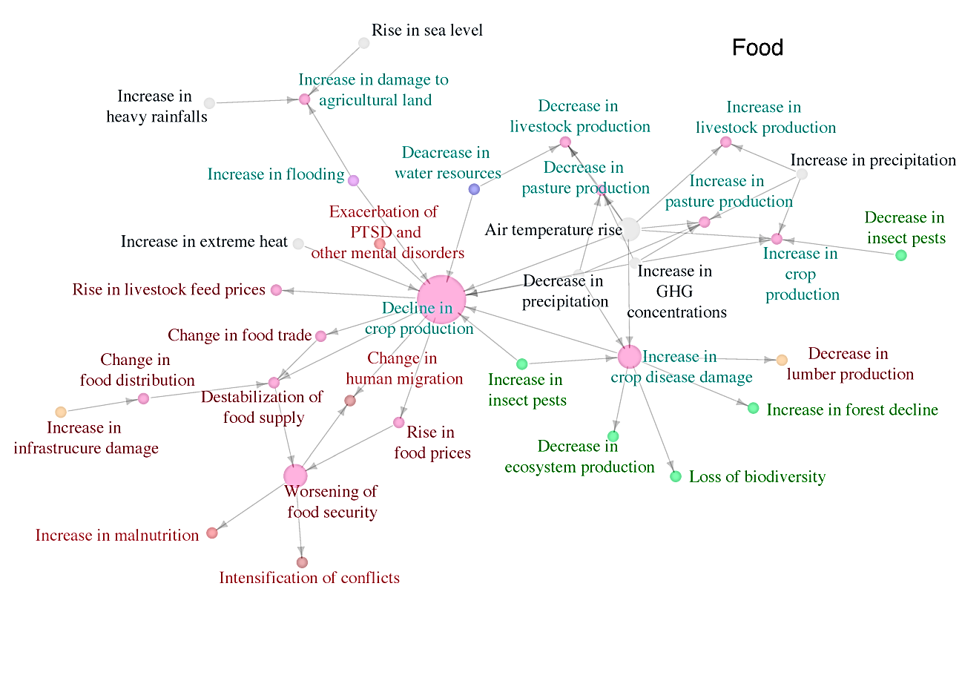
Figure S2. The original figure of the risk map for the food sector. The colors of the risk items (nodes) indicate climate drivers (gray), natural system (cyan), ecosystems (green), socio-economic and human systems (magenta). Risks with ten or more linkages are shown in large nodes. Those with five or more but fewer than 4 linkages are shown in medium-sized nodes. Those with less than three linkages are shown in small nodes. This figure was graphically refined by one of the co-authors, who is a professional designer. Figure 2 in the main text is the result of this refinement.

Slide 4
Figure 2. Map of climate risk interconnections related to the food sector. The size of each node reflects the number of causal relationships associated with the nodes. The color of nodes indicates a sector of the risk terms. Thick arrows within the icons indicate the directions of change (for example, “decline” is accompanied by a downward arrow). For the sake of discussion, we also include the risk interconnections related to the worsening of food security and increase in plant disease.

Slide 5
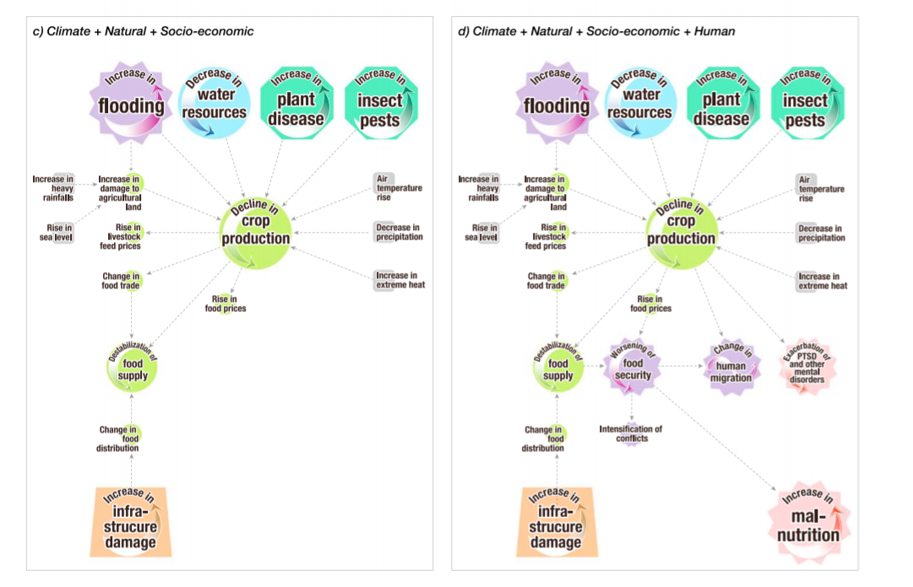
Figure 3. Network map of climate risk interconnection related to the term “decline in crop production.” Cause–effect relationships concerning (a) climate diver, (b) climate driver and natural system, (c) climate driver and natural and socioeconomic systems, and (d) climate driver and natural, socioeconomic, and human system are illustrated.

Slide 6
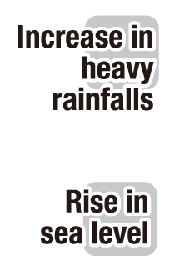
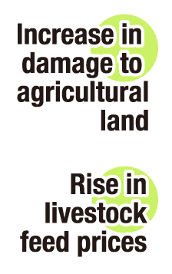
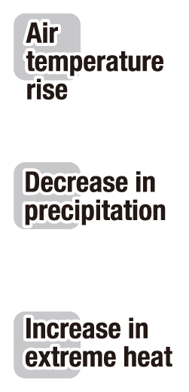
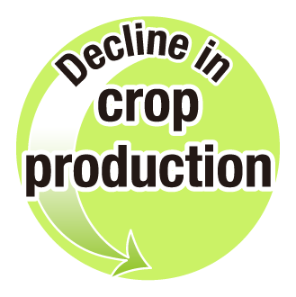
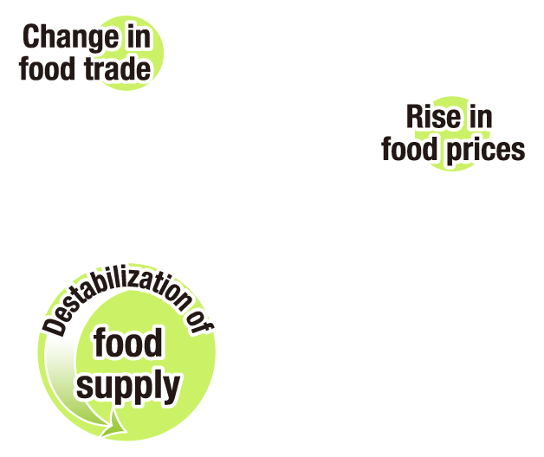
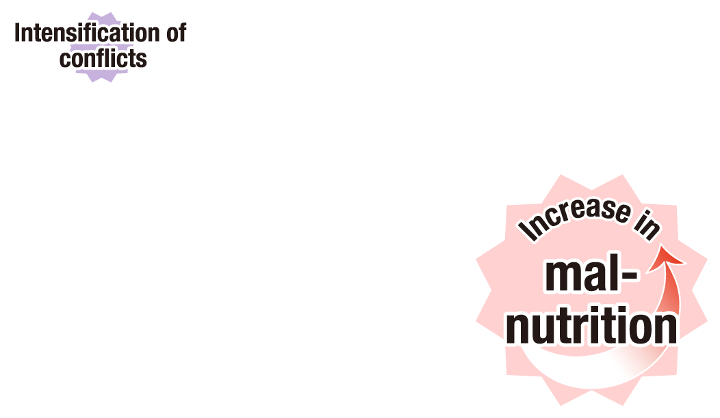
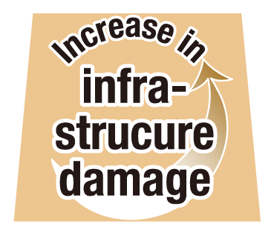
a) Climate
+ b) Natural
+ c) Socio-economic
+ d) Human

Slide 7
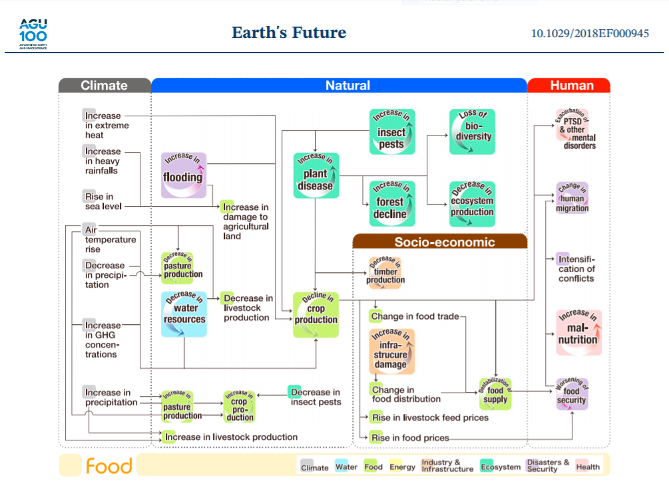
Figure 4. Flowchart of climate risk interconnections related to the food sector. The climatic drivers are allocated in the far left column. The risk terms of the sectors related to the natural and socioeconomic systems (upper rectangle in Figure 1) are placed in the middle column (blue and brown). The risk terms related to human life (lower rectangle in Figure 1) are allocated in the far right column. Causal links of the network flowchart (Figure 4) is the same as those of the
corresponding network map (Figure 2).

Slide 8
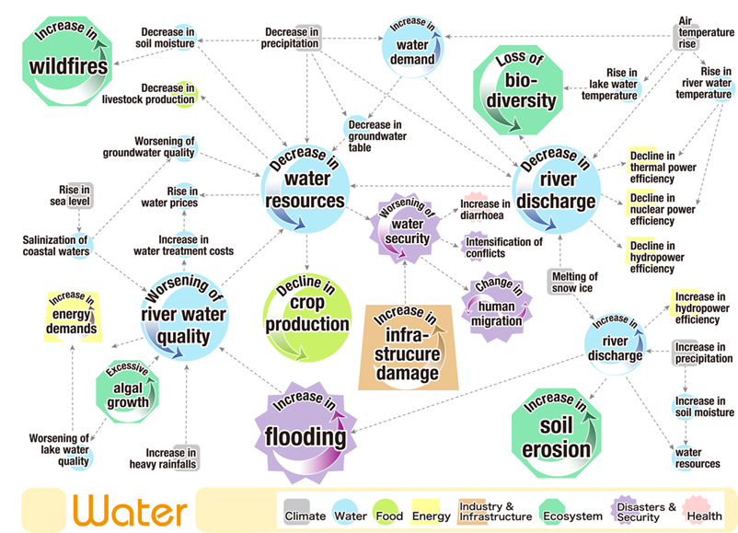
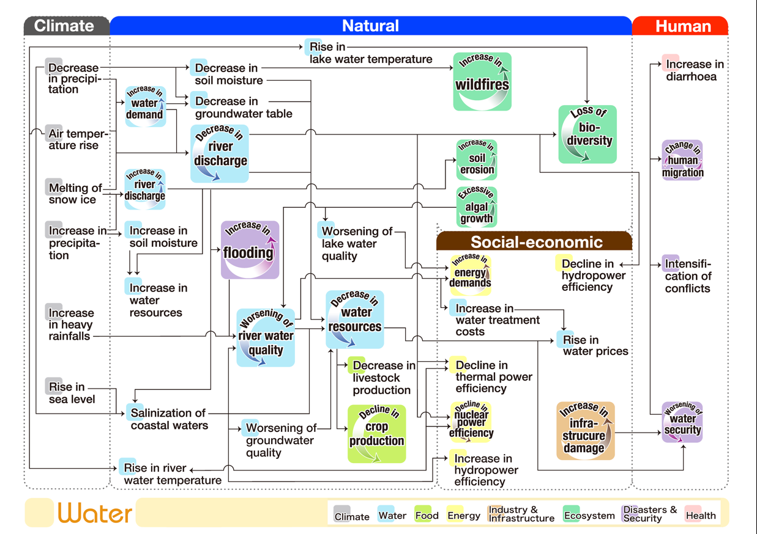
Figure S4. Risk map (a) and flowchart (b) for the water sector.

Slide 9
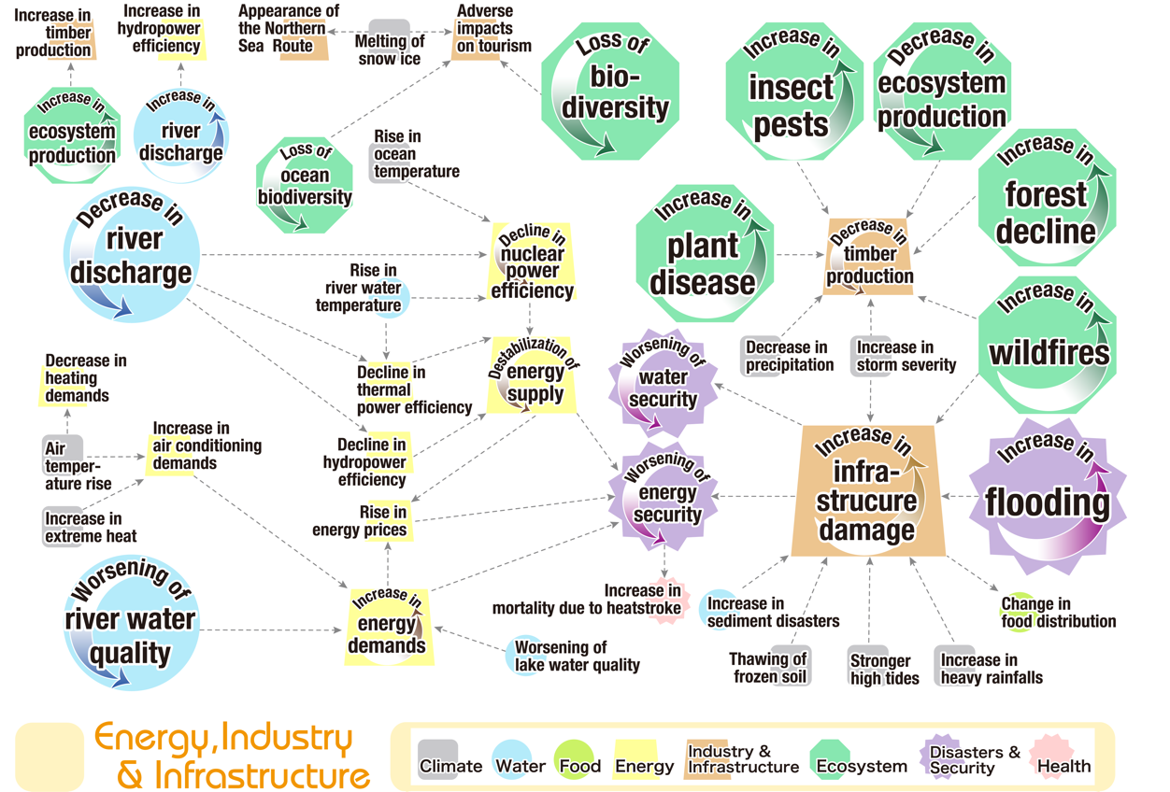
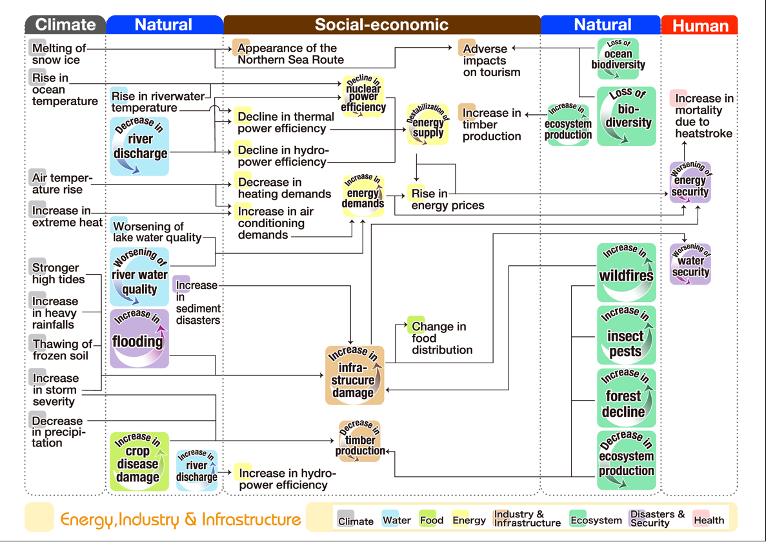
Figure S5. Risk map (a) and flowchart (b) related to the energy, industry, and infrastructure sectors.

Slide 10
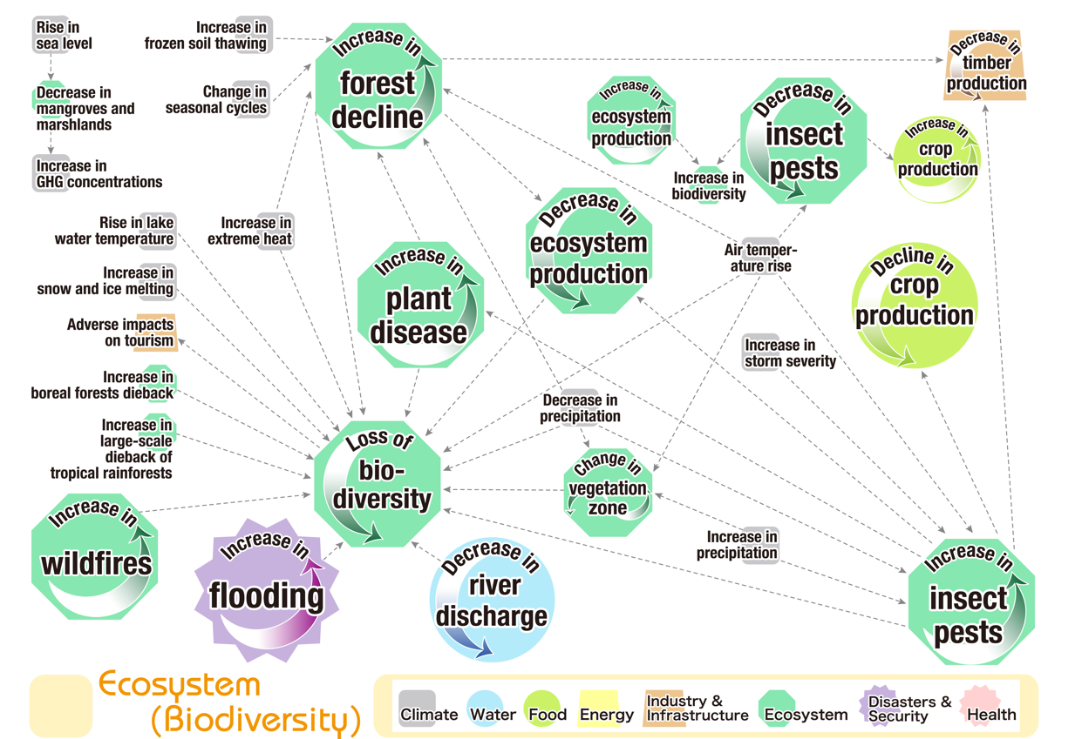
Figure S6. Risk map (a) and flowchart (b) for loss of biodiversity in the ecosystem sector.

Slide 11
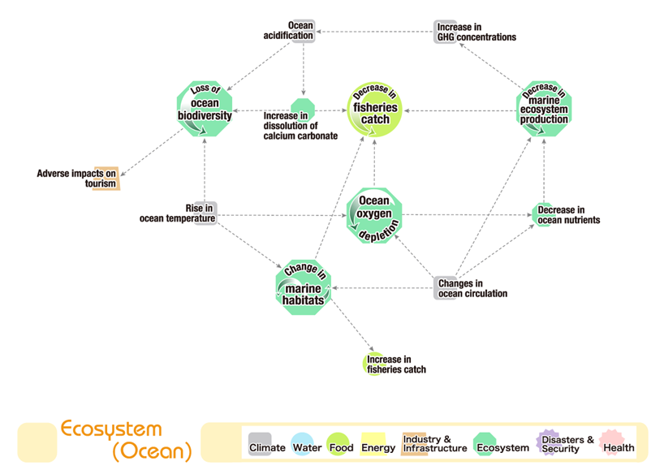
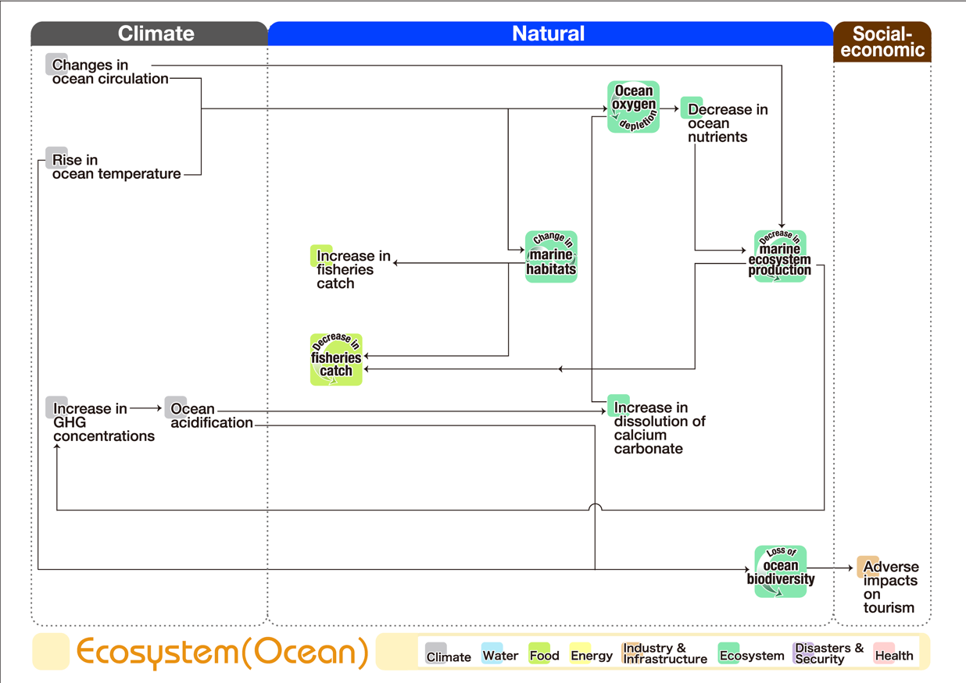
Figure S8. Risk map (a) and flowchart (b) for the marine ecosystem in the ecosystem sector.

Slide 12
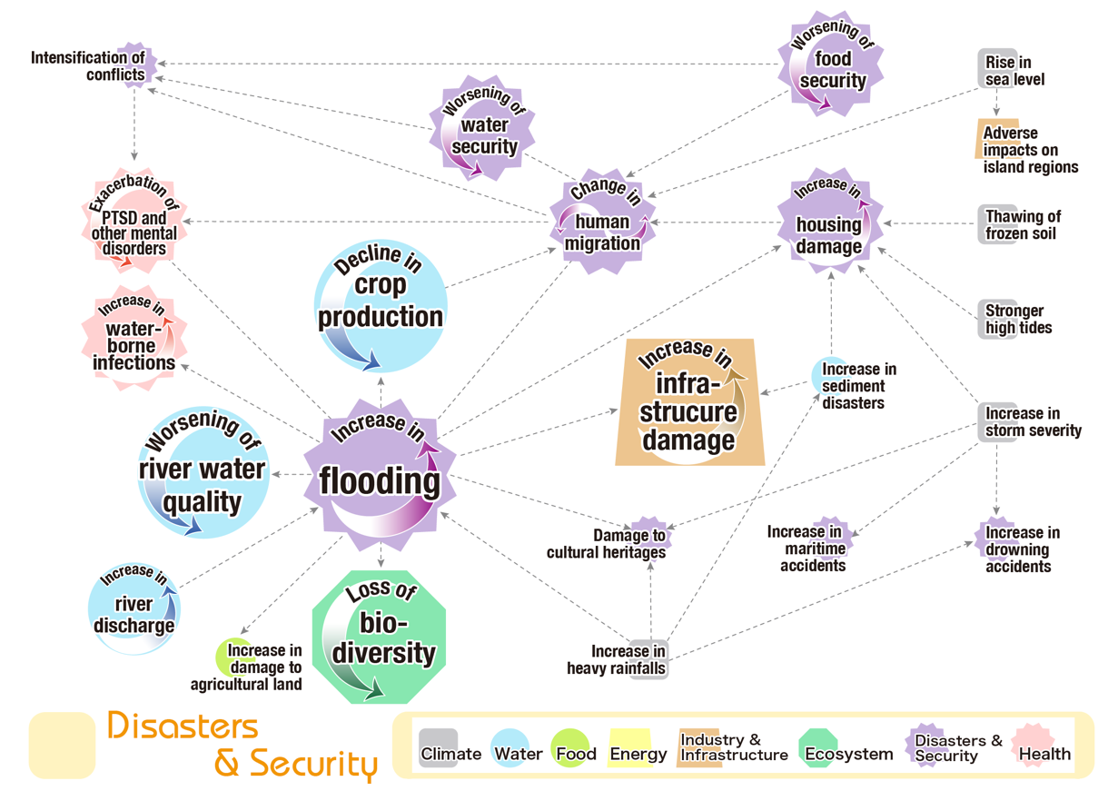
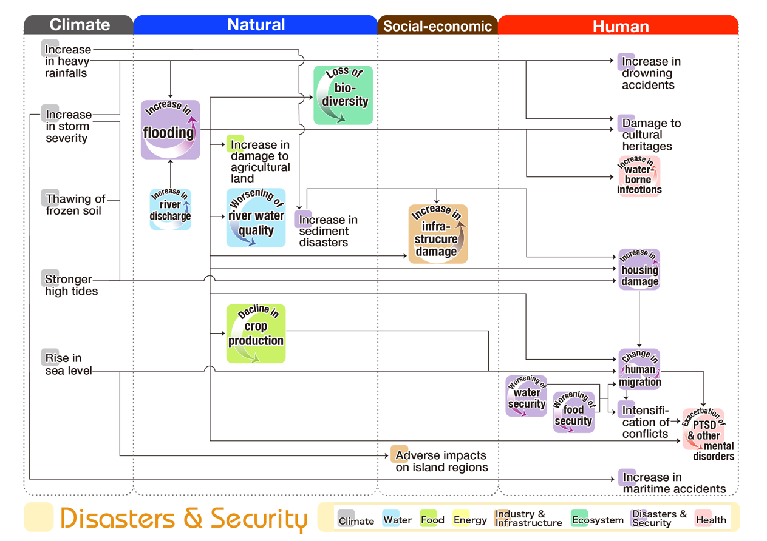
Figure S9. Risk map (a) and flowchart (b) for the disaster and security sectors.

Slide 13
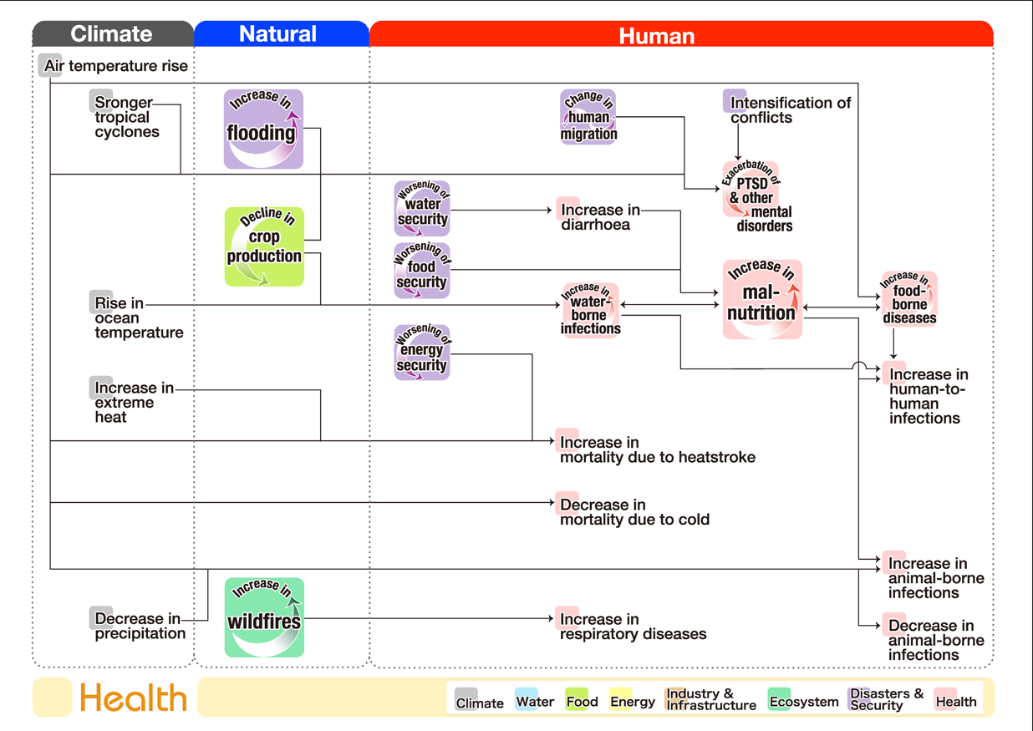
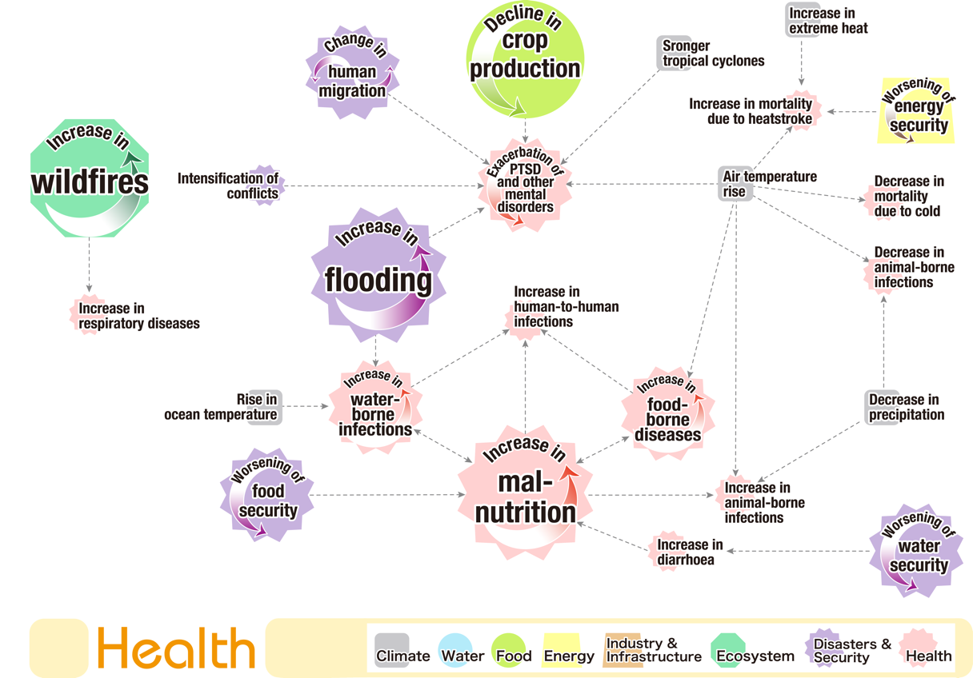
Figure S10. Risk map (a) and flowchart (b) for the health sector.

