Slide 1
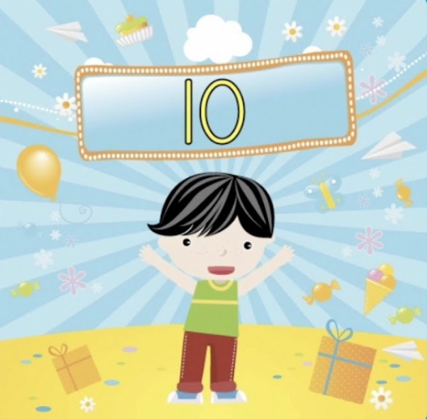
Count by tens
Count by tens
Count by tens
Count by tens
Count by tens
Lemmie hear you sing
Let me see you dance
Let me see you swing
Let’s start at ten get close to the ground
We’ll count to one hundred
Then get up and get loud
10, 20,
30, 40, 50
60 70
80 90 100
(Repeat 3 times)
Count by tens
Count by tens
Count by tens
Count by tens
10, 20,
30, 40, 50
60, 70
80, 90, 100
(Repeat 3 times)
Count by tens
Count by tens
Count by tens
Count by tens
Count by Tens Song
Have Fun Teaching

