Slide 1
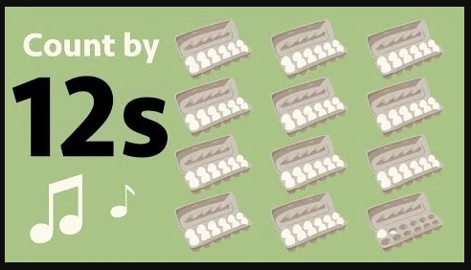
Count by 12s Song
Hopscotch
12, 24, 36, 48
60,72
84, 96, 108
120, 132
There’s one more 144.
(repeat x1)
A group of 12 is called a dozen
Like a dozen roses with a dozen bees a’ buzzin’
And once you’re skip-counting by them
Just use your fingers to multiply them
12, 24, 36, 48
60,72
84, 96, 108
120, 132
There’s one more 144.
(repeat x4)
There’s one more 144.

