Slide 1
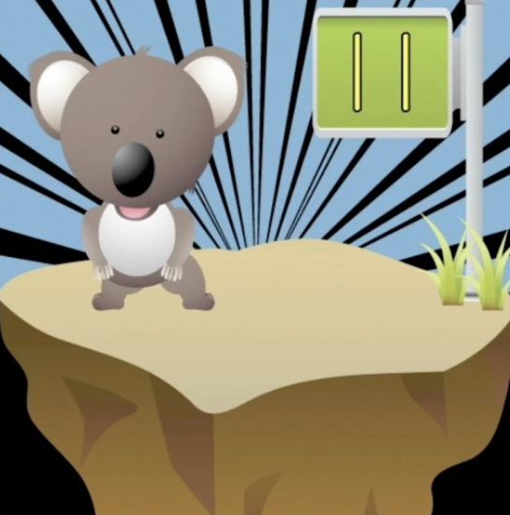
Count by eleven
Let me see you get down
Let me see you get up
Let me see you move around
Let’s go on the floor
Let’s bounce with the flow
Dance to the music as you count
Here we go….
Count by eleven
Let me see you get down
Let me see you get up
Let me see you move around
Let’s go on the floor
Let’s bounce with the flow
Dance to the music as you count
Here we go….
11, 22,
33, 44,
55, 66,
77, 88
99
110
121
Repeat

