Slide 1
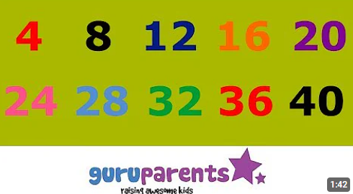
Let’s count by four!
Four, eight, twelve, sixteen, twenty, twenty-four, twenty-eight, thirty-two, thirty-six, forty, forty-four, forty-eight
Four, eight, twelve, sixteen, twenty, twenty-four, twenty-eight, thirty-two, thirty-six, forty, forty-four, forty-eight
Four, eight, twelve, sixteen, twenty, twenty-four, twenty-eight, thirty-two, thirty-six, forty, forty-four, forty-eight
Four, eight, twelve, sixteen, twenty, twenty-four, twenty-eight, thirty-two, thirty-six, forty, forty-four, forty-eight
Four, eight, twelve, sixteen, twenty, twenty-four, twenty-eight, thirty-two, thirty-six, forty, forty-four, forty-eight
And that’s how you count by four!

