Slide 1
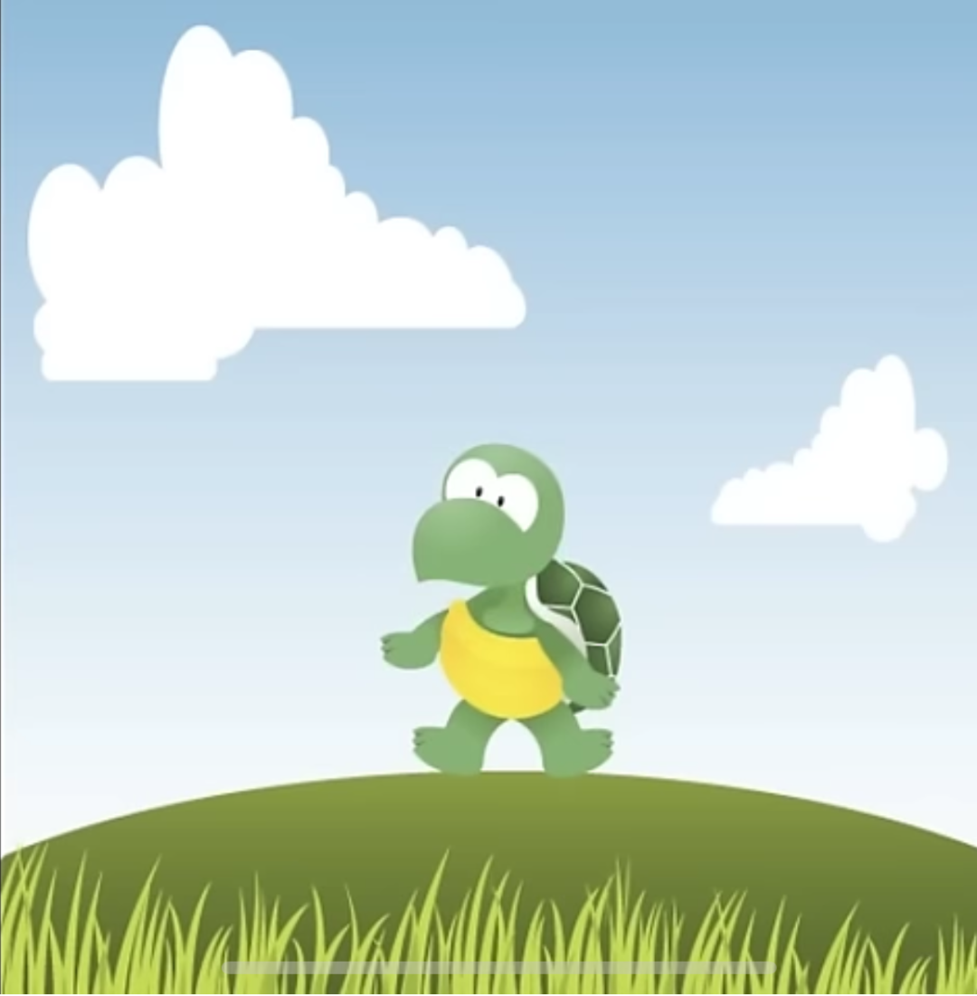
Dance to the mix, Dance to the mix, Dance to the mix
We’re counting by six (x3)
Dance to the mix we’re counting by six spin your body around now we’ll do it like this. Slide to the left, Slide to the right count up to thirty we’ll start with six!
Six, twelve, eighteen, twenty-four, thirty! (x10)
Dance to the mix, Dance to the mix, Dance to the mix
We’re counting by six (x3)
Dance to the mix we’re counting by six spin your body around now we’ll do it like this. Slide to the left, Slide to the right count up to sixty we’ll start with six!
Six, twelve, eighteen, twenty-four, thirty, thirty-six, forty-two, forty-eight, fifty- four, sixty! (x5)
Dance to the mix, Dance to the mix, Dance to the mix
We’re counting by six (x3)
Dance to the mix we’re counting by six spin your body around now we’ll do it like this. Slide to the left, Slide to the right count up to ninety we’ll start with six!
Six, twelve, eighteen, twenty-four, thirty, thirty-six, forty-two, forty-eight, fifty- four, sixty, sixty-six, seventy-two, seventy-eight, eighty-four, ninety!
Dance to the mix we’re counting by six spin your body around now we’ll do it like this. Slide to the left, Slide to the right everybody get up! We’re gonna jump SIX times! ONE! TWO! THREE! FOUR! FIVE! SIX! Dance to the mix! (x3) We’re counting by SIX!

