Slide 1
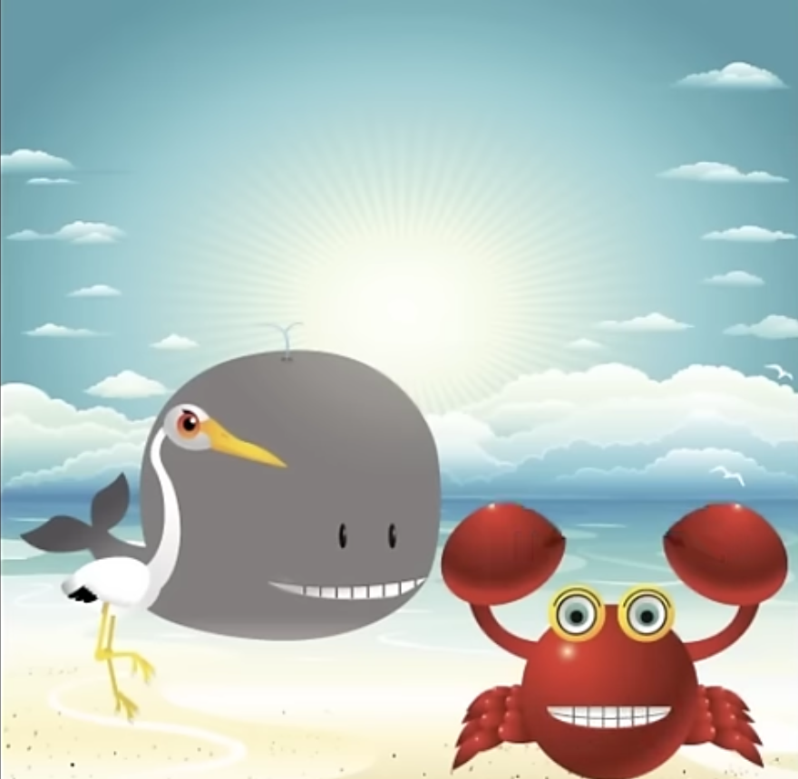
Counting by nines can you sing this rhyme? I know we can dance we can have a good time.
Counting by nines can you sing this rhyme? I know we can dance we can have a good time.
Nine
Eighteen
Twenty-Seven
Thirty-Six
Forty-Five
Fifty-Four
Sixty-Three
Seventy-Two
Eighty-One
Ninety!
(Ninety-Nine, One Oh Eight)
Counting by nines can you sing this rhyme? I know we can dance we can have a good time.
Counting by nines can you sing this rhyme? I know we can dance we can have a good time.

