Slide 1
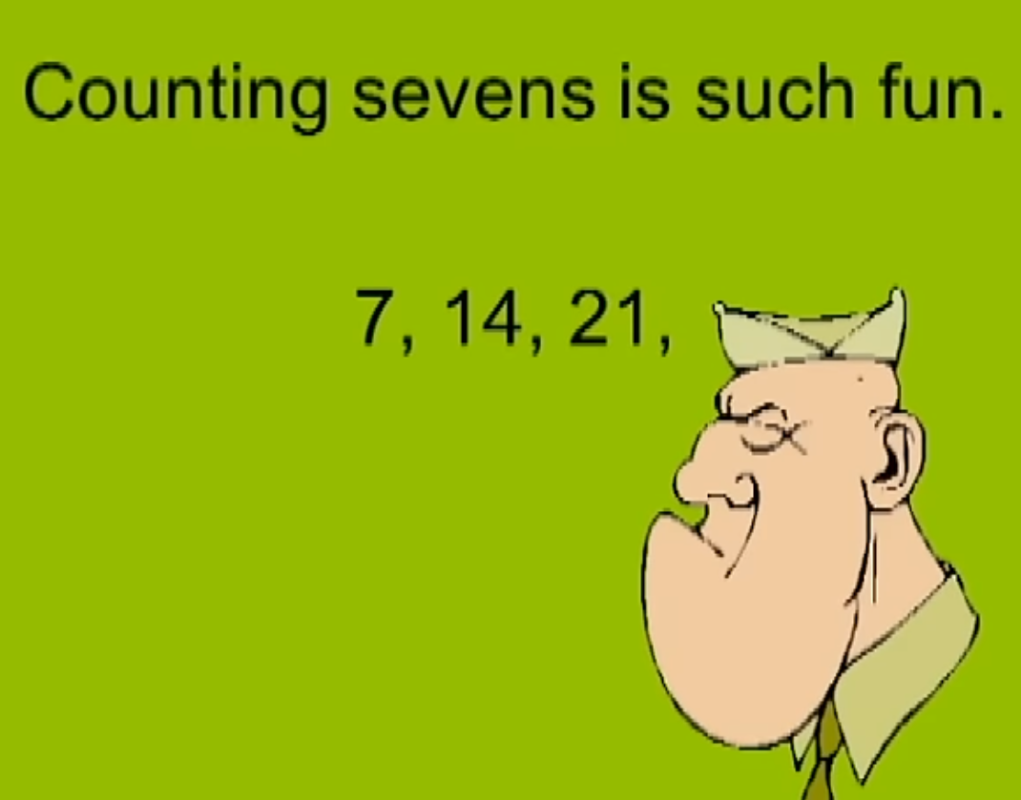
Counting sevens is such fun!
7, 14, 21
Come and see what I can do!
28, 35, 42,
Easier than ABC’s
49, 56, 63
Seventy is next there’s more
77, 84
Sargent Seven is my name counting seven’s is my game. Sargent Seven is my name counting seven’s is my game.
Counting sevens is such fun!
7, 14, 21
Come and see what I can do!
28, 35, 42,
Easier than ABC’s
49, 56, 63
Seventy is next there’s more
77, 84
Sargent Seven is my name counting seven’s is my game. Sargent Seven is my name counting seven’s is my game.
That was good and that was fine, now let’s do it one more time,
Counting sevens is such fun!
7, 14, 21
Come and see what I can do!
28, 35, 42,
Easier than ABC’s
49, 56, 63
Seventy is next there’s more
77, 84
Sargent Seven is my name counting seven’s is my game. Sargent Seven is my name counting seven’s is my game.
That was good and that was fine, now lets try it all streamline
7, 14 , 21, 28, 35, 42, 49, 56, 63, 70, 77, 84 , Count your seven’s out the door! (Repeat)

