Slide 1
Chapter 6 – Hyperbolic functions
Starter
Write cos𝜃, sin𝜃, tan𝜃 in terms of exponentials
Show that $\frac{1}{\cos^{2}x}−\tan^{2}x ≡1$

Slide 2
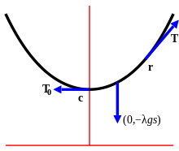
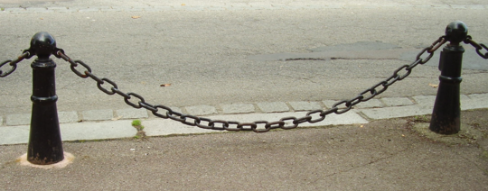
Why?
Hyperbolic functions often result from differential equations (e.g. in mechanics), and we’ll see later in this module how we can use these functions in calculus.
For example, we can consider forces acting on each point on a hanging piece of string.
Solving the relevant differential equations, we end up with:
$$y=\cosh{x}$$

Slide 3
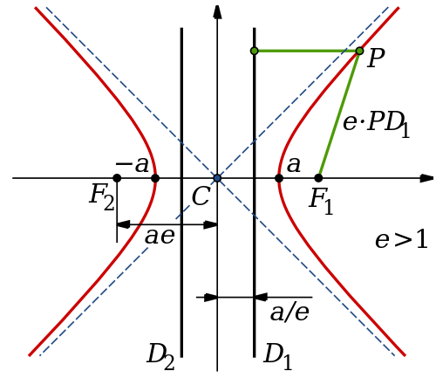
6.1 Circles vs Hyperbolas
Circles
Hyperbolas
$$1$$
$$\left(x,y\right)$$
$$θ$$
$$1$$
The ‘simplest’ circle is a unit circle centred at the origin.
Cartesian equation:
The equivalent hyperbola (which crosses $x$-axis at $(1,0)$ and $\left(−1,0\right)$)
Cartesian equation:
Parametric equations:
$$x^{2}+y^{2}=1$$
$$x^{2}−y^{2}=1$$
Parametric eqns (in terms of $θ$):
$$x=cos θ \\ y=sin θ$$
$$x=cosh θ \\ y=sinh θ$$

Slide 4
6.1 Equations of Hyperbolic functions
Hyperbolic sine:
Hyperbolic cosine:
Hyperbolic tangent:
$$\sinh{x}=\frac{e^{x}−e^{−x}}{2} x∈ℝ$$
Say as “shine” of $x$
$$\cosh{x}=\frac{e^{x}+e^{−x}}{2} x∈ℝ$$
Say as “cosh”
Say as “tanch”
$$\tanh{=}\frac{\sinh{x}}{\cosh{x}}=\frac{e^{2x}−1}{e^{2x}+1} x∈ℝ$$
$$\operatorname{sech}{x}=\frac{1}{\cosh{x}}=\frac{2}{e^{x}+e^{−x}} x∈ℝ$$
$$\operatorname{cosech}{x}=\frac{1}{\sinh{x}}=\frac{2}{e^{x}−e^{−x}} x∈ℝ, x≠0$$
$$\coth{x}=\frac{1}{\tanh{x}}=\frac{\left(e^{2x}+1\right)}{e^{2x}−1} x∈ℝ, x≠0$$
Say as “setch”
Say as “cosetch”
Say as “coth”

Slide 5
6.1 Finding values
Find cosh 2 to 3 decimal places
Find the exact value of tanh(ln3)
Find the value of x when sinhx = 3

Slide 6
6.1 few to try
Find sinh 7 to 2 decimal places
Find cosh (ln4)
Find tanh x = 0.2

Slide 7
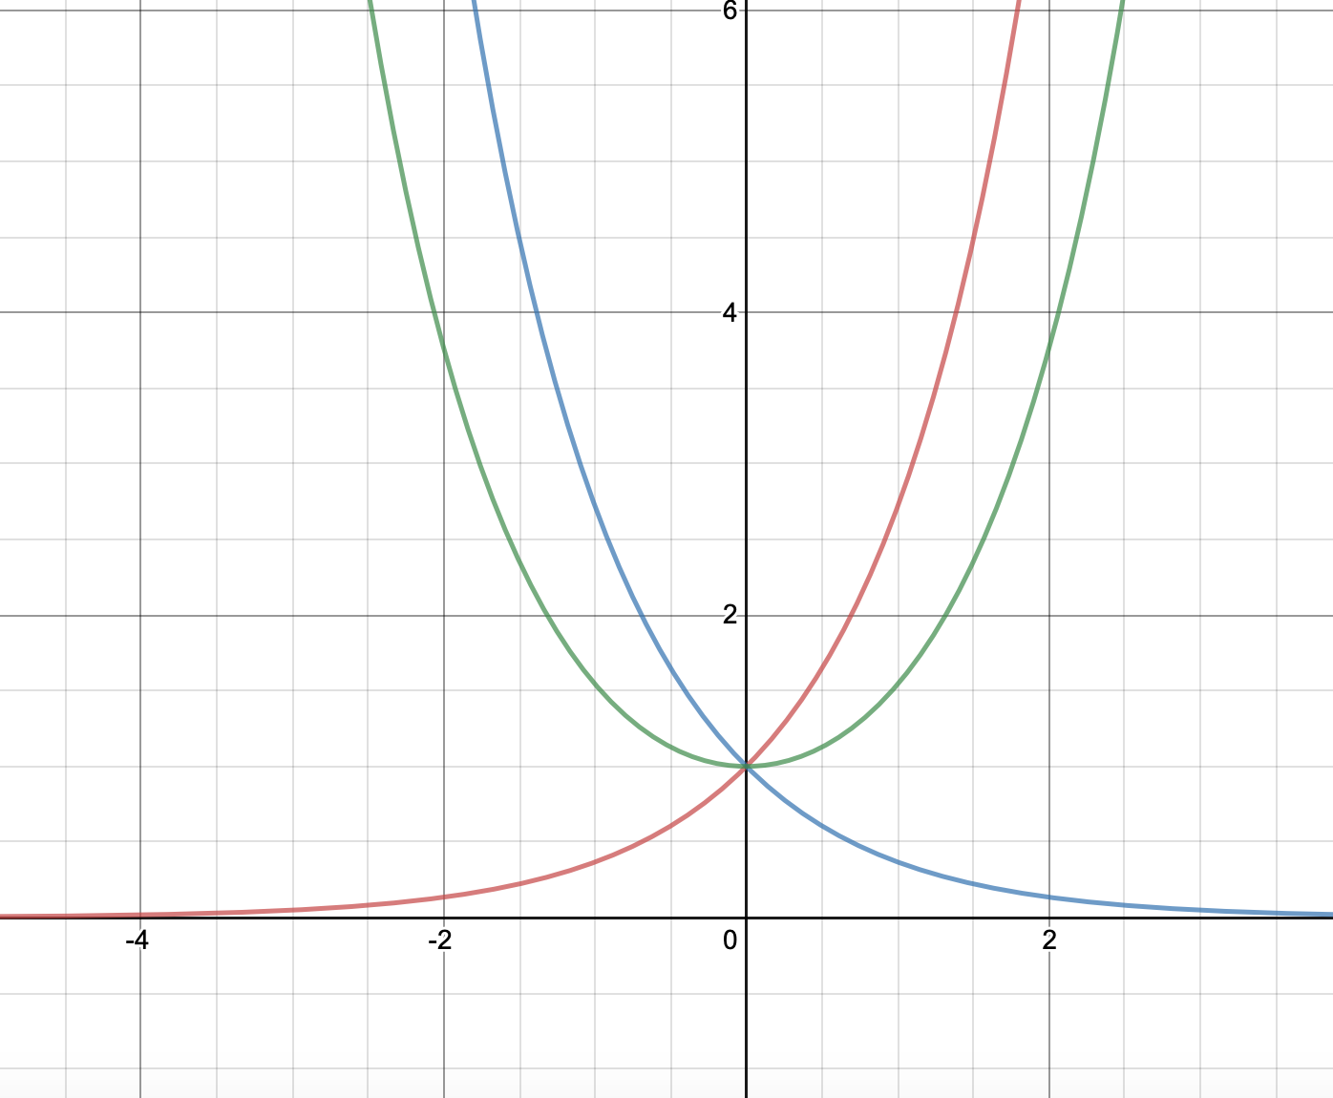
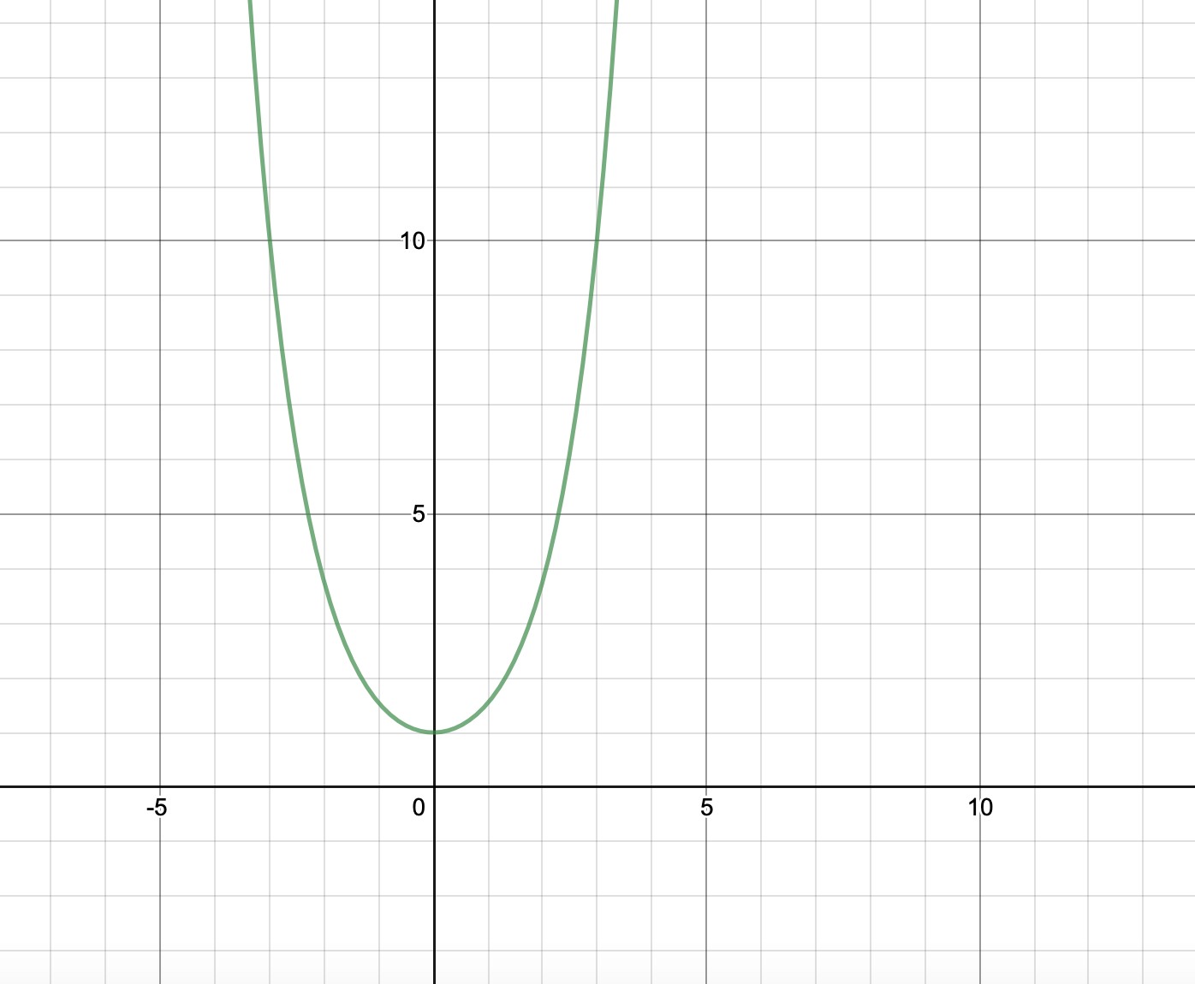
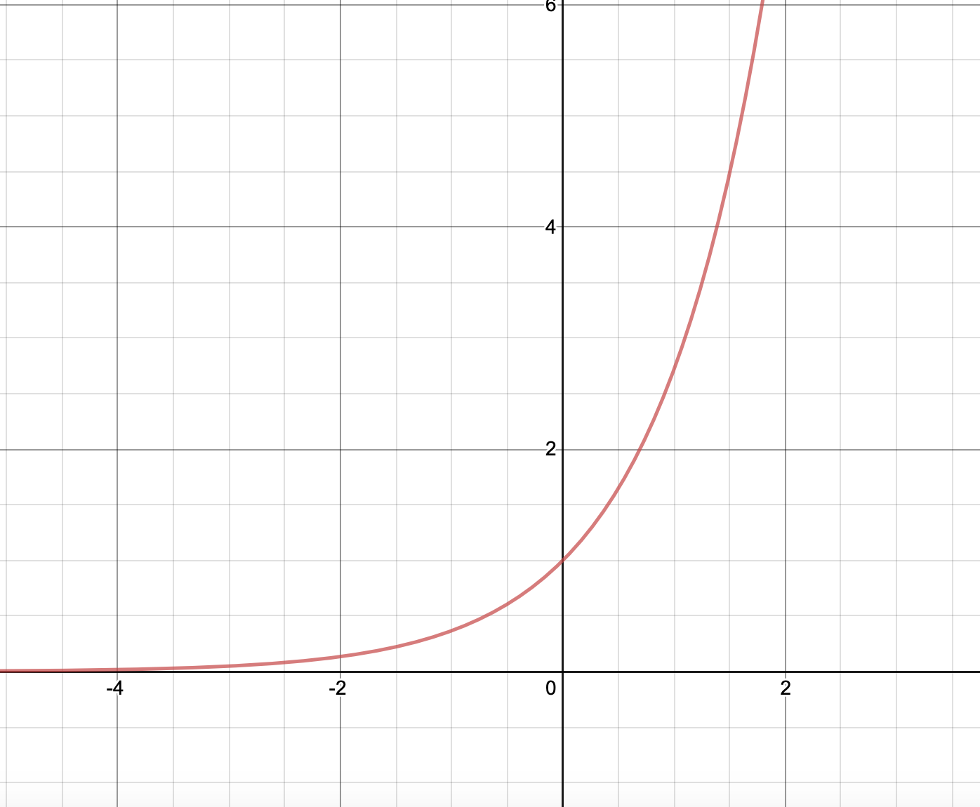
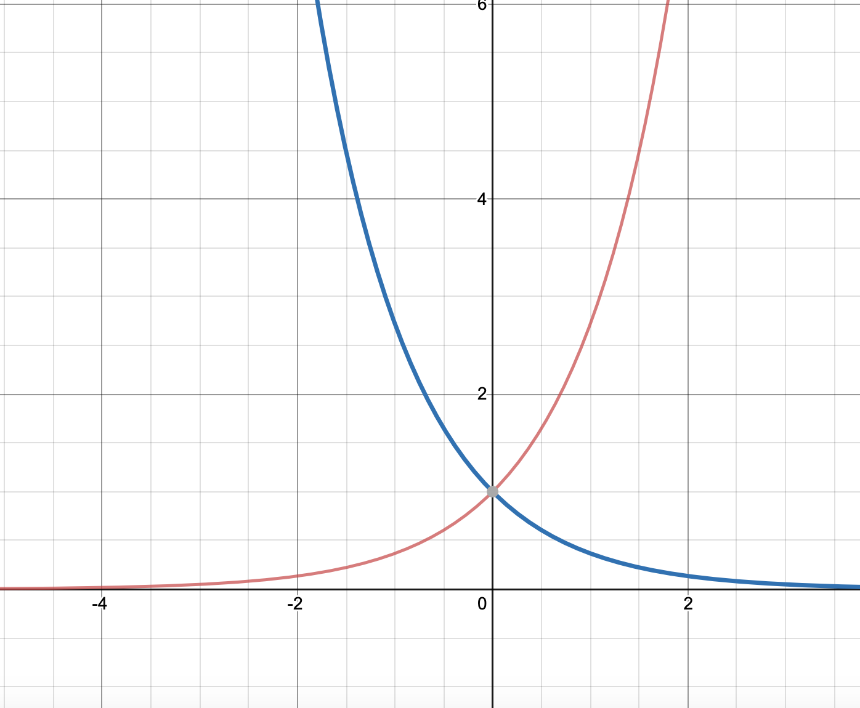
6.1 Sketching the curves
$$\cosh{x}=\frac{e^{x}+e^{−x}}{2}$$
What does look like?
It’s the average of $e^{x}+e^{−x}$
So we draw both $e^{x} and e^{−x}$ then draw the midpoints of those graphs.
Draw Sinhx and tanhx
For tanh think of limits

Slide 8
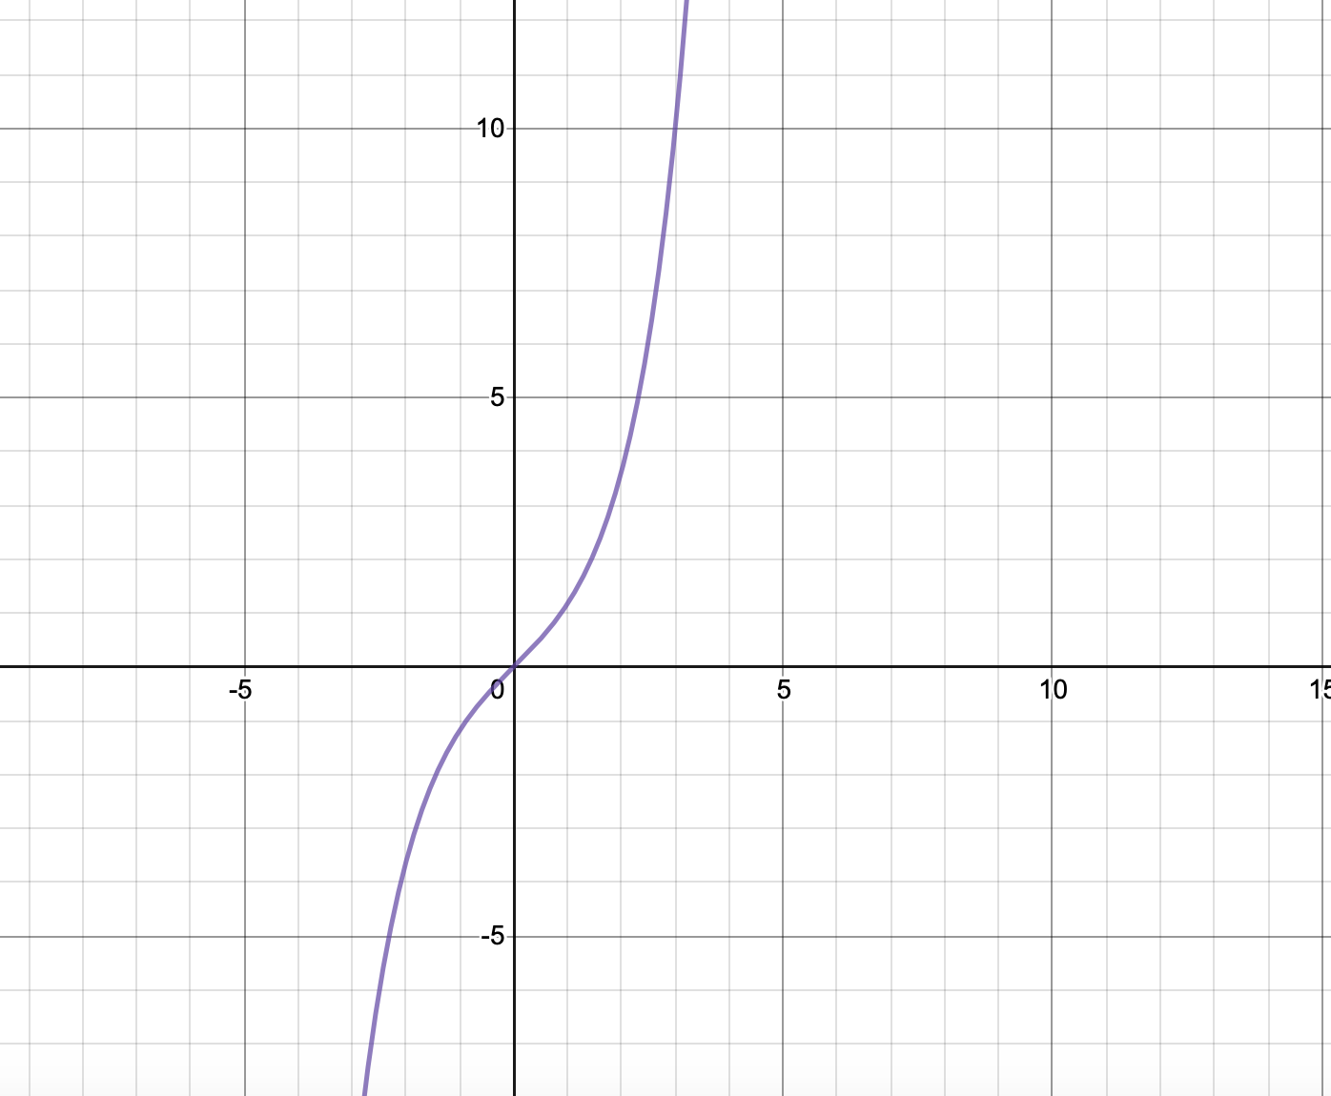
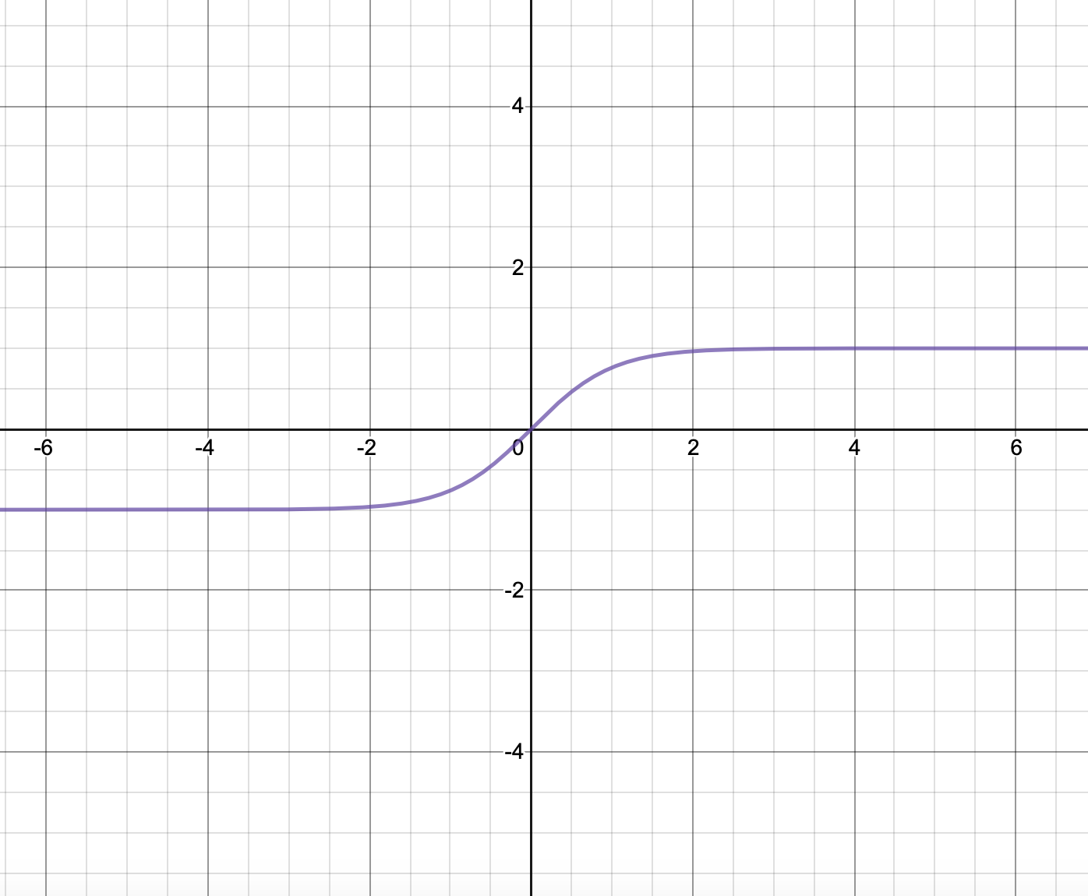
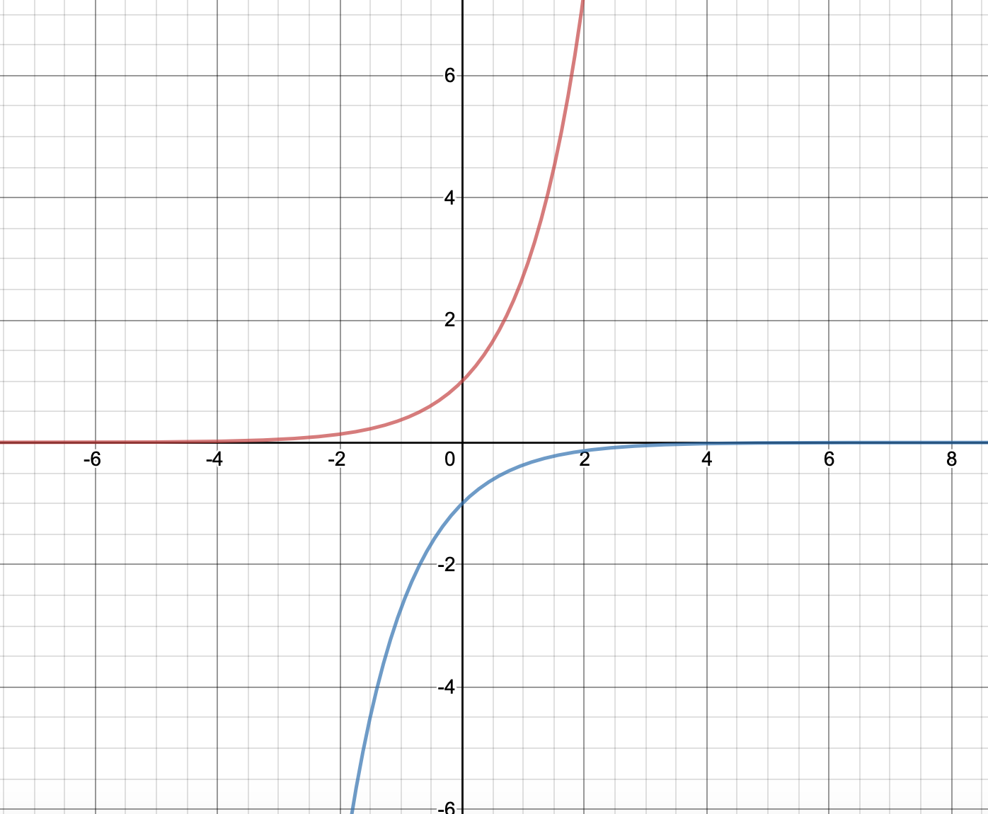
6.1 Sinh and tanh graphs

Slide 9
6.1 Important facts
$sinh⁡(x)$ is known as an odd function because $f\left(−x\right)=−f(x)$. Can you think of other odd functions?
$$f\left(x\right)=\sin\left(x\right), f\left(x\right)=x^{3}$$
$cosh⁡(x)$ is known as an even function because $f\left(−x\right)=f(x)$. Can you think of other even functions?
$$f\left(x\right)=\cos\left(x\right), f\left(x\right)=x^{2}$$

Slide 10
6.1 Connections
cos𝜃 = $\frac{e^{i∅}+e^{−i∅}}{2}$
Cosh 𝜃 = $\frac{e^{∅}+e^{−∅}}{2}$
Cosh i𝜃 = cos 𝜃
Geogebra

Slide 11
Test your knowledge
Sketch the graph of $y=\operatorname{sech}{x}$
Sketch the graph of $y=2coshx−3$
Exercise 6A pages 122 to 123

Slide 12
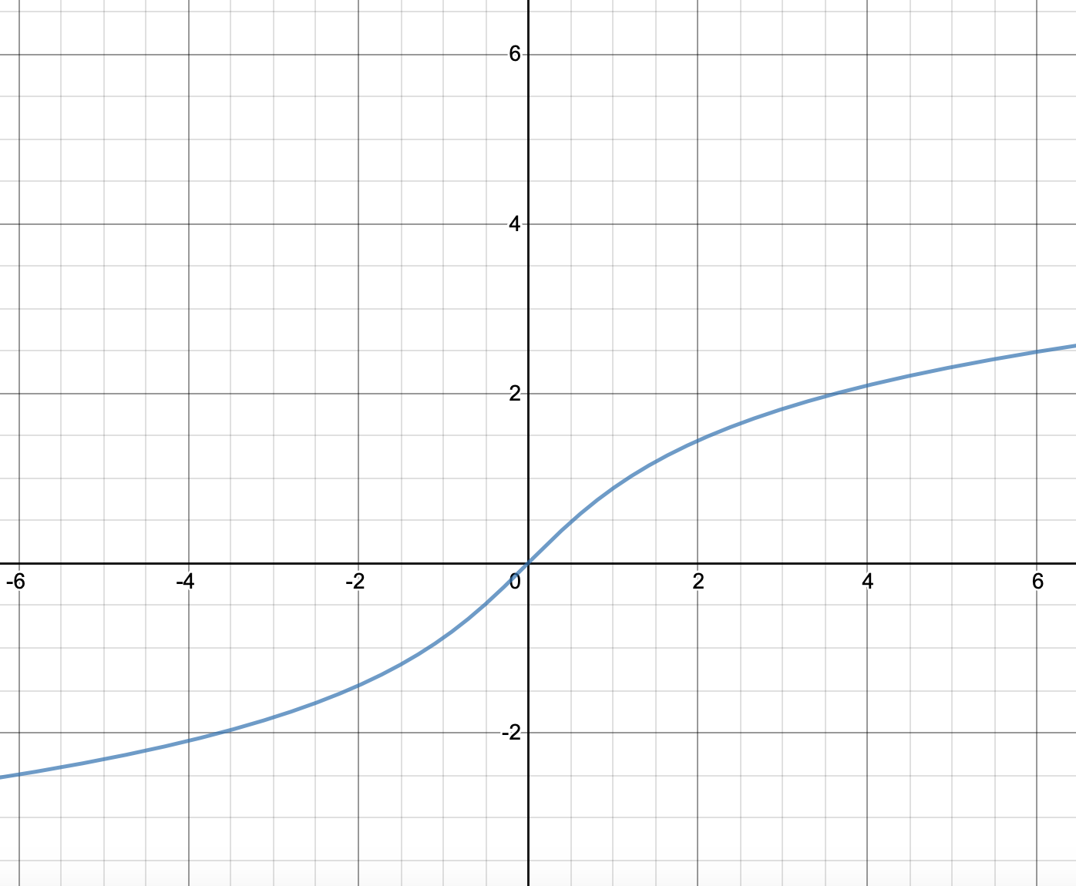
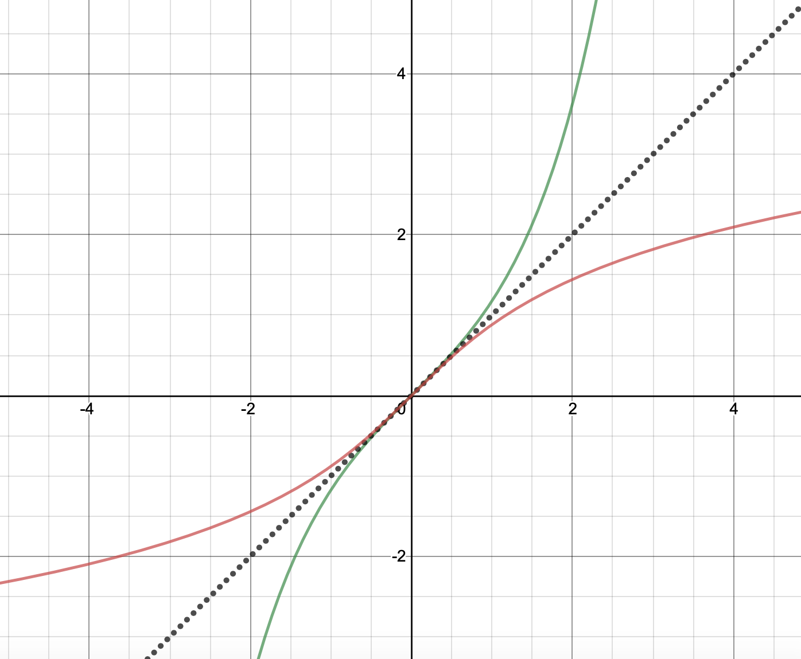
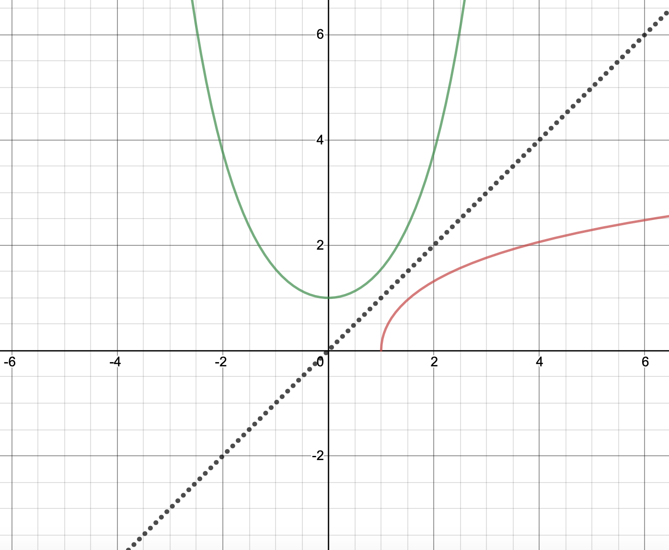
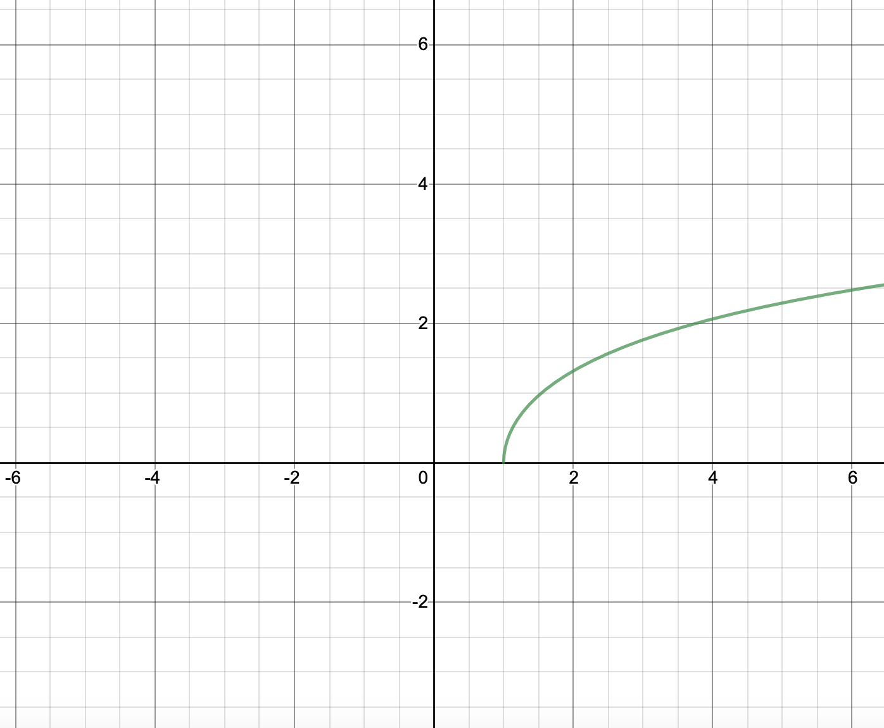
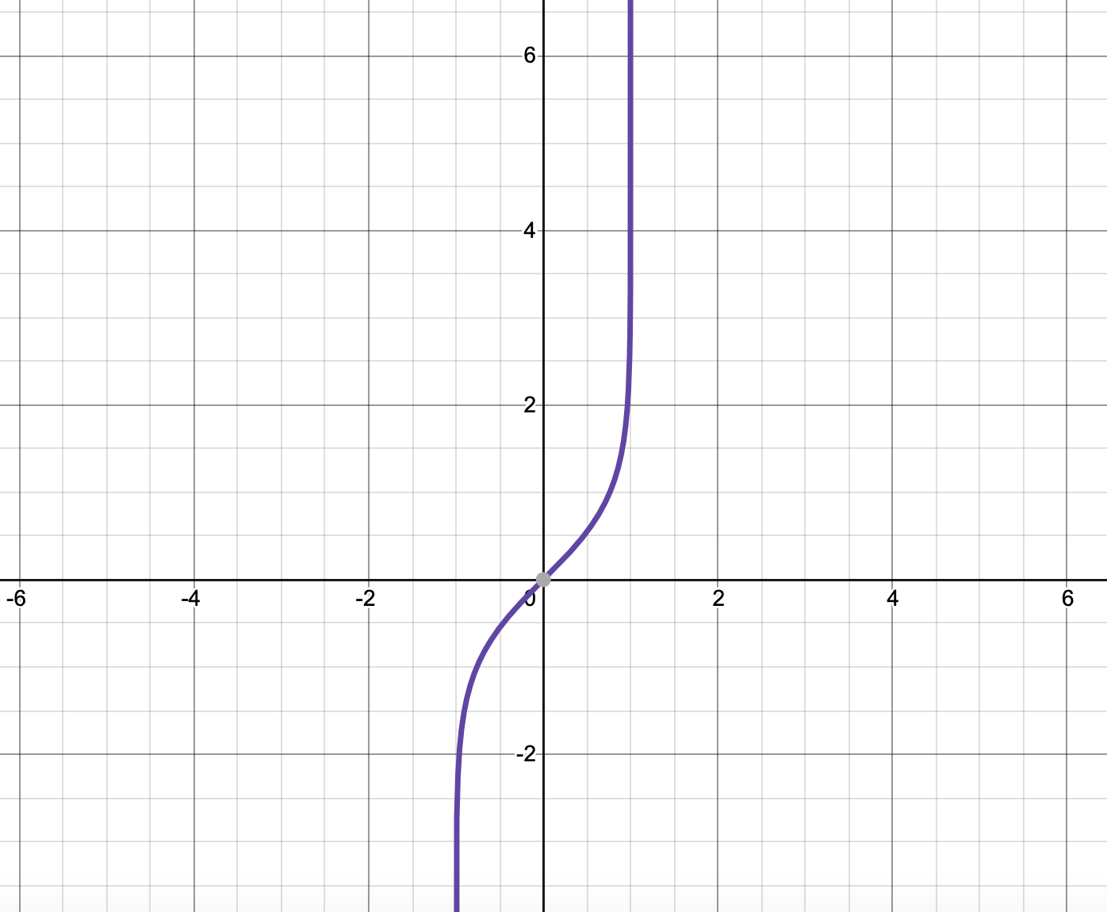
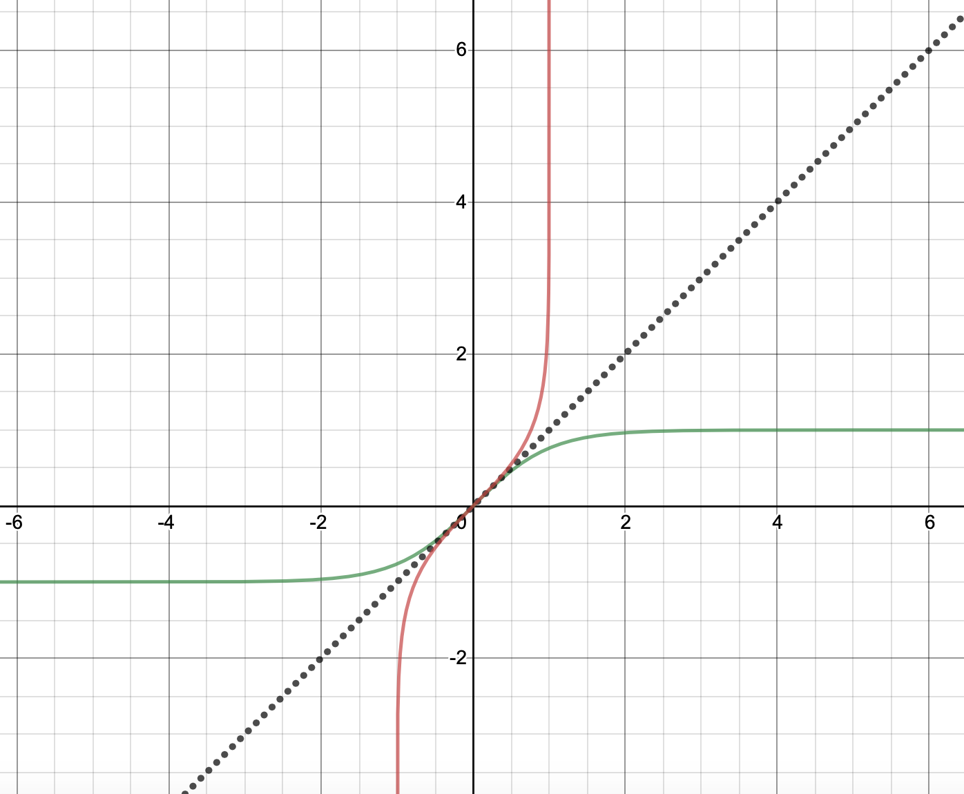
6.2 Inverse hyperbolic functions
Like sin, cos and tan, sinh, cosh and tanh have inverses as well.
The difference is they are arsinh, arcosh and artanh.
To draw these graphs you need to reflect the curve in the line y=x

Slide 13
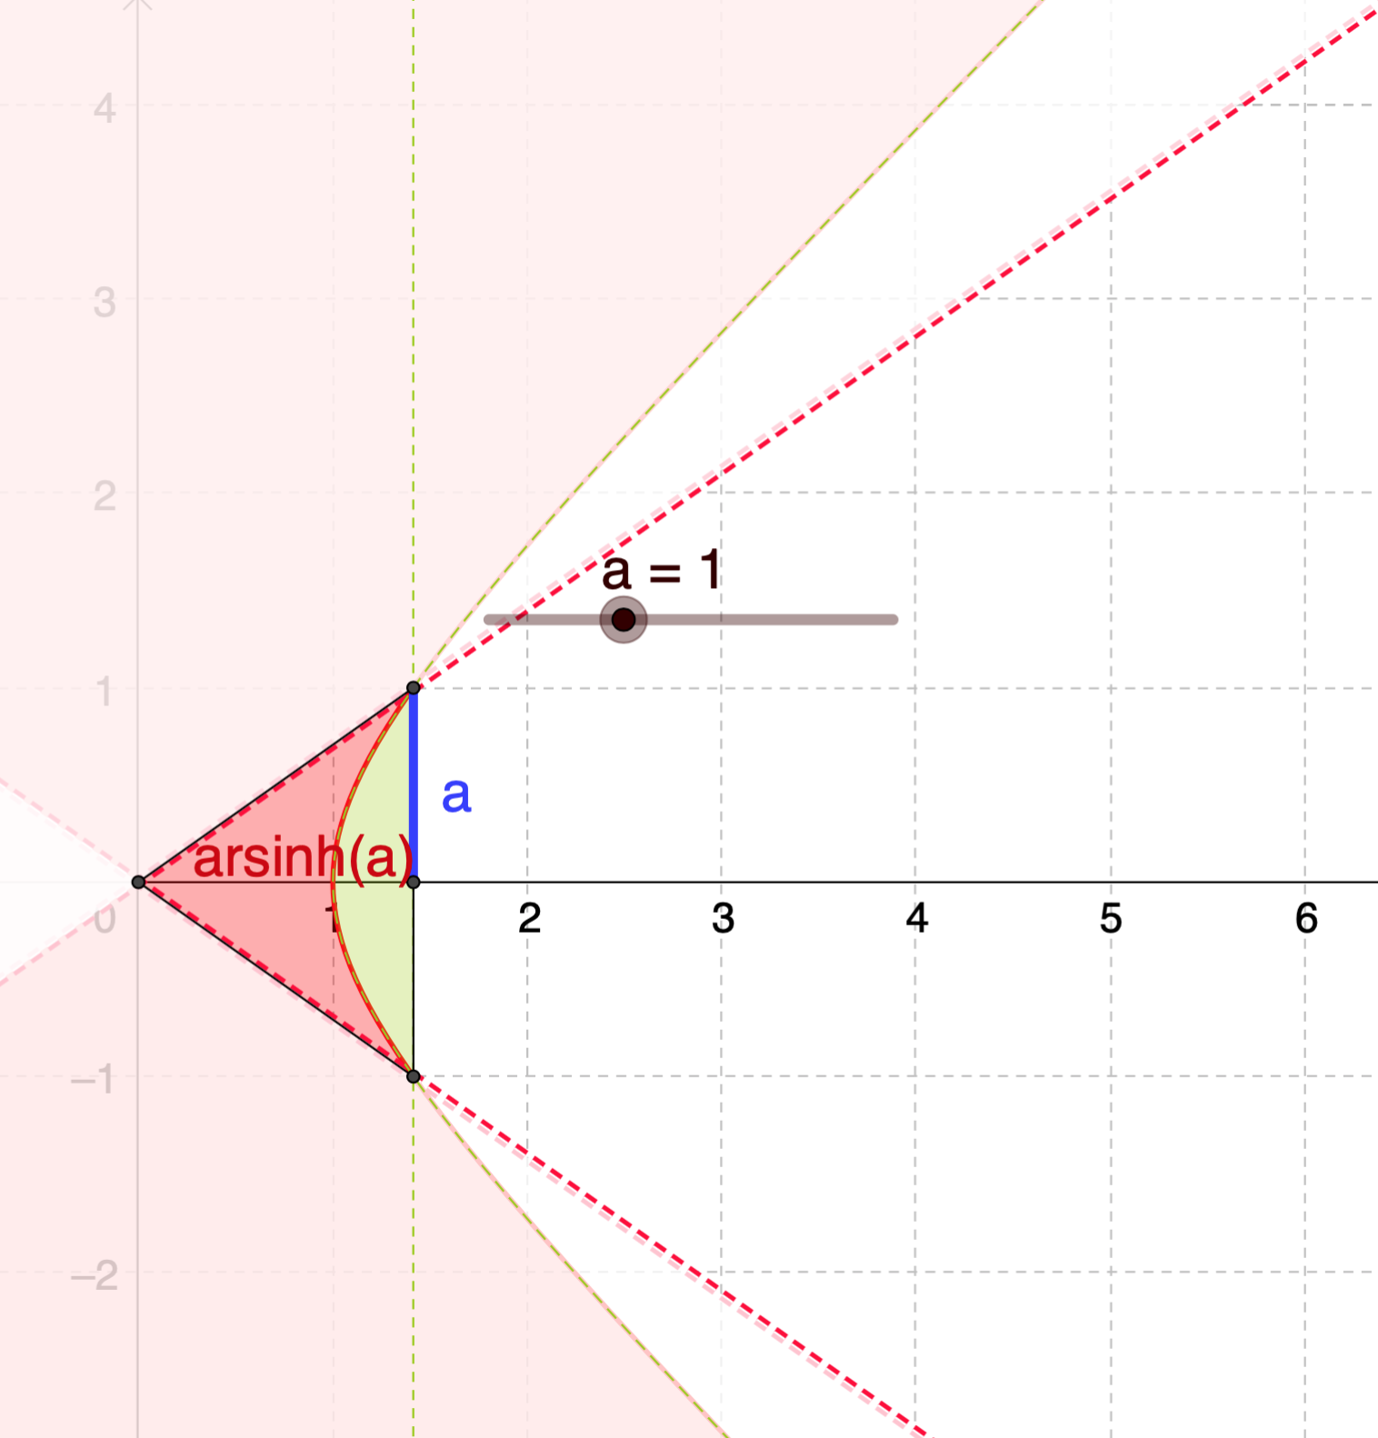
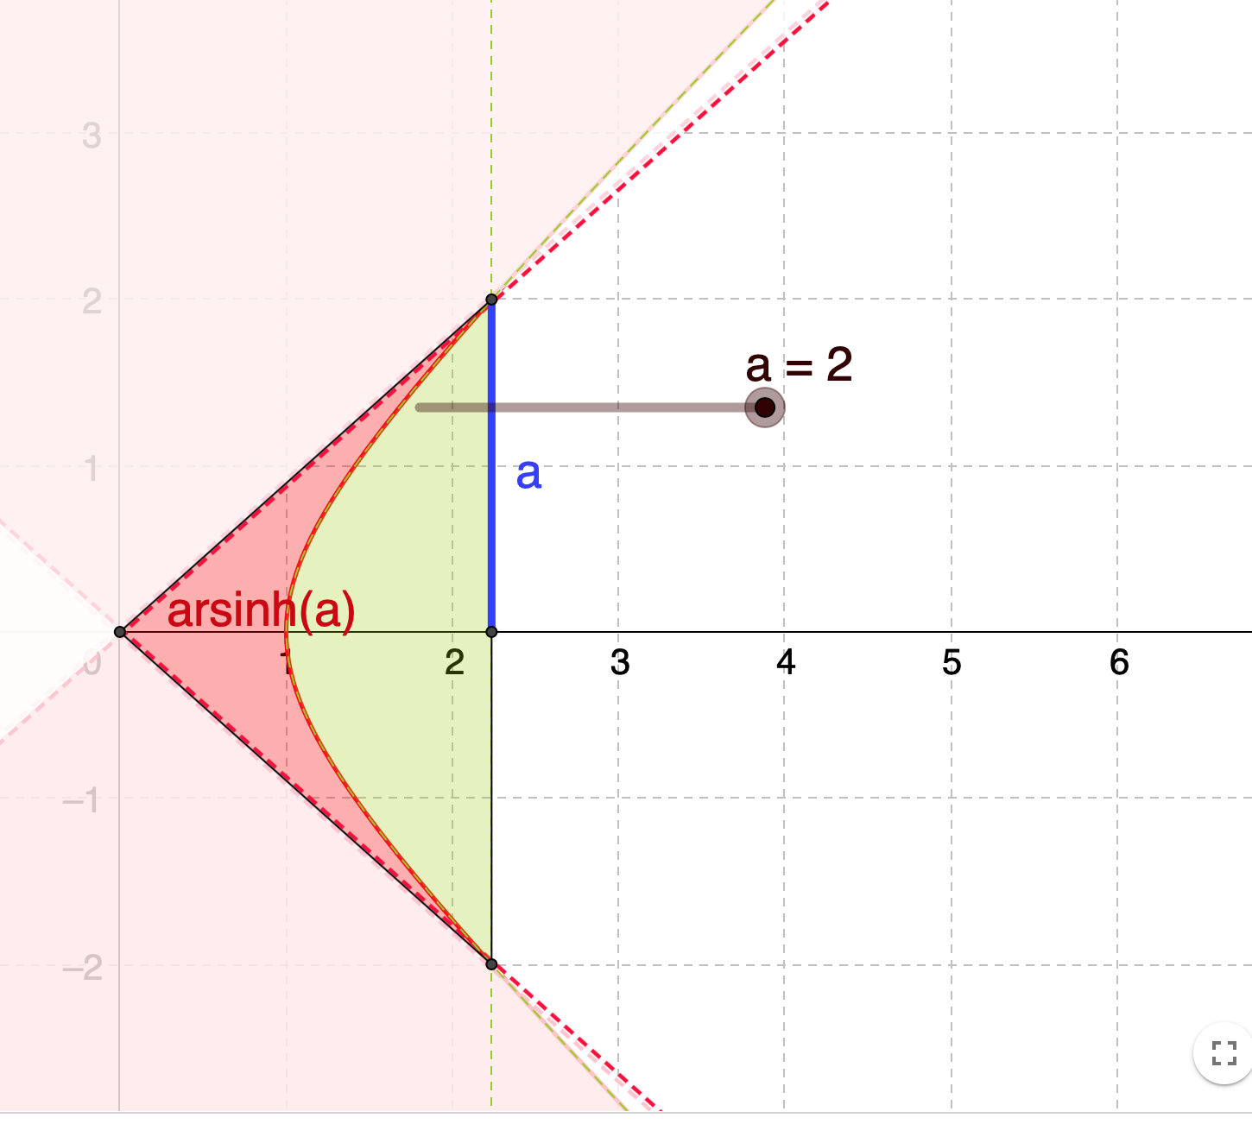
6.2 why arsinh and not arcsinh?
It's because arcsin gives the arc length on the unit circle for a given y-coordinate, whereas arsinh gives an area enclosed by a hyperbola and two rays from the origin for a given y-coordinate.

Slide 14
6.2 Examples
Prove that $arsinh x=\ln\left(x+\sqrt{x^{2}+1}\right)$
Express arsinh 3 as natural logs

Slide 15
6.2 class question
Prove that $arcosh x=\ln\left(x+\sqrt{x^{2}−1}\right), x≥1$
Express arcosh 2.5 as natural logs

Slide 16
6.2 Summary
Given in formula book
$$arsinh x=\ln\left(x+\sqrt{x^{2}+1}\right) \\ arcosh x=\ln\left(x+\sqrt{x^{2}−1}\right), x≥1 \\ artanh x=\frac{1}{2}\ln\left(\frac{1+x}{1−x}\right), \left|x\right|<1$$
Exercise 6B page 125
Hyperbolic | Domain | Sketch | Inverse Hyperbolic | Domain | Sketch
$$y=\sinh{x}$$ | $$x∈ℝ$$ |  | $$y=arsinh x$$ | $$x∈ℝ$$
$$y=\cosh{x}$$ | $$x≥0$$ |  | $$y=arcosh x$$ | $$x≥1$$
$$y=\tanh{x}$$ | $$x∈ℝ$$ |  | $$y=artanh x$$ | $$\left|x\right|<1$$
$$y=\operatorname{sech}{x}$$ | $$x≥0$$ |  | $$y=arsech x$$ | $$0<x≤1$$
$$y=cosech x$$ | $$x≠0$$ |  | $$y=arcosech x$$ | $$x≠0$$
$$y=\coth{x}$$ | $$x≠0$$ |  | $$y=\operatorname{arcoth}{x}$$ | $$\left|x\right|>1$$
1
1
1
-1
1
1
-1

Slide 17
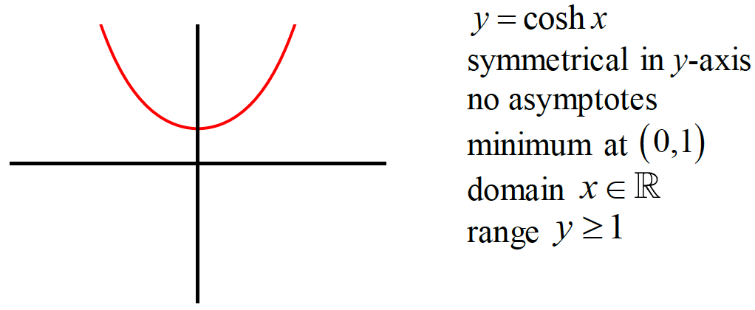
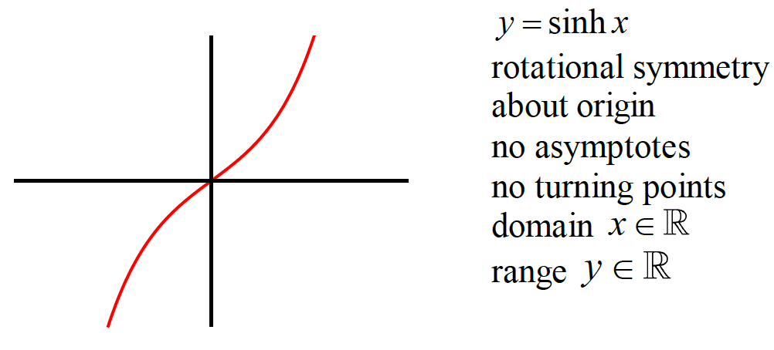
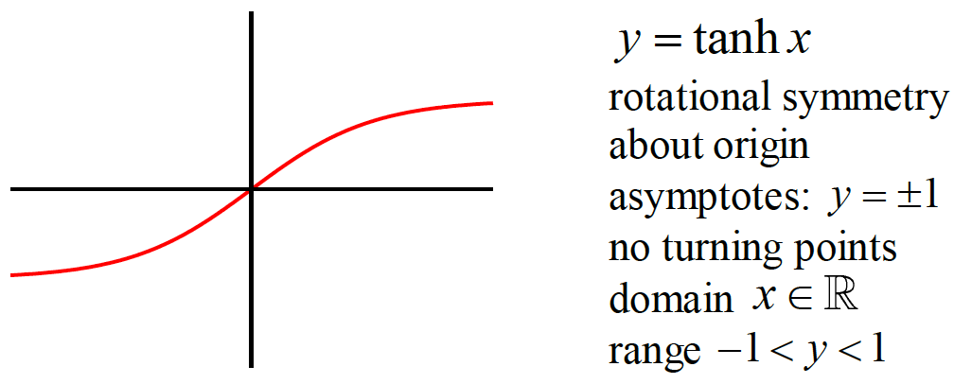
6.3 Identities and equations
Starter Hyperbolic graph matching cards

Slide 18
6.3 Identities and equations
Like the trig functions, hyperbolic functions also have identities
For example $\cos^{2}x+ \sin^{2}x=1$
Prove $\cosh^{2}x−\sinh^{2}x=1$
Prove $\cosh\left(A+B\right)=coshA coshB+sinhA sinhB$

Slide 19
6.3 Questions for you

Slide 20
6.3 Osborn rule
As you may have noticed there are similarities to sine and cosine.
Replace cos by cosh and sin by sinh.
One rule is any product of sin is the minus of sinh.
Ie sinA sinB goes to –sinhAsinhB

Slide 21
6.3 Osborn rule
$$cos2A=2\cos^{2}{A}−1 → \cosh{2A}=2cosh^{2}A−1$$
$$\tan\left(A−B\right)=\frac{\tan{A}−\tan{B}}{1+\tan{A}\tan{B}} → \frac{\tanh{A}−\tanh{B}}{1−\tanh{A}\tanh{B}}$$

Slide 22
6.3 Examples
Pure Year 1 one: If $\cos{x}=\frac{3}{5}$, find $\sin{x}$.
If $\sinh{x}=\frac{3}{4}$, find the exact value of:
$\cosh{x}$
$\tanh{x}$
$\sinh{2x}$

Slide 23
Examples for solving
Solve for all real $x$
$$6\sinh{x}−2\cosh{x}=7$$
Solve for all real $x$
$$2\cosh^{2}{x}−5sinh{x}=5$$

Slide 24
Questions for you
Solve
$$2\cosh^{2}x−11sinhx=−10$$
$$cosh2x−5coshx+4=0$$
Exercise 6C
Page 128 and 129

Slide 25
6.4 Differentiating hyperbolic functions
$$\frac{d}{dx}\left(\sinh{x}\right)=\cosh{x} \\ \frac{d}{dx}\left(\cosh{x}\right)=\sinh{x} \\ \frac{d}{dx}\left(\tanh{x}\right)={sech}^{2}{x} \\ \frac{d}{dx}\left(\coth{x}\right)=−cosech^{2}x$$
As you can see these are very similar to sin cos and tan.
Prove these derivatives.

Slide 26
6.4 Differentiation
Same rules apply like chain rule.
Differentiate sinh4x
Differentiate $x^{2}sinh3x$

Slide 27
6.4 Differentiating the inverse functions
Find/proof the derivates of the inverse functions
$$y=arsinh x \\ \sinh{y}=x \\ \frac{dx}{dy}=\cosh{y} \\ \frac{dx}{dy}=\sqrt{\sinh^{2}{y}+1} \\ =\sqrt{x^{2}+1} \\ \frac{dy}{dx}=\frac{1}{\sqrt{x^{2}+1}}$$
$$y=arcosh x \\ \cosh{y}=x \\ \frac{dx}{dy}=\sinh{y} \\ \frac{dx}{dy}=\sqrt{\cosh^{2}{y}−1} \\ =\sqrt{x^{2}−1} \\ \frac{dy}{dx}=\frac{1}{\sqrt{x^{2}−1}}$$
$$\frac{d}{dx}\left(\operatorname{arsinh}{x}\right)=\frac{1}{\sqrt{x^{2}+1}} \\ \frac{d}{dx}\left(\operatorname{arcosh}{x}\right)=\frac{1}{\sqrt{x^{2}−1}} \\ \frac{d}{dx}\left(\operatorname{artanh}{x}\right)=\frac{1}{1−x^{2}}$$

Slide 28
6.4 Example
Given that $y={\left(arcosh x\right)}^{2}$ prove that $\left(x^{2}−1\right){\left(\frac{dy}{dx}\right)}^{2}=4y$

Slide 29
6.4 Questions for you

Slide 30
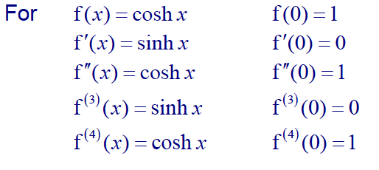
Power series for Hyperbolic functions

Slide 31
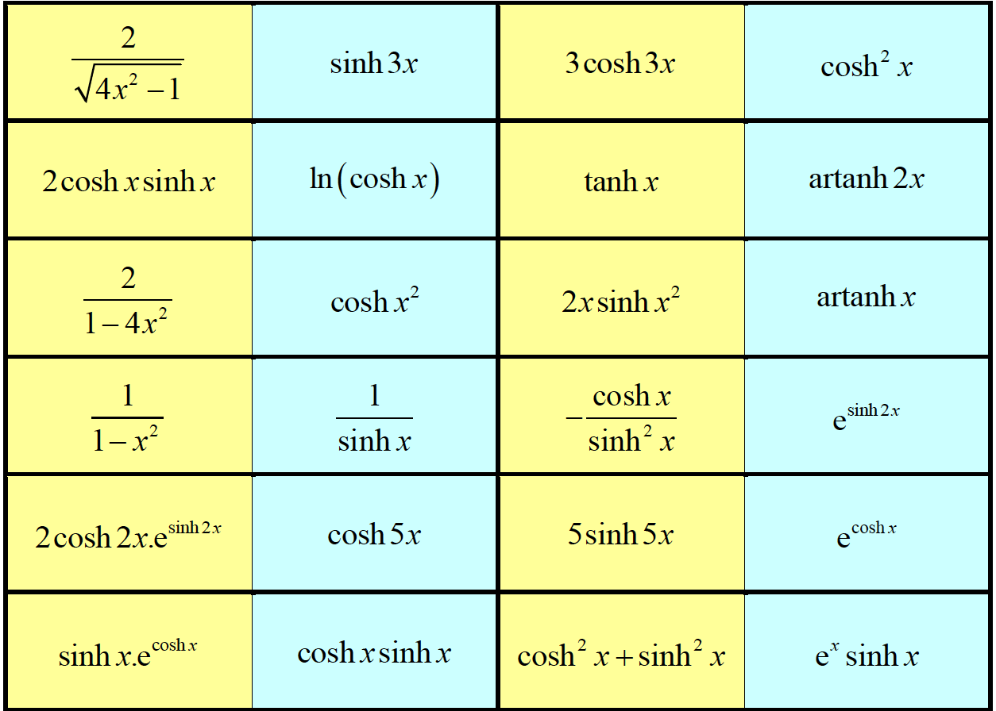
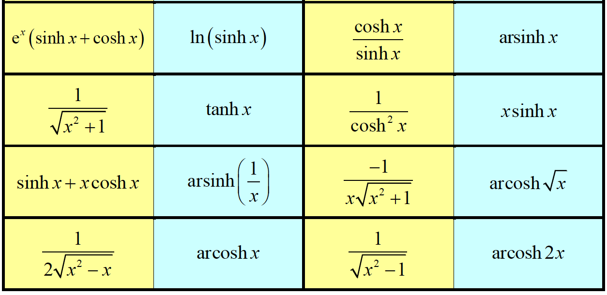
Exercise 6D
Page 133

Slide 32
6.5 Integrating hyperbolic functions
By using the rules for differentiation the following can be used
Same as non-hyperbolic version?
?
$$\int{\sinh{x} dx}=\cosh{x}+C \\ \int{\cosh{x} dx}=\sinh{x}+C \\ \int{{sech}^{2}{x} dx}=\tanh{x}+C \\ \int{{cosech}^{2}{x} dx}=−coth{x}+C \\ \int{\operatorname{sech}{x}\tanh{x} dx}=−{\operatorname{sech}{x}}+C \\ \int{\operatorname{cosech}{x}\coth{x}dx}=−cosech{x}+C$$
✗
✓
?
?
✓
Not in this chapter but worth briefly mentioning.
?
✓
?
Not in formula booklet.
✗
✓
?

Slide 33
6.5 Integration hyperbolic functions
$$\int{\frac{1}{\sqrt{1−x^{2}}} dx}=\arcsin{x}+C, \left|x\right|<1 \\ \int{\frac{1}{1+x^{2}} dx}=\arctan{x}+C \\ \int{\frac{1}{\sqrt{1+x^{2}}} dx}=\operatorname{arcsinh}{x}+C \\ \int{\frac{1}{\sqrt{x^{2}−1}} dx}=\operatorname{arccosh}{x}+C, x>1$$
?
?
?
?

Slide 34
Quick questions
?
$$\int{\cosh\left(4x−1\right)dx}=\frac{1}{4}\sinh\left(4x−1\right)+C \\ \int{sinh \left(\frac{2}{3}x\right)} dx=\frac{3}{2}\cosh\left(\frac{2}{3}x\right)+C \\ \int{\frac{3}{\sqrt{1+x^{2}}}dx}=3 arsinh x \\ \int{\frac{4}{\sqrt{x^{2}−1}}dx}=4 arcosh x \\ \int{sinh \left(3x\right)} dx=\frac{1}{3}\cosh\left(3x\right)+C \\ \int{\frac{10}{\sqrt{x^{2}−1}}dx}=10 arcosh x \\ \int{\frac{2}{\sqrt{1+x^{2}}}dx}=2 arsinh x$$
?
?
?
?
?
?

Slide 35
Examples
$$\int{\sinh{x} dx}=\cosh{x}+C \\ \int{\cosh{x} dx}=\sinh{x}+C \\ \int{\frac{1}{\sqrt{1+x^{2}}} dx}=\operatorname{arcsinh}{x}+C \\ \int{\frac{1}{\sqrt{x^{2}−1}} dx}=\operatorname{arccosh}{x}+C, x>1$$
$$\int{\frac{2+5x}{\sqrt{x^{2}+1}} dx}$$
$$\int{\tanh{x} dx}$$

Slide 36
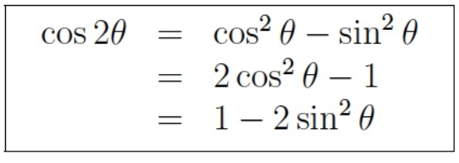
Examples with identities
$$\int{\cosh^{2}{3x} dx}$$
Use double angle formulae for $\cos{2A}$
$$\int{\sinh^{3}{x} dx}$$

Slide 37
Different techniques
Sometimes there are techniques which work on non-hyperbolic trig functions but doesn’t work on hyperbolic ones. Just first replace any hyperbolic functions with their definition.
Find $\int{e^{2x}\sinh{x} dx}$
Find $\int{\operatorname{sech}{x} dx}$

Slide 38
Arsinh and arcosh
Show that $\int{\frac{1}{\sqrt{x^{2}−a^{2}}}dx}=arcosh \left(\frac{x}{a}\right)+c$
Let $x=a\cosh{u}$ $⇒\frac{dx}{du}=a\sinh{u}$
$$\int{\frac{1}{\sqrt{x^{2}−a^{2}}}dx}=\int{\frac{1}{\sqrt{a^{2}\cosh^{2}{u}−a^{2}}} a\sinh{u}du} \\ =\frac{1}{a}\int{\frac{a \sinh{u}}{\sqrt{\cosh^{2}{u}−1}} du=\int{\frac{\sinh{u}}{\sinh{u}} du}} \\ =u+c=arcosh \left(\frac{x}{a}\right)+c$$
$$\int{\frac{1}{\sqrt{a^{2}+x^{2}}}dx}=arsinh \left(\frac{x}{a}\right)+c$$
$$\int{\frac{1}{\sqrt{x^{2}−a^{2}}}dx}=arcosh \left(\frac{x}{a}\right)+c, x>a$$

Slide 39
Your turn
Show that $\int{\sqrt{1+x^{2}} dx}=\frac{1}{2}arsinh x+\frac{1}{2}x\sqrt{1+x^{2}}+C$.
Trying $x=\sinh{u}$:
$$\frac{dx}{du}=\cosh{u} → dx=\cosh{u} du$$
$$\int{\sqrt{1+x^{2}} dx}=\int{\cosh{u}×\cosh{u} du} \\ =\int{\cosh^{2}{u} du} \\ =\frac{1}{2}\int{1+\cosh{2u} du} \\ =\frac{1}{2}\left(u+\frac{1}{2}\sinh{2u}\right)+C \\ =\frac{1}{2}arsinh x+\frac{1}{2}x\sqrt{1+x^{2}}+C$$

Slide 40
Examples
Show that $\int_{5}^{8}{\frac{1}{\sqrt{x^{2}−16}}dx}=\ln\left(\frac{2+\sqrt{3}}{2}\right)$

Slide 41
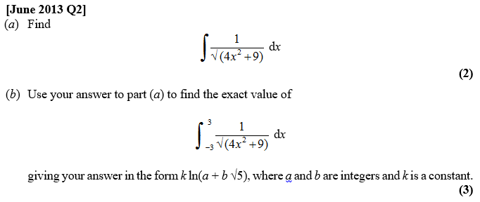
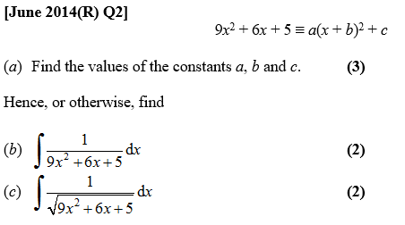
Your turn
Using a hyperbolic substitution, evaluate $\int_{0}^{6}{\frac{x^{3}}{\sqrt{x^{2}+9}} dx}$

Slide 42
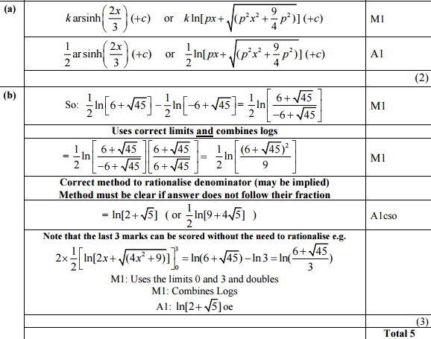
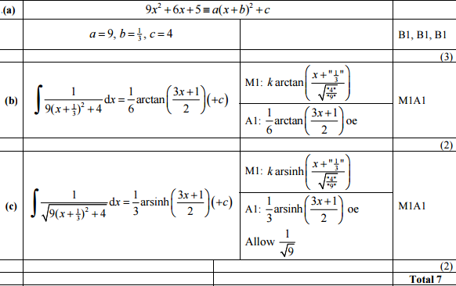
Answers
Using $x=3\sinh{u}$ yields $18\left(\sqrt{5}+1\right)$

