Slide 1
Chapter 5 – Polar co-ordinates

Slide 2
Polar Co-ordinates?
You have been used to (x,y) known as cartesian plane. These can be represented as polar co-ordinates
Find the equivalent polar co-ordinates
(3,6) (-2,7) (-5,-10)

Slide 3
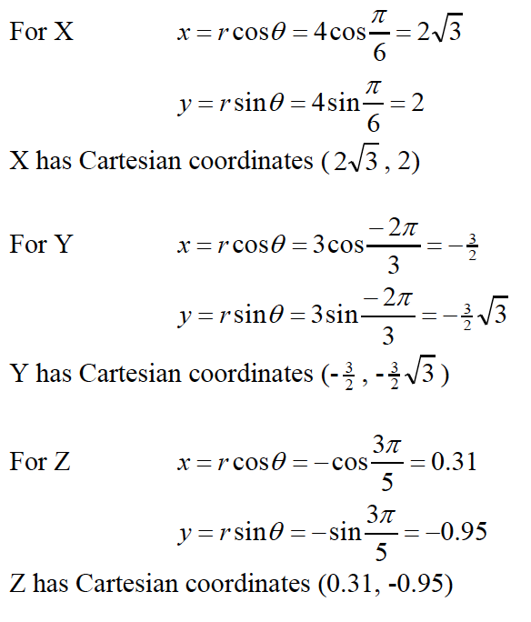
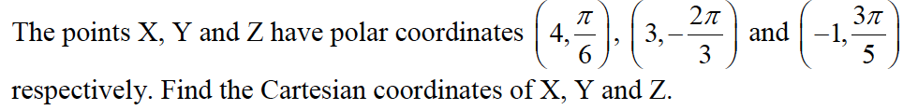
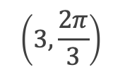
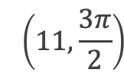
Converting back
$$\left(11,\frac{3π}{2}\right)$$
$$\left(3,\frac{2π}{3}\right)$$
Your turn

Slide 4

Polar Curves
Polar equations of curves are given in the form $r=f(θ)$
Examples are
r = 2cos $θ$
r = 1+3 $θ$
r = 4

Slide 5



Try to work these out
Use these to help
$$r^{2}=x^{2}+y^{2} \\ x=r\cos{θ} \\ y=r\sin{θ}$$
$$r=5 \\ \sqrt{x^{2}+y^{2}}=5 \\ x^{2}+y^{2}=25$$
$$r=2+\cos{2θ} \\ r=2+2\cos^{2}θ{−1}=1+2\cos^{2}{θ} \\ r=1+\frac{2x^{2}}{r^{2}} \\ r^{3}=r^{2}+2x^{2} \\ {\left(x^{2}+y^{2}\right)}^{\frac{3}{2}}=x^{2}+y^{2}+2x^{2}=3x^{2}+y^{2}$$
$$r^{2}=\sin{2θ} \\ r^{2}=2\sin{θ}\cos{θ} \\ r^{2}=2\left(\frac{y}{r}\right)\left(\frac{x}{r}\right)=\frac{2xy}{r^{2}} \\ r^{4}=2xy \\ {\left(x^{2}+y^{2}\right)}^{2}=2xy$$
$$y^{2}=4x \\ r^{2}\sin^{2}{θ}=4r\cos{θ} \\ r=4\cot{θ}\operatorname{cosec}{θ}$$
$$x^{2}−y^{2}=5 \\ r^{2}\cos^{2}{θ}−r^{2}\sin^{2}{θ}=5 \\ r^{2}\left(\cos^{2}{θ−\sin^{2}{θ}}\right)=5 \\ r^{2}\cos{2θ}=5 \\ r^{2}=5\sec{2θ}$$
$$y\sqrt{3}=x+4 \\ r\sqrt{3} \sin{θ}=r\cos{θ}+4 \\ r\left(\sqrt{3}\sin{θ}−\cos{θ}\right)=4 \\ r\sin\left(θ−\frac{π}{6}\right)=2$$
Exercise 5A
Page 104

Slide 6

Sketching Curves
You can use the following rules
r = a is a circle with centre 0 and radius a. Think about argand diagrams, z=5
$θ$ = b is a half line through 0 and angle b with initial line. Again think about argand diagrams
r = $aθ$ is a spiral starting at 0

Slide 7
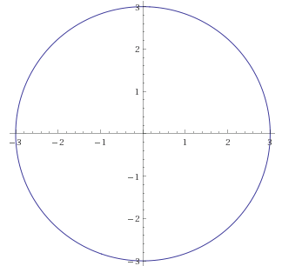
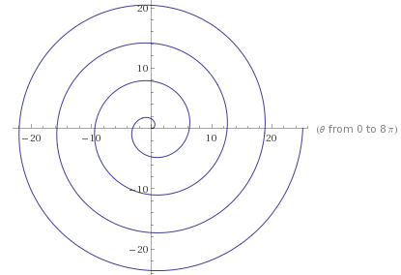




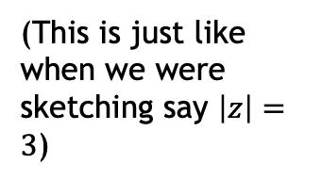


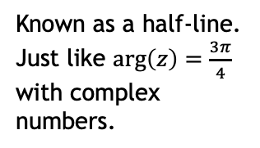
Diagrams
$$r=a$$
$$θ=α$$
$$r=aθ$$
e.g. $r=3$
e.g. $θ=\frac{3π}{4}$
e.g. $r=θ$
(This is just like when we were sketching say $\left|z\right|=3$)
Known as a half-line.
Just like $\arg\left(z\right)=\frac{3π}{4}$ with complex numbers.

Slide 8
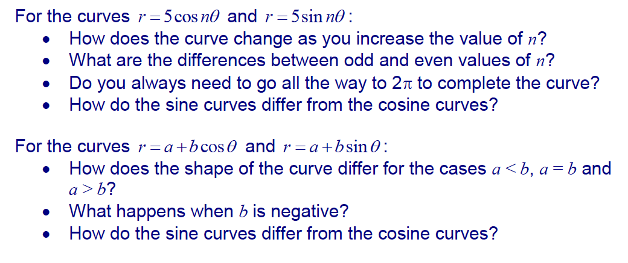
Investigation

Slide 9
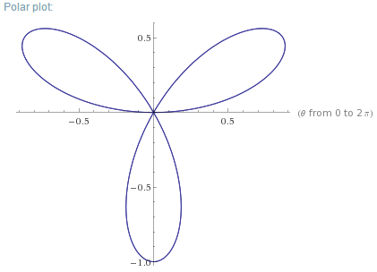
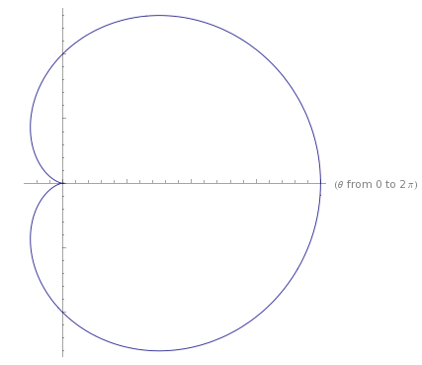
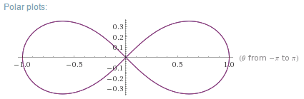

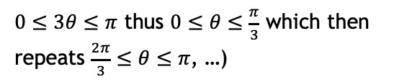
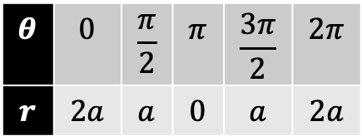



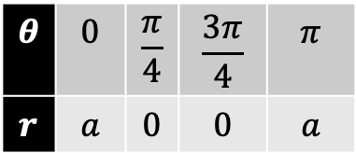






Sketching
You can make a table of values or you can think of the important angles. These are when r is 0 or it takes the maximum or minimum value.
$$r=a\left(1+\cos{θ}\right)$$
$$r=\sin{3θ}$$
$$r^{2}=a^{2}\cos{2θ}$$
$0≤3θ≤π$ thus $0≤θ≤\frac{π}{3}$ which then repeats $\frac{2π}{3}≤θ≤π$, …)
$$θ$$ | $$0$$ | $$\frac{π}{2}$$ | $$π$$ | $$\frac{3π}{2}$$ | $$2π$$
$$r$$ | $$2a$$ | $$a$$ | $$0$$ | $$a$$ | $$2a$$
$$θ$$ | $$0$$ | $$\frac{π}{6}$$ | $$\frac{π}{3}$$
$$r$$ | $$0$$ | $$a$$ | $$0$$
$$θ$$ | $$0$$ | $$\frac{π}{4}$$ | $$\frac{3π}{4}$$ | $$π$$
$$r$$ | $$a$$ | $$0$$ | $$0$$ | $$a$$
$$θ=\frac{π}{2}$$
$$a$$
$$θ=π$$
$$θ=0$$
$$2a$$
$$a$$
Cardioid

Slide 10
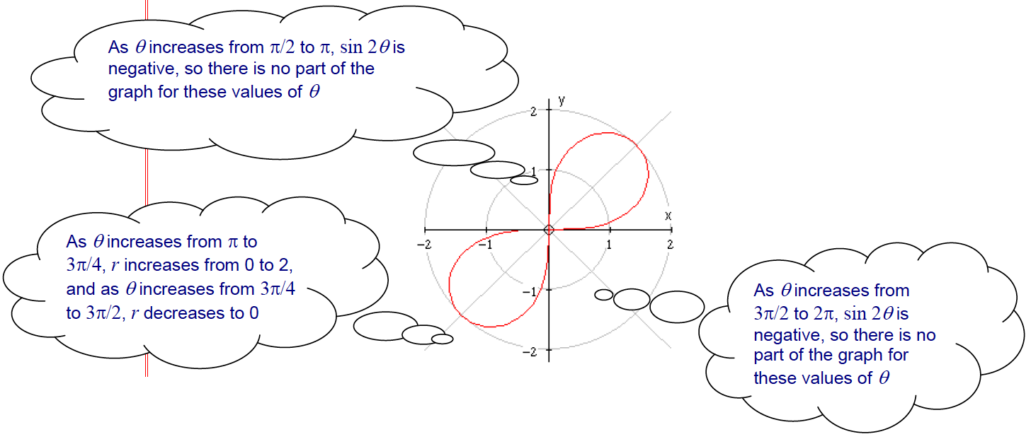

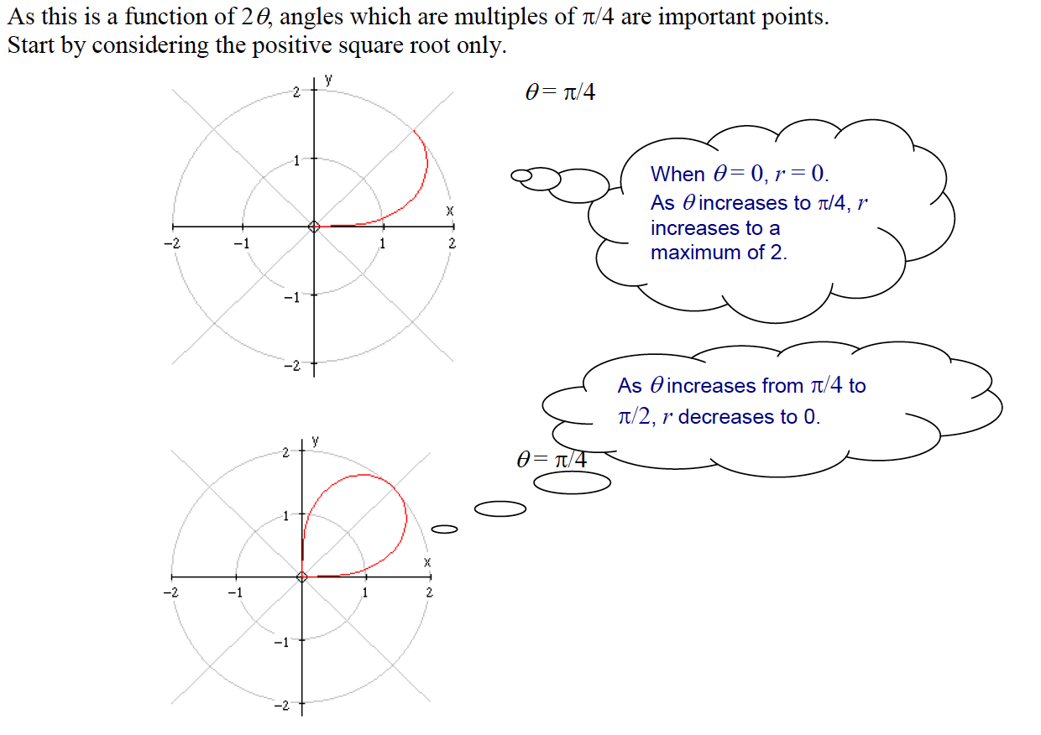
Without table

Slide 11
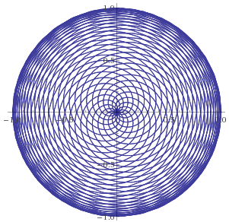
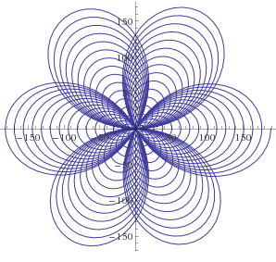
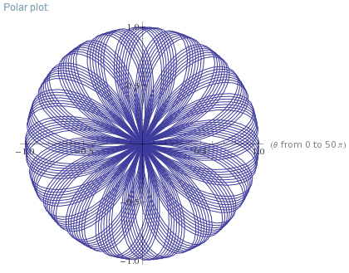
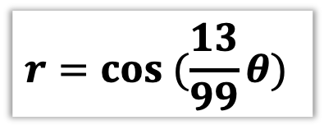

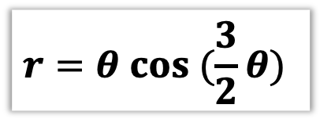
Some patterns. Because why not.
$$r=cos (\frac{13}{99}θ)$$
$$r=θ cos (\frac{3}{2}θ)$$
For $θ$ from 0 to $50π$
(This is a spiral combined with a polar rose)

Slide 12
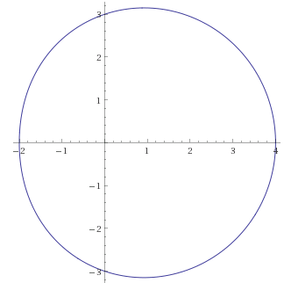
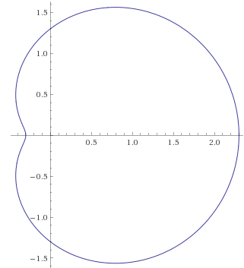
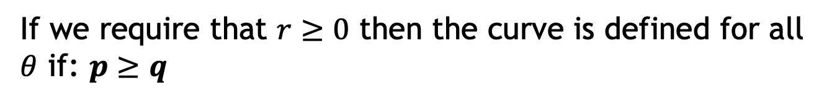
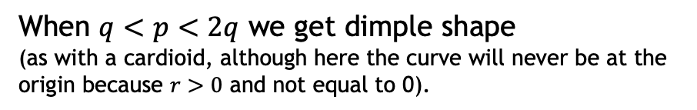



Egg or dimple
$$r=a\left(p+q\cos{θ}\right)$$
If we require that $r≥0$ then the curve is defined for all $θ$ if: $p≥q$
Case 1
When $p=q$ we get a cardioid (where the curve reaches the origin when $θ=π$
Case 2
When $p≥2q$ we get an oval shape
(and if $q=0$, a circle centred at the origin).
Case 3
When $q<p<2q$ we get dimple shape
(as with a cardioid, although here the curve will never be at the origin because $r>0$ and not equal to 0).

Slide 13


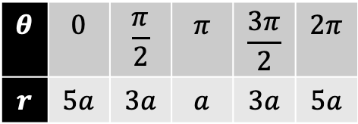
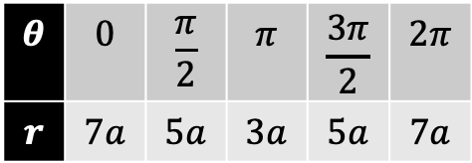
Examples
Sketch $r=a\left(5+2\cos{θ}\right)$
Sketch $r=a\left(3+2\cos{θ}\right)$
$$θ$$ | $$0$$ | $$\frac{π}{2}$$ | $$π$$ | $$\frac{3π}{2}$$ | $$2π$$
$$r$$ | $$7a$$ | $$5a$$ | $$3a$$ | $$5a$$ | $$7a$$
$$θ$$ | $$0$$ | $$\frac{π}{2}$$ | $$π$$ | $$\frac{3π}{2}$$ | $$2π$$
$$r$$ | $$5a$$ | $$3a$$ | $$a$$ | $$3a$$ | $$5a$$

Slide 14
Example 2
(a) Show on an Argand diagram the locus of points given by the values of $z$ satisfying $\left|z−3−4i\right|=5$
(b) Show that this locus of points can be represented by the polar curve $r=6\cos{θ}+8\sin{θ}$
Exercise 5B
Page 108 and 109

Slide 15





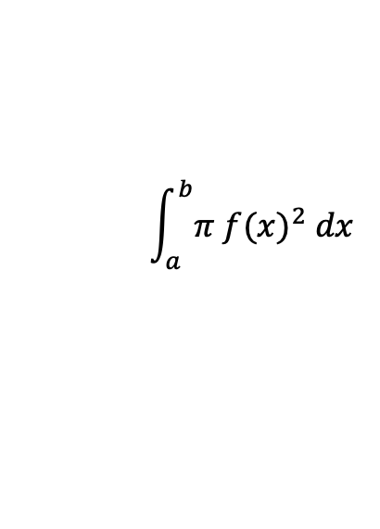


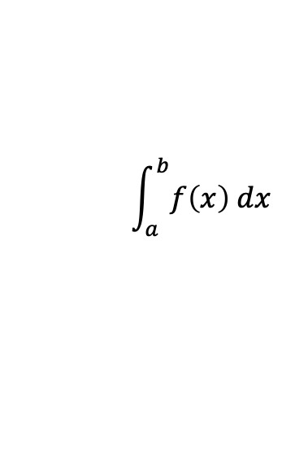

5.3 Area enclosed by a polar curve
When integrating normal Cartesian 2D areas, we know we’re summing a bunch of infinitely thin rectangles:
$$\int_{a}^{b}{f\left(x\right) dx}$$
$$f(x)$$
$$a$$
$$dx$$
$$b$$
Similarly in Core Pure Years 1, we could get a volume of revolution by summing the volumes of infinitely thin cylinders:
$$\int_{a}^{b}{π {f(x)}^{2} dx }$$
$$f(x)$$
$$a$$
$$b$$
$$dx$$

Slide 16

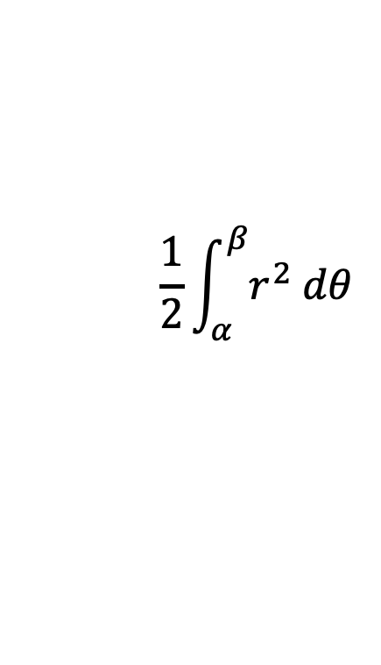

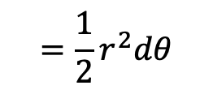


What about polar curves?
Area of each sector:
$$=\frac{1}{2}r^{2}dθ$$
$$θ=β$$
$$dθ$$
$$r$$
Adding them all for total area:
$$θ=α$$
$$\frac{1}{2}\int_{α}^{β}{r^{2} dθ}$$

Slide 17

Examples
Find the area enclosed by the cardioid with equation $r=a\left(1+\cos{θ}\right)$
Find the area of one loop of the polar rose $r=a\sin{4θ}$
$\cos^{2}{x}=\frac{1}{2}+\frac{1}{2}\cos{2x}$ and $\sin^{2}{x}=\frac{1}{2}−\frac{1}{2}\cos{2x}$

Slide 18
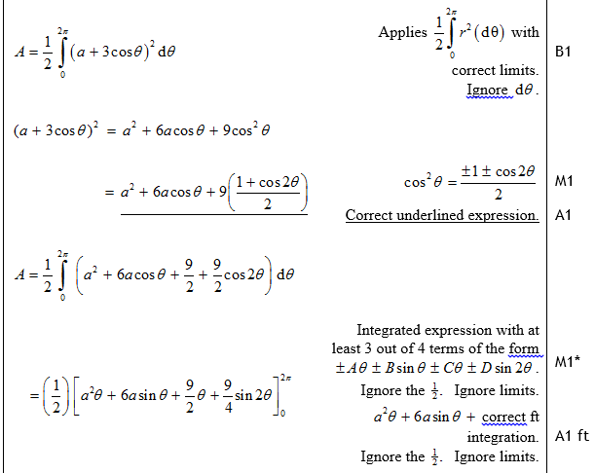
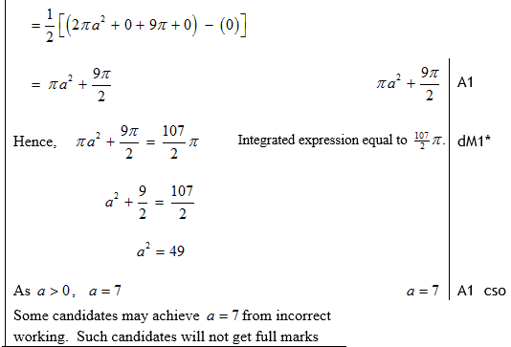
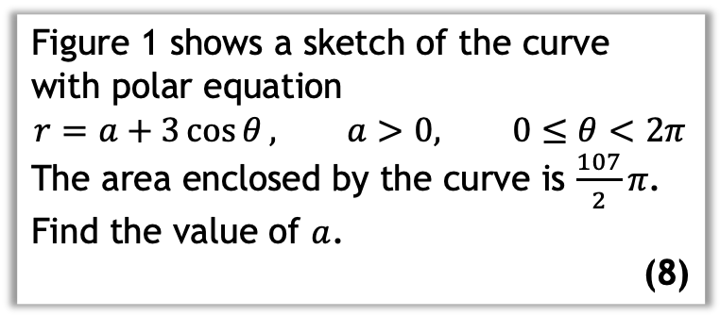
Your turn
Figure 1 shows a sketch of the curve with polar equation
$$r=a+3\cos{θ}, a>0, 0≤θ<2π$$
The area enclosed by the curve is $\frac{107}{2}π$.
Find the value of $a$.
(8)

Slide 19
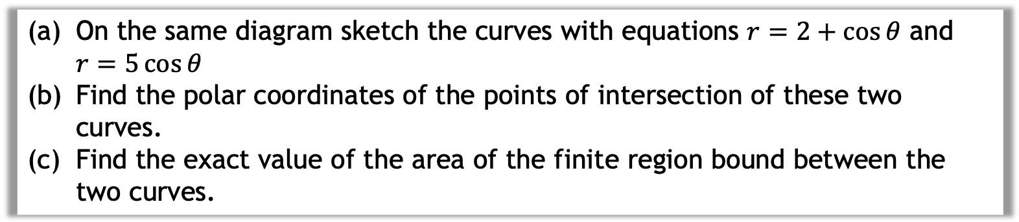
Intersecting areas
On the same diagram sketch the curves with equations $r=2+\cos{θ}$ and $r=5\cos{θ}$
Find the polar coordinates of the points of intersection of these two curves.
Find the exact value of the area of the finite region bound between the two curves.

Slide 20
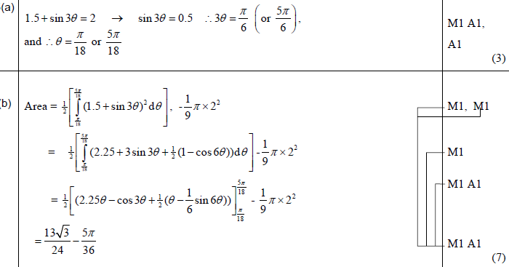
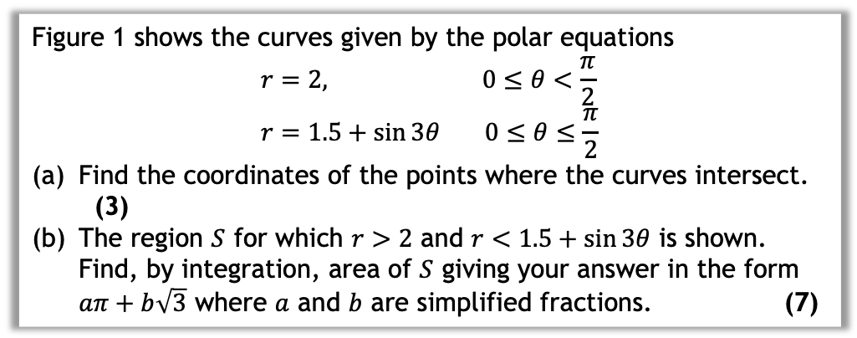
Your turn
Figure 1 shows the curves given by the polar equations
$$r=2, 0≤θ<\frac{π}{2} \\ r=1.5+\sin{3θ} 0≤θ≤\frac{π}{2}$$
Find the coordinates of the points where the curves intersect. (3)
The region $S$ for which $r>2$ and $r<1.5+\sin{3θ}$ is shown. Find, by integration, area of $S$ giving your answer in the form $aπ+b\sqrt{3}$ where $a$ and $b$ are simplified fractions. (7)
Exercise 5C
Page 111 and 112

Slide 21
5.4 Tangents to polar curves
What is the gradient of the tangent to the curve parallel to the x axis? How do you work out the co-ordinate?
Same for tangent parallel to the initial line
How would you find perpendicular to the initial line?

Slide 22
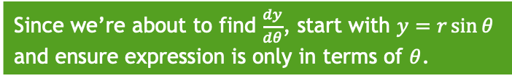
Example
Find the coordinates of the points on $r=a\left(1+\cos{θ}\right)$ where the tangents are parallel to the initial line $θ=0$.
Since we’re about to find $\frac{dy}{dθ}$, start with $y=r\sin{θ}$
and ensure expression is only in terms of $θ$.

Slide 23
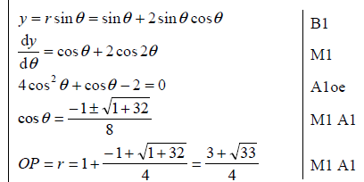
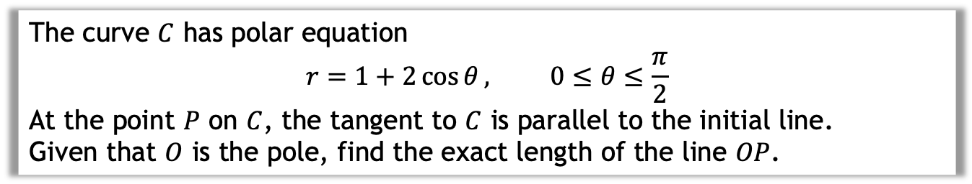
Your turn
The curve $C$ has polar equation
$$r=1+2\cos{θ}, 0≤θ≤\frac{π}{2}$$
At the point $P$ on $C$, the tangent to $C$ is parallel to the initial line.
Given that $O$ is the pole, find the exact length of the line $OP$.

Slide 24
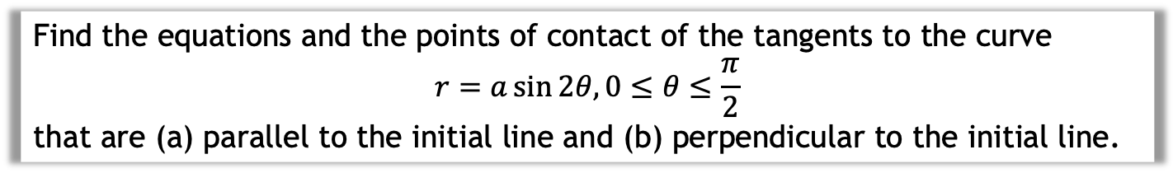
Example 2
Find the equations and the points of contact of the tangents to the curve
$$r=a\sin{2θ, 0≤θ≤\frac{π}{2}}$$
that are (a) parallel to the initial line and (b) perpendicular to the initial line.
Exercise 5D
Page 115 and 116

