Slide 1
Chapter 1 : Algebraic methods

Slide 2
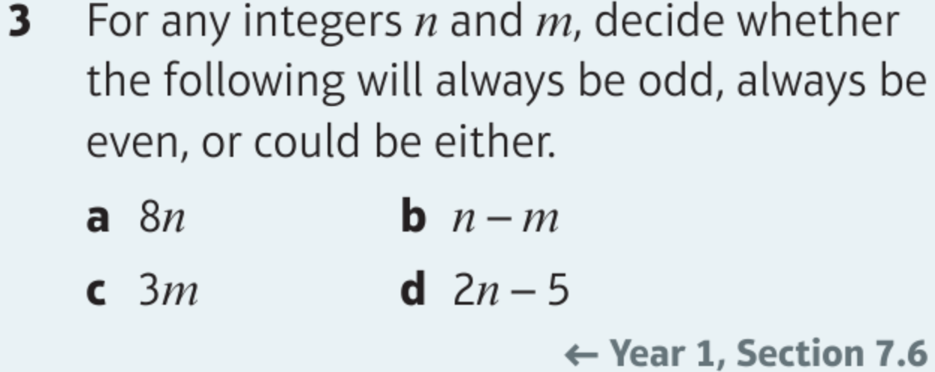
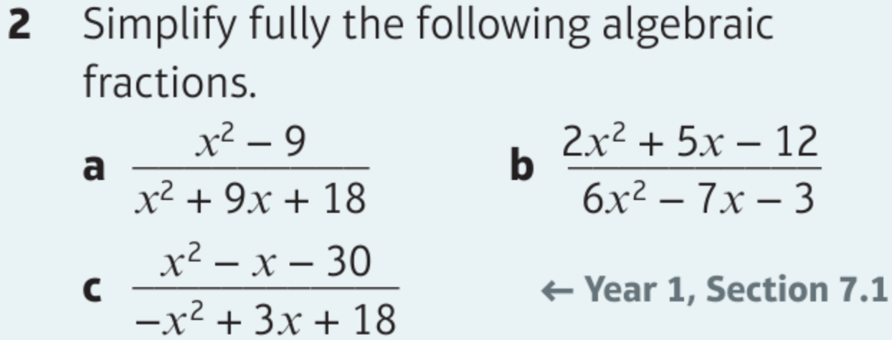
Chapter 1: Algebraic expressions

Slide 3
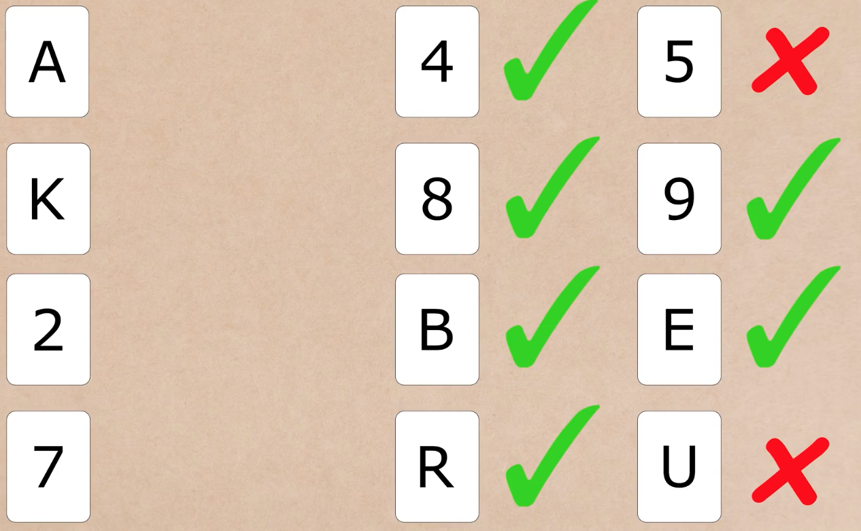
Puzzle
If a card has a vowel on one side, it must have an even number on the other side.
Which card(s) must be turned over to determined if this rule is followed?

Slide 4
1.1 Proof by contradiction
How to structure/word proof:
“Assume that [negation of statement].”
[Reasoning followed by…] “This contradicts the assumption that…” or “This is a contradiction”.
“Therefore [restate original statement].”
To prove a statement is true by contradiction:
Assume that the statement is in fact false.
Prove that this would lead to a contradiction.
Therefore we were wrong in assuming the statement was false, and therefore it must be true.
Prove that there is no greatest odd integer.
Assumption
Assume that there is a greatest odd integer, $n$.
Show contradiction
Then $n+2$ is an odd integer which is larger than $n$.
This contradicts the assumption that $n$ is the greatest odd integer.
Conclusion
Therefore, there is no greatest odd integer.

Slide 5
1.1 Examples
The first part of a proof by contradiction requires you to negate the original statement.
What is the negation of each of these statements?
“There are infinitely many prime numbers.”
“All Popes are Catholic.”
“If it is raining, my garden is wet.”
“There are infinitely many non-prime (i.e. composite) numbers.”
“There exists a Pope who is not Catholic.”
“It is not raining, and my garden is dry.”
“There are finitely many prime numbers.”
“No Popes are Catholic.”
“It is not raining, and my garden is wet.”
“There are finitely many non-composite numbers.”
“Mr Lynton is the Pope.”
“It is raining, and my garden is not wet.”
Comments: The negation of “all are” is not “none are”. So the negation of “everyone likes green” wouldn’t be “no one likes green”, but: “not everyone likes green”. Do not confuse a ‘negation’ with the ‘opposite’.
Comments: If you have a conditional statement like “If A then B”, then the negation is “A and not B”, i.e. the condition is true, but the conclusion is false/negated.

Slide 6
1.1 Example
Prove by contradiction that there is no greatest odd integer
Assumption: There is a greatest odd integer, $n$
We need to use logical steps to reach a contradiction/impossibility
If $n$ is an integer, then $n+2$ is also an integer
$$n+2>n$$
$$n+2=odd+even$$
So $n+2$ would be an odd integer and is greater than $n$. Therefore, there is no greatest odd integer.

Slide 7
1.1 Example 2
Prove by contradiction that if $n^{2}$ is even, then $n$ must be even
Assumption: There exists a number $n$ such that $n$ is odd, but $n^{2}$ is even.
We need to use logical steps to reach a contradiction/impossibility
If $n$ is odd then it can be written in the form $2k+1$
Therefore $n^{2}={\left(2k+1\right)}^{2}$
$$={4k}^{2}+4k+1$$
$$=2(2k^{2}+2k)+1$$
So $n^{2}$ is odd, which contradicts the original statement that if $n$ is odd, then $n^{2}$ can be even

Slide 8
1.1 Example 3
Prove by contradiction that $\sqrt{2}$ is an irrational number
Assumption: $\sqrt{2}$ is a rational number, and can therefore be expressed as $\frac{a}{b}$, with the fraction is its simplest form
We need to use logical steps to reach a contradiction/impossibility
$$\sqrt{2}=\frac{a}{b}$$
$$2=\frac{a^{2}}{b^{2}}$$
This means that $a^{2}$ is even, so therefore $a$ must also be even
→ This means that $a$ can be written as $2n$, where $n$ is a different integer…
$$2b^{2}=a^{2}$$
This means that $b^{2}$ is also even, so therefore $b$ must also be even
$$2b^{2}={(2n)}^{2}$$
$$2b^{2}={4n}^{2}$$
We have just shown that $a$ and $b$ are both even – how does this contradict the original statement?
$$b^{2}={2n}^{2}$$
If $a$ and $b$ are both even, then we can simplify the fraction $\frac{a}{b}$
However, our assumption was that $\sqrt{2}$ can be written as $\frac{a}{b}$, which has been fully simplified
What we showed contradicts this!
1A

Slide 9
1.1 Example 4
Prove by contradiction that there are infinitely many Prime numbers
Assumption: There is a finite number of Primes, with the largest being $p_{n}$
We need to use logical steps to reach a contradiction/impossibility
Imagine we listed all the prime numbers:
$$p_{1}, p_{2}, p_{3},…,…,…p_{n}$$
→ A number N will exist which is created by multiplying all the primes up to $p_{n}$, and then adding 1
$$p_{1}×p_{2}×p_{3},…,…×p_{n}$$
→ This number will not be divisible by any of the primes, since 1 has been added
→ Therefore, this number must either be Prime, or have a prime factor which was not on the original list
→ Either way, the statement has been contradicted!

Slide 10
1.1 Question for you

Slide 11
1.1 Question for you again
Exercise 1A page 4 and 5

Slide 12
1.2 Algebraic fractions
As your saw at GCSE level, multiplying algebraic fractions is no different to multiply numeric fractions.
You may however need to cancel common factors, by factorising where possible.
$$\frac{a}{b}×\frac{c}{a}=$$
$$\frac{x+1}{2}×\frac{3}{x^{2}−1} =$$
$$\frac{p}{q}÷\frac{r}{q}= \\ \frac{x+2}{x+4}÷\frac{3x+6}{x^{2}−16} =$$

Slide 13
1.2 Class questions
$$\frac{x^{2}+y}{2y} =\frac{x^{2}}{2}$$
$$\frac{x+3}{5}×\frac{10}{x^{2}−9}$$
$$\frac{x^{2}+x}{y}÷\frac{x^{2}−x−2}{y^{2}}$$
Exercise 1B page 6 and 7

Slide 14
1.3 Algebraic fractions
To add/subtract two fractions, find a common denominator.
This can be achieved by multiplying the denominators and cross-multiplying the numerators:
$$\frac{3}{x+1}−\frac{2}{x+2}=$$
However, often we should see if first if there are common factors in the denominator to avoid multiplying unnecessarily:
$$\frac{3}{x+1}−\frac{4x}{x^{2}−1}$$

Slide 15
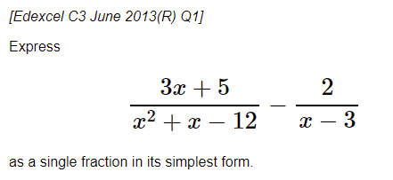
1.3 Class questions

Slide 16
1.3 Question for you
Exercise 1C page 8

Slide 17
1.4 Partial fractions
$$\frac{3}{x+1}−\frac{2}{x+2}=$$
If the denominator is a product of a linear terms, it can be split into the sum of ‘partial fractions’, where each denominator is a single linear term.
$$\frac{6x−2}{\left(x−3\right)\left(x+1\right)}$$

Slide 18
1.4 Partial fractions
Given that $\frac{6x^{2}+5x−2}{x\left(x−1\right)\left(2x+1\right)}≡\frac{A}{x}+\frac{B}{x−1}+\frac{C}{2x+1}$, find the values of the constants $A,B,C$.

Slide 19
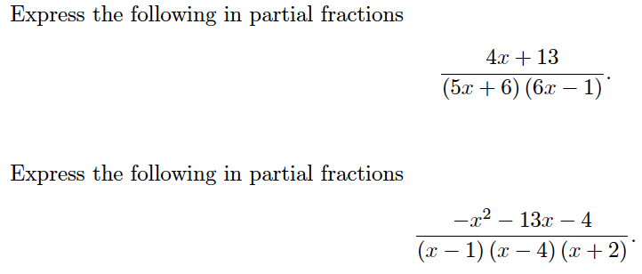
1.4 Class question

Slide 20
1.4 Question for you
Exercise 1D page 11

Slide 21
1.5 Repeated partial fractions
Suppose we wished to express $\frac{2x+1}{{\left(x+1\right)}^{2}}$ as $\frac{A}{x+1}+\frac{B}{x+1}$. What’s the problem?
Split $\frac{11x^{2}+14x+5}{{\left(x+1\right)}^{2}\left(2x+1\right)}$ into partial fractions.

Slide 22
1.5 Class question
$$\frac{3x^{2}−4x+2}{\left(x+1\right)(x−5)^{2}}$$

Slide 23
1.5 Question for you
Exercise 1E page 13

Slide 24
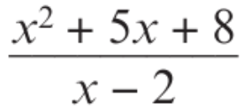
1.6 Partial fractions
Divide this polynomial

Slide 25
1.6 Improper fractions
An algebraic fraction is improper if the degree of the numerator is at least the degree of the denominator.
$$\frac{x^{2}−3}{x+2}$$
$$\frac{x+1}{x−1}$$
$$\frac{x^{3}−x^{2}+3}{x^{2}−x}$$
Questions might take one of two forms:
Do the division to express as a quotient and a remainder, e.g. $\frac{x+1}{x−1} → 1+\frac{2}{x−1}$
Express as partial fractions, e.g. $\frac{x^{2}+x}{\left(x+1\right)\left(x−2\right)}=A+\frac{B}{x+1}+\frac{C}{x−2}$
In general:
$$\frac{F\left(x\right)}{divisor}=Q\left(x\right)+\frac{remainder}{divisor}$$

Slide 26
1.6 Example
If $\frac{x^{2}+5x−9}{x+2}=Ax+B+\frac{C}{x+2}$, determine the values of $A$, $B$ and $C$.

Slide 27
1.6 Another example

Slide 28
1.6 Class question
Given that $\frac{x^{3}+x^{2}−7}{x−3}≡{Ax}^{2}+Bx+C+\frac{D}{x−3}$, find the values of $A$, $B$, $C$ and $D$

Slide 29
1.6 Question for you
Exercise 1F page 16 and 17

Slide 30
1.7 Improper partial fractions
Split $\frac{3x^{2}−3x−2}{\left(x−1\right)\left(x−2\right)}$ into partial fractions.

Slide 31
1.7 class question
Exercise 1G page 18

