Slide 1
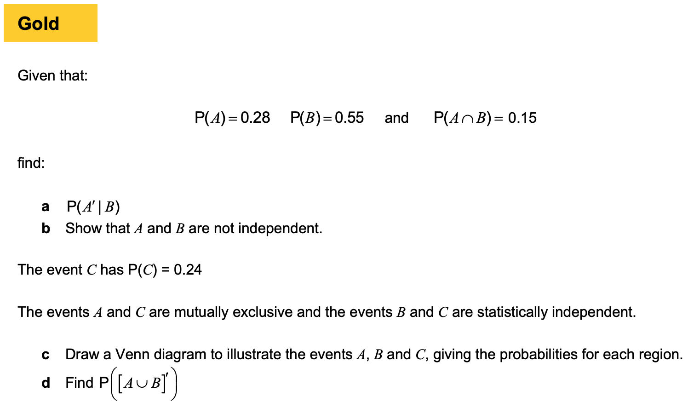
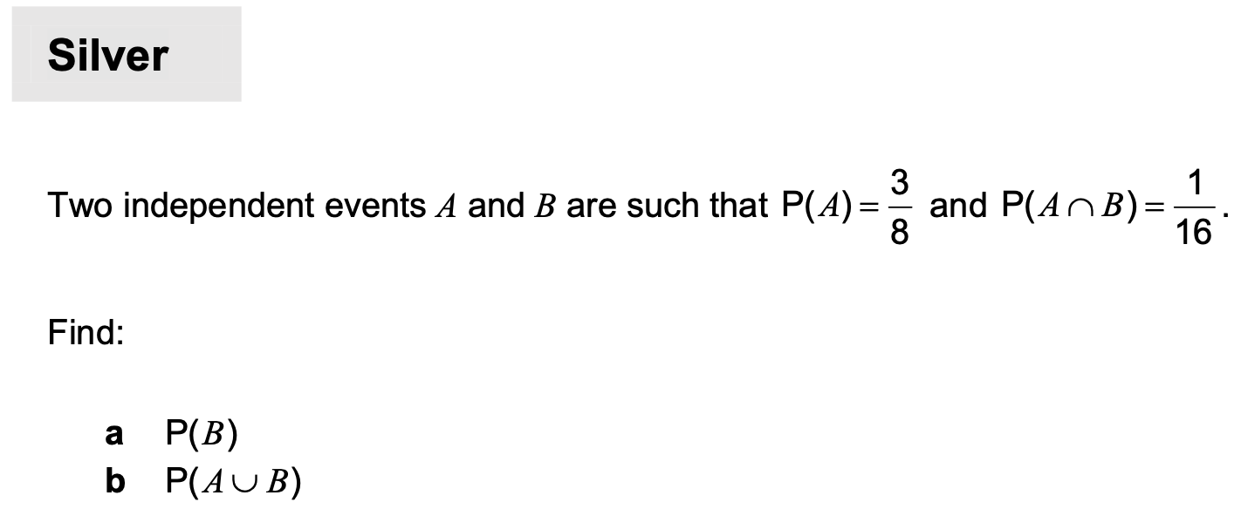
Chapter 3 – Normal distribution

Slide 2
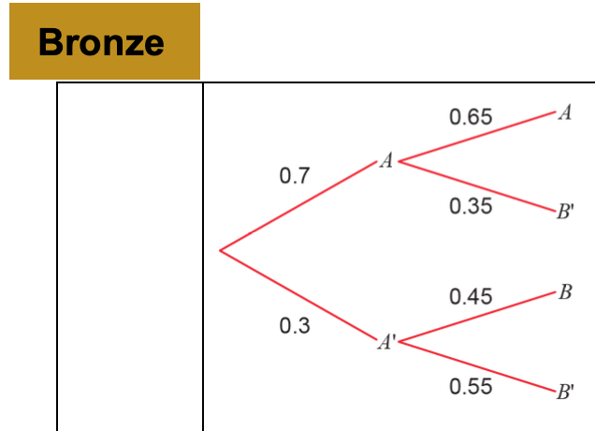
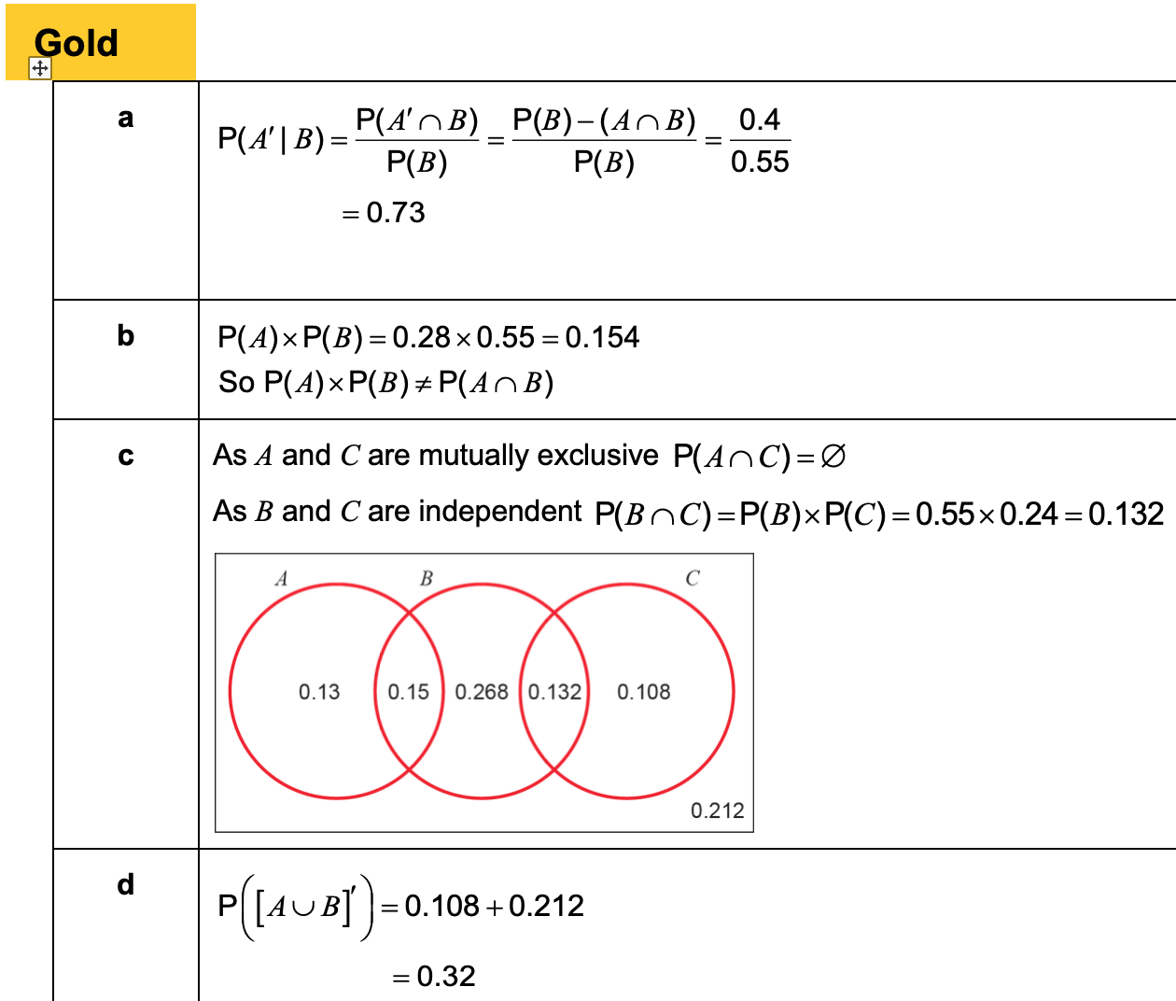
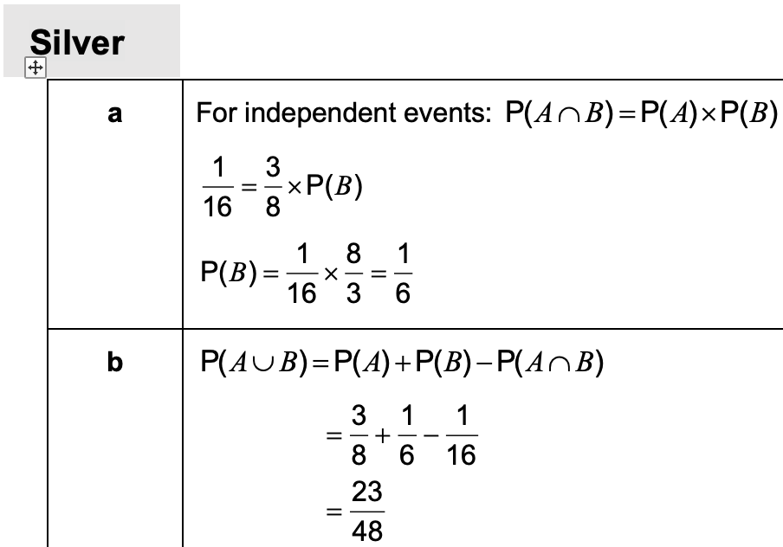
Answers

Slide 3
3.1 Normal distribution
The following shows what the probability distribution might look like for a random variable $X,$ if $X$ is the height of a randomly chosen person.
We expect this ‘bell-curve’ shape, where we’re most likely to pick someone with a height around the mean of 180cm, with the probability diminishing symmetrically either side of the mean.
$$f\left(x\right)$$
180cm
Height in cm ($x$)
A variable with this kind of distribution is said to have a normal distribution.
For normal distributions we tend to draw the $y$ axis at the mean for symmetry.

Slide 4
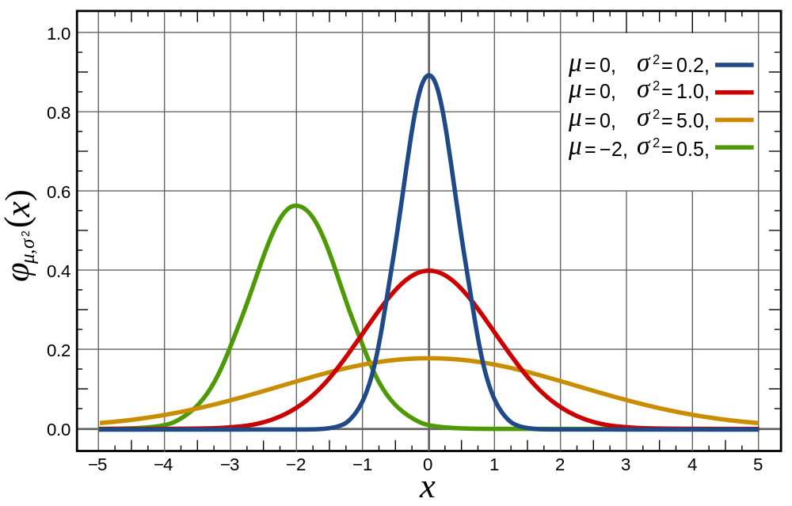
3.1 Normal distribution
We can set the mean $μ$ and the standard deviation $σ$ of the Normal Distribution. If a random variable $X$ is normally distributed, then we write
$$X\sim N\left(μ,σ^{2}\right)$$

Slide 5
3.1 Normal distribution
For a Normal Distribution to be used, the variable must be:
$$f\left(x\right)$$
continuous
With a discrete variable, all the probabilities had to add up to 1.
For a continuous variable, similarly:
the area under the probability graph has
to be 1.
To find $P\left(170<X<190\right)$, we could:
find the area between these values.
170cm
180cm
190cm
Height in cm ($x$)
Would we ever want to find $P\left(X=200\right)$ say?
Since height is continuous, the probability someone is ‘exactly’ 200cm is infinitesimally small. So not a ‘probability’ in the normal sense.

Slide 6
3.1 Venn diagrams
$$f\left(x\right)$$
The curve has points of inflection one standard deviation from the mean, i.e. $μ±σ$
(recall from Pure that this is where the curve changes concavity, and where the gradient is not changing)
The Normal Distribution is symmetrical, i.e. mean = mode = median
$$μ−σ$$
$$μ+σ$$
Height in cm ($x$)

Slide 7
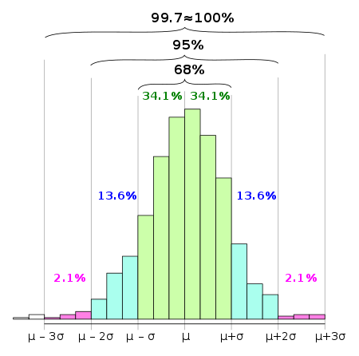
3.1 68%, 95%, 99.7% rule
The 68-95-99.7 rule is a shorthand used to remember the percentage of data that is within 1, 2 and 3 standard deviations from the mean respectively.
You need to memorise this!
$≈68\%$ of data is within one standard deviation of the mean. $≈95\%$ of data is within two standard deviations of the mean.
$≈99.7\%$ of data is within three standard deviations of the mean.
For practical purposes we consider all data to lie within $μ±5σ$
The histogram above is for a quantity which is approximately normally distributed.

Slide 8
3.1 Example
The diameters of a rivet produced by a machine, $X$ mm, is modelled as $X\sim N\left({8,0.2}^{2}\right)$. Find:
$P\left(X>8\right)$
$P\left(7.8<X<8.2\right)$

Slide 9
3.1 Question for you
IQ (“Intelligence Quotient”) for a given population is, by definition, distributed using $X\sim N\left({100,15}^{2}\right)$. Find:
$P\left(70<X<130\right)$
$P\left(X>115\right)$
Exercise 3A Page 40-41

Slide 10
3.2 Finding probabilities for ND
Just like a cumulative frequency graph gives the running total of the frequency up to a given value, a cumulative distribution gives the running total of the probability up to a given value.
IQ is distributed using $X\sim N\left({100,15}^{2}\right)$. Find
$P\left(X<109\right)$
$P\left(X≥93\right)$
$P\left(110<X<120\right)$
$P\left(X<80 or X>106\right)$

Slide 11
3.2 Example
An IQ test is applied to a population of adults. The scores, X, on the test are found to be normally distributed with $X\sim N(100,{15}^{2})$. Adults scoring more than 140 on the test are classified as ‘genius’.
Find the probability that an adult chosen at random achieves a ‘genius’ classification
Twenty adults take the test. Find the probability that two or more are classified as ‘genius’

Slide 12
3.2 Question for you
The criteria for joining Mensa is an IQ of at least 131.
Assuming that IQ has the distribution $X\sim N\left({100,15}^{2}\right)$ for a population, determine:
What percentage of people are eligible to join Mensa.
If 30 adults are randomly chosen, the probability that at least 3 of them will be eligible to join.

Slide 13
3.3 Inverse normal distribution
We now know how to use a calculator to value of the variable to obtain a probability. But we might want to do the reverse: given a probability of being in a region, how do we find the value of the boundary?
$X\sim N\left({20,3}^{2}\right)$. Find, correct to two decimal places, the values of $a$ such that:
$P\left(X<a\right)=0.75$
$P\left(X>a\right)=0.4$
$P\left(16<X<a\right)=0.3$

Slide 14
3.3 Example 2
If the IQ of a population is distributed using $X\sim N\left({100,15}^{2}\right)$.
Determine the IQ corresponding to the top 30% of the population.
Determine the interquartile range of IQs.

Slide 15
3.3 Class question
Plates made using a manufacturing process have a diameter, $D cm$, which can be modelled using a normal distribution, $D\sim N(20,{1.5}^{2})$.
Given that 60% of plates are less than $x cm$, find the value of $x$.
Find the interquartile range of the plate diameters

Slide 16
3.3 Question for you
$X\sim N\left({80,7}^{2}\right)$. Using your calculator,
determine the $a$ such that $P\left(X>a\right)=0.65$
determine the $b$ such that $P\left(75<X<b\right)=0.4$
determine the $c$ such that $P\left(c<X<76\right)=0.2$
determine the interquartile range of $X$.
Exercise 3C
Pages 46 to 47

Slide 17
3.4 Standard normal distribution
$$μ=25$$
A set of normally distributed data can be coded so it fits the standard normal distribution
→ The standard normal distribution has a mean of 0 and a standard deviation of 1
$$σ=3$$
Let $X\sim N(25,3^{2})$
$$25$$
$$31$$
The coding will change all values in the same way, such that the mean becomes 0 and the standard deviation becomes 1
All values maintain their relative positions
So a value of 31 in the original distribution will become a value of 2 in the standard distribution (2 standard deviations above the mean)
$$μ=0$$
$$σ=1$$
Then $Z\sim N(0,1^{2})$
$$0$$
$$2$$

Slide 18
3.4 Standard normal distribution
The original set of values
The mean
The coding used is shown, and would be applied to all values in the original data set…
$$Z=\frac{X−μ}{σ}$$
The standardised set of values
The standard deviation

Slide 19
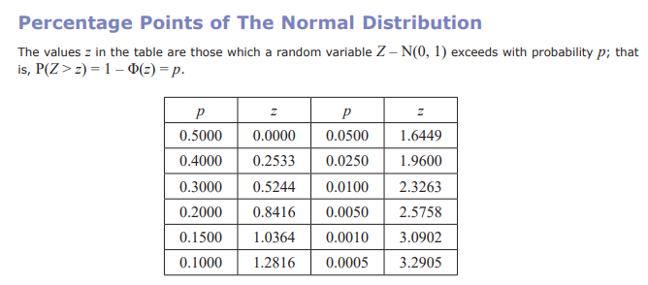
3.4 What’s the point?
The point of coding in this context is that all different possible normal distributions become a single unified distribution where we no longer have to worry about the mean and standard deviation.
It means for example when we calculate $P\left(Z<3\right)$, this will always give the same probability regardless of the original distribution.
It also means we can look up probabilities in a $z$-table:
$$φ\left(a\right)=P\left(Z<a\right)$$
! $Φ\left(a\right)=P\left(Z<a\right)$ is the cumulative distribution for the standard normal distribution. The values of $Φ(a)$ can be found in a $z$-table.
$$a$$
0

Slide 20
3.4 Examples
The random variable $X\sim N\left({50,4}^{2}\right)$. Write in terms of $Φ\left(z\right)$ for some value of $z$.
(a) $P\left(X<53\right)$ (b) $P\left(X≥55\right)$
The systolic blood pressure of an adult population, $S$ mmHg, is modelled as a normal distribution with mean 127 and standard deviation 16. A medical research wants to study adults with blood pressures higher than the 95th percentile. Find the minimum blood pressure for an adult included in her study.

Slide 21
3.4 Further examples
Determine $P(Z>−1.3)$
Determine $P\left(−2<Z<1\right)$
Determine the $a$ such that $P\left(Z>a\right)=0.7$
Determine the $a$ such that $P\left(−a<Z<a\right)=0.6$

Slide 22
3.4 Class questions
The distance, D miles, a motorbike will travel on one gallon of petrol is modelled as D ~ N(145, 8²).
a Given that a journey starts with one gallon of petrol in the tank, find the
probability that, without refuelling, the motorbike can travel:
i more than 125 miles
ii between 150 and 159 miles.
b Find the longest journey, to the nearest mile, that can be undertaken,
to have a probability of at least 0.9 of completing it on one gallon of petrol.

Slide 23
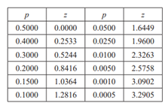
3.4 Questions for you
IQ is distributed with mean 100 and standard deviation 15. Using an appropriate table, determine the IQ corresponding to the
top 10% of people.
bottom 20% of people.
If $X\sim N\left({100,15}^{2}\right)$, determine, in terms of $Φ$:
$P(X>115)$
$P\left(77.5<X<112\right)$
Find the $a$ such that:
$P\left(−a<Z<a\right)=0.2$
$P\left(0<Z<a\right)=0.35$
Exercise 3D
Page 49

Slide 24
3.5 Finding mean and SD
In the last section, you may have thought, “what’s the point of standardising to $Z$ when I can just use the DISTRIBUTION mode on my calculator?”
Fair point, but both forward and reverse normal lookups on the calculator required you to specify $μ$ and $σ$.
$X\sim N\left(μ,3^{2}\right)$. Given that $P\left(X>20\right)=0.2$, find the value of $μ$.
A machine makes metal sheets with width, $X$ cm, modelled as a normal distribution such that $X\sim N\left(50,σ^{2}\right)$.
Given that $P\left(X<46\right)=0.2119$, find the value of $σ$.
Find the 90th percentile of the widths.

Slide 25
3.5 Both missing?

Slide 26
3.5 Class question
The random variable $X\sim N(μ,σ^{2})$. Given that $P\left(X>35\right)=0.025$ and $P\left(X<15\right)=0.1469$, find the values of $μ$ and $σ$.

Slide 27
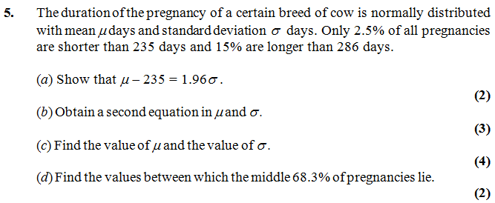
3.5 Questions for you
Exercise 3E
Page 51-52

Slide 28
3.6 Approximating a binomial distribution
You need to be able to approximate a binomial distribution
Let’s compare the two quickly…
Binomial distribution
→ Discrete data
Normal distribution
→ Continuous data
No. heads when flipping a coin 7 times
Height of the flipped coin
You can use the processes you have learnt for the normal distribution to approximate a binomial distribution under 2 conditions
The value of $n$ (the number of trials) must be ‘large’ (this will mean the distribution is smoother)
The probability of success must be close to 0.5 (if it is not, then the distribution will not be symmetrical)

Slide 29
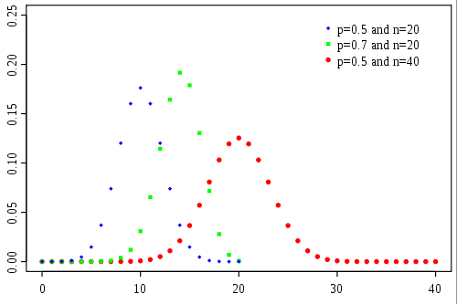
3.6 Approximating a binomial distribution
$$p\left(x\right)$$
$x$ (#successes)
The graph shows the probability function for different Binomial Distributions. Which one resembles another distribution and what distribution does it resemble?
When $p$ is close to 0.5, and $n$ is large, it resembles a normal distribution.
The $p=0.5$ results in the distribution being symmetrical. e.g. For a fair coin toss with 10 throws, we’re just as likely to get 1 Head out of 10 as we are 1 Tail.

Slide 30
3.6 Approximating a binomial distribution
If we’re going to use a normal distribution to approximate a Binomial distribution, it makes sense that we set the mean and standard deviation of the normal distribution to match that of the original binomial distribution:
If $n$ is large and $p$ close to 0.5, then the binomial distribution $X\sim B\left(n,p\right)$ can be approximated by the normal distribution $N\left(μ,σ^{2}\right)$ where
$$μ=np \\ σ=\sqrt{np\left(1−p\right)}$$
$$X\sim B\left(10,0.2\right) → Y\sim N(2, 1.6)$$
$$X\sim B\left(20,0.5\right) → Y\sim N(10, 5)$$
$$X\sim B\left(6, 0.3\right) → Y\sim N(1.8, 1.26)$$

Slide 31
3.6 Continuity correction
One problem is that the outcomes of a binomial distribution (i.e. number of successes) are discrete whereas the Normal distribution is continuous.
We apply something called a continuity correction to approximate a discrete distribution using a continuous one.
The random variable $X$ represents the time to finish a race in hours. We’re interested in knowing the probability Alice took 6 hours to the nearest hour.
How would you represent this time on a number line given hours is discrete? And what about if hours was now considered to be continuous (as $Y$)?
Discrete:
$$X=6$$
Continuous:
$$5.5<Y<6.5$$
3 4 5 6 7 8 9 10
We can’t just find $P\left(Y=6\right)$ when $Y$ is continuous, because the probability is effectively 0. But $P\left(5.5<Y<6.5\right)$ would seem a sensible interval to use because any time between 5.5 and 6.5 would have rounded to 6 hours were it discrete.

Slide 32
3.6 Continuity correction
If $X$ is a discrete variable, and $Y$ is its continuous equivalent,
how would you represent $P\left(X≥5\right)$ for $Y$?
Discrete:
$$X≥5$$
Continuous:
$$Y≥4.5$$
Notice the range has been enlarged by an extra 0.5.
3 4 5 6 7 8 9 10
How would represent $P\left(X<9\right)$ for $Y$?
Discrete:
$$X<9→X≤8$$
Continuous:
$$Y≤8.5$$
3 4 5 6 7 8 9 10
A continuity correction is approximating a discrete range using a continuous one.
1. If > or <, convert to $≥,≤$ first.
2. Enlarge the range by 0.5.

Slide 33
3.6 Examples and questions
Discrete
Continuous
$$P\left(X≤7\right) \\ P\left(X<10\right) \\ P\left(X>9\right) \\ P\left(1≤X≤10\right) \\ P\left(3<X<6\right) \\ P\left(3≤X<6\right)$$
$$P\left(3<X≤6\right)$$
$$P(X=3)$$
$$≈P\left(Y≤7.5\right) \\ =P\left(X≤9\right)≈P\left(Y≤9.5\right) \\ =P\left(X≥10\right)≈P\left(Y≥9.5\right) \\ ≈P\left(0.5≤Y≤10.5\right) \\ =P\left(4≤X≤5\right)≈P\left(3.5≤Y≤5.5\right) \\ ≈P\left(2.5≤Y≤5.5\right)$$
$$≈P\left(3.5≤X≤6.5\right)$$
$$≈P\left(2.5≤X≤3.5\right)$$

Slide 34
3.6 Example
For a particular type of flower bulbs, 55% will produce yellow flowers. A random sample of 80 bulbs is planted.
Calculate the actual probability that there are exactly 26 flowers.
Use a normal approximation to find an estimate that there are exactly 26 flowers.
Hence determine the percentage error of the normal approximation for 26 flowers.

Slide 35
3.6 Class question

Slide 36
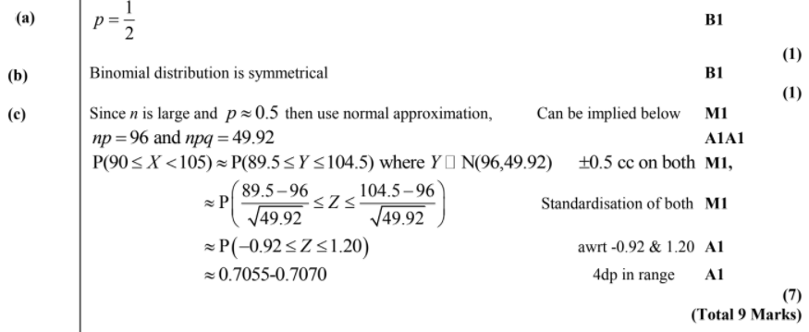
3.6 Question for you
Exercise 3F
Page 55-52

Slide 37
3.7 Hypothesis testing for normal distribution
Imagine we had a set of data as follows:
1 2 3 4 4 5 5 6
6 6 7 7 8 8 9 10 11
For this data, the information is as follows:
$$X\sim N(6, {2.65}^{2})$$
In this case, the data set is so small that we can include all the data
In more practical situations, we would most likely take a sample of the population
We need to consider how this would affect our use of the mean and variance

Slide 38
3.7 Hypothesis testing
You need to be able to do hypothesis testing using the normal distribution
Imagine we had a set of data as follows:
1 2 3 4 4 5 5 6
6 6 7 7 8 8 9 10 11
Imagine we took samples from this data, all of size 2 (ie – choosing 2 values at random)
For example:
Value 1 | Value 2 | Mean
4
5
4.5
3
9
6
6
5
5.5
$$X\sim N(6, {2.65}^{2})$$
2
8
5
7
10
8.5
Notation for the population
6
8
7
Notation for this sample
Let’s now calculate the mean and variance of this data set…
Sample mean = 6.08
$$\overline{X}\sim N(6.08, {1.33}^{2})$$
Variance (of the sample means) = 1.78
Standard Deviation (of the sample means) = 1.33

Slide 39
3.7 Hypothesis testing
You need to be able to do hypothesis testing using the normal distribution
Imagine we had a set of data as follows:
1 2 3 4 4 5 5 6
6 6 7 7 8 8 9 10 11
Imagine we took samples from this data, all of size 2 (ie – choosing 2 values at random)
For example:
Value 1 | Value 2 | Mean
4
5
4.5
3
9
6
6
5
5.5
$$X\sim N(6, {2.65}^{2})$$
2
8
5
7
10
8.5
Notation for the population
6
8
7
Notation for this sample
If we take enough samples, then because the data is normally distributed, the sample mean will average out to be the same as the population mean
How is the variance affected though?
$$\overline{X}\sim N(6.08, {1.33}^{2})$$
3G

Slide 40
3.7 Hypothesis testing
Value 1 | Value 2 | Mean
You need to be able to do hypothesis testing using the normal distribution
Imagine we had a set of data as follows:
1 2 3 4 4 5 5 6
6 6 7 7 8 8 9 10 11
4
5
4.5
3
9
6
6
5
5.5
2
8
5
7
10
8.5
6
8
7
$$X\sim N(6, {2.65}^{2})$$
When choosing only 2 values for our sample, consider the range of possible means
The smallest possible mean would be 1.5 (if 1 and 2 were selected), and the highest would be 10.5, if 10 and 11 were selected)
If we took a sample size 10, the smallest possible mean would be 4.2, and the largest would be 7.8
$$\overline{X}\sim N(6.08, {1.33}^{2})$$
Population range: 1-11
Sample size 2 range: 1.5-10.5
Sample size 10 range: 4.2-7.8

Slide 41
3.7 Hypothesis testing
Value 1 | Value 2 | Mean
You need to be able to do hypothesis testing using the normal distribution
Imagine we had a set of data as follows:
1 2 3 4 4 5 5 6
6 6 7 7 8 8 9 10 11
4
5
4.5
3
9
6
6
5
5.5
2
8
5
7
10
8.5
6
8
7
$$X\sim N(6, {2.65}^{2})$$
The key idea to take from this is that with a larger sample size, the range of possible values is lower
Hence, the variance is also going to be lower as there is a smaller range for the values to exist in
When dealing with a sample, the variance is estimated by dividing the population variance by the size of the sample
That way, a larger sample will have a smaller estimated value for the variance…
$$\overline{X}\sim N(6.08, {1.33}^{2})$$
Population range: 1-11
Sample size 2 range: 1.5-10.5
Sample size 10 range: 4.2-7.8

Slide 42
3.7 Sampling
You need to be able to do hypothesis testing using the normal distribution
When hypothesis testing with a population, you use values as follows:
With a sample, we use the following relationship instead:
$$X\sim N(μ,σ^{2})$$
$$\overline{X}\sim N\left(μ,\frac{σ^{2}}{n}\right)$$
We divide the population variance by the sample size, $n$
→ Remember that this represents the variance of the sample means!
We use the population mean

Slide 43
3.7 Example
A certain company sells fruit juice in cartons. The amount of juice in a carton has a normal distribution with a standard deviation of 3ml.
The company claims that the mean amount of juice per carton, $μ$, is 60ml. A trading inspector has received complaints that the company is overstating the mean amount of juice per carton and wishes to investigate this complaint. The trading inspector takes a random sample of 16 cartons and finds that the mean amount of juice per carton is 59.1ml.
Using a 5% level of significance, and stating your hypotheses clearly, test whether or not there is evidence to uphold this complaint.

Slide 44
3.7 Class question
A machine products bolts of diameter $D$ where $D$ has a normal distribution with mean 0.580 cm and standard deviation 0.015 cm. The machine is serviced and after the service a random sample of 50 bolts from the next production run is taken to see if the mean diameter of the bolts has changed from 0.580 cm. The distribution of the diameters of bolts after the service is still normal with a standard deviation of 0.015 cm.
Find, at the 1% level, the critical region for this test, stating your hypotheses clearly.
The mean diameter of the sample of 50 bolts is calculated to be 0.587 cm.
(b) Comment on this observation in light of the critical region.

Slide 45
3.7 Question for you
Exercise 3G
Page 58-60

Slide 46
Challenging questions
This is not in the textbook. But given the recent Chapter 2 on Conditional Probabilities and the fact that the type of question below occurred frequently in S1 papers, it seems worthwhile to cover!
$$P\left(X>μ+15 | X>μ−15\right) \\ =\frac{P\left(X>μ+15\right)}{P\left(X>μ−15\right)} \\ =\frac{0.35}{0.65}=\frac{7}{13}$$
0.35
$$μ−15$$
$$μ$$
$$μ+15$$

Slide 47
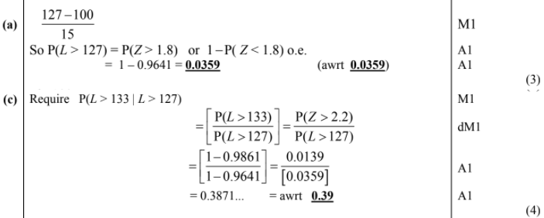
Challenging questions

Slide 48
Last challenging question
IQ is distributed as $X\sim N\left({100,15}^{2}\right)$.
A person is considered to be ‘pretty smart’ if their IQ is at least 130.
Determine the median IQ of ‘pretty smart’ people.
Let $a$ be the median IQ of ‘pretty smart’ people.
$$P\left(X>a | X>130\right)=0.5 \\ \frac{P\left(X>a\right)}{P\left(X>130\right)}=0.5$$
$$P\left(X>a\right)=0.5×P\left(X>130\right)=0.5×P\left(Z>2\right)=0.5×0.0228 \\ =0.0114$$
$$2.277=\frac{a−100}{15} \\ a=134.155$$

