Slide 1
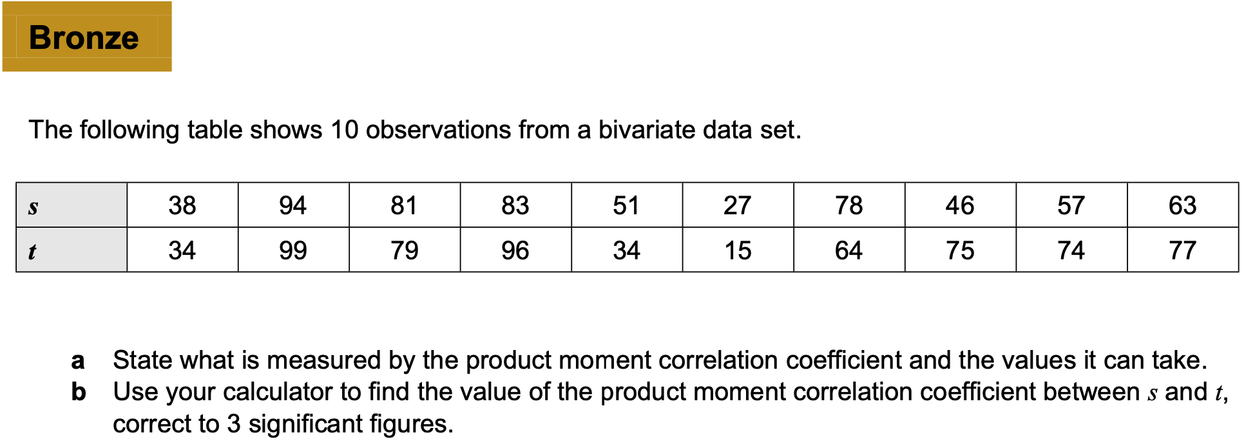
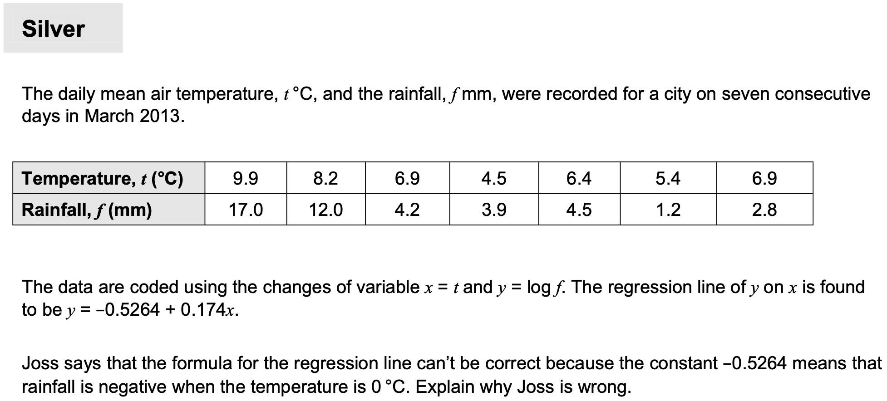
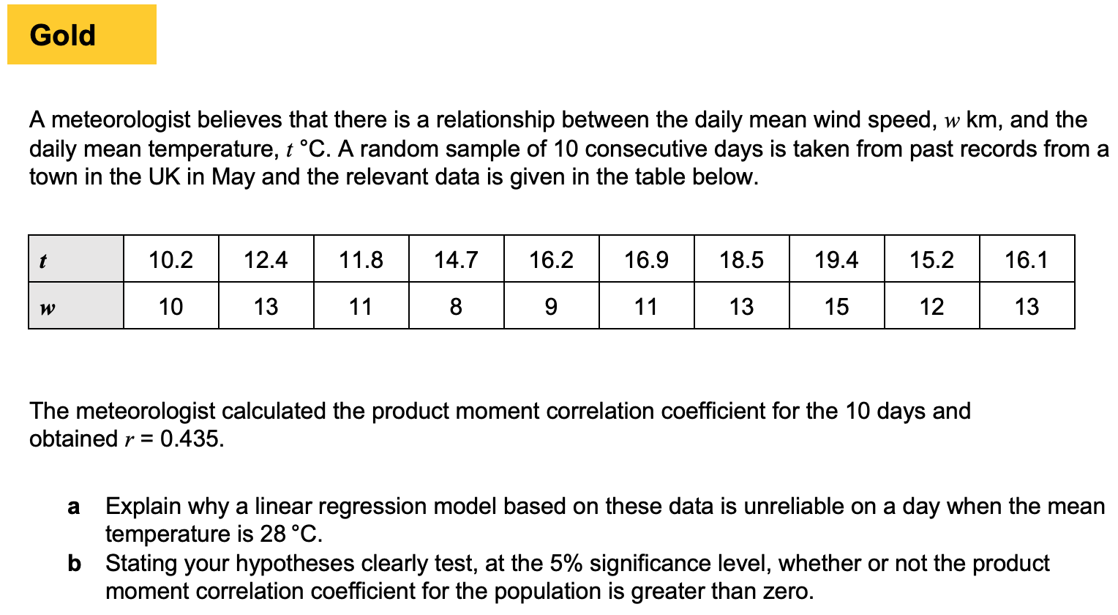
Chapter 2 - Probability

Slide 2
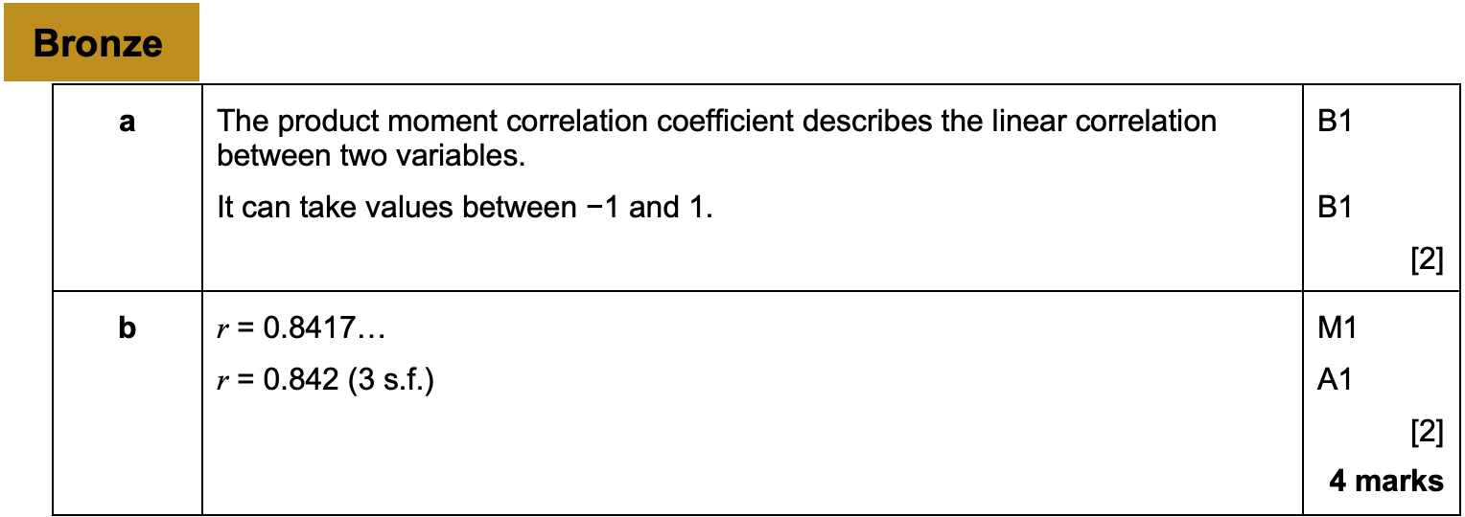
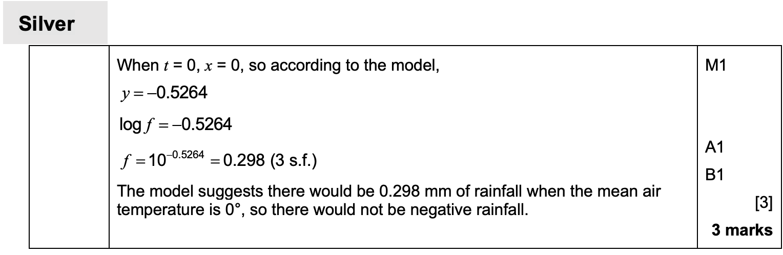
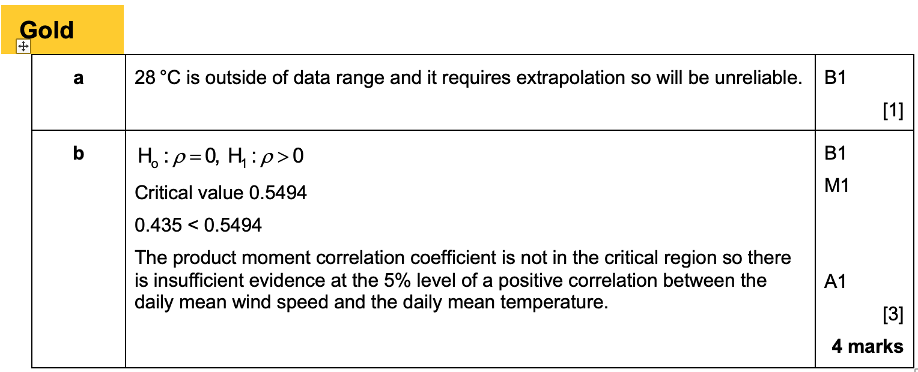
Answers

Slide 3
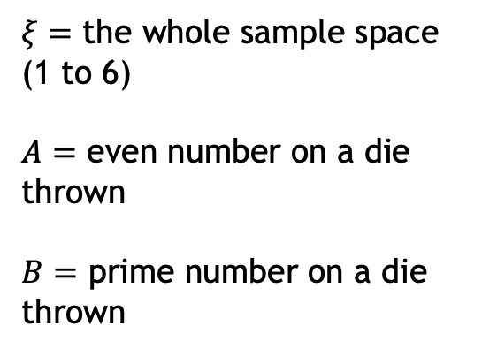






2.1 Venn diagrams
$$ξ$$
$$A$$
$$B$$
$ξ=$ the whole sample space (1 to 6)
$A=$ even number on a die thrown
$B=$ prime number on a die thrown
3
4
1
2
6
5
What does it mean in this context?
What is the resulting set of outcomes?
$$A′$$
$$A∪B$$
$$A∩B$$

Slide 4



2.1 Venn diagrams
$$ξ$$
$$A$$
$$B$$
$ξ=$ the whole sample space (1 to 6)
$A=$ even number on a die thrown
$B=$ prime number on a die thrown
3
4
1
2
6
5
What does it mean in this context?
What is the resulting set of outcomes?
$$A∩B′$$
$$(A∪B)′$$
$${\left(A∩B\right)}^{′}$$

Slide 5




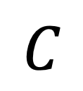
2.1 Venn diagrams
$$A$$
$$B$$
$$C$$
$$ξ$$
$$A∩B$$

Slide 6

2.1 Venn diagrams
$$A$$
$$B$$
$$C$$
$$ξ$$
$$A∪B$$

Slide 7

2.1 Venn diagrams
$$A$$
$$B$$
$$C$$
$$ξ$$
$$A∩B∩C$$

Slide 8

2.1 Venn diagrams
$$A$$
$$B$$
$$C$$
$$ξ$$
$$A∩C^{′}$$

Slide 9

2.1 Venn diagrams
$$A$$
$$B$$
$$C$$
$$ξ$$
$$A∩B∩C^{′}$$

Slide 10



2.1 Venn diagrams
$$ξ$$
$$A$$
$$B$$
$$C$$
$$A^{′}∩B^{′}∩C^{′}$$
or
alternatively…
$${\left(A∪B∪C\right)}^{′}$$

Slide 11

2.1 Venn diagrams
$$ξ$$
$$A$$
$$B$$
$$C$$
$$A^{′}$$

Slide 12

2.1 Venn diagrams
$$ξ$$
$$A$$
$$B$$
$$C$$
$$A∩{\left(B∩C\right)}^{′}$$

Slide 13


2.1 Venn diagrams
$$ξ$$
$$A$$
$$B$$
$$C$$
$$A∩B^{′}∩C′$$

Slide 14
2.1 Recap on keywords
Two events are said to be mutually exclusive if they can’t occur at the same time.
If A and B are mutually exclusive, then the follow rules apply.
  P(A and B) = 0
  P(A or B) = P(A) + P(B)
Two events are independent if one event doesn’t effect the other. This means the probability of b stays the same regardless of A
P(A n B) = P(A) x P(B)

Slide 15
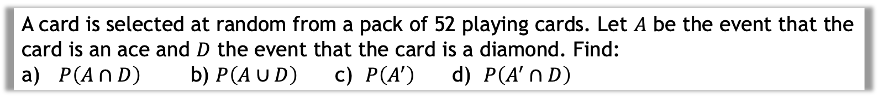
2.1 Example
A card is selected at random from a pack of 52 playing cards. Let $A$ be the event that the card is an ace and $D$ the event that the card is a diamond. Find:
$P\left(A∩D\right)$ b) $P\left(A∪D\right)$ c) $P\left(A^{′}\right)$ d) $P\left(A^{′}∩D\right)$

Slide 16
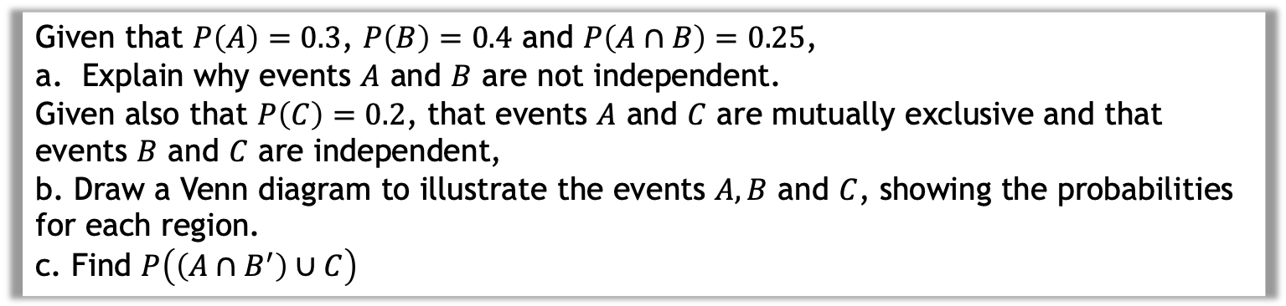
2.1 Example
Given that $P\left(A\right)=0.3$, $P\left(B\right)=0.4$ and $P\left(A∩B\right)=0.25$,
Explain why events $A$ and $B$ are not independent.
Given also that $P\left(C\right)=0.2$, that events $A$ and $C$ are mutually exclusive and that events $B$ and $C$ are independent,
b. Draw a Venn diagram to illustrate the events $A, B$ and $C$, showing the probabilities for each region.
c. Find $P\left(\left(A∩B^{′}\right)∪C\right)$

Slide 17
2.1 Questions for you
Exercise 2A
Pages 19 to 21
The Venn diagram in Figure 1 shows three events A, B and C and the probabilities associated with each region of B. The constants p, q and r each represent probabilities associated with the three separate regions outside B.
The events A and B are independent.
Find the value of p. (3)

Slide 18





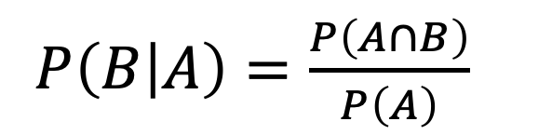

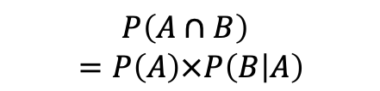


2.2 Conditional probability
Think about how we formed a probability tree at GCSE:
$$P\left(A∩B\right) \\ =P\left(A\right)×P\left(B | A\right)$$
P$\left(B|A\right)$
$$B$$
$$P\left(A\right)$$
$$A$$
Read the ‘|’ symbol as “given that”. i.e. “B occurred given that A occurred”.
$$B′$$
$$B$$
$$A′$$
$$B′$$
$P\left(B | A\right)=\frac{P\left(A∩B\right)}{P\left(A\right)}$
You’re dividing by the event you’re conditioning on.

Slide 19


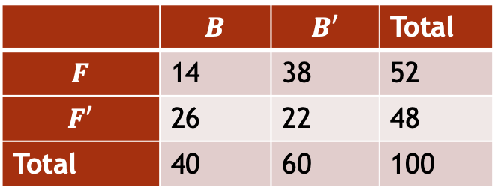



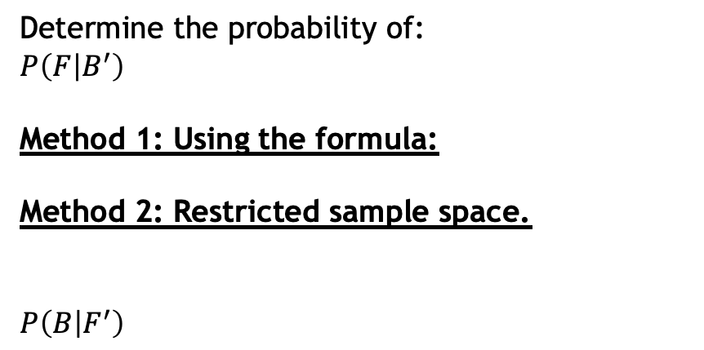

Examples
The following two-way table shows what foreign language students in Year 9 study.
$B$ is the event that the student is a boy. $F$ is the event they chose French as their language.
 | $$B$$ | $$B′$$ | Total
$$F$$ | 14 | 38 | 52
$$F′$$ | 26 | 22 | 48
Total | 40 | 60 | 100
Determine the probability of:
$P\left(F | B^{′}\right)$
Method 1: Using the formula:
Method 2: Restricted sample space.
$$P\left(B | F^{′}\right)$$
Using the Venn Diagram, determine:
$P\left(A | B\right)$
$$ξ$$
$$A$$
$$B$$
$$P\left(A′ | B′\right)$$
2
3
6
4
$$P\left(B | A∪B\right)$$

Slide 20
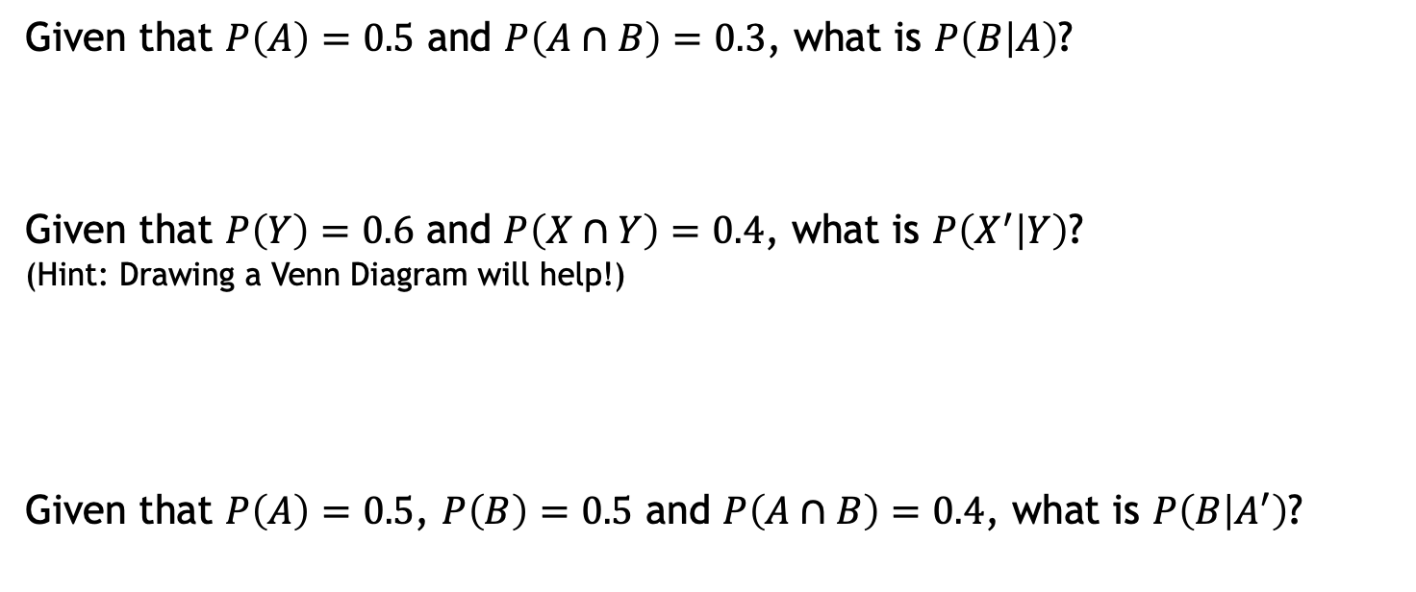
2.2 More examples
a
Given that $P\left(A\right)=0.5$ and $P\left(A∩B\right)=0.3$, what is $P\left(B | A\right)$?
Given that $P\left(Y\right)=0.6$ and $P\left(X∩Y\right)=0.4$, what is $P\left(X^{′} | Y\right)$?
(Hint: Drawing a Venn Diagram will help!)
Given that $P\left(A\right)=0.5$, $P\left(B\right)=0.5$ and $P\left(A∩B\right)=0.4$, what is $P\left(B | A^{′}\right)$?
b
c

Slide 21
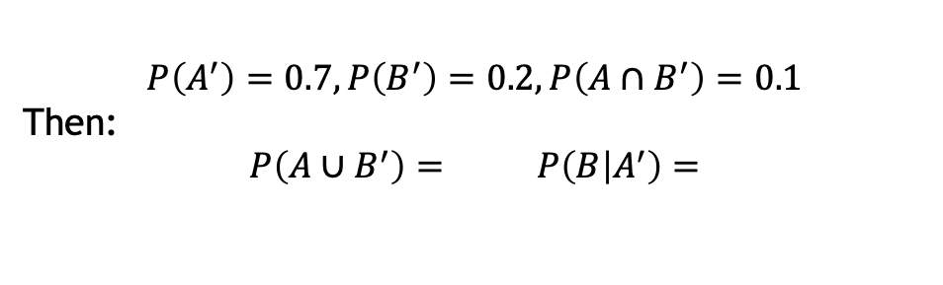
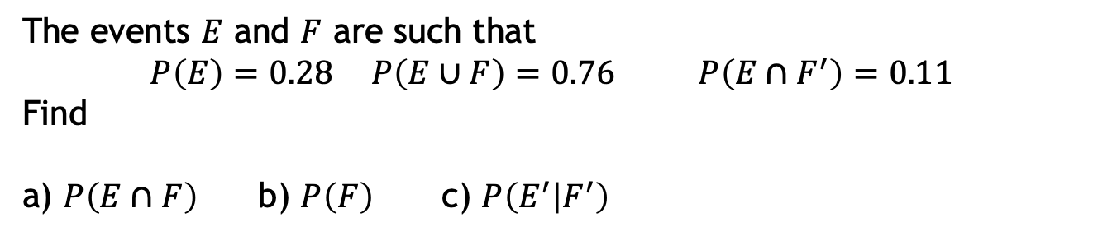
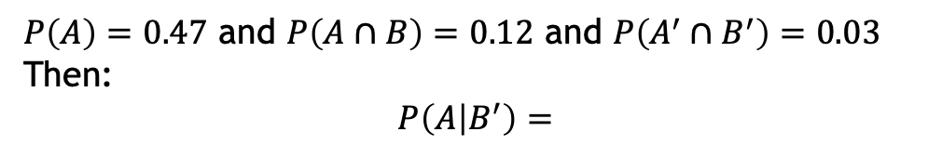
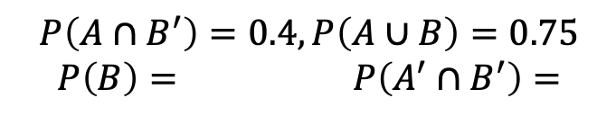
Class questions
The events $E$ and $F$ are such that
$$P\left(E\right)=0.28 P\left(E∪F\right)=0.76 P\left(E∩F^{′}\right)=0.11$$
Find
a) $P\left(E∩F\right)$b) $P\left(F\right)$c) $P\left(E^{′} | F^{′}\right)$
$$P\left(A∩B^{′}\right)=0.4, P\left(A∪B\right)=0.75$$
$$P\left(B\right)= P\left(A^{′}∩B^{′}\right)=$$
$P\left(A\right)=0.47$ and $P\left(A∩B\right)=0.12$ and $P\left(A^{′}∩B^{′}\right)=0.03$
Then:
$$P\left(A | B^{′}\right)=$$
$$P\left(A^{′}\right)=0.7, P\left(B^{′}\right)=0.2, P\left(A∩B^{′}\right)=0.1$$
Then:
$$P\left(A∪B^{′}\right)= P\left(B | A^{′}\right)=$$

Slide 22
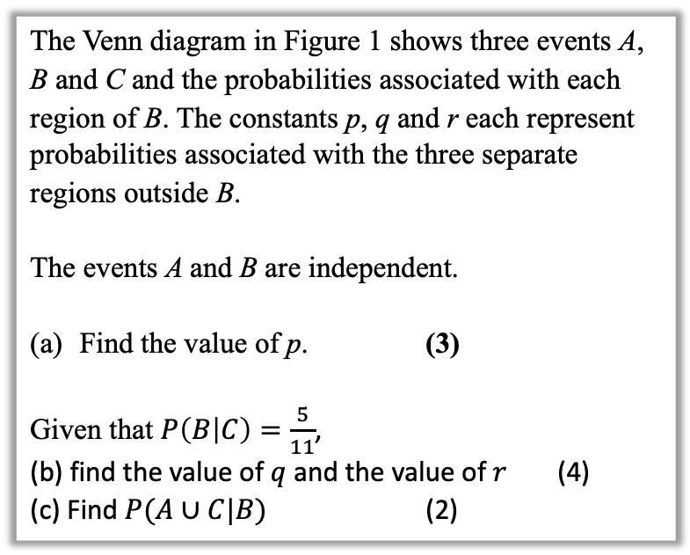
2.2 Question for you
Exercise 2B
Pages 23 to 24
Exercise 2C
Pages 25 to 27
The Venn diagram in Figure 1 shows three events A, B and C and the probabilities associated with each region of B. The constants p, q and r each represent probabilities associated with the three separate regions outside B.
The events A and B are independent.
Find the value of p. (3)
Given that $P\left(B | C\right)=\frac{5}{11}$,
(b) find the value of $q$ and the value of $r$ (4)
(c) Find $P(A∪C|B)$ (2)
Extension:
I have 2 children. One of them is a boy. What’s the probability the other is a boy?

Slide 23
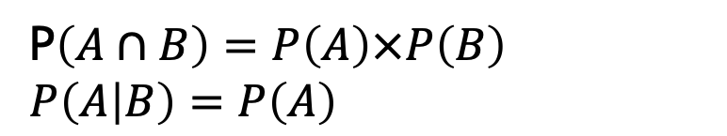
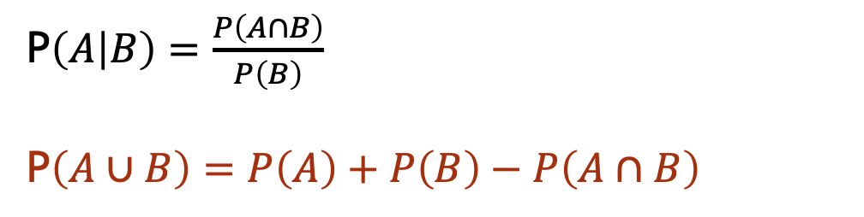
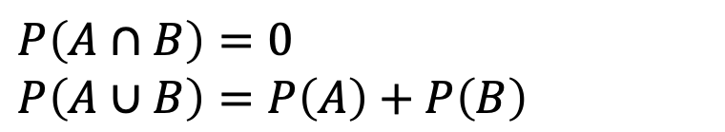
2.4 Probability formulae
If events $A$ and $B$ are independent.
P$\left(A∩B\right)=P\left(A\right)×P\left(B\right)$
$P\left(A | B\right)=P\left(A\right)$
If events $A$ and $B$ are mutually exclusive:
$P\left(A∩B\right)=0$
$P\left(A∪B\right)=P\left(A\right)+P\left(B\right)$
In general:
P$\left(A | B\right)=\frac{P\left(A∩B\right)}{P\left(B\right)}$
P$\left(A∪B\right)=P\left(A\right)+P\left(B\right)−P\left(A∩B\right)$

Slide 24
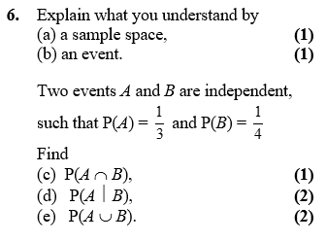
2.4 Example

Slide 25
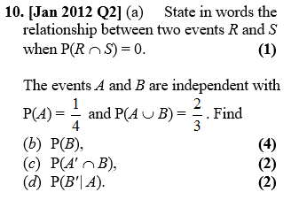
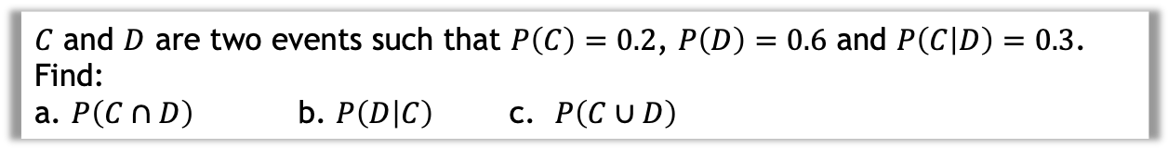
2.4 More examples
$C$ and $D$ are two events such that $P\left(C\right)=0.2$, $P\left(D\right)=0.6$ and $P\left(C | D\right)=0.3$. Find:
a. $P\left(C∩D\right)$ b. $P\left(D | C\right)$ c. $P\left(C∪D\right)$

Slide 26
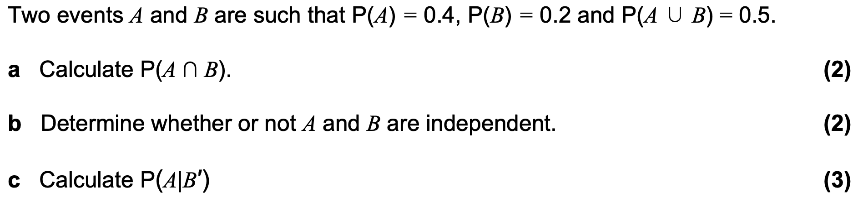
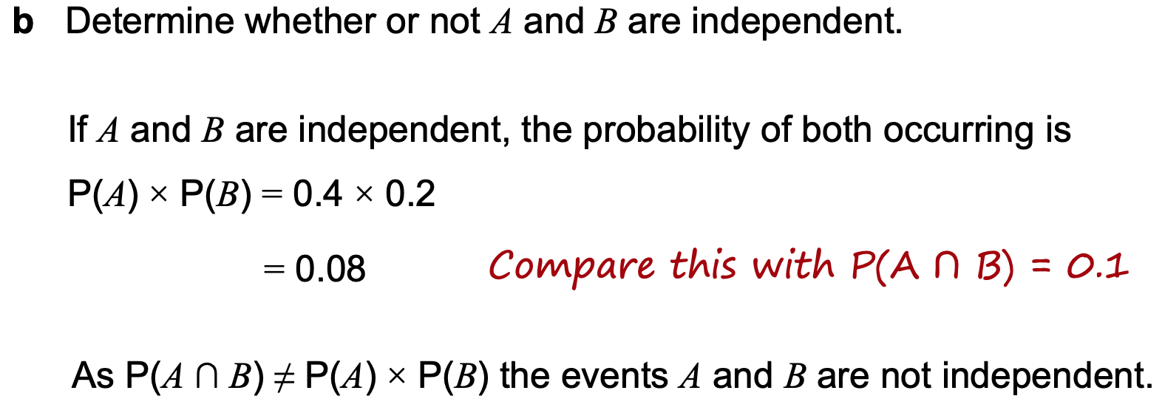
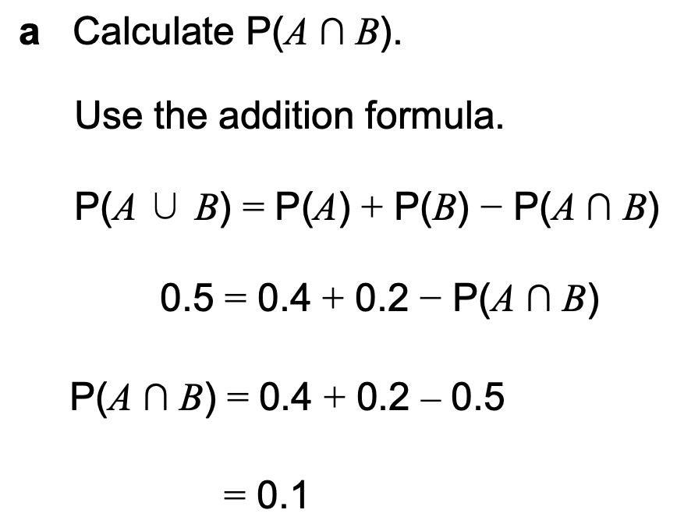
Class question

Slide 27
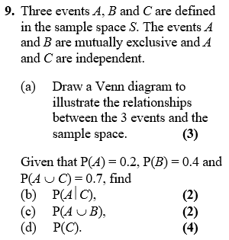
Question for you

Slide 28
Tips to help
If you see the words ‘given that’, Immediately write out the law for conditional probability.
Example: “Given Bob walks to school, find the probability that he’s not late…”
If you see the words ‘are independent’, Immediately write out the laws for independence.
(Even before you’ve finished reading the question!)
Example: “$A$ is independent from $B$…”
Exercise 2D
Pages 29 to 30

Slide 29






2.5 Tree diagrams
We saw probability trees in Year 1. The only difference here is determining a conditional probability using your tree.
Example: You have two bags, the first with 5 red balls and 5 blue balls, and the second with 3 red balls and 6 blue balls. You first pick a ball from the first bag and place it in the second. You then pick a ball from the second bag. Complete the tree diagram.
$$R_{2}$$
$$R_{1}$$
$$B_{2}$$
$$R_{2}$$
$$B_{1}$$
$$B_{2}$$

Slide 30
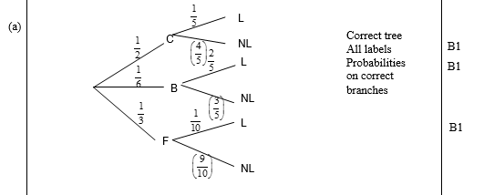
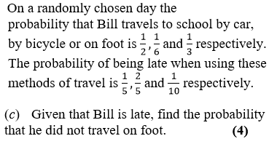
2.5 Example 2

Slide 31
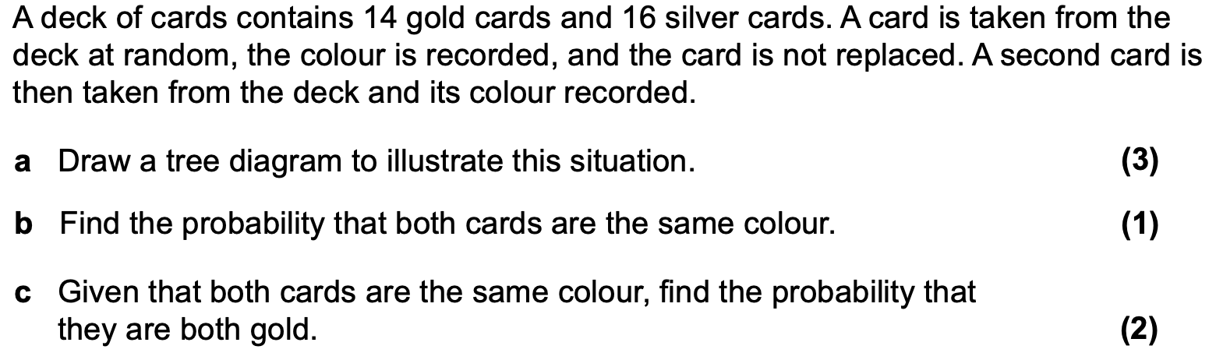
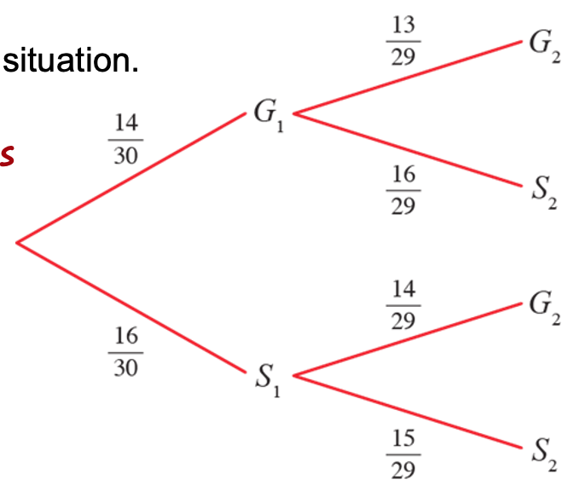
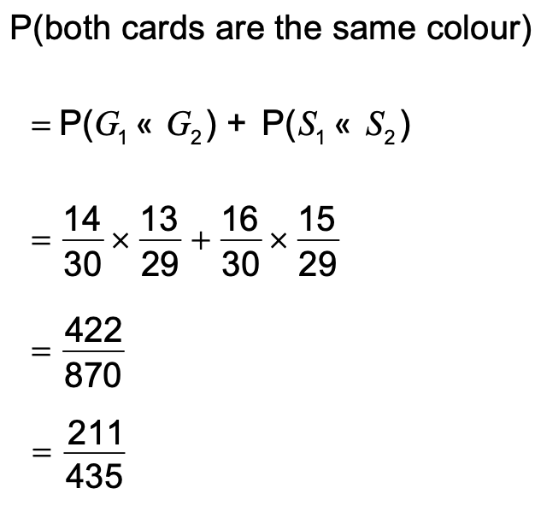
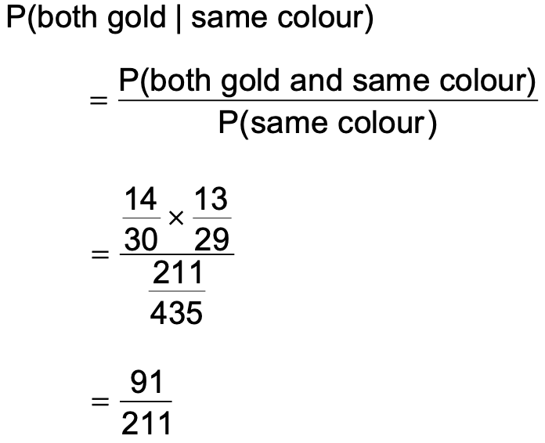
Class question

Slide 32
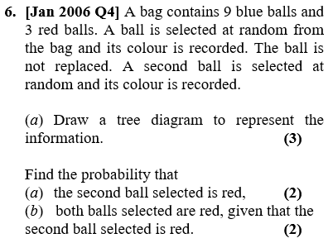
Question for you
Exercise 2E
Pages 31 to 34

