Slide 1
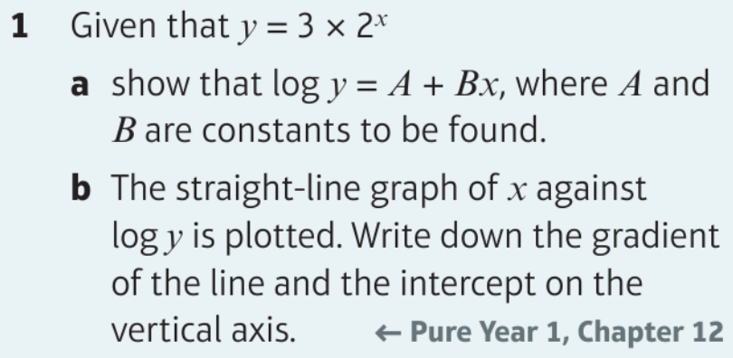
Chapter 1 Regression, correlation

Slide 2
What is regression?
A measure of relation between two variables. It determines the strength and character if the relationship.
It differs from correlation by giving a numerical value and it generates a line of best fit.
Exam mark $(y)$
$$y=20+3x$$
Time spent revising $(x)$

Slide 3
1.1 Exponential regression
Linear regression line not a good fit for the data.
$$y=a+bx$$
Rabbit population $(y)$
Exponential line much better fit.
$$y=ab^{x}$$
Time$(x)$
For some variables, e.g. population with time, it may be more appropriate to use an exponential equation, i.e. $y=ab^{x}$, where $a$ and $b$ are constants we need to fix to best match the data.
$$y=ab^{x}$$
$$\log{y}=\log\left(ab^{x}\right)$$
$$\log{y}=\log{a}+x\log{b}$$
If $y=kb^{x}$ for constants $k$ and $b$ then $\log{y}=\log{k}+x\log{b}$

Slide 4
1.1 But why?
$$\log{y}$$
Rabbit population $(y)$
Time ($x$)
Time ($x$)
Comparing the equations, we can see that if we log the $y$ values (although leave the $x$ values), the data then forms a straight line, with $y$-intercept $\log{k}$ and gradient $\log{b}$.

Slide 5
Example
The table shows some data collected on the temperature, in $°$C, of a colony of bacteria ($t$) and its growth rate ($g$).
The data are coded using the changes of variable $x=t$ and $y=\log{g}$. The regression line of $y$ on $x$ is found to be $y=−0.2215+0.0792x$.
a) Mika says that the constant -0.2215 in the regression line means that the colony is shrinking when the temperature is $0°$C. Explain why Mika is wrong
b) Given that the data can be modelled by an equation of the form $g=kb^{t}$ where $k$ and $b$ are constants, find the values of $k$ and $b$.
Temperature, $t$ ($°$C) | 3 | 5 | 6 | 8 | 9 | 11
Growth rate, $g$ | 1.04 | 1.49 | 1.79 | 2.58 | 3.1 | 4.46
a
When $t=0,y=−0.2215+\left(0.0792×0\right)=−0.2215$
$$y=\log{g} ∴g={10}^{y}={10}^{−0.2215}=0.600 (3sf)$$
The growth rate is positive.
b
$$g=kb^{t} \\ \log{g}=\log{k}+t\log{b}$$
Compare to $y=−0.2215+0.0792x → \log{g}=−0.2215+0.0792g$
$$\log{k}=−0.2215 → k={10}^{−0.2215}=0.600 \\ \log{b}=0.0792 → b={10}^{0.0792}=1.20$$

Slide 6
Class question

Slide 7
1.1 Questions for you
Robert wants to model a rabbit population $P$ with respect to time in years $t$. He proposes that the population can be modelled using an exponential model: $P=kb^{t}$
The data is coded using $x=t$ and $y=\log{P}$. The regression line of $y$ on $x$ is found to be $y=2+0.3x$. Determine the values of $k$ and $b$.
$$P=kb^{t} \\ \log{P}=\log{k}+t\log{b} \\ y=\log{k}+x\log{b}$$
$$∴\log{k}=2 → k=100 \\ \log{b}=0.3 → b=2.00 (3sf)$$
Exercise 1A
Pages 3 to 5
Mr Lynton wished he had the following annual numbers of page views each year:
Determine the appropriate constants if we assume a polynomial model $V=at^{b}$, where $t$ is the number of years after 2011.
Year | 2012 | 2013 | 2014 | 2015 | 2016 | 2017 | 2018 | 2019
Views $V$ | 10115 | 26790 | 60306 | 180386 | 1119801 | 8.3 m | 21.9 m | 57.5 m
$$V=at^{b} \\ \log{V}=\log{a}+b\log{t}$$
So need to log the t values and V values.
$$log t$$ | 0 | 0.3010 | 0.4771 | 0.6020 | 0.6989 | 0.7781 | 0.8450 | 0.9030
$$log V$$ | 4.0050 | 4.4280 | 4.7804 | 5.2562 | 6.0491 | 6.9191 | 7.3404 | 7.7597
Using calculator stats mode, y-intercept: $\log{a}=3.3406$, gradient: $b=4.3025$
Therefore $V=2191×t^{4.3025}$

Slide 8
1.2 Measuring correlation
You’re used to use qualitative terms such as “positive correlation” and “negative correlation” and “no correlation” to describe the type of correlation, and terms such as “perfect”, “strong” and “weak” to describe the strength.
The Product Moment Correlation Coefficient is one way to quantify this:
The product moment correlation coefficient (PMCC), denoted by $r$, describes the linear correlation between two variables. It can take values between -1 and 1.
Note that PMCC is only applicable for a linear correlation, i.e. closeness of fit to a linear regression line (i.e. a straight ‘line of best fit’). It may be the data exhibits strong correlation with respect to a different model (e.g. exponential) even when the PMCC is low.
$$r=−1$$
$$0$$
$$1$$
Perfect negative
Strong negative
Weak positive
Perfect positive
No correlation
Rule of thumb: $r<−0.7$ or $r>0.7$ is ‘strong’ correlation.

Slide 9
Calculating r
$$x$$ | $$y$$
1 | 3
2 | 6
3 | 5
4 | 8
If you have the required calculator then you can calculate r using it.
From the large data set, the daily mean windspeed, $w$ knots, and the daily maximum gust, $g$ knots, were recorded for the first 10 days in September in Hurn in 1987.
State the meaning of n/a in the table above.
Calculate the product moment correlation coefficient for the remaining 8 days.
With reference to your answer to part b, comment on the suitability of a linear regression model for these data.
Day of month | 1 | 2 | 3 | 4 | 5 | 6 | 7 | 8 | 9 | 10
$$w$$ | 4 | 4 | 8 | 7 | 12 | 12 | 3 | 4 | 7 | 10
$$g$$ | 13 | 12 | 19 | 23 | 33 | 37 | 10 | n/a | n/a | 23
a
Data on daily maximum gust is not available for these days.
b
$$r=0.9533$$
c
$r$ is close to 1 so there is a strong positive correlation between daily mean windspeed and daily maximum gust. This means that the data points lie close to a straight line, so a linear regression model is suitable.

Slide 10
1.2 Class question
Exercise 1B
Pages 6 to 8
r = 0.996194
r = 0.996194 is positive and is very close to 1.
There is a strong correlation between log n and time, indicating that the data points lie very close to a straight line. So an exponential model is a good fit for this data.

Slide 11
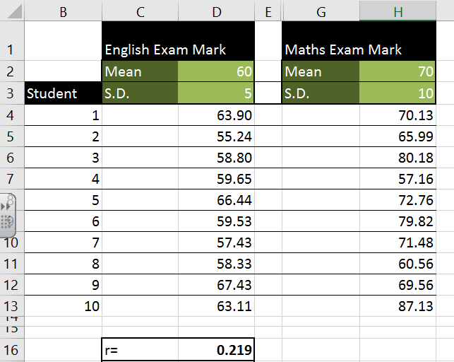
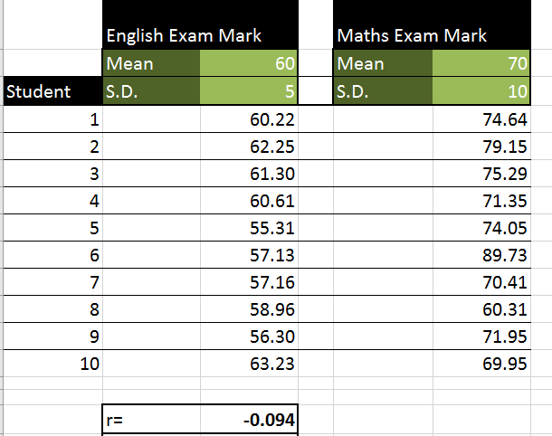
1.3 Hypothesis for testing
Suppose we use a spreadsheet to randomly generate maths marks for students, and separately generate random English marks.
What is the observed PMCC between Maths and English marks in this first set of data?
But what is the true underlying PMCC between Maths and English?
Is the PMCC of $r=0.219$ statistically significant, or are Maths/English marks not correlated, and this observed correlation emerged just by chance?

Slide 12
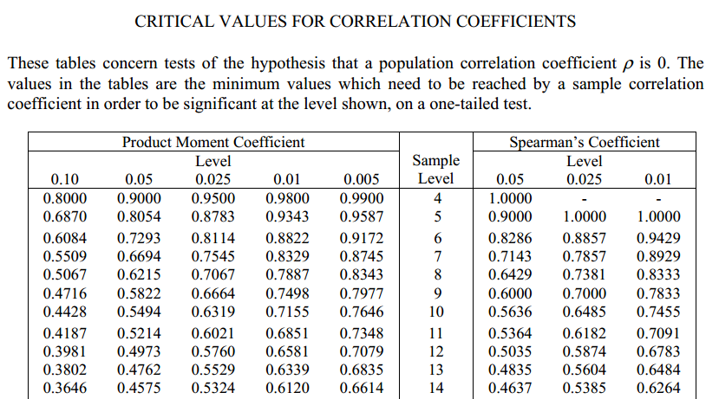
Example
Let’s carry out a hypothesis test on whether there is positive correlation between English and Maths marks, at 10% significance level:
$$H_{0}: ρ=0 \\ H_{1}: ρ>0$$
Sample size
$$=10$$
Critical value for 10% significance level:
0.4428
$0.219<0.4428$, therefore do not reject $H_{0}$.
Therefore, insufficient evidence to suggest that English and Maths marks are correlated.

Slide 13
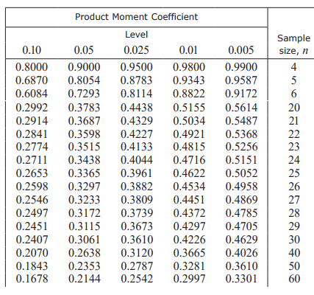
1.3 Two tail example
A scientist takes 30 observations of the masses of two reactants in an experiment. She calculates a product moment correlation coefficient of $r=−0.45$.
The scientist believes there is no correlation between the masses of the two reactants. Test at the 10% level of significance, the scientist’s claim, stating your hypotheses clearly.
$$H_{0}:ρ=0 \\ H_{1}:ρ≠0$$
Sample size $=30$
Critical value at 5% significance:
0.3061
$−0.45<−0.3061$, therefore reject $H_{0}$.
There is evidence, at the 10% level of significance, that there is a correlation between the masses of the two reactants.

Slide 14
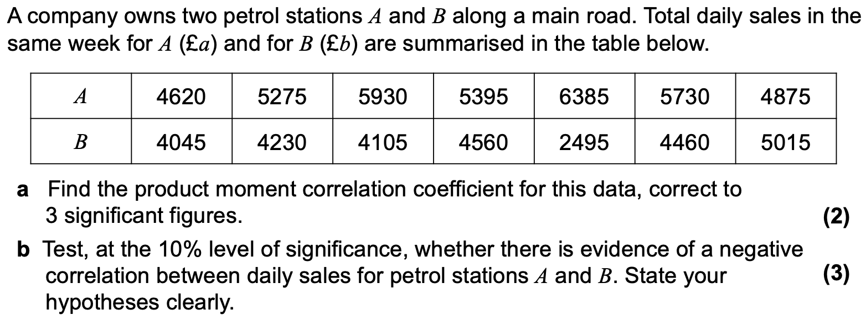
1.3 Class question
r = −0.664 (3 s.f.)
H₀ : ρ = 0, H₁ : ρ < 0
The critical value of r is −0.5509 and the critical region is r < −0.5509.
so there is enough evidence to reject H₀.

Slide 15
Question for you
The table from the large data set shows the daily maximum gust, $x$ kn, and the daily maximum relative humidity, $y$%, in Leeming for a sample of eight days in May 2015.
Find the product moment correlation coefficient for this data.
Test, at the 10% level of significance, whether there is evidence of a positive correlation between daily maximum gust and daily maximum relative humidity. State your hypotheses clearly.
$$x$$ | 31 | 28 | 38 | 37 | 18 | 17 | 21 | 29
$$y$$ | 99 | 94 | 87 | 80 | 80 | 89 | 84 | 86
$$r=0.1149$$
$$H_{0}:ρ=0, H_{1}:ρ>0$$
Sample size = 8
Critical value at 10% significant level $=0.5067$
$0.1149<0.5067$ therefore insufficient evidence to reject $H_{0}$.
Not sufficient evidence, at 10% significance level, of a positive correlation between the daily maximum gust and the daily maximum relative humidity.
Exercise 1C
Pages 10 to 12

