Slide 1
Chapter 7 – Hypothesis testing

Slide 2
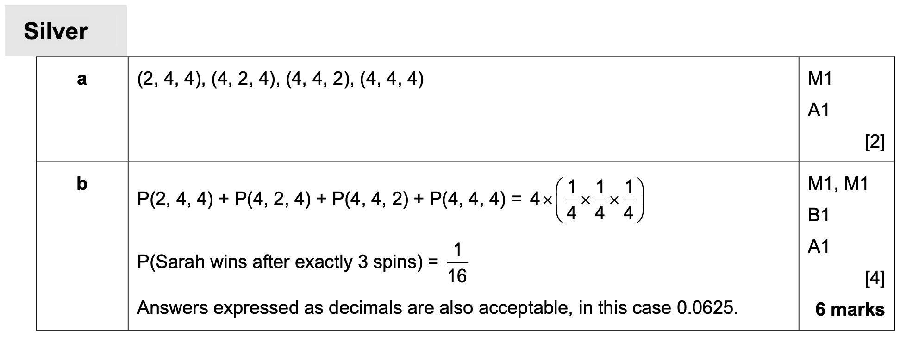
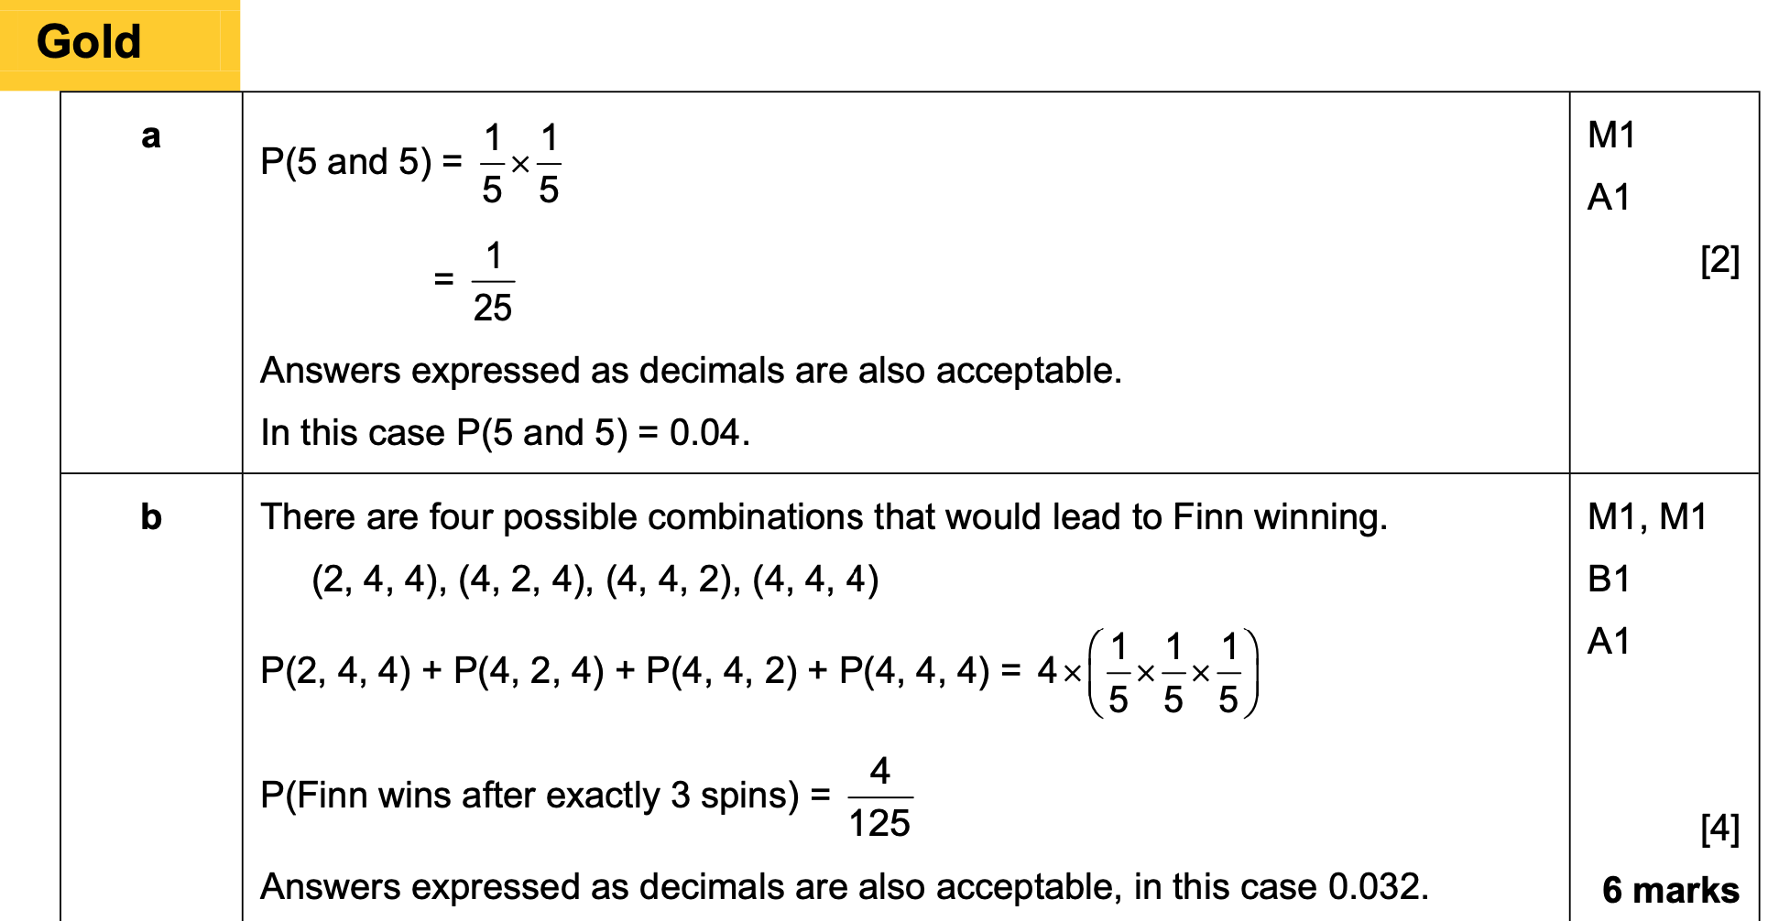
Answers

Slide 3
7.1 Hypothesis testing
A population parameter is a statistical measure relating to a population
→ For example, the mean is a population parameter
A hypothesis is a statement made about a population parameter
The Null hypothesis is the ‘default’ position which we usually initially assume to be true
→ For rolling a dice and getting a 6, then $H_{0}:p=\frac{1}{6}$
The alternative hypothesis tells us about the parameter/situation if our null hypothesis turns out to be incorrect
→ For rolling a dice and getting a 6, then $H_{1}:p≠\frac{1}{6}$
A test statistic is the result of the experiment we are using, which we use to test $H_{0}$
→ If we tossed a coin 4 times and got 3 heads then that value/proportion is the test statistic

Slide 4
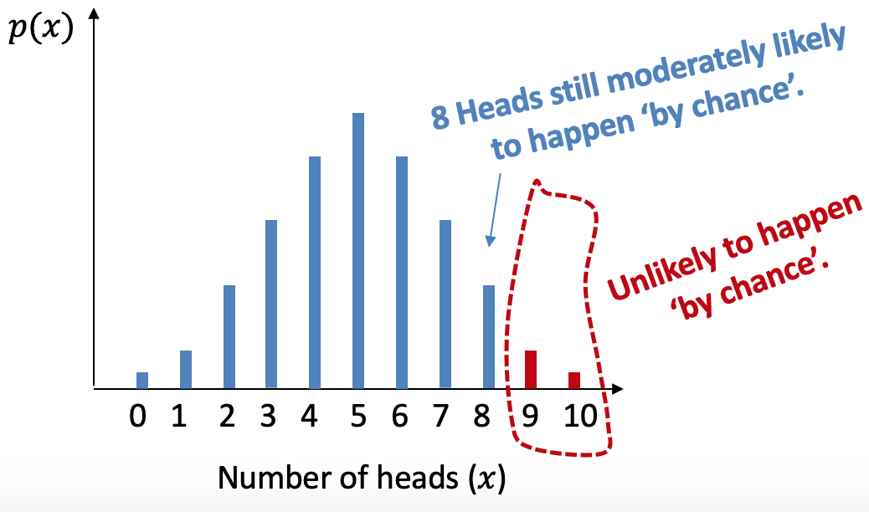
Real life example
Imagine you was going to flip a coin 10 times what would you expect to happen?
How many heads would it have to be for the coin to be biased?

Slide 5
Understanding
How does it link?
In a hypothesis test, the evidence from the sample is a test statistic.
The test statistic $X$ is what we observed, in this case, $X$ is the number of heads seen in 10 throws.
Note that the test statistic is a distribution (i.e. across the possible things we might observe).
$$X\sim B(10,p)$$
noting that $p$ is not known until we start making assumptions.
We said that if we saw a number of heads within ranges of outcomes that were sufficiently unlikely, then we’d rule out that the coin is fair and conclude it was in fact biased.
But how unlikely is ‘sufficiently unlikely’? If $α=5\%$, then we’d find a region of outcomes where there’s (at most) a 5% chance of one of these extreme values happening ‘by chance’ (i.e. if the coin was fair).
The level of significance $α$ is the maximum probability where we would reject the null hypothesis. This is usually 5% or 1%.

Slide 6
Example
Imagine we believe that a dice is biased towards landing on 6s.
We roll the dice 20 times and get a 6 on 8 occasions
What is the test statistic for this situation?
Write a sensible null hypothesis for this situation
Write a sensible alternative hypothesis for this situation
Is the dice biased?

Slide 7
Difference in the wording
John wants to see whether a coin is unbiased, or whether it is biased towards coming down on heads. He tosses the coin 8 times and counts the numbers of times, $X$, that it lands heads up.
Describe the test statistic
Write down a suitable null hypothesis
Write down a suitable alternative hypothesis
John wants to see whether a coin is unbiased, or whether it is biased towards coming down on heads. He tosses the coin 8 times and counts the numbers of times, $X$, that it lands heads up.
Describe the test statistic
Write down a suitable null hypothesis
Write down a suitable alternative hypothesis

Slide 8
Example 2
An election candidate believes she has the support of 40% of the residents in a town. A researcher wants to test, at the 5% significance level, whether the candidate is overestimating her support. The researcher asks 20 people whether they support the candidate, and 3 say that they do.
Write down a suitable test statistic
Write down two suitable hypotheses
Explain the condition under which the null hypothesis would be rejected

Slide 9
Exercise book
Exercise 7A pages 100-101

Slide 10
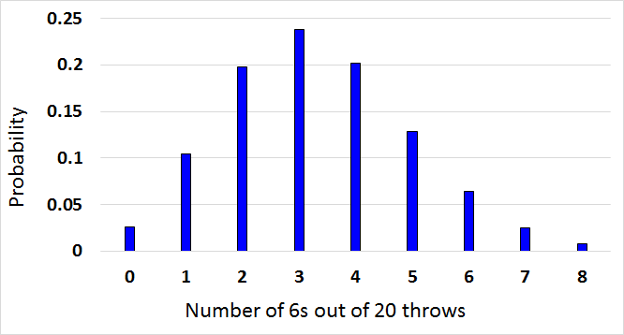
7.2 Finding critical values
A critical region is one which, if the test statistic falls within it, would cause you to reject the null hypothesis
$X$ (the number of sixes from 20 throws) | Probability
0
1
2
3
4
5
6
7
8
Critical value
0.026
Critical Region
0.104
5%
0.198
0.238
0.202
0.129
0.064
Originally, we were considering whether the dice was biased towards 6s, at the 5% significance level. This can be represented on the diagram…
The critical value in that example was 7, in that once we get to 7 sixes out of 20, the probability is low enough to reject the idea that the dice is unbiased
The critical region would be the set of values that would lead to the null hypothesis being rejected, so in this example any number of sixes equal to or greater than 7
0.025
0.0084
Is there another one?

Slide 11
One or two tailed

Slide 12
Example
A single observation is taken from a Binomial distribution $B(6, p)$. The observation is then used to test $H_{0}:p=0.35$ against $H_{1}:p>0.35$.
Using a 5% significance level, find the critical region for this test
State the actual significance level of this test
$$H_{0}:p=0.35$$
Assuming $H_{0}$ is true, then $X\sim B(6, 0.35)$
→ You can then use your calculator or the statistical tables to find the value for which the probability would be less than 5%
As always, think about what the numbers mean
The 0.8826 means that there is an 88.26% chance of the number of successes being less than or equal to 3
It therefore also means that there is a 11.74% chance of getting 4, 5 or 6 successes
This is not unlikely enough to reject the null hypothesis that the probability is 0.35
We need to check these values

Slide 13
More understanding
The 0.9777 means that there is an 97.77% chance of the number of successes being less than or equal to 4
It therefore also means that there is a 2.23% chance of getting 5 or 6 successes
This is unlikely enough to reject the null hypothesis that the probability is 0.35
The critical region is therefore 5 or 6

Slide 14
Example 2
A single observation is taken from a Binomial distribution $B(6, p)$. The observation is then used to test $H_{0}:p=0.35$ against $H_{1}:p>0.35$.
Using a 5% significance level, find the critical region for this test
State the actual significance level of this test
The ‘actual significance level’ is the probability of the test statistic falling within the critical region
→ It can also be thought of as ‘the probability of incorrectly rejecting the null hypothesis’
5 or 6
We already found the critical region in part a
In this case, the chance of getting 5 or 6 ‘successes’ can be calculated as follows
$$2.23\%$$
$$P\left(X≥5\right)=1−P(X≤4)$$
$$P\left(X≥5\right)=1−0.9777$$
$$P\left(X≥5\right)=0.0223$$

Slide 15
Example 2
A random variable $X$ has binomial distribution $B(40, p)$. A single observation in used to test $H_{0}:p=0.25$ against $H_{1}:p≠0.25$.
Using the 2% level of significance, find the critical region of this test. The probability in each ‘tail’ should be as close to possible as 0.01
b) State the actual significance level of the test

Slide 16
Exercise book
Exercise 7B pages 103-104

Slide 17
7.3 – One–tailed test
This is when the alternative hypothesis is < or >
The steps that are:
Formulate a model for a test statistic
Identify suitable H₀ and H₁
Calculate the probability of that test statistic
Compare to the significance level
Write a conclusion

Slide 18
Example
John tosses a coin 8 times and it comes up heads 6 times. He claims the coin is biased towards heads. With a significance level of 5%, test his claim.
STEP 1: Define test statistic $X$ (stating its distribution), and the parameter $p$.
STEP 2: Write null and alternative hypotheses.
$X$ is number of heads.
$p$ is probability of heads.
$$X\sim B\left(8,p\right)$$
$$H_{0}:p=0.5 \\ H_{1}:p>0.5$$
STEP 3: Determine probability of observed test statistic (or ‘more extreme’), assuming null hypothesis.
i.e. Determine probability we’d see this outcome just by chance.
STEP 4: Two-part conclusion:
1. Do we reject $H_{0}$ or not?
2. Put in context of original problem.
Assume $H_{0}$ is true, $X\sim B\left(8,0.5\right)$
$$P\left(X≥6\right)=1−P\left(X≤5\right) \\ =1−0.8555 \\ =0.1445$$
14.45% > 5%, so insufficient evidence to reject $H_{0}$.
Coin is not biased.

Slide 19
Example 2
The standard treatment for a particular disease has a $\frac{2}{5}$ probability of success. A certain doctor has undertake research in this area and has produced a new drug which has been successful with 11 out of 20 patients. The doctor claims the new drug represents an improvement on the standard treatment.
Test, at the 5% significance level, the claim made by the doctor.

Slide 20
Class question
A student takes a multiple-choice test. The test is made up of 10 questions each with 5 possible answers. The student gets 4 questions correct. Her teacher claims she was guessing the answers. Using a one tailed test, at the 5% level of significance, test whether or not there is evidence to reject the teacher’s claim.
State your hypotheses clearly. (6)

Slide 21
Exercise book
Exercise 7C pages 106-107

Slide 22
7.4 – Two–tailed test
This is when the alternative hypothesis is ≠
The process is the same but one major difference. You need to half the significance level.
You can find out the expected value by calculating np.
If this value is lower, consider P(X≤x)
If this value is higher, consider P(X≥x)

Slide 23
Example
A single observation, $x$, is taken from a Binomial distribution $X\sim B\left(10,p\right)$, and a value of 1 is obtained. Use this observation to test $H_{0}:p=0.45$ against $H_{1}:p≠0.45$ using a 5% significance level.

Slide 24
Example 2
Over a long period of time it has been found that in Enrico’s restaurant the ratio of non-vegetarian to vegetarian meals sold is 2:1. In Manuel’s restaurant, in a random sample of 12 people ordering meals, 2 ordered a vegetarian meal. Using a 5% significance level, test whether or not the proportion of people eating vegetarian meals in Manuel’s restaurant is different to that in Enrico’s restaurant.

Slide 25
Class question
A student takes a multiple-choice test. The test is made up of 10 questions each with 5 possible answers. The student gets 4 questions correct. Her teacher claims she was guessing the answers. Using a one tailed test, at the 5% level of significance, test whether or not there is evidence to reject the teacher’s claim.
State your hypotheses clearly. (6)

Slide 26
Exercise book
Exercise 7C pages 106-107

