Slide 1
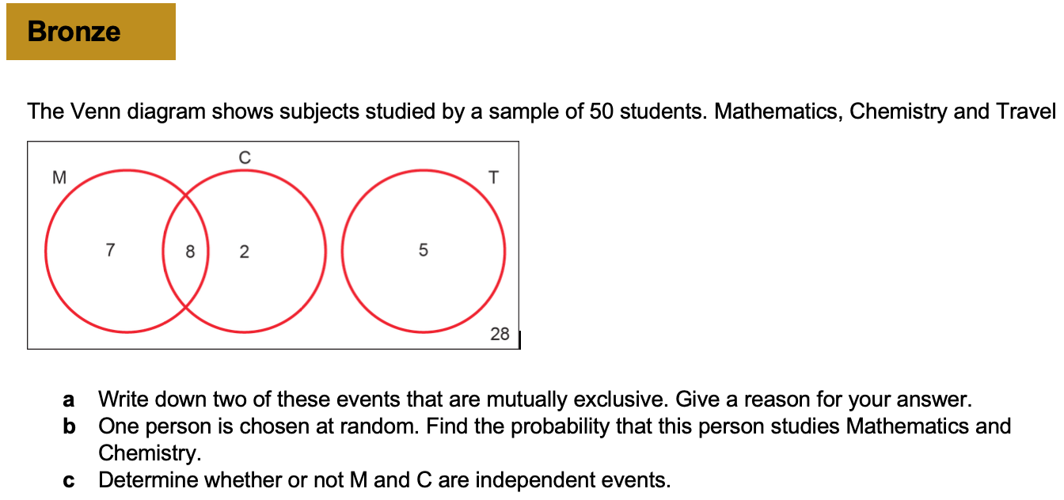
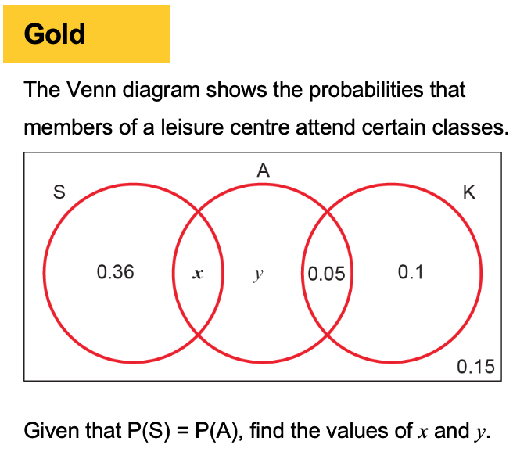
Chapter 6 – Statistical distribution

Slide 2
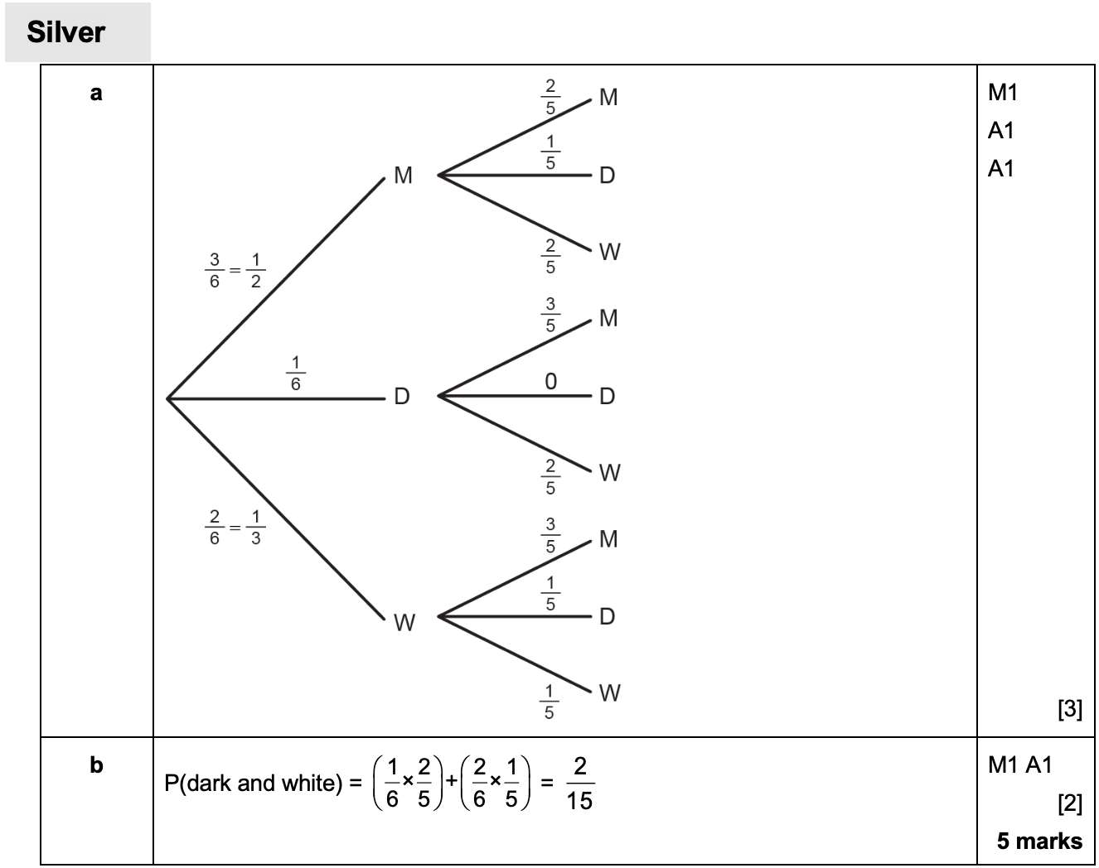
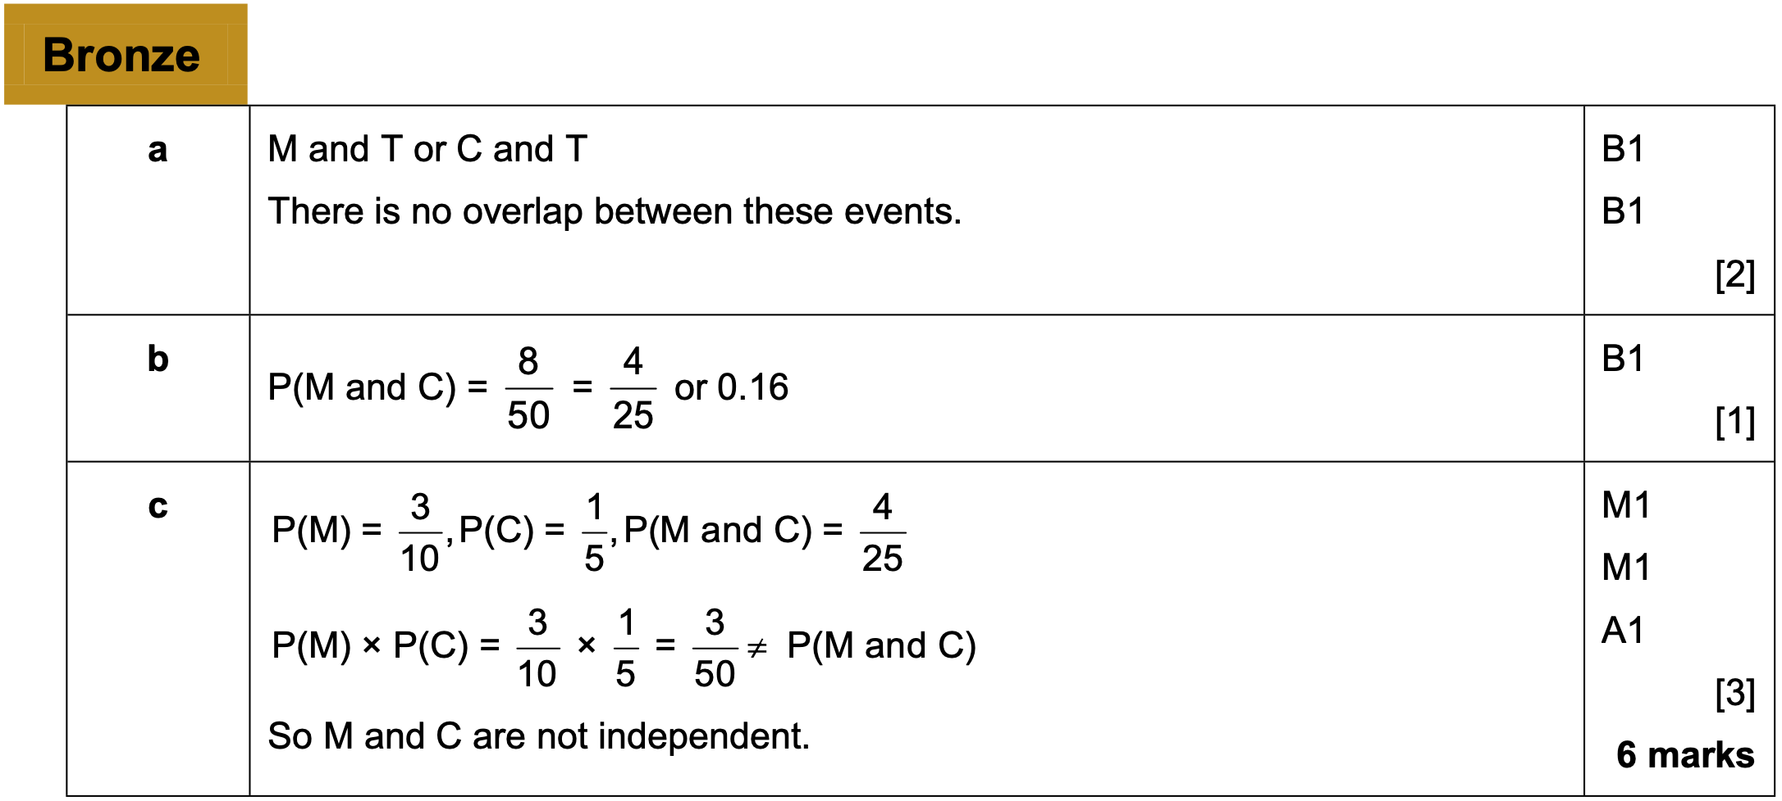
Answers

Slide 3
6.1 Probability distributions
A variable is a characteristic, number or quantity that can be measured or counted.
$$x$$ | red | green | blue | orange
$$P(X=x)$$ | 0.3 | 0.4 | 0.1 | 0.2
If each is assigned a probability of occurring, it becomes a random variable.
A random variable X represents a single trial. It consists of outcomes with a probability for each
$$P(X=x)$$
“The probability that…
…the outcome of the random variable $X$…
…was the specific outcome $x$”

Slide 4
Probability functions
There are two ways to write the mapping from outcomes to probabilities:
As a function
e.g. if $x=2$, then the probability is $0.1×2=0.2$
$$p\left(x\right)=\left\{\begin{aligned}0.1x, x=1,2,3,4 \\ &0, otherwise\end{aligned}\right.$$
Advantages of functional form:
Can have a rule/expression based on the outcome. Particularly for continuous random variables (in Yr2), it would be impossible to list the probability for every outcome. More compact.
As a table
$$x$$ | 1 | 2 | 3 | 4
$$p(x)$$ | 0.1 | 0.2 | 0.3 | 0.4
Advantages of table form:
Probability for each outcome more explicit.

Slide 5
Example
Three fair coins are tossed.
a) Write down all the possible outcomes when the three coins are tossed.
A random variable, $X$, is defined as the number of heads when the three coins are tossed.
b) Write the probability distribution of $X$ as:
A table
A probability mass function

Slide 6
Example 2
A biased four-sided dice with faces numbered 1, 2, 3 and 4 is rolled. The number on the bottom face is modelled as a random variable $x$.
Given that $P\left(X=x\right)=\frac{k}{x}$
Find the value of $k$
Give the probability distribution of $X$ in table form.

Slide 7
Example 3
The spinner below is spun until it lands on red or has been spun 4 times in total. Find the probability distribution of the random variable $S$, the number of times the spinner is spun.

Slide 8
Class question
$$x$$ | $$2$$ | $$3$$ | $$4$$ | $$5$$
$$p(x)$$ | $$0.1$$ | $$0.3$$ | $$0.2$$ | $$0.4$$
Determine:
$$P\left(X>3\right) \\ P\left(2≤X<4\right) \\ P\left(2X+1≥6\right)$$

Slide 9
Last things to consider
We can also represent a probability distribution graphically:
$$p(x)$$
$$\frac{1}{6}$$
$$x$$
$$1$$
$$2$$
$$3$$
$$4$$
$$5$$
$$6$$
The throw of a die is an example of a discrete uniform distribution because the probability of each outcome is the same.
$p(x)$ for discrete random variables is known as a probability mass function, because the probability of each outcome represents an actual ‘amount’ (i.e. mass) of probability.

Slide 10
Exercise book
Exercise 6A pages 86-88

Slide 11
6.2 The binomial distribution
Have a go at the following questions
The probability a randomly chosen person is left-handed is 0.1. If there is a group of 3 people, what is the probability that:
All 3 are left-handed.
0 are left-handed.
1 person is left-handed.
2 people are left-handed.

Slide 12
Binomial
You can model a random variable $X$ with a binomial distribution $B(n,p)$ if
there are a fixed number of trials, $n$,
there are two possible outcomes: ‘success’ and ‘failure’,
there is a fixed probability of success, $p$
the trials are independent of each other
If $X\sim B(n,p)$ then:
$$P\left(X=r\right)=\left(\begin{matrix}n \\ r\end{matrix}\right)p^{r}{\left(1−p\right)}^{n−r}$$
N is sometimes called the index
P is sometimes called the parameter

Slide 13
Example 1
The Jones's family invited over 3 friends. On a table of 8 people, 6 people are left-handed.
Suggest a suitable model for a random variable $X$: the number of left-handed people in a group of 8, where the probability of being left-handed is 0.1.
Find the probability 6 people are left-handed.
Suggest why the chosen model may not have been appropriate.

Slide 14
Class question
Gary is playing chess against Nigel and has a $\frac{2}{3}$ chance of winning each game. If they play 5 games, what is the probability of Gary winning exactly 3?

Slide 15
Example 2
The random variable $X\sim B\left(12,\frac{1}{6}\right)$. Find:
a) $P(X=2)$
b) $P(X=9)$
c) $P(X≤1)$

Slide 16
Example 3
The probability that a randomly chosen member of a reading group is left-handed is 0.15. A random sample of 20 members of the group is taken.
a) Suggest a suitable model for the random variable $X$, the number of members in the sample who are left-handed. Justify your choice.
b) Use your model to calculate the probability that:
Exactly 7 sample members are left-handed
Less than two members are left-handed

Slide 17
Exercise book
Exercise 6B pages 90-91

Slide 18
6.3 – Cumulative probabilities
Often, we wish to find the probability of a range of values.
For a Binomial distribution, this was relatively easy if the range was narrow,
e.g. $P\left(X≤1\right)=P\left(X=0\right)+P(X=1) but$ would be much more computationally expensive if we wanted say $P\left(X≤6\right)$.
Cumulative probability function tells the sum for all individual probabilities up to a given value
$$P\left(X≤x\right)$$
If $X\sim B(10,0.3)$, find $P\left(X≤6\right)$.
Press Menu then ‘Distributions’.
Choose “Binomial CD” (the C stands for ‘Cumulative’).
Choose ‘Variable’.
$$x=6 \\ N=10 \\ p=0.3$$
Pressing = gives the desired value.
Look up $n=10$ and the column $p=0.3$.
Then look up the row $x=6$.
The value should be 0.9894.
Table is on Page 204

Slide 19
Example
The random variable $X\sim B(20,0.4)$. Find:
$$P\left(X≤7\right)$$
$$P\left(X<6\right) \\ P\left(X≥15\right)$$
Given that $X\sim B\left(25,0.25\right)$
$$P\left(X=6\right)$$
$$P\left(X>20\right) \\ P\left(6<X≤10\right)$$

Slide 20
Part C help
Question | Calculation
X ≤ 5 | P(X ≤ 5)
X ≥ 4 | 1 – P(X ≤ 3)
X ≥ 9 | 1 – P(X ≤ 8)
X < 7 | P( X ≤ 6)
X > 10 | 1 – P(X ≤ 10)
Always change ≥ straight away

Slide 21
Example 2
A spinner is designed so that probability it lands on red is 0.3. Jane has 12 spins.
Find the probability that Jane obtains at least 5 reds.
Jane decides to use this spinner for a class competition. She wants the probability of winning a prize to be $<0.05$. Each member of the class will have 12 spins and the number of reds will be recorded.
b) Find how many reds are needed to win the prize.

Slide 22
Exercise book
Exercise 6C pages 93-94

