Slide 1
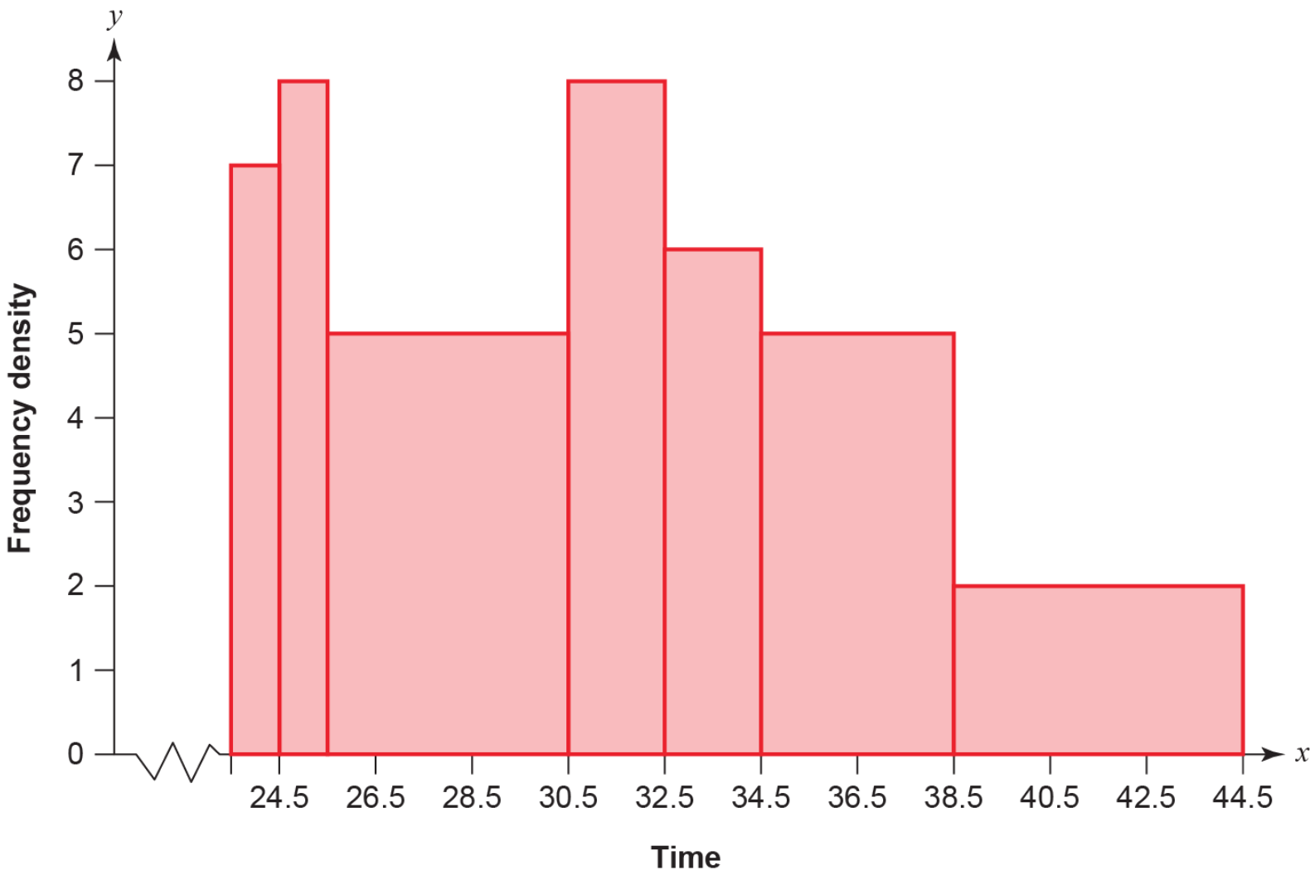
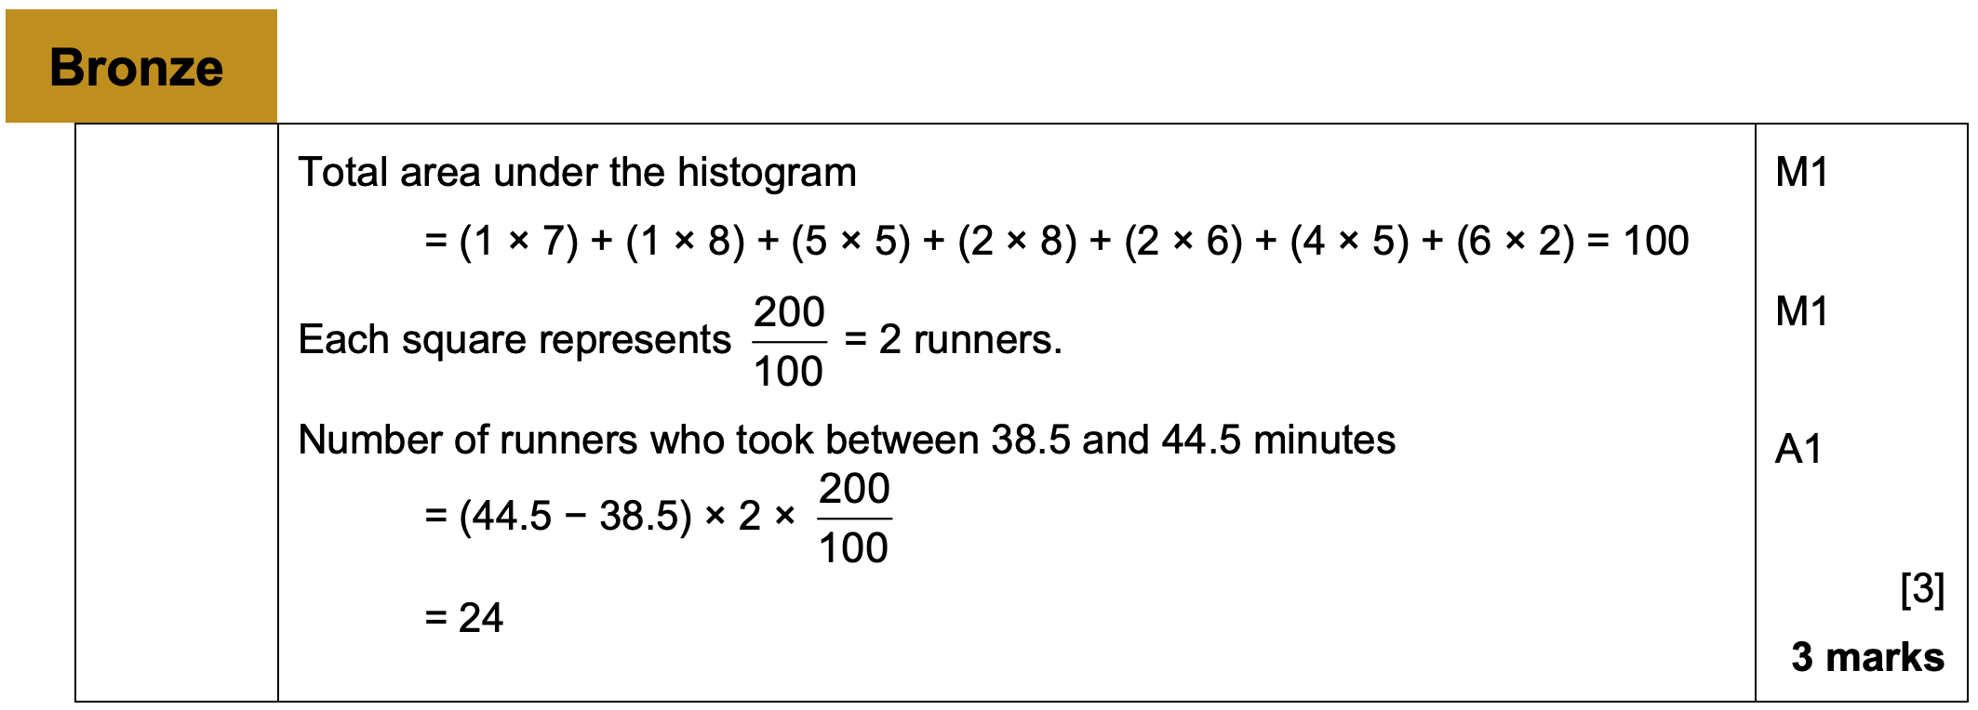
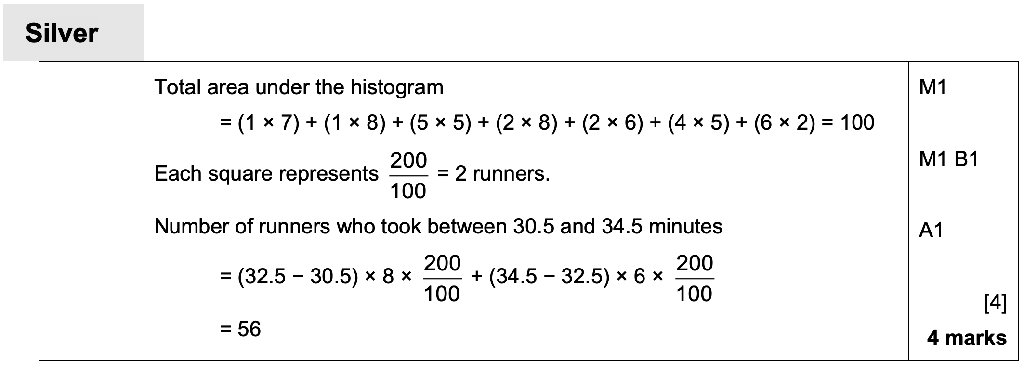
Chapter 4 – Correlation

Slide 2
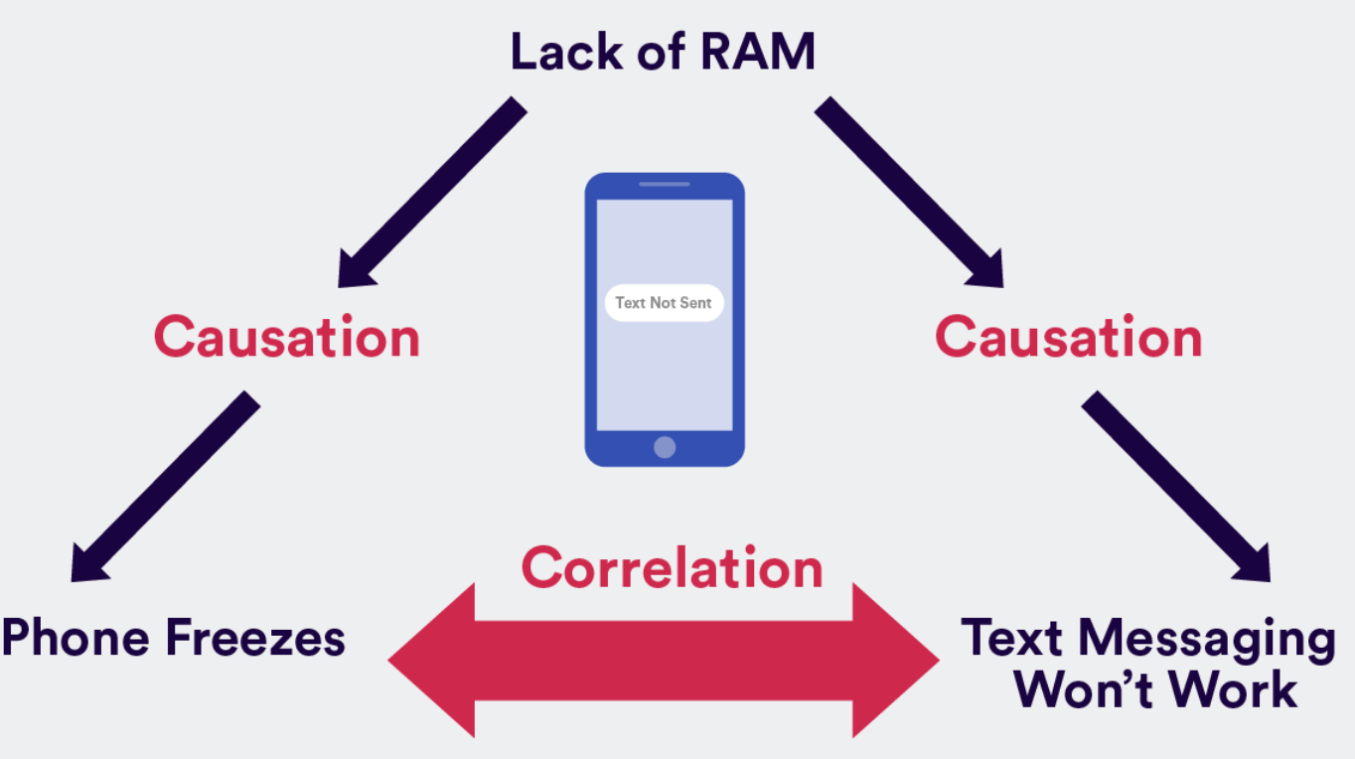
4.1 - Correlation
Bivariate data is data which has two pairs of values. Scatter graphs are used to display this data
Horizontal axis has the independent variable. Also known as explanatory
Vertical axis has the dependent variable. Also known as response
Correlation describes the nature of the relationship.
A casual relationship is when a change in one affects the change in the other
Just because two events are correlated doesn’t mean they have a casual relationship.
For example fire and smoke.
If there is a fire, there will be smoke.

Slide 3
Types of correlation
Positive Correlation
→ As one variable increases, so does the other
Negative Correlation
→ As one variable increases, the other decreases
No Correlation
→ There seems to be no pattern linking the two variables
Positive
Negative
None

Slide 4
Example
Scatter graphs are used to represent data linking 2 variables (bivariate data)
Hideko was interested to see if there was a relationship between what people earn and the age at which they left education or training. She asked 14 friends to fill in an anonymous questionnaire and recorded her results in a scatter diagram.
Describe the type of correlation shown
20
16
12
Hourly pay (£)
8
4
0
14
16
18
20
22
Age at which education/training ended

Slide 5
Example
Scatter graphs are used to represent data linking 2 variables (bivariate data)
Hideko says that her data supports the conclusion that more education causes people to earn a lower hourly rate of pay
b) Give one reason why Hideko’s conclusion might not be valid
20
16
12
Hourly pay (£)
8
4
0
14
16
18
20
22
Age at which education/training ended

Slide 6
Exercise book
Exercise 4A pages 61-62

Slide 7
4.2 Linear regression
One type of line of best fit. Known as least squares regression line
How do we interpret the gradient of 3?
$$d_{7}$$
$$d_{5}$$
$$d_{6}$$
Exam mark $(y)$
$$y=20+3x$$
$$d_{3}$$
$$d_{4}$$
How do we interpret the $y$-intercept of 20?
$$d_{2}$$
$$d_{1}$$
Regression line is always in the form y = a + bx.
Only use the regression line to find the dependent variable (y axis) given the independent variable

Slide 8
Example
From the large data set, the daily mean windspeed, $w$ knots, and the daily maximum gust, $g$ knots, were recorded for the first 15 days in May in Camborne in 2015.
The data was plotted on a scatter diagram.
$$w$$ | 14 | 13 | 13 | 9 | 18 | 18 | 7 | 15 | 10 | 14 | 11 | 9 | 8 | 10 | 7
$$g$$ | 33 | 37 | 29 | 23 | 43 | 38 | 17 | 30 | 28 | 29 | 29 | 23 | 21 | 28 | 20
© Met Office
Describe the correlation between daily mean windspeed and daily maximum gust.
The equation of the regression line of $g$ on $w$ for these 15 days is $g=7.23+1.82w$
(b) Give an interpretation of the value of the gradient of this regression line.
(c) Justify the use of a linear regression line in this instance.
50
40
30
20
10
0
Daily maximum gust, $g$ (knots)
0 5 10 15 20
Daily mean windspeed, $w$ (knots)

Slide 9
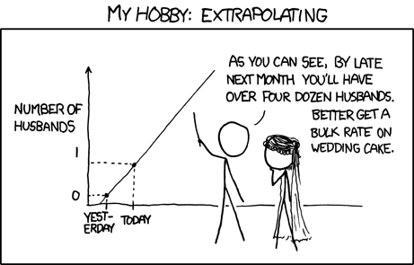
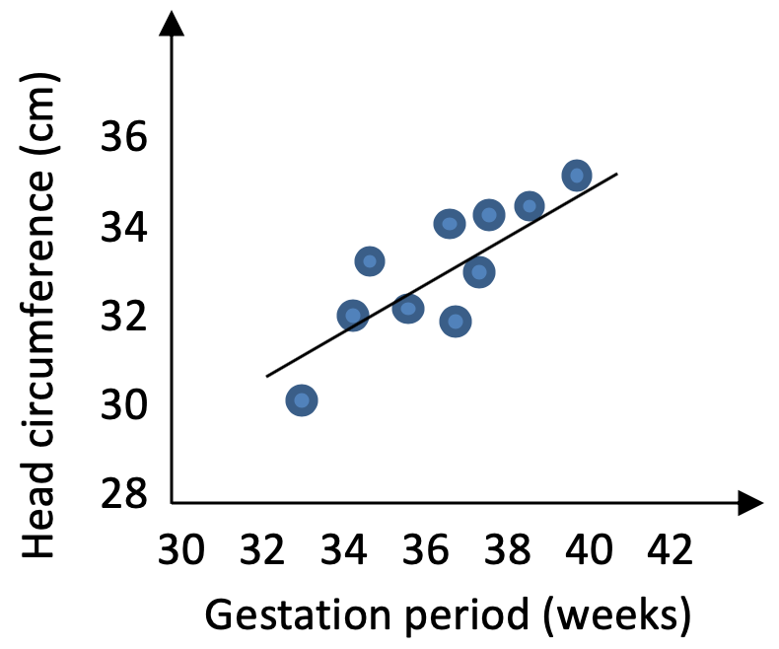
Predicting
Estimating a value inside the data range is known as interpolating.
Estimating a value outside the data range is known as extrapolating. This is less reliable and not suggested
The head circumference, $y$ cm, and gestation period, $x$ weeks, for a random sample of eight newborn babies at a clinic are recorded.
The scatter graph shows the results.
The equation of the regression line of $y$ on $x$ is $y=8.91+0.624x$. The regression equation is used to estimate the head circumference of a baby born at 39 weeks and a baby born at 30 weeks.
Comment on the reliability of these estimates.
A nurse wants to estimate the gestation period for a baby born with a head circumference of 31.6cm.
(b) Explain why the regression equation given above is not suitable for this estimate.

Slide 10
Exercise book
Exercise 4B pages 65-66

Slide 11
3.5 Comparing data
Comment on measure of location and measure of spread
Use mean and standard deviation
or
Use Median and IQR
You can’t cross over for example mean and IQR.
If the data contains extreme values, then use median and IQR.
Explain each question with its scenario and what it means.

