Slide 1
Chapter 3 – Representations of data

Slide 2
3.1 - Outliers
These are extreme values that lay outside of the pattern.
The formulas you need to follow are in the form
Greater than Q₃ + k(IQR)
Less than Q₁ - k(IQR)
K will be given to you in the question
Individual data that should be removed are called anomalies
Cleaning the data is the name given when removing anomalies

Slide 3
Examples
The diameters of 11 different Roman coins are measured in centimetres:
2.2 2.5 2.7 2.7 2.8 3.0 3.1 3.1 3.2 4.0 4.7
Determine the quartiles and hence any outliers.
The lengths, in cm, of 12 giant African land snails are given below:
17 18 18 19 20 20 20 20 21 23 24 32
Calculate the mean and standard deviation, given that $Σx=252$ and $Σx^{2}=5468$.
An outlier is an observation which lies $±2$ standard deviations from the mean. Identify any outliers for this data.

Slide 4
3.2 Box plots
Box Plots allow us to visually represent the distribution of the data.
Minimum | Lower Quartile | Median | Upper Quartile | Maximum
3 | 15 | 17 | 22 | 27
range
IQR
0 5 10 15 20 25 30

Slide 5
Example with an outlier
Smallest values | Largest values | Lower Quartile | Median | Upper Quartile
0, 3 | 21, 27 | 8 | 10 | 14
Any data 1.5 x interquartile rate above Q₃ or below Q₁ is an outlier.

Slide 6
Comparing box plots
Croydon
Kingston
£400k £450k £500k £550k £600k £650k £700k £750k
“Compare the prices of houses in Croydon with those in Kingston”. (2 marks)
For 1 mark:
The median house price in Kingston was greater than that in Croydon.
For 1 mark, one of:
The interquartile range of house prices in Kingston is greater than Croydon meaning its less consistent.
Include some measure of location (median is best).
Include some measure of spread.

Slide 7
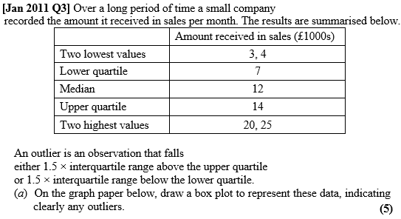
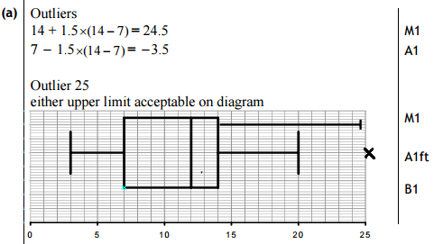
Class example
(c) The company claims that for 75% of the months, the amount received per month is greater than £10 000. Comment on this claim, giving a reason for your answer. (2)

Slide 8
Exercise book
Exercise 3A/B pages 42-43 and 45

Slide 9
3.3 Cumulative frequency (CF)
Cumulative frequency is used with group data. To find CF you keep adding the next interval on like a running total.
When plotting you use the end of the interval with the CF value

Slide 10
Plotting
Time (s) | Frequency | Cum Freq
9.6 < t ≤ 9.7 | 1 | 1
9.7 < t ≤ 9.9 | 4 | 5
9.9 < t ≤ 10.05 | 10 | 15
10.05 < t ≤ 10.2 | 17 | 32
32
28
24
20
16
12
8
4
0
Estimate of $Q_{2}=$
10.07s
Cumulative Frequency
Estimate of $Q_{1}=$
9.95s
Estimate of $Q_{3}=$
10.13s
Interquartile Range =
0.18s
9.5 9.6 9.7 9.8 9.9 10.0 10.1 10.2 10.3
Time (s)

Slide 11
Exercise book
Exercise 3C pages 47-48

Slide 12
3.4 Histograms
Only grouped continuous data can be plotted on histograms.
Area of the bars is proportional to the frequencies.
$$Frequency density= \frac{frequency }{class width}$$
To create a frequency polygon join the middle of the tops together. Don’t connect the first and last point together

Slide 13
Example 1
A random sample of 200 students was asked how long it took them to complete their homework the previous night. The time was recorded and summarised in the table to the right.
Draw a Histogram and frequency polygon for this data
Estimate how many students took less than 32 minutes
Estimate how many students took more than 46 minutes
Estimate how many students took between 36 and 45 minutes to complete their homework
Time, t (mins) | Frequency
$$25≤t<30$$ | 55
$$30≤t<35$$ | 39
$$35≤t<40$$ | 68
$$40≤t<50$$ | 32
$$50≤t<80$$ | 6

Slide 14
Example 2
A random sample of daily mean temperatures $(T,℃)$ was taken from the large data set for Hurn in 2015. The temperatures were summarised in a grouped frequency and represented by a Histogram.
Give a reason to support the use of a Histogram to represent this data
Write down the underlying feature associated with each of the bars in a Histogram
On the Histogram, the rectangle representing the $16≤T<18$ class was 3.2cm high and 2cm wide. The frequency for this class was 8.
c) Show that each day is represented by an area of 0.8
d) Given that the total area of the Histogram was 48cm², find the total number of days in the sample.

Slide 15
Exercise book
Exercise 3D pages 50-52

Slide 16
3.5 Comparing data
Comment on measure of location and measure of spread
Use mean and standard deviation
or
Use Median and IQR
You can’t cross over for example mean and IQR.
If the data contains extreme values, then use median and IQR.
Explain each question with its scenario and what it means.

