Slide 1
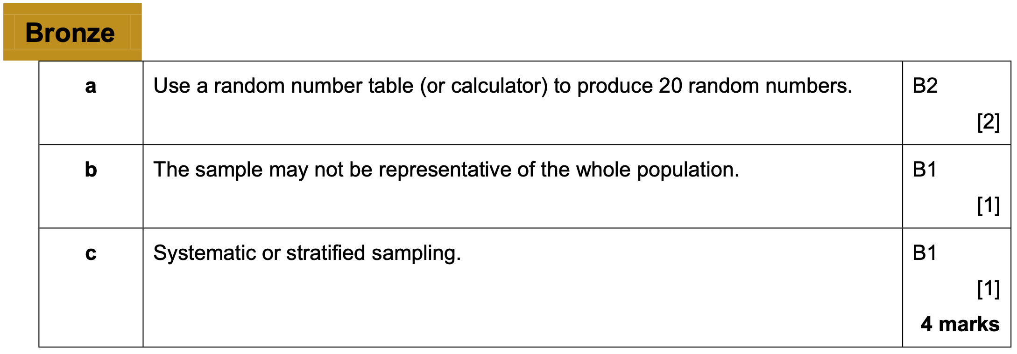
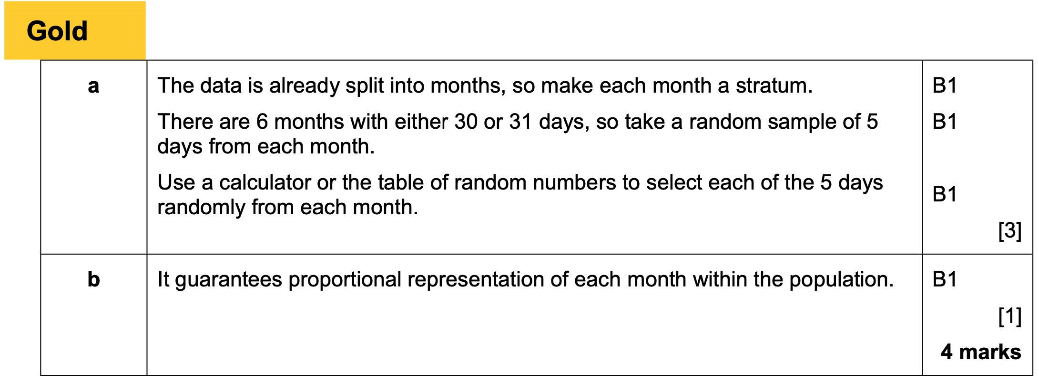
Chapter 2 – Measures of spread

Slide 2
2.1 Measures of central tendency
Measures of Location
Measures of Spread
Range
Standard Deviation
Measures of Central Tendency
Maximum
Median
Minimum
Mode
Quartiles
Interquartile Range
Mean
Percentiles
Variance
Deciles
Measures of location are single values which describe a position in a data set.
Of these, measures of central tendency are to do with the centre of the data, i.e. a notion of ‘average’.
Measures of spread are to do with how data is spread out.

Slide 3
2.1 Measures of central tendency
Node/model class?
Median?
Mean?
Mean is denoted as x bar $\overline{x}$
$\overline{x}=\frac{\sum{x}}{n}$ Where $\sum{x}$ is the sum of x values and n is the number of data
For values in a frequency table
$\overline{x}=\frac{\sum{xf}}{\sum{f}}$ Where $\sum{xf}$ is the sum of products of the data and $\sum{f}$ is the sum of the frequency

Slide 4
Using a calculator
Diameter of coin $x$ (cm) | $$2.2$$ | $$2.5$$ | $$2.6$$ | $$2.65$$ | $$2.9$$
Use the MENU button to access STATS mode.
Select 1-Variable.
Enter each value above, pressing = after each entry.
Press AC to start a statistical calculation.
Press the OPTN button. “1-Variable Calc” will calculate all common statistics.
Exam Tip: In the exam you get a method mark for the division and an accuracy mark for the final answer. Write:
$$\overline{x}=\frac{46.75}{40}=1.16875$$
You’re not required to show working like “$0×4+…$”

Slide 5
Using a calculator – Frequency table
Number of Children ($x$) | Frequency ($f$)
$$0$$ | $$4$$
$$1$$ | $$3$$
$$2$$ | $$9$$
$$3$$ | $$2$$
To add a frequency column for data input, press SHIFT $→$ SETUP, press Down, then choose Statistics. Turn frequency ‘On’.

Slide 6
Using a calculator – grouped data
Height $h$ of bear (in metres) | Frequency
$$0≤h<0.5$$ | $$4$$
$$0.5≤h<1.2$$ | $$20$$
$$1.2≤h<1.5$$ | $$5$$
$$1.5≤h<2.5$$ | $$11$$
When we have grouped data, we use the midpoint
Estimate of Mean: $\overline{x}=1.17m$
Why is our mean just an estimate?
Because we don’t know the exact heights within each group. Grouping data loses information.

Slide 7
Exercise book
Exercise 2A/B pages 22-23 and 24-25

Slide 8
2.2 Other measures of location
Question in exams but not in the book
The mean maths score of 20 pupils in class A is 62.
The mean maths score of 30 pupils in class B is 75.
What is the overall mean of all the pupils’ marks.
The teacher realises they mismarked one student’s paper; he should have received 100 instead of 95. Explain the effect on the mean and median.

Slide 9
2.2 Other measures of location
LQ is a ¼ of the data, Median is ½ and UQ is ¾
Listed data
To find the position of the median for listed data, find $\frac{n}{2}$:
- If a decimal, round up.
- If whole, use halfway between this item and the one after.
Grouped data
To find the median of grouped data, find $\frac{n}{2}$, then use linear interpolation.

Slide 10
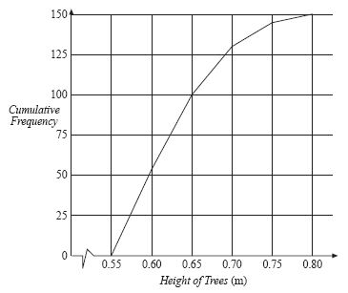
GCSE
Height of tree (m) | Freq | C.F.
$$0.55≤h<0.6$$ | $$55$$ | $$55$$
$$0.6≤h<0.65$$ | $$45$$ | $$100$$
$$0.65≤h<0.7$$ | $$30$$ | $$130$$
$$0.7≤h<0.75$$ | $$15$$ | $$145$$
$$0.75≤h<0.8$$ | $$5$$ | $$150$$
At GCSE we could find the median by drawing a suitable line on a cumulative frequency graph.
What could we do now?
We can say that the difference between lower point and Median is proportional to lower to the upper.

Slide 11
Linear interpolation - example
Height of tree (m) | Freq | C.F.
$$0.55≤h<0.6$$ | $$55$$ | $$55$$
$$0.6≤h<0.65$$ | $$45$$ | $$100$$
$$0.65≤h<0.7$$ | $$30$$ | $$130$$
$$0.7≤h<0.75$$ | $$15$$ | $$145$$
$$0.75≤h<0.8$$ | $$5$$ | $$150$$
The 75th item is within the $0.6≤h<0.65$ class interval because 75 is within the first 100 items but not the first 55.
Frequency up until this interval
Item number we’re interested in.
Frequency by end of this interval
?
?
?
55
75
100
0.6m
Med
0.65m
?
?
Height at start of interval.
Height by end of interval.
$$\frac{75−55}{100−55} = \frac{m −0.6}{0.65−0.6}$$
$$\frac{20}{45} = \frac{m −0.6}{0.05}$$
m = 0.62

Slide 12
Simplistic way of thinking
Frequency up until this interval
Item number we’re interested in.
Frequency by end of this interval
55
75
100
0.6m
Med
0.65m
Height at start of interval.
Height by end of interval.
What fraction of the way across the interval are we?
$$\frac{20}{45}$$
$$Median=0.6+\left(\frac{20}{45}×0.05\right)$$

Slide 13
Another example
Time (s) | Freq | C.F.
$$8≤t<10$$ | $$4$$ | $$4$$
$$10≤t<12$$ | $$3$$ | $$7$$
$$12≤t<14$$ | $$13$$ | $$20$$

Slide 14
Different style
Weight of cat to nearest kg | Frequency
$$10−12$$ | $$7$$
$$13−15$$ | $$2$$
$$16−18$$ | $$9$$
$$19−20$$ | $$4$$
There are GAPS between intervals!
What interval does this represent?
$$10−12$$
?
$$9.5−12.5$$
Lower class boundary
Upper class boundary
Class width = 3
?

Slide 15
Class examples
Distance $d$ travelled (in m) | …
$$0≤d<150$$
$$150≤d<200$$
$$200≤d<210$$
Time $t$ taken (in seconds) | …
$$0−3$$
$$4−6$$
$$7−11$$
Weight $w$ in kg | …
$$10−20$$
$$21−30$$
$$31−40$$
Speed $s$ (in mph) | …
$$10≤s<20$$
$$20≤s<29$$
$$29≤s<31$$

Slide 16
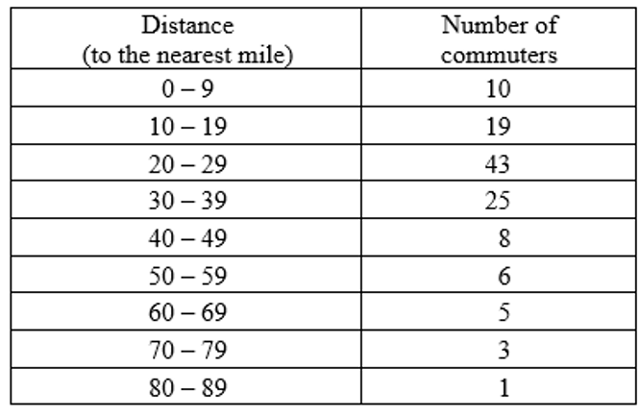
Example

Slide 17
Exercise book
Exercise 2C pages 27-28
Not Q1b, 2, 4b-d, 5b-c, 6

Slide 18
2.3 measure of spread
Range?
Interquartile range (IQR)?
Interpercentile?
Listed data
To find the position of the LQ/UQ for listed data, find $\frac{1}{4}n$ or $\frac{3}{4}n$ then as before:
- If a decimal, round up.
- If whole, use halfway between this item and the one after.
Grouped data
To find the LQ and UQ of grouped data, find $\frac{1}{4}n$ and $\frac{3}{4}n$, then use linear interpolation.

Slide 19
Examples
Age of relic (years) | Frequency
0-1000 | 24
1001-1500 | 29
1501-1700 | 12
1701-2000 | 35
Shark length (cm) | Frequency
$$40≤x<100$$ | 17
$$100≤x<300$$ | 5
$$300≤x<600$$ | 8
$$600≤x<1000$$ | 11
Find the IQR
Find the 10th to the 90th interpercentile

Slide 20
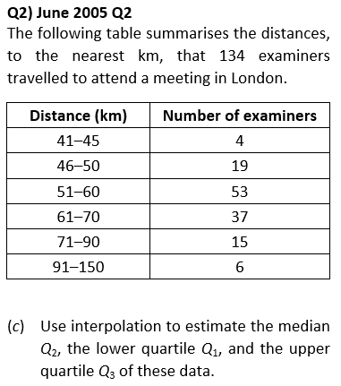
Class example

Slide 21
Exercise book
Exercise 2D pages 27-28

Slide 22
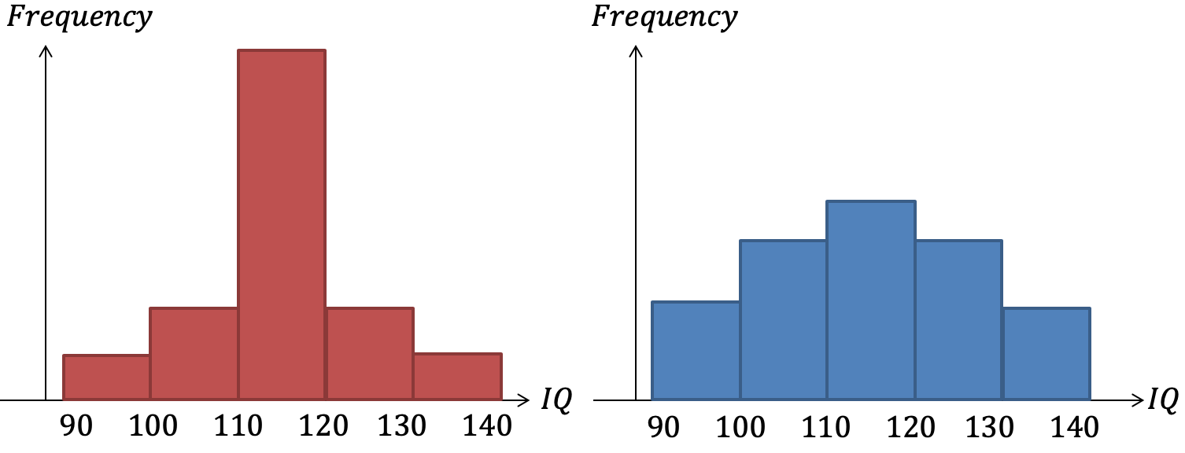
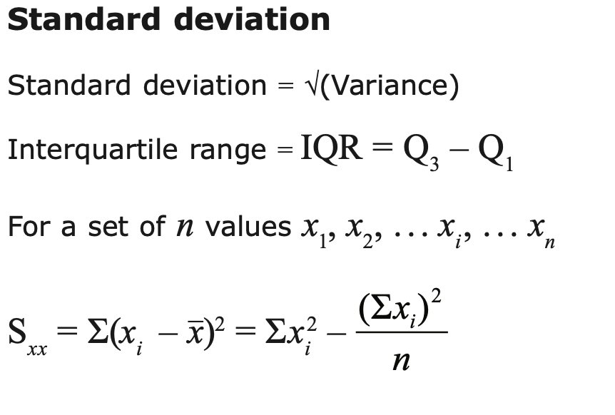
Variance and standard deviation
The mean IQ is the same for the two classes, as is the range, but the overall spread of values is greater for the second class.
The interquartile range would convey this, but do we have a method of measuring spread that considers all the values?
Variance is a way that would include all data values
$$\frac{\sum{x^{2}}}{n}−{\left(\frac{\sum{x}}{n}\right)}^{2}$$
$$\frac{s_{xx}}{n}$$
or

Slide 23
Standard deviation
Notated as $σ$. This is equal to $\sqrt{Variance}$. Therefore $σ^{2}$ is variance
The standard deviation can ‘roughly’ be thought of as the average distance from the mean.

Slide 24
Examples
3, 11
2cm 3cm 3cm 5cm 7cm

Slide 25
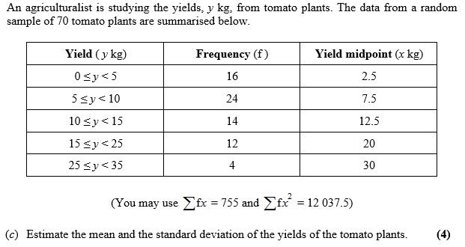
Class question

Slide 26
Misconceptions and errors
Thinking $Σfx^{2}$ means ${\left(Σfx\right)}^{2}$. It means the sum of each value squared!
When asked to calculate the mean followed by standard deviation, using a rounded version of the mean in calculating the standard deviation, and hence introducing rounding errors.
Forgetting to square root the variance to get the standard deviation.
ALL these mistakes can be easily spotted if you check your value against “$σx$” in STATS mode.

Slide 27
Exercise book
Exercise 2E pages 32-33

Slide 28
Coding
A way of simplifying calculations
For example £10,000 £27,000 £18,000 £12,300 can be expressed by 10,27,18,12.3.
The coding for this would be $y= \frac{x}{100}$
Think of the mean height of the class?
Think of the variance in the height of the class?
What would change if we all stood on chairs?
The mean would increase by the height of the chair, but the variance would remain the same

Slide 29
Coding formulas
$$y=\frac{x−a}{b}$$
$$Mean is \overline{y}=\frac{\overline{x}−a}{b}$$
$$Standard deviation is σy=\frac{σx}{b}$$
Which is rearranged
Which is rearranged
$b\overline{y}+a=$ $\overline{x}$
$$bσy=σx$$
You normally need to find the mean and standard deviation of the original given the coding values hence the rearranged forms

Slide 30
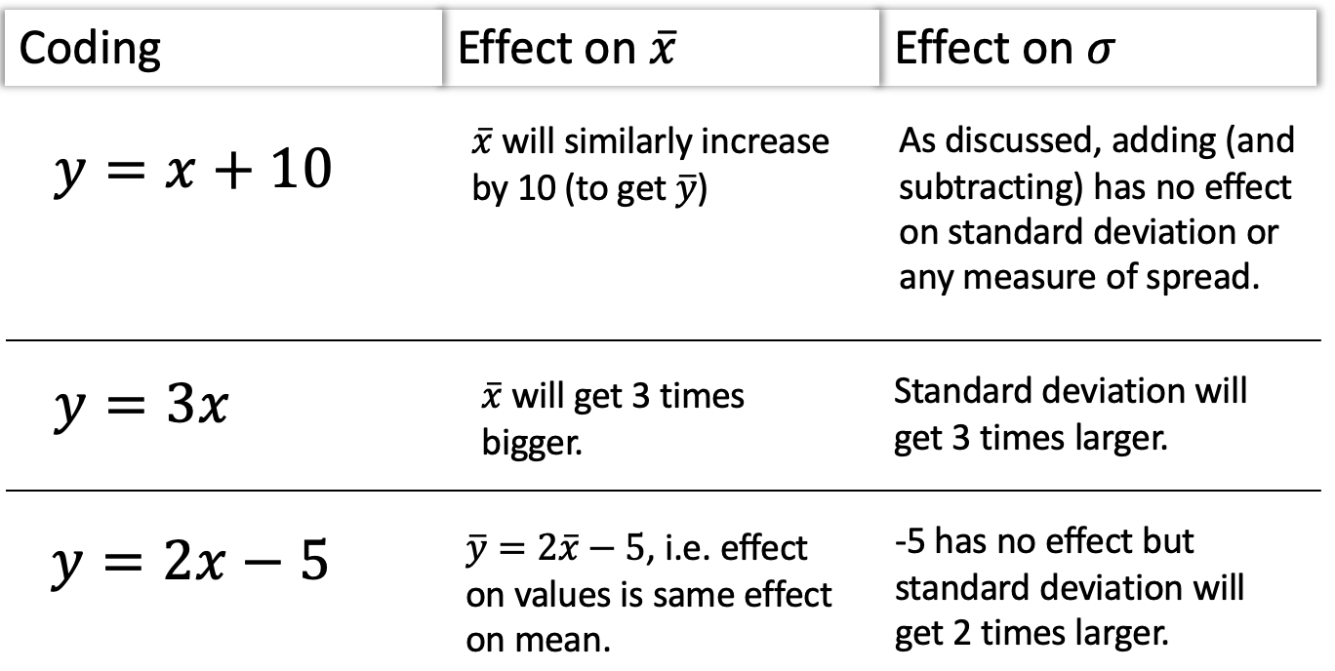
Rules of coding – summary

Slide 31
Example
Cost $x$ of diamond ring (£)
£1010 £1020 £1030 £1040 £1050
We ‘code’ our variable using the following:
$$y=\frac{x−1000}{10}$$
Find the values of y.
Calculate the mean and standard deviation
Find the original mean and standard deviation from the values of y

