Slide 1
Chapter 1 -Data collection
Stater – Just a minute.
You have a minute to discuss what you know about data and how it can be collected

Slide 2
Some potential answers
Grouped
Discrete
Continuous
Population
Sample
Quantitative (number)
Qualitative (Words)
Census

Slide 3
1.1 Population and samples
A population is
A sample is
the whole set of items that are of interest.
some subset of the population intended to represent the population.
Population
Sample
Sample units are individual units of a population
Sample frame is a list of sample units normally named or numbered

Slide 4
Census and sampling
Census measures the whole population where a sample measures a fair representation of the population.
 | Advantages | Disadvantages
Census | Completely accurate results | Time consuming Can’t be used if the item will be destroyed Hard to process all the data
Sample | Less time and cheaper Less data to process Fewer people to respond | Data won't be as accurate Sample may not be large enough
Notes on answering questions
Make sure you know the definitions, advantages and disadvantages
Sampling can be improved by more being asked

Slide 5
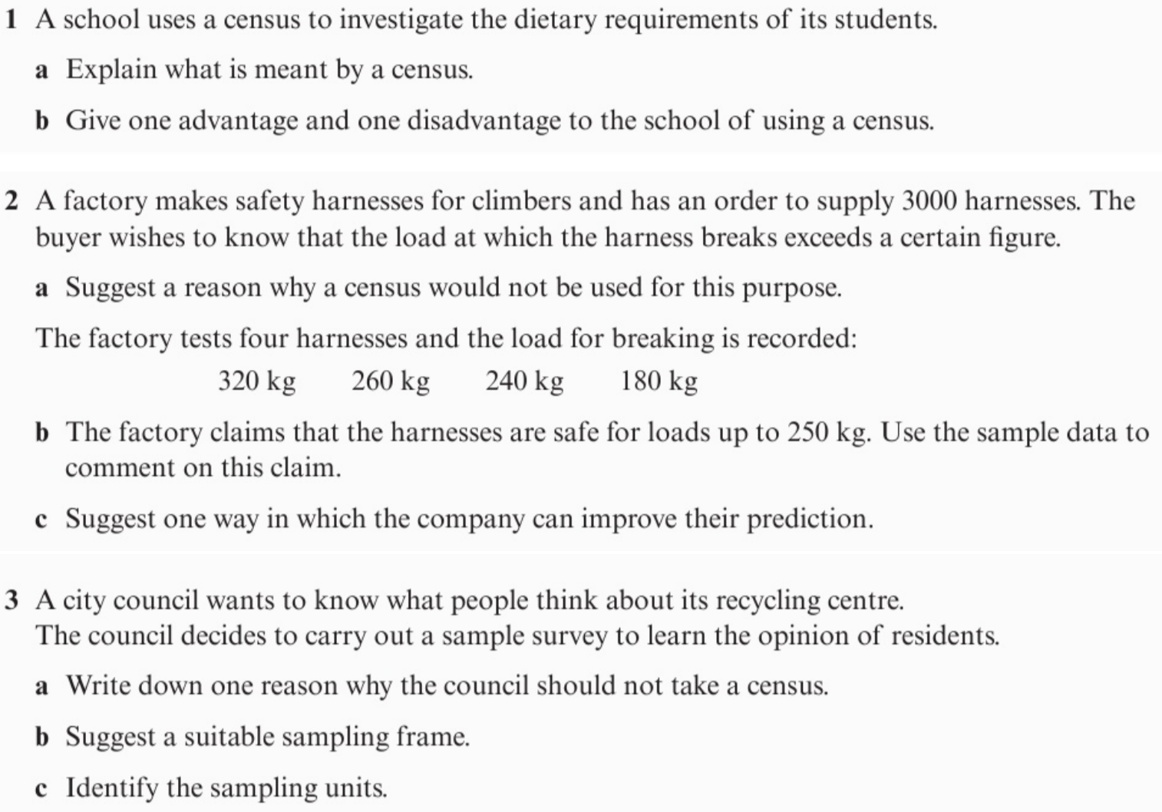
Questions

Slide 6
1.2 Sampling
Sampling should be representative of the population.
Random sampling helps to reduce biasness.
There are three types of random sampling
Simple random sampling – all sample units have equal chance
Systematic sampling – sample units are chosen at regular intervals
Stratified sampling – population is divided into strata and randomly selected

Slide 7
Advantages and disadvantages
 | How to carry out | Advantages | Disadvantages
Simple random | In the sampling frame, each item has identifying number. Use random number generator, or ‘lottery sampling’ (names in a hat). | Free of bias Easy and cheap Equal known chance | Not suitable when data is large Sample frame needed
Systematic | Take every k^{th} elements where: $$k=\frac{pop size \left(N\right)}{samp size \left(n\right)}$$ starting at random item between 1 and $k$. | Simple and quick Large sample or population | Sample frame needed Bias if sample frame is not random
Stratified | Same proportion $\frac{samp size \left(n\right)}{pop size \left(N\right)} ×number in stratum$ sampled from each strata. | Sample reflects the population Guarantees proportional in the groups | Population needs to be into multiple strata Not suitable when data is large Sample frame needed

Slide 8
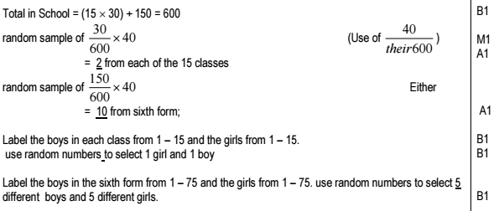
Example
A school has 15 classes and a sixth form. In each class there are 30 students. In the sixth form there are 150 students. There are equal numbers of boys and girls in each class. There are equal numbers of boys and girls in the sixth form. The head teacher wishes to obtain the opinions of the students about school uniforms. Explain how the head teacher would take a stratified sample of size 40. (7)

Slide 9
1.3 Non-random sampling
All the random sampling required a sample frame but what happens if we don’t have one?
We use non-random sampling which there are two methods.
Quota sampling – selects a sample which reflects characteristics of the population
Opportunity (convenience) sampling – taking a sample from people at that time
Quota sampling
As with stratified sampling, divide population into groups according to characteristic of interest, then determine size of each group in sample to reflect proportions within the population.
But instead of random sampling within each group, we actively choose people within each group via suitable means (e.g. advertising), until the ‘quota’ for each group is filled.
A variant of this is opportunity sampling, where we find people at the same time the survey is being carried out (e.g. exit polls at polling stations).

Slide 10
Advantages and disadvantages
 | How to carry out | Advantages | Disadvantages
Quota | Population divided into groups according to characteristic. A quota of items/people in each group is set to try and reflect the group’s proportion in the whole population. Interviewer selects the actual sampling units. | Allows for a small sample to represent the whole population No sample frame Quick, easy and cheap Easy comparison between groups | Could be biased Inaccuracy when dividing into groups Increasing scope, increases number of groups which adds time and expense No responses are recorded
Opportunity | Sample taken from people who are available at time of study, who meet criteria. | Easy to carry out Inexpensive | Unlikely to represent the population Dependent on the researcher

Slide 11
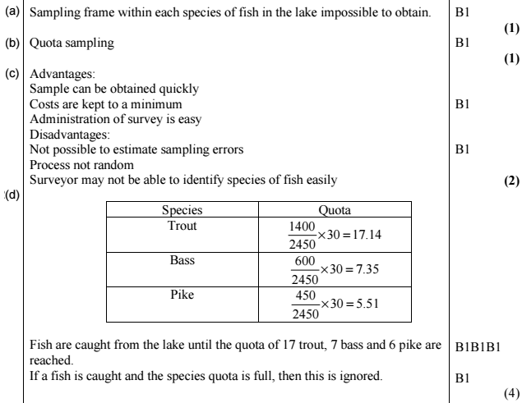
Example

Slide 12
1.4 Types of data
Data is either
Quantitative
Numerical data
Qualitative
Non-numerical data
Continuous
Any value including decimals
Discrete
Can only take whole numbers
Data can also be grouped. This data is always quantitative but could be either continuous or discrete.
This is known as a
class interval.
$$20≤w<70$$
Lower class boundary
Midpoint = 45
Upper class boundary
Look at exercise 1D page 10

Slide 13
1.5 Large data set
You will need to ask questions about a large data set. You won't be expected to remember every bit of data but will need some basic understanding. The exam will include the data if you need to do calculations.
Location of all stations

Slide 14
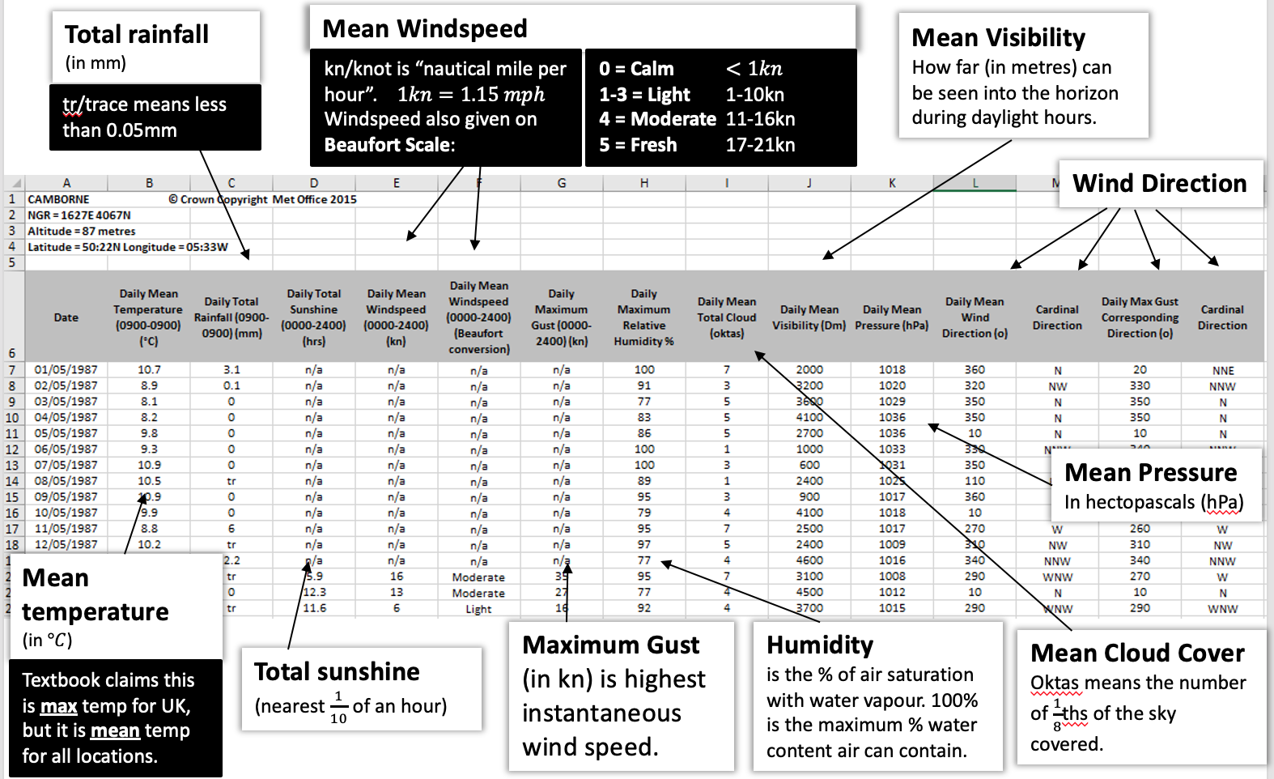
Continued

Slide 15
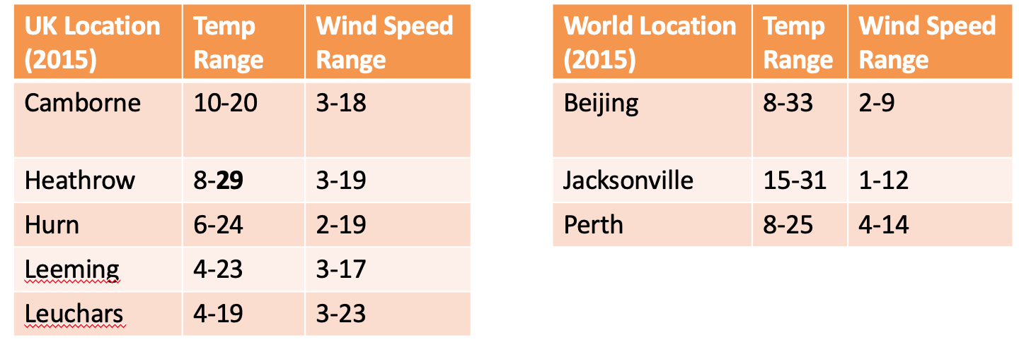
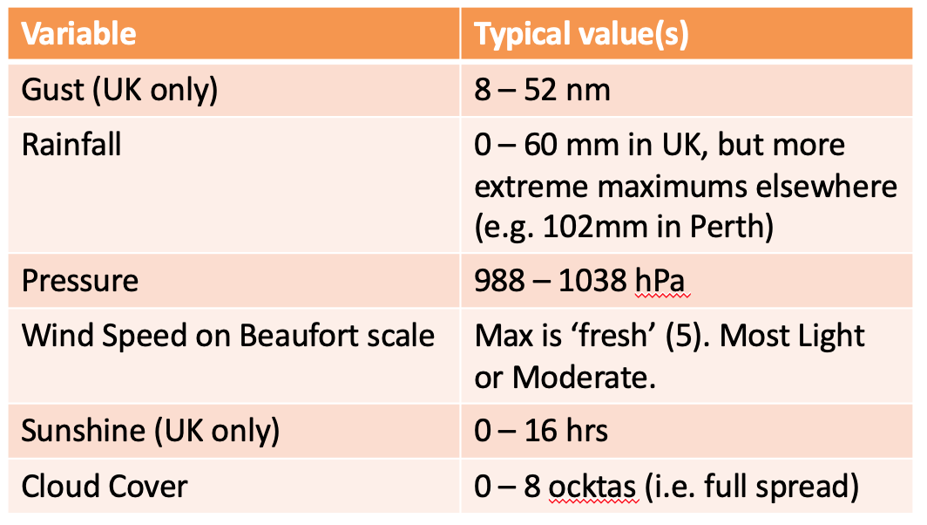
Continued

