Slide 1
THE HOLY SPIRIT
Getting to know him

Slide 2
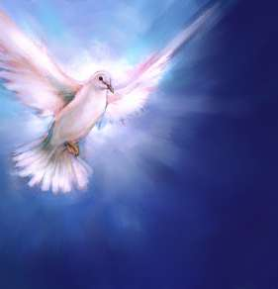
Saying "Jesus is Lord"
Only through the Holy Spirit can a person be in touch with Christ. By Baptism, the Spirit gives us the life of the Father which is offered in the Son. "Those who bear God's Spirit are led to the Son, and the Son presents them to the Father who confers incorruptibility on them" (St. Irenaeus).

Slide 3
The Spirit - The Last Person Revealed
Although the Spirit is the first to communicate new life, the Spirit was the last of the persons to be revealed. St. Gregory of Nazianzus explained this pedagogy of divine "condescension" when he wrote that the Father was revealed in the Old Testament and the Son in the New. It was not prudent to reveal the Son's divinity until the Father's divinity was confessed. So, also, the Spirit's divinity was withheld until the Son's divinity was believed.

Slide 4
The Spirit Works in Our Midst
The Nicene Creed teaches that the Holy Spirit is a person of the Trinity, of one substance with the Father and the Son. This section will study how the Spirit does his works (the divine "economy").
In this "final age" (ushered in by Christ's redeeming Incarnation), the divine plan is accomplished by the outpouring of the Spirit. He brings about the Church, the Communion of Saints, the forgiveness of sins, the resurrection of the body and life everlasting.

Slide 5
Hidden - Yet Known by His Works
Although the Spirit reveals Christ and makes us hear the Father's Word, we do not hear the Spirit himself because he "will not speak on his own.”
Because of this "divine self-effacement," the world "cannot receive him because it neither sees him nor knows him." Believers, however, know the Spirit because he dwells in them.
The Spirit inspired the Scriptures, gave us Tradition, assists the Church's Magisterium, gives us communion with Christ through the sacraments, intercedes in prayer, bestows charisms and ministries, inspires missionary life, and witnesses through the saints.

Slide 6
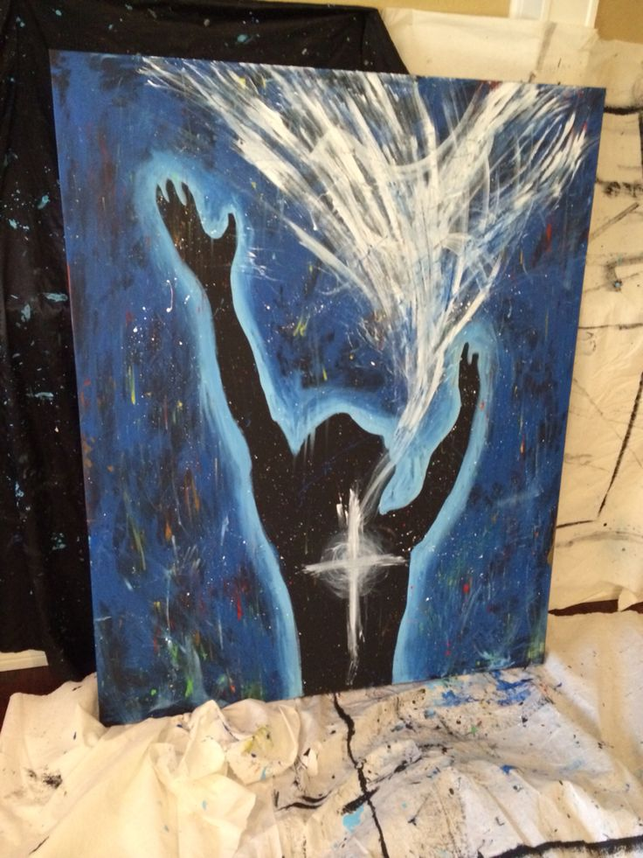
The Son and Spirit Working Together
The Spirit is truly God, consubstantial and inseparable from the Father and the Son (both in their inner life and in their work). When the Father sends his Son, he also sends his Breath. Distinct but inseparable, both have a joint mission. The Son is seen and the Spirit reveals the Son.
When Christ was glorified, he could send the Spirit and give his glory to believers. This joint mission (of Christ and the Spirit) is manifested in the children adopted by the Father who are united to Christ by the Spirit.
"Just as there is no distance between the body and the anointing oil, so there is no distance nor intermediary between the Son and the Spirit. Contact with the Son requires contact with the oil because every part is covered with the Spirit's anointing" (St. Gregory of Nyssa).

Slide 7
Name, Titles and Symbols
Both Spirit and Holy
Seven Other Names
The name "Holy Spirit" was given by Christ. "Spirit" and "Holy" are two attributes common to all three divine persons. By joining these two words, the Church designates clearly this inexpressible person, the Holy Spirit.
On four occasions, Jesus also calls the Holy Spirit "Paraclete,” meaning "advocate" and "consoler." Jesus also calls him "the Spirit of truth.”.
St. Paul calls him "the Spirit of the promise,” "the Spirit of adoption,” "the Spirit of Christ,” "the Spirit of the Lord,” and "the Spirit of God.”

Slide 8
Eight symbols of the holy spirit

Slide 9
Water - Water signifies the Spirit's action in Baptism. Our first birth took place in water, so the
baptismal water signifies our divine birth.
2. Anointing - Anointing is the sacramental sign of Confirmation (called "Chrismation" in the East).
Jesus is God's Anointed in a unique way because the Spirit established him as the Christ at his
conception. Now, the glorified Jesus pours out the Holy Spirit until the saints constitute "the whole
Christ" (St. Augustine).
3. Fire - Fire symbolizes the transforming energy of the Spirit. John the Baptist proclaimed that Jesus
would "baptize with the Holy Spirit and with fire.” Jesus came "to cast fire on the earth" and on
Pentecost, the Spirit came in the form of tongues "as of fire.” Paul uses the image saying, "Do not
quench the Spirit.”
4. Cloud and Light - In the New Testament, the Spirit "overshadowed" the Virgin Mary and during the
Transfiguration the Spirit came in a "cloud and overshadowed everyone.” At the Ascension, the cloud
took Jesus from the disciples' sight.
5. The seal - This is a symbol very similar to anointing. "The Father has set his seal" on Christ. This
seal indicates the indelible effect of the Spirit in Baptism, Confirmation, and Holy Orders.
6. The hand - In Acts, the apostles bestow the Spirit by the laying on of hands. The Church has kept
this sign of the Spirit's power in the sacramental epiclesis.
7. The finger - The Spirit, "the finger of the Father's right hand," writes "on the tablets of human
hearts.”
8. The dove - When Christ came up from his baptismal bath, the Spirit in the form of a dove
remained upon him.

Slide 10
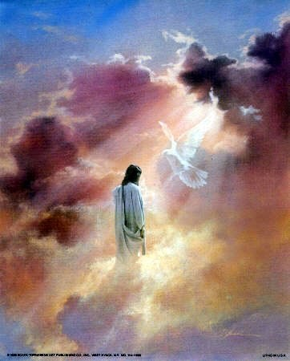
The Time of the Promises

Slide 11
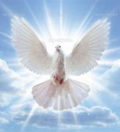
The Spirit's Words about Christ
Until Christ's coming (the "fullness of time") the joint mission of the Son and the Spirit remained hidden. Both the Son and the Spirit were to be watched for. Therefore, the Church searches the Old Testament for what the Spirit, by inspiring the authors, tells us about Christ.

Slide 12
Creation - Both at Work The Promised Progeny
God's Word and God's Breath are present at the origin of every creature. The Spirit "preserves creation in the Father through the Son" (Byzantine liturgy).
"God fashioned man with his two hands (the Son and the Spirit) so that even what was visible would bear the divine form" (St. Irenaeus).
God's promise to Abraham began the work of salvation which culminated in the Son, who assumed human nature, restored it to the Father's likeness, and gave it God's Glory, the Spirit.
God promised Abraham a progeny in which all the nations would be blessed. This progeny is Christ himself. God promised to give both his Son and Holy Spirit, "the guarantee of our inheritance.”

Slide 13
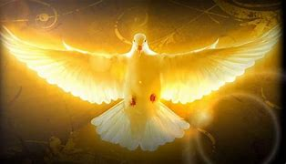
The Spirit Revealing Yet Concealing
In the Old Testament manifestations, Christian Tradition saw that the Word allowed himself to be seen and heard, while the cloud of the Spirit both revealed God and concealed him.
God gave the Law as a teacher to lead people to Christ. Although man found the law powerless to save, his growing awareness of sin enkindled a desire for the Holy Spirit.
God Amidst Israel's Infidelity
God's Law should have governed Israel. Unfortunately, Israel gave in to the temptation to become a kingdom like the other nations.
Because of their infidelity, Israel was led into the Exile (seemingly the failure of the promises). However, God began the restoration of his people and the purified remnant of exiles prefigured the Church.

Slide 14
The Spirit Prophesying the Messiah
Two prophetic lines developed among this purified remnant. One led to an expectation of the Messiah and the other to the expectation of the Spirit.
In his "Book of Emmanuel," Isaiah prophesied that the Messiah would come from "the stump of Jesse," saying that "the Spirit of the Lord shall rest upon him.” Isaiah's Servant Song prophesied that the Messiah would "pour out the Holy Spirit."

Slide 15
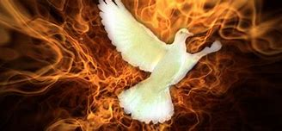
The Spirit and Jesus
Jesus quoted Isaiah in saying, "The Spirit of the Lord God is upon me because the Lord has anointed me.” Peter proclaimed that the prophecies about God sending the Spirit had been fulfilled at Pentecost. These prophecies describe a time when God's Spirit would renew men's hearts, reconcile peoples, and transform creation.
Before Jesus returns, the Spirit would bring about "a people prepared for the Lord.” These "people of the poor" would rely on God's plans and would not seek the justice of men, but of the Messiah.

Slide 16
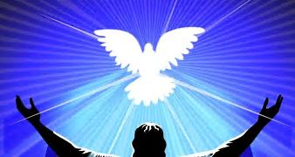
The time of fulfillment

Slide 17
John - Elijah in the Power of the Spirit
When Mary visited Elizabeth, John was "filled with the Holy Spirit even from his mother's womb.” John completed the Spirit's work of forming "a people prepared for the Lord.”
Jesus called him "more than a prophet.” John prefigured the Holy Spirit as "a voice" who bore "witness to the light.” John actually saw the Spirit descend on Jesus and he could bear witness that Jesus is "the Lamb of God.” Through John, the Spirit could begin his work of restoring man.

Slide 18
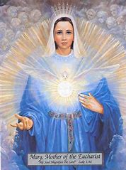
Mary - The Spirit's Masterpiece
Mary is the masterwork of the joint mission of the Son and the Spirit. She was a worthy dwelling place where the Son and Spirit could dwell among men. She is the "Seat of Wisdom." In her, the Spirit's wonders began to be manifest.
She was "full of grace" so she could carry Jesus "in whom the fullness of the deity dwells bodily.” Conceived without sin, she was capable of welcoming this inexpressible gift of the Almighty. In Mary, the Spirit fulfilled the Father's plan, making her virginity uniquely fruitful in the birth of the Son.

Slide 19
The Spirit Uniting Others in Mary
Jesus was made known first to the shepherds (representing the poor) and to the Magi (representing the Gentiles). Through Mary, the Spirit brought others into communion with Christ (Simeon and Anna, the bride and groom at Cana, and the first disciples).
Through the Spirit, Mary became the Woman, the new Eve (mother of the living), the mother of the "whole Christ" (represented by John at the cross). At Pentecost (the dawn of the end time) she was with the disciples when the Spirit inaugurated the Church.

Slide 20
Jesus - Anointed by the Spirit
The entire mission of the Son and the Spirit is contained in this - that the Son is anointed with the Spirit from the first moment of his conception. Although Christ's whole work is a joint mission of Son and Spirit, we focus here on Jesus' promise of his sending of the Spirit.

Slide 21
Revealing the Spirit Giving the Spirit
Jesus alluded often to the Spirit. He spoke of the Spirit to Nicodemus, to the Samaritan woman, and to his disciples, concerning their prayer and concerning their witnessing. At the hour of his death, Jesus promised that the Spirit would be given by the Father (in answer to Jesus' prayer) and by Jesus (at the side of the Father).
The Spirit would come and teach us everything. He would remind us of Jesus' teachings and help us to bear witness to Jesus. The Spirit would also prove that the world is wrong about sin, righteousness, and judgment.
Immediately after his Resurrection, Jesus gave the Holy Spirit to his apostles by breathing on them. At this moment, the mission of Christ and the Spirit became the mission of the Church. "As the Father has sent me, even so I send you.”

Slide 22
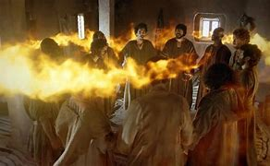
Pentecost - The Spirit's Continual Coming
On Pentecost, Christ's Passover was fulfilled by the outpouring of the Spirit who is manifested as a divine person and the Trinity is fully revealed. Those who believe in Christ come in the flesh and share in the communion of the Trinity. The Holy Spirit brings the world into "the Last Days," the time of the Church and of the kingdom

Slide 23
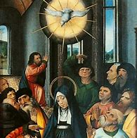
Forgiving Sins and Bearing Fruit Bringing All into God’s Communion
The first effect of the Spirit is the forgiveness of sins. Then, the Spirit gives us the very life of the Trinity which is to love "as God has loved us.”
By his power, we can "bear the fruit of the Spirit (love, joy, peace, patience, kindness, goodness, faithfulness, gentleness, and self-control). "Through the Spirit we are restored to paradise, led back to the kingdom of heaven, adopted as children, and given confidence to call God Father" (St. Basil).
This joint mission of Son and Spirit is completed in the Church bringing the faithful into Christ's communion with the Father in the Spirit. By grace, the Spirit makes present the mystery of Christ (most of all in the Eucharist) to bring men into communion with God.

Slide 24
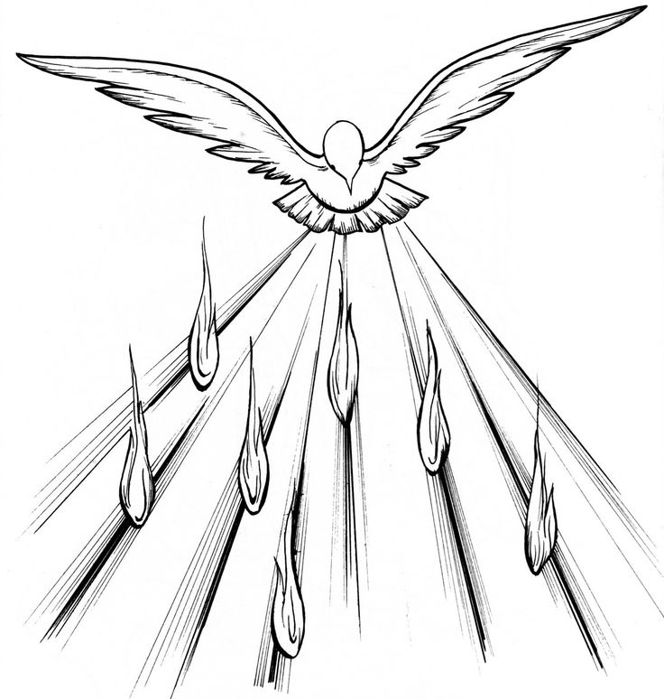
Sending the Church
The Church's mission is not an addition to the joint mission of Son and Spirit but is its sacrament. The Church announces and makes present the mystery of the communion of the Holy Trinity. "Just as the power of Christ's sacred flesh unites those who receive into one body, so the undivided Spirit leads all into spiritual unity" (St. Cyril of Alexandria).

