Slide 1
woMAN’S RESPONSE TO GOD
FAITH AND OBEDIENCE

Slide 2
By Revelation, God calls woman
By faith, woman responds to God's invitation. By this "obedience of faith" woman submits her will and intellect to God, the Revealer, because God guarantees its truth.
Abraham is the model of this obedience and Mary is the most perfect embodiment of this submission.

Slide 3
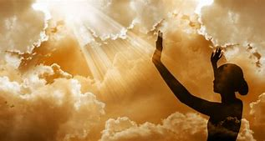
God Calls Woman
My Reflection:
In response to God’s call I submit my will and intellect to His commands and bow in humility to what He asks of me.
As Mary is the embodiment of this submission, I must emulate Mary in order to achieve obedience.
Your Reflection

Slide 4
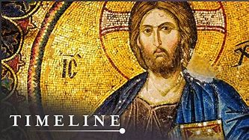
Jesus - The Perfecter
Although Hebrews praises the many Old Testament persons who "received divine approval," the author says that "something better" awaits us, namely, Jesus the "perfecter of our faith" (Heb 12:2).
My Reflection:
I am blessed to have been born at a time after Jesus came to save the world. In His care, I entrust my faith.
Your Reflection:

Slide 5
Abraham
Abraham went as a pilgrim to a strange land, even when he did not know where he was going. After his wife Sarah conceived by faith, Abraham was willing in faith to sacrifice his son, Isaac (Heb 11:17).
Being "strong in faith" Abraham became the "father of all who believe" (Rom 4:11).

Slide 6
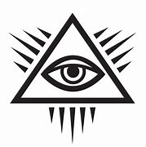
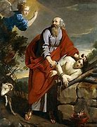
Abraham
My Reflection:
Would I have the courage to leave my home and go to a strange new land unquestioningly? Would I respond with blind obedience to what God asks of me? And would I be willing to sacrifice my own child as Abraham was?
A faith as strong as Abraham’s must be hard to achieve. I must pray for the grace to increase my faith.
Your Reflection:

Slide 7
Mary - The Purest Realization
By the "obedience of faith" Mary welcomed the angel and gave her consent: "Let it be done to me according to your Word" (Lk 1:37-38). Elizabeth praised her for believing that "The Word spoken to you would be fulfilled". Because of her faith, Mary is blessed by all generations to come.
Because Mary's faith never wavered, the Church venerates her as the purest realization of faith.

Slide 8
Mary - The Purest Realization
My Reflection:
May I have the courage of Mary to accept God’s will for my life, and not to complain if things don’t seem to be going my way
Your Reflection:

Slide 9
A Unique, Personal Adherence
Faith is a personal adherence to God and a free assent to all that God has revealed. Because we entrust ourselves fully to God, it is different from any faith we place in a human person.

Slide 10
Personal Reflections:
I choose by my free will to have faith in my savior.
I trust fully in the Lord My God.
The holy spirit is the guardian of my faith

