Slide 1
The Canon of Scripture
Based upon the apostolic Tradition, the Church discerned 73 inspired books (46 Old Testament books and 27 New Testament books).

Slide 2
Permanent Value of Old Testament
The Old Testament books are divinely inspired and have permanent value.
The Old Testament was oriented to prepare for Christ and the books are a storehouse of sublime teaching and sound wisdom.
The Church always venerated the Old Testament books and condemned Marcionism (a heresy claiming that the Old Testament was void).

Slide 3
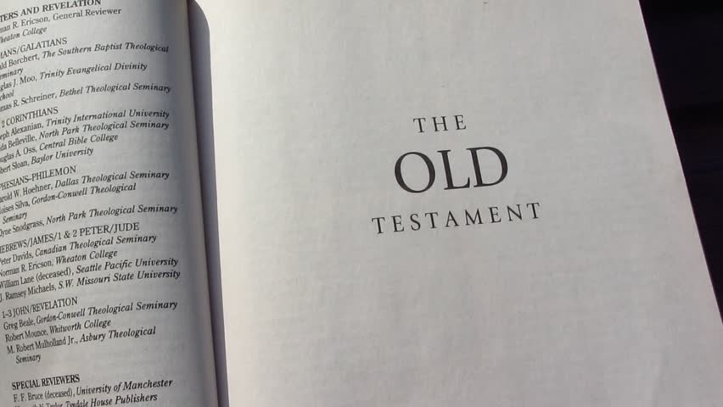
Permanent Value of Old Testament
My Reflection:
In keeping with my faith, I must believe that the Old Testament Books were inspired by God, were written in preparation for Christ, and contain the wisdom of the Holy Spirit. I should reject those teachings that claim otherwise.
Your Reflection:

Slide 4
Gospels - The Heart of the New Testament
The central object of the New Testament is the acts, passion, and glorification of Jesus Christ and his Church's beginnings under the Spirit.
The Gospels are the heart of all the Scriptures and the principle source of Christ's life and teachings.

Slide 5
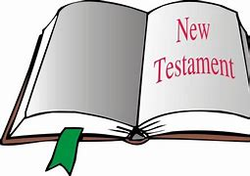
The New Testament
My Reflection:
I trust that the New Testament will inspire me to a greater faith in Jesus, His Passion, Death, Resurrection, and the Descent of the Holy Spirit. I will respect the gospels as the only true account of Christ’s life and teachings.
Your Reflection:

Slide 6
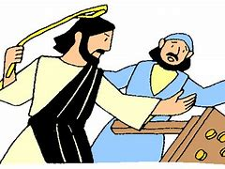
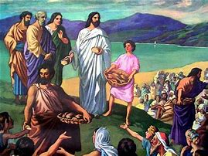
The Gospel’s Three Stages of Formation
What Jesus Did While Living Among Us
What the four authors selected to be written and which was shaped according to the situation of their churches
What the Church, under the Spirit's power, taught orally about Jesus after his Ascension

Slide 7
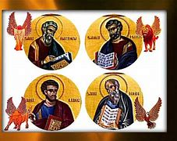
Three Stages of Formation
My Reflections:
The life of Jesus is an open book which can serve as a daily example of how to live our own lives. Even if we can never be perfect as Jesus is perfect, we can look at his activities and try to act according to what He said and did.
The church is our guide when we have questions regarding the choices we make here on earth. Sometimes it is hard to interpret the bible to understand how we are to act in certain situations. The church through its catechism then becomes the word of Jesus spoken through His church.
The evangelists have brought the words of Jesus down to us through the gospels. We rely on their God given wisdom and on the inspiration of the Holy Spirit as we try to pattern our lives according to the principles by which Jesus lived and died.

Slide 8
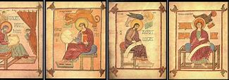
Three Stages of Formation
Your Reflections:

Slide 9
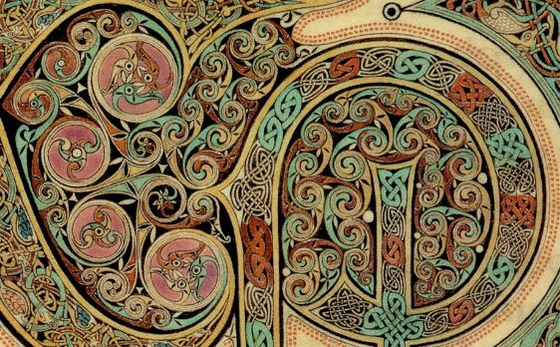
Old and New - Light for Each Other
The Church has shown the unity of God's plan by seeing Old Testament "types" which prefigure what Christ accomplished.

Slide 10
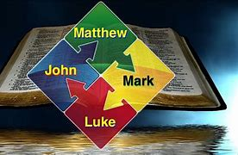
Old and New
Because the Old Testament retains its own intrinsic value, the New Testament must be read in light of the Old (as the early Christians always did). "The New Testament lies hidden in the Old and the Old is unveiled in the New" (St. Augustine). Old Testament events (such as the call of the Patriarchs and the Exodus) have value in God's plan even though they were intermediate stages.

Slide 11
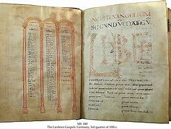
Old and New
My REFLECTION:
YOUR REFLECTION
It is difficult to study the New Testament in light of the Old Testament, but if this is how the gospels were written—inspired by people and events in the Old Testament—then we must exert the effort to understand the relationship of the Old Testament to the life and truth that is Jesus Christ.

Slide 12
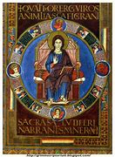
Life in God's Word
Everyone must have access to the Bible. The Word of God must be the soul of theology (in all its forms) and of the ministry of the Word. Especially, the homily must be nourished by Scripture. By reading Scripture, the faithful learn the "surpassing knowledge of Jesus Christ." "Ignorance of the Scriptures is ignorance of Christ"
(St. Jerome).

Slide 13
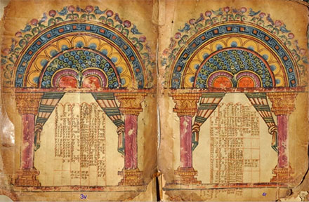
Life in God’s Word
Your reflection
My reflection
I have not always had access to the Bible as we were discouraged to read it in Catholic school, but I realize its value now and must follow its dictates. I must learn to love the word of God as it is Jesus Himself.

