Slide 1
Scripture must be interpreted in light of the Spirit who wrote the Scriptures.
INTERPRETER OF SCRIPTURE

Slide 2
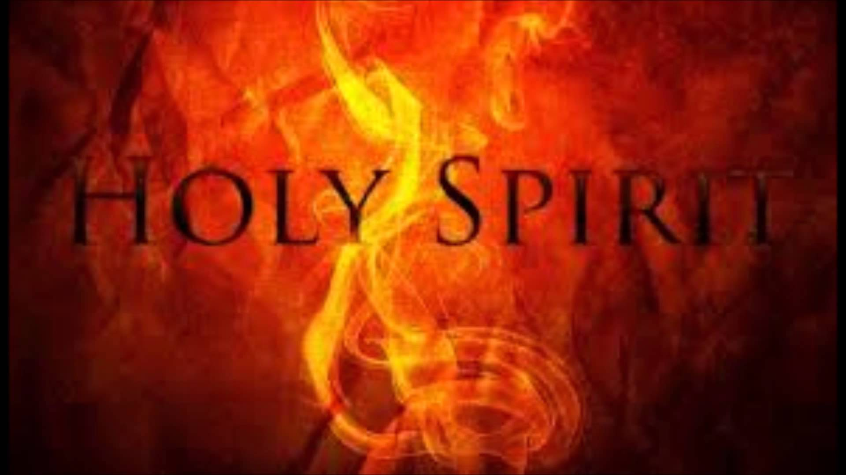
Attentiveness and Study Needed
The correct interpretation of Scripture demands attentiveness to what the human author wanted to say and to what God wanted to reveal.
Discovering the human author's intention demands a study of the culture, the modes of narrating, and the different forms of writing (history, poetry, prophecy, etc.).

Slide 3
Attentiveness and Study Needed
My Reflection: Attentiveness is crucial to the correct interpretation of Scripture. I think attentiveness means more than awareness; it means a serious focus on study of Scripture must be developed.
Your Reflection:
My Reflection: It seems to require a kind of pre-study of the pervading culture and language of the time when Scripture was written. Or do we depend on the clergy to have established this pre-study for us?
Your Reflection:

Slide 4
Correct interpretation requires that the reader:
Be attentive to the "content and unity of the whole Scripture." God's plan (in the Old and New Testament) has a unity in Christ. "Sacred Scripture, like the ‘heart of Christ' was closed before the Passion. Since the Passion, the Scriptures have been opened" (St. Thomas Aquinas).
Read the Scriptures within the Church's living Tradition. "According to the spiritual meaning which the Spirit grants to the Church" (Origin).
Apply the "analogy of faith" (the coherence of all truths among themselves and within God's plan).

Slide 5
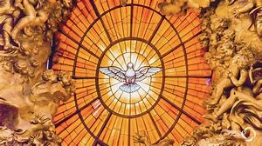
THE READER
My Reflection: Content and unity seem to be imperative in studying Scripture, realizing that the Old and New Testaments are united in Christ and that the Passion of Christ reopened Scripture for us.
Your Reflection:
My Reflection: We must read Scripture in the light of Tradition which was inspired by the Holy Spirit.
Your Reflection:
My Reflection: I must learn to understand what is meant by “the analogy of faith,” a concept I am unfamiliar with, but which has something to do with the coherence of all truths according to God’s plan.
Your Reflection:

Slide 6
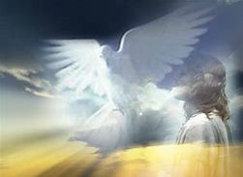
Three Spiritual Senses
Scripture has both a literal sense (the words themselves) and three different spiritual senses:
Allegorical sense - Recognizing events in the light of Christ (the parting of the Red Sea) as a sign of Baptism
2. Moral sense - Using as a help to act justly
3. Anagogical sense - Seeing the truths in light of eternal happiness
All interpretation is subject to the Church and exegetes must help the Church form a firmer judgment. "I believe in the Gospel because of the authority of the Church" (St. Augustine).

Slide 7
Three Spiritual Senses
My Reflection: The Allegorical meaning I think, would be the most difficult to absorb unless we have some idea about the images popular during the author’s time.
Your Reflection:
My Reflection: The moral sense although sometimes difficult to implement in real life, would be the simplest to understand and apply.
Your Reflection:
My Reflection: I have never had experience with interpreting anything using the anagogical sense. I have to familiarize myself with this concept before I can apply it to the study of Scripture.
Your Reflection:

