Slide 1
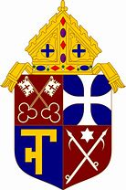
Interpretation of the Faith Heritage
The Apostolic Teaching

Slide 2
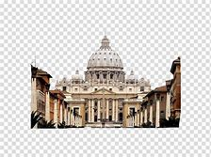
Giving an authentic interpretation of God's Word (written or oral) belongs to the teaching office of the Church, that is, to the bishops in communion with the Pope, who exercise their authority in Jesus' name.
An Authentic Interpretation
This Magisterium is not superior to God's Word, because the Church teaches what has been handed down by the Spirit, expounding God's Word from the single deposit of faith.

Slide 3
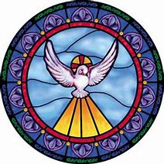
Dogmas - Proposed Truths
The Church proposes truths which are actually contained in or have a necessary connection with Divine Revelation. The faithful must adhere to these dogmas by faith.
Dogmas and the spiritual life are connected because dogma illuminates the path of holiness. The person should welcome this light.
All dogmas are connected and coherent. They have a "hierarchy" since they vary in their relationship to the Church's foundation.
The dogmas of the Church are to be believed by faith alone. Please grant me the gift of faith,Lord, and allow me to appreciate the divine truths of your Church on earth.
That dogma illuminates the path to holiness is a profound truth. Studying the dogmas more fully, will I hope grant me the grace to use the lessons they teach to improve my spiritual life.
The hierarchy of the dogmas is not within my current knowledge, but I hope to read about them more diligently in order to comprehend their coherence.

Slide 4
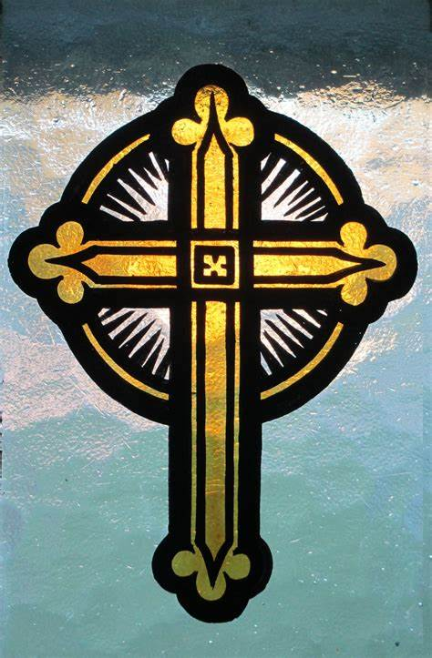
Dogmas - Proposed Truths
The Church proposes truths which are actually contained in or have a necessary connection with Divine Revelation. The faithful must adhere to these dogmas by faith.
Dogmas and the spiritual life are connected because dogma illuminates the path of holiness. The person should welcome this light.
All dogmas are connected and coherent. They have a "hierarchy" since they vary in their relationship to the Church's foundation.
Your reflections:

Slide 5
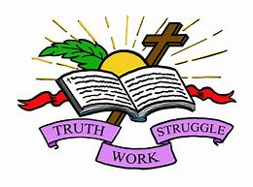
The Inability to Err/ Ways of Growing in Faith
All the faithful, anointed by the Spirit, can understand and reflect on these truths.
When the bishops and the faithful, by their supernatural appreciation of faith manifest a universal consent in matters of faith or morals, the whole body of the faithful cannot err.
The People of God, guided by Church's Magisterium, can adhere to these truths and apply them in daily living.
My Reflection:
The anointment by the Spirit is crucial to understanding and the supernatural appreciation of faith. May I be guided to adhere to these truths and apply them.
Faith grows by the study of believers, by theological research, by reading the Scriptures and by preaching.
Sacred Tradition, Sacred Scripture, and the Magisterium of the Church are so connected that one cannot stand without the others.
I have been trying to study not just the truths of my faith, but the truths of other faiths as well, thinking to link them in terms of a common message. I’m not sure how exactly the church itself is connected to Sacred Scripture and Tradition, it must be through the Magisterium of the Church.

Slide 6
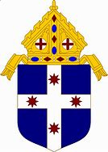
The Inability to Err/ Ways of Growing in Faith
All the faithful, anointed by the Spirit, can understand and reflect on these truths.
When the bishops and the faithful, by their supernatural appreciation of faith manifest a universal consent in matters of faith or morals, the whole body of the faithful cannot err.
The People of God, guided by Church's Magisterium, can adhere to these truths and apply them in daily living.
Your Reflection:
Faith grows by the study of believers, by theological research, by reading the Scriptures and by preaching.
Sacred Tradition, Sacred Scripture, and the Magisterium of the Church are so connected that one cannot stand without the others.
Your Reflection:

Slide 7
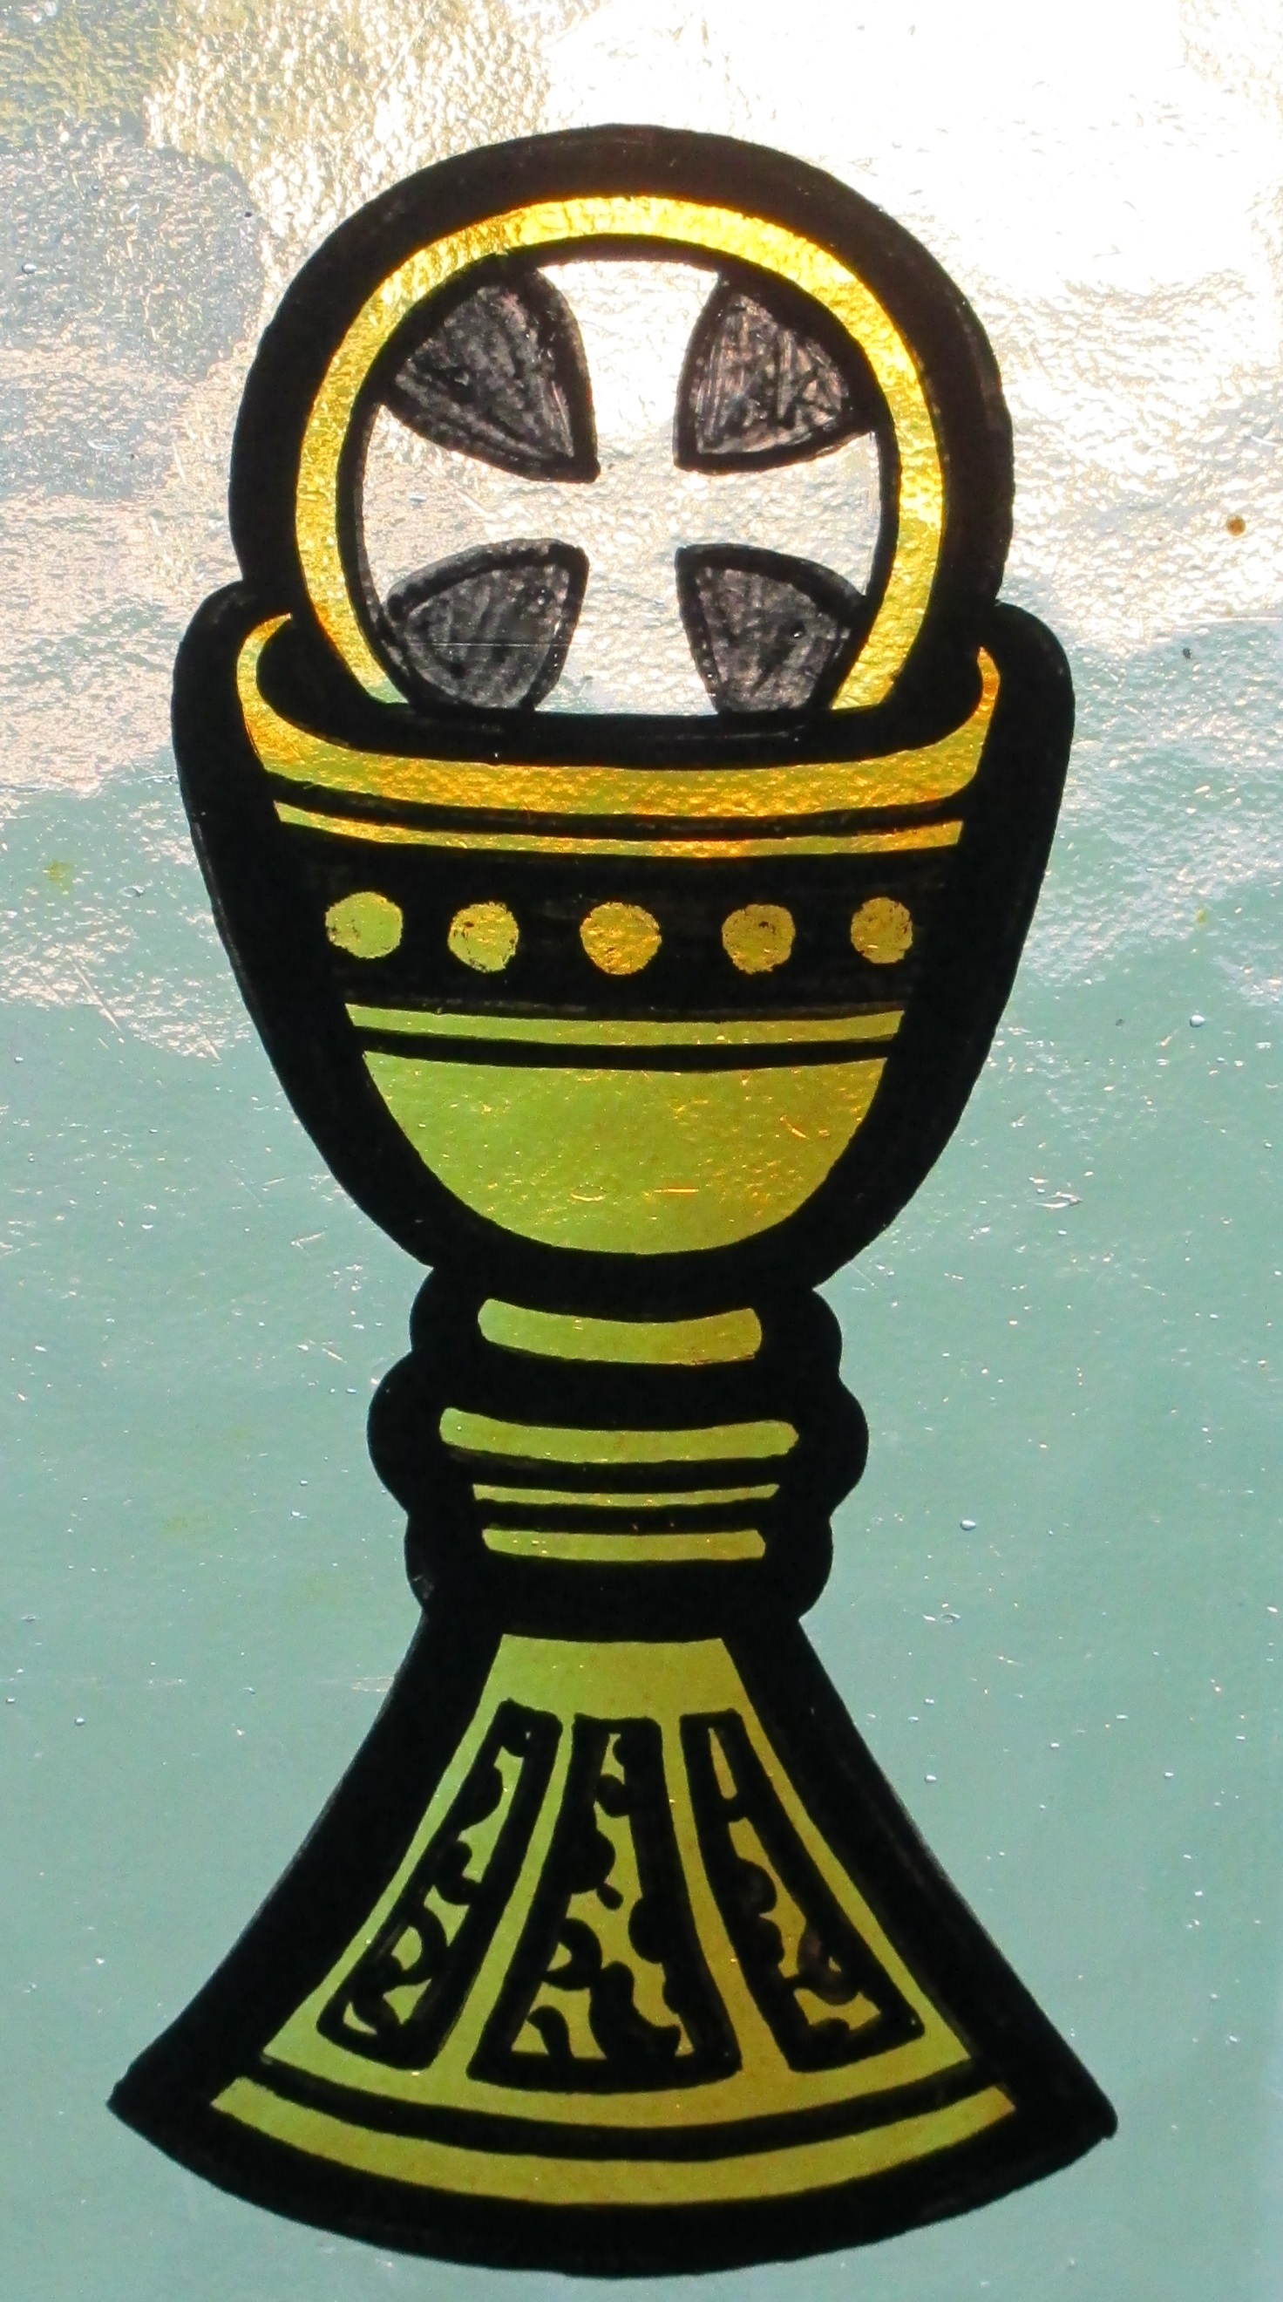
God Uses Words to Speak
Just as the Lord Jesus took the nature of man, so God speaks to us in the words of men.
Throughout Sacred Scripture, God speaks one Word which expresses himself completely. "One and the same Word of God extends throughout Scripture. One and the same utterance resounds in the mouths of all the sacred writers" (St. Augustine).
Therefore, the Church venerates the Scripture as she does the Lord's Body. She feeds all the faithful from the one table of God's Word and Christ's Body.
My reflection: I understand that God needs to speak to us in our own words, and I must believe that His word is the only thing that matters and that it is unchangeable. So, we as the faithful, need to venerate Scripture as we do Christ’s Body.

Slide 8
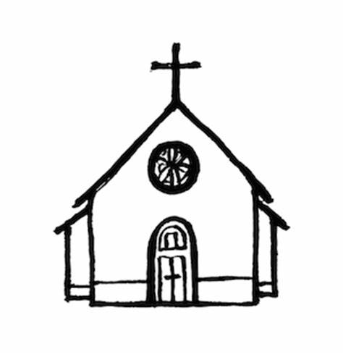
Written by God Who Used Human Authors
God is the author of Sacred Scripture because it has been written under the guidance of the Holy Spirit. The Church accepts as sacred and canonical all of the books of the Old and New Testament, whole and entire, with all their parts.
Because all that the human author wrote was affirmed by the Spirit, these books teach faithfully and without error what God wanted to reveal for our salvation.
Nevertheless, the Christian faith is not a "religion of the book" but of the living Word of God .
God chose and inspired certain men who used their own powers in writing. The Spirit showed them what he wanted written and no more. They were still true authors.

Slide 9
Written by God Who Used Human Authors
My Reflection:
As the church accepts all the books of Scripture as sacred, so should my response be as well.
Your Reflection:
My reflection:
The men who were inspired by the Spirit to write the word of God used their own powers of writing as well.
Your Reflection:
My reflection:
Scripture is without error, but Christianity is not just a religion of the book, but of the Living Word of God.
Your Reflection:

