Slide 1
Christ Jesus
Fullness of all revelation

Slide 2
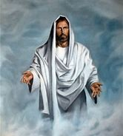
Content Layout
God’s Final and Complete Word
Private Revelations
Intact and Transmitted
Two Forms
The Bishops and Tradition
Same Source and Goal
Two Modes: Scripture and Tradition
What the Apostles Learned

Slide 3
God’s Final and Complete Word
Images | My Meaning
Insurpassable Word | Cannot be argued
No Other Word | The only word that exists
Plan of Salvation | How to attain everlasting life
No New Public Revelation | Not to expect anything else
Christian Revelation | What God has revealed to us
Not Yet Completely Explicit | Additional explanations forthcoming
In his own unsurpassable Word, God has said everything. There will be no other word. "In giving us his Son, he spoke everything to us. He has no more to say" (St. John of the Cross).
Because this plan of salvation will never pass away, there will be no new public revelation. However, much in Christian revelation is not yet completely explicit.

Slide 4
God’s Final and Complete Word
In his own unsurpassable Word, God has said everything. There will be no other word. "In giving us his Son, he spoke everything to us. He has no more to say" (St. John of the Cross).
Because this plan of salvation will never pass away, there will be no new public revelation. However, much in Christian revelation is not yet completely explicit.
Images | Your Meaning

Slide 5
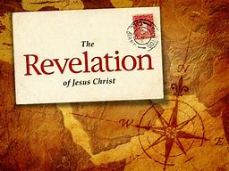
Private Revelations
Step 1
Private revelations (discerned and welcomed by the Church) do not complete Christ's definitive Revelation.
Step 2
Step 3
The Church rejects those revelations (associated with non-Christian religions and recent sects) which claim to surpass or correct Christ's revelation.
Rather, they help believers in a certain historical period to live Christ's revelation more fully.

Slide 6
Private Revelations
My Reflections
The concept of revelation is quite hard to understand especially since it has been transmitted through other people through the ages. I must pray for enlightenment and a stronger faith in order to accept and understand revelation as the true word of God.
Your Reflections

Slide 7
Intact and Transmitted
God wants everyone to be saved through Jesus Christ
(1 Tim 2:4), who must be proclaimed to all nations. Therefore, God has kept this revelation intact to be transmitted to all ages

Slide 8
Intact and Transmitted
God wants everyone to be saved through Jesus Christ.
My reflection: I believe that this is the one and only message of God that remains intact and that must give rise to any other minor messages. I will strive to absorb and understand this message in all its fullness and strive to impart it to others.
Your reflection:

Slide 9
Two Forms: The Gospel Was Transmitted in Two Forms
Orally
By their preaching, good example, and establishing institutions, the apostles passed on what they heard from Christ or were taught by the Spirit.
In writing
The apostles and others (under the Spirit's inspiration) put this message into writing.

Slide 10
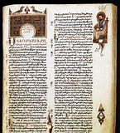
Two Forms: The Gospel Was Transmitted in Two Forms
In writing
My reflection: It is easier to understand the written word since you can repeatedly return to it, study and absorb it, and perhaps verbalize questions about the meaning.
Your reflection:
Orally
My reflection: Messages handed down orally by the Apostles, although said to have been inspired by God are more difficult to comprehend, although Christ has said that through the Holy Spirit, everything is made clear.
Your Reflection:

Slide 11
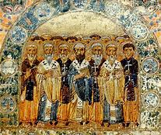
The Bishops and Tradition
The apostles established bishops as their successors with the authority to teach. This apostolic preaching, especially as expressed in the inspired books, must be preserved through a continuous line of apostolic succession.
This living transmission is called Tradition. It is distinct from, yet closely united with, Sacred Scripture.
God's revelation will always remain active and present in the Church because God still speaks to the Church, and the Spirit still leads believers into full truth.

Slide 12
The Bishops and Tradition
My reflections: Apostolic succession must be meticulously honored and preserved in the manner the Apostles would have wanted with errors or mistakes admitted and corrected by church leaders. Otherwise the message itself is compromised. Tradition, if it is to be valued and followed must be free of any unjustified human error. The faithful must pray that our Holy Spirit guide all those who continue to communicate and interpret Tradition.
Your reflections:

Slide 13
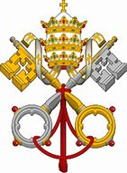
Same Source and Goal
Both Sacred Tradition and Sacred Scripture (which are bound closely together) flow from a common source and have the same goal. They make present the mystery of Christ who always remains with the Church.
My reflection: The fact that both Scripture and Tradition have the same goal and flow from the same source assures me that Christ’s bond with the Church remains strong and insoluble.
Your reflection:

Slide 14
Sacred Scripture is God's speech written under the breath of the Holy Spirit. Tradition transmits, in its entirety, the Word of God to the apostles' successors. The Church does not derive her certainty about revealed truths from Scripture alone. Both Scripture and Tradition must be equally honored.
Two Modes: Scripture and Tradition

Slide 15
My reflection: I think I often forget the importance of tradition in terms of imparting the same messages that Scripture focuses on. I need to review the Church’s sources of tradition and honor them as well. Your Reflection:
Two Modes: Scripture and Tradition

Slide 16
What the Apostles Learned
This Tradition comes from what the apostles learned from Jesus and the Holy Spirit. The first generation Church had no written New Testament and the New Testament itself shows the process of a living Tradition. This Tradition must be distinguished from various types of traditions (liturgical, theological, etc.) which grew up in local churches and is subject to Church Magisterium.

Slide 17
WHAT WE HAVE LEARNED
My Lessons: My devotion to the Holy Spirit must deepen since He is the inspiration for a true understanding of Scripture and Tradition.
I was not aware that the New Testament is itself a form of Tradition handed down by the evangelists and the Apostles. This is a truth I need to reflect on more fully.
Your Lessons:

