Slide 1
Faith and Obedience
By revelation God calls woman

Slide 2
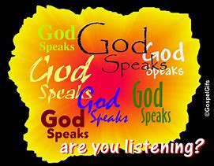
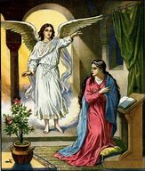
By faith, woman responds to God's invitation. By this "obedience of faith" (Rom 1:5) woman submits her will and intellect to God, the Revealer, because God guarantees its truth.
Abraham is the model of this obedience and Mary is the most perfect embodiment of this submission.

Slide 3
How do I respond to God’s invitation?
The Ten Commandments
The Commandments of the Church
The Beatitudes
The Sacrament of Holy Matrimony
Fidelity to my Husband
Loyalty to my Work Responsibilities
My Baptism
Confirmation
Reconciliation
First Communion
Faithful Companion
Grandmother
Meditative Stillness
Defender of the Faith
As Mother
Guardian of my Home
Housework and Homework
Discipline and Love

Slide 4
How do You respond to God’s invitation?

Slide 5
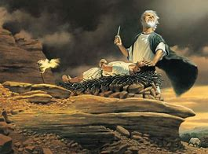
Abraham went as a pilgrim to a strange land, even when he did not know where he was going. After his wife Sarah conceived by faith, Abraham was willing in faith to sacrifice his son, Isaac (Heb 11:17).
Being "strong in faith" Abraham became the "father of all who believe" (Rom 4:11).

Slide 6
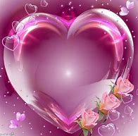
Something Better
Jesus the Perfecter
Mary - The Purest Realization
Although Hebrews praises the many Old Testament persons who "received divine approval," the author says that "something better" awaits us, namely, Jesus the "perfecter of our faith"
(Heb 12:2).
By the "obedience of faith" Mary welcomed the angel and gave her consent: "Let it be done to me according to your Word" (Lk 1:37-38). Elizabeth praised her for believing that "The Word spoken to you would be fulfilled" (1:45). Because of her faith, Mary is blessed by all generations to come (1:48).
Because Mary's faith never wavered, the Church venerates her as the purest realization of faith.

Slide 7
Something Better
How do I prepare for Jesus?
How do I emulate Mary?
Divine Approval: Does my way of life meet with God’s approval?
Something Better: Do I believe that I must make myself worthy of something better?
Perfecter of Our Faith: Am I ready to follow Jesus as I strive for perfection?
Obedience of Faith: How do I transform my spirit to be able to obey God in complete faith?
“May it be done to me according to your word.” : Am I humble enough to submit my will to God’s will the way Mary did?
“The Word spoken to you would be fulfilled.” : What are the ways that I can fulfill God’s word in my life?

Slide 8
A unique personal adherence
Faith is a personal adherence to God and a free assent to all that God has revealed. Because we entrust ourselves fully to God, it is different from any faith we place in a human person.

Slide 9
Describe your personal adherence to god
Personal Adherence
Free Assent
Entrusting Ourselves
Fully to God
Making a Difference

