Slide 1
GOD COMES TO WOMAN
Fortunately, God has revealed his eternal plan by sending his Son, Jesus Christ, and the Holy Spirit (a mystery revealed only in this final age).
God wants everyone to have access to him through Christ and in the Holy Spirit. Although "dwelling in unapproachable light" (1 Tim 6:16), God wants to communicate his life to woman. Woman can share in God's nature and live beyond her natural capacity.
God's revelation culminated in the person and mission of Jesus Christ. "The Word of God became the Son of man in order to accustom man to perceive God and to accustom God to dwell in man" (St. Irenaeus).

Slide 2
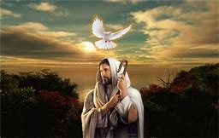
In spite of the fact that I went to Catholic school for 12 years, my understanding of Christ was less personal than I would have hoped. The term “dwelling in unapproachable light,” was indeed applicable to how I felt about my relationship with Christ.
He was too perfect, too covered in divine light, too difficult to comprehend. Why would God leave His perfect home to suffer and die for people who didn’t deserve it anyway.
I needed to mature in my faith to be able to accept that God wanted people to get close enough for Him to dwell in us, and that was the mission of Christ. We are to go through Christ to the Father with the help of the Holy Spirit.

Slide 3
What is your experience of God coming to you?

Slide 4
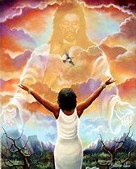
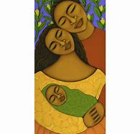
Woman’s Natural Capacity
Woman Beyond Her Natural Capacity

Slide 5
Revelation Not Destroyed by Sin
God manifested himself to our first parents and clothed them with grace. Even sin did not ruin God's plan because he immediately promised redemption.
Sin shattered man's unity. However, God said to Noah, "I am establishing my Covenant with you and your descendants after you" (Gen 9:9). God planned salvation according to groups, "each with its own language, by their families, in their nations" (Gen 10:5).
This division into nations was cosmic, social and religious. However, God's plan was always threatened by polytheism and idolatry.

Slide 6
Revelation as Truth
The truth of original sin is a difficult concept to understand particularly when you think of God being all-just. How can He punish all mankind for the sin of one man? Why are all women condemned to a life of suffering for the sin of one woman?
That the unity between God and man separated by sin, must be restored—was God’s promise to Noah. God has a plan of salvation for all men and women of all families, communities and nations. Revelation demands obedience from those of us who wish for salvation.

Slide 7
Revelation as Truth
What is your understanding of original sin?
What is your understanding of salvation?

Slide 8
Gathered Together in Abraham
To gather scattered humanity, God chose Abram and named him Abraham, "the father of many nations.” His descendants (Israel) prepared for the Church and were the root onto which the Gentiles were grafted.
God freed his people from Egypt, made a Covenant with them (through Moses on Mt. Sinai) and gave them his law. Israel is God's priestly people, the first to hear God's Word.
Through the prophets, God proclaimed a radical redemption and told his people to await a new Covenant. In the Old Testament, God used many women to keep Israel's hopes alive (Sarah, Rebecca, Judith, Esther, etc.). Among these, Mary is the purest figure.

Slide 9
Helping God Gather Us Together
What can I possibly do to help in this herculean task of bringing the peoples if the world together under God? I believe the answer lies in my writing and spreading the word of God through this means. Although my faith remains weak and immature, I believe it can also grown through the study of what I am to write in order to help evangelize others to come to Christ.
I must look for role models in the Bible and among the saints. Mary the Mother of Christ must be my icon of grace. Through the rosary, she can help enlighten my unbelieving heart.

Slide 10
Helping God Gather Us Together

Slide 11
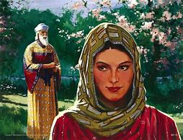
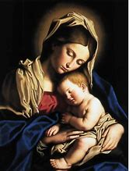
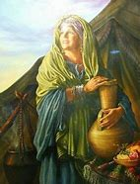
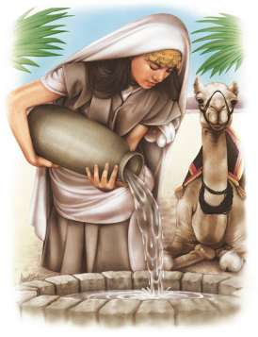
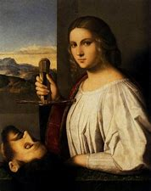
ESTHER
SARAH
MARY
JUDITH
REBECCA

