Slide 1
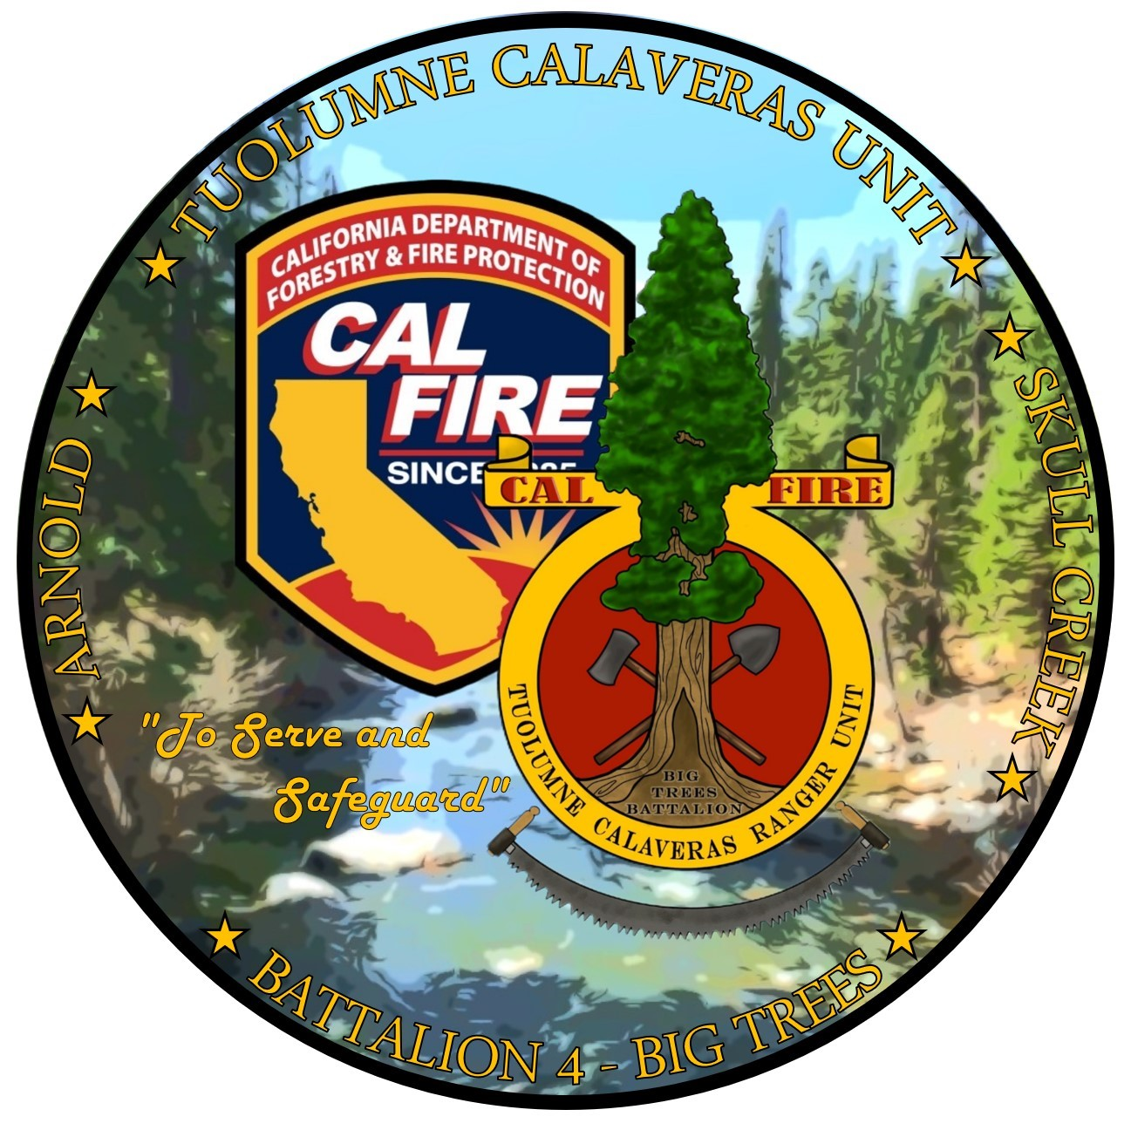
Debris Burning
How to Safely Burn Your Natural Yard Material

Slide 2
Why Do We Burn?
It is effective and efficient
Reduces the amount of hazardous fuel on your property
It is cost efficient

Slide 3
What Are The Drawbacks?
Fire is a tool
Like any tool, if used improperly, it can cause damage or injury
Burning of wet material generates smoke
This is because of the incomplete combustion process
Wet piles are not an efficient way to dispose of material
May adversely impact neighbors
Can escape your control!

Slide 4
What are my legal obligations?
The answer to this question is based on the time of year and how big your pile is, in addition to the property type.

Slide 5
What are my legal obligations?
You need to obtain the right permit
If pile size is over 4’ x 4’, you need an in person visit from CAL FIRE and a LE-5 Burn Permit
4’ x 4’ piles, permit can be obtained from https://burnpermit.fire.ca.gov/ and does not need an in-person visit
All CAL FIRE permits are free
Burn only on designated burn days
Call (209) 754-6600 and listen to whole recording until the very end
Maintain control of your burn pile at all times!

Slide 6
Times of The Year
Open Burning
Open burning is the time of year where permits are not required (Except if over five acres, required by Calaveras County Air Pollution Control)
Generally, when conditions allow for down staffing of seasonal personnel and dangerous fire conditions have moderated
Between December and May (But Not Always!)
This is the best time to conduct burning since fire danger is the lowest
Fires can and do escape during this time especially during prolonged periods without rain
Do as much of your planned burning during this time to reduce the risk of escape
More lenient rules, however same legal consequences if your fire escapes

Slide 7
Times of The Year
Permits Required
Public Resources Code requires permits between May 1 and a date when conditions are no longer conducive to frequent escapes
Generally May 1 – November 15 (But not always!)
Permits can be required at any time if the fire conditions are such that without following the terms of the permit, a fire can escape
Permits dictate pile size, criteria for burning, and how you can burn
This time should be used to finish any planned or last-minute burning of debris

Slide 8
Times of The Year
Permits Suspended
The Director of CAL FIRE or their Designee (Unit Chief or Region Chief) can suspend burning in the State Responsibility Areas at any time the threat of fire is significant.
Generally June 15 to Mid-October/Early November (But not always the case)
No debris burning is allowed during this time
If you have debris to burn, you waited too long and need to cover the pile to ensure it is ready for burning when the season allows you to do so.
Burning during this time is multiple misdemeanor crimes and can hurt your checkbook

Slide 9
What Should I Do Before Burning?
Identify an area away from buildings and flammable material
Clear an area 10’ of all vegetation down to bare mineral soil
Not doing this is the most common reason for escapes
Have a constant water source and fire tool ready to go
A garden hose with shutoff nozzle and extra working hose
Spray any vegetation outside of the 10’ cleared areas
Round point shovels or McCloud tools are good tools to use
Ensure your pile is dry and only has natural vegetation
Wet piles generate smoke
Trash, lumber, paper, etc. are all treated materials and may not be burned

Slide 10
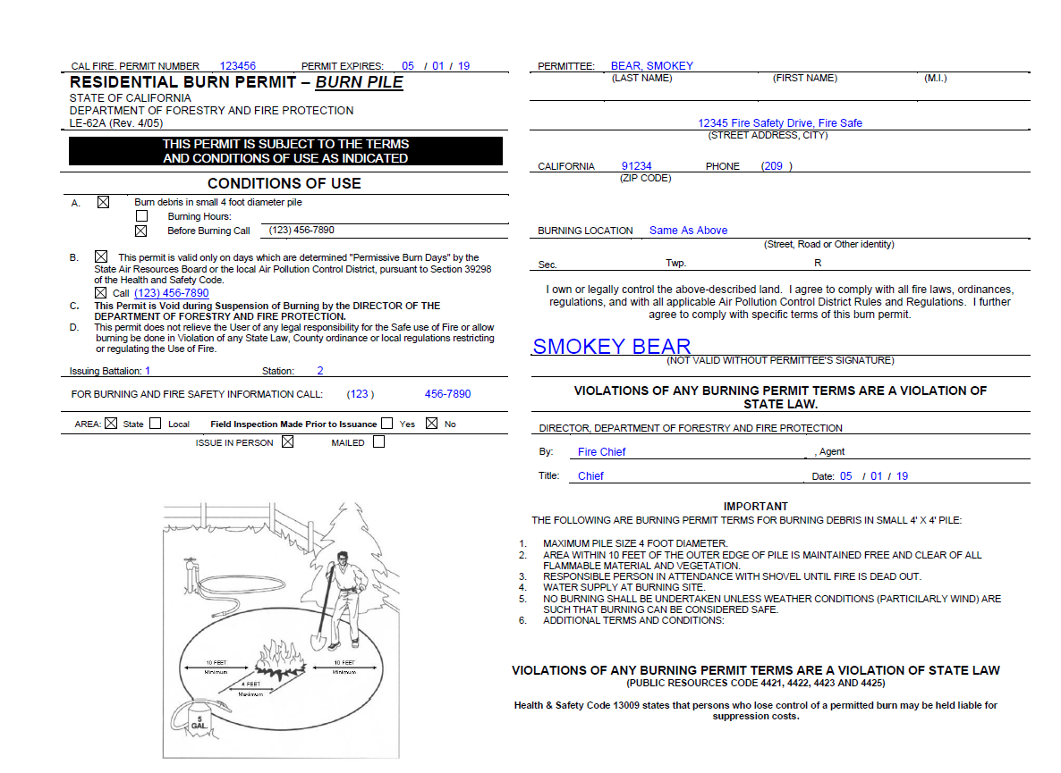

Slide 11
What Should I Do Before Burning?
Make sure you have the proper permits
Notify your neighbors
Avoids mistaken 911 calls
Make sure it’s a burn day

Slide 12
What Should I Do While Burning?
Have your burn permit with you
A burn permit “back in the house” is not a permit
A responsible adult must remain in attendance
Attendance means able to react to an escape
Ensure the pile remains in your control

Slide 13
Can I Burn Debris in an Incinerator or Burn Barrel?
No
The California Air Resources Board has allowed each individual Air Pollution Control District to authorize or ban burn barrels or incinerators as a mean of disposal.
Calaveras County has banned the use of burn barrels and incinerators for debris disposal.

Slide 14
What Should I Do After Burning?
Ensure the fire is out cold
Spray water and mix around the ashes with your fire tool
Would you feel comfortable putting your hand inside the ashes?
If no, put more water on it.
Check it regularly for the next two days to ensure no hidden heat has generated enough heat to start burning again.
Piles not completely extinguished have come back to life months after the initial burn
Leave your garden hose nearby and ready to use until you feel confident the fire is completely out

Slide 15
When Should I Not Burn?
Do not burn on windy days
Do not burn on rainy days
Wet piles generate more smoke and will not burn complete
Cover piles to prevent them from getting wet
If you cannot stay with your burn pile
If you cannot provide clearance
During a burn suspension
When it is hot and dry
Early morning or evening hours are better due to higher humidity levels

Slide 16
What Are The Consequences For Not Following These Rules?
Loss of Control
Fires escaping your control are a misdemeanor in California
Fires burning on to your neighbor's property may result in civil and/or criminal liability
The cost of extinguishing a fire by CAL FIRE may be billed back to you
Terms of Permit
Not following the rules on the permit render the permit null and void
This means you have no permit
No permit when required is a misdemeanor crime
Burning during permits suspended is a misdemeanor crime

Slide 17
What Are The Consequences For Not Following These Rules?
Burning on no burn days
Burning on a no burn day is enforced by Calaveras County Air Pollution Control District
May assess a fine into the thousands of dollars

Slide 18
Common Excuses/Misconceptions
It’s ok to burn right after the first rain
Not at all, always call first, conditions may still not be suitable
I’ve lived here for years I know what I’m doing
Most violators are local residents
These rules/laws have been around for just as long

Slide 19
Closing Out
Burn piles do not escape when you follow these rules
When in doubt, don’t burn
If you have questions, call us, we still make house calls

Slide 20
Questions?

Slide 21
Contact Us
Arnold CAL FIRE
2517 State Highway 4
Arnold, CA 95223
(209) 795-1542
Murphys CAL FIRE
33 Apple Blossom
Murphys, CA 95247
(209) 728-0398
Altaville CAL FIRE
125 N Main Street
Angels Camp, CA 95222
(209) 736-2037
San Andreas Headquarters
785 Mountain Ranch Road
San Andreas, CA 95249
(209) 754-3831
Online Burn Permits
https://burnpermit.fire.ca.gov/

