Slide 1
Music Questionnaire

Slide 2
Here are your questions
What was the first rock band to successfully combine their music with the music of different cultures?
What band was the first to use “sampling” or loops (sounds or small sections from other songs) in the recording studio much like today’s rap and R + B artists?
What band is the most covered band in History?
What band sold more albums in the United States than any other artist in History? (Billions)
What band was one of the first to use distorted guitars and successfully record a song with beginning elements of heavy metal?
What was the first band to have a more aggressive style of stage presence?
What band was the first to popularize the standard rock quartet setup, consisting of drums, guitar or two, bass and vocals?

Slide 3
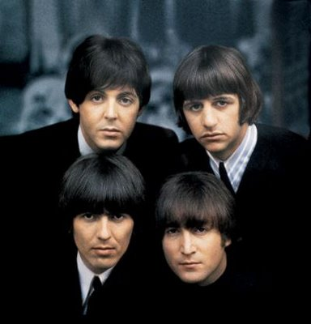
Answer?
Paul McCartney
Ringo Starr
George Harrison
John Lennon

