Slide 1
The DuBois Circle Celebrates its 110th Anniversary.
Closing Program Presentation
Tuesday, May 17, 2016

Slide 2
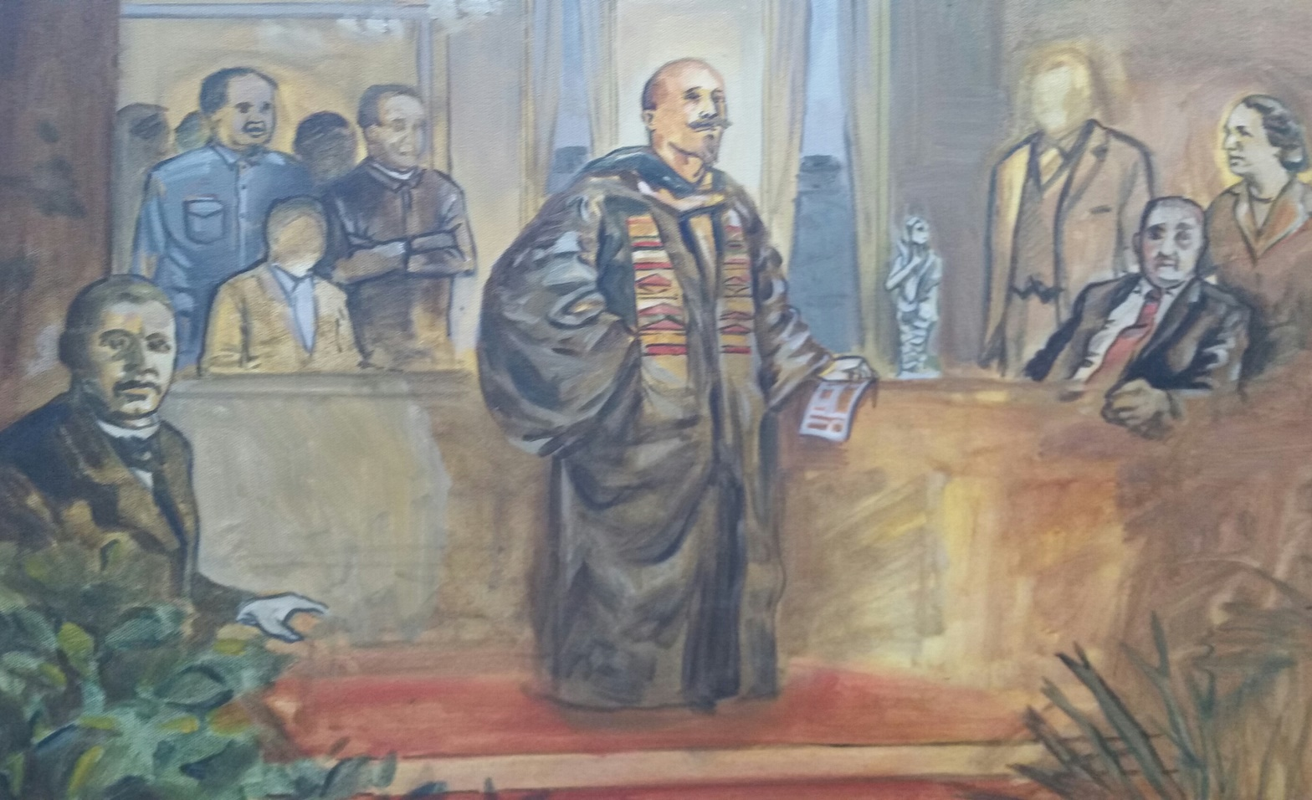
In 1905, William Edward Burghardt DuBois met at the Lyric Theatre in Baltimore, MD with 29 African-American ministers, educators, and other professionals to form an organization, The Niagara Movement, to address the social, political, and economic injustices faced by African Americans.
1905

Slide 3
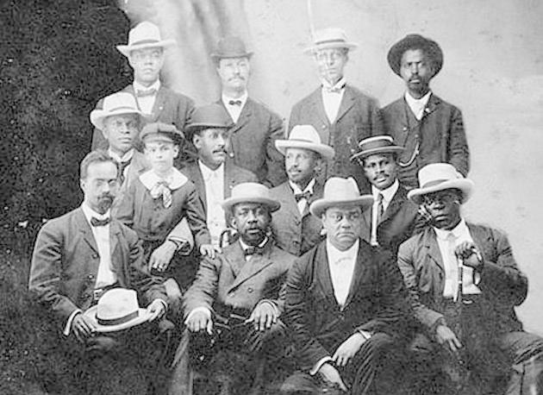
Dr. Garnet Waller, founder of the Niagara Movement, organized a group of women for a special auxiliary committee to serve as hostesses for a meeting. Founders of The Niagara Movement Fort Erie, Ontario, July 1905
1905

Slide 4
On January 6, 1906, the committee became known as The DuBois Circle. Pictured: Miss Carolyn Cook, Mrs. Marjorie Hawkins, and Mrs. Minnie Gaines; Not Pictured: Mrs. G. R. Waller and Mrs. Eva Jenifer
1906

Slide 5
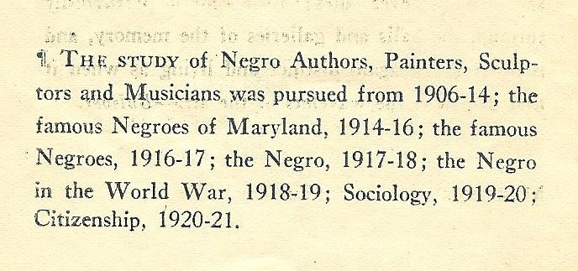
Early Years of The DuBois Circle The DuBois Circle Studies the African American in Society.
1906-1921

Slide 6
The DuBois Circle Celebrates its 16th Anniversary and Focuses on the Opera.
1921-1922

Slide 7
Early Years of The DuBois Circle In 1926 The DuBois Circle Celebrates its 25th Anniversary.
1926

Slide 8
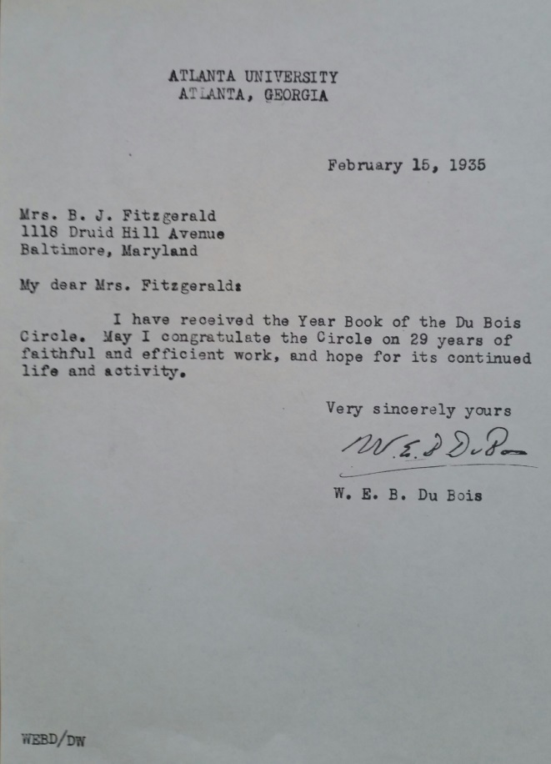
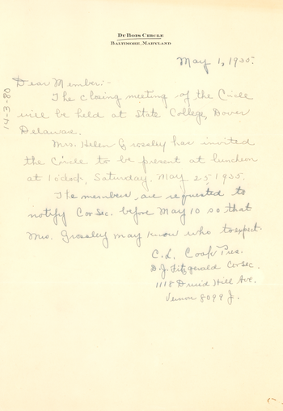
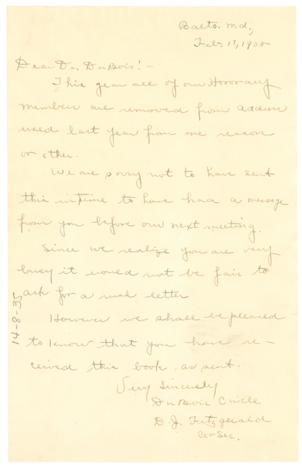
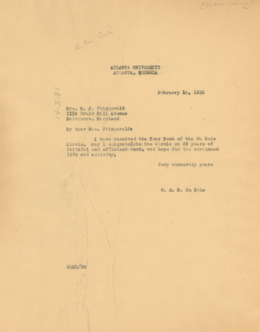
1935
Early Correspondence
Letters from The DuBois Circle Members B.J. Fitzgerald and Mrs. Caroline Cook, President, to W.E.B. DuBois and his reply (The DuBois Circle Archives and Special Collections and University Archives, University of Massachusetts Amherst Libraries MS 312)

Slide 9
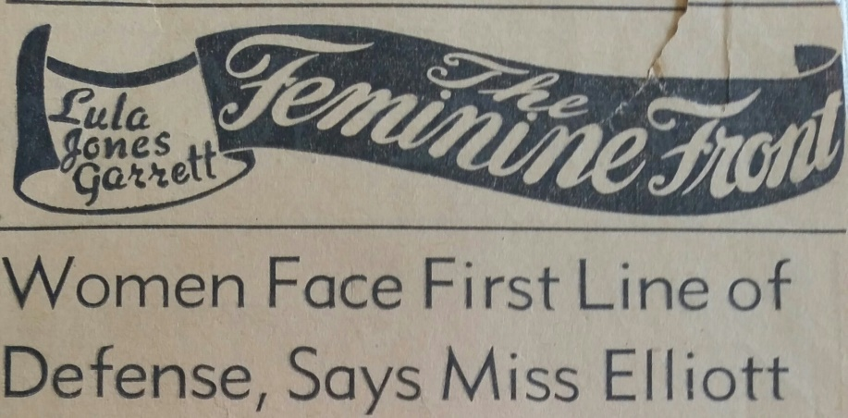
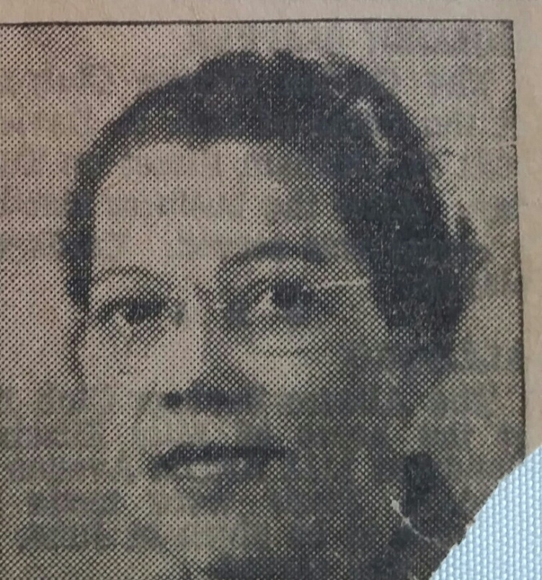
The DuBois Circle Post WWII In 1946 Miss Susie Elliott, Dean of Women at Howard University, spoke of the “Role of Women in a Changing World”
1946

Slide 10
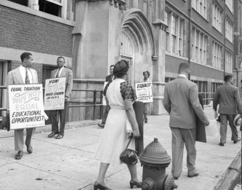
The DuBois Circle Post WWII
1949
In 1949, The DuBois Circle sent a letter to Maryland’s Governor and Commissioner of Higher Education urging the University of Maryland system to open its graduate departments to African Americans.

Slide 11
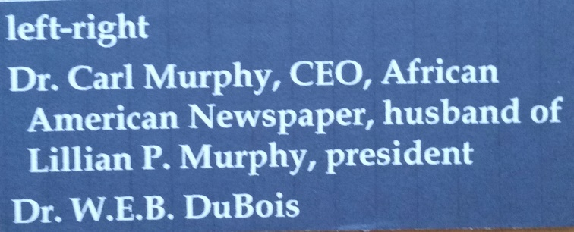
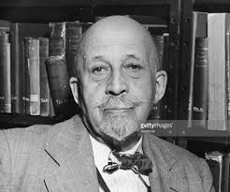
1950s
Dr. William Edward Burghardt DuBois
February 23, 1868 – August 27, 1963

Slide 12
Maryland Historical Society The DuBois Circle Manuscript Collection Inventory List Special Collections Department
1923-1978
BOX 3 Folder 1: DuBois Circle programs and Constitutions, 1923‐1964, 9 items. Folder 2: DuBois Circle Year Books, 1936 — 1949, 11 items. Folder 3: Miscellaneous (DuBois Circle Committee paper, St. James Church calling card, Birthday Greetings card), 1948; 1973; and
undated, 3 items. Folder 4: DuBois Circle booklets, 1915‐1978, 22 items. Folder 5: DuBois Circle booklets, 1949‐1957, 8 items.
Folder 6: DuBois Circle Booklets, 1957‐1976, 20 items.
Folder 7: DuBois Circle Booklets, 1949‐1956, 12 items.
Folder 8: DuBois Circle Booklets, 1956‐1973, 13 items.
Folder 9: DuBois Circle Booklets, 1941‐1949, 6 items.
Folder 10: DuBois Circle booklets, 1941; 1946; 1968, 3 items.

Slide 13
The 1968 Closing Program
1968

Slide 14
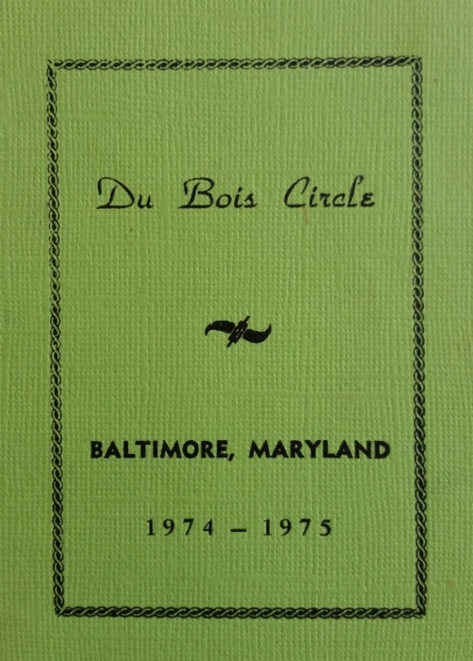
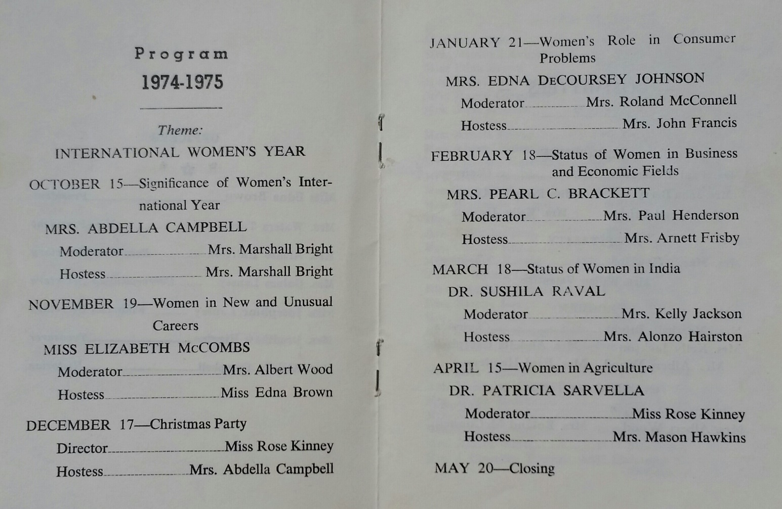
1974-75 Annual Program International Women’s Year
1974-1975

Slide 15
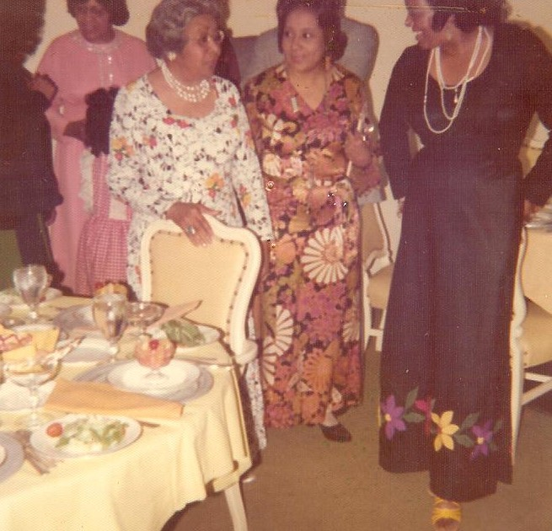
The 1975 Closing Celebration
1975
Dr. Jean Turpin, Helena Hairston, and Dr. Vivian Cook

Slide 16
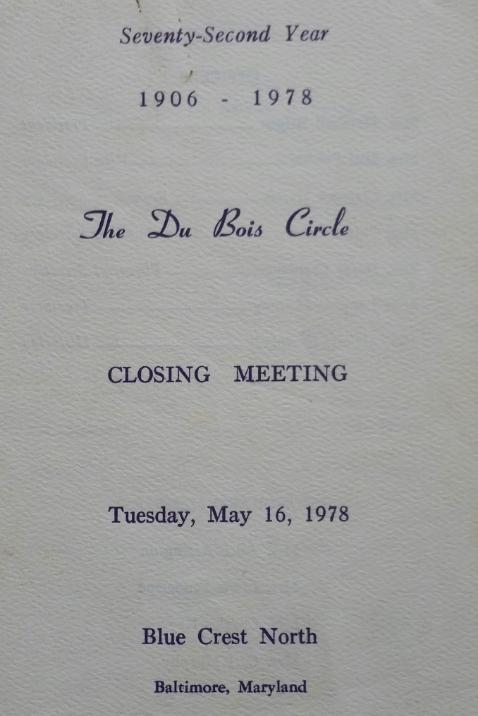
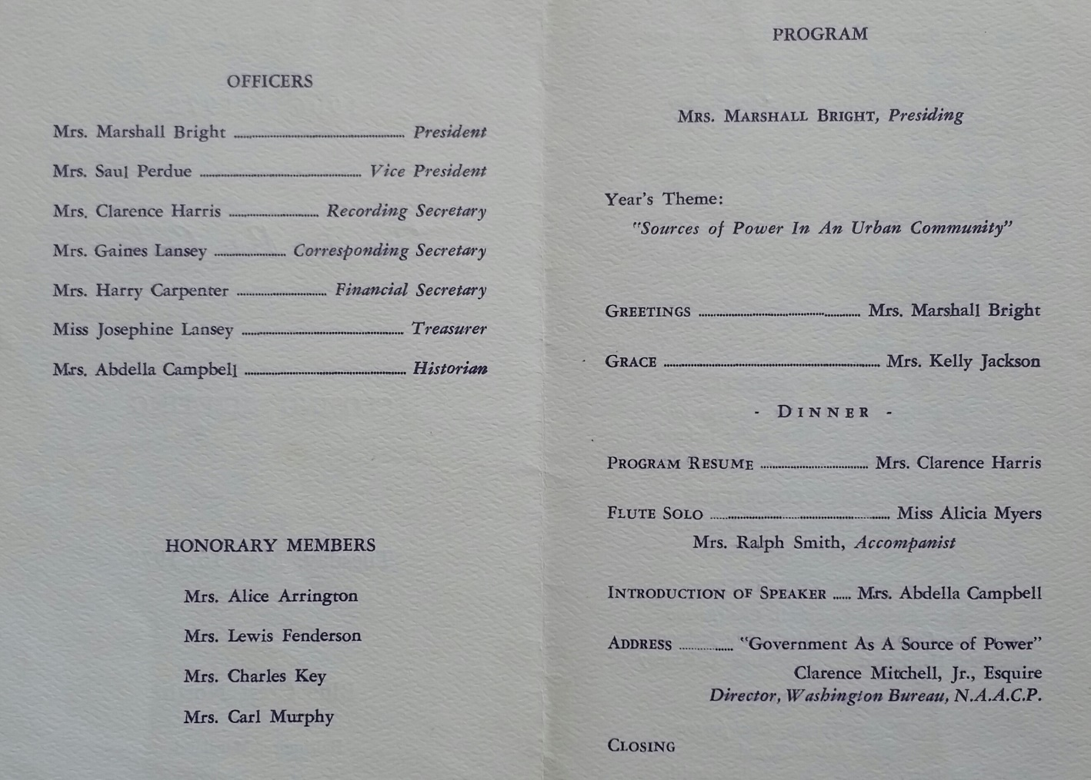
The 1978 Closing Program
1978
Sources of Power in an Urban Community
Fosters

Slide 17
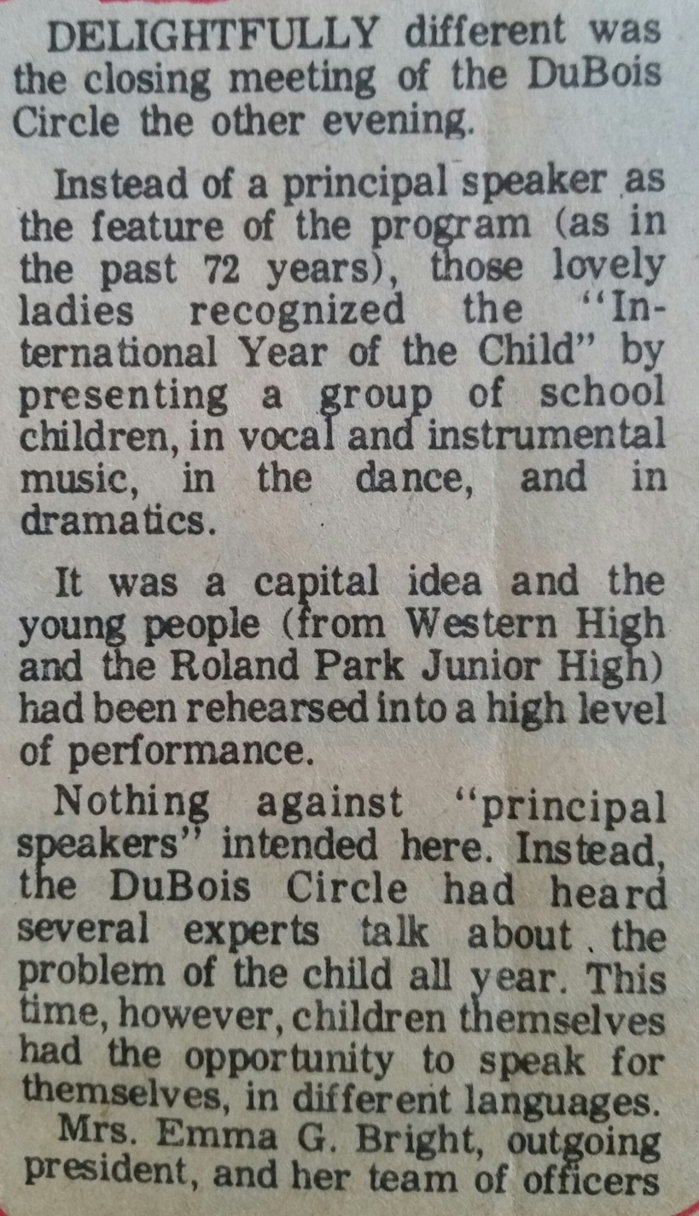
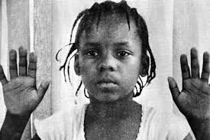
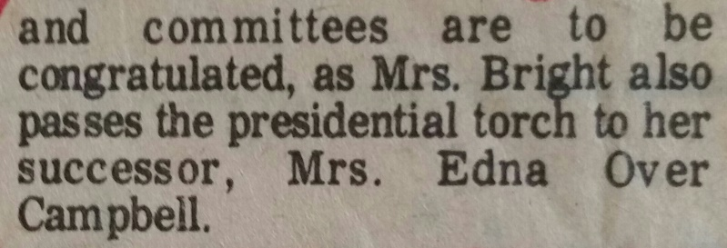
1979 Closing Program
1979
International Year of the Child

Slide 18
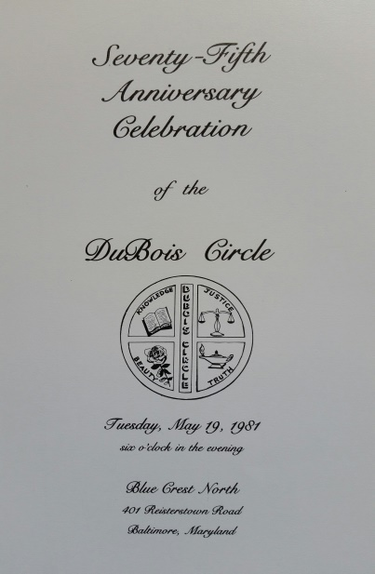
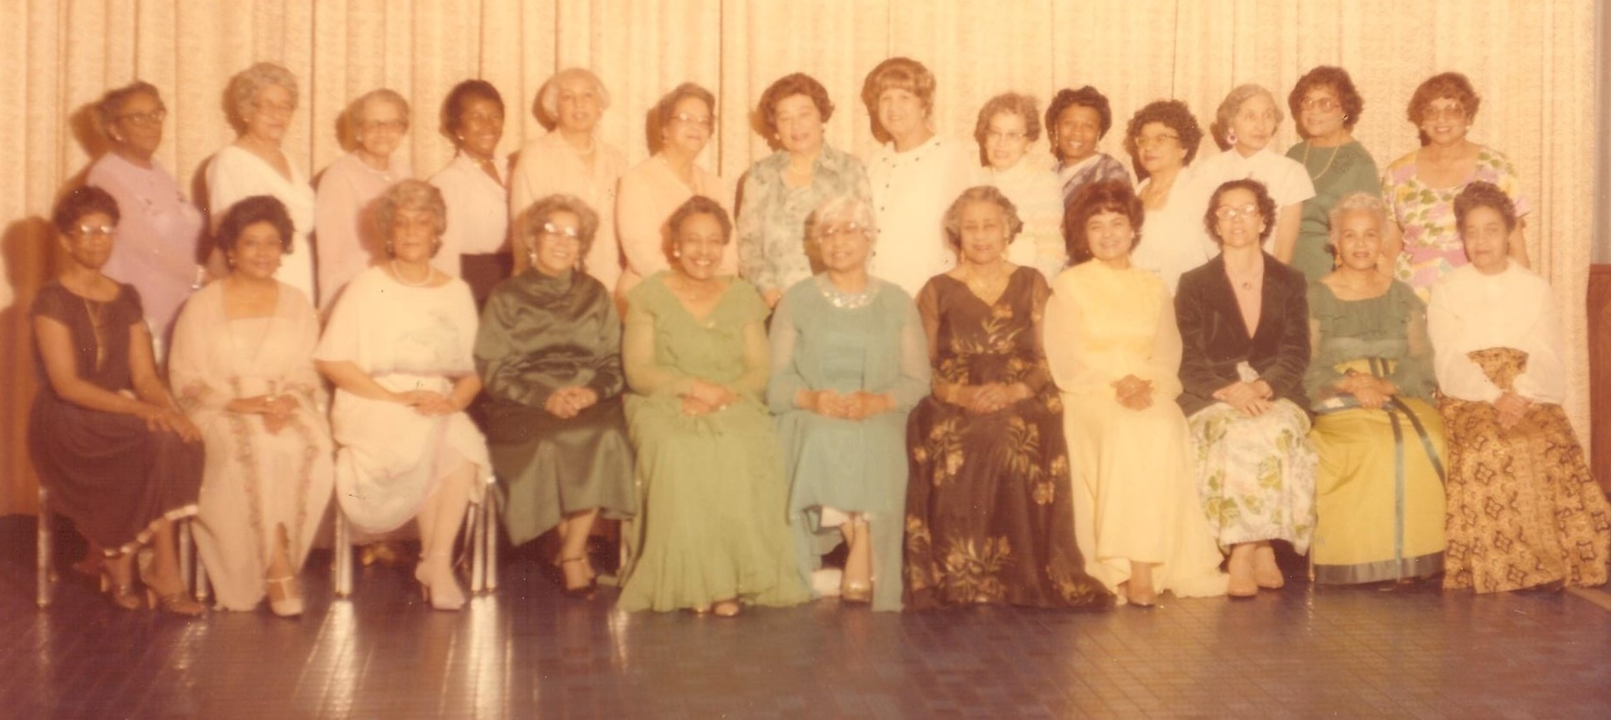
The 1981 Closing Program
1981
(In the 1980s The DuBois Circle became
officially a life member of the NAACP.)

Slide 19
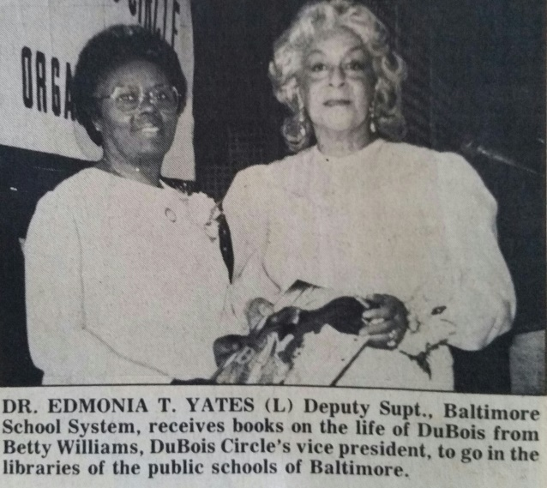
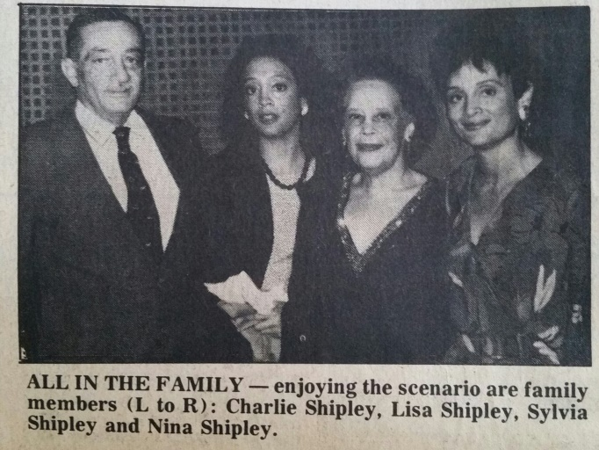
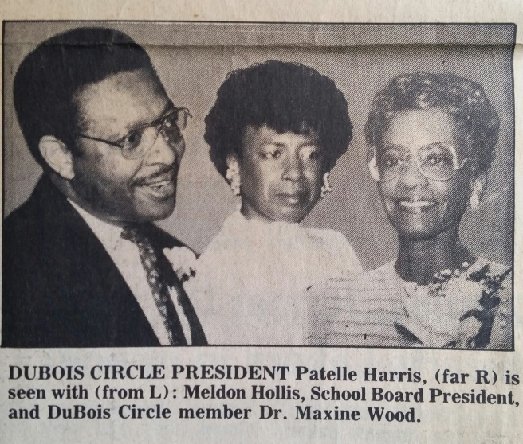
1982
Dr. Edmonia Yates and Miss Betty Williams
The Shipleys
Mr. Melvin Hollins, Dr. Maxine Wood,
and Miss Patelle Harris

Slide 20
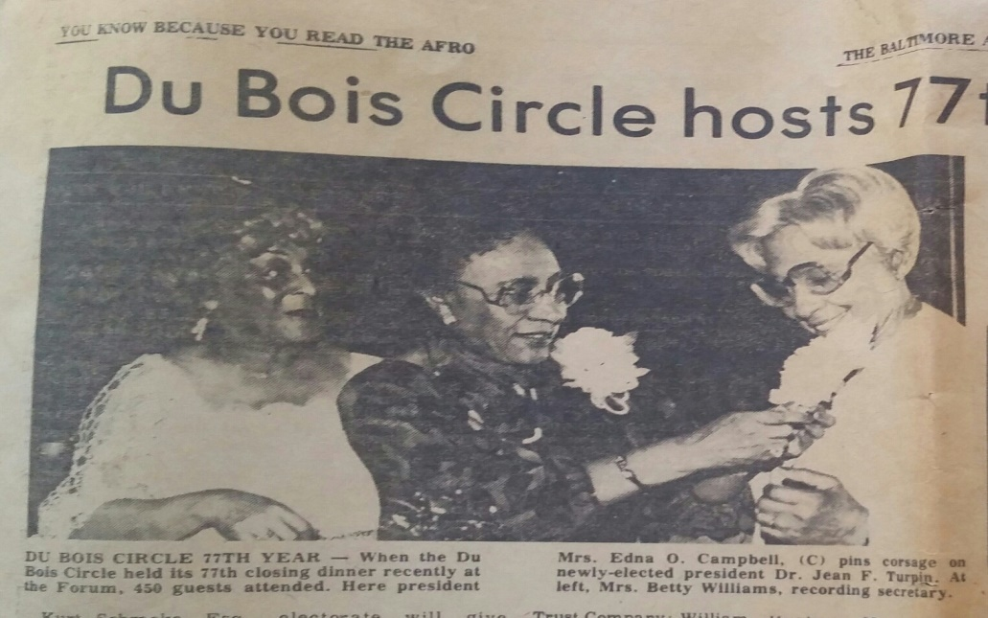
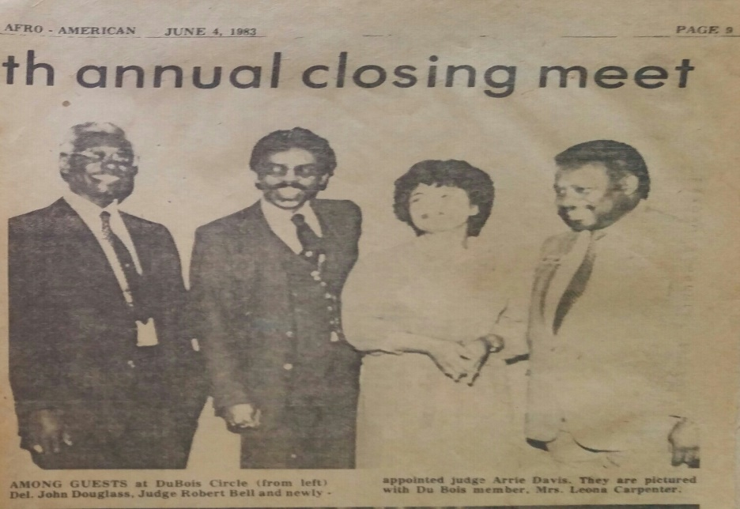
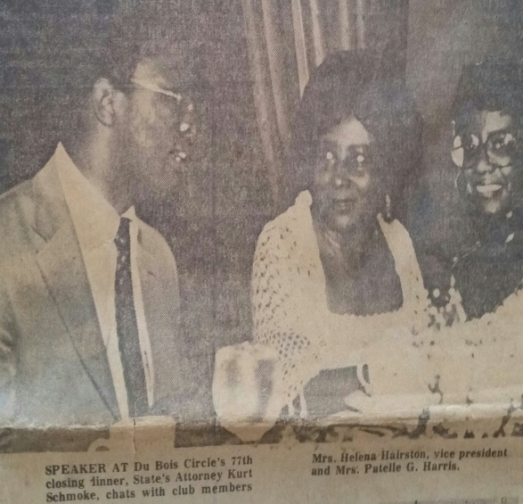
The 77th Closing Program
1983

Slide 21
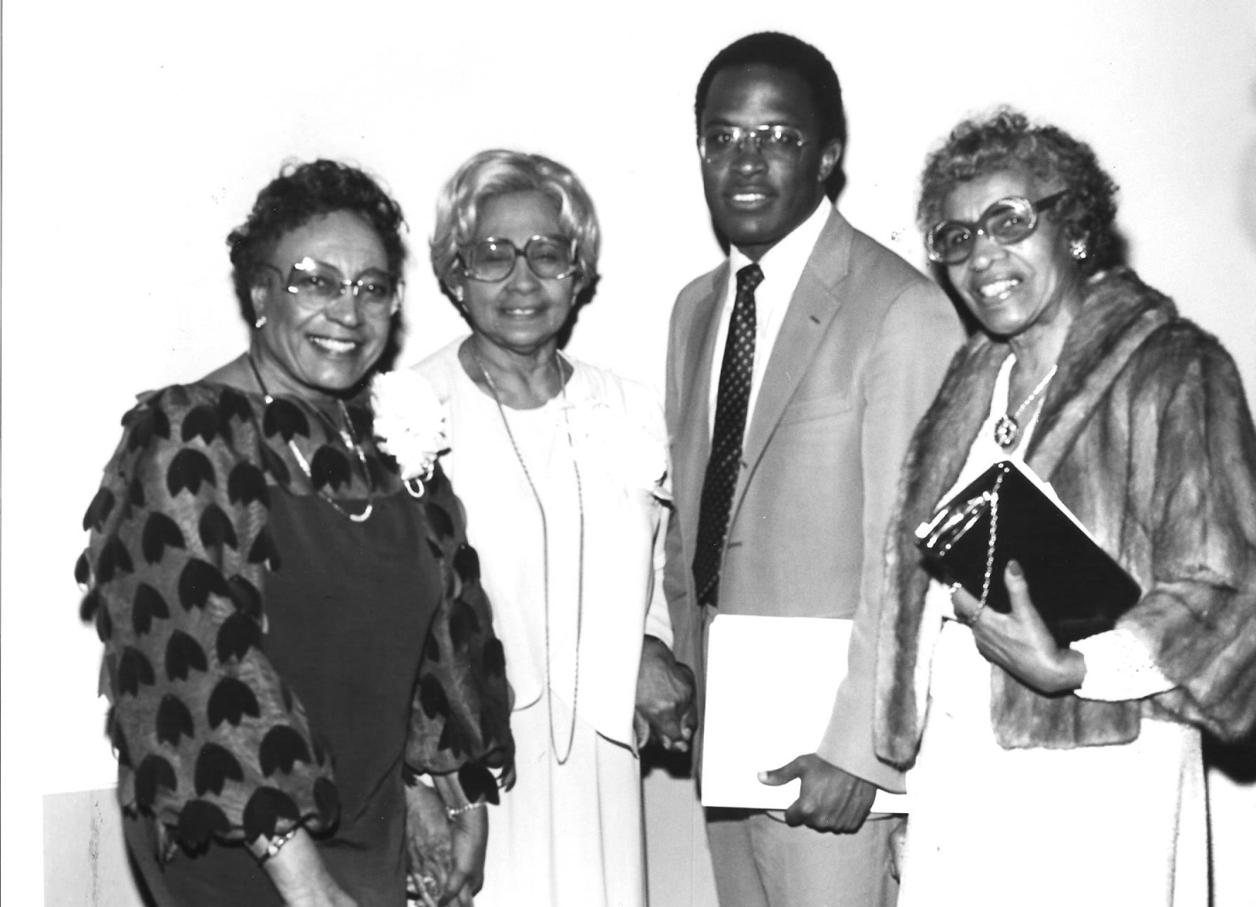
The 77th Closing Program
1983
Closing Speaker:
State’s Attorney
Kurt Schmoke
Kurt

Slide 22
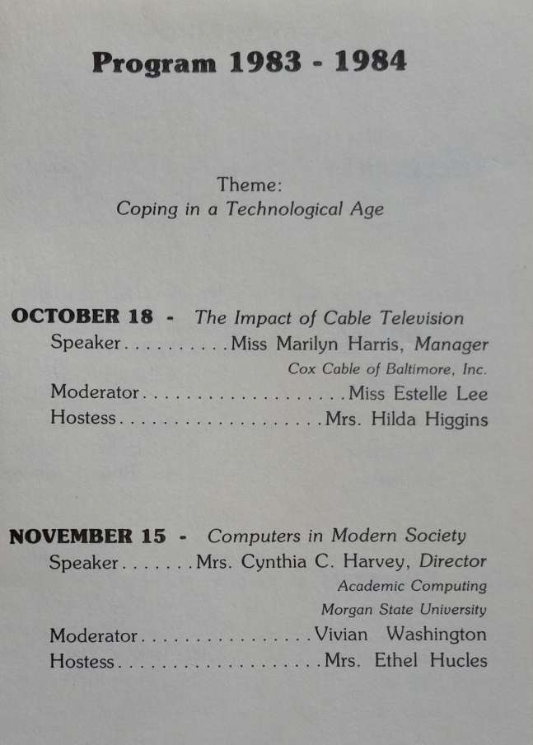
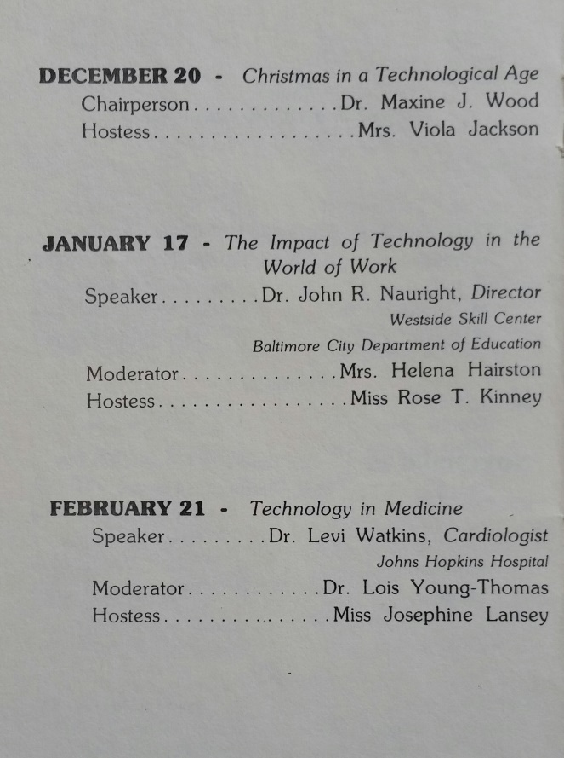
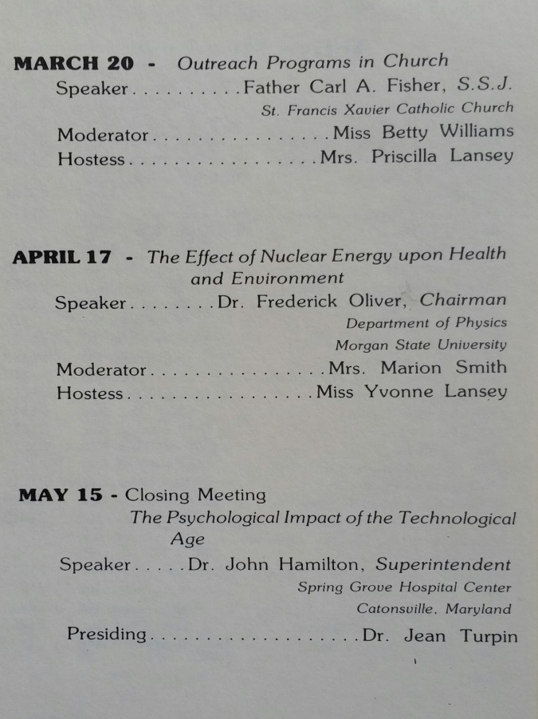
1983 - 1984 Annual Program
1983-1984
Coping in a Technological Age

Slide 23
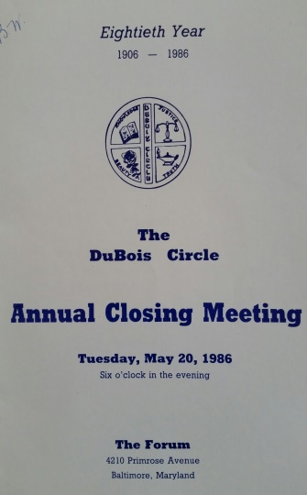
The DuBois Circle Celebrates its 80th Anniversary.
1986

Slide 24
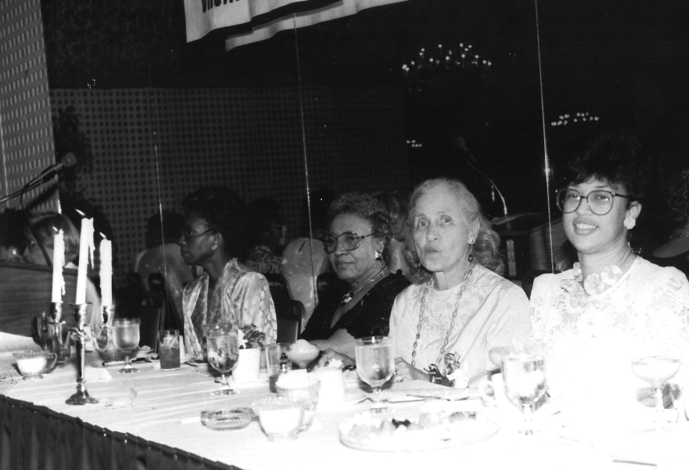
The 80th Anniversary Dais
1986
The DuBois Circle Officers with Dr. Bettye Collier-Thomas, Executive Director, Bethune Museum-Archives, Inc., National Historic Site

Slide 25
The 1987 Officers of The DuBois Circle
1987

Slide 26
The 1988 Closing Program of The DuBois Circle
1988

Slide 27
The 1988 Closing Program of The DuBois Circle
1988

Slide 28
The DuBois Circle Coffee Project for Christmas 1988
1988
Miss Betty Williams and Mrs. Courtney Valentine
en route to Our Daily Bread

Slide 29
1988-1989 Program Activities
1988-1989
Ethel Hucles, Emma Bright, Betty Williams, Marion Smith, Lena Lee
Valerie Hairston, Evelyn McClary, M. Perdue, Vernon Gray

Slide 30
1988-1989 Program Activities
1988-1989
Gladys Reed, Margery Prout, Dr. D. Belcher
Lena McKinney, Dr. Jean Turpin, David Mitchell

Slide 31
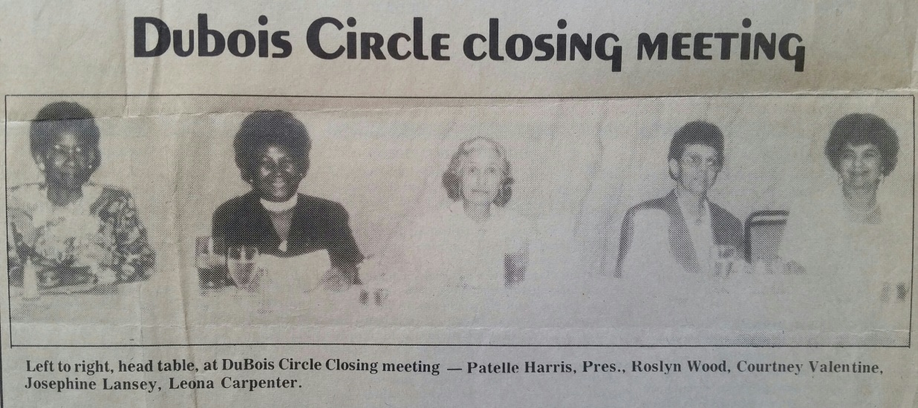
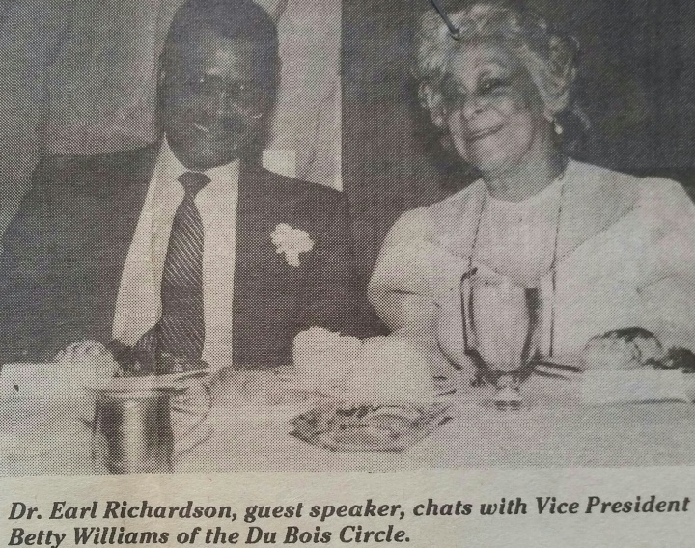
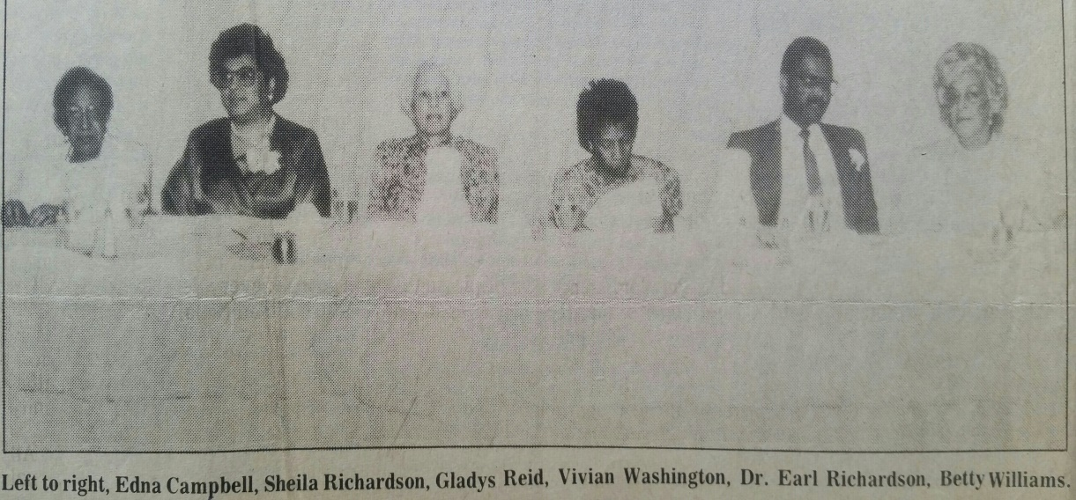
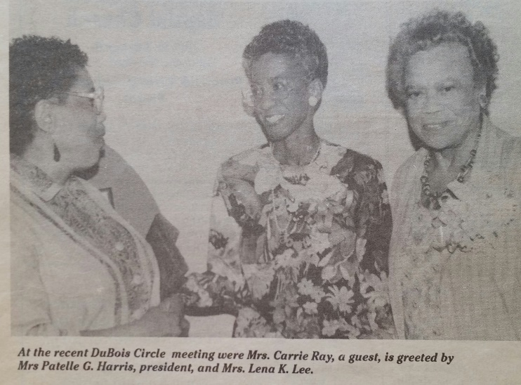
The 1989 Closing Meeting and Program
1989

Slide 32
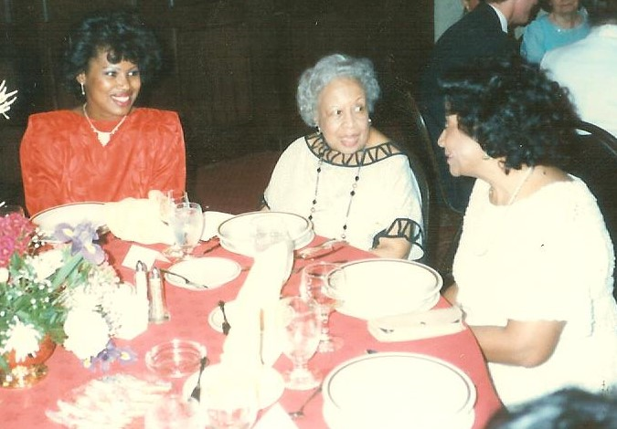
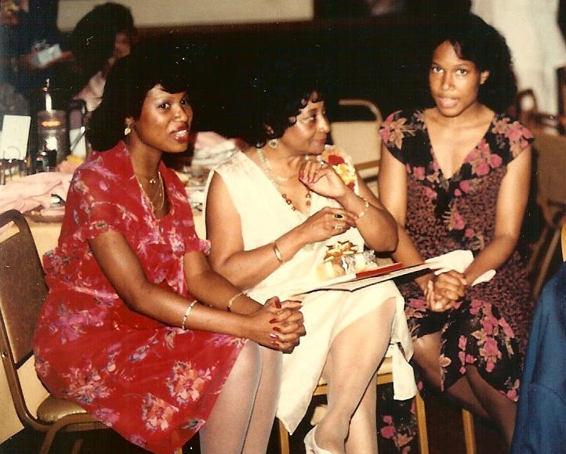
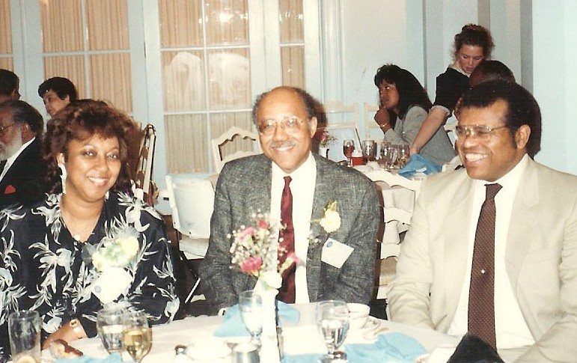
Members and Guests at Closing Programs
1980s-1990s

Slide 33
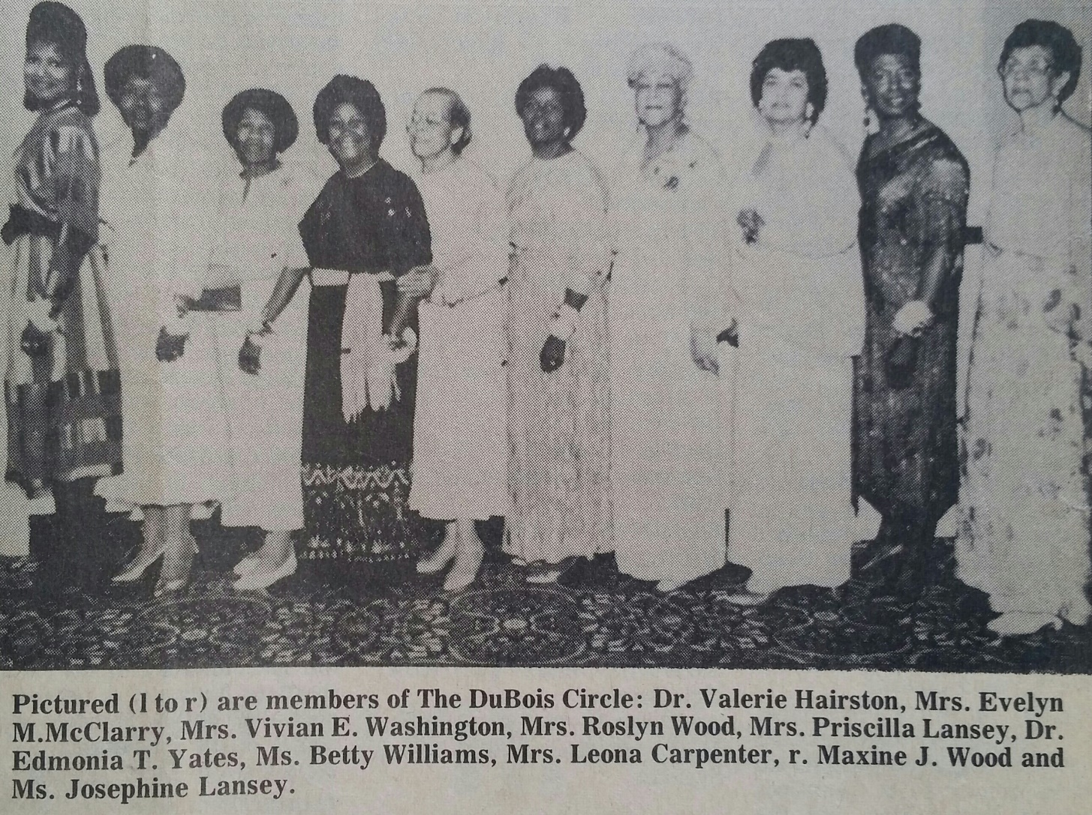
The 1991 Closing Program
1991

Slide 34
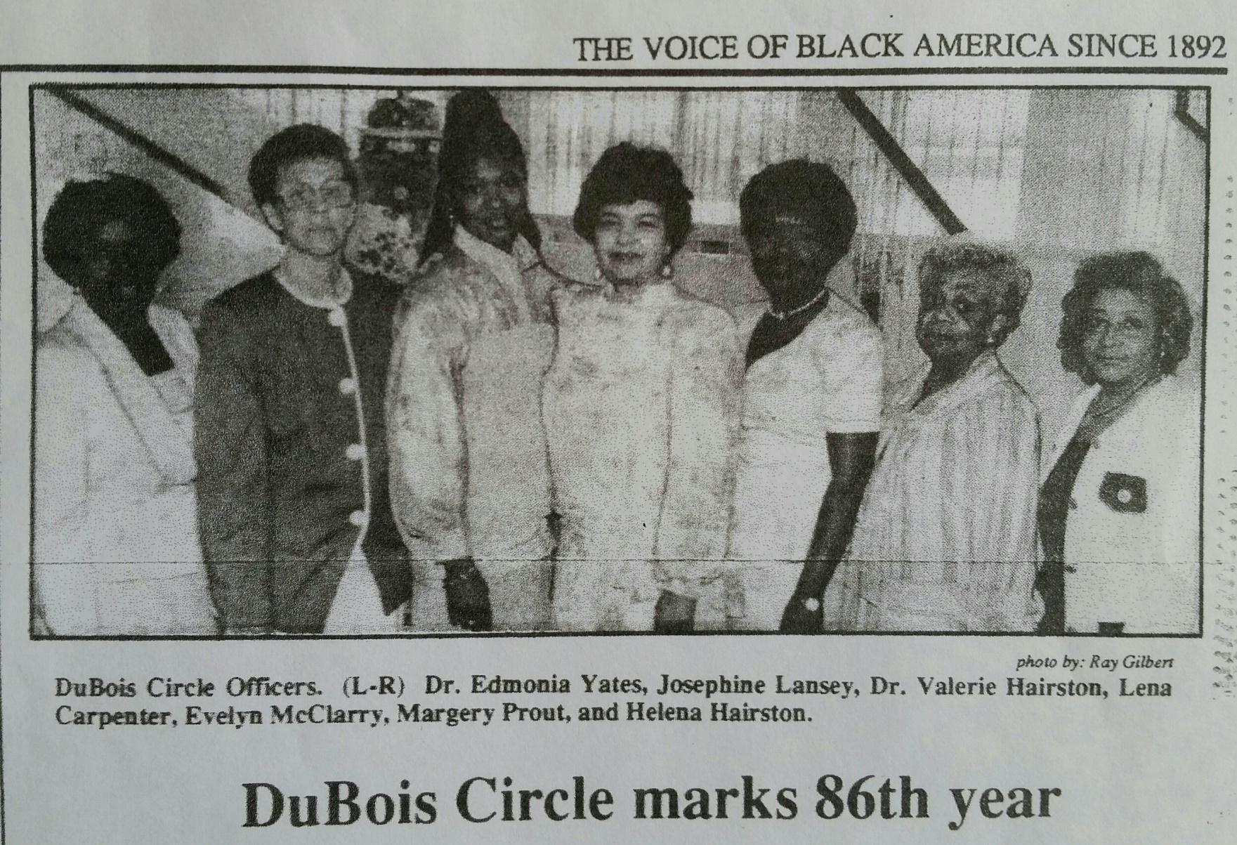
1992: Officers of The DuBois Circle
1992

Slide 35
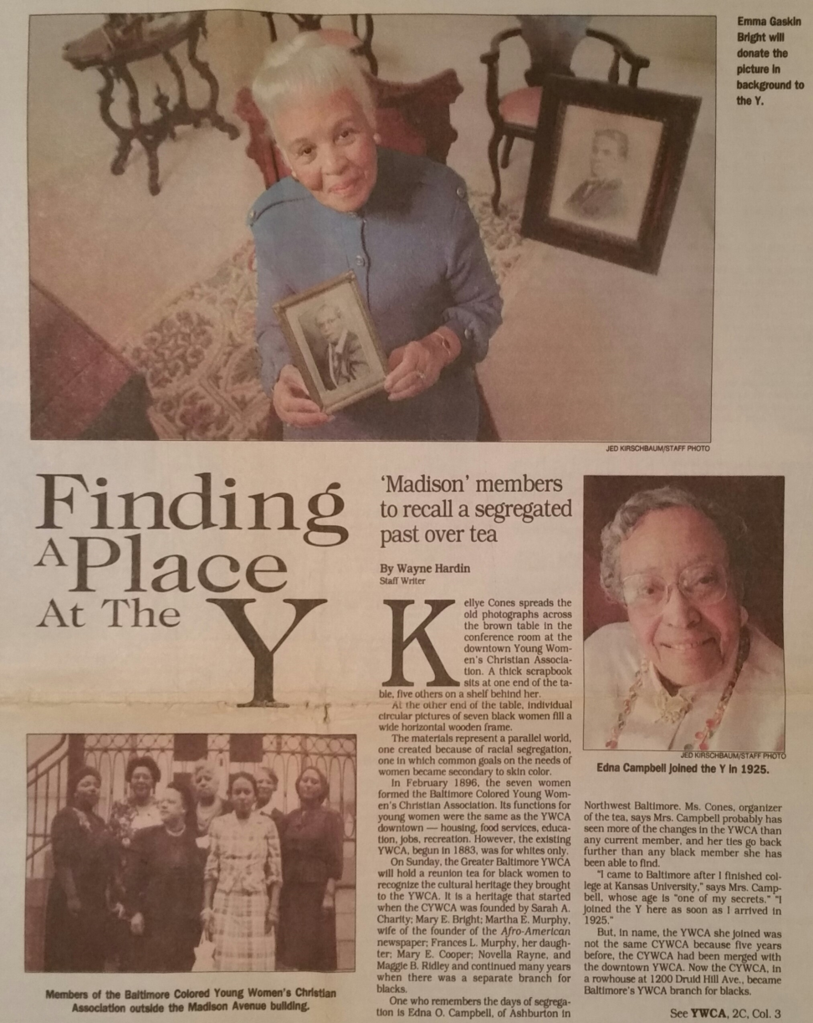
Two DuBois Circle Members Reflect on the History of the Madison Avenue YMCA.
1993
Mrs. Emma Bright
Mrs. Edna O. Campbell

Slide 36
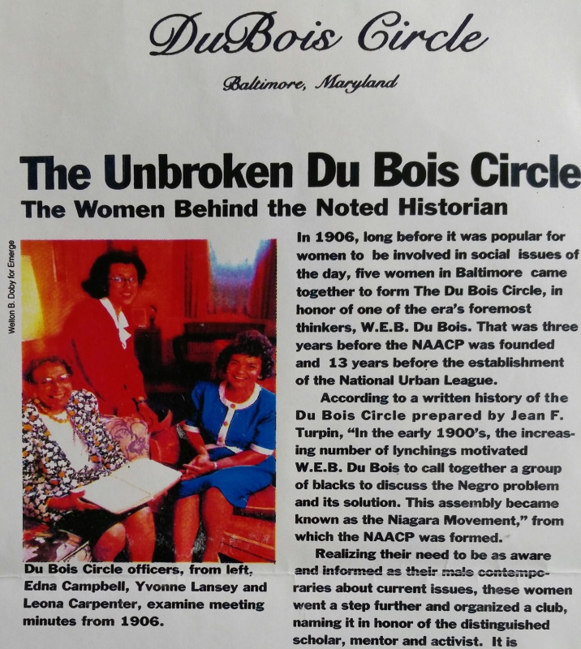
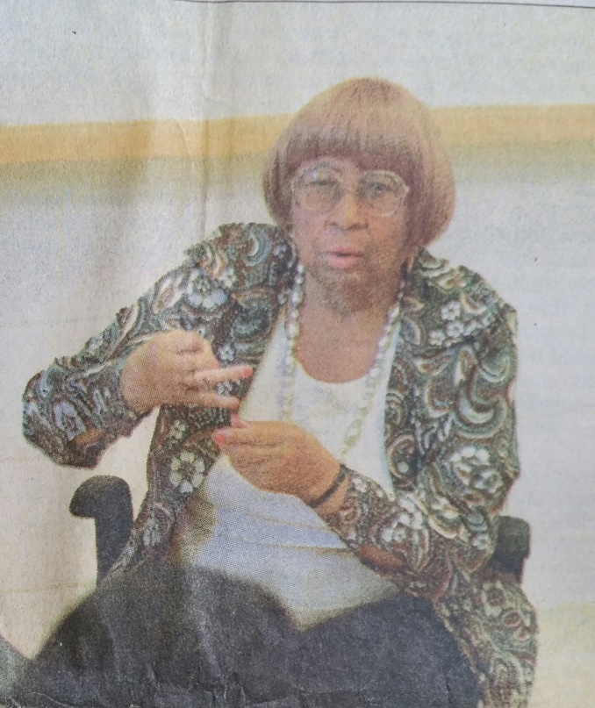
The DuBois Circle Members in the News
1993-1994
1993
1994
Edna Campbell, Yvonne Lansey,
Leona Carpenter
Dr. Jean Turpin

Slide 37
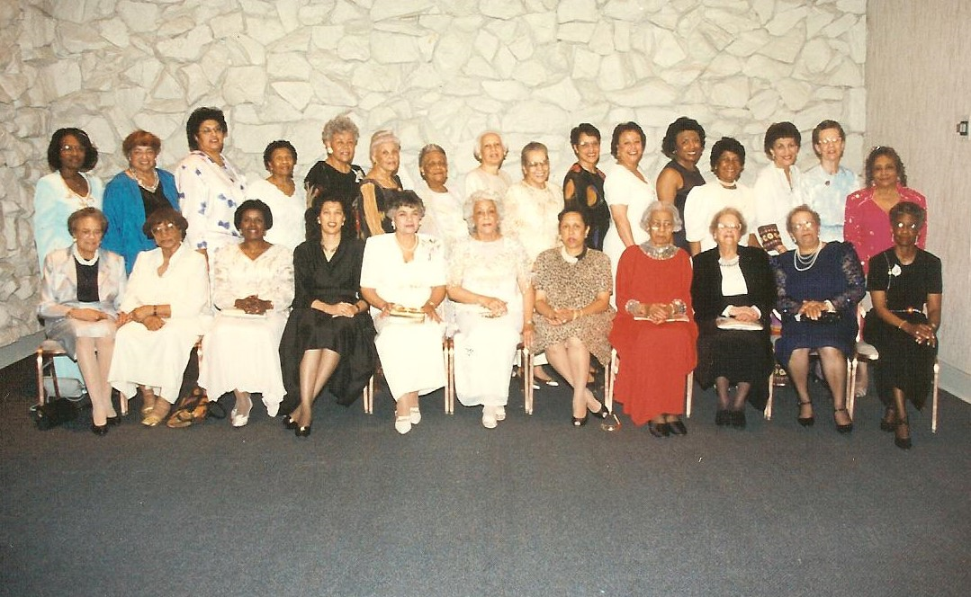
The DuBois Circle Celebrates 90th Anniversary!
1996

Slide 38
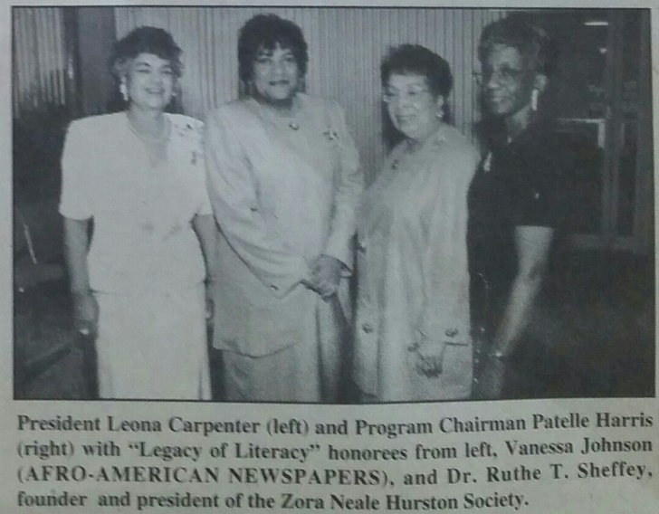
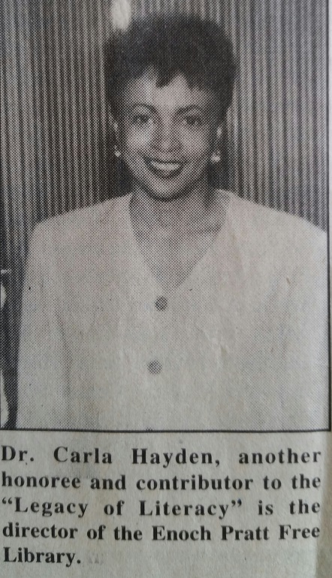
1996

Slide 39
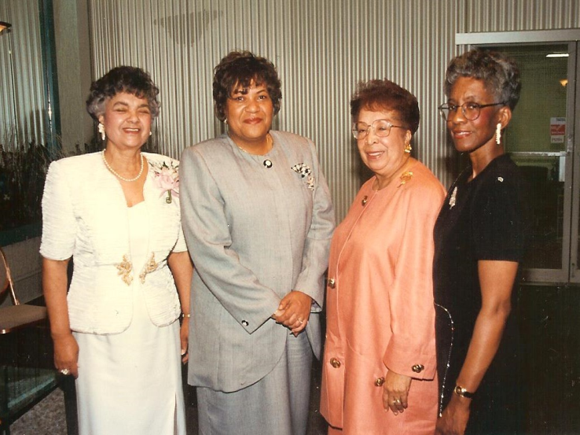
1996
Dr. Carla Hayden receives
The DuBois Circle’s…
Legacy of Literacy Award.

Slide 40
DuBois and The Circle in the News
1997

Slide 41
The DuBois Circle Celebrates its 92nd Year.
1998
Mr. Carl Snowden Guest Speaker

Slide 42
1999
The DuBois Circle Celebrates the 93rd
Closing in 1999…
Featuring Student Performers.

Slide 43
Reverend Dr. Vashti McKenzie Delivers the Closing Keynote Address.
1999

Slide 44
1999
The DuBois Circle Unveils the Portrait of
Dr. W.E.B. DuBois at the Enoch Pratt Library. (subsequently given to Morgan State University)
Dr. Edmonia Yates

Slide 45
The Dubois Circle Closes the 1999-2000 Year.
1999-2000

Slide 46
2001: The 95th DuBois Circle
Closing

Slide 47
2001
The DuBois Circle
Members and Guests at Closing Program

Slide 48
2001
The DuBois Circle
Members and Guests at Closing Program

Slide 49
2001
The DuBois Circle
Members and Guests at Closing Program

Slide 50
May 2001 Members and Guests Celebrate Together!
In 2001
The DuBois Circle Toasts 95 Years.

Slide 51
2004
The DuBois Circle Makes Another $1000 Donation to
Mrs. Santa!

Slide 52
The 2004 Annual Christmas Program
2004

Slide 53
The 2004 Annual Christmas Program: Donation to Mrs. Santa
2004

Slide 54
The DuBois Circle Centennial Tea: Where Civility, History, and Black Culture Meet (The Sun)
2006

Slide 55
The DuBois Circle Centennial Tea: “Where Civility, History, and Black Culture Meet” (The Sun)
2006

Slide 56
In 2006 The DuBois Circle Celebrates its Centennial!
2006

Slide 57
In 2006 The DuBois Circle Celebrates its Centennial!
2006

Slide 58
2006
The Maryland Governor’s Citation in Recognition of
the 100-Year Milestone for
The DuBois Circle

Slide 59
2013
The DuBois Circle Collects and Donates
500 Forks to Our Daily Bread.
Volunteers Mr. Arthur Jasmin and Miss Betty Williams with Volunteer Coordinator, Mr. Brandon Williams

Slide 60
2014
The DuBois Circle Members Visit
the Schomberg Center in N.Y.C.

Slide 61
2010-2014
The DuBois Circle Members and Guests
Enjoy the Closing Programs.

Slide 62
2010-2014
The DuBois Circle Members and Guests
Enjoy the Closing Programs.

Slide 63
2010-2014
The DuBois Circle Members and Guests
Enjoy the Closing Programs.

Slide 64
2010-2014
The DuBois Circle Members and Guests
Enjoy the Closing Programs.

Slide 65
April 2015
The DuBois Circle Monthly Meeting
Topic: Education As A Human Right:
Higher Education

Slide 66
April 2015
The DuBois Circle Monthly Meeting
Guest Speaker: The Honorable Kurt Schmoke,
President, University of Baltimore

Slide 67
May 2015
The DuBois Circle Members and Guests
Enjoy the Closing Program.

Slide 68
November 2015
The DuBois Circle Program Theme:
After the Unrest: What is Next?
Guest Speaker: Michael Cryer,
President, The Cryer Group
“One Baltimore Campaign”
Officers: President, Patricia Jessamy, Esq., Vice President,
Margarett Shipley, Rev. Canon Dr. Sandye Wilson, Recording Secretary

Slide 69
January 2016
The DuBois Circle Program Theme:
After the Unrest: What is Next?
Guest Speaker: Annette March-Grier,
Founder and President, Roberta’s House
“The Devastating Effects of Grief and Loss”

Slide 70
March 2016
The DuBois Circle Program Theme:
After the Unrest: What is Next?
Guest Speaker Dr. Lena Wen,
Baltimore Commissioner of Health
“Working Toward a Healthier Baltimore”

Slide 71
1906-2016
The DuBois Circle
The DuBois Circle, the oldest Black women’s organization in Baltimore, has donated to Mrs. Santa,
My Sister’s Place, House of Ruth, Christopher’s Place, and The Nathan Carter School of Music at New Shiloh Baptist Church, The Enoch Pratt Library, the Afro-American Newspaper, and Florence Crittenton Services.
In its 110th year, The DuBois Circle continues an
active concern for politics, immigration, and education.
(Brenda Johnson, The Baltimore Times)

Slide 72
May 17, 2016
The DuBois Circle
(The DuBois Circle Members)

Slide 73
1906-2016
From The DuBois Circle
LORD, MAKE US MINDFUL OF THE LITTLE THINGS THAT GROW AND BLOSSOM IN THESE DAYS TO MAKE THE WORLD BEAUTIFUL FOR US. TEACH US TO REVERENCE IN THIS WORLD, NOT SIMPLY THE GREAT AND IMPRESSIVE, BUT ALL THE MINUTE AND MYRIAD-SIDED BEAUTY OF FIELD AND FLOWER AND TREE.
AND AS WE WORSHIP THESE, SO IN OUR LIVES, LET US STRIVE NOT FOR THE MASTERFUL AND SPECTATULAR BUT FOR THE GOOD AND TRUE, NOT FOR THE THUNDER BUT FOR THE STILL SMALL VOICE OF DUTY. AMEN.
Prayers for DARK PEOPLE
W.E.B. DuBOIS

Slide 74
1906-2016
Resources
-The Baltimore Afro-American Newspaper
-The Baltimore Times
-The DuBois Circle Archives
-The Maryland Historical Society
-The Sun Newspaper
- University Archives, University
of Massachusetts, Amherst Libraries
Compiled by Dr. Judith B. Smith
at the request of The DuBois Circle – May 2016

