Slide 1
W.E.B. DuBois and Afrofuturism
The Significance of “The Comet”

Slide 2
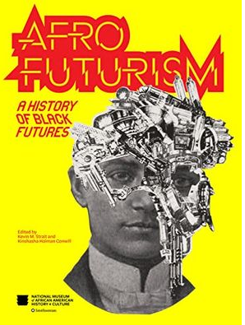
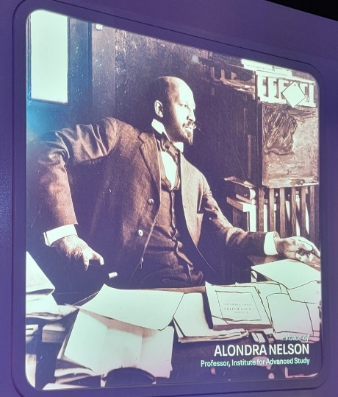
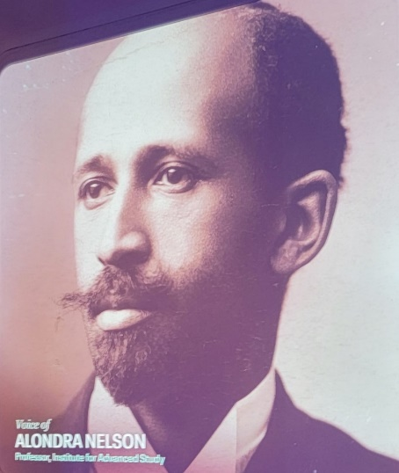
Afrofuturism
Afrofuturism is a cultural aesthetic philosophy of science and history that focuses on the intersection of the African diaspora's culture, science, and technology (Strait et al., 2023).

Slide 4
W.E.B. Du Bois’s Data Portraits: Visualizing Black America: The Color Line at the Turn of the Twentieth Century Edited by Whitney Battle-Baptiste and Britt Rusert W.E.B. Du Bois Center at the University of Massachusetts Amherst/Princeton Architectural Press W.E.B. Du Bois’s exhibit at the 1900 Paris Exposition offered him a chance to present a “graphical narrative” of the dramatic gains made by Black Americans since the end of slavery.

Slide 5
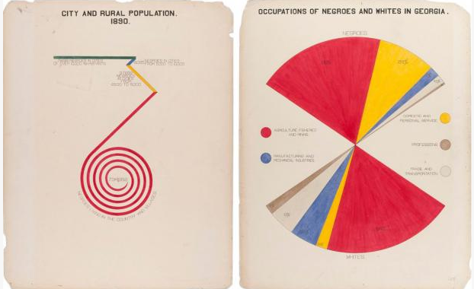
Left: Diagram of urban and urbal Black population in Georgia in 1890
Right: Chart of occupations of Black and White Georgians circa 1900, Library of Congress

Slide 6
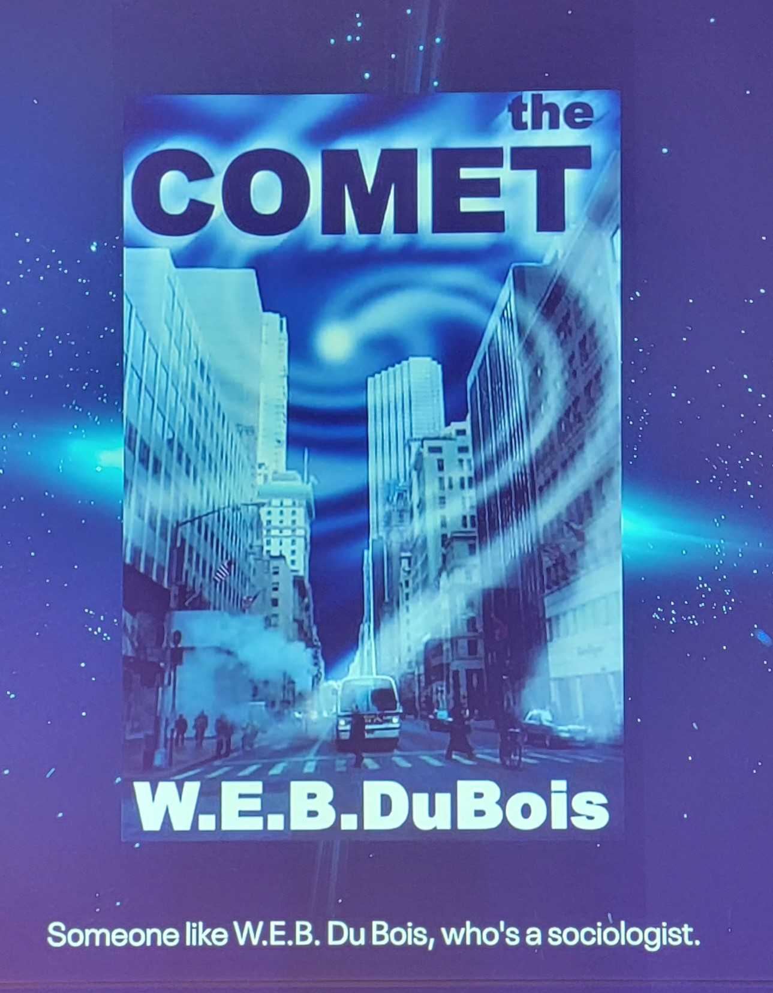
Smithsonian National Museum of African American History and Culture The curators of the exhibit credited DuBois as an afrofuturist. They cite Chapter 10 of Darkwater: Voices from the Veil which recounts a short fictional story, "The Comet."

Slide 7
Summary of “The Comet” The grizzly coming of Halley's Comet has a ravishing effect on New York City. The comet's toxic gases kill everyone except Jim, a Black man, and Julia, a wealthy White woman. Their venture to find their families leaves them vulnerable to emotion until a voice of reality hits Jim with the single N-word, called out by a White man. Jim is spared lynching as he had saved Julia's life. Their eyes never met again.

Slide 8
Critique of “The Comet” Elia (2016) postulated that by portraying Jim as a Black man, DuBois engages in Black speculative fiction, a characterization of Afrofuturism. DuBois reimagines the past and future of African Americans to articulate a historical and diasporic narrative (Womack, 2013). DuBois approached the story as a parable, with the supernatural element of the comet to speculate on racial discrimination, prejudices, and the chasm of the status quo (Elia, 2014). Ogbunu (2020) argued that DuBois' "foray into fantasy in 1920" bluntly takes a stance on racism's inevitability and lays the foundation for Afrofuturism. Metaphorically, a century later, a comet carrying disease and social unrest is upending the world and revealing still-existing racism. Afrofuturism can help guide us "out of rubble" toward better alternatives.

Slide 9
Quote from the Souls of Blackfolk: Essays and Sketches

Slide 10
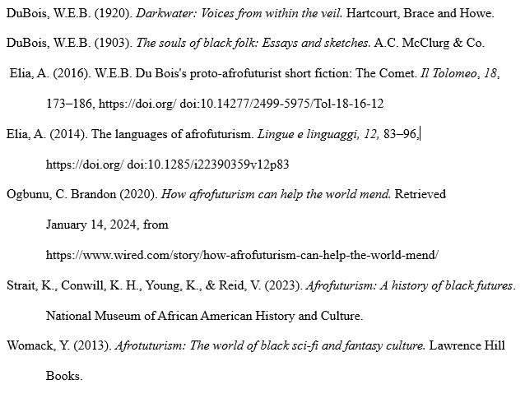
References
https://nmaahc.si.edu/explore/exhibitions/afrofuturism

