Slide 1
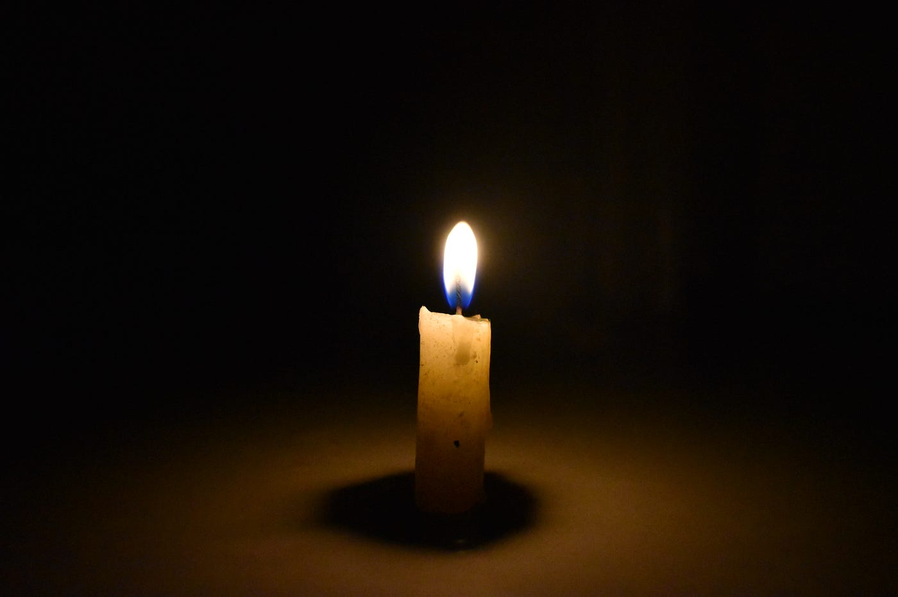
"Light In The Dark"
2 Peter 1:19-21

Slide 2
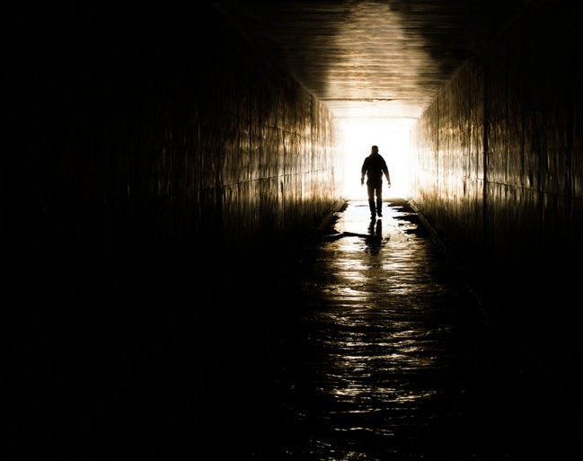
2 Peter 1:19-21 Verse By Verse

Slide 3
Light In The Dark - Value of the Prophetic Word Today 2 Peter 1:19-21 -(D. Jeremiah, R. Jeffries, others)
1. Prophesy Plays A Leading Role In The New Testament Luke 12:56

Slide 4
Light In The Dark - Value of the Prophetic Word Today 2 Peter 1:19-21 -(D. Jeremiah, R. Jeffries, others)
1. Prophesy Plays A Leading Role In The New Testament Luke 12:56
2. Prophesy Proves The Integrity of Scripture 1 Peter 1:10-11

Slide 5
Light In The Dark - Value of the Prophetic Word Today 2 Peter 1:19-21 -(D. Jeremiah, R. Jeffries, others)
1. Prophesy Plays A Leading Role In The New Testament Luke 12:56
2. Prophesy Proves The Integrity of Scripture 1 Peter 1:10-11
3. Prophesy Protects Us From False Teaching Matthew 24:4-5, John 16:1

Slide 6
Light In The Dark - Value of the Prophetic Word Today 2 Peter 1:19-21 -(D. Jeremiah, R. Jeffries, others)
1. Prophesy Plays A Leading Role In The New Testament Luke 12:56
2. Prophesy Proves The Integrity of Scripture 1 Peter 1:10-11
3. Prophesy Protects Us From False Teaching Matthew 24:4-5, John 16:1
4. Prophesy Prepares Us For The Last Days Matthew 24:43, 1 Thessalonians 5:4

Slide 7
Light In The Dark - Value of the Prophetic Word Today 2 Peter 1:19-21 -(D. Jeremiah, R. Jeffries, others)
1. Prophesy Plays A Leading Role In The New Testament Luke 12:56
2. Prophesy Proves The Integrity of Scripture 1 Peter 1:10-11
3. Prophesy Protects Us From False Teaching Matthew 24:4-5, John 16:1
4. Prophesy Prepares Us For The Last Days Matthew 24:43, 1 Thessalonians 5:4
5. Prophesy Provides Practical Guidance for Everyday Living Revelation 2-3

Slide 8
Light In The Dark - Value of the Prophetic Word Today 2 Peter 1:19-21 -(D. Jeremiah, R. Jeffries, others)
1. Prophesy Plays A Leading Role In The New Testament Luke 12:56
2. Prophesy Proves The Integrity of Scripture 1 Peter 1:10-11
3. Prophesy Protects Us From False Teaching Matthew 24:4-5, John 16:1
4. Prophesy Prepares Us For The Last Days Matthew 24:43, 1 Thessalonians 5:4
5. Prophesy Provides Practical Guidance for Everyday Living Revelation 2-3
6. Prophesy Promises Spiritual Blessings Rev 1:3, 22:7

Slide 9
"Light In The Dark" 2 Peter 1:19-21
Important, Integrity, Protects, Prepares, Guidance, Spiritual Blessings
"We also have the prophetic message as something completely reliable, and you will do well to pay attention to it, as to a light shining in a dark place, until the day dawns and the morning star rises in your hearts." 2 Peter 1:19 NKJV

